Slide 1
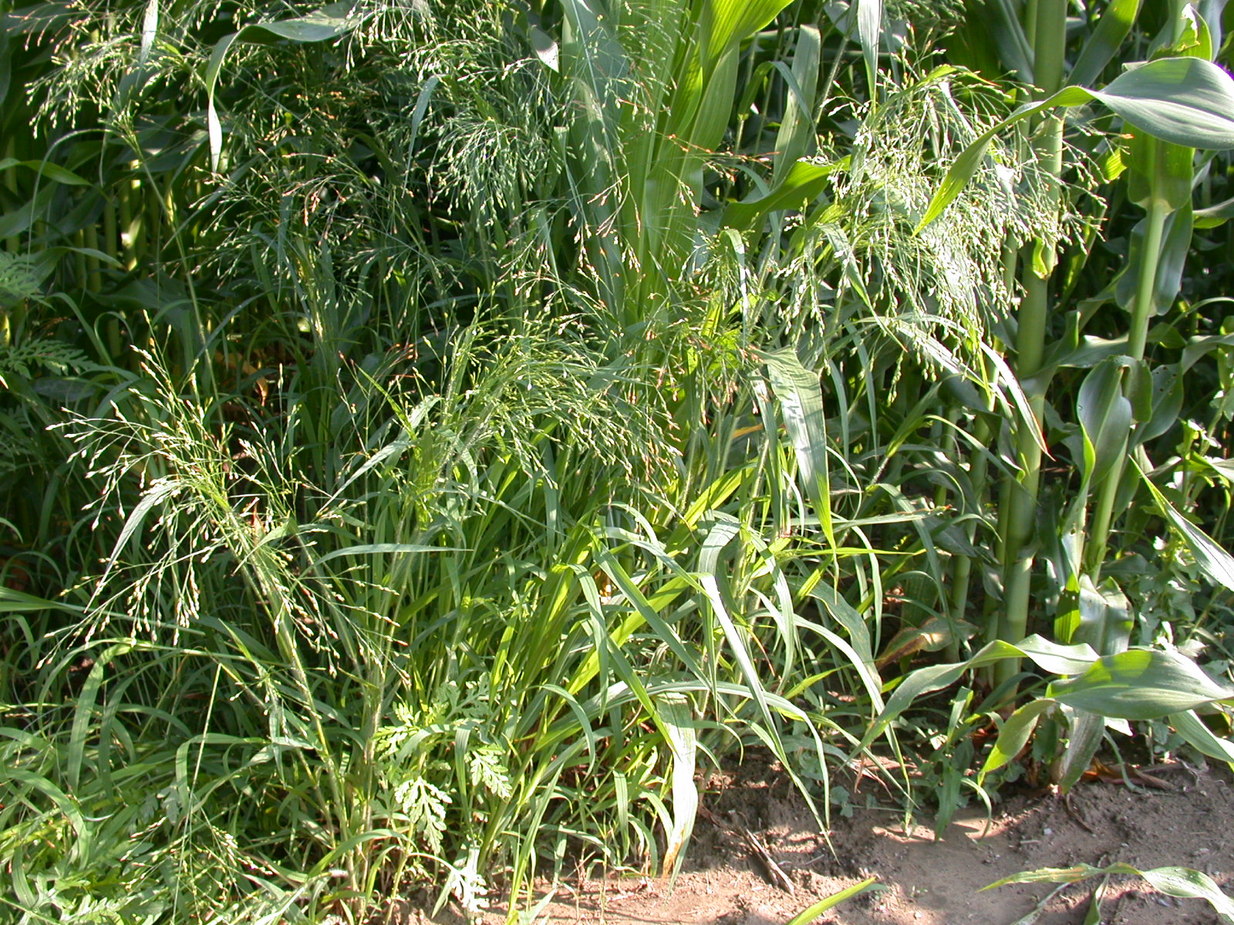
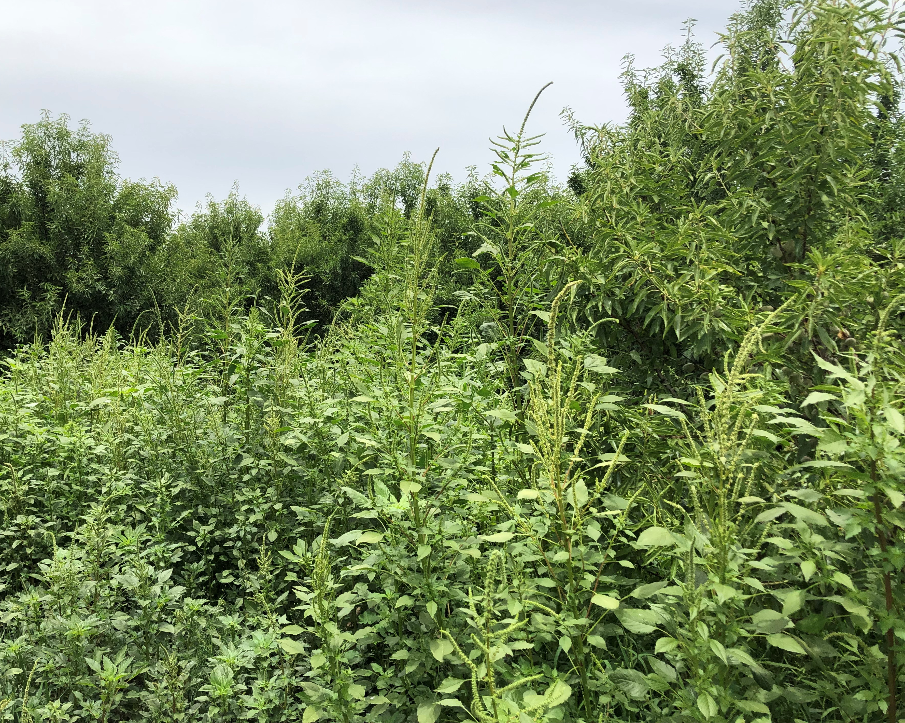
Weed Management Unit
Left photo: witchgrass in corn field by Randy Prostak of UMass Amherst. Right photo: palmer amaranth in orchard by Lynn Sosnoskie of Cornell University.

Slide 2
General Guidelines for Management
Know where they are most prevalent across the United States and where they have been found in New York State
Know their biology (seed competition, aggressive germination, herbicide resistance, and competitiveness)
Know how it spreads (manure, equipment, feed, hay, grain, mulch, and contaminated seed)
Know how to reduce their impact, including stopping the spread of seed

Slide 3
What is IPM?
Prevention
Intervention
Chemical
Biological
Mechanical
Cultural
Increasing
Image credit: Isabella Colucci

Slide 4
Management Examples…

Slide 5
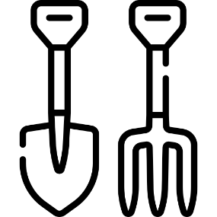
Icons for Different IPM Methods
Chemical
Biological
Mechanical
Cultural
Chemical
Mechanical
Cultural
Icons: FreePik
Icons: FreePik

Slide 6
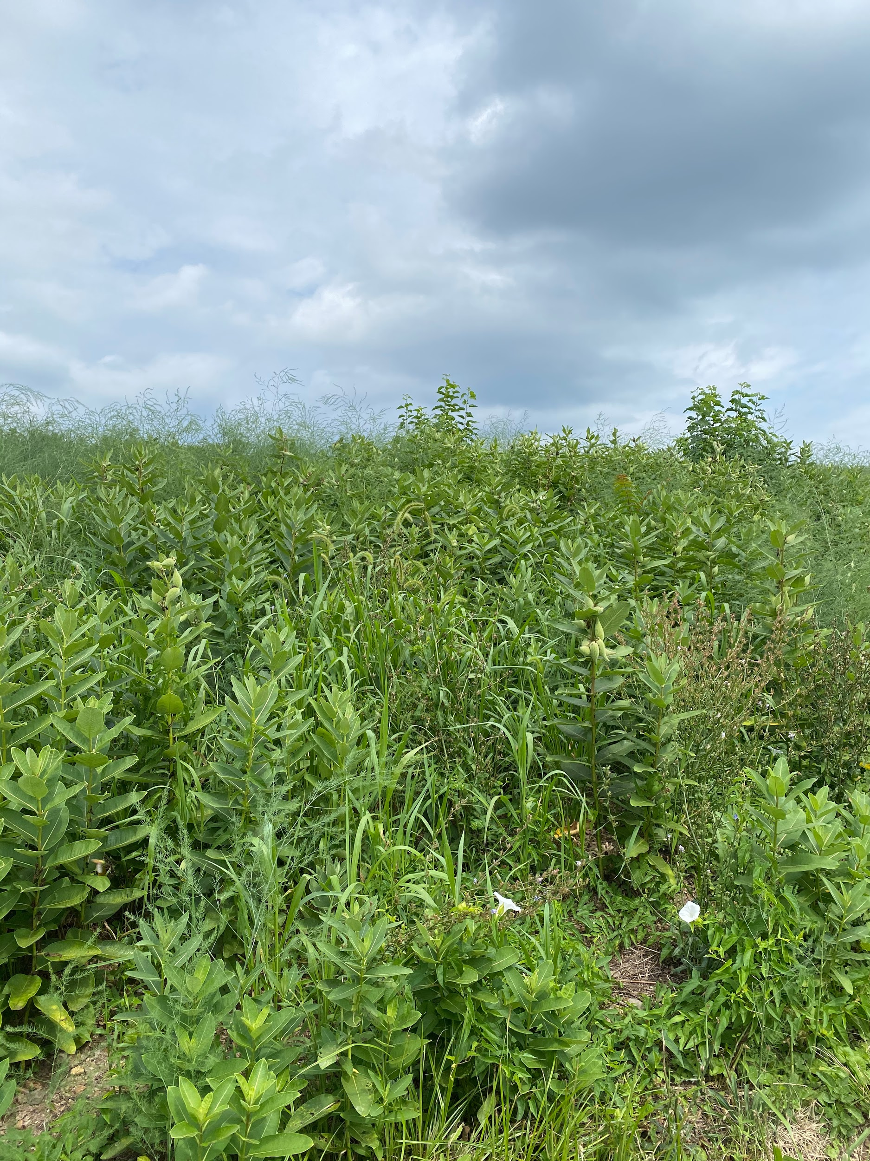
How Would I Manage Milkweed?
In a small area, hand pulling could be effective, however, you must make sure you do not leave any rhizome fragments behind.
An herbicidal approach would be glyphosate after budding but before flowering
Tillage would be ineffective because of the rhizomatous nature of the plant. Cutting the root system up would encourage new growth.

Slide 7
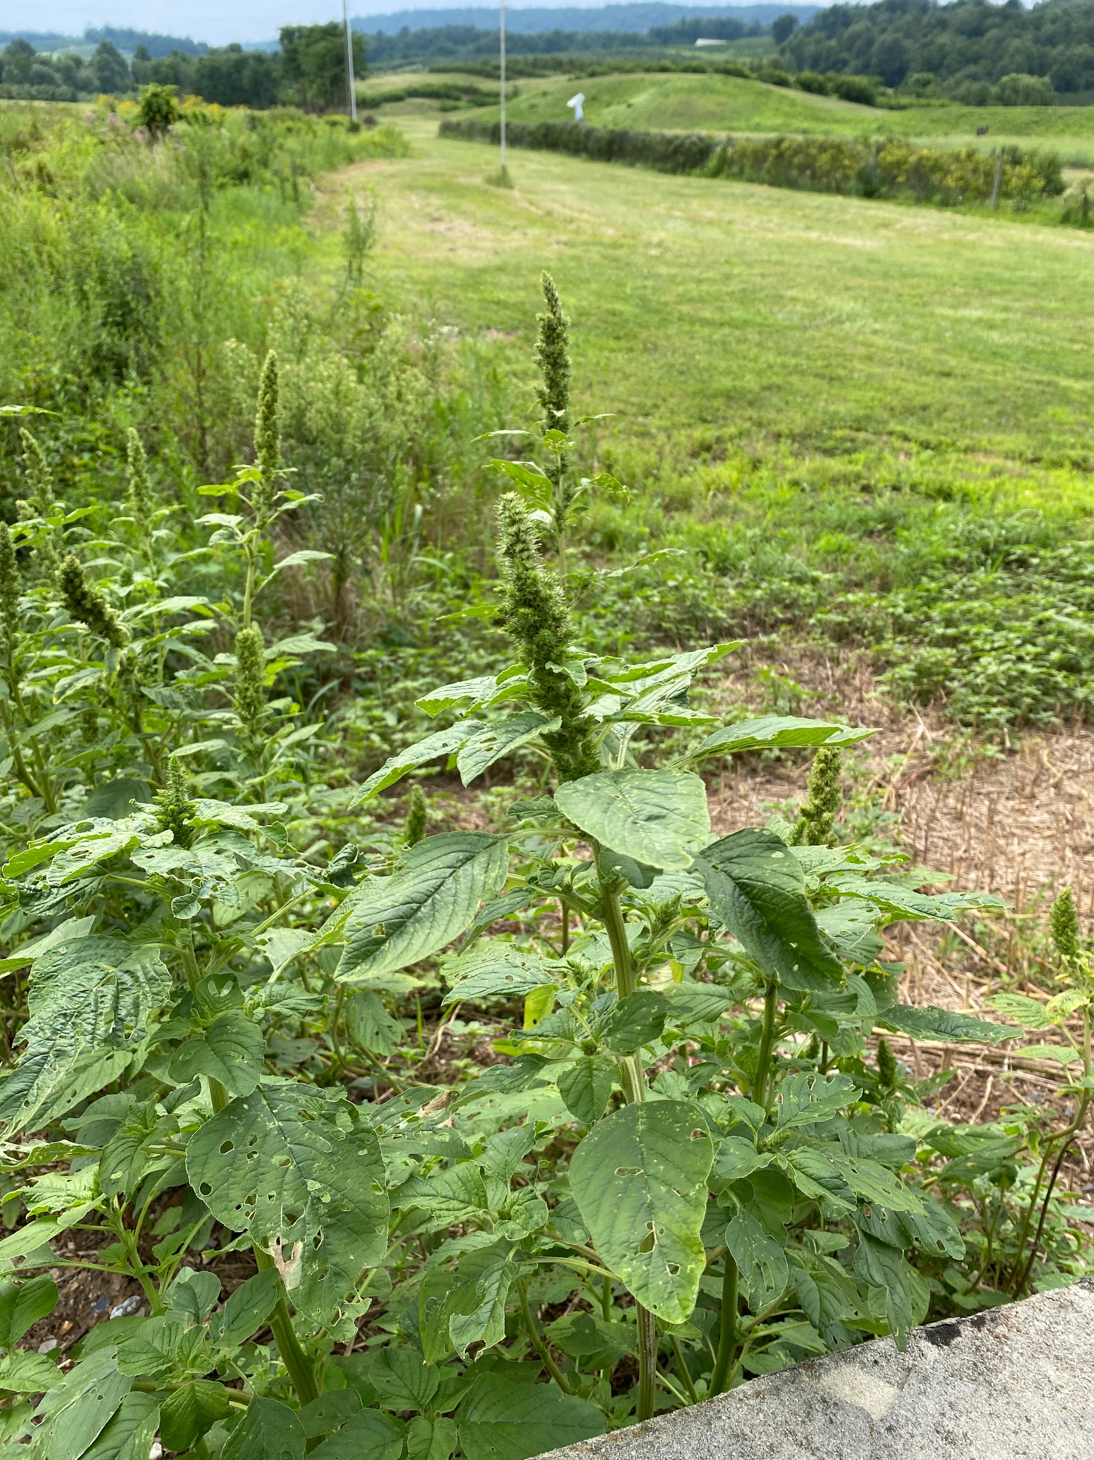
How Would I Manage Redroot Pigweed?
Because it is a summer annual, tillage would be effective
Crop rotation and an earlier crop planting date would also be effective

Slide 8
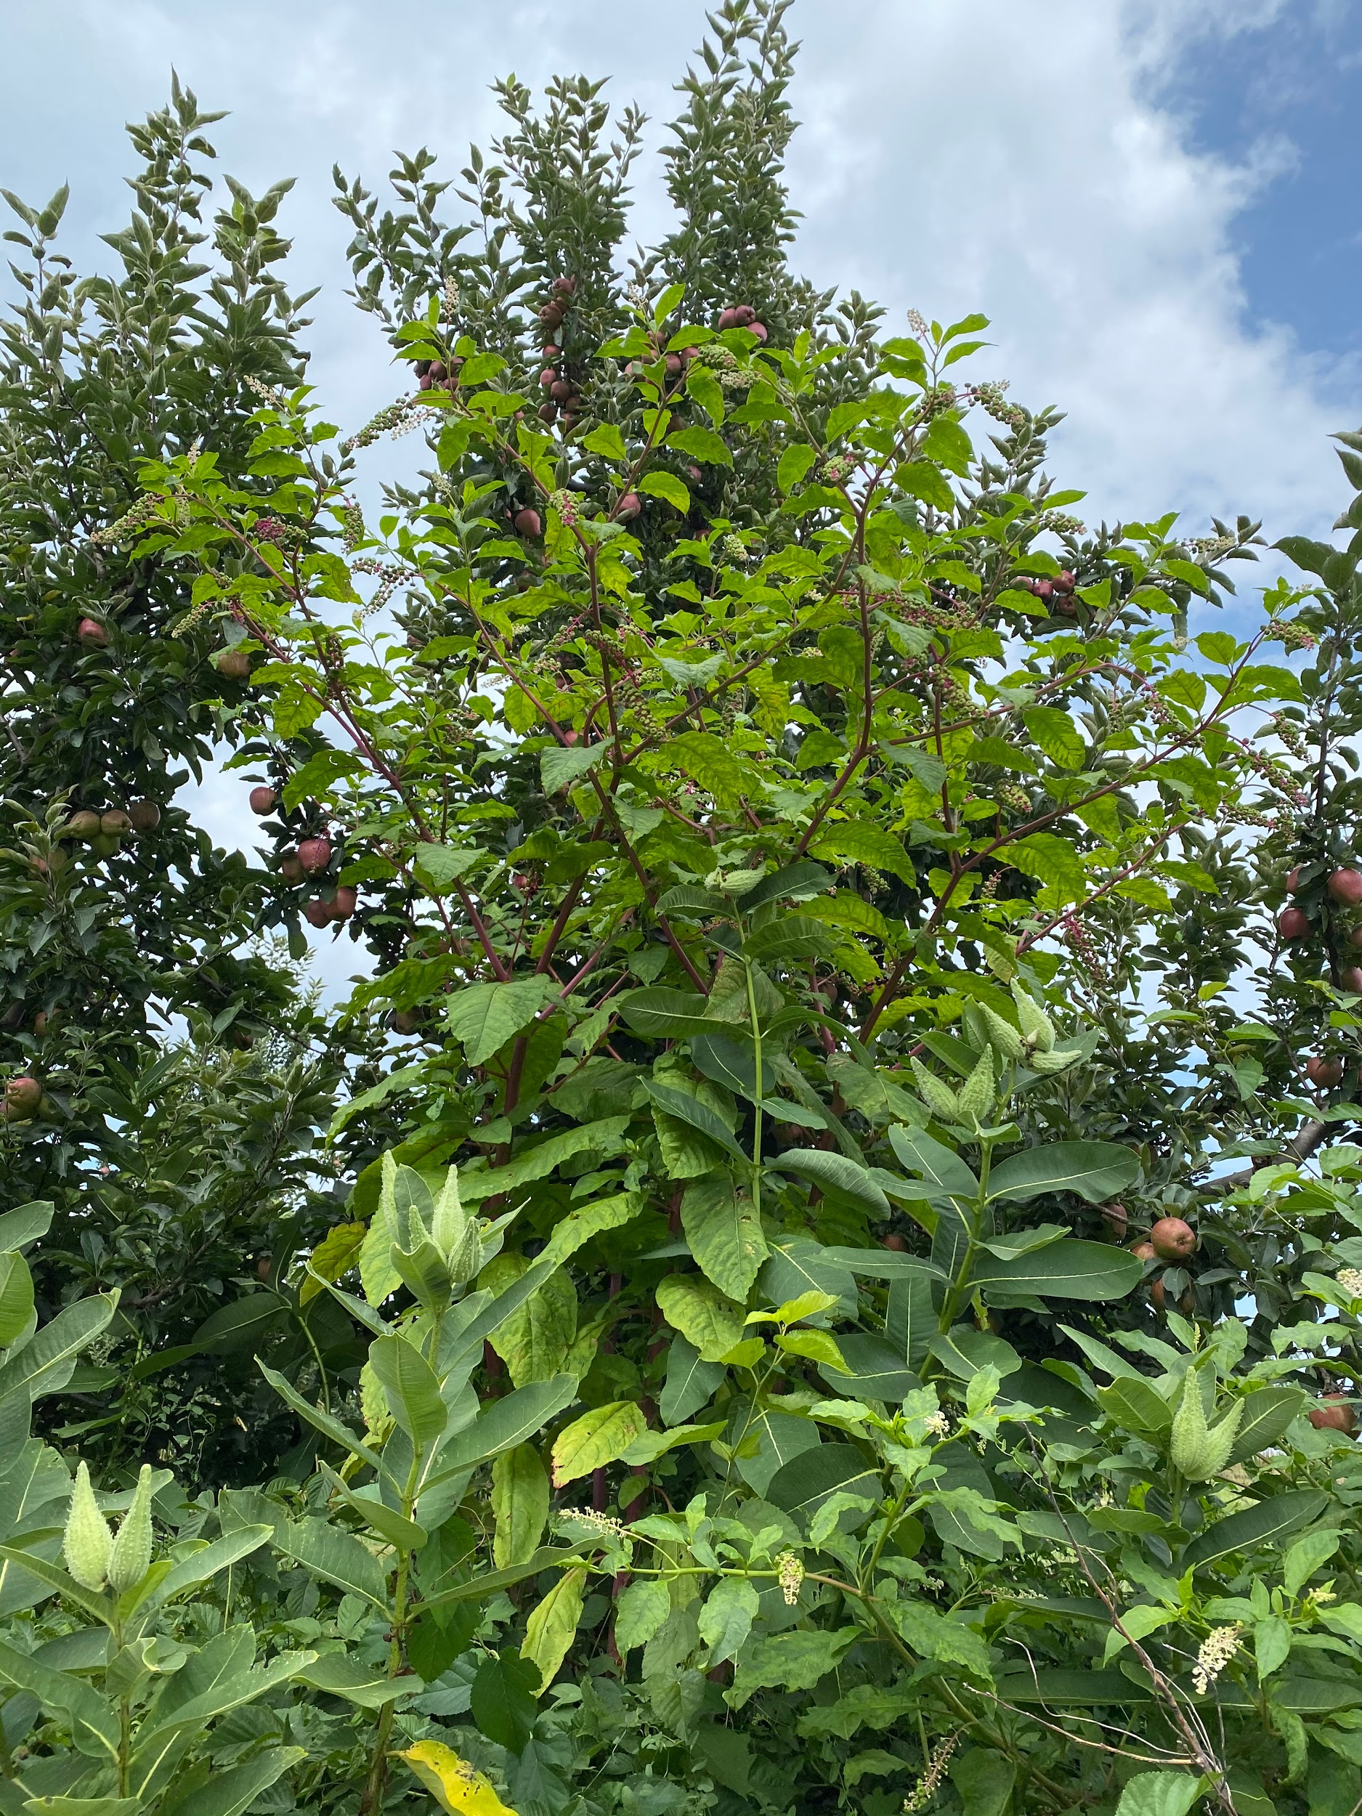
How Would I Manage Common Pokeweed
A first year plant can be pulled out by hand, but a well established plant may pose more of a challenge
Another method recommended by Penn State Extension is to cut the plant multiple times during the season to exhaust its energy reserves
Glyphosate, 2, 4-D, and Dicamba can be used late in summer as a chemical approach

Slide 9
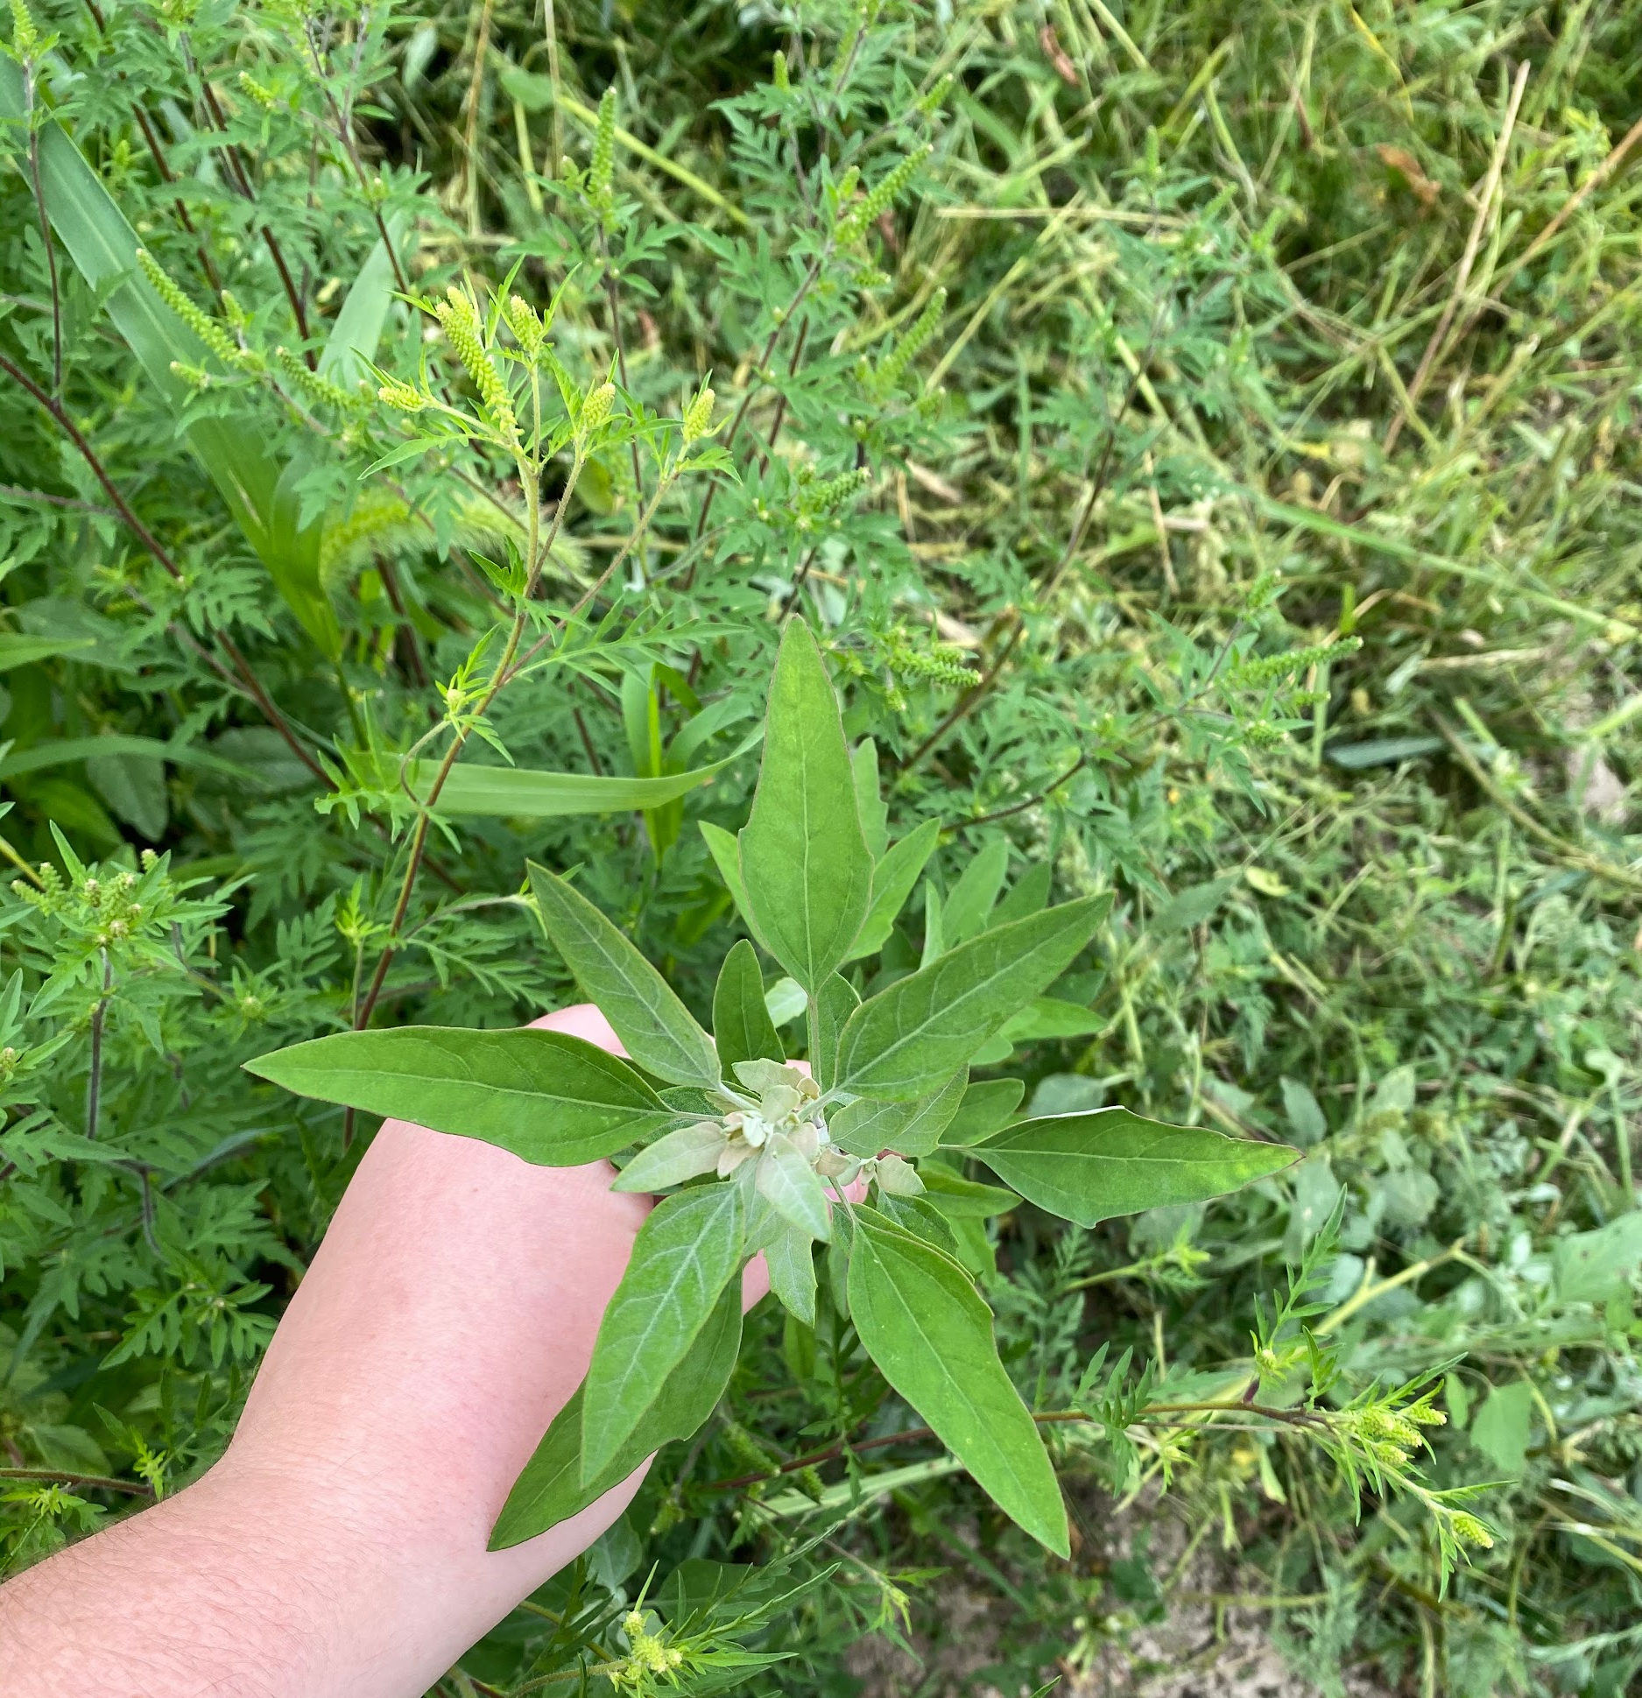
How Would I Manage Common Lambsquarter?
Because it is a summer annual, common lambsquarters can be managed with tillage.
It can also be managed using crop rotation and altering the planting date of crops
It is difficult to manage with post emergence herbicide because it emerges very early in the growing season

Slide 10
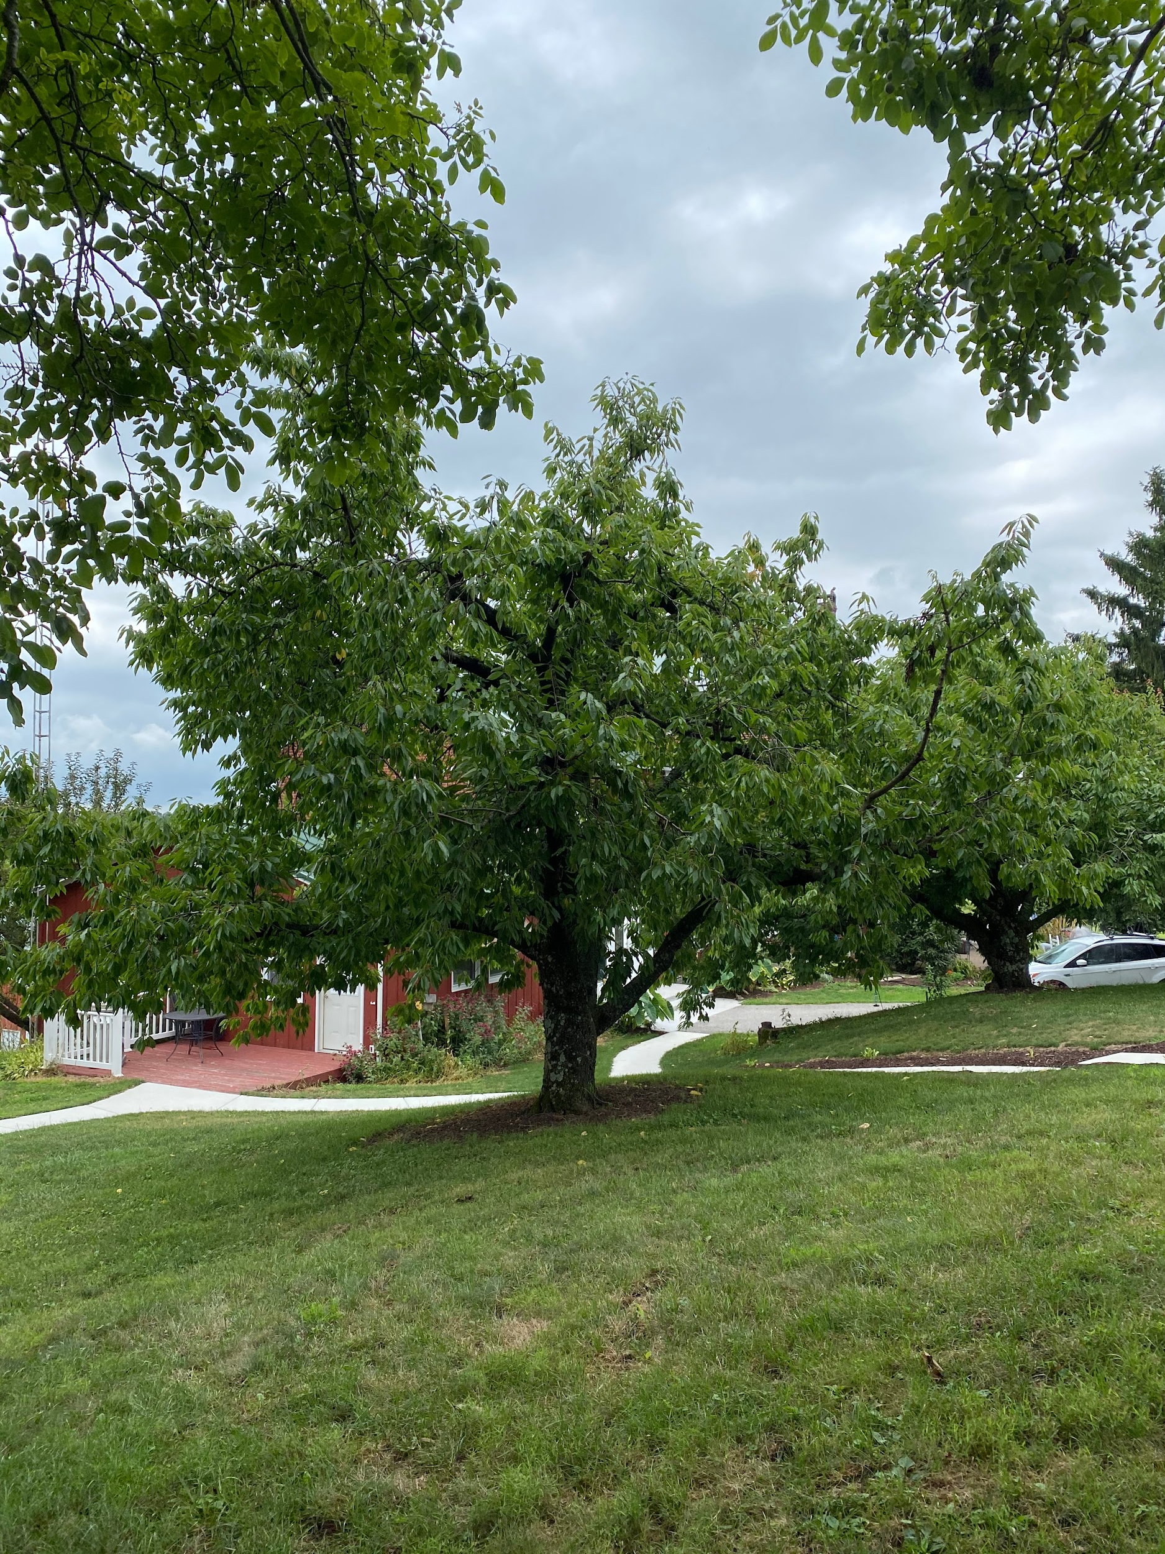
How Would I Manage Prunus Weeds?
On young plants, unlike the one pictured, the plant can be pulled
Larger plants may require heavy machinery
Young plants can also be controlled with glyphosate or 2, 4-D, imazethapyr, or triclopyr.

Slide 11
How Would I Manage Milkweed?
?
Mechanical
Chemical
In a small area, hand pulling could be effective, however, you must make sure you do not leave any rhizome fragments behind.
Tillage would be ineffective because of the rhizomatous nature of the plant. Cutting the root system up would encourage new growth.
An herbicidal approach would be glyphosate after budding but before flowering
Icons: FreePik

Slide 12
How Would I Manage Redroot Pigweed?
Mechanical
Cultural
Crop rotation and an earlier crop planting date would also be effective
Because it is a summer annual, tillage would be effective
Icons: FreePik

Slide 13
How Would I Manage Common Pokeweed?
Mechanical
Chemical
A first year plant can be pulled out by hand, but a well established plant may pose more of a challenge
Another method recommended by Penn State Extension is to cut the plant multiple times during the season to exhaust its energy reserves
Glyphosate, 2, 4-D, and Dicamba can be used late in summer as a chemical approach
Icons: FreePik

Slide 14
How Would I Manage Common Lambsquarter?
Mechanical
Cultural
Chemical
Because it is a summer annual, common lambsquarters can be managed with tillage.
It can also be managed using crop rotation and altering the planting date of crops
It is difficult to manage with post emergence herbicide because it emerges very early in the growing season
Icons: FreePik

Slide 15
How Would I Manage Prunus Weeds?
Mechanical
Chemical
On young plants, unlike the one pictured, the plant can be pulled.
Larger plants may require heavy machiner
Young plants can also be controlled with glyphosate or 2, 4-D, imazethapyr, or triclopyr.
Icons: FreePik

Slide 16
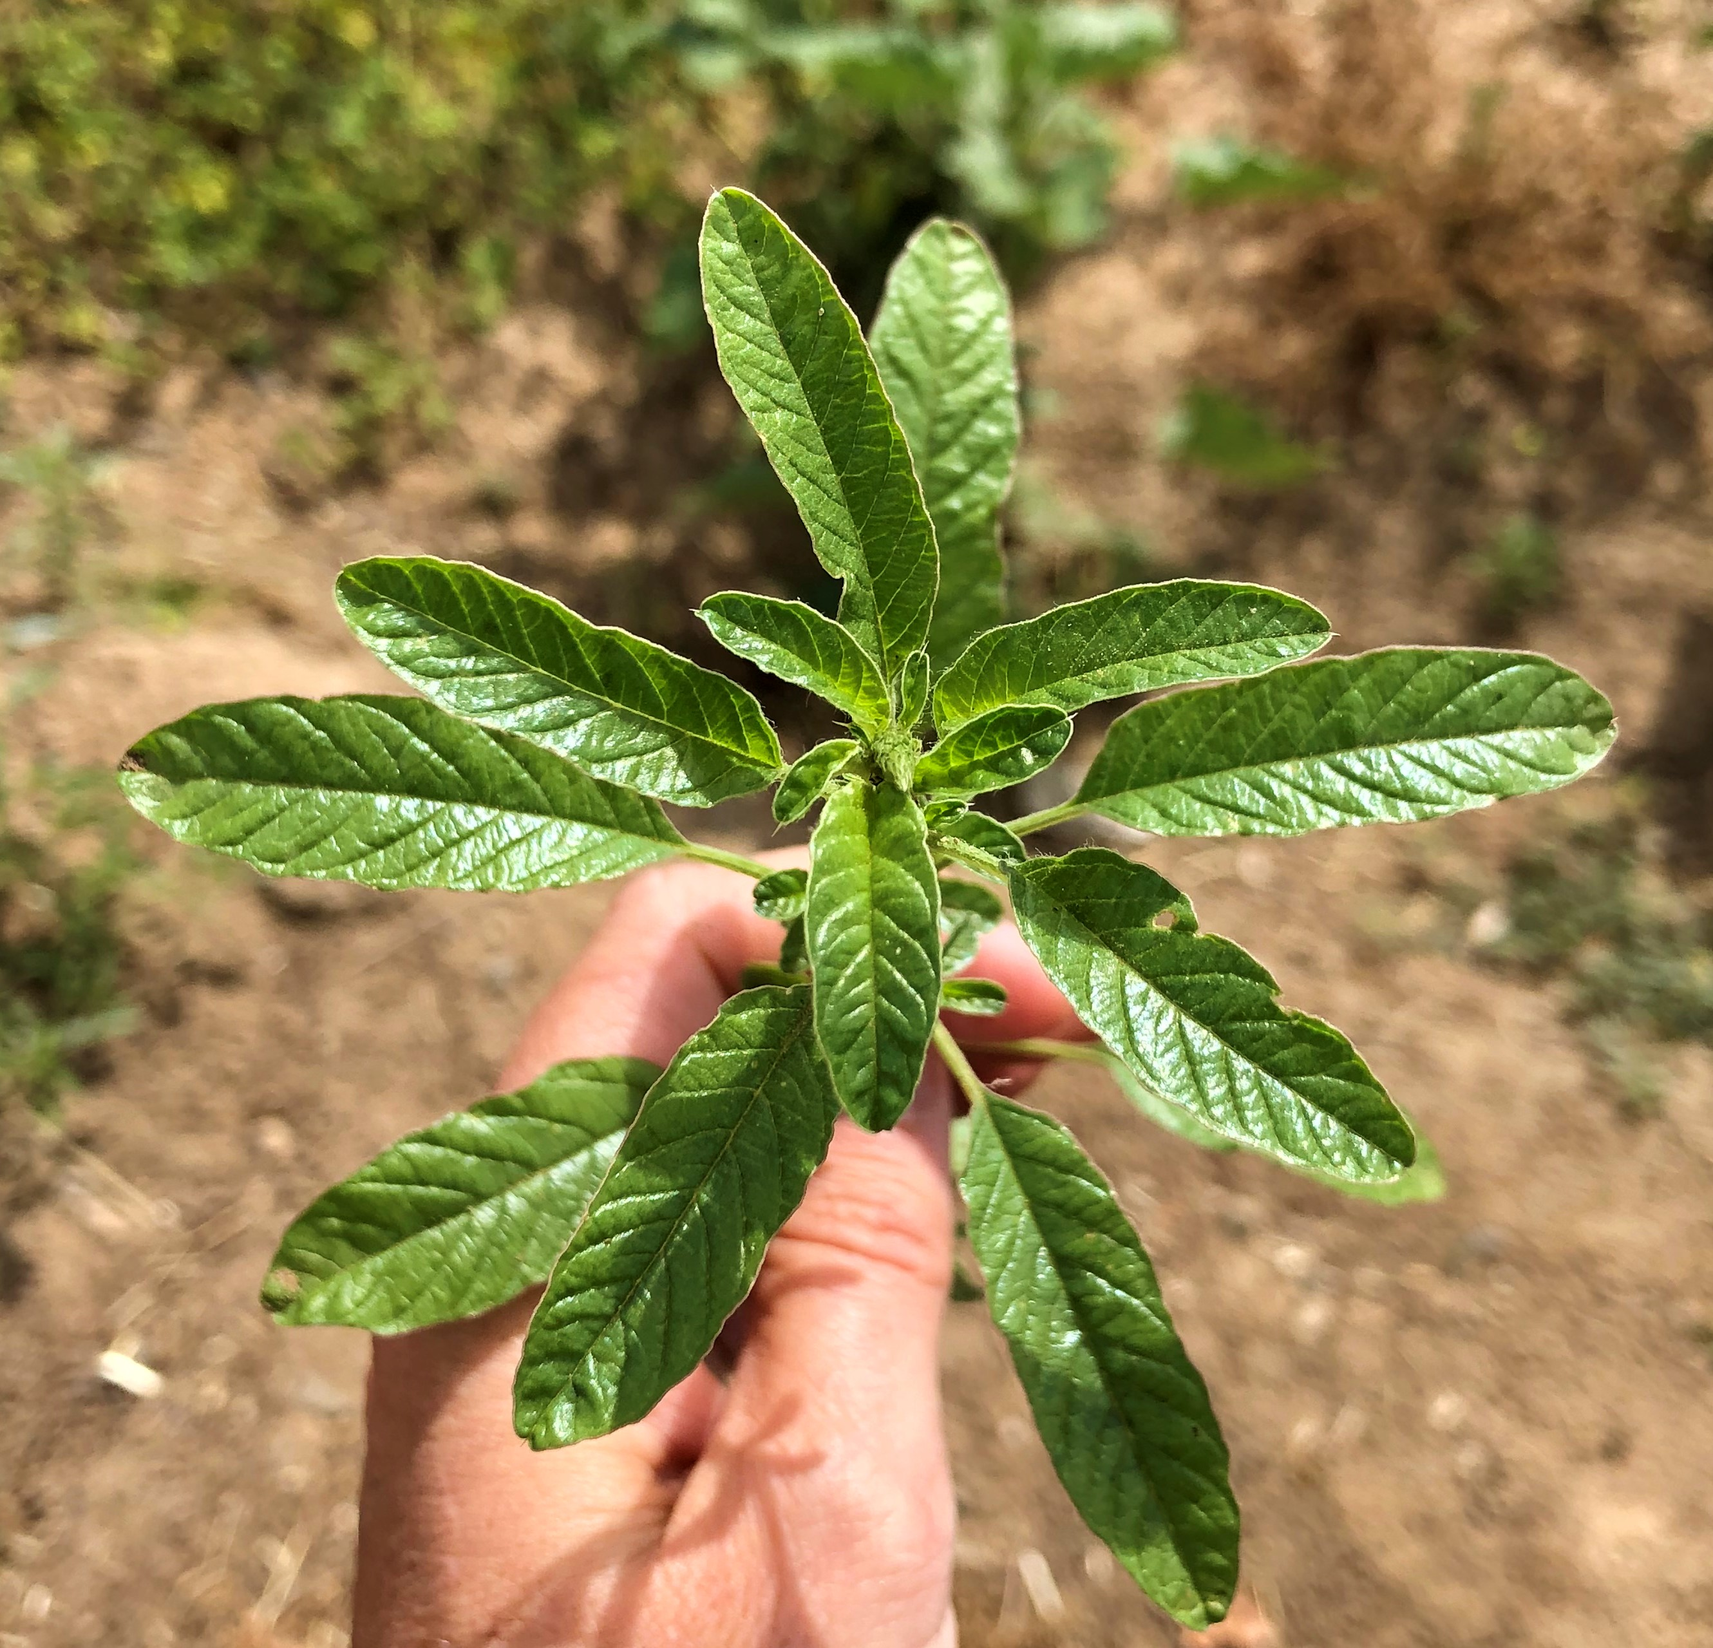
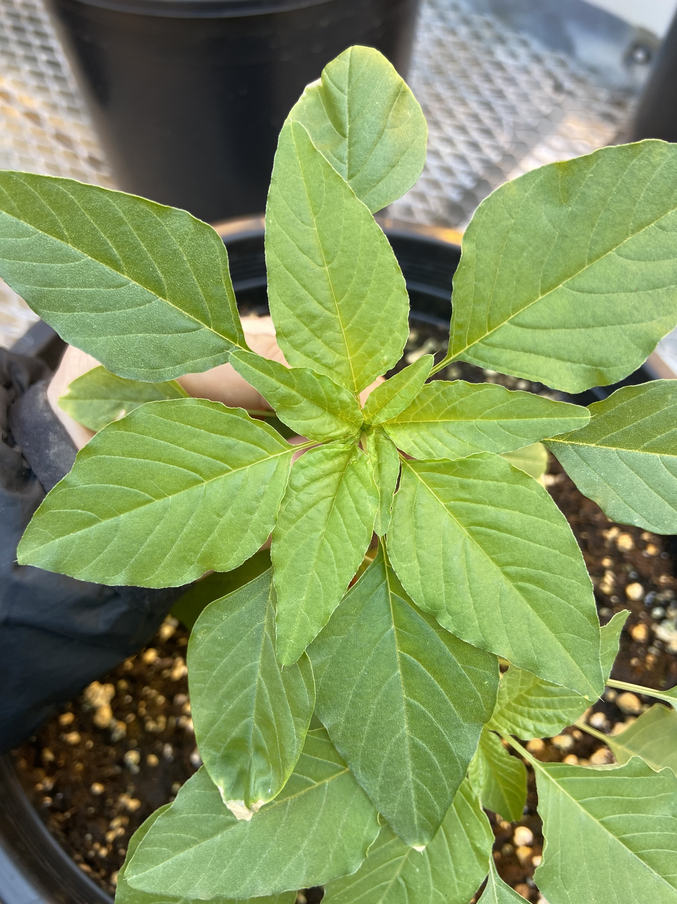
Rising Problems: Waterhemp & Palmer Amaranth
Specifically, waterhemp and palmer amaranth have been causing a lot of issues related to herbicide resistance. Here is a rundown of what herbicide resistance is:
When a single plant survives after chemical management, it will create more plants with the same gene, which in turn will create a population of herbicide resistant plants.
Caused because farmers will use the same weed control strategies or the same herbicides over and over again, allowing the plant to evolve.
Plants produces thousands of tiny black seeds that can easily be transported to other sites via equipment sharing, manure, hay, feed, grain, and contaminated seed
Crucial that your weed management strategy should be multi-faceted, so that no weeds are left standing.
Waterhemp
Palmer
Amaranth
Herbicide resistance is an evolving and developing issue!

Slide 17
Activity: Management Scenarios
Scenario 1
An organic grower plants his field corn crop in mid-May when the soil temperature has reached the optimum for seed germination? Why is this beneficial and what impact might it have on weed competition for the crop?
Scenario 2
Your area is currently under moderate drought stress and you have wild cherry trees, elderberries and Johnson grass just outside the fence of your horse pasture. Should you be more concerned about these plants under these conditions? Why? What action should you take after a wind storm that might bring down branches?
Scenario 3
All of the sudden plant xyz is EVERYWHERE in your field. This plant always used to be under control. Someone of the farm applied herbicide according to the pesticide product label rate in the spring and then no problem. When you look back at your records of herbicides being used, it looks like products with the same mode of action have been used for many years in a row. What may be happening here? What steps would you suggest taking to help address this weed on your farm?

Slide 18
Scenarios Cont.
Scenario 4
There is a new plant growing along the road side near your corn fields. It has yellow, flat topped flowers and while it looks like dill, the plants don’t smell and the leaves aren’t feathery like dill. You have heard somewhere that you shouldn’t touch this plant. Why? What plant is it? What plant family is it in? What common root vegetable that we eat is also in this family? Think about how this plant reproduces and what steps you might take to keep it from spreading on your farm? What steps should you take to protect yourself while seeking to control this plant, necessary protection may vary throughout the day and year?
Scenario 5
Your family is purchasing a used piece of equipment because it will help save you a lot of work and money. It’s totally worth the gas money to travel to southern Ohio to pick it up. What should your family ask the seller to do to ensure you aren’t also buying hitch hiking weed seeds? How would you inspect the equipment to make sure you aren’t moving a potential problem weed? What questions would you ask the grower that might help you identify anything of concern that could be transferred from his farm with the machine? Who else might you reach out to in the local area for more information about problem weeds? If you suspect the piece hasn’t been thoroughly cleaned what steps would you recommend taking upon getting the piece to your farm?
Scenario 6
My horse has real bad photosensitivity and burns around his muzzle and on the white areas of his coat. He’s become colicky and others have liver toxicity. I’ve called my vet and they referred me to an extension specialist to do a pasture walk. How so can you come to look at my pasture to see if there are any species out here that are causing the issue? What questions as an equine specialist should you be asking yourself before the visit or thinking to ask at the visit?

Slide 19
Activity: Discussion/Research time!
With the information provided in this presentation you now understand some basic weed management tools. For this activity we would like to divide into groups and discuss the tools discussed in this presentation. If time allows and there resources for this… do some research of your own to discover more about weed management and/or herbicide resistance. Consider reaching out to CCE, crop advisors, and/or grower groups for more information. Here are a few online resources to get you started:
Cornell University’s Weed ID Network: https://blogs.cornell.edu/weedid/
Cornell Cooperative Extension’s Pesticide Management Education Program: http://pmep.cce.cornell.edu
Cornell University Herbicide Look Up: https://enych.cce.cornell.edu/submission.php?id=744&crumb=crops%7Ccrops%7Capples%7Ccrop*38
Univeristy of Missouri’s Weed ID Guide: https://weedid.missouri.edu
PennState’s Weed ID and Management: https://extension.psu.edu/trees-lawns-and-landscaping/turfgrass-and-lawn-care/weed-management
Take Action Herbicide Classification Chart: https://iwilltakeaction.com/uploads/files/59847-1-ta-hrm-classificationposter-update-17-425-fnl-hr-nobleed2.pdf
International Herbicide-Resistant Weed Database: http://www.weedscience.org/Home.aspx

