Slide 1
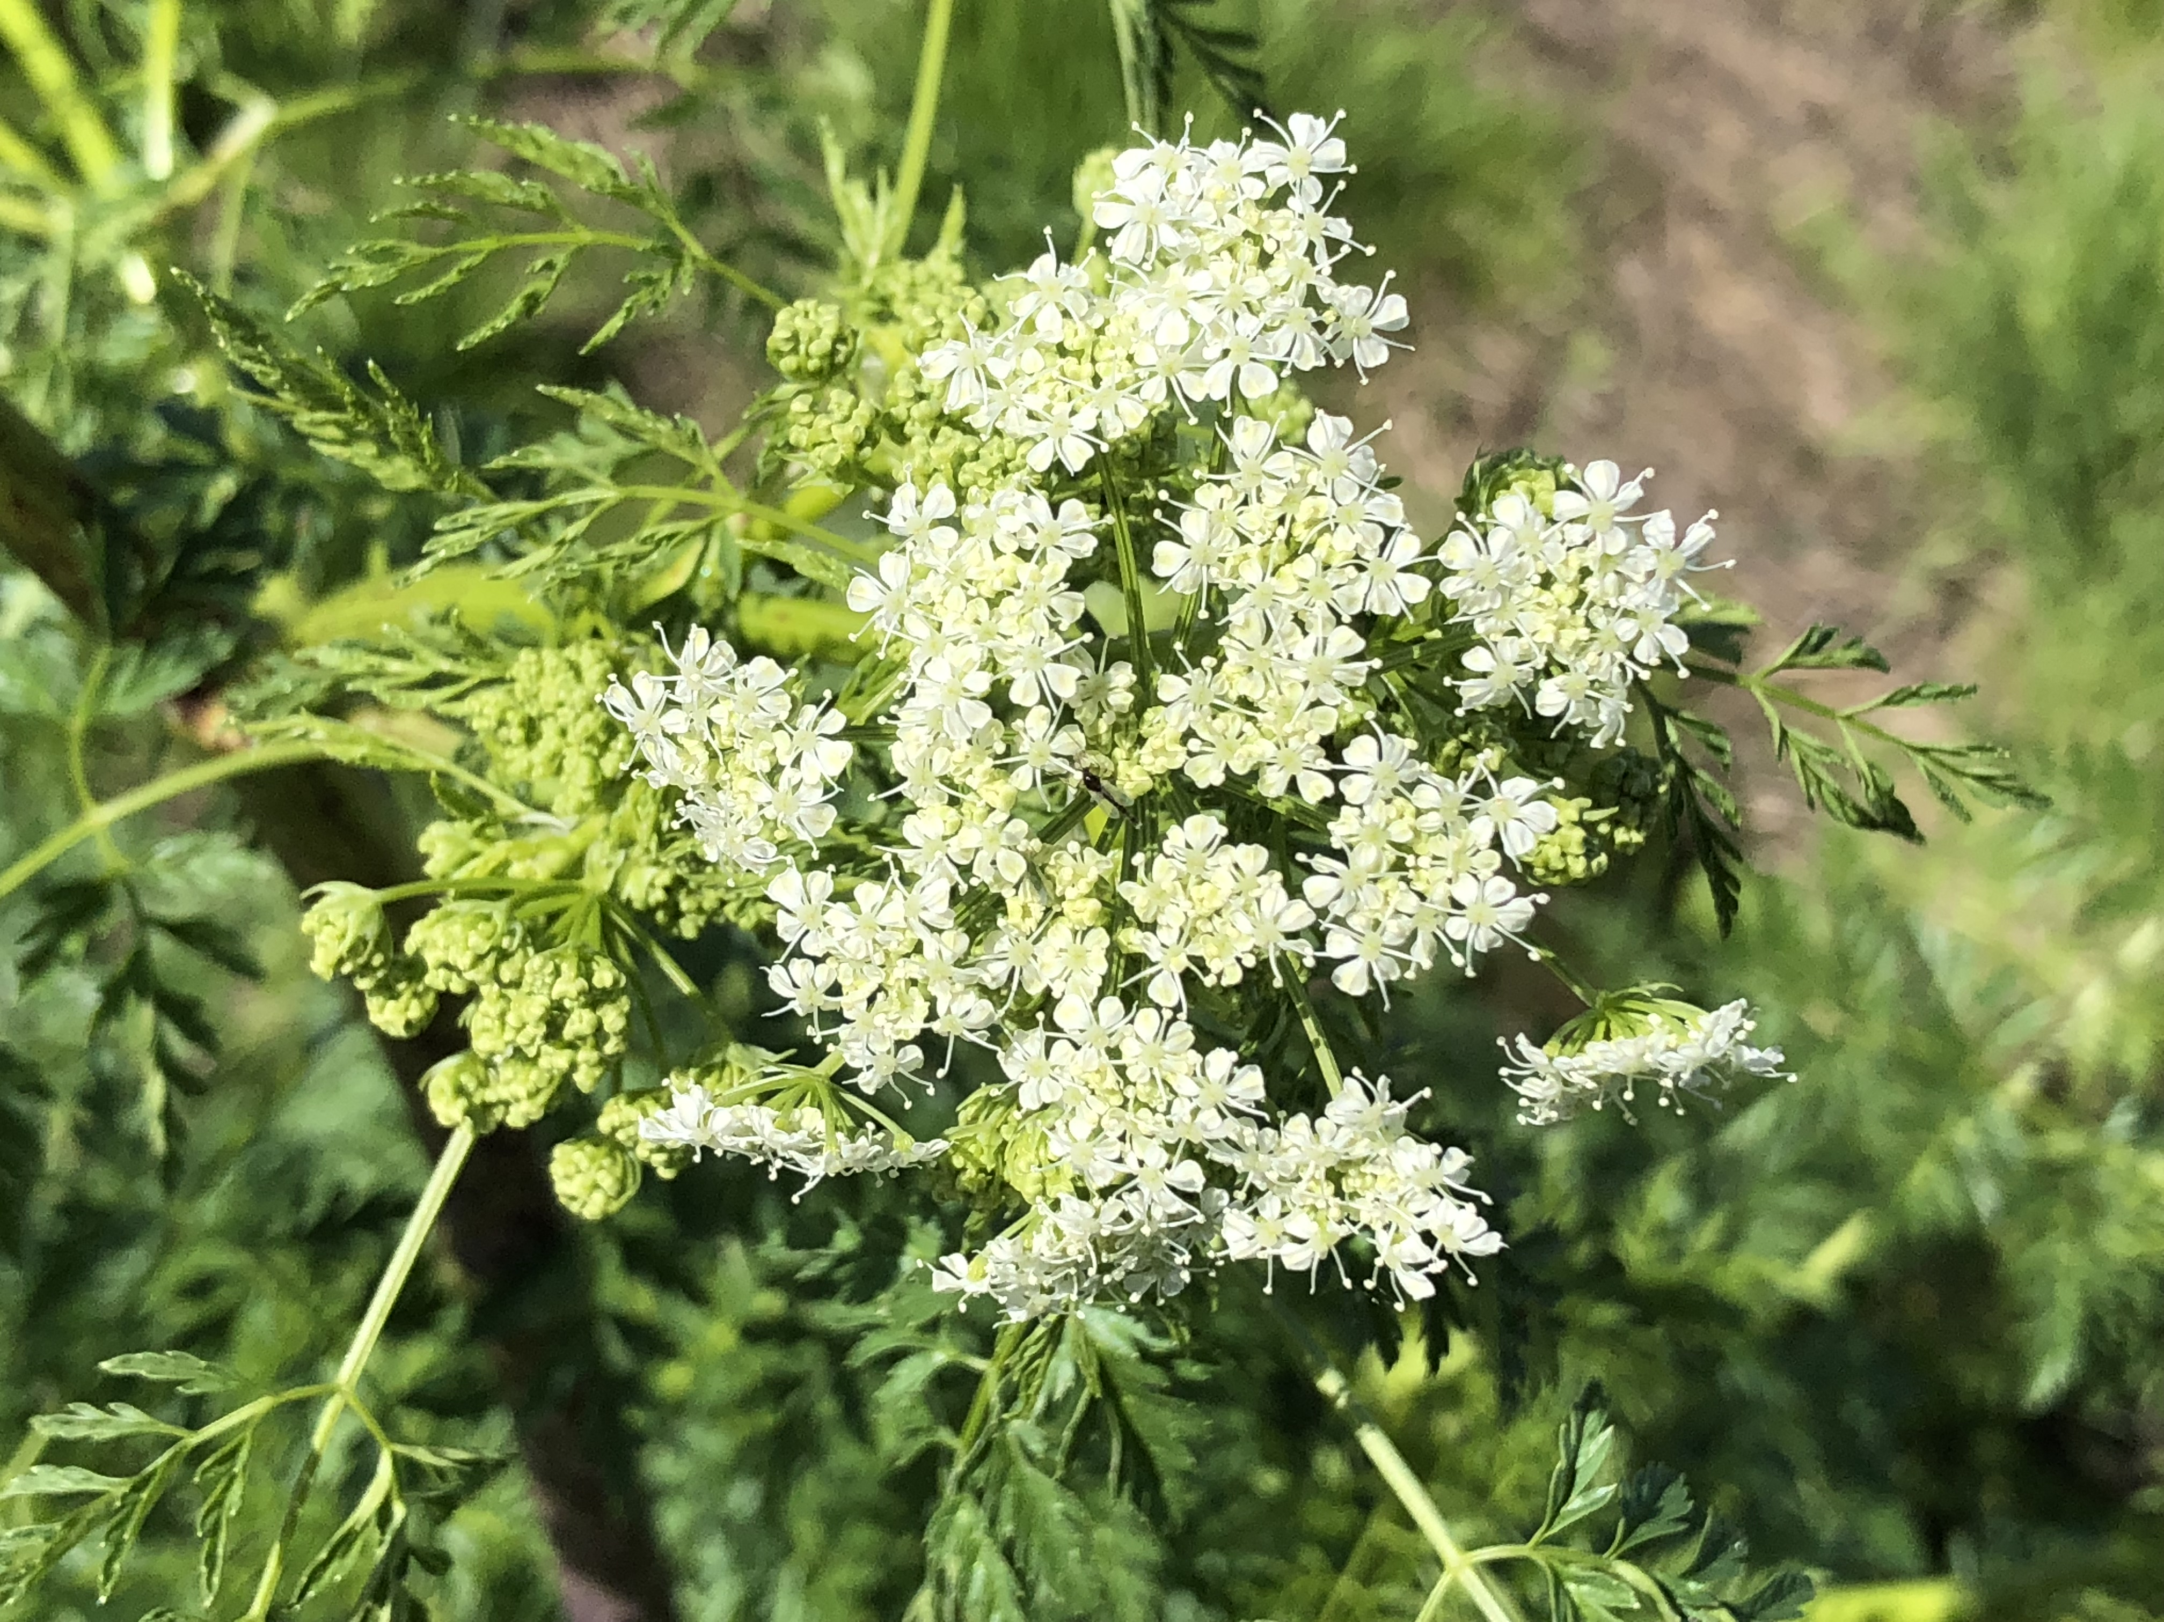
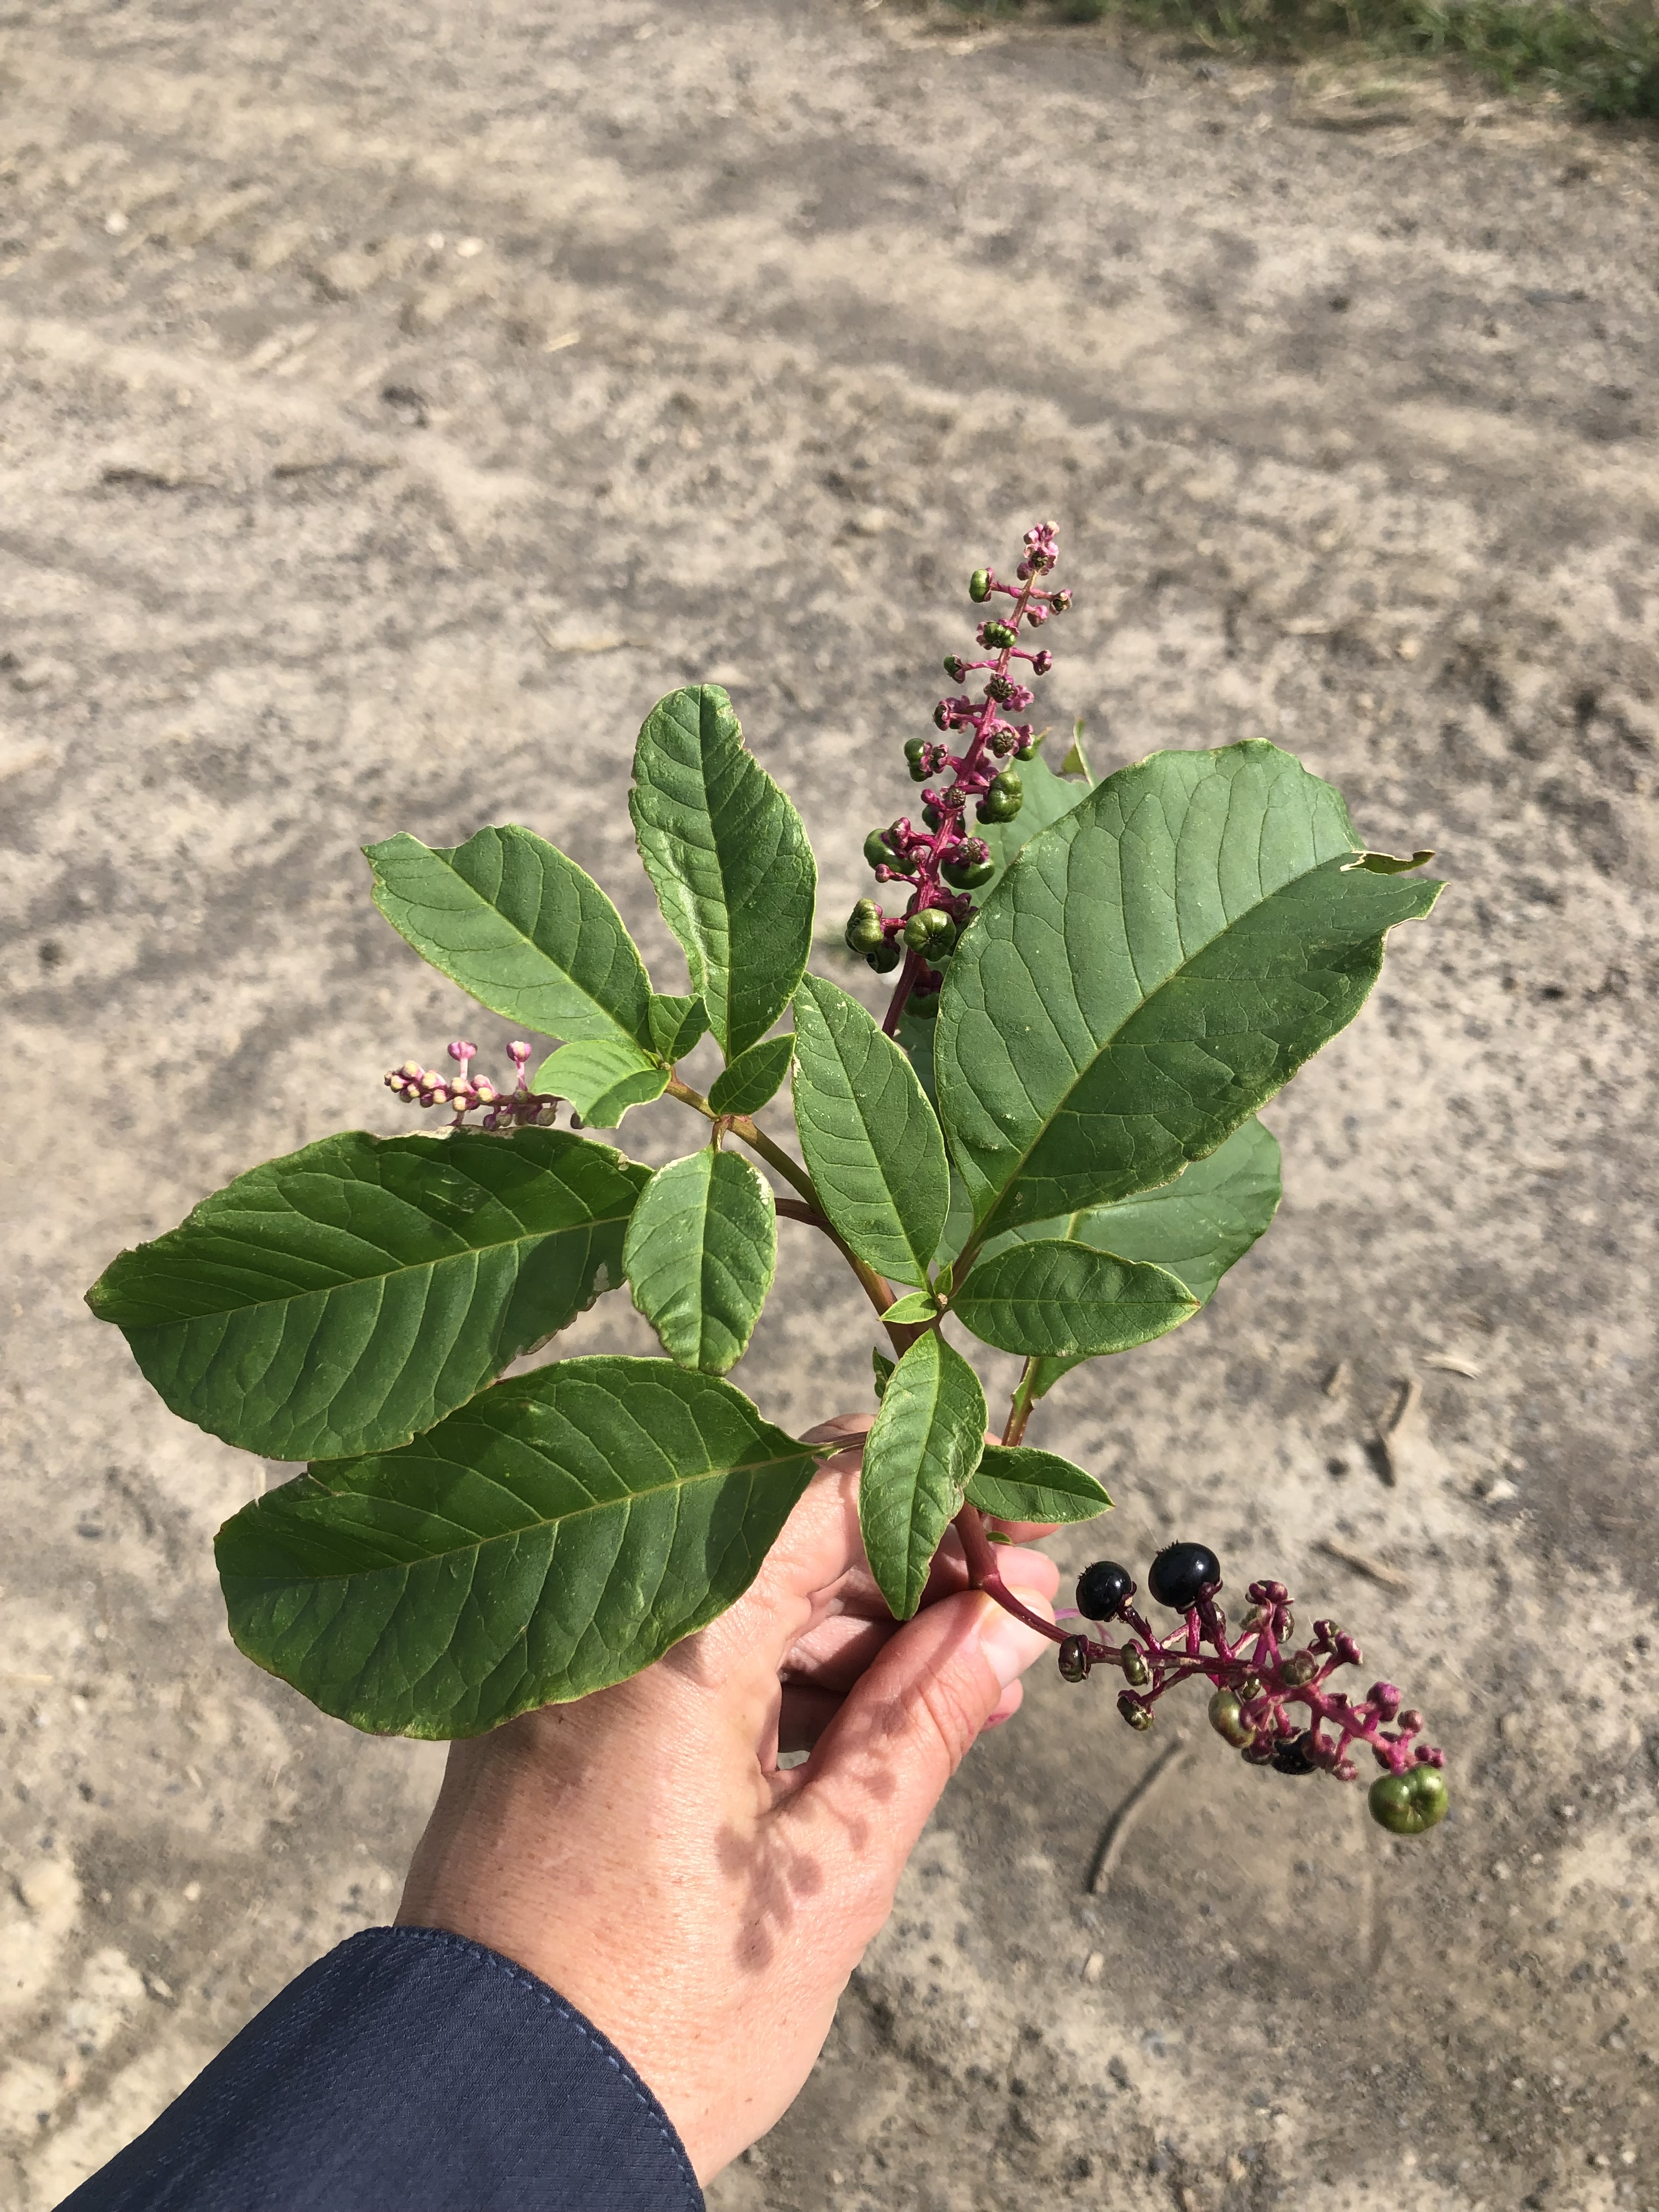
Poisonous Weeds Unit
Photos by Lynn Sosnoskie of Cornell University.

Slide 2
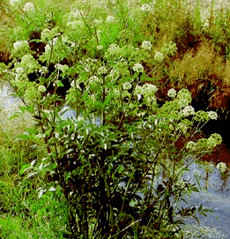
Water hemlock, Cicuta spp.
Characteristics:
Resembles wild carrot, but it has smooth, purple spotted stems
Small, white flowers that grow in umbrella-like clusters
Rootstalks of the plant contain small chambers that hold highly-poisonous liquid that is released when the stems are broken
Roots and seed heads are most toxic, new growth is both tasty and toxic to animals
Toxic perennial that thrives in wet seepage areas of pastures, meadows, and in streams
Image Credits: United States Department of Agricultural, Agricultural Research Services

Slide 3
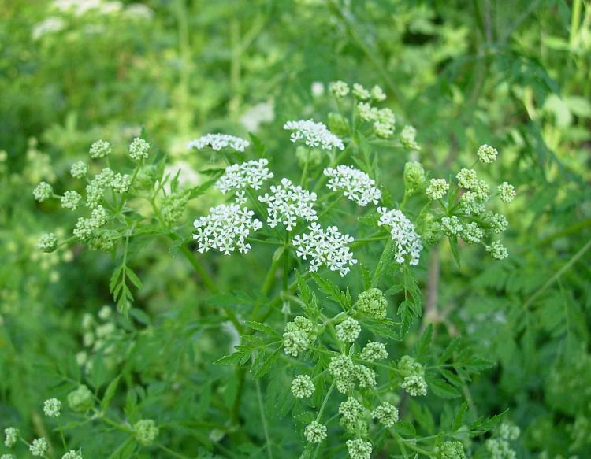
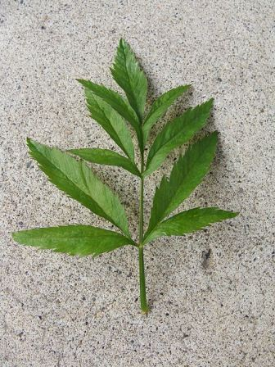
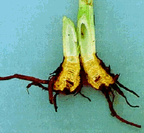
Additional water hemlock info…
Small amount of toxin is needed to be poisonous to humans and livestock
Cicutoxin, directly affects the nervous system and is a violent convulsant
Symptoms include: nausea, seizures, and twitching
Death often occurs within eight hours from heart failure or anoxia
Image Credits (left to right): Michelle Peziol, Alderleaf Wilderness College, Missouri Department of Conservation, and United States Department of Agricultural, Agricultural Research Services

Slide 4
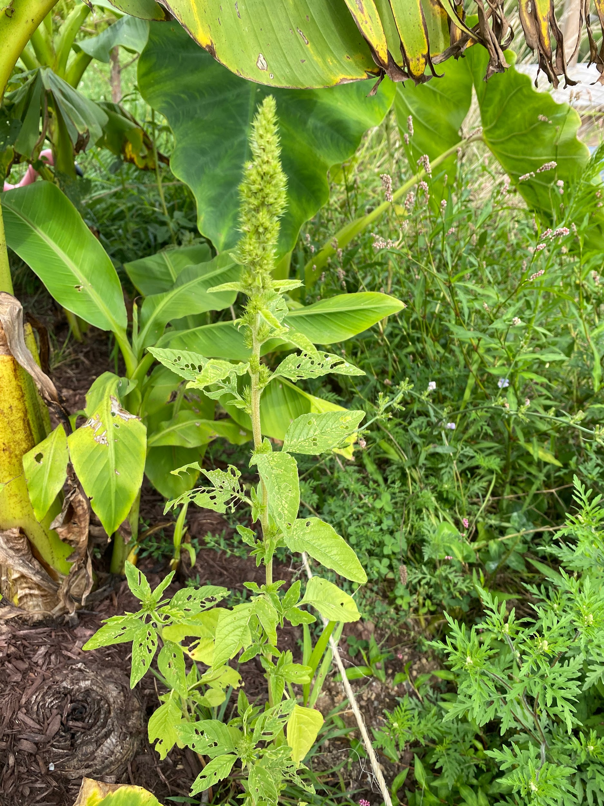
Redroot pigweed (Amaranthus retroflexus)
Characteristics:
Alternate simple leaves
Seed head has thick “fingers”
Lower stem smooth, upper stem and branches hairy
White veins under leaf
Toxic to: cattle and swine

Slide 5
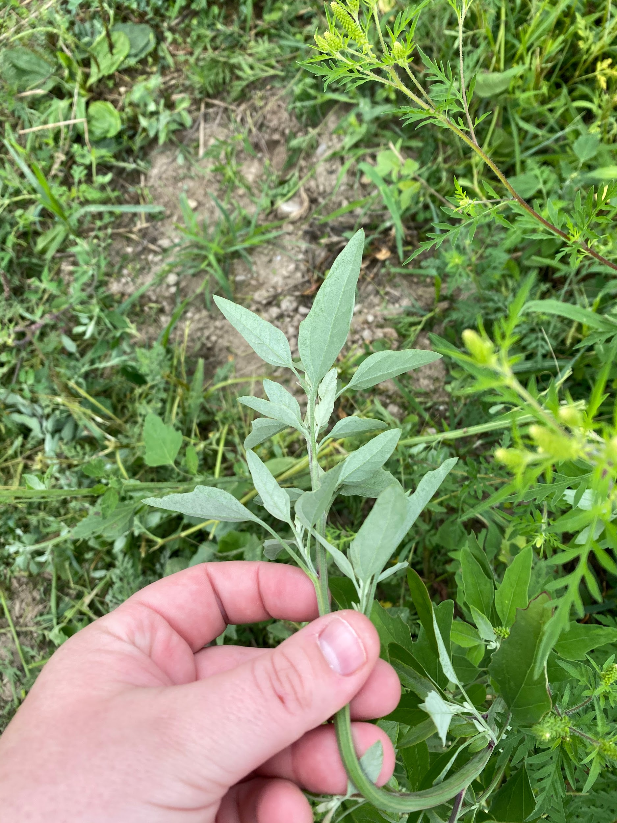
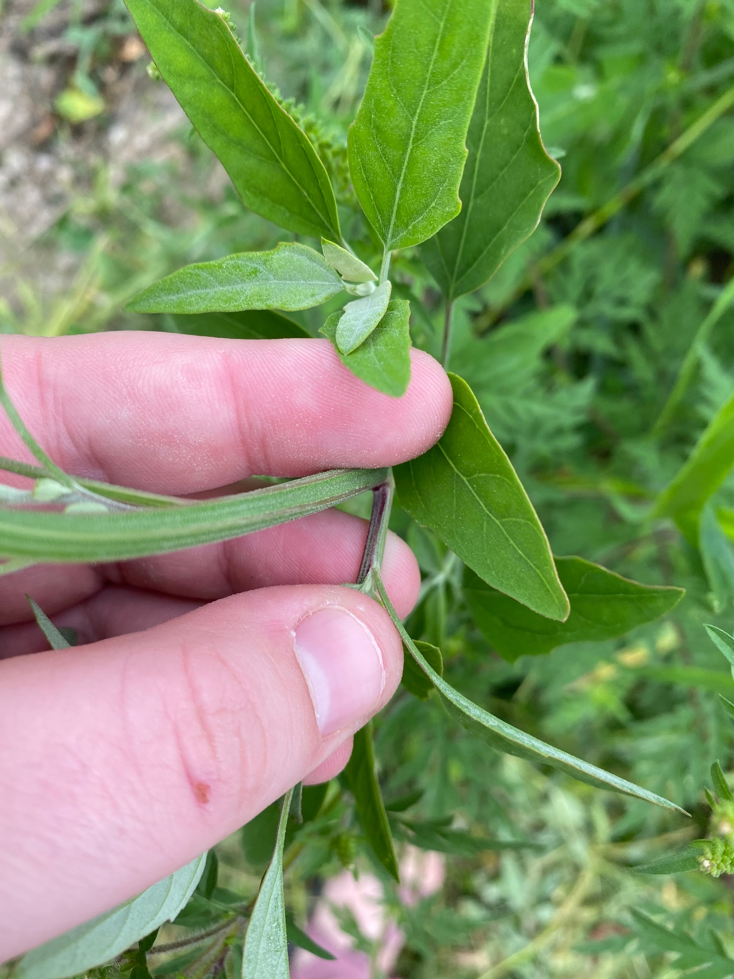
Common lambsquarters (Chenopodium album)
Characteristics:
Erect and branching
Mealy coating on young leaves
Stems have dark red stripes
Leaves alternate and irregularly toothed
Toxic to: cattle, horses, humans, sheep, swine

Slide 6
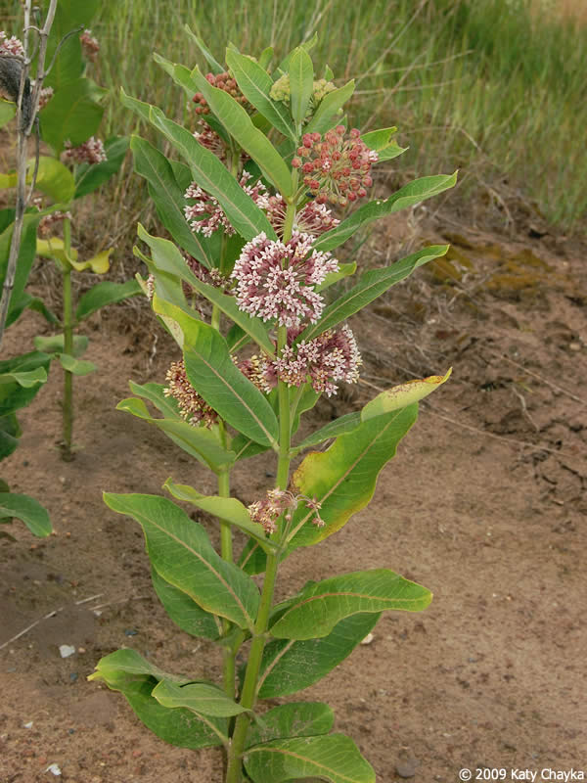
Common milkweed, Asclepia syriaca
Plant Characteristics:
Erect, stout rhizomatous perennial
Leaves are opposite, dark green, oblong, and pointed at the apex
Stems are unbranched, erect, and covered in downy hairs
Stems hollow, but filled with a milky sap that oozes out when broken
Flowers produced are purplish pink to white globe-like clusters
Toxicity Information:
Fruits and seeds are most toxic and the roots and lower leaves are the least toxic
Dried plants can stay toxic for up to two months, so the toxicity persists in hay
Image Credits: Katy Chayka, Minnesota Wildflowers

Slide 7
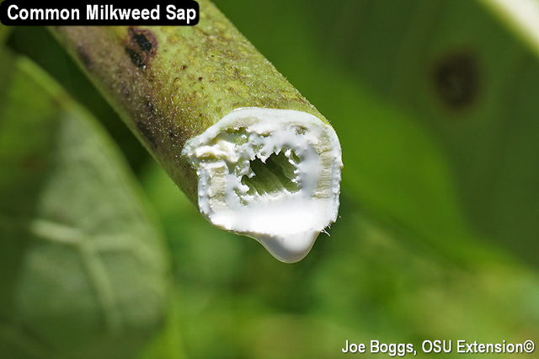
Additional common milkweed info…
Cattle and sheep are the most at risk for poisoning
Poisonous species are not found in New York
Poisoning can cause cardenolide digestive tract irritation in cattle and sheep
Symptoms are reluctance to stand, abdominal pain, grunting, and potentially death
For poultry, milkweed is neurotoxic
Symptoms include slumped standing, conclusions, twitching, and death
Image Credits: Joe Boggs, Ohio State Extension

Slide 8
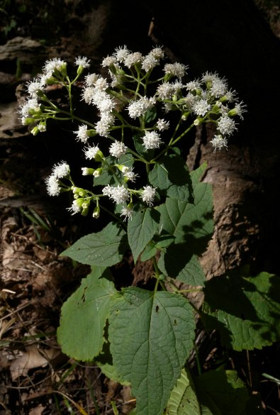
White snakeroot, Ageratina altissima or Eupatorium rugosum
Characteristics:
Poisonous rhizomatous perennial herb
Thrives in shady areas along forest edges and in meadows
Opposite, coarsely-toothed leaves that are sharply pointed at the apex and rounded at the base
Flowers are produced in bright white flat-topped clusters
Image Credits: Illinois Wildflowers

Slide 9
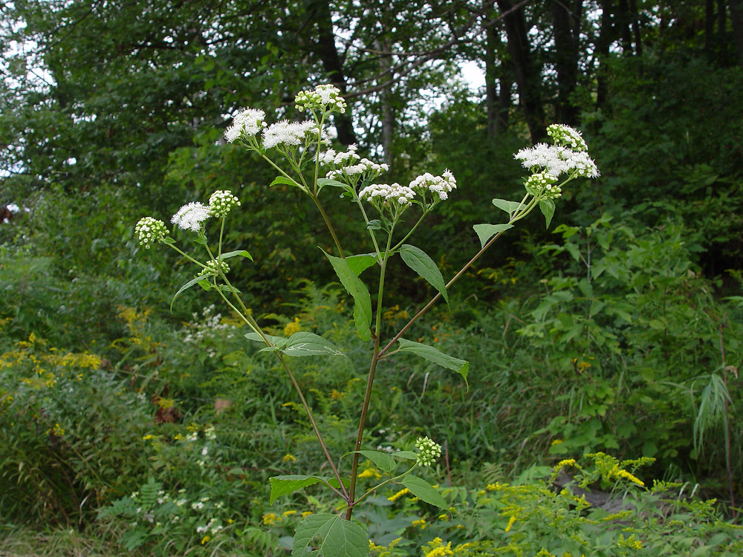
Additional white snakeroot info…
Most toxic part of the plant are the leaves and stems.
Interestingly, Northeast states have no reported cases of snakeroot toxicity, even though the plant is quite common. However, there have been cases reported in Illinois, Indiana, Ohio, Kentucky, Tennessee, North Carolina, and Arkansas
Ingestion of the plant creates a deadly condition called trembles in animals
Consuming the milk from affected animals gives humans milk sickness
Image Credits: Donald Cameron, Go Botany

Slide 10
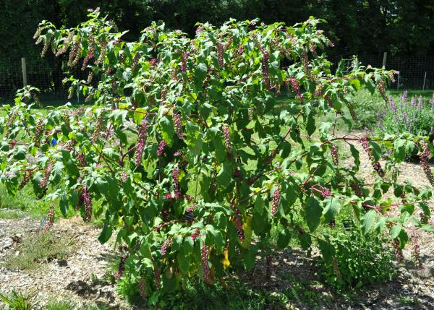
Common Pokeweed, Phytolacca americana
Characteristics:
Large herbaceous perennial species
Resembles a tree when fully mature
branched with smooth, erect stems that are almost purple to red in color
Leaves are alternately arranged
Leaves are relatively egg shaped and decrease in size towards the top
Flowers grow on reddish stemmed erect racemes and the ends of the upper branches
Produce individual white to pink flowers
Berries produced are green when immature, but turn purplish black when mature
Toxic to: cattle, sheep, humans, turkeys, swine, horses
Image Credits: Grant Thompson, Cornell University Turfgrass and Landscape Weed ID

Slide 11
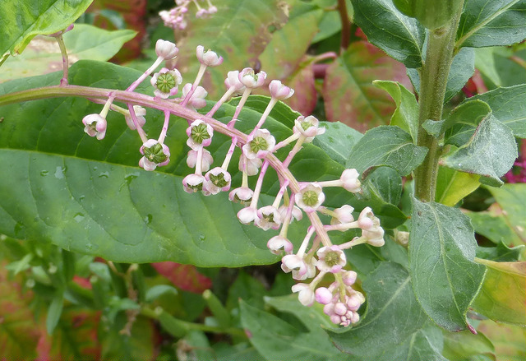
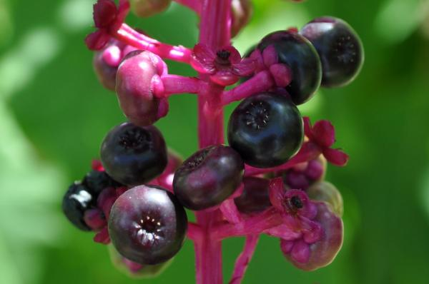
Additional common pokeweed info…
The leaves and roots are the most toxic, but deaths have been reported in cattle and swine from berry ingestion.
Livestock may vomit shortly after consumption and is sometimes followed by bloody diarrhea
Animals typically recover in 24 to 48 hours
Pokeweed can cause gastrointestinal distress, such as diarrhea and colic
Birth defects and tumors are possible
Very rarely is this plant fatal to humans
Image Credits (top to bottom): Lorianne DiSabato, Extension Master Gardener Volunteers of Buncombe County and Grant Thompson, Cornell University Turfgrass and Landscape Weed ID

Slide 12
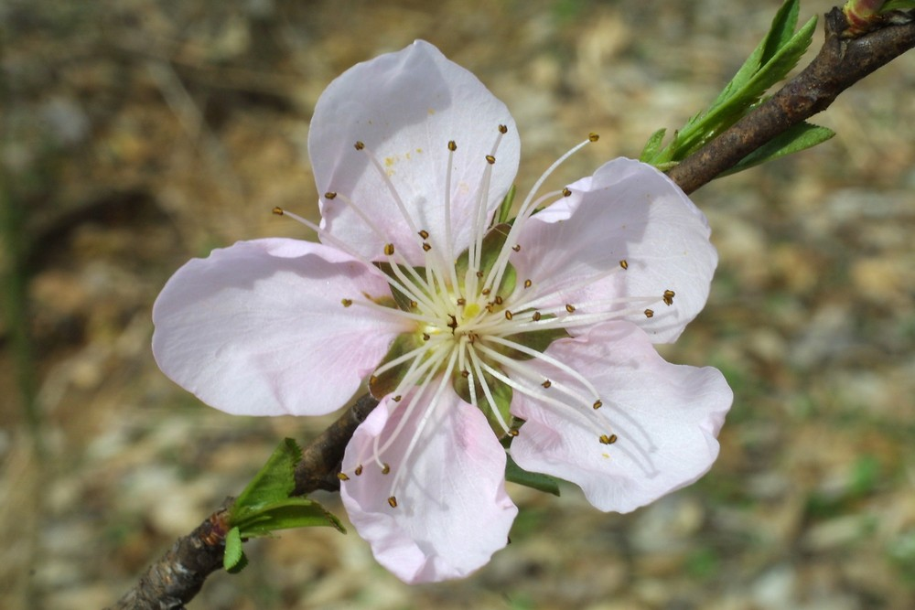
Prunus Species, Prunus spp.
Characteristics:
Deciduous and evergreen plants, but most commonly recognized are cherries, plums, peaches, nectarines, almonds, and apricots
Almost all are woody perennials
Leaves are typically simple with toothed margins
Flowers in this genus have five petals.
Toxic to: horses, cattle, moose, sheep, swine, goats
Image Credits: Steven Baskauf, Go Botany

Slide 13
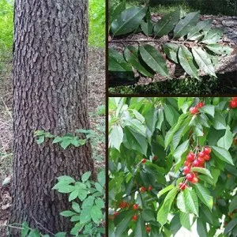
Additional prunus species info…
All species are toxic to livestock
Black cherry is considered the most toxic.
Every part of the plant except the mature fruit is toxic
Ruminant animals are more likely to be poisoned because the bacteria in their rumen expedite the break down
The acidity of some non-ruminants inactivate some of the enzymes necessary for breakdown.
Hydrogen cyanide prevents red blood cells from releasing oxygen
Signs of ingestion include excitement, muscle tremors, rapid pulse and breathing, and runny eyes. If a large amount is eaten, death typically occurs within minutes.
Image Credits: Indiana Timber and Veneer LLC

Slide 14
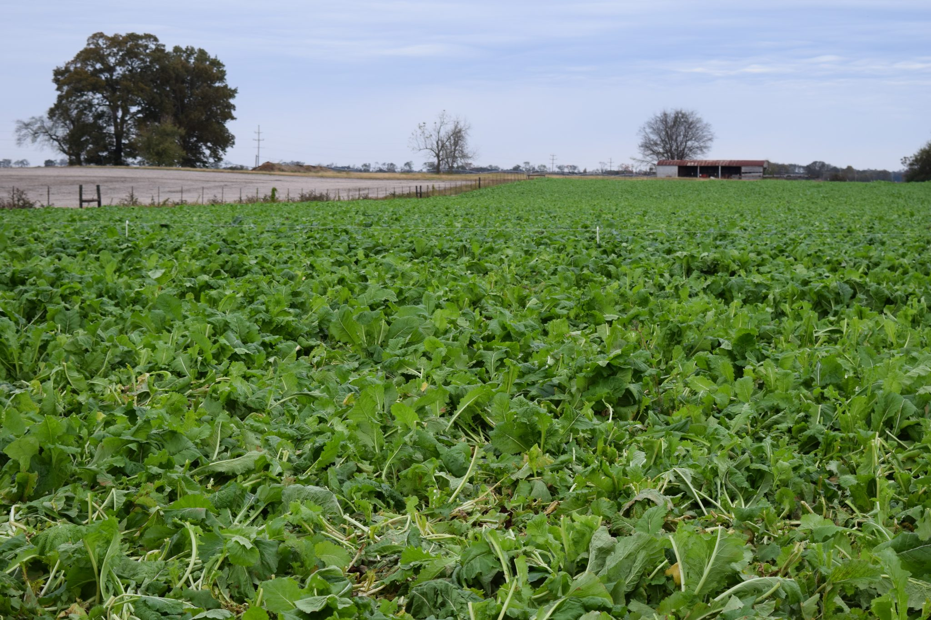
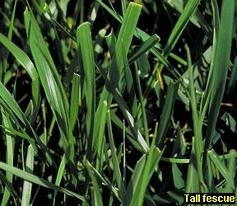
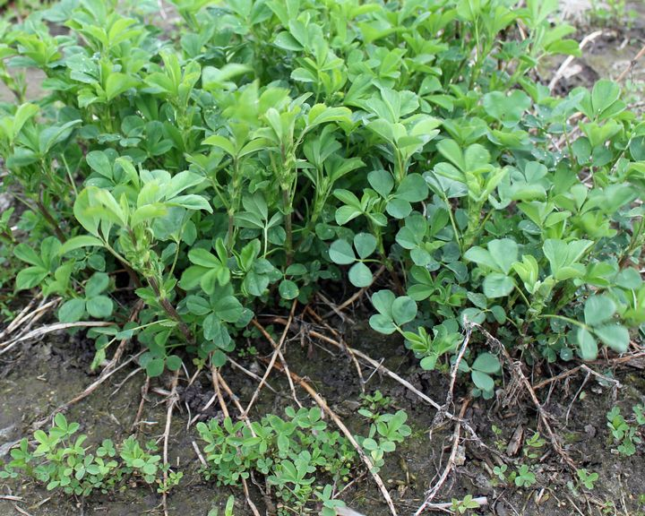
Too Much of A Good Thing
Brassica Forage Mixture
Some crop species can make great feed for animals and livestock, but can become toxic if consumed in large quantities. These crops include alfalfa, tall fescue, and a number of crops in the brassica family.
Tall Fescue
Alfalfa
Image Credits (left to right): MSU Extension, UC IPM, and Alabama Extension

Slide 15
Activity
Given a few hints about the weeds biology and key characteristics, can you match the name to the photo of the plant?
If more photos are desired for this activity please visit https://blogs.cornell.edu/weedid/
Notes:
*Could use some specimens if comfortable

