Slide 1
4H Match game cards
Weed ID Network
Compiled by Isabella Colucci
Note: You may need to play around with your printing settings to get the slides to print correctly. The dashed lines represent cutting lines.

Slide 2
Specifically poisonous spp.
Common pokeweed (Phytolacca americana)
Water hemlock (Cicuta spp.)
Redroot pigweed (Amaranthus retroflexus)
Common milkweed (Asclepia syriaca)
White snakeroot (Ageratina altissuma or Eupatorium rugosum)
Prunus species (Prunus spp.)

Slide 3
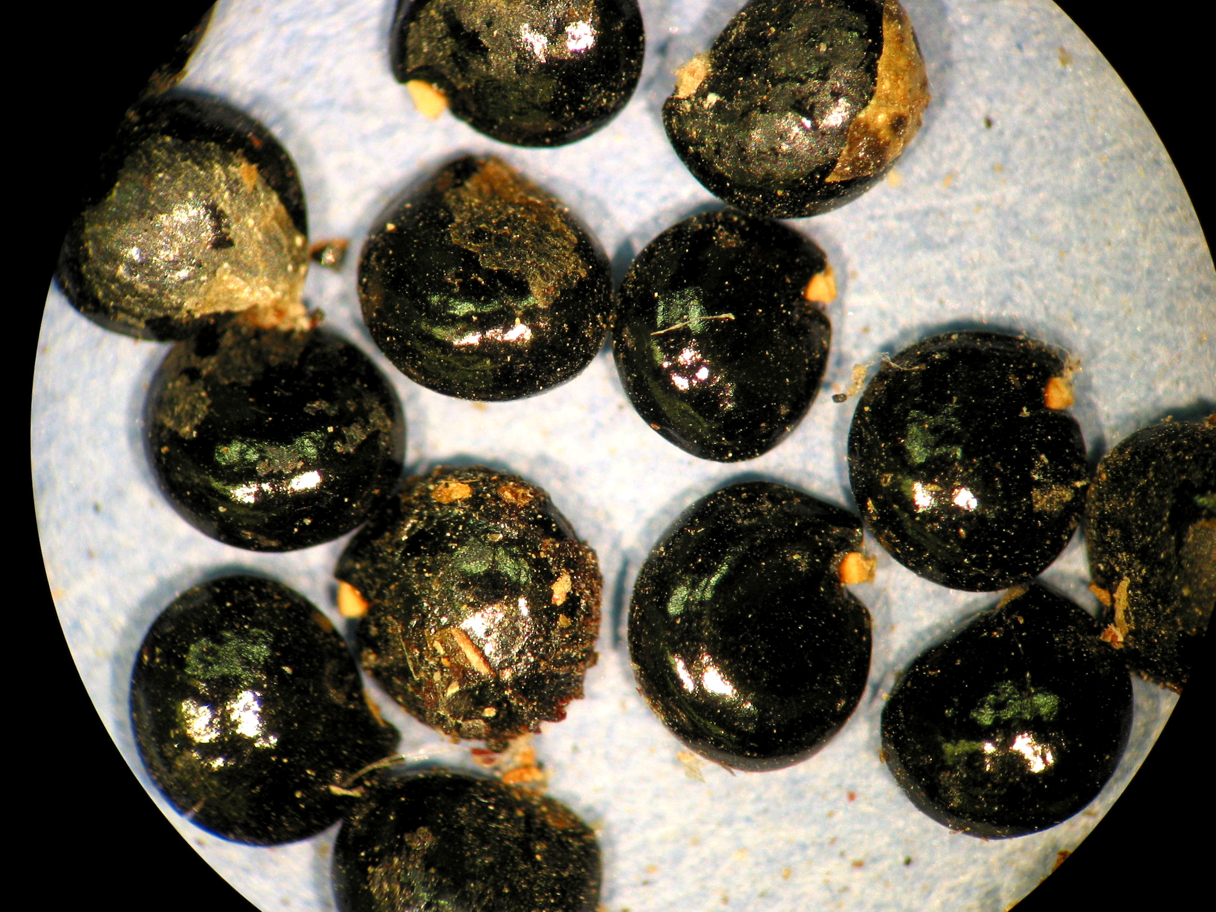
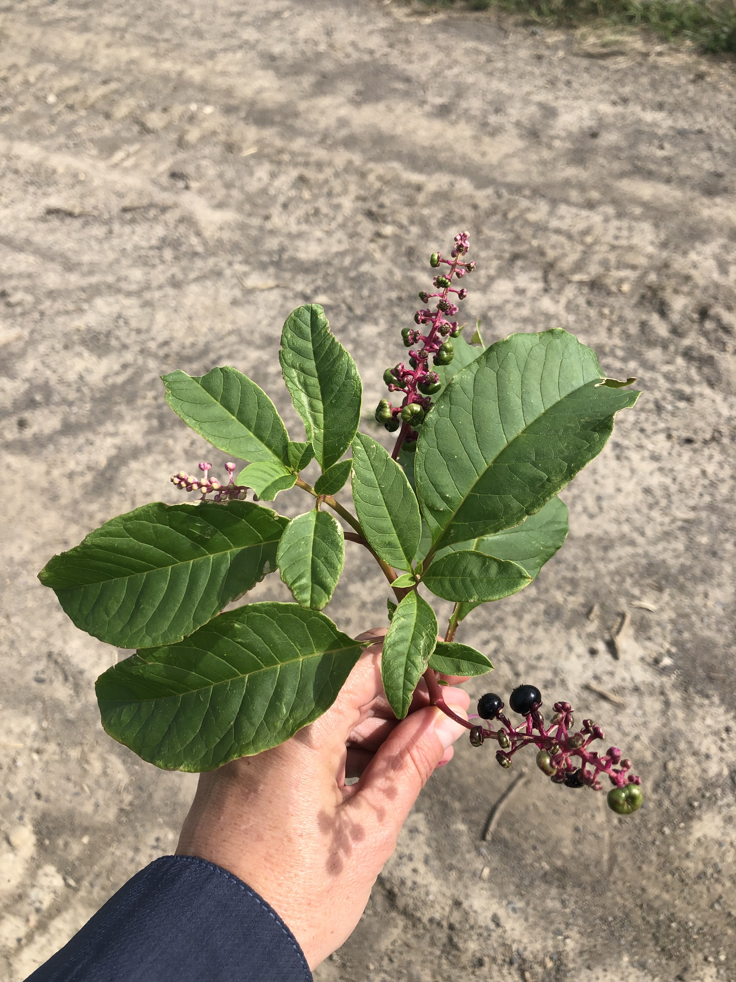
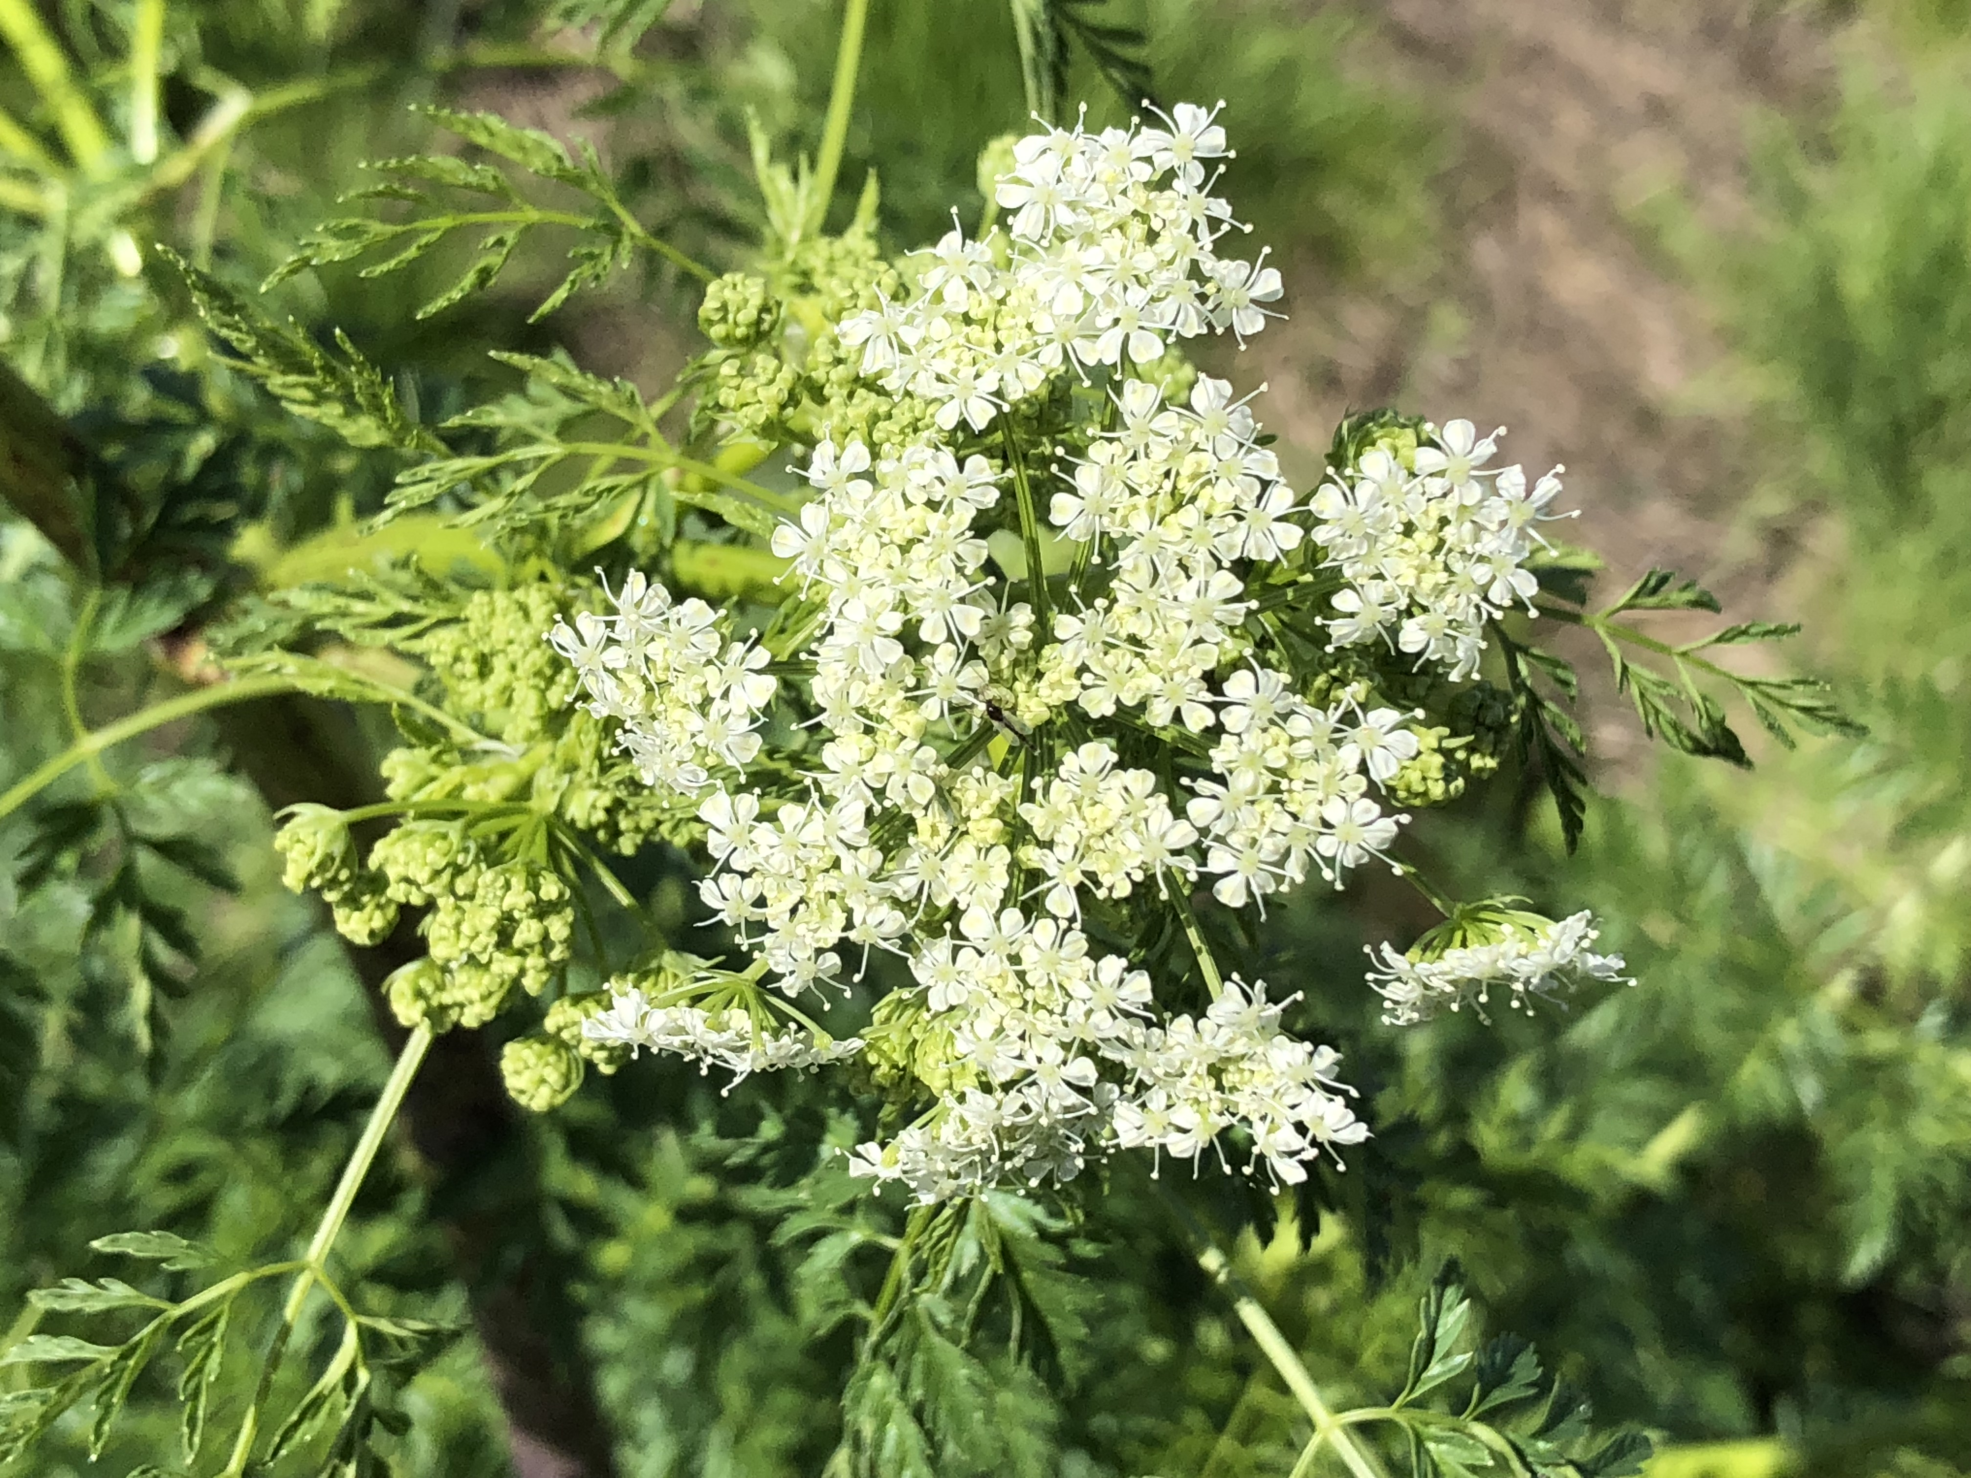
Characteristics:
Annual, biennial, or perennial?
Monocot or dicot?
Broadleaf or grass-like?
Leaf arrangement? Alternate
Leaf shape? Lance shape
Root system? Taproot (large & white)
Flowers white, berries green first then turn purple-black late summer/fall
Berries eaten and then spread by birds
Common pokeweed
Phytolacca americana
Toxic to cattle, sheep, humans, turkeys, swine, horses
Photos by Lynn Sosnoskie of Cornell University.
Characteristics:
Annual, biennial, or perennial?
Monocot or dicot?
Broadleaf or grass-like?
Leaf arrangement? Alternate
Leaf shape? seedling: lance shape; mature: edges turn lobed and pinnate compound
Root system? tuber
Flowers white; shape umbel
Water hemlock
Cicuta spp.
Poisonous to humans & livestock
Photo by Lynn Sosnoskie of Cornell University.

Slide 4
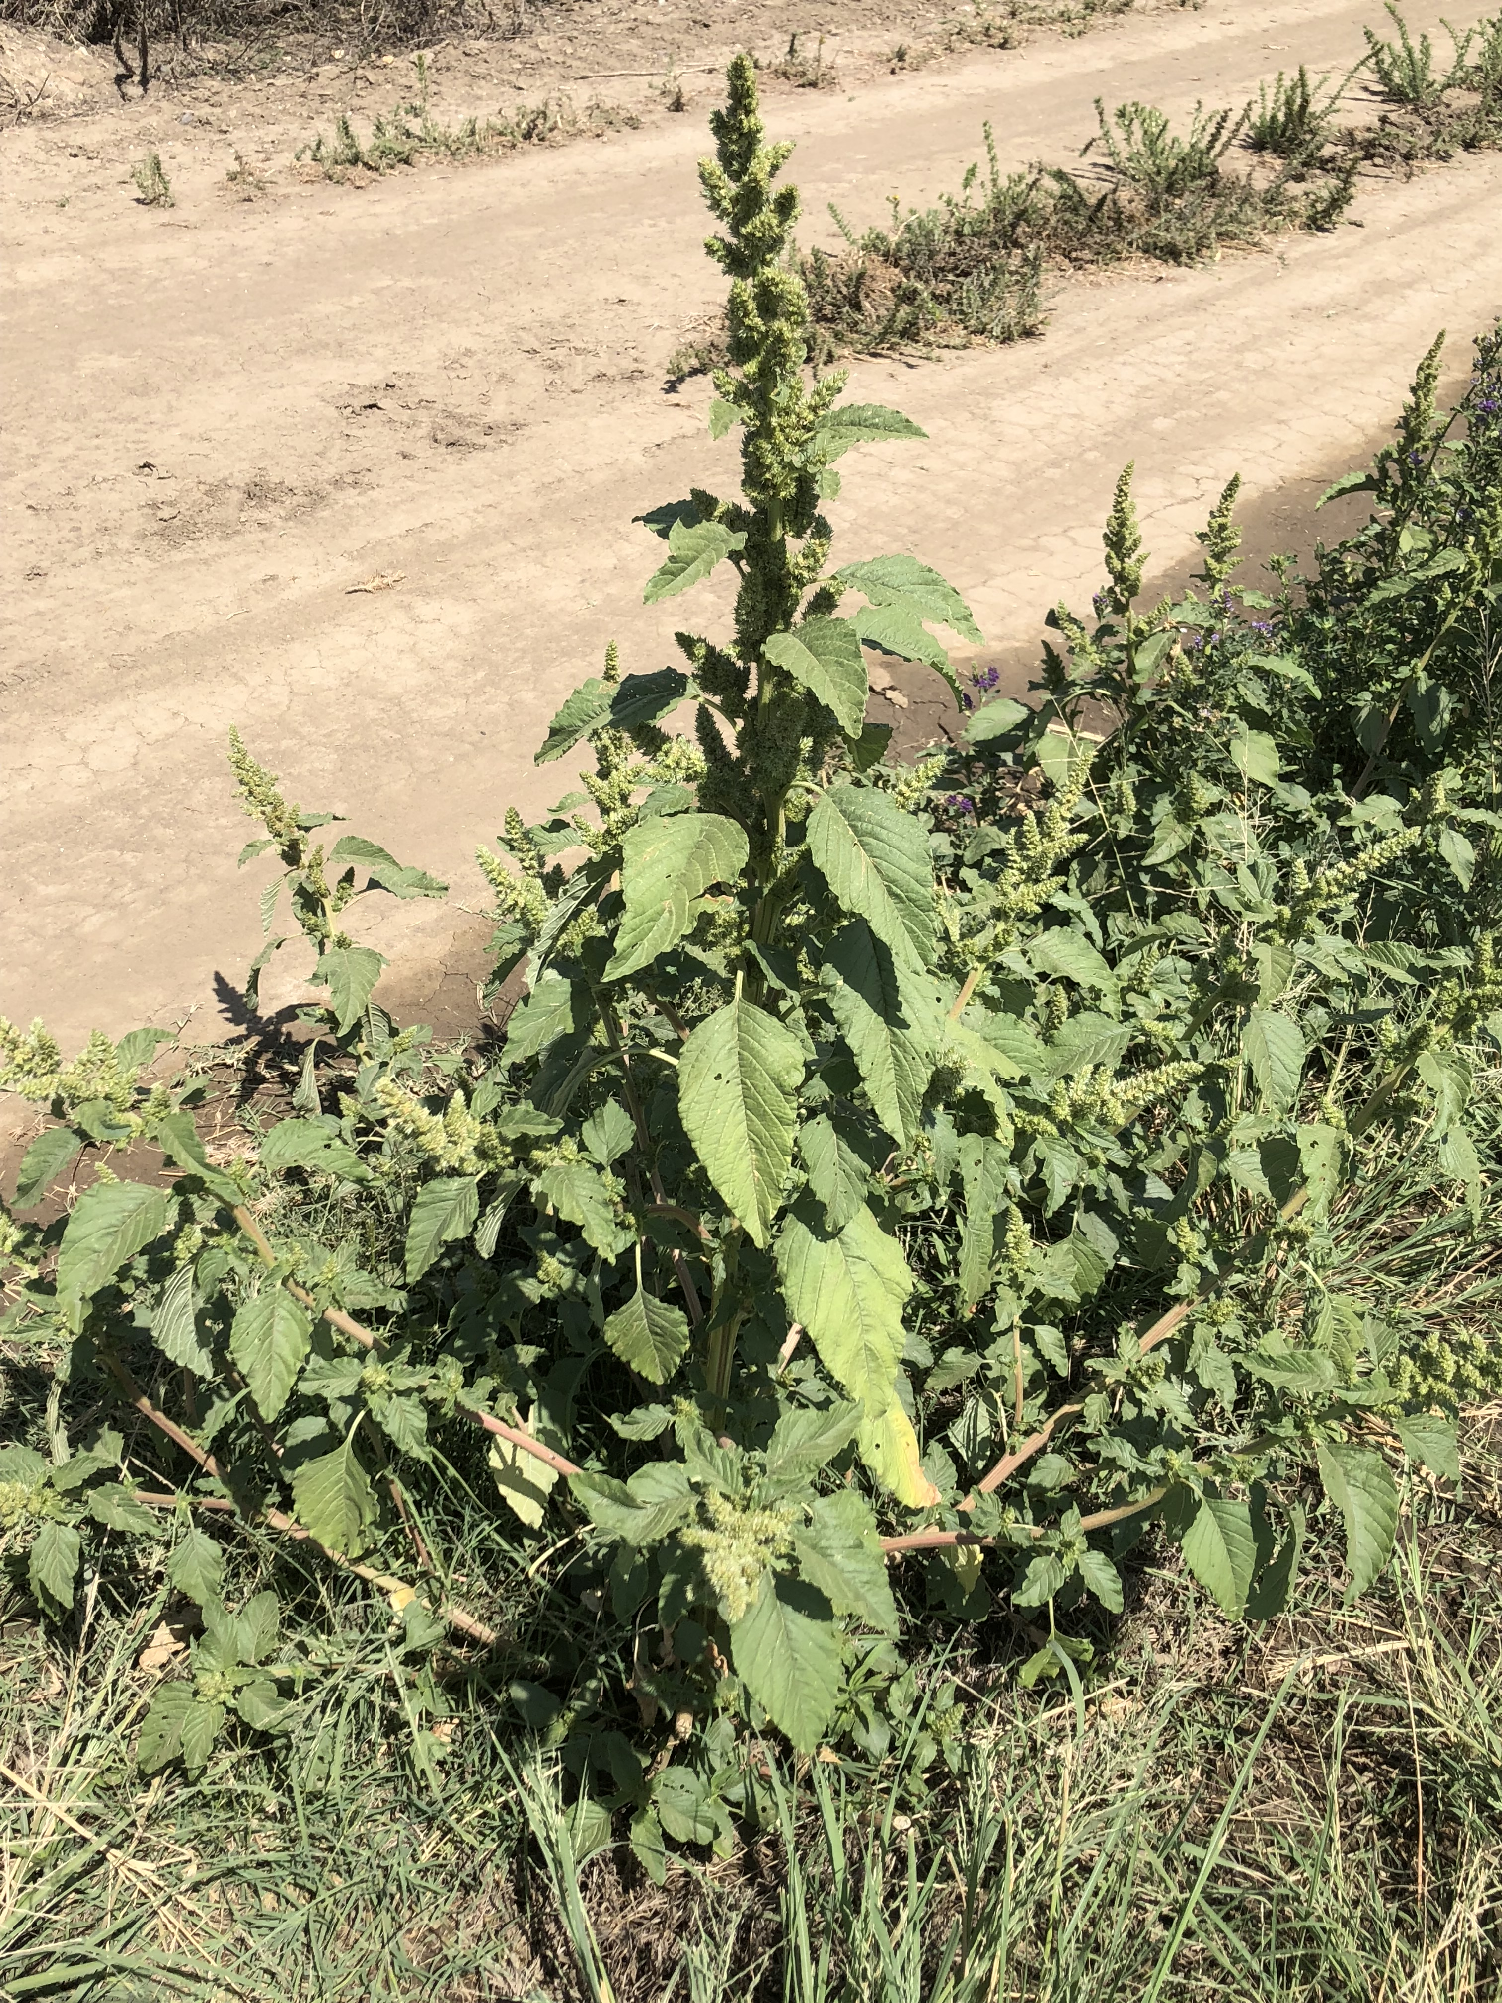
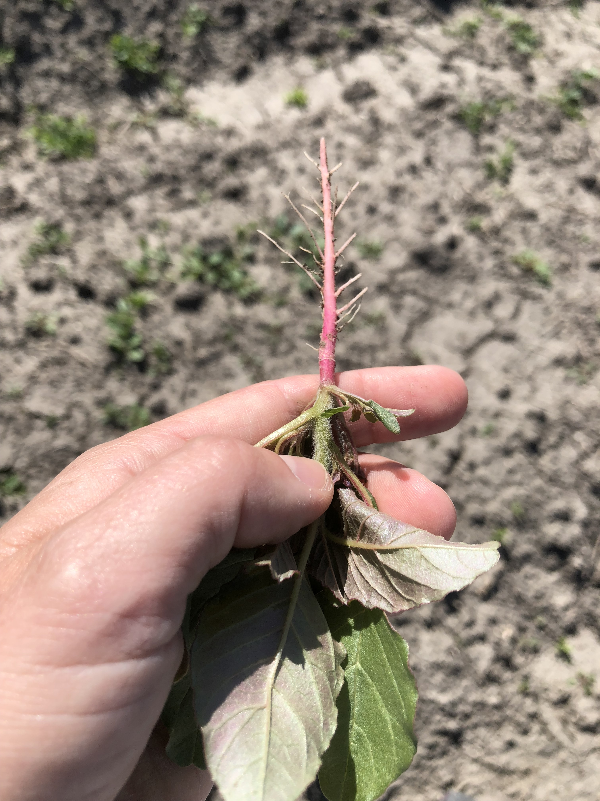
Characteristics:
Annual, biennial, or perennial?
Monocot or dicot?
Broadleaf or grass-like?
Leaf arrangement? Alternate
Leaf shape? Ovate shape; veins underneath white
Root system? Taproot (red)
Flowers greenish; shape panicle
Redroot pigweed
Amaranthus retroflexus
Toxic to cattle & swine
Photos by Lynn Sosnoskie of Cornell University.
Characteristics:
Annual, biennial, or perennial?
Monocot or dicot?
Broadleaf or grass-like?
Leaf arrangement? Seedlings: opposite; mature alternate
Leaf shape? Roughly triangular to lance shape, irregular teeth
Root system? Fibrous, short taproot
Flowers white; shape cyme
Young leaves have greyish white coating
Common lambsquarters
Chenopodium album.
Toxic to cattle, horses, humans, sheep & swine
Photo by Lynn Sosnoskie of Cornell University.

Slide 5
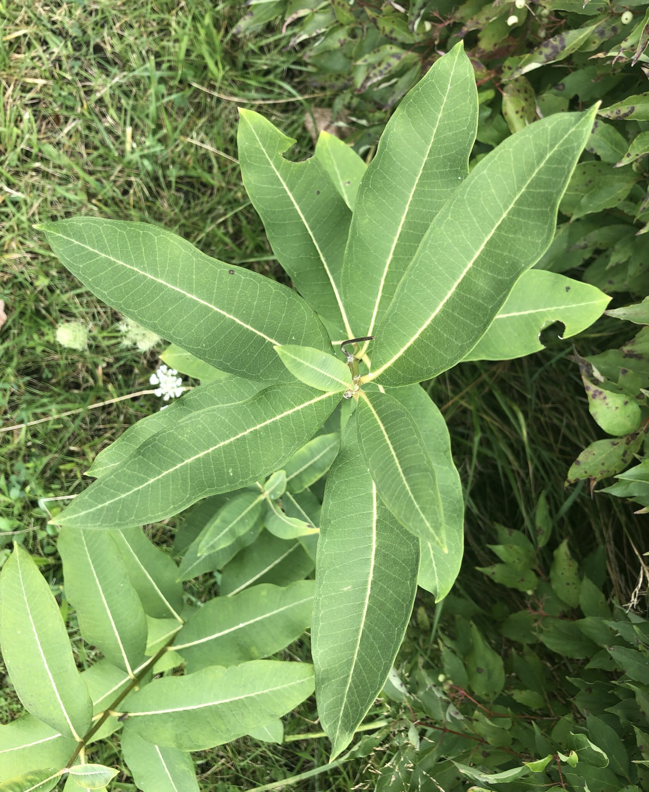
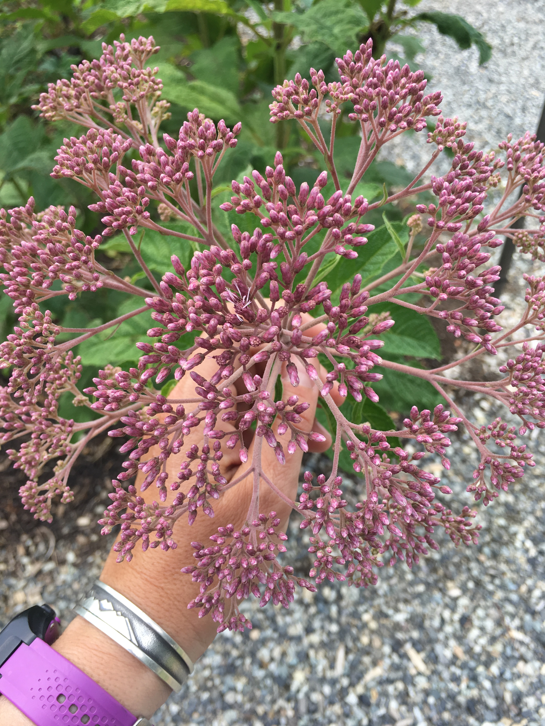
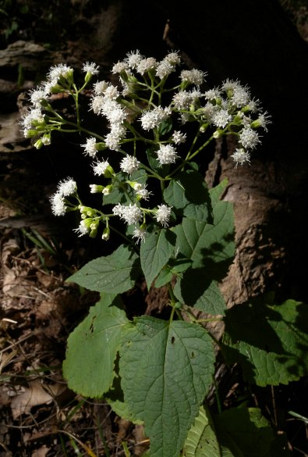
Characteristics:
Annual, biennial, or perennial?
Monocot or dicot?
Broadleaf or grass-like?
Leaf arrangement? Opposite
Leaf shape? Ovate-lanceolate shape
Root system? Rhizomes
Flowers greenish-pink; shape umbel
Common milkweed
Asclepia syriaca
Toxic to cattle, sheep & goats; poisonous species not in NYS
Photos by Lynn Sosnoskie of Cornell University.
Characteristics:
Annual, biennial, or perennial?
Monocot or dicot?
Broadleaf or grass-like?
Leaf arrangement? Opposite & toothed
Leaf shape? Lanceolate
Root system? Rhizomes & shallow fibrous roots
Flowers white; shape flat-headed panicle
White snakeroot
Ageratina altissima or Eupatorium rugosum
Toxic to cattle, dogs, goats, horses, humans, rabbits, sheep
Image Credits: Illinois Wildflowers

Slide 6
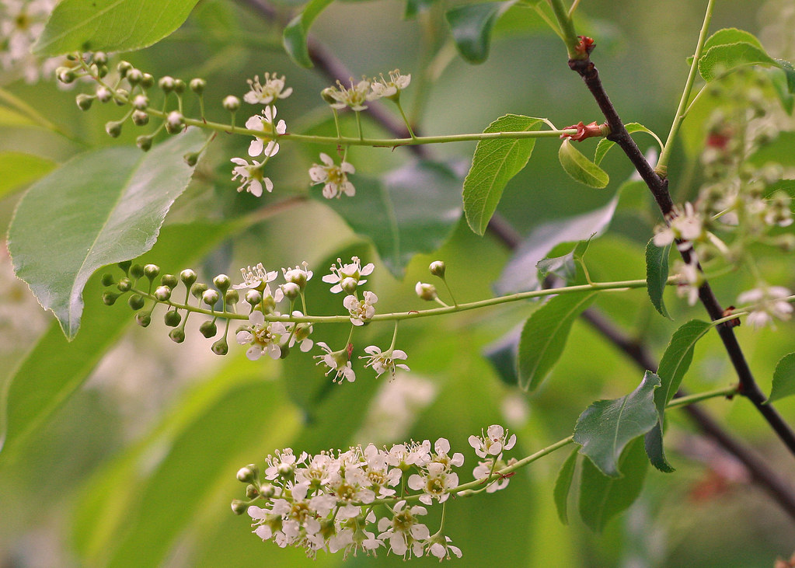
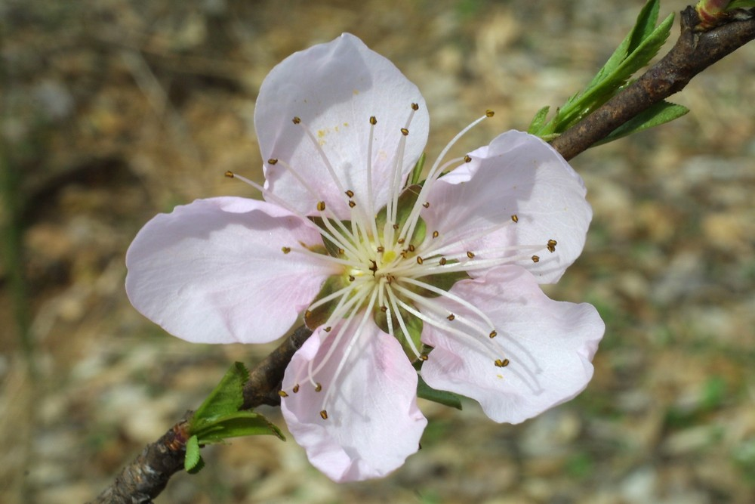
Image Credits: Mary Keim https://www.flickr.com/photos/38514062@N03/8505460752/
Characteristics:
Annual, biennial, or perennial?
Monocot or dicot?
Broadleaf or grass-like?
Leaf arrangement? Alternate Leaf shape? Generally simple with toothed margins
Root system? Taproot
Flowers white and shape raceme (black cherry, choke cherry); white panicle (pin cherry & sweet cherry)
Prunus species
Prunus spp.
Toxic to horses, cattle, moose, sheep, swine & goats
Image Credits: Steven Baskauf, Go Botany

Slide 7
Specifically broadleaf spp.
Palmer amaranth (Amaranthus palmeri)
Waterhemp (Amaranthus tuberculatus)
Common lambsquarters, cross-listed with poisonous list
Common ragweed (Ambrosia artemisifolia)
Redroot pigweed, cross-listed with poisonous list

Slide 8
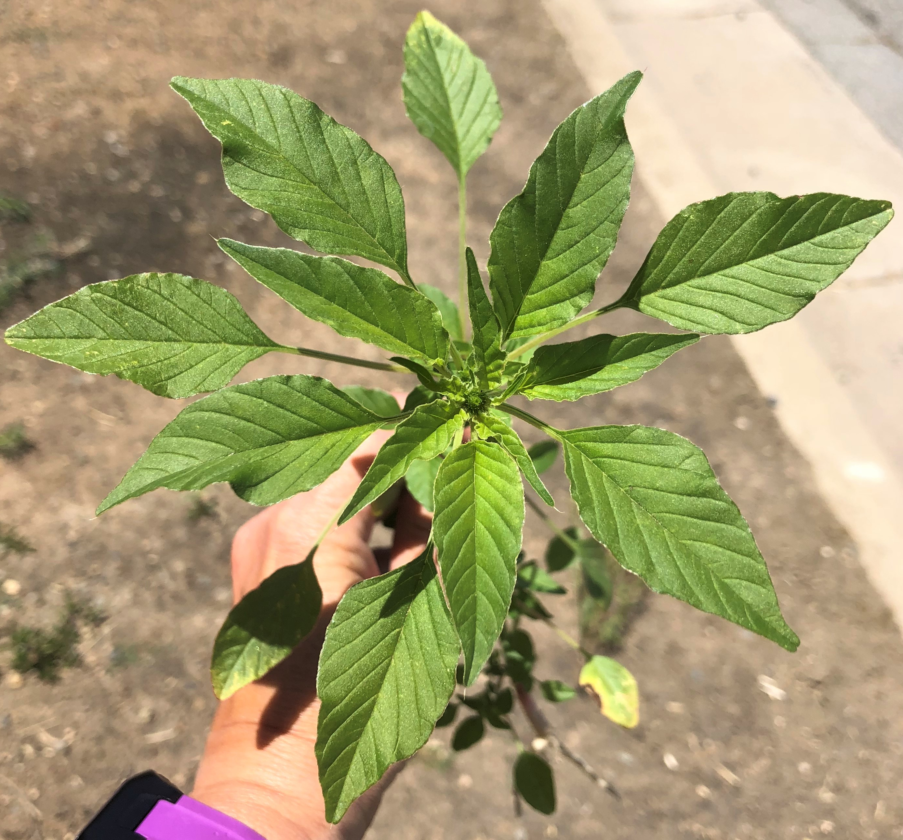
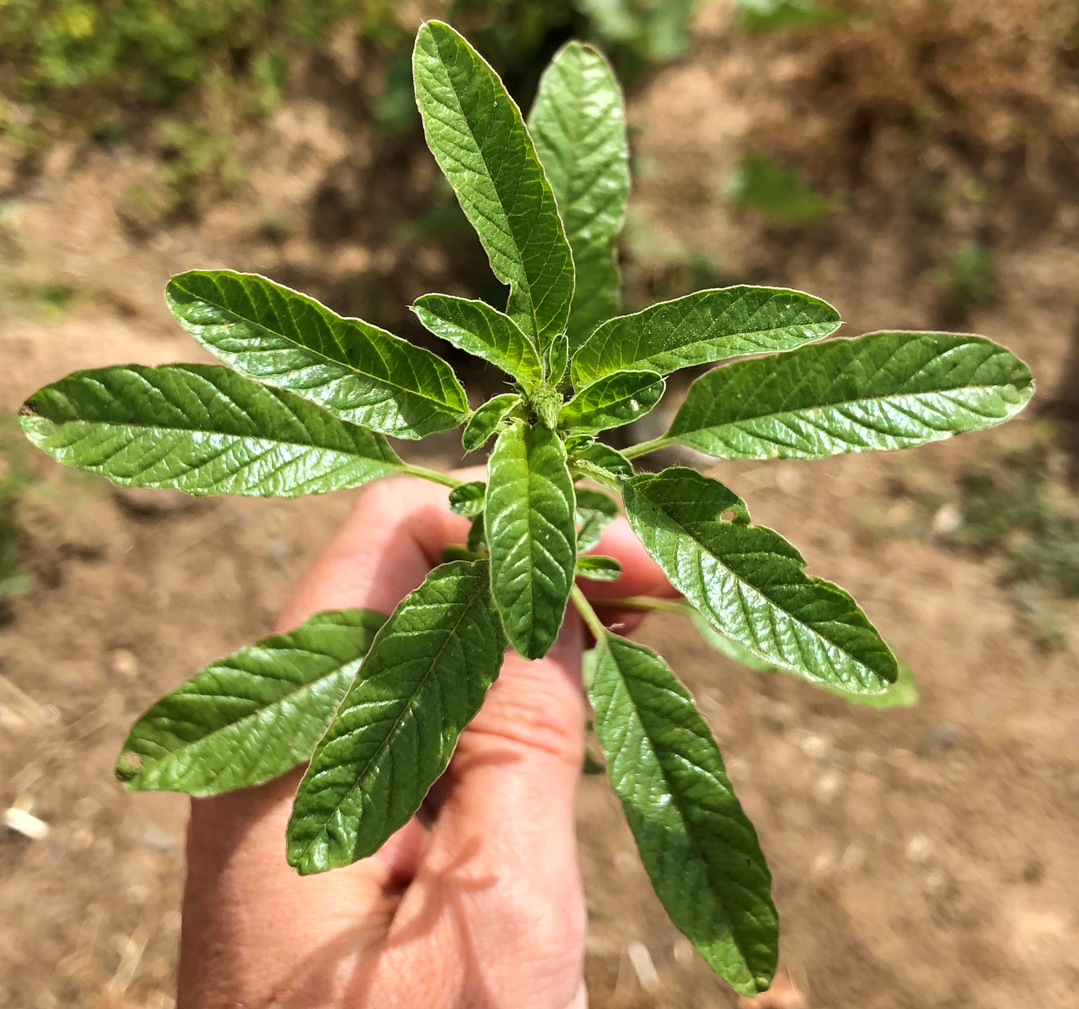
Characteristics:
Annual, biennial, or perennial?
Monocot or dicot?
Broadleaf or grass-like?
Leaf arrangement? Whorled, alternate
Leaf shape? Generally simple, “diamond”
Stems hairless, petiole long
Root system? Taproot
Flowers small, green compact panicle. Separate male and female plants
Palmer amaranth
Amaranthus palmeri
Toxic to pigs, cattle, sheep, goats, & horses (if eaten in large quantities)
Image Credits: Lynn Sosnoskie
Characteristics:
Annual, biennial, or perennial?
Monocot or dicot?
Broadleaf or grass-like?
Leaf arrangement? Whorled, alternate
Leaf shape? Lanceolate
Stems hairless, petiole short
Root system? Taproot with fibrous roots
Flowers green to reddish-pink dense spike. Separate male and female plants
Waterhemp
Amaranthus tuberculatus
Toxic to pigs, cattle, sheep, goats, & horses (if eaten in large quantities)
Image Credits: Lynn Sosnoskie

Slide 9
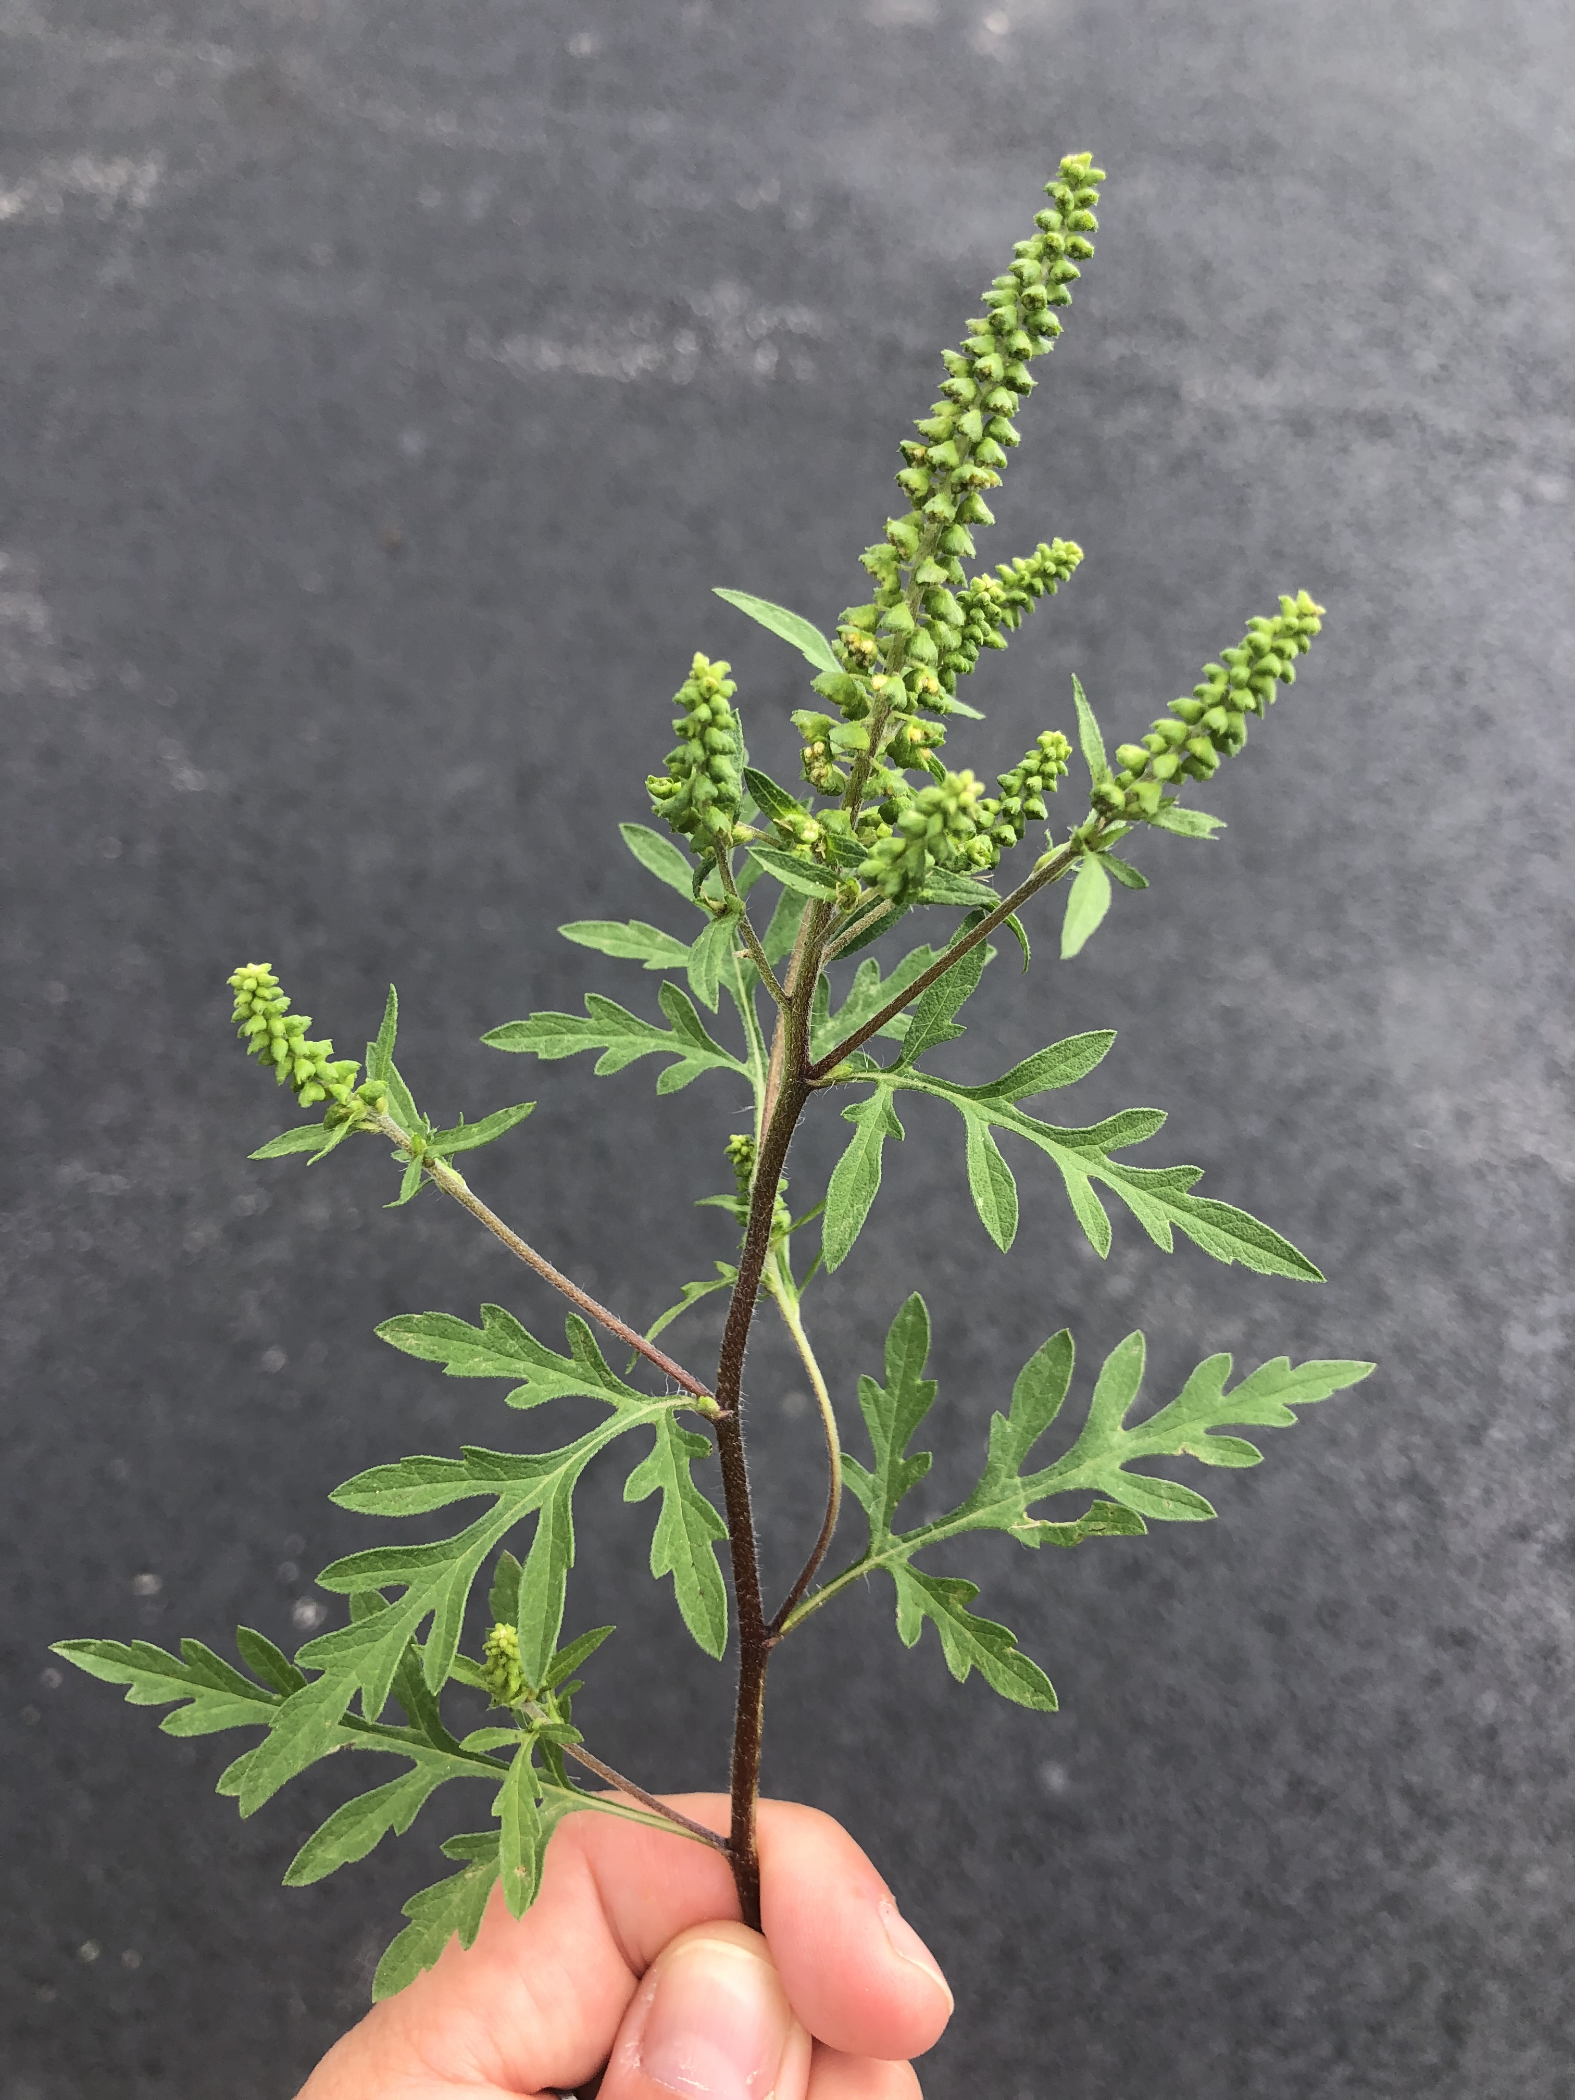
Characteristics:
Annual, biennial, or perennial?
Monocot or dicot?
Broadleaf or grass-like?
Leaf arrangement? Alternate, lower leaves may be opposite Leaf shape? Egg-shaped outline, pinnatifid
Root system? Shallow taproot
Flowers small and green on raceme, produces LOTS of pollen
Common ragweed
Ambrosia artemisiifolia
Image Credits: Lynn Sosnoskie

Slide 10
Specifically grass-like spp.
Giant foxtail (Setaria faberi)
Large crabgrass (Digitaria sanguinalis)
Barnyardgrass (Echinochloa crus-galli)
Quackgrass (Elytrigia repens)
Reed canarygrass (Phalaris arundinacea)
Johnsongrass (Sorghym halepense)

Slide 11
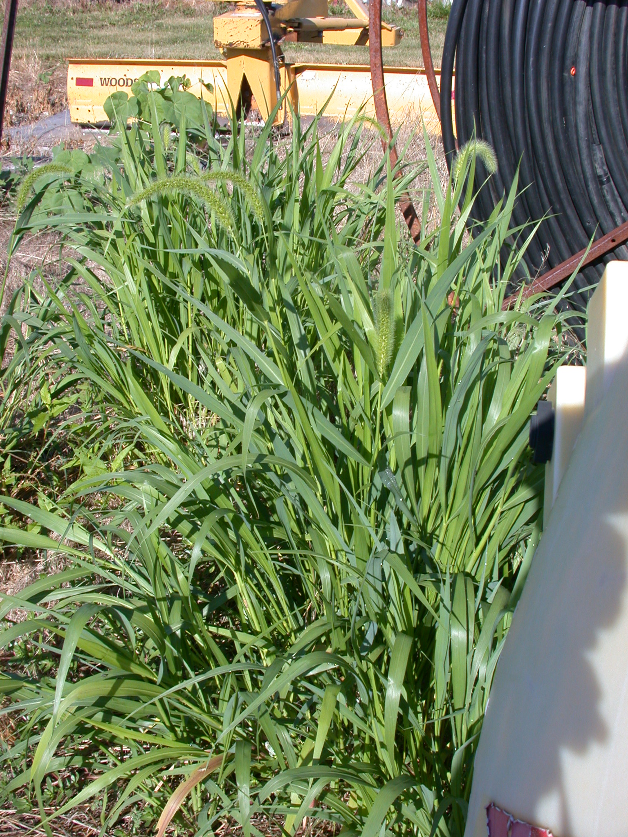
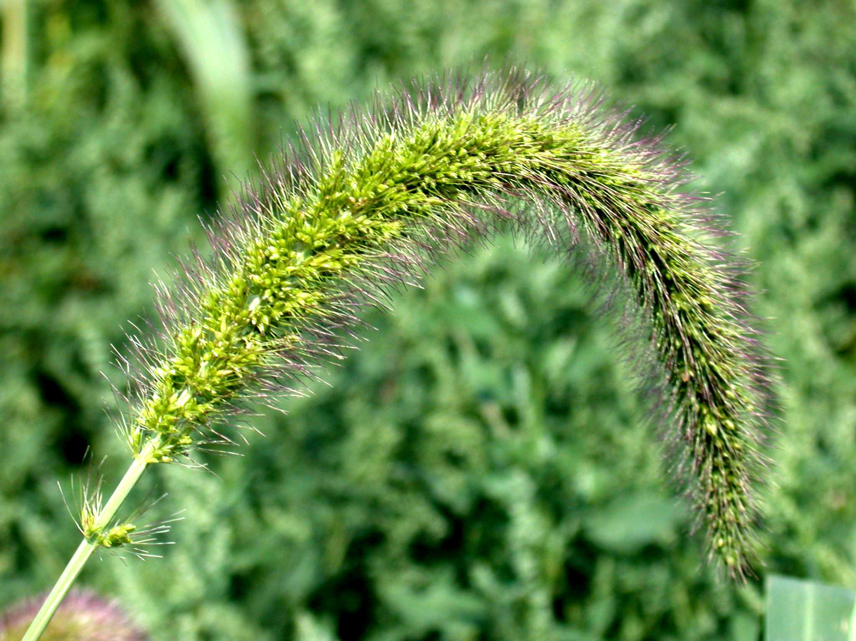
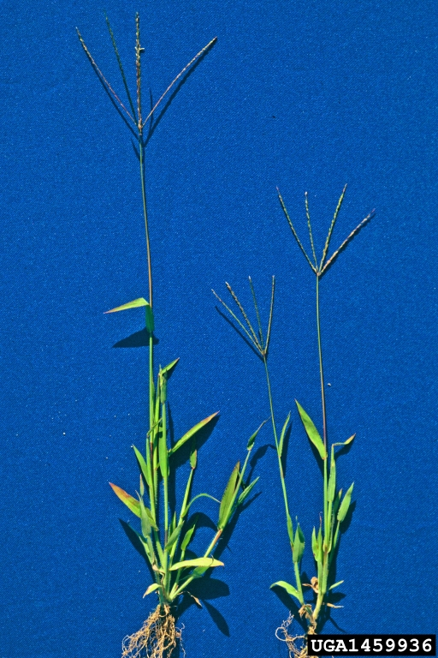
Characteristics:
Annual, biennial, or perennial?
Monocot or dicot?
Broadleaf or grass-like?
Leaf bud? Rolled
Ligule? Fringe of hairs
Auricle? Absent
Root system?
Fibrous
Flower head: cylindrical, bristly panicle that droops at maturity
Giant foxtail
Setaria faberi
Image Credits: Antoni DiTommaso,
Cornell University
Characteristics:
Annual, biennial, or perennial?
Monocot or dicot?
Broadleaf or grass-like?
Leaf bud? Rolled
Ligule? Jagged, membranous
Auricle? Absent
Root system? Fibrous
Flower head: Cluster of spikes, hand-like appearance
Large crabgrass
Digitaria sanguinalis
Image Credits: Steve Dewey, Utah State University, Bugwood.org

Slide 12
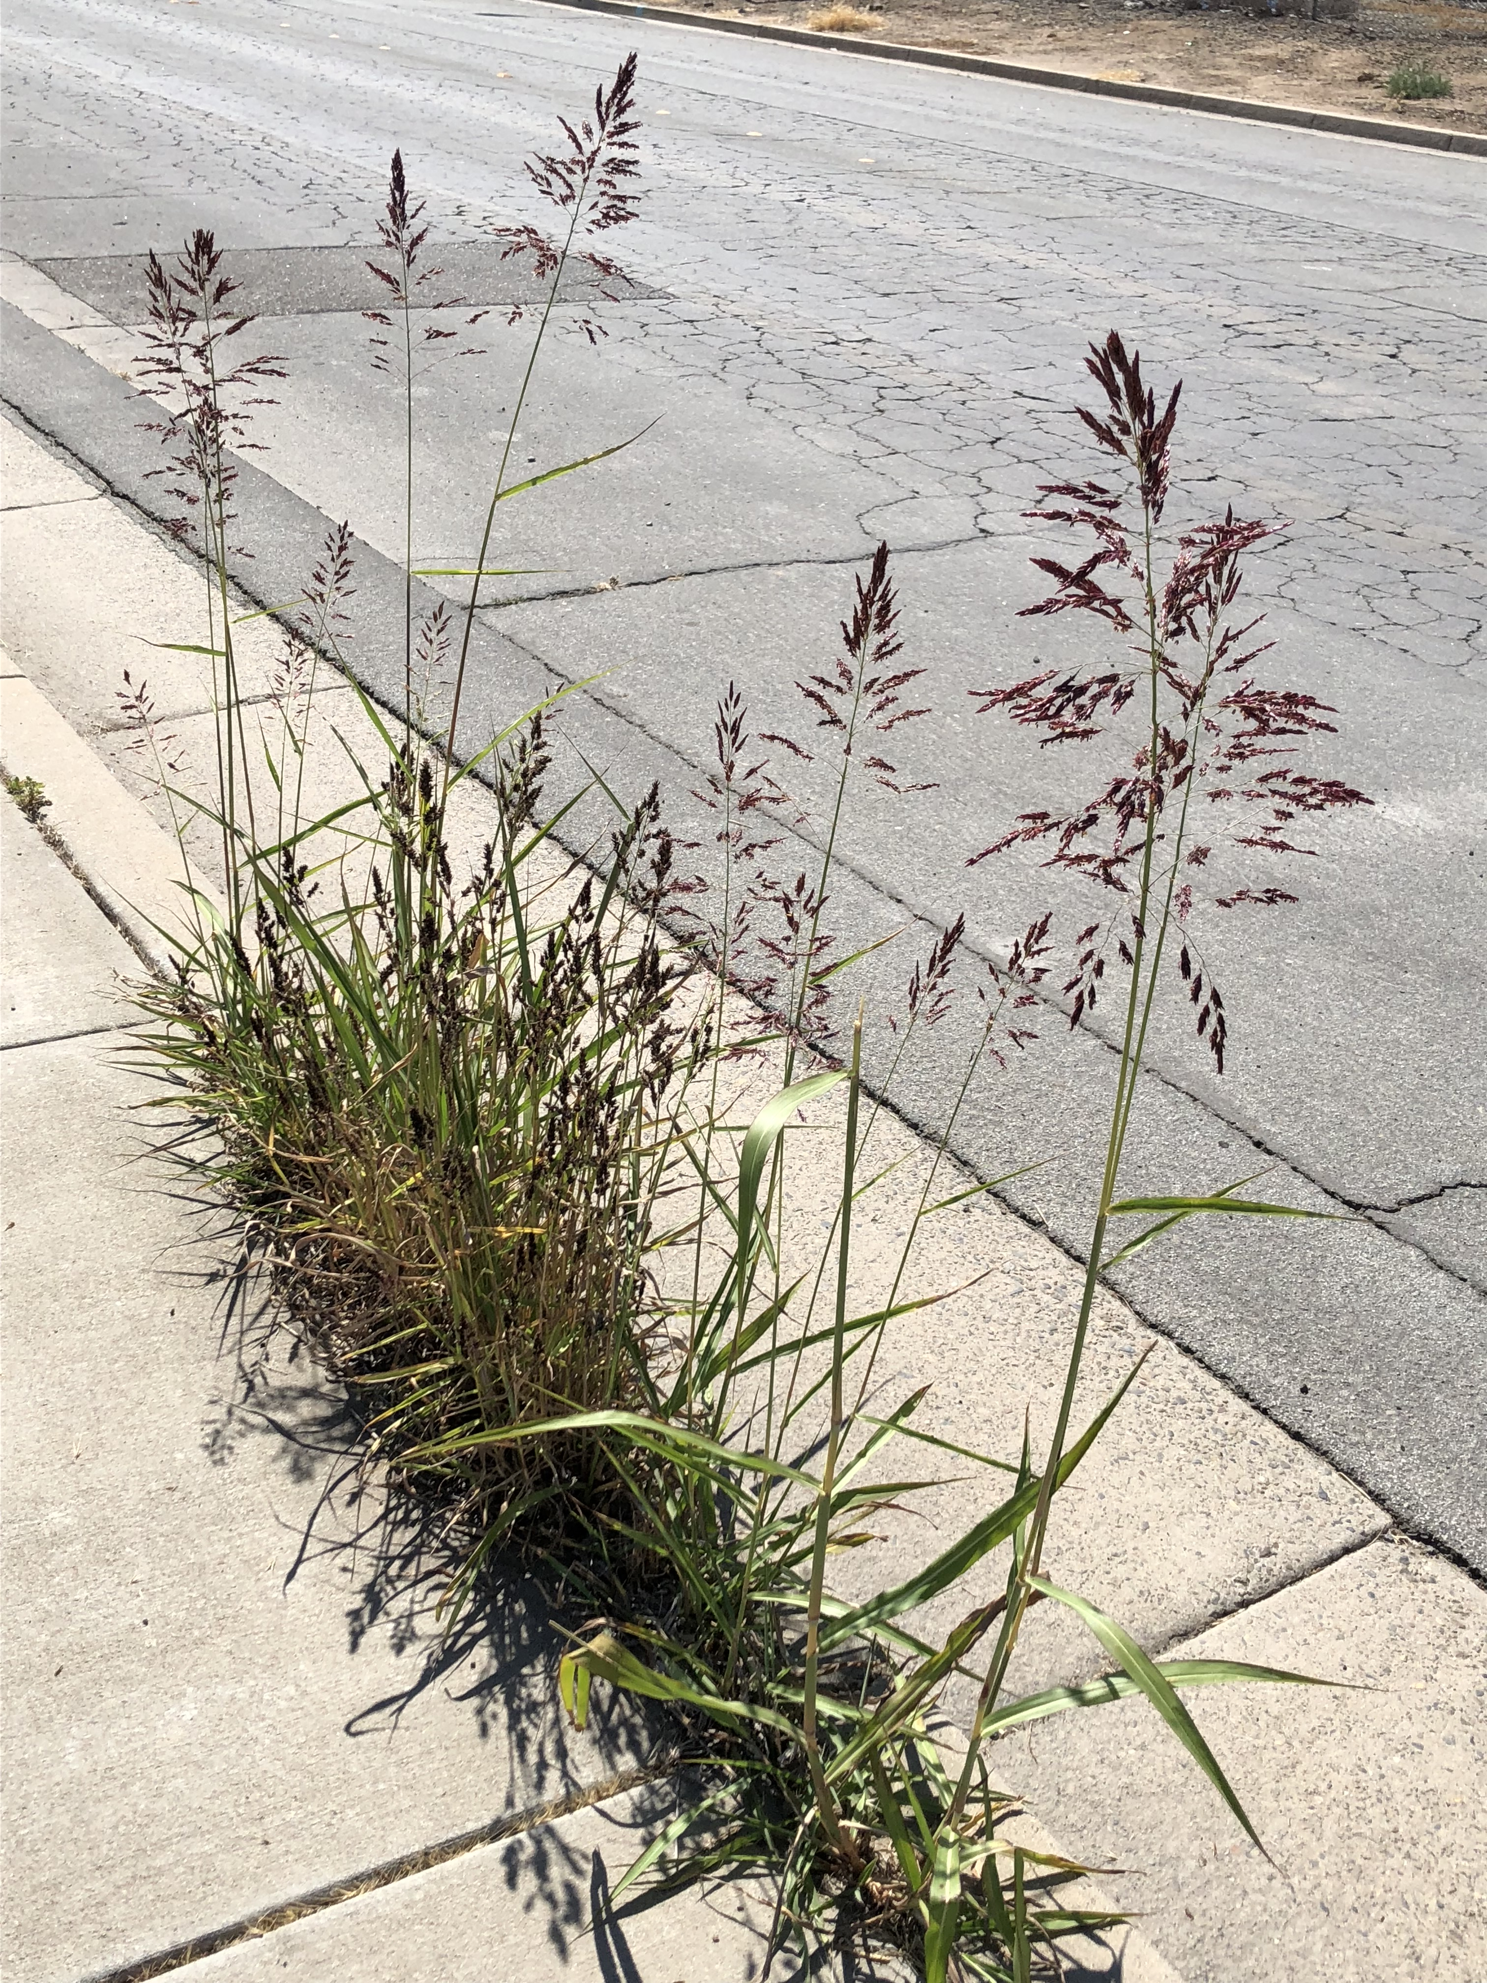
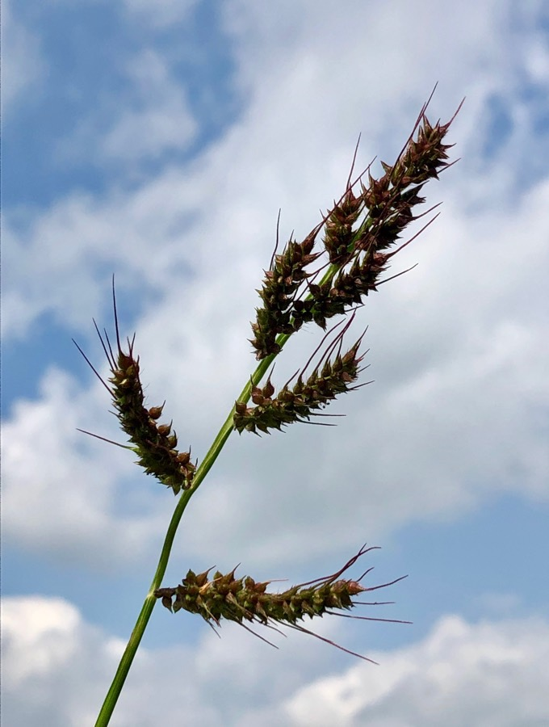
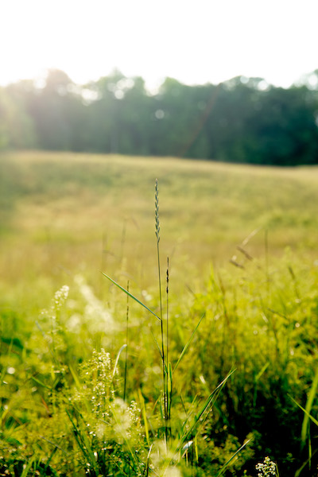
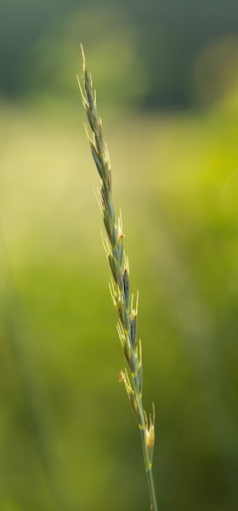
Characteristics:
Annual, biennial, or perennial?
Monocot or dicot?
Broadleaf or grass-like?
Leaf bud? Rolled
Ligule? Absent
Auricle? Absent
Underground root system? Fibrous
Flower head: coarsely branched, purplish-green panicle
Barnyardgrass
Echinochloa crus-galli
Image Credits: Lynn Sosnoskie
Characteristics:
Annual, biennial, or perennial?
Monocot or dicot?
Broadleaf or grass-like?
Leaf bud? Rolled
Ligule? Short, membranous
Auricle? Clasping
Underground root system?
Fibrous with rhizomes
Flower head: long spike, spikelets (individual flowers on stalk) arranged in two rows
Quackgrass
Elytrigia repens
Image Credits: Kelly Colucci

Slide 13
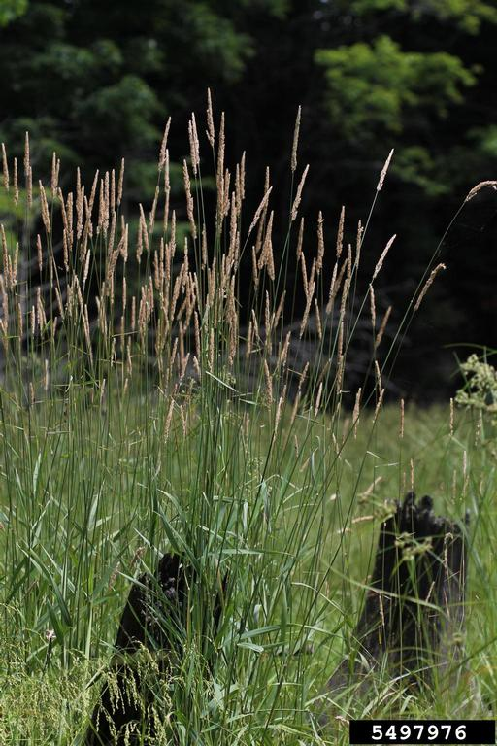
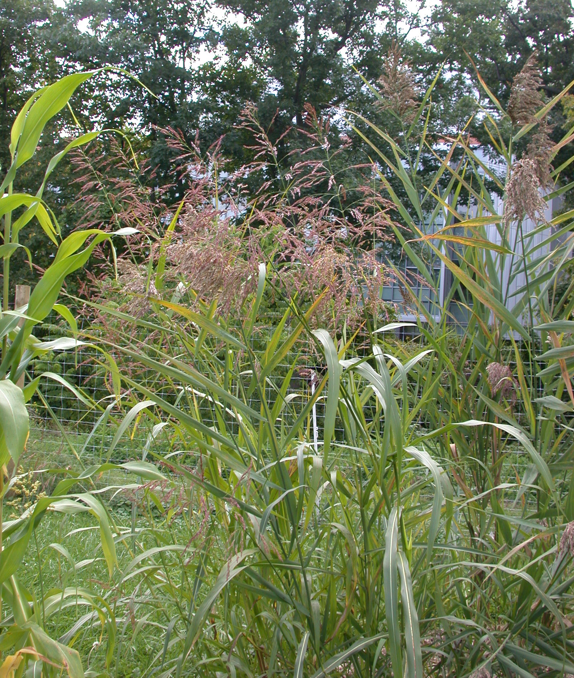
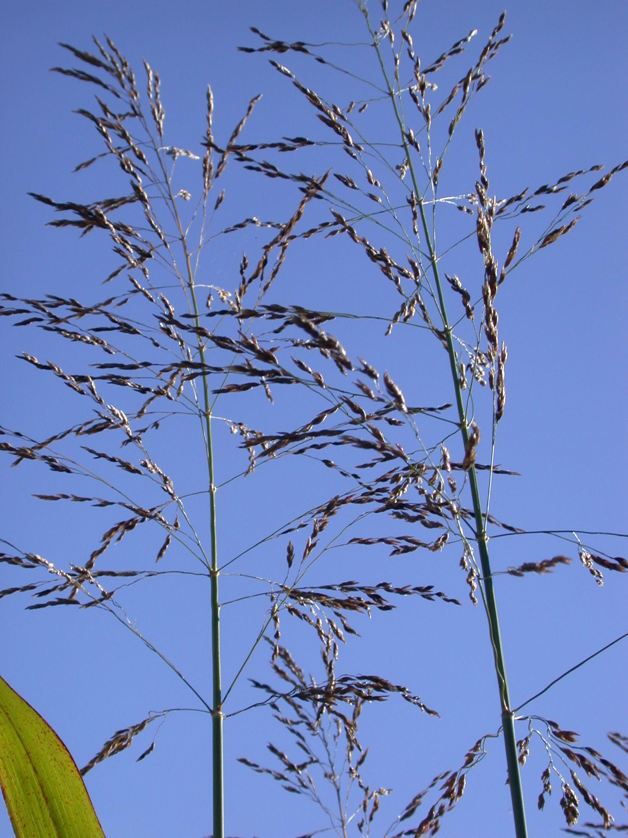
Characteristics:
Annual, biennial, or perennial?
Monocot or dicot?
Broadleaf or grass-like?
Leaf bud? Rolled
Ligule? Membranous, curved-flat top
Auricle? Absent
Root system?
Fibrous, with aggressive rhizomes
Flower head densely branched panicle
Reed canarygrass
Phalaris arundinacea
Image Credits: Rob Routledge, Sault College, Bugwood.org
Characteristics:
Annual, biennial, or perennial?
Monocot or dicot?
Broadleaf or grass-like?
Leaf bud? Rolled
Ligule? Membranous, shallow teeth across top
Auricle? Absent
Leaf blade: white midrib
Root system? Fibrous, with aggressive rhizomes
Flower head: large purple panicle
Johnsongrass
Sorghum halepense
Image Credits: Antoni DiTommaso,
Cornell University

Slide 14
Answer Key (for 1st three questions):
Common pokeweed
Annual, biennial, or perennial?
Monocot or dicot?
Broadleaf or grass-like?
Water hemlock
Annual, biennial, or perennial?
Monocot or dicot?
Broadleaf or grass-like?
Redroot pigweed
Annual, biennial, or perennial?
Monocot or dicot?
Broadleaf or grass-like?
Common lambsquarters
Annual, biennial, or perennial?
Monocot or dicot?
Broadleaf or grass-like?
Common milkweed
Annual, biennial, or perennial?
Monocot or dicot?
Broadleaf or grass-like?
White snakeroot
Annual, biennial, or perennial?
Monocot or dicot?
Broadleaf or grass-like?
Prunus species
Annual, biennial, or perennial?
Monocot or dicot?
Broadleaf or grass-like?
Palmer amaranth
Annual, biennial, or perennial?
Monocot or dicot?
Broadleaf or grass-like?
Waterhemp
Annual, biennial, or perennial?
Monocot or dicot?
Broadleaf or grass-like?
Common ragweed
Annual, biennial, or perennial?
Monocot or dicot?
Broadleaf or grass-like?
Giant foxtail
Annual, biennial, or perennial?
Monocot or dicot?
Broadleaf or grass-like?

