Slide 1
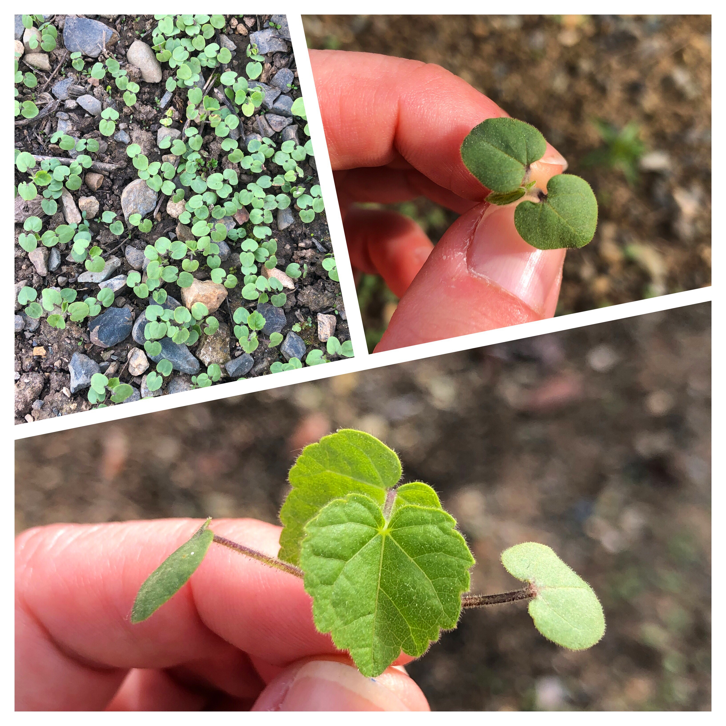
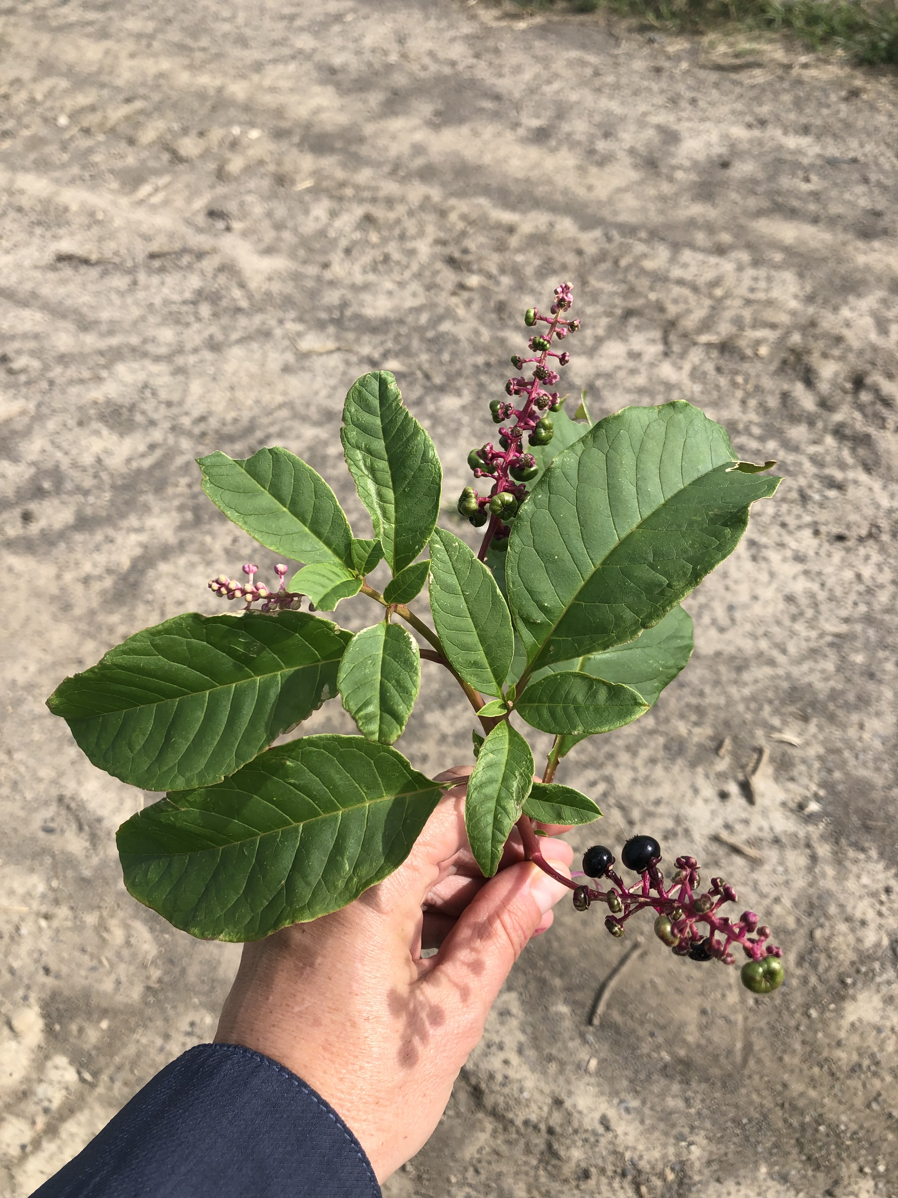
Weed Biology Unit
Photos by Lynn Sosnoskie of Cornell University.

Slide 2
Review: Broadleaf vs grass-like plants
Broadleaf
Grass-like
vs
Photos by Lynn Sosnoskie of Cornell University.

Slide 3
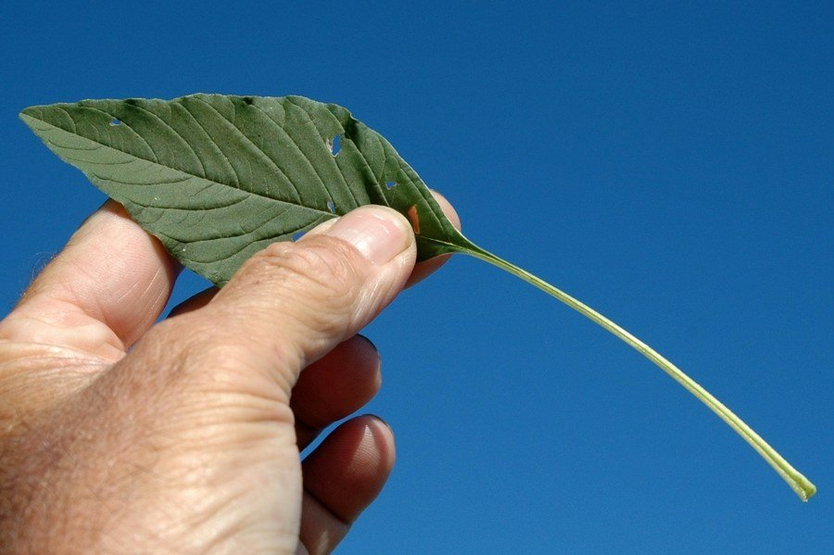
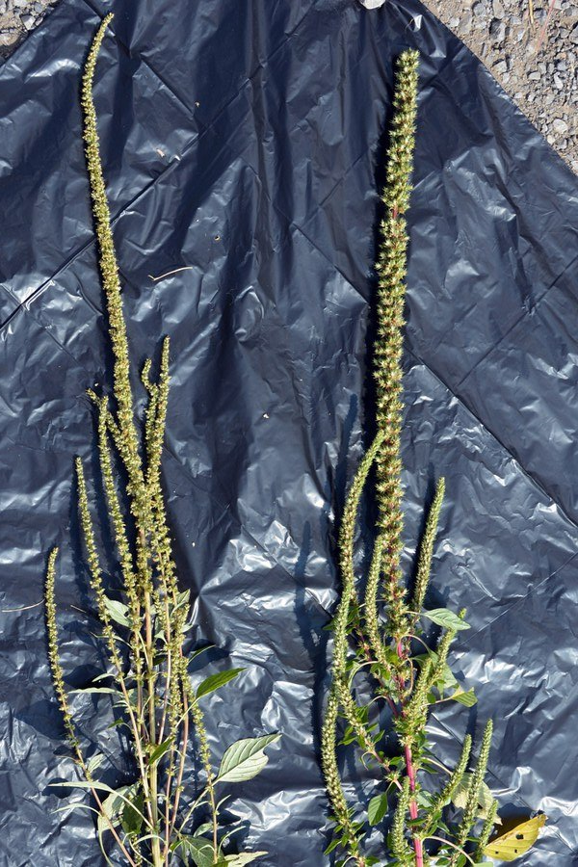
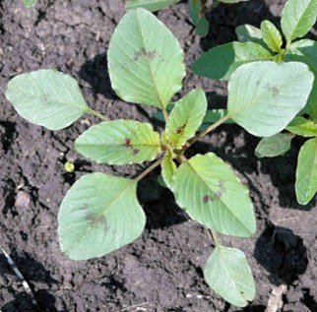
Common Broadleaf Annuals
Palmer Amaranth, Amaranthus palmeri
The plant lacks hairs on stems, leaves, and petioles
Leaves are arranged in a whorl, different from pigweed
Petioles are longer than the leaf itself
Flower can either be a large prickly female, or a softer, smaller male
Image Credits: Penn State Extension

Slide 4
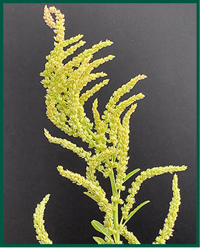
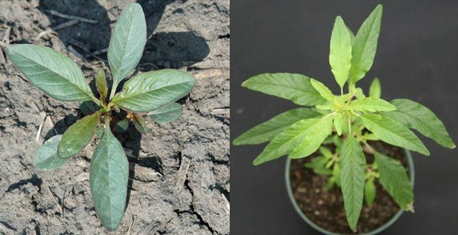
Common Broadleaf Annuals
Waterhemp, Amaranthus tuberculatus
Leaves in a whorled pattern
Stems, leaves, and petioles are smooth and hairless
Petiole is short in comparison to palmer amaranth
Leaves elongated and narrow
Inflorescence is unbranched
Separate male and female plants, similar to palmer amaranth
Image Credits: Penn State Extension

Slide 5
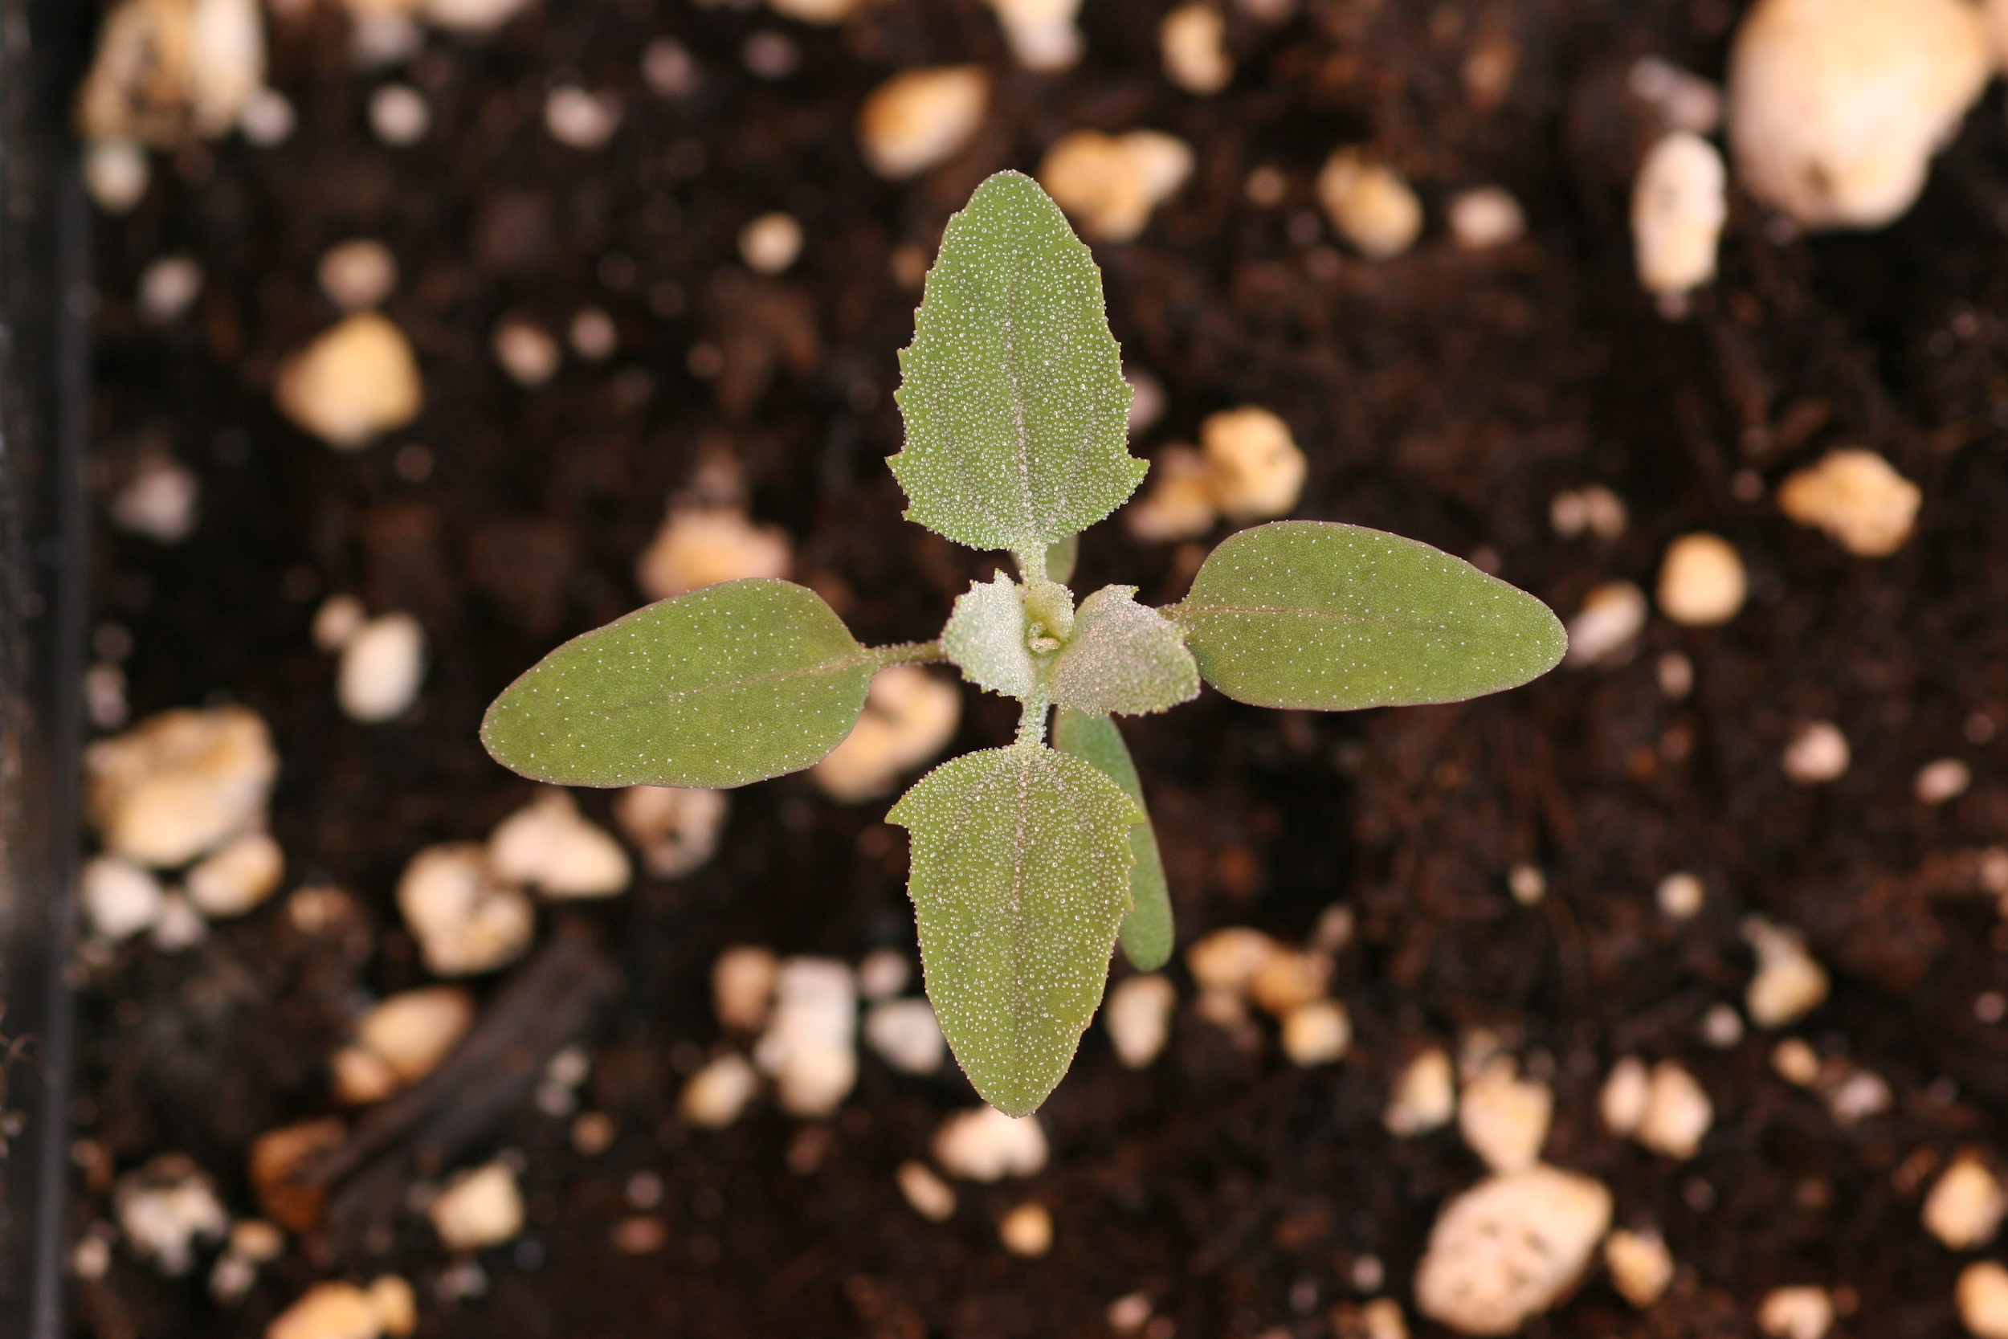
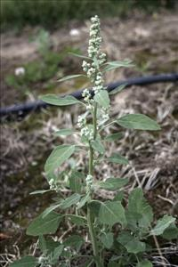
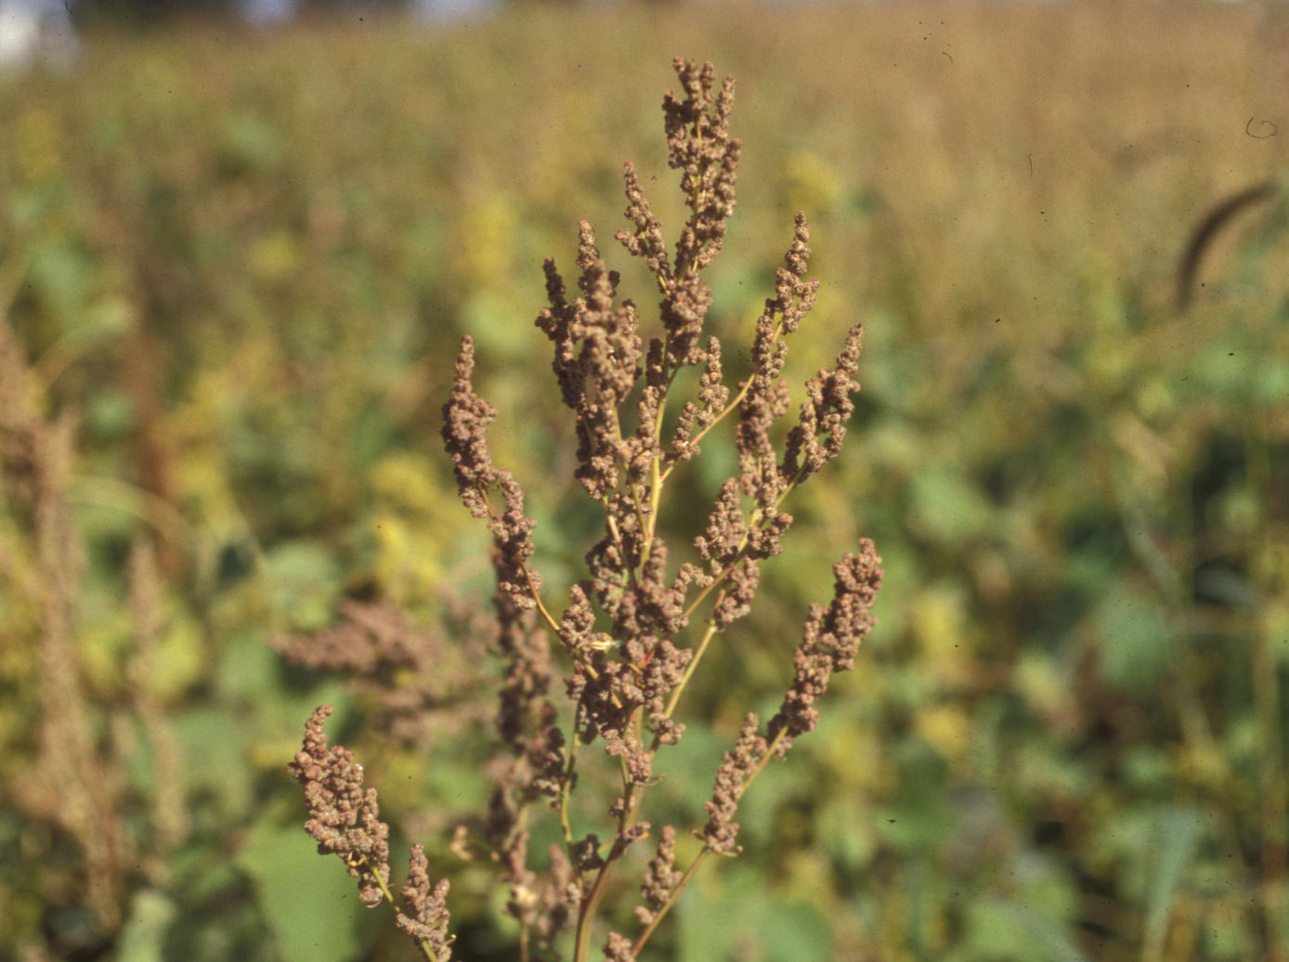
Common Broadleaf Annuals
Common Lambsquarters, Chenopodium album
Erect branching summer annual
Leaves are alternate and irregularly toothed
Gray mealy coating on young leaves
Stems are branching and hairless, often with dark red stripes
Flowers are formed in spikes along the stems of the lower and upper branches.
Image Credits (left to right): Hortsense, Washington State University, Plant and Pest Diagnostics, Michigan State Univers, and Plant and Pest Diagnostics, Michigan State Universi

Slide 6
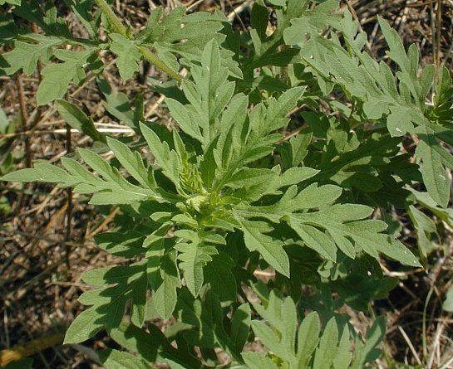
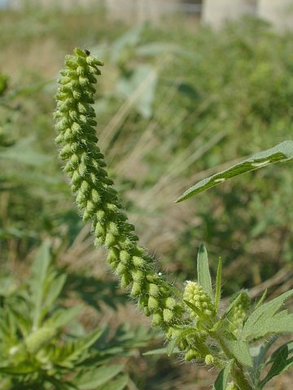
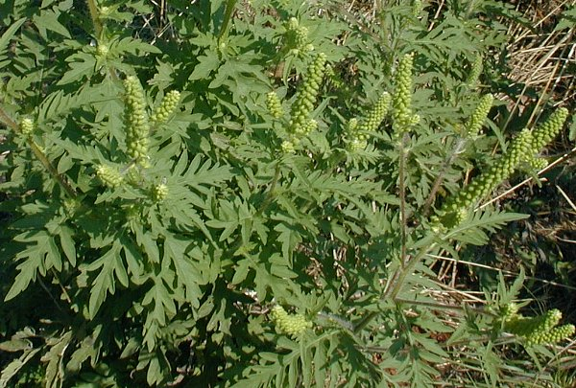
Common Broadleaf Annuals
Common Ragweed, Ambrosia artemisiifolia
Erect branching summer annual
Emerges early
Mature plant are nearly smooth to hairy
Most of the leaves are alternate, some of the lower leaves may be opposite
Flowers and flowerheads are small and green
Flowers also produce large amounts of pollen, typically wind-dispersed
Primary cause of hay fever
Image Credits: Illinois Wildflowers

Slide 7
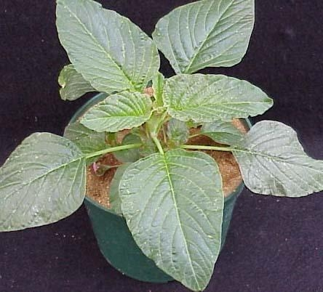
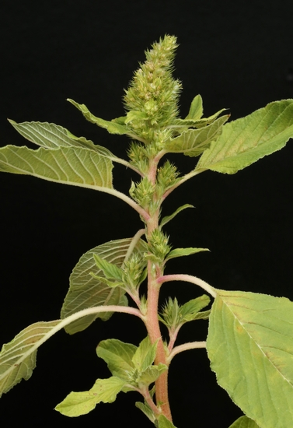
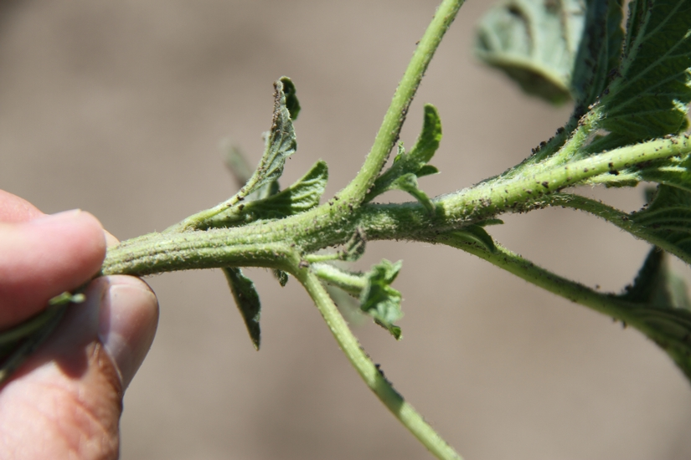
Common Broadleaf Annuals
Redroot Pigweed, Amaranthus retroflexus
Erect branching summer annual.
Mature plant stems are slender and erect.
Upper part of the branches are typically branched and hairy
Lower portion is thick and smooth
Leaves are alternate and simple
Veins on the underside of the leaves are distinctly white
Seed head has branches that resemble thick fingers when flowering
Image Credits: Weed ID Guide, University of Missouri

Slide 8
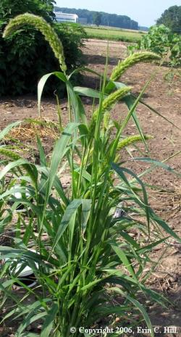
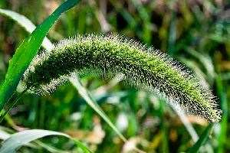
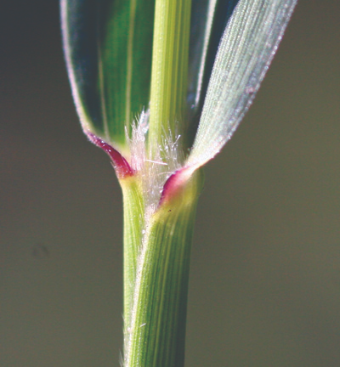
Common Annual Grass Species
Giant Foxtail, Setaria faberi
Erect, clump-forming summer annual
Leaves are rolled in the bud
Ligule is a fringe of hairs
No auricles
Largest of the foxtail species
Short hairs on the upper side of the blades and on the sheath margins
Seed head is a bristly spike panicle
Image Credits (left to right): Erin C. Hill, Farms.com, and Integrated Pest Management, Michigan State University

Slide 9
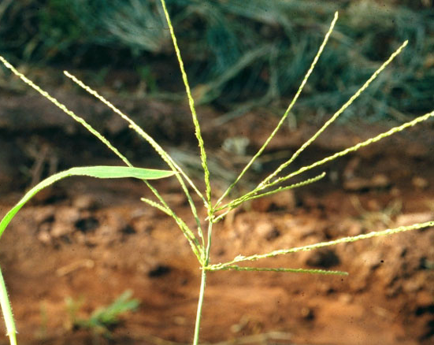
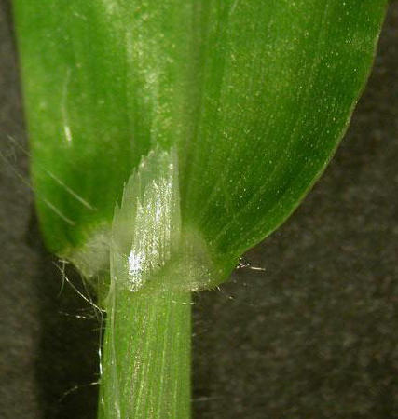
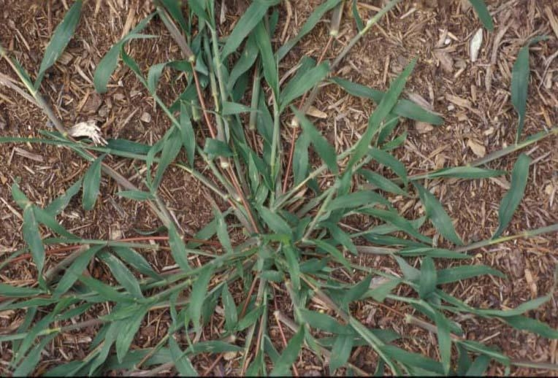
Common Annual Grass Species
Large Crabgrass, Digitaria sanguinalis
Summer annual
Rolled in the bud
No auricles
Jagged, membranous ligule
Blades, collar, and sheath are covered in hairs that stick out at ninety degree angles from the plant
Seed head consists of spikes clustered at the top of the stems, with a hand-like appearance
Image Credits (left to right): TurfFiles, North Carolina State Extension, Got Pests?, Maine Department of Agriculture, and Weed ID Guide, University of Missouri

Slide 10
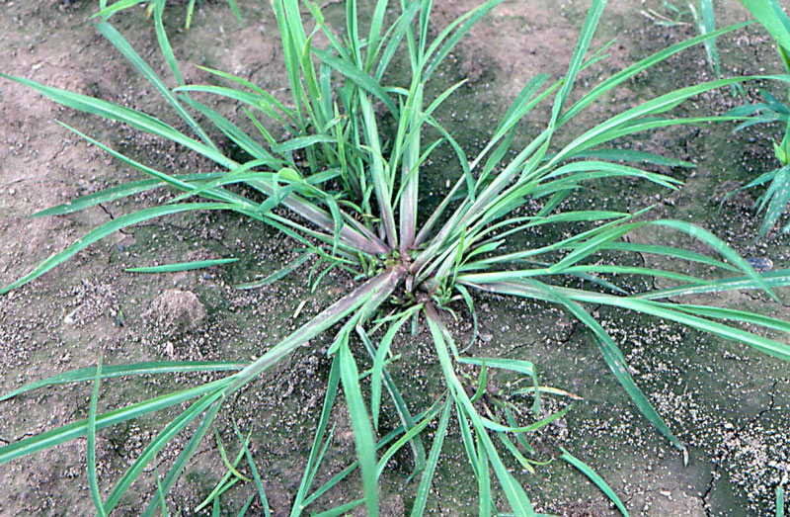
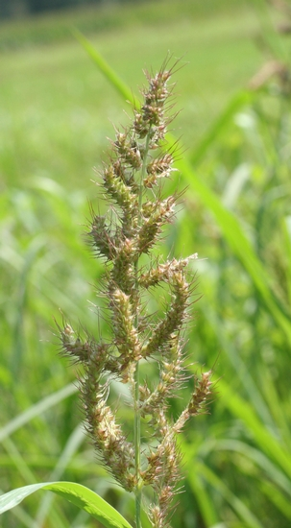
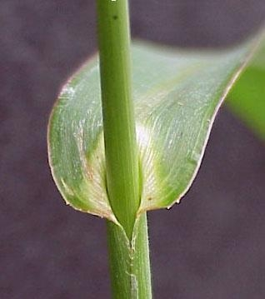
Common Annual Grass Species
Barnyardgrass, Echinochloa crus-galli
Erect, clump-forming summer annual
Leaves are rolled in the bud and have
No ligule or auricles. This is their distinguishing factor
Plant lacks hairs, but has a
prominent keeled midvein
Seed head is coarsely branched and has a purplish-green panicle
Image Credits (left to right): Weed ID Guide, University of Missouri, Protec Pest Control Services, and Weed ID Guide, University of Missouri

Slide 11
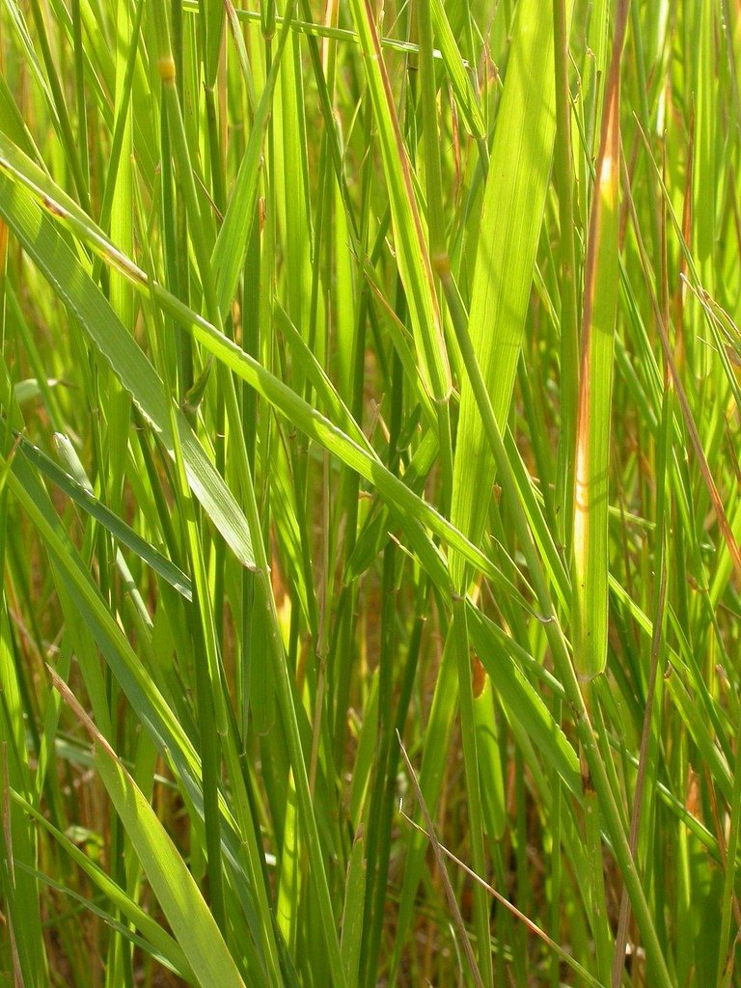
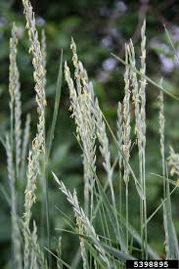
Common Perennial Grass Species
Quackgrass, Elytrigia repens
Erect, rhizomatous perennial
Leaves are rolled in the bud
Auricles are very distinct
Ligule is membranous and short
Sheaths and blades are smooth, may have some short hairs near the base of the plant
Seed head is a long spike, with spikelets being arranged in two rows
Image Credits (left to right): Got Pests?, Maine Department of Agriculture, Heather Rhoades, Gardening Know How, and Aaron Patton, Purdue University

Slide 12
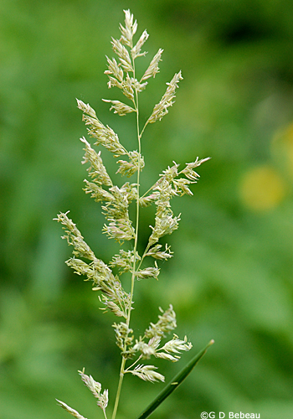
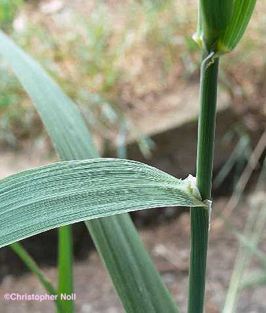
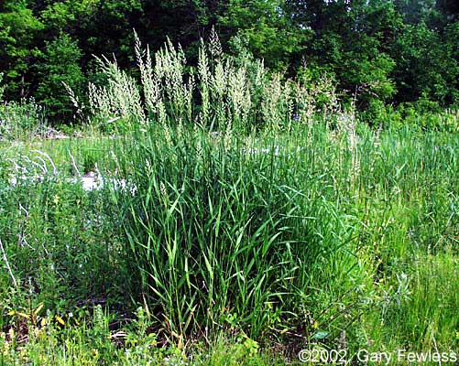
Common Perennial Grass Species
Reed Canarygrass, Phalaris arundinacea
Colony-forming rhizomatous perennial
Quite aggressive
Leaves are rolled in the bud
No auricles
Ligule is membranous with a curved to flat top
Blades are rough around the collar, but the plant is hairless
Seed head is densely branched panicle that extends well beyond the leaves
Image Credits (left to right): Christopher Noll, Wisconsin Flora, he Friends of the Wild Flower Garden, Inc., and Herbarium, University of Wisconsin- Green Bay

Slide 13
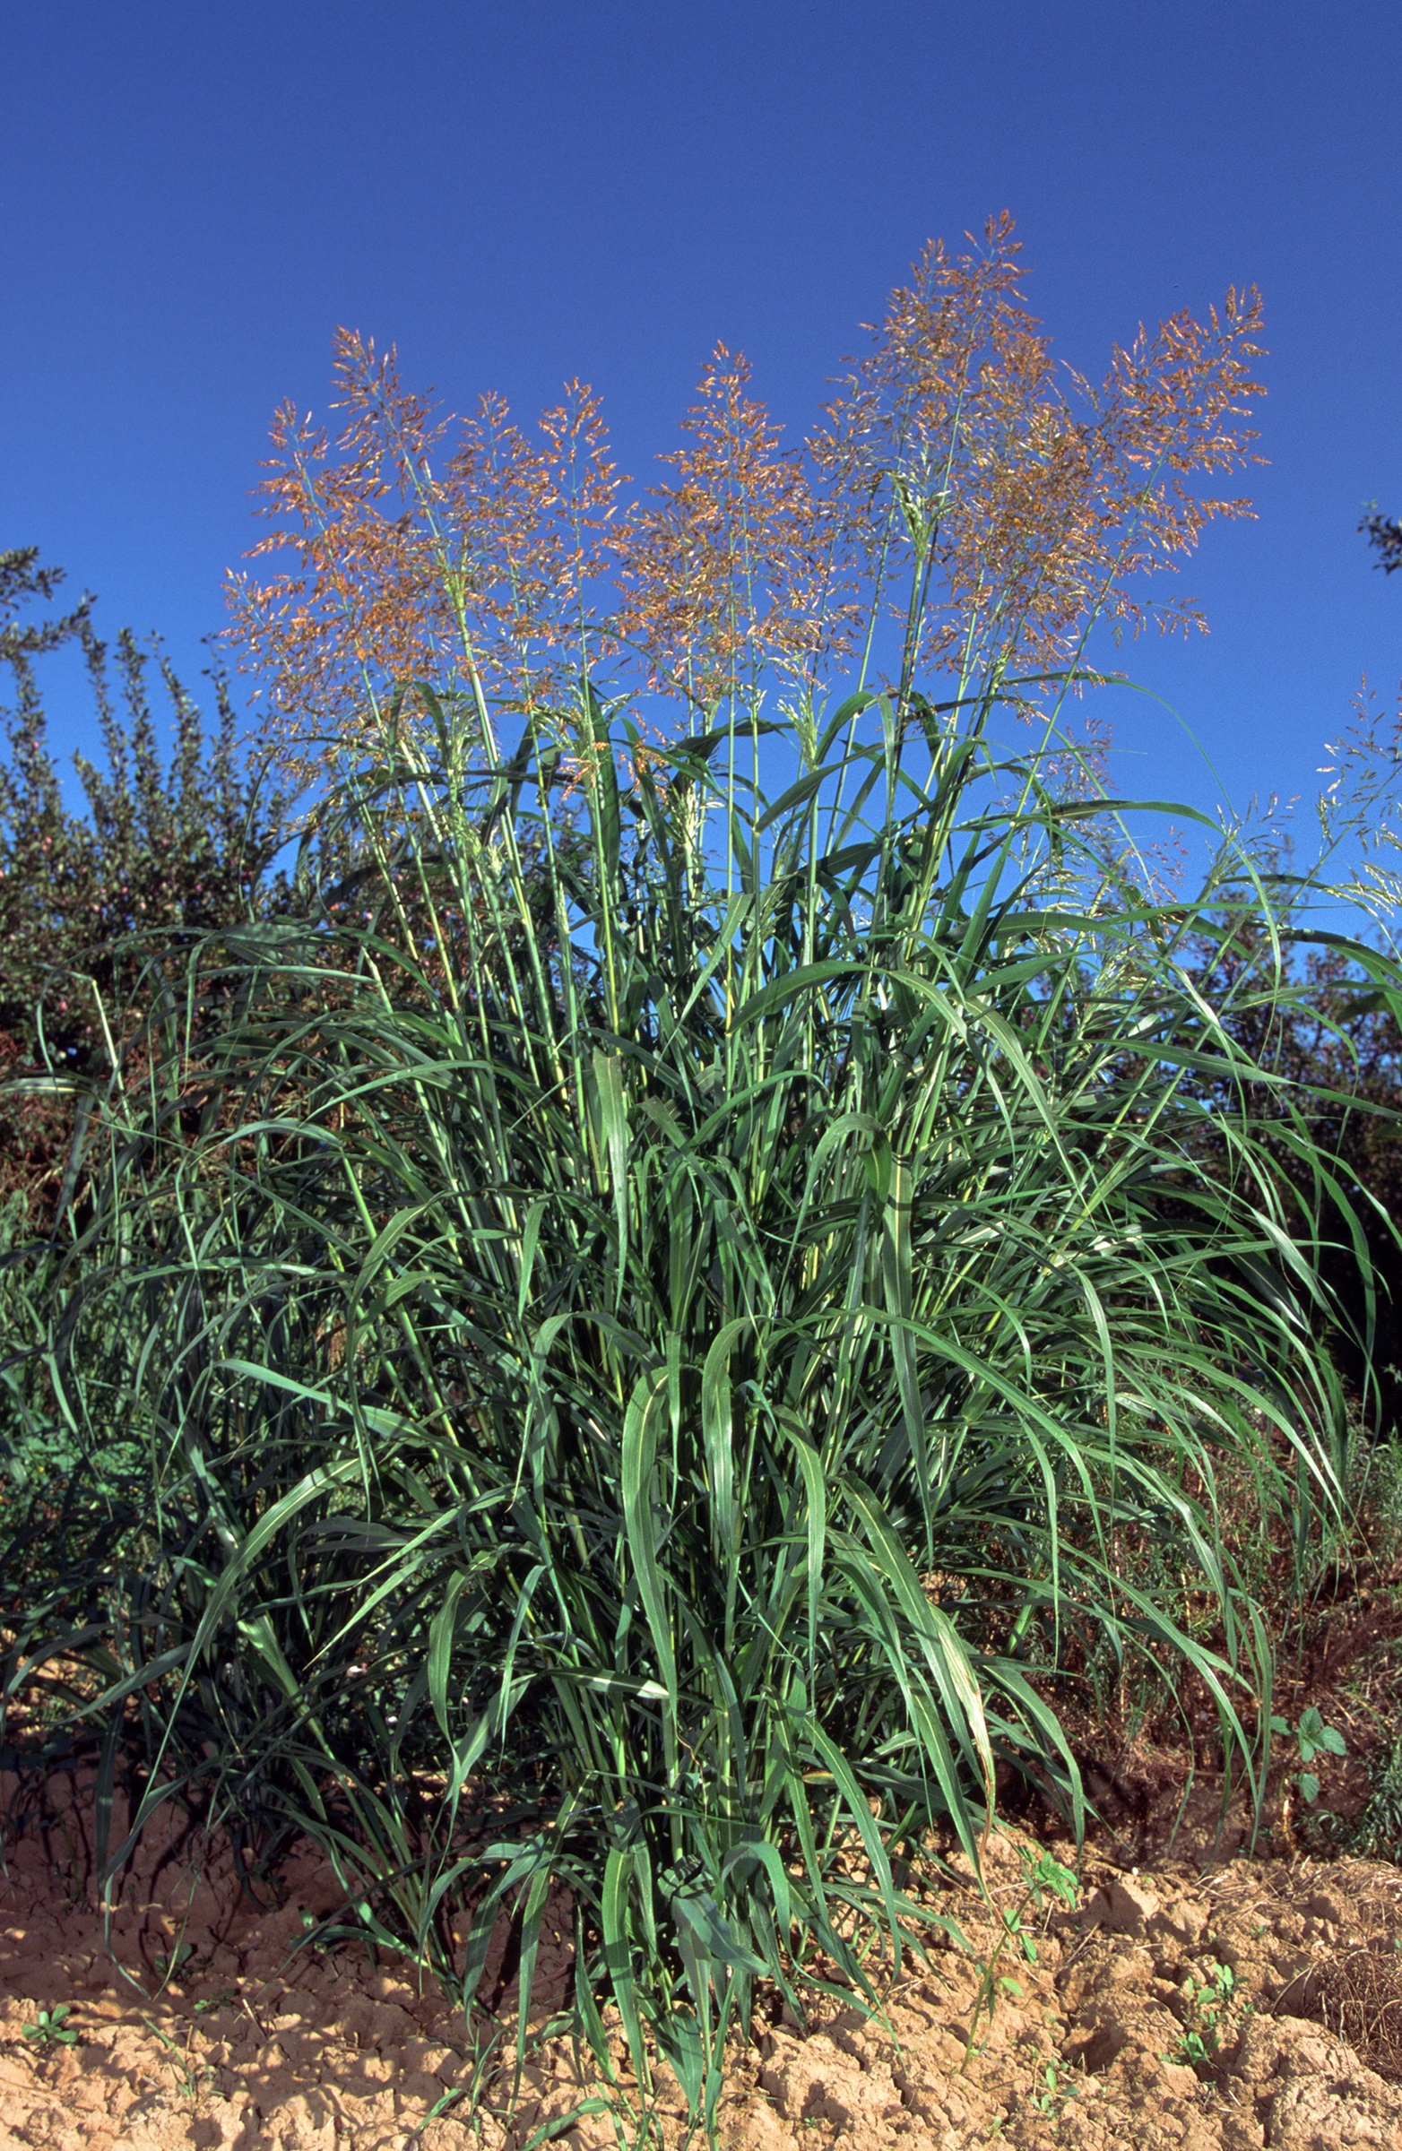
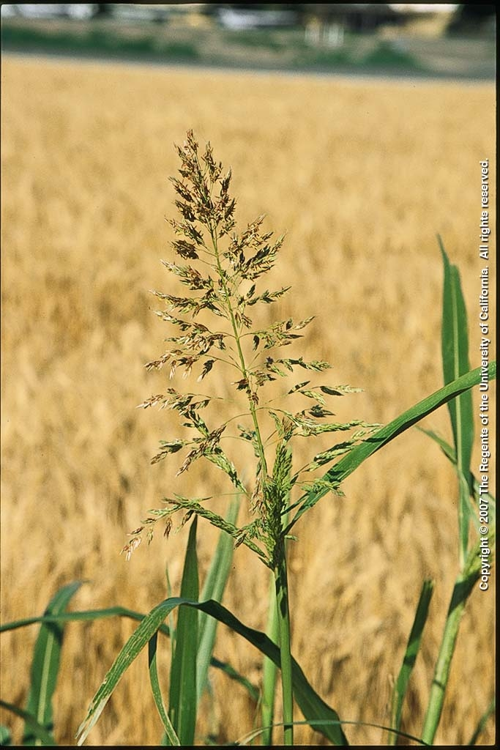
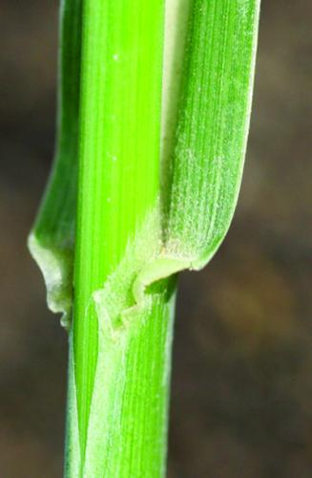
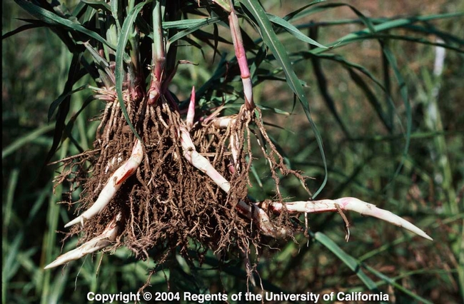
Common Perennial Grass Species
Johnsongrass, Sorghum halepense
Aggressive rhizomatous perennial
Coarse-textured leaves
Leaves are rolled in the bud
No auricles
Membranous ligule with shallow teeth across the top
Blades are flat
Prominent white mid-vein
Seed head is a large panicle that is purple in color
Image Credits (left to right): Integrated Pest Management, Michigan State University, Jack Kelly Clark, University of California Statewide IPM Program, and University of California

Slide 14
Activity: Draw your specimen!
Get a good look at your plant’s identifying characteristics by using your eyes to depict what you see on paper. Draw the whole plant or just a leaf, whatever you would like to do!
Before diving in, first determine whether you have a broad-leaf or a grass-like plant, then think about the other ID factors discussed previously:
What is the leaf arrangement of your specimen?
What leaf shape does your plant have?
If it’s a grass does it have a ligule or auricle?
Ask your instructor other ID questions…
Is it an annual, biennial, or perennial?
Monocot or dicot?
How does it reproduce? By pollination or clonally?
What kind of root system does it have?
Examine your specimen with a magnifying glass to help you illustrate these unique distinctions.

Slide 15
Activity #2
Rainy day/bad weather alternative. Match game… See “Match game cards” presentation.

