Slide 1
ESS Summer Teaching and Learning Series Considerations for Remote Assessment
Marnie FitzMaurice and Andrea Beukema
July 15, 2020

Slide 2
COVID Remote Assessment Considerations
Assessment as a driver of student learning
Proctoring
Academic integrity
Open vs. closed book
Faculty time to create and grade assessment
Student stress
Effective Question Writing
Notes:
Marnie

Slide 3
Assessment Drives Learning
It’s not the only driver, but plays a big role
Why?
Practical - students want to pass the test
Ego - students want to get good grades
Assessment establishes expectations - this is what faculty think is important
Assessment provides feedback
Testing/Retrieval Effect
Notes:
Marnie

Slide 4
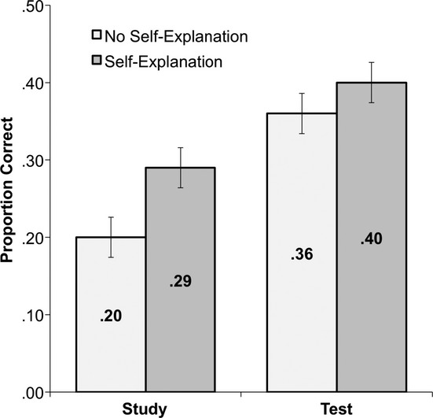
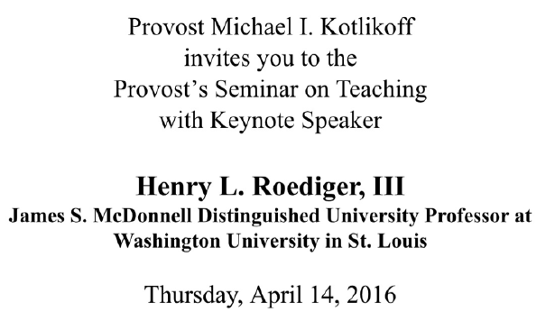
Testing Effect (Retrieval Effect)
Active and moderately effortful retrieval of information enhances learning and retention of that information.
1st year medical students
Study content
Study content and write explanation
Test on content
Test and write explanation of answer
6 month delay – clinical application test
Notes:
In some studies, students prepped more, attended more classes and review sessions

Slide 5
Remote Proctoring Options
Neither supported by nor endorsed by CTI
Overall, likely to be problematic WRT logistics and ethics
Turn-it-in as an option to check for unauthorized collaboration (“collusion” via similarity report)
Notes:
Andrea

Slide 6
Academic Integrity
Students have expressed high levels of concern about cheating if tests are closed-book
Recent college discussions about academic integrity
CTI / University Policy still in the works but previous statements discouraged high-stakes closed-book exams

Slide 7
Proctoring and Academic Integrity Summary
Remote proctoring is challenging, costly, unsupported, unreliable, and raises privacy concerns
Reliance on the Honor Code to administer closed-book, un-proctored tests is problematic

Slide 8
Open-Book vs. Closed-Book Debate
What are the advantages and disadvantages of Open-Book Exams (OBEs)?

Slide 9
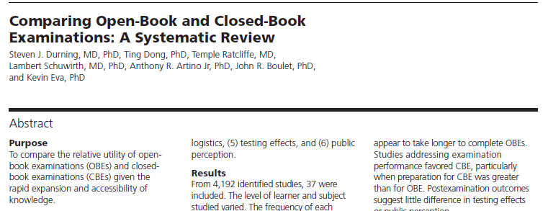
“Any exam of relevance must assess the examinee’s ability to find, understand, evaluate, and use external resources”
“Open book exams are more authentic to real-world practice”
“Because professionals of the future will not be able to ‘know’ all the information needed for competent performance, meaningful assessment of medical practice…should allow individuals to look up information when taking an exam”

Slide 10
“Literature has consistently found expert performance to be closely tied to rich, well organized content knowledge of a subject”
“In many situations, a physicians ability to look up unknown information is restricted by time constraints and internet access…”
“reliance on information technology could detrimentally increase cognitive load… and ultimately harm patient care.”

Slide 11
Exam preparation by students
Test Anxiety
Exam Performance
Psychometrics and Logistics
Testing Effect
Teacher and Learner Perceptions
Notes:
In some studies, students prepped more, attended more classes and review sessions

Slide 12
Exam preparation by students – some studies indicate better for CBEs, some indicate no difference
Test Anxiety – poorly investigated, but some suggestion that OBEs do not reduce test anxiety
Exam Performance –trend toward better performance on CBEs, but limitations on interpretation
Psychometrics and Logistics –OBEs may take longer, may result in fewer questions, thus reducing reliability
Testing Effect – both improve learning relative to studying, CBEs had greater impact in one study (now 2)
Teacher and Learner Perceptions – students have more positive perception of OBEs but find them harder
Notes:
In some studies, students prepped more, attended more classes and review sessions

Slide 13
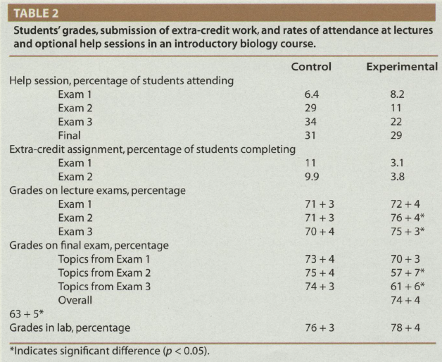
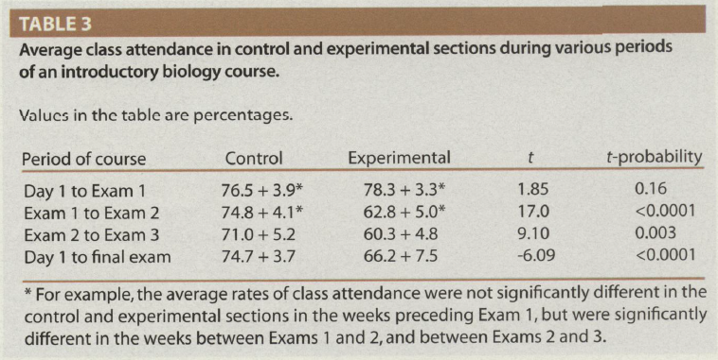
All exams identical
Exam 1 – closed book
Exams 2 and 3
Control - closed book
Experimental - open book
Final – closed book
Notes:
In some studies, students prepped more, attended more classes and review sessions

Slide 14
Students who took interim CBEs performed better on the final exam than students who took the same interim exams as OBEs.
Open-book exams promote behaviors that are associated with diminished learning in an introductory biology course.
Both testing effect and motivation likely contributed to performance differential.
Not all students demonstrated this – some prepared for OBEs in the same manner as for CBEs (including regular attendance, submission of extra credit, etc.) – how can we foster this?
All exams identical
Exam 1 – closed book
Exams 2 and 3
Control - closed book
Experimental - open book
Final – closed book
Notes:
In some studies, students prepped more, attended more classes and review sessions

Slide 15
Student Stress – finding the right balance
OBEs are not necessarily the solution to reduce student stress
Not all stress is bad
important to message that to students
important to provide opportunities for students to manage and overcome stress
important to leverage the motivational value of mild-moderate stress
Evidence-based methods to reduce stress while promoting learning
formative assessment – positive role of feedback
retrieval/testing effect
coaching for OBEs

Slide 16
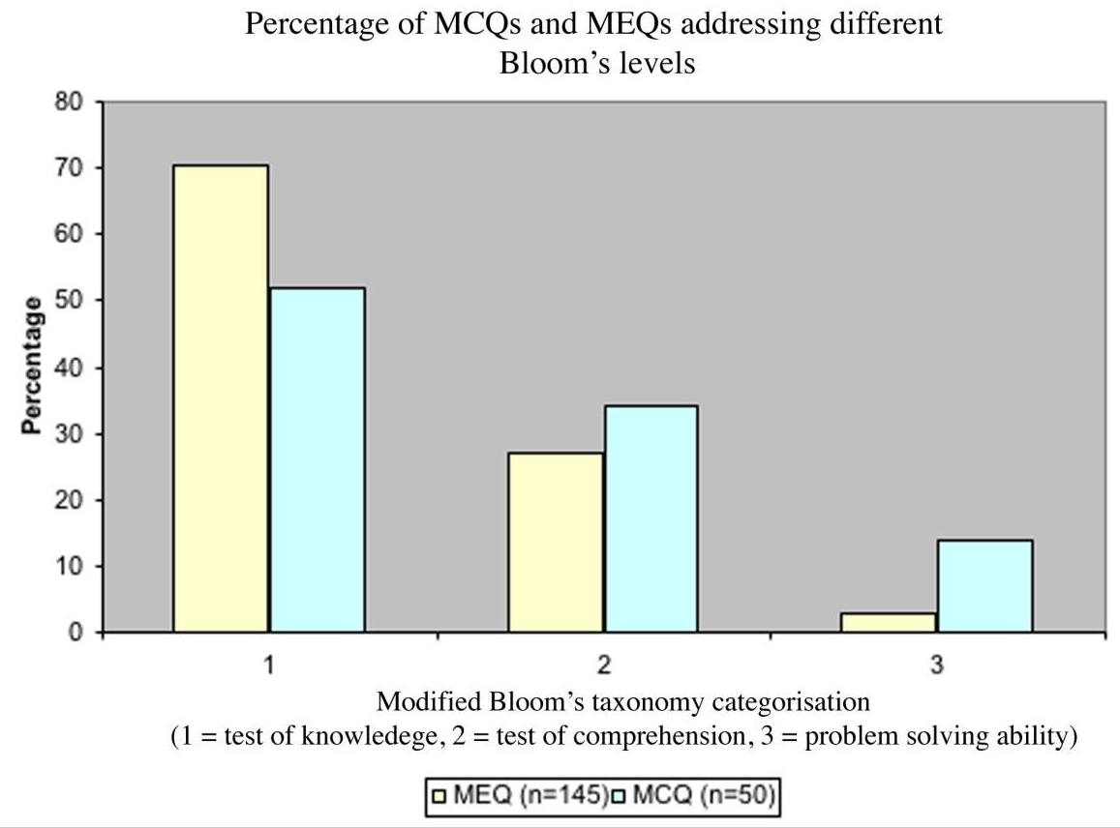
Faculty time to create and grade assessments
Are essay questions the best option for OBEs?
Essay questions
Laborious and subjective to score (low inter-rater reliability)
Take longer to answer → fewer questions → reduced reliability
Are as subject to construction flaws as MCQs
Have a role in testing specific abilities
MCQs can be more difficult to write (or maybe not?)
Take Home Point: quality construction of questions is
more important than question format

Slide 17
How can we leverage advantages and mitigate problems associated with OBEs?
Coaching for OBEs - set clear expectations and uphold rigorous standards for OBEs
Limit time to take exams (within reason) such that students must work efficiently
Construct quality exam questions
Notes:
For formative assessments consider 2 step exam – CBE followed by OBE to promote growth mindset

Slide 18
High Quality Exam Questions
require command of knowledge as well as ability to apply knowledge
are applied and relevant
are auto-gradable or easily graded
are relatively short response so reliability isn’t compromised by limited number of questions
Notes:
For formative assessments consider 2 step exam – CBE followed by OBE to promote growth mindset

Slide 19
General strategies for exam questions
Are you assessing interpretation and application of knowledge, comprehension skills, or critical thinking skills rather than basic knowledge recall?
Do questions require students to apply and make use of the information? (avoid scavenger hunts)
Consider using problem-based scenarios or real-world cases.
Refer specifically to course content, lectures, and materials
There must be a correct “best possible” answer
All options should be plausible (avoid funny/non-topical distractors)
Avoid negatively worded questions, “always,” “never,” and tricks

Slide 20
Example Question
ATP is crucial for crossbridge cycling because:
It is required for the release of the myosin head from the actin filament
It is utilized to initiate the powerstroke
It enhances calcium binding to troponin
It is not actually critical for crossbridging, but it does speed up the rate of crossbridging

Slide 21
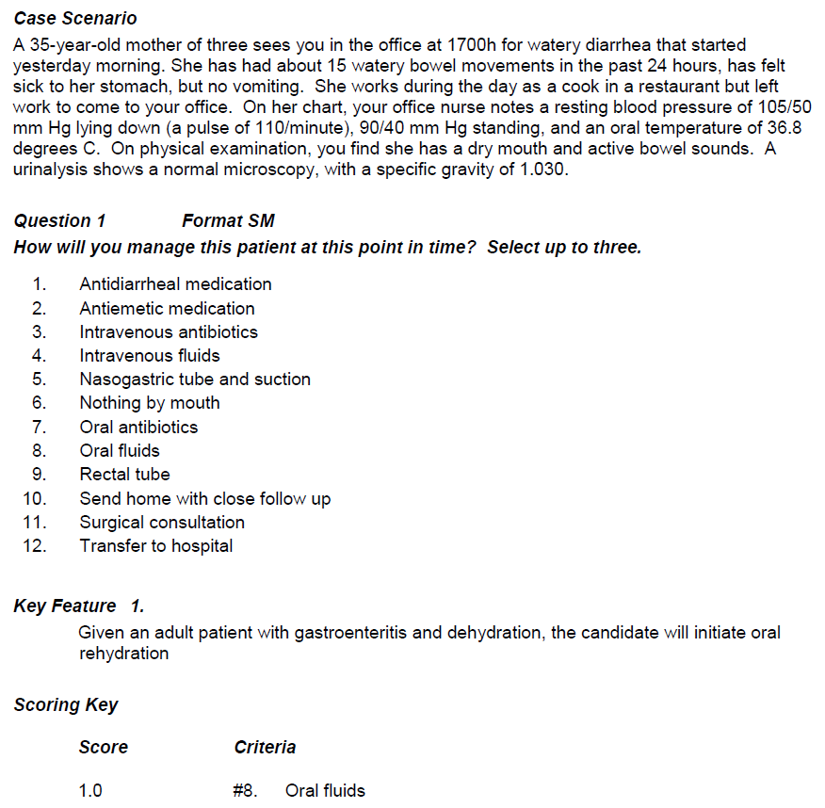
Key Features Questions

Slide 22
Applying key features principles to pre-clinical course
Orient questions around realistic application (must also teach that way if you test that way)
Assess knowledge and reasoning indirectly through the end product (decisions and actions) rather than by rote knowledge questioning or exhaustive explanations of reasoning
Do not assess factual knowledge (i.e. describe the features of Horner’s Syndrome)​
Do not assess the reasoning process (i.e. why do you think this is Horner’s Syndrome?)​
Do assess the “application of knowledge to the resolution of a problem” (i.e. recognize Horner’s Syndrome in a patient, localize the lesion, or manage patient appropriately)​
Present information in its most basic form to encourage students to do the interpretation
Reduces cuing and improves test discrimination
Avoid medical-ese (ascites​ vs distended abdomen)

Slide 23
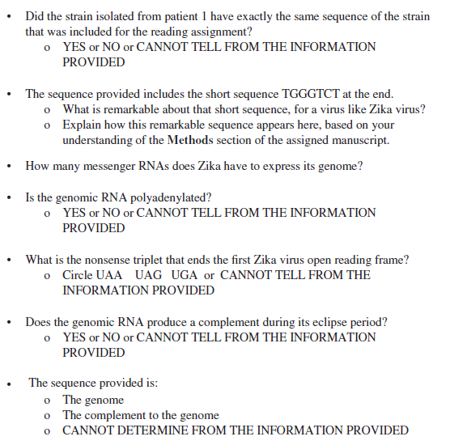
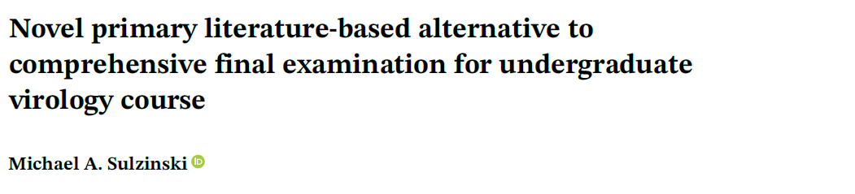
Alternative Question Formats for OBEs
Students told to locate a specific research paper to read in advance of exam, and to find the GenBank sequence for Zika virus genome to bring to the exam along with the paper
“To answer in that context requires a full understanding of the manuscript, rather than a simple search to find an obvious answer hidden in the body of the paper”
Average performance was the same as for the traditional exam.

Slide 24
What Platform?
Don’t reinvent your wheel
Etest or Canvas – wherever you are comfortable and have experience is fine
Canvas – Quizzes and New Quizzes now available
New Quizzes added question types: categorization, ordering, hot spot
But caution – editing has a learning curve
Comparison on Canvas Docs

Slide 25
Making it Harder to Cheat
Question banks
Shuffle answers (don’t number or letter answer options)
Display one question at a time
Controlled availability windows

Slide 26
Considerations for Remote Assessment Summary
Assessment drives learning and is worth the time investment faculty make
Un-proctored, open-book exams are your best bet
can effectively assess knowledge and reasoning though higher level questions
can do thin with auto-graded and short answer questions that are reasonably efficient to grade
Open-book exam formats vary and do not necessarily require essay type questions
Use formative assessment to improve learning and retention, and to ensure students are comfortable with the exam format

Slide 27
References
Durning SJ, Dong T, Ratcliffe T, Schuwirth L, Artino Jr AR, Boulet JR, Eva K. Comparing Open-Book and Closed-Book Examinations: A Systematic Review. Academic Medicine, Vol. 91, No. 4. April 2016, 583-599.
Larsen DP, Butler AC, and Roediger II HL. Comparative effects of test-enhanced learning and self-explanation on long-term retention. Medical Education, 2013, 47,7, 674-82. doi: 10.1111/medu.12141.
Moore R and Jensen PA. Do Open-Book Exams Impede Long-Term Learning in Introductory Biology Courses? Journal of College Science Teaching, July/August 2007, Vol. 36, No. 7, July/August 2007, 46-49.
Palmer EJ and Devitt PG. Assessment of higher order cognitive skills in undergraduate education: modified essay or multiple choice questions? Research paper. BMC Medical Education 2007, 7:49doi:10.1186/1472-6920-7-49.
Rummer R, Schweppe J, and Schwede A. Open-Book Versus Closed-Book Tests in University Classes: A Field Experiment. Frontiers in Psychology. 15 March 2019. https://doi.org/10.3389/fpsyg.2019.00463
Sulzinski MA. Novel primary literature-based alternative to comprehensive final examination for undergraduate virology course. Biochemistry and Molecular Biology Education, 2020, 1–9.

