Slide 1
Summer Teaching and Learning Series
The Basics of Accessibility
Nicky Beaudoin, M.Ed.
July 17, 2020

Slide 2
What you can expect from this session:
Provide links to University and Application specific accessibility resources
Review ADA compliance priorities as outlined by the Office of University Counsel
Review the 5 strategies for creating accessible courses
Demonstrate using the accessibility checklist in the following applications: Microsoft Word, Microsoft PowerPoint, Kaltura, and Canvas
This session will not have time to cover Adobe PDFs, Zoom, Webpages, Google Docs, Panopto, and Qualtrics.

Slide 3
What we want you to takeaway
Knowledge: Increased level of comfort knowing what is expected of you for Fall courses from the University.
Skill: Awareness of how to use built in layouts, styles, and accessibility checkers within popular applications.
Attitude: Appreciation that learners experience your course differently.

Slide 4
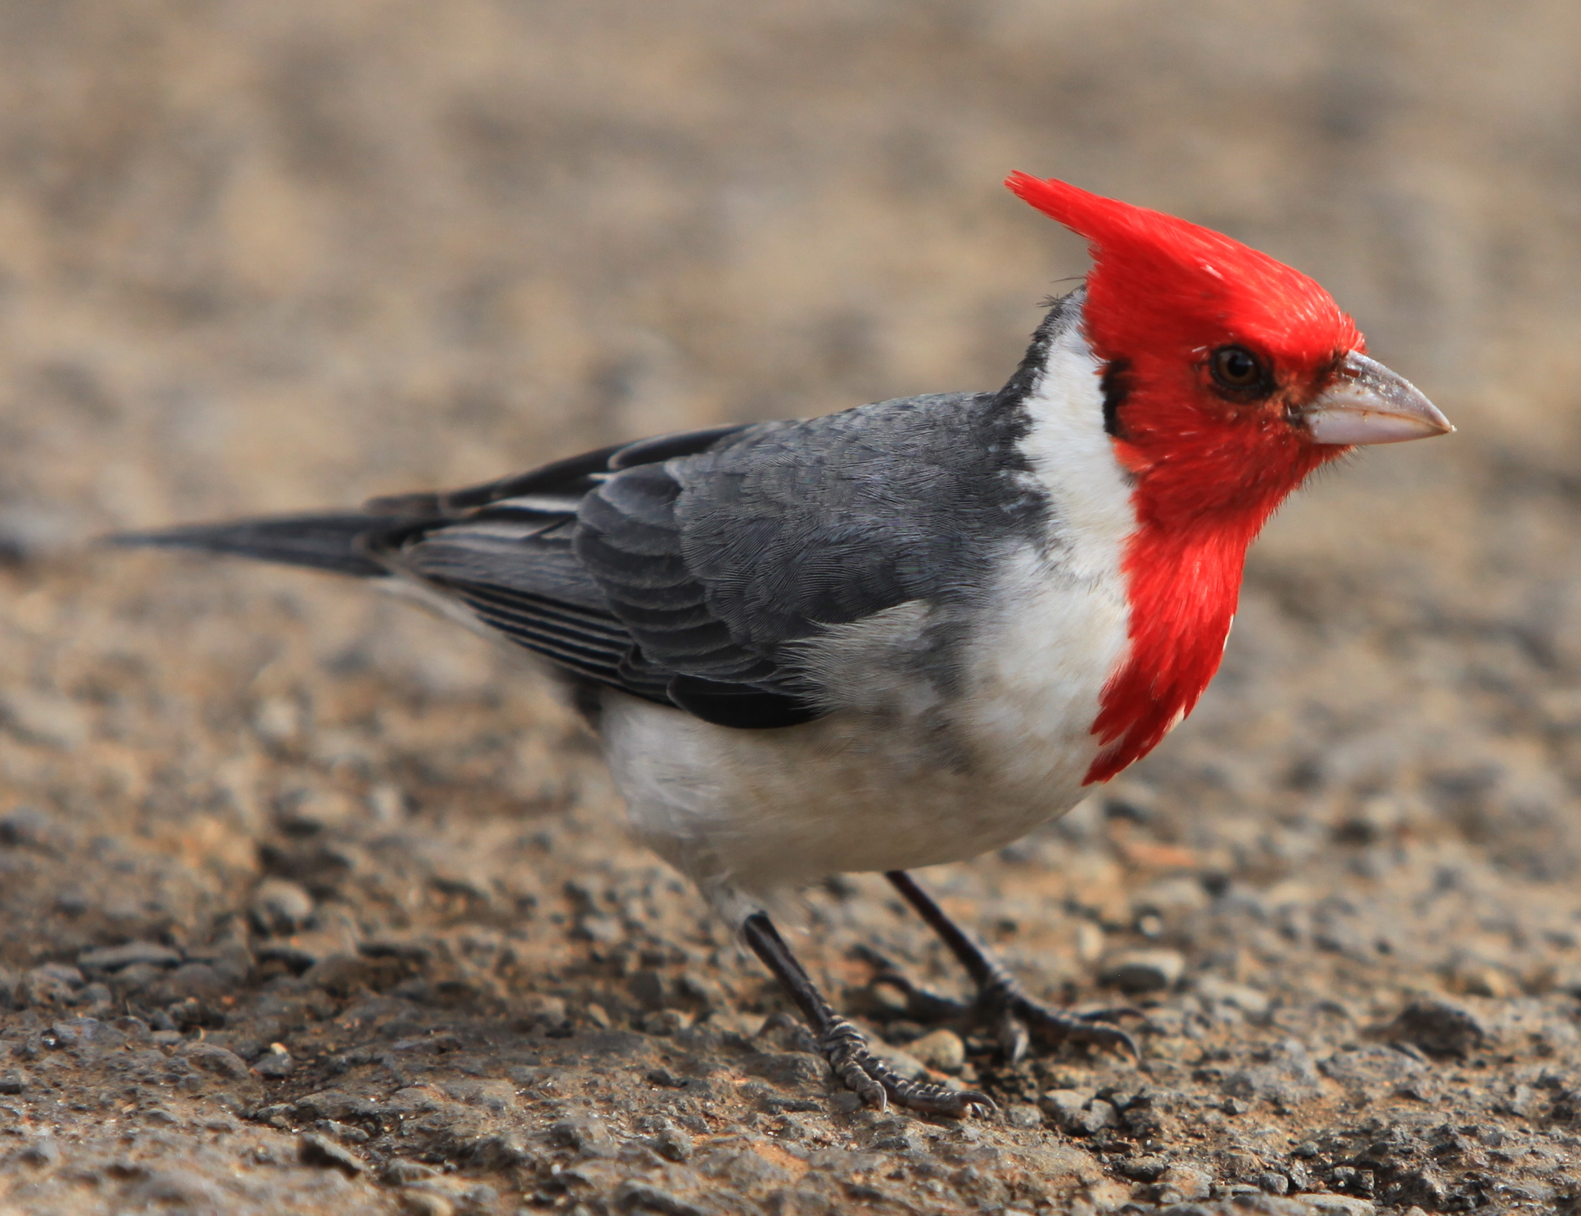
Links at your fingertips
Accessibility Quick Guide
CTI website
ESS Knowledgebase
ESS Canvas Course
Student Disability Services
Web Accessibility in Mind

Slide 5
Experiencing Content from a Different Perspective
Notes:
Low Vision (contrast, font size, color, screen reader, alt text, transcripts),
Colorblind (contrast, color, alt text),
Hard of hearing (transcripts, lip reading)

Slide 6
Simulated Examples of Color Blindness
To learn more, visit Low Vision Needs from Web Content Accessibility Guidelines

Slide 7
Cornell University’s Accessibility Quick Guide
Definition, Strategies, Applications, Accessibility Checker

Slide 8
Get to know your tools
Where are they and what do they do?

Slide 9
Locating the Accessibility Checker
In PowerPoint
In Word
In Canvas

Slide 10
Examining the Strategies
Bad
2. BETTER
C best practice

Slide 11
Examining the Strategies
Bad, better, and best examples

Slide 12
Strategy: Hyperlinks
What you need to do: Ensure all hyperlinks have descriptive text.

Slide 13
Ensure all hyperlinks have descriptive text.
What does this look like:
Bad Example: Click here
Better Example: Click here for an example
Best Practice: To see an example, visit the Color Blindness Simulator Website
How do you do this in PowerPoint, Word, and Canvas?
Same for all:
Write out your text.
Select the text.
Click Insert Hyperlink.

Slide 14
Strategy: Text Design
What you need to do: All text should be readable by screen readers. Use simple fonts that are easiest to read. Use high contrast; it is best to have a dark-colored font on a light-colored background; avoid red-green or yellow-blue combinations as contrasting colors because individuals with colorblindness are unable to differentiate the text from the background. Text formatting should be simple. The only text that should be underlined is text that is hyperlinked.

Slide 15
All text should be readable by screen readers
What does this look like:
Styles Pane used for Title, Headings, Heading Tag
Font is easy to read
Colors are high-contrast
Lists used appropriately
Underline hyperlinks
Tables and Charts have headers and labels
How do you do this in PowerPoint, Word, and Canvas?

Slide 16
Smart Art and Chart Tools

Slide 17
Strategy: Images/Graphics
What you need to do: Add Alternative Text to describe the image or graphic.

Slide 18
Add Alternative Text to describe the image or graphic
What does this sound like?
How do you do this in PowerPoint, Word, and Canvas?

Slide 19
Strategy: Documents
What you need to do: All text in a course should be searchable, which allows learners to search for words or phrases within a document. Tables and charts need to have identified headers and labels.
Course Syllabus: Include an accessibility statement for students which outlines accommodation procedures.
Working with SDS

Slide 20
Strategy: Audio/Video
What you need to do: Audio files require written transcription and video files require closed-captioning. It is best practice to have audio or video clips that are 3 to 10 minutes in length. If the content that takes longer to cover, it is best to create short, segmented videos, each ranging from 3 to 10 minutes in length.

Slide 21
Transcribing
What does this look like?
Bad Example: Providing notes
Better Example: Generate transcript without review
Best Practice: Write a script and/or generate and review transcript
How do you do this in Kaltura? Panopto and Zoom will be covered in a future session.

Slide 22
Check In
Thumbs up or thumbs down to the following:
Knowledge: Increased level of comfort knowing what is expected of you for Fall courses from the University.
Skill: Awareness of how to use built in layouts, styles, and accessibility checkers within Microsoft Word, PowerPoint, Kaltura, and Canvas.
Attitude: Appreciation that learners experience your course differently.

Slide 23
Questions & Answers

