Slide 1
NatureRx
What is
EcoRx?
Keith G. Tidball, PhD
Cornell University
2023

Slide 2
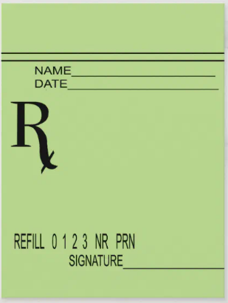
What’s with the “Rx”?
Rx: A medical prescription. The symbol "Rx" is usually said to stand for the Latin word "recipe" meaning "to take." It is customarily part of the superscription (heading) of a prescription.
Military Families
Today
Go outside!
Notes:
As nature-based approaches have gained popularity across a variety of disciplines, therapeutic recreation (TR) practitioners have used nature-based interventions and activities to address functional outcomes and provide recreation opportunities for military and veteran populations with Post-Traumatic Stress (Hawkins et al., 2016, Craig et al., 2020). Multiple types of nature-based approaches, such as outdoor adventure therapy, wilderness therapy, outdoor experiential therapy, and eco-therapy utilize the natural environment for specific therapeutic outcomes (Poulsen et al., 2015). Although this line of research is relatively new, preliminary evidence suggests that nature-based recreation approaches merit continued investigation to evaluate efficacy and implementation within the DoD, the VA, and community-based TR and recreation settings serving military personnel, military families, and veterans (Townsend et al., 2018). Further, there are efforts to move the clinical community to consider prescribing times spent outdoors to address health and wellbeing concerns beyond PTS. Enter the term “Rx” into this conversation, such as seen in terms like OutdoorsRx or EcoRx, which we will return to in future blog posts.

Slide 3
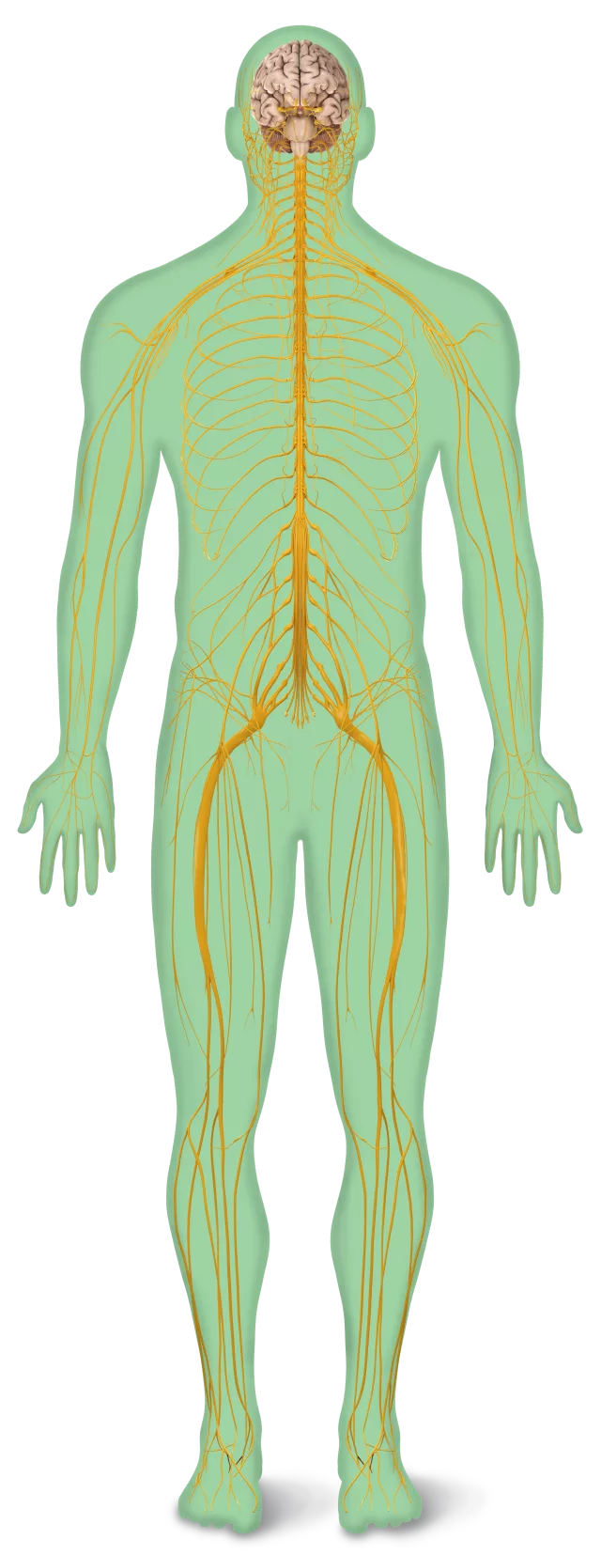
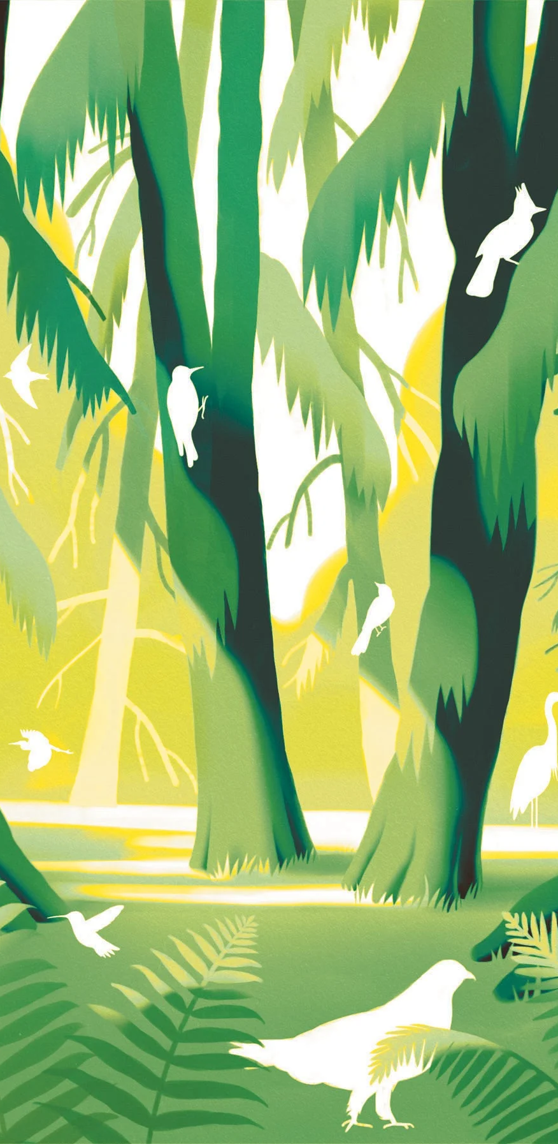
What’s the symptom or demand signal?
Individuals, families, and sometimes whole communities experiencing pressing, even urgent stress or trauma seek out doses of contact and engagement with nature to further their efforts to summon and demonstrate resilience in the face of crisis… this is Urgent Biophilia.
Tidball, Keith G. “Urgent Biophilia: Human-Nature Interactions and Biological Attractions in Disaster Resilience.” Ecology and Society, vol. 17, no. 2, 2012. JSTOR, http://www.jstor.org/stable/26269048.

Slide 4
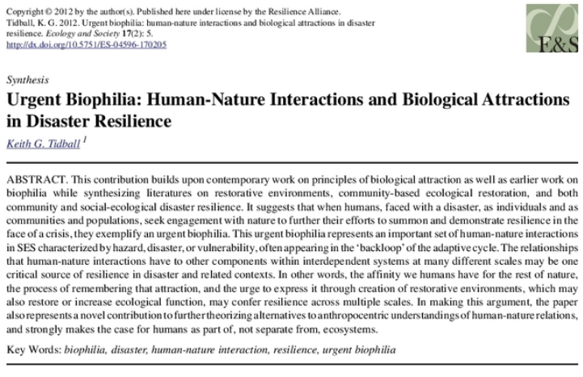
Urgent Biophilia
“Urgent Biophilia is the affinity we humans have for the rest of nature, the process of remembering that affinity and the urge to express it through recreation and creation of restorative environments, which may also restore or increase ecological function and confer resilience across multiple scales.” ~ Keith G. Tidball, PhD

Slide 5
Responding to Urgent Biophilia - the “Rx”
Therapeutic recreation (TR) practitioners have used nature-based interventions and activities to address functional outcomes and provide recreation opportunities for populations with Post-Traumatic Stress (Hawkins et al., 2016, Craig et al., 2020).
Multiple types of nature-based approaches utilize the natural environment for specific therapeutic outcomes (Poulsen et al., 2015).
Evidence suggests that nature-based recreation approaches merit continued investigation to evaluate efficacy and implementation (Townsend et al., 2018).
There are efforts to move the clinical community to consider prescribing times spent outdoors to address health and wellbeing concerns beyond PTS.
Notes:
As nature-based approaches have gained popularity across a variety of disciplines, therapeutic recreation (TR) practitioners have used nature-based interventions and activities to address functional outcomes and provide recreation opportunities for military and veteran populations with Post-Traumatic Stress (Hawkins et al., 2016, Craig et al., 2020). Multiple types of nature-based approaches, such as outdoor adventure therapy, wilderness therapy, outdoor experiential therapy, and eco-therapy utilize the natural environment for specific therapeutic outcomes (Poulsen et al., 2015). Although this line of research is relatively new, preliminary evidence suggests that nature-based recreation approaches merit continued investigation to evaluate efficacy and implementation within the DoD, the VA, and community-based TR and recreation settings serving military personnel, military families, and veterans (Townsend et al., 2018). Further, there are efforts to move the clinical community to consider prescribing times spent outdoors to address health and wellbeing concerns beyond PTS. Enter the term “Rx” into this conversation, such as seen in terms like OutdoorsRx or EcoRx, which we will return to in future blog posts.

Slide 6
Types of Rx
OutdoorRx
Veteran and servicemember-centric. Started in NY Legislature and currently spreading. Features both back-country and front-country outdoor-based therapeutic approaches.
ParksRx
Formal park designation-centric, with heavy emphasis on the spectrum of attributes of “Nature” as therapeutic. Not only as recreation, but as setting as well.
https://www.parkrx.org/
OutdoorRx
NatureRx
ParksRx
NatureRx
Student-focused with an emphasis on natural settings and time spent within them as “good for your overall health and well-being.” https://health.cornell.edu/resources/health-topics/nature-rx
EcoRx

Slide 7
NatureRx
EcoRx is…
EcoRx exists at the nexus of similar understandings regarding the properties of Parks, Nature or the Outdoors as prescribeable alternative complimentary medicine.
Explicitly includes Social within Ecological Determinants of Health in its social-ecological systems framing.
Represents a more holistic, comprehensive, systemic therapeutic approach that sees the environment not merely as a setting but as a partner in the health and wellbeing process.

