Slide 1
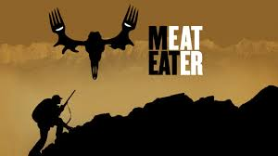
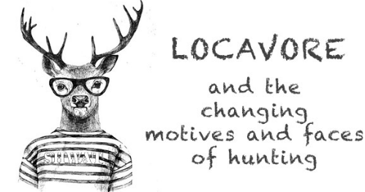
R3 and the Locavore Movement: How Far We Have Come and Where We Have Yet to Go
Keith G. Tidball & Moira M. Tidball

Slide 2
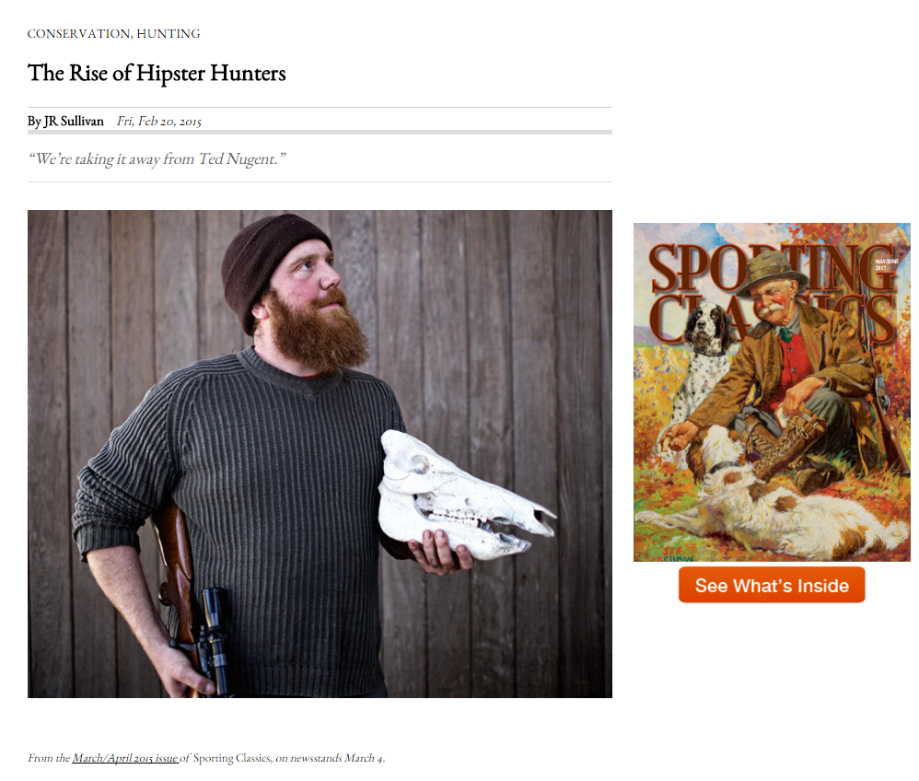
People are talking about this…

Slide 3
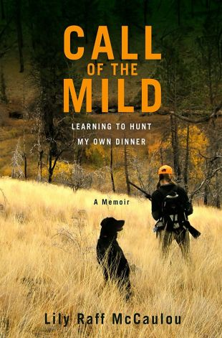
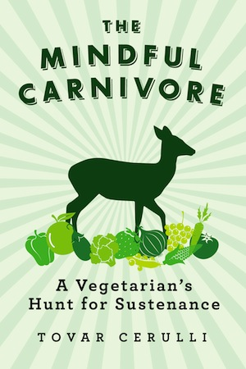
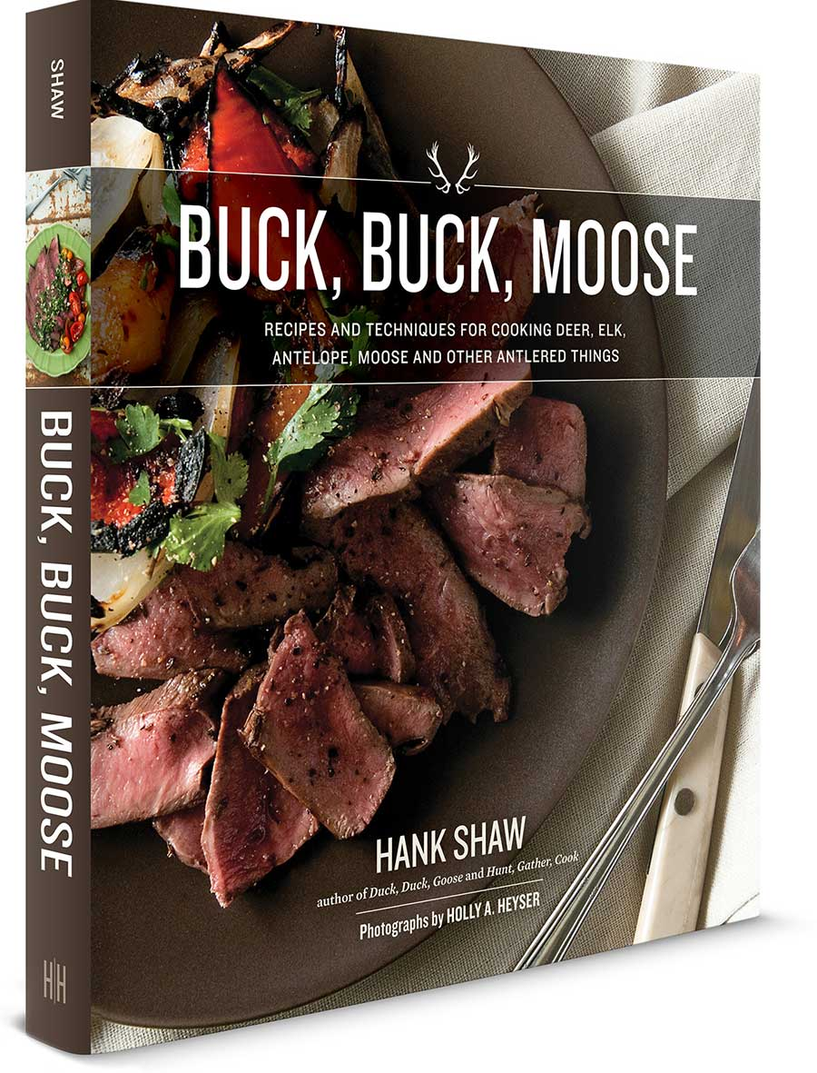
People are talking about this… popular press

Slide 4
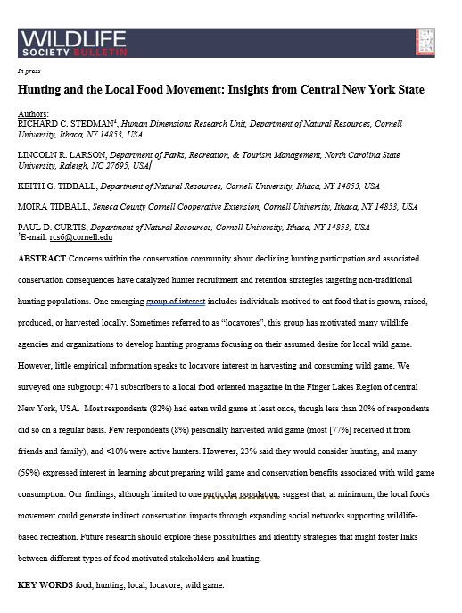
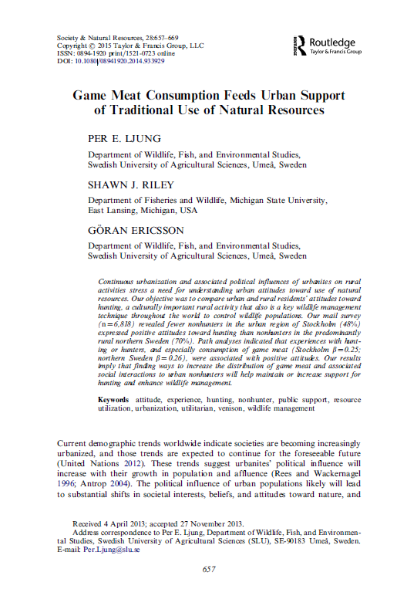
People are talking about this… Researchers

Slide 5
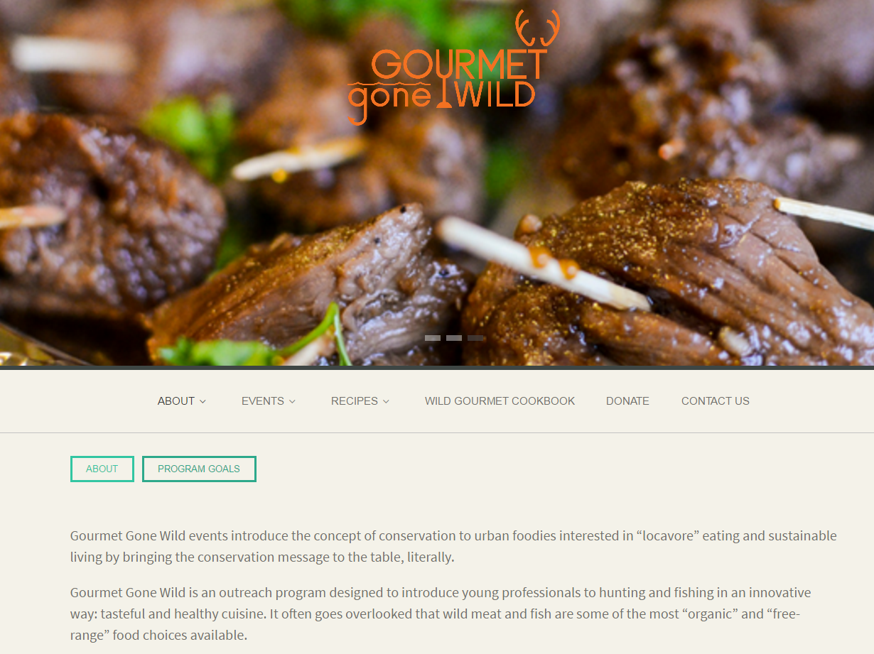
People are talking about this - agencies

Slide 6
Just a couple of days ago…

Slide 7
People are talking about this… on the web

Slide 8
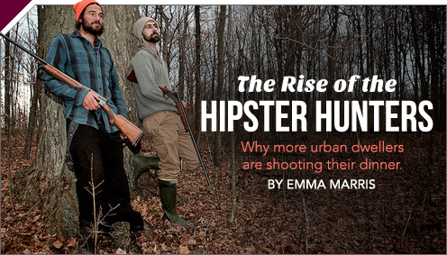
Title | Source | Date
Wisconsin aims to put more female fingers on the triggers | Wisconsin State Journal | 2013
More Women Give Hunting a Shot | National Geographic | 2013
The Professional Women Who Hunt, Shoot and Gut Their Dinners | New York Times | 2013
ICYMI: All The Cool Girls Go Hunting For Food | Organic Authority | 2013
All the Cool Girls Hunt Their Own Food | Jezebel | 2013
The Rise of the Hipster Hunters | Sporting Classics | 2015
Hipsters Who Hunt: More Liberals are Shooting Their Own Supper | Slate | 2012
On Hipsters and Hunting | Field & Stream | 2015
Hipster’s are Going Hunting | Maclean’s | 2014
A Profile of a Hipster Hunter, the Next Generation of Conservationists | Outdoorhub | 2015
The Changing Culture of Killing for Food | The Texas Observer | 2014
Locavore movement takes to deer hunting across US | Yahoo News/Assoc. Press | 2014
The Meat-Eater Revolution | Petersen’s Hunting | 2014
Locavore, Get Your Gun | NY Times | 2007
The Hunt to Table Movement | Isthmus | 2015
(Pink) new levels of female participation; (Blue) the growing trend of hunting among so-called “hipsters” and “millennials” (undefined herein, intentionally); and (Green) the expanding locavore, food/environment issues driven hunting trend.
Notes:
Meanwhile, we've compiled a reading list of 15 articles found in the popular press dealing with these issues within the last ten years There are 5 from each of the categories mentioned above, organized and color-coded for easy reference. They are hyper-linked under the heading “Source”. There are many articles to explore this further, as our search results described above confirm. These, however, seem to most completely capture the complexities of the issues, and preserve the nuance of each category, while providing a reasonably comprehensive lay understanding.

Slide 9
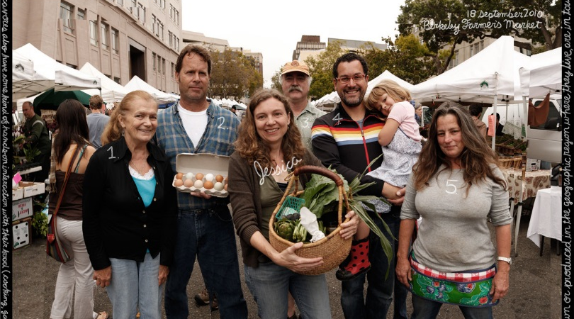
Locavore
“person motivated to eat food that is grown, raised, produced or harvested locally”
… a growing national trend reflecting interest in eating locally and taking a more active role in the acquisition of food, especially organic, free-range, chemical- and hormone-free meat. Through the locavore movement, individuals from nontraditional hunting backgrounds have flocked to lessons and seminars offering instruction on how to hunt and process game meat. Locavore hunters are often educated millennials who hail from urban and suburban areas; lacking traditional hunting mentors, they nonetheless have been moved to take up hunting as adults for reasons of self-sufficiency, health, sustainability, or a desire to reconnect with nature. -- Responsive Management

Slide 10
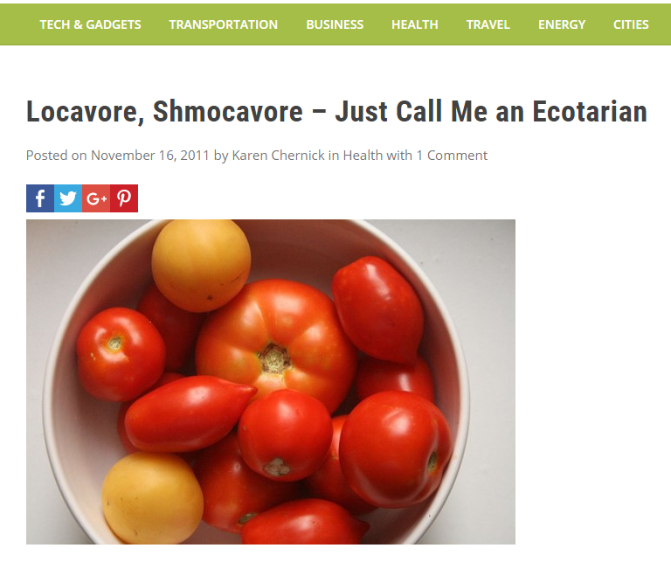
The term Locavore?
Resonates with a lot of people
Annoys some, especially those who don’t want to be labeled
Term serves it’s purpose to identify as local food advocate, but some argue has become a bit passé since all this work began (but note steady increase in searches using the term in conjunction with hunting).

Slide 11
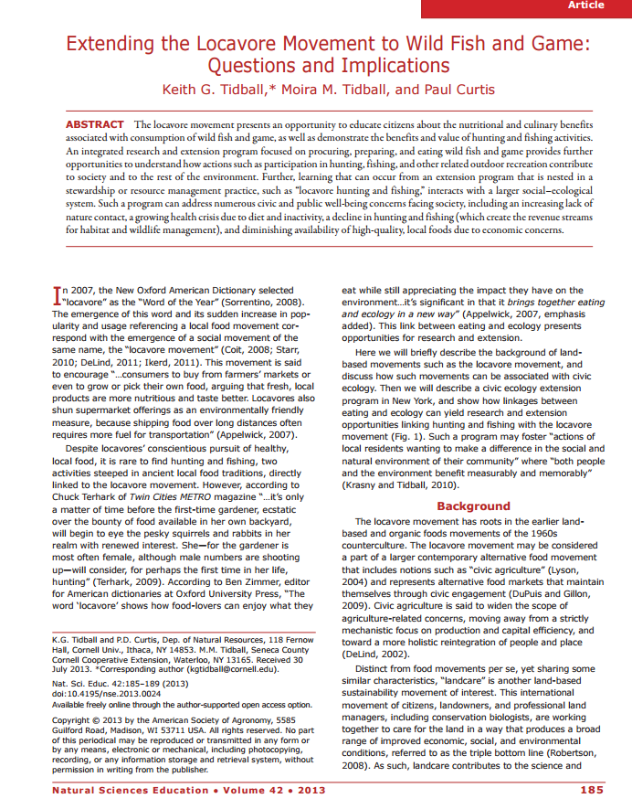
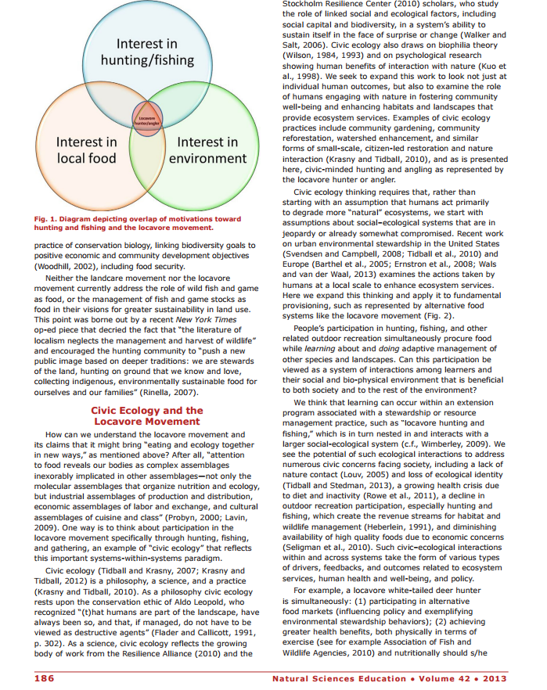
http://www.wildharvesttable.com/files/2014/01/WHT-article-167vnut.pdf

Slide 12
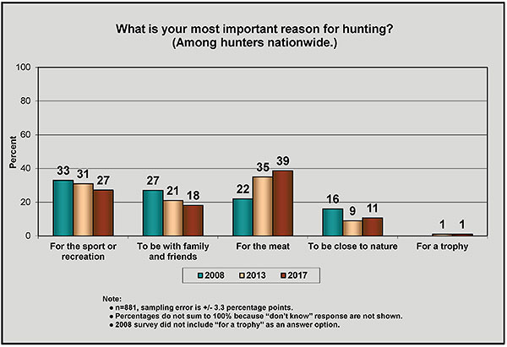
Food Motivations – Its about the meat
Responsive Management - www.responsivemanagement.com

Slide 13
Food motivations…
Taste Sustainable
Free-Range Ethically -raised
Organic Satisfaction in Procuring
DIY Hormone-free
Nutritious
Notes:
Taste- #1 and great that all of these cookbooks and resources are out there to make wild game taste great. A bad experience with game meat, will for sure turn someone off hunting and or cause the hunter to get a lot of flack for bringing that “awful, gamey meat home”- So we have to continue to have great resources for properly preparing and cooking the meat.
Nutriton- wild game touted as a lean source of protein- How many of you have heard that wild game meat is a lean source of protein? Where have you heard or read this? We can see this when we cook and prepare wild game meat. A lot less fat to cut away, have to use tenderizing techniques when cooking (marinades, brines, braising, not overcook, ect).
Does knowing nutrition content of the meat and being able to put a nutrition fact label on the meat and recipes increase participation and satisfaction in hunting?

Slide 14
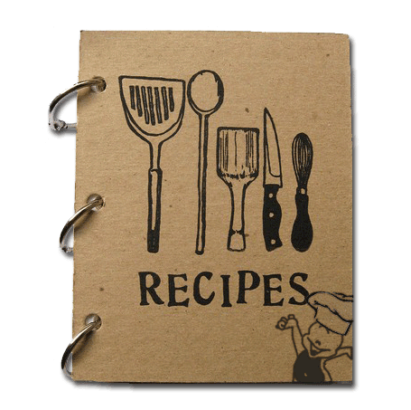
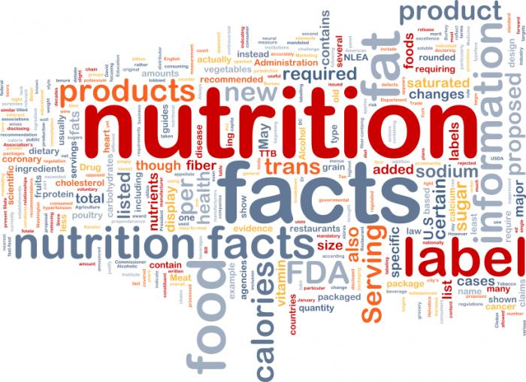
How tasty? How healthy?

Slide 15
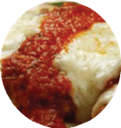
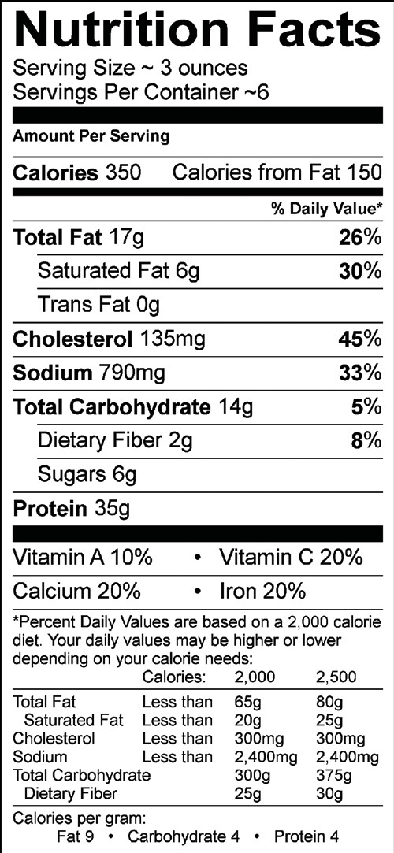
Canada Goose Parmesan
1 pound goose breast
½ cup onion, sliced
½ cup fresh herbs such as parsley, rosemary, thyme or 2 tablespoons dried Italian seasoning
1 quart water
2-4 tablespoons salt
1 egg, stirred
½ cup skim milk
½ cup seasoned bread crumbs, panko or whole
wheat
1-2 tablespoons olive oil
2 cups marinara sauce
1 cup Italian cheese blend, mozzarella, and Parmesan
Notes:
But the actual data was not there for most species! I couldn’t generate this nutrition fact label 4 years ago with actual Canada goose data. I am a food and nutrition motivated hunter and this bugged me! I come at this all from a nutrition educator angle with Extension. All of our recipes have to have nutrition data attached to them for the public’s knowledge. So we hypothesized that knowing the nutrition is important and set out to do more research about it.

Slide 16
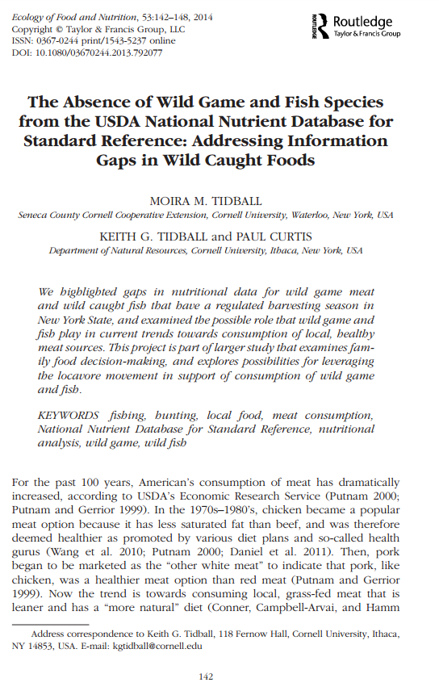
Species Listed in NYS DEC Hunting & Fishing Regulations: | Listed in USDA National Nutrient Database? | Closest Species Listed in Database
Beaver (fb) | Yes
Black Bass, small or largemouth | Yes | mixed species of fresh water bass
Black Bear (fb) | Yes | black bear (Alaska Native)
Bobcat (fb) | No | N/A
Brant | No | domesticated goose
Brook Trout | No | trout, mixed species
Bullhead | No | catfish, channel, wild, raw
Coot | No | duck, wild
Coyote (fb) | No | N/A
Crappie | No | N/A
Crow | No | N/A
Duck, multiple species | Yes | duck, wild
Feral swine* | No* | Game meat, boar or pork
Fisher (fb) | No | N/A
Fox (fb) | No | N/A
Frog | yes, legs only | not indicated if farmed or wild
Gallinule | No | N/A
Canada Goose | No | domesticated goose
Lake trout | No | trout, mixed species
Lake whitefish | Yes | whitefish, mixed species
Landlocked salmon | No | Atlantic salmon
Marten (fb) | No | N/A
Merganser | No | duck, wild
Mink (fb) | No | N/A
Muskellunge | No | N/A
Muskrat (fb) | No | N/A
Northern Pike | Yes
Opossum (fb) | Yes
Pheasant | Yes | not indicated if farmed or wild
Pickerel | No | N/A
Porcupine | No | N/A
Quail, Bobwhite | Yes | not indicated if farmed or wild
Rabbit, cottontail and varying hare | Yes | rabbit, wild
Raccoon (fb) | Yes
Rail | No | N/A
Ruffed Grouse, Spruce Grouse | No | N/A
Shad | Yes | shad, American
Skunk (fb) | No | N/A
Snapping turtle | No | green turtle (endangered & illegal to harvest)
Snipe | No | N/A
Snow Goose | No | domesticated goose
Squirrel; gray, black, fox and red | Yes | game meat, squirrel
Sunfish (bluegill, pumpkinseed, redbreast) | Yes | sunfish, pumpkin seed
Walleye | Yes
Weasel (fb) | No | N/A
White-tailed deer | No | game meat, deer
Wild Turkey | No | domesticated turkey, all classes
Woodchuck | No | N/A
Woodcock | No | N/A
Yellow perch | No | perch, mixed species
Note: (fb) indicates fur bearer
*feral swine special case in NY
38% of species (16 of 42) that are legal to hunt or fish in New York State are specifically listed in the USDA National Nutrient Database for Standard Reference when we began this work- much higher if did a national search.
Papers and species- initial funding for 3 species:
Brook trout
Canada goose
Ruffed grouse
(Eastern Wild Turkey)
The Absence of Wild Game and Fish Species from the USDA National Nutrient Database for Standard Reference: Addressing Information Gaps in Wild Caught Foods

Slide 17
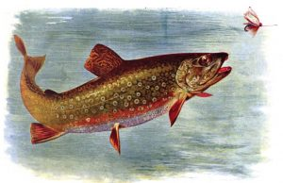
Example - Brook Trout
Nutrition comparison for wild-caught brook trout vs. wild and store-bought rainbow trout
Based on 100 g portion | Wild Brook Trout NYS | Wild Rainbow Trout | Domesticated Rainbow Trout
 | (n=3)*
Nutrients:
Energy (kcal) | 110 | 119 | 141
Protein (g) | 21.23 | 20.48 | 19.94
Total fat(g) | 2.73 | 3.46 | 6.18
Total saturated fatty acids (g) | 0.595 | 0.722 | 1.383
Total mono- unsaturated fatty acids (g) | 0.815 | 1.129 | 1.979
Total poly-unsaturated fatty acids (g) | 0.772 | 1.237 | 1.507
Cholesterol (mg) | 60 | 59 | 59
*n=3 refers to 29 collected fish samples being aggregated into a composited sample size of 3
Data source: US Department of Agriculture, Agricultural Research Service, Nutrient Data Laboratory.
USDA National Nutrient Database for Standard Reference, Release 27. Version Current: August 2014.
Journal of Food Composition and Analysis, Volume 60, July 2017
Notes:
Quickly look through this, but this slide is more for you to have later if you want to reference back and for the hyperlink to the paper. We found wild caught brook trout to be a lean source of PRO.

Slide 18
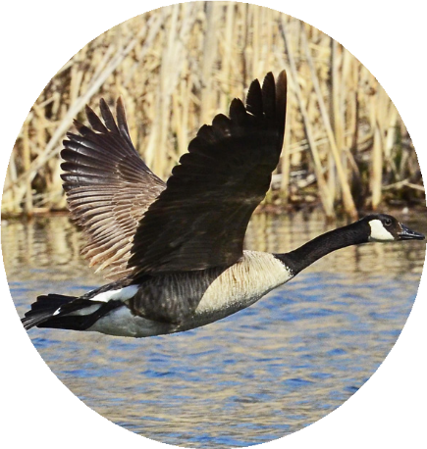
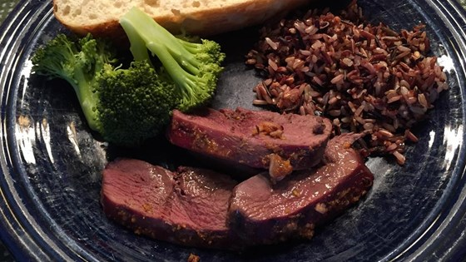
Example - Canada Goose
Comparison of Wild Goose and Domesticated Goose
 |  | Wild Canada | Domesticated
Based on 3 ounce portions (85g): |  | Goose, skinless | Goose, skinless
Nutrients:
Energy (kcal) |  | 113 | 137
Protein (g) |  | 20.66 | 19.34
Total fat (g) |  | 3.42 | 6.06
Total saturated fat (g) |  | 0.518 | 2.372
Total mono-unsaturated fat (g) |  | 0.694 | 1.572
Total poly-unsaturated fat (g) |  | 0.295 | 0.765
Cholesterol (mg) |  | 68 | 71
Minerals:
Ca (mg) |  | 3 | 11
Fe (mg) |  | 5.02 | 2.18
Mg (mg) |  | 25 | 20
P (mg) |  | 218 | 265
K (mg) |  | 286 | 357
Na (mg) |  | 42 | 74
Zn (mg) |  | 1.43 | 1.99
Data source: U.S. Department of Agriculture, Agricultural Research Service. 2011. USDA National Nutrient Database for Standard Reference, Release 24. Nutrient Data Laboratory Home Page, http://www.ars.usda.gov/ba/bhnrc/ndl. Compiled by Moira M. Tidball, Cornell University Cooperative Extension, revised September 2014.
Notes:
We have lots of Canada geese in NY and extended hunting seasons and bag limits in some places.
Often people say goose meat is fatty, but not if you take the skin off…look at fat content and iron content high (use there wings a lot, more blood flow to those breast muscles= high FE content.

Slide 19
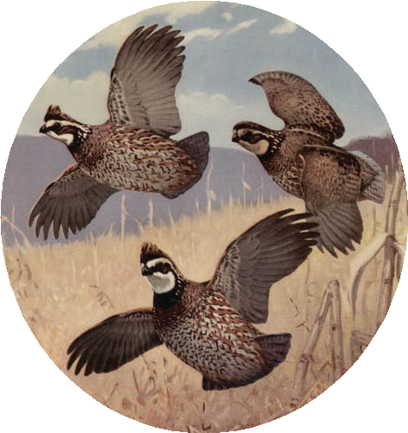
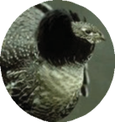
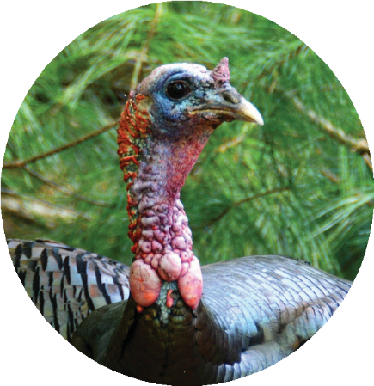
Example – Upland Birds
Comparison of Upland Game Birds
Based on 3 ounce portions | Pheasant | Quail | Ruffed Grouse | Spruce Grouse,
(85g): |  |  |  | Native (Canadian)
Nutrients:
Energy (kcal) | 113 | 105 | 95 | 92.6
Protein (g) | 20.71 | 19.2 | 21.98 | 20.4
Total fat (g) | 2.76 | 2.54 | 0.75 | 0.85
Total saturated fat (g) | 0.935 | 0.74 | 0.036 | 0.085
Total mono-unsaturated fat (g) | 0.884 | 0.71 | 0.036 | 0.085
Total poly-unsaturated fat (g) | 0.468 | 0.66 | 0.112 | trace
Cholesterol (mg) | 49 | 49 | 34 | N/A
Minerals:
Ca (mg) | 3 | 8 | 4 | 2.55
Fe (mg) | 0.67 | 1.96 | 0.49 | 3.4
Mg (mg) | 18 | 24 | 27 | 25.5
P (mg) | 170 | 194 | 194 | 161
K (mg) | 206 | 221 | 264 | 278
Na (mg) | 28 | 47 | 42 | 45
Zn (mg) | 0.54 | 2.3 | 0.43 | 0.77
Eastern Wild Turkey not on the list (yet)
Data source: U.S. Department of Agriculture, Agricultural Research Service. 2011. USDA www.ars.usda.gov/ba/bhnrc/ndl. Compiled by Moira M. Tidball, Cornell University Cooperative Extension, revised September 2014
National Nutrient Database for Standard Reference, Release 24. Nutrient Data Laboratory Home Page, http://
Notes:
Ruffed grouse- again very high in PRO, super low in fat and calories, consistent in minerals- healthy meat according to dietary guidelines
Eastern wild turkey- we partnered with NYSDEC, NWTF (biologists helped collect samples from SE, NE, and Midwest regions) and USDA. Data not released yet, but I can tell you half the fat, Protein, iron, and zinc were higher in wild turkey while cholesterol and magnesium were lower, compared to the domestic.
We are talking with USDA right now about a white-tailed deer study, because the “venison, Deer meat” currently in the database are from farm raised, fallow deer. Lot more work to be done and super satisfying to me to be able to offer this information to the consumer.

Slide 20
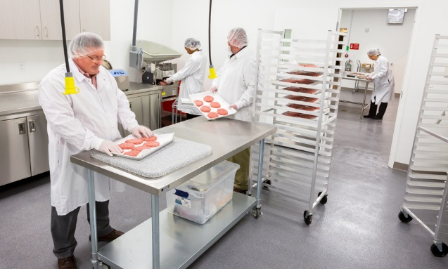
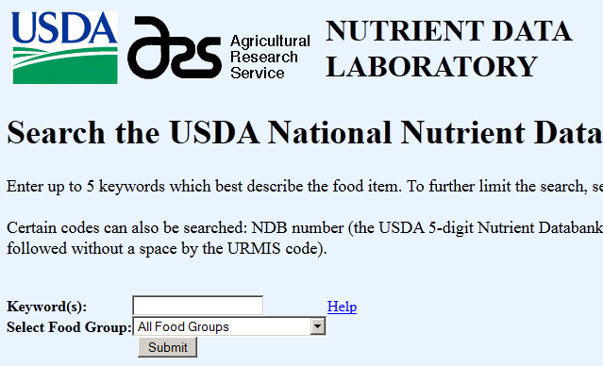
A word about the white label

Slide 22
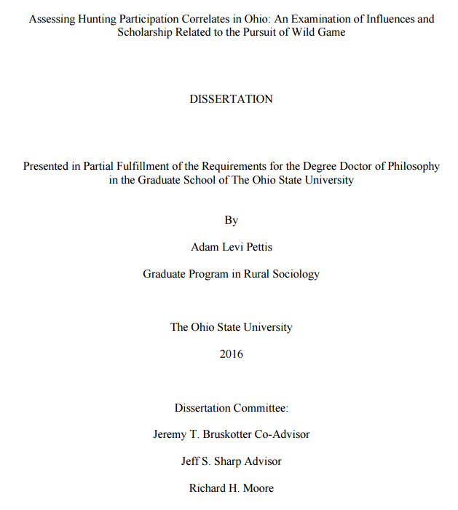
Where to from here? more demographic research
“…the rise in hunting for food is likely … rationalization of hunting rather than increase motivation to acquire wild game meat. If increases in alternative food support lead to increased support for hunting, we likely would have seen some impact over the last several decades with the increased popularity of alternative food, but hunting rates have steadily dropped over this period.”
“But hunting participation increased by 9 percent from 2006 to 2011, the latest U.S. Fish and Wildlife Service’s national five-year survey found, and wildlife officials around the country suspect that it’s local food connoisseurs — or locavores — partly helping to level it off…” (http://www.santafenewmexican.com/news/locavore-movement-takes-to-deer-hunting-across-u-s/article_3aa7beb4-28ad-5cfb-ab1b-f284fd008da9.html )
https://senr.osu.edu/twel-dissertation-adam-pettis

Slide 23
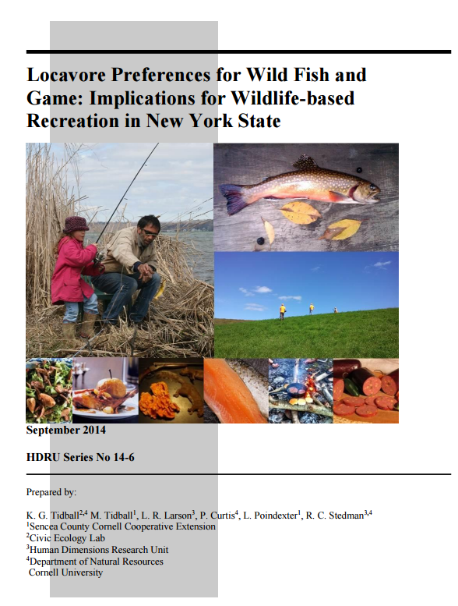
Where to from here? More demographic research
Based on our sample, the Locavore movement is not resoundingly a panacea for hunter and angler recruitment and retention (see also Pettis, 2014)
Yet, our sample looks predominantly like this
Do these white, well educated, affluent female 50 somethings represent the locavore movement? Or a small subset of what the Locavore movement is?
Or is locavorism a part of a larger social movement (like alt foods), encompassing the hipsters, the faux-hemians, millennials, and other demographic segments not found where we looked?

Slide 24
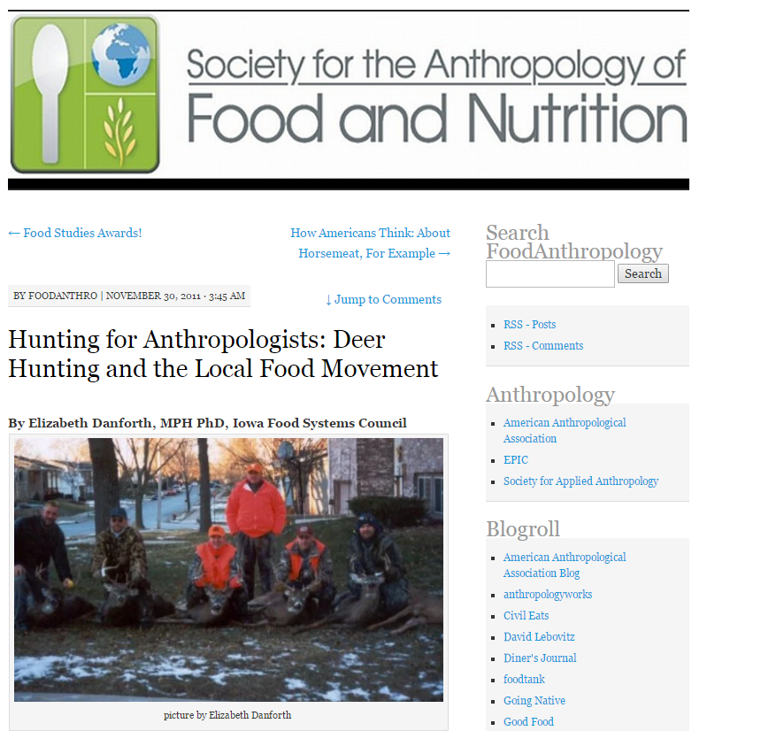
Where to from here?
A quick search of recent anthropological articles related to hunting supplies a multitude of articles related to Inuit groups, Amazonian small land holders, and indigenous Nicaraguan communities. However, anthropologists have provided virtually nothing related to the 12.5 million people who currently hunt in the United States.
https://foodanthro.com/2011/11/30/hunting-for-anthropologists-deer-hunting-and-the-local-food-movement/

Slide 25
Where to from here? Evaluation…

Slide 26
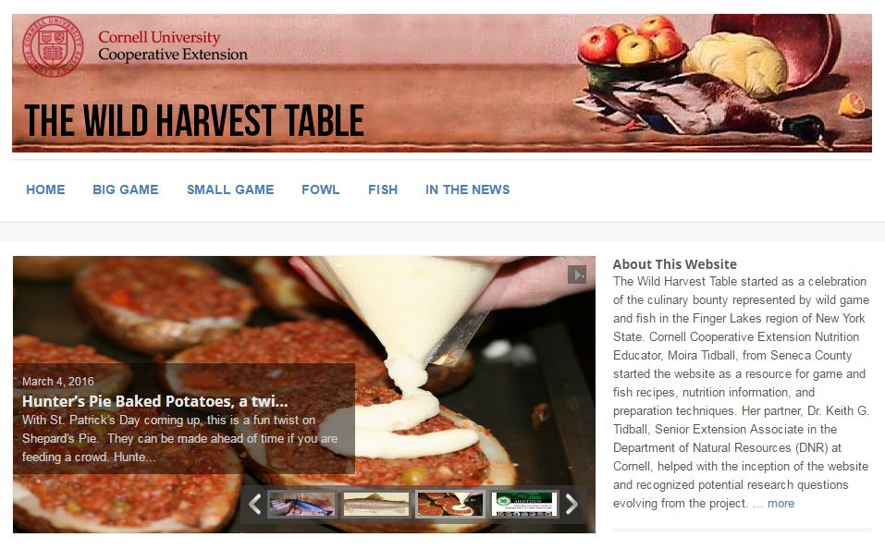
Where to from here? Public access not just elite & affluent

Slide 27
Where to from here? R3 & Food Motivations Clearing House
R3 Food Motivations

Slide 28
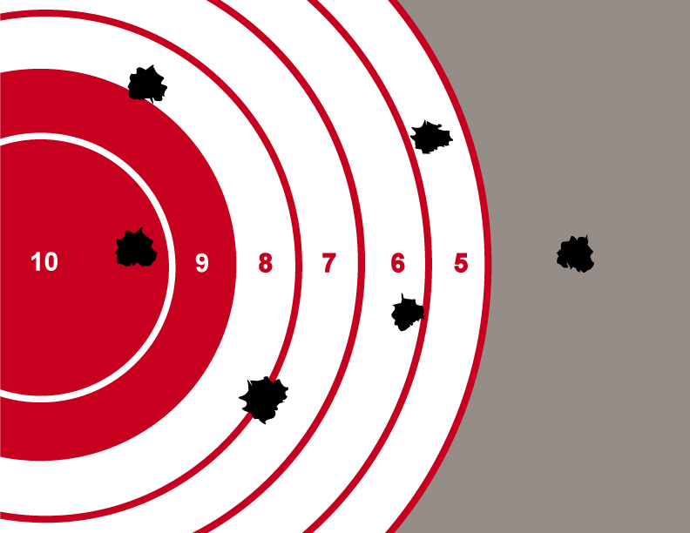
In conclusion-
As managers and practitioners, we have listened to the demand signal and reacted.
As researchers, we are zeroing in on the empirical approach to understanding the audiences and mechanisms.
Now its time to invest in evaluation of our current and future efforts, and in refining and enhancing them to maximize benefits.

