Slide 1
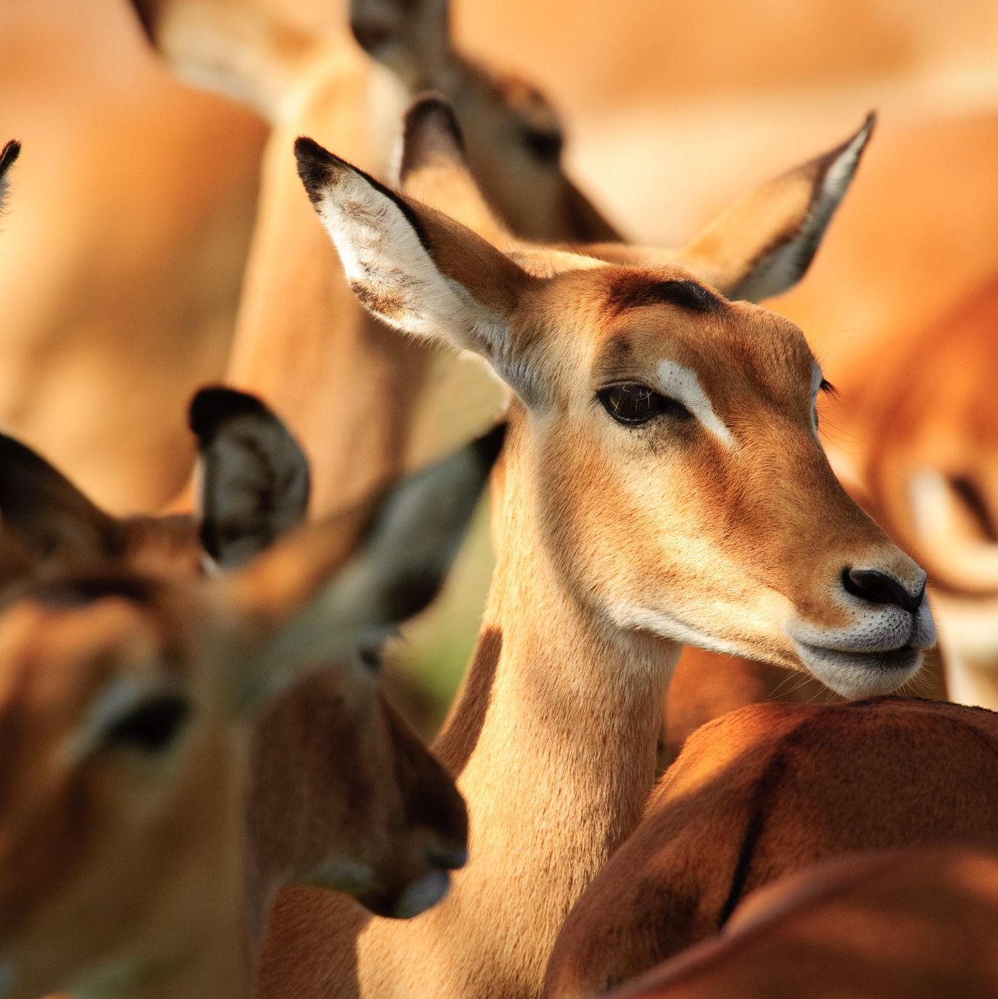
Communication about Hunting in Africa Among North American Audiences: Lessons from Leveraging Food Motivations in Recruiting and Retaining New Hunter Demographics
Keith G. Tidball, PhD
Cornell University
Department of Natural Resources and the Environment

Slide 2
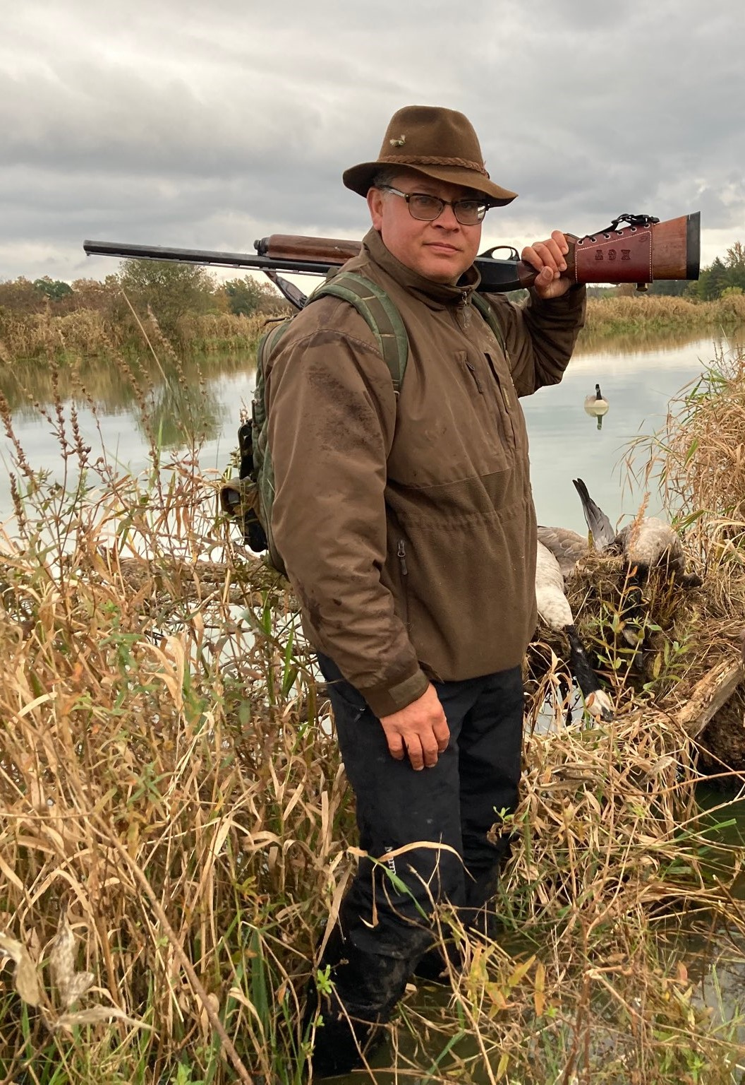
Brief intro Keith G. Tidball, PhD Cornell University – Dept. of Natural Resources and the Environment kgtidball@cornell.edu
Environmental anthropologist and naturalist
Conservation hunting and human dimensions of wildlife management
Cultural support of hunting
R3 in international contexts
Food motivations in R3
Health & well-being implications of hunting & angling
Ecological identities

Slide 3
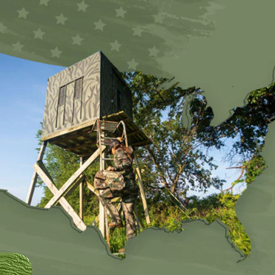
Context: Overall Approval of Hunting in the US
The “Americans’ Attitudes Toward Legal, Regulated Fishing, Target/Sport Shooting, Hunting, and Trapping” survey, conducted by Responsive Management, was released last month by the Outdoor Stewards of Conservation Foundation.
Details here - https://www.outdoorstewards.org/americans-attitudes-towards-fishing-target-shooting-hunting-and-trapping/

Slide 4
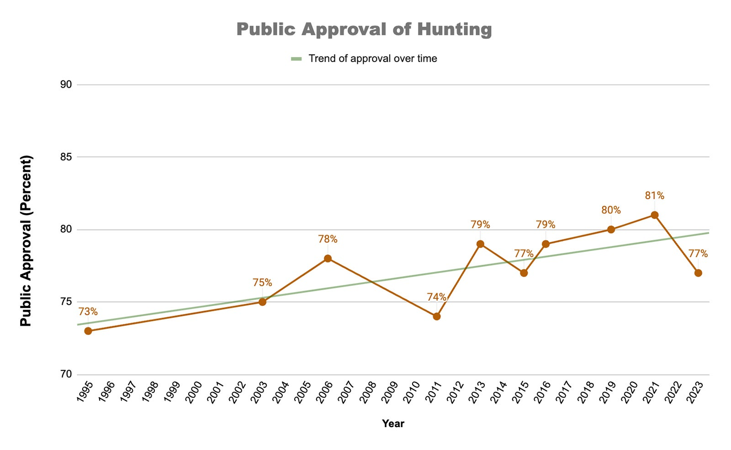
Getting to a 30 Billion Wildlife Economy – Overall Approval of Hunting in the US
Public approval of hunting has been trending upward over time, but the most recent survey indicates a sharp dip in this pattern. Outdoor Life / Data: OSCF

Slide 5
US Results of Interest
The groups with the lowest approval of hunting are:
Black, Hispanic
did not fish or shoot in the past three years
are between 18 and 34 years old
are female
live in the North West US region
and reside in a large city, urban area, or suburban area
Data: OSCF

Slide 6
US Results of Interest
Hunting either to protect humans from harm or for wildlife management purposes had the highest approval rating, at 78 and 77 percent, respectively.
Hunting “for the meat” had a 75 percent approval rating in 2023, down from 84 percent in 2019.
Surprisingly, hunting “to get locally sourced food” or “to get organic meat” showed major declines in approval, down 11 and 14 percentage points, respectively, from a similar question in 2019.
Data: OSCF

Slide 7
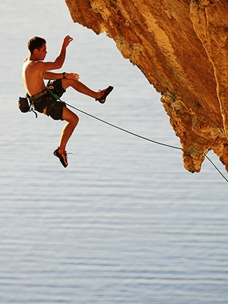
Why Are We Losing Ground?
“I’m a researcher, and it’s not my business to tell you why we’re seeing these changes,” Mark Duda says (presenter at AWCF 2022 in Mozambique). “But I can tell you that we are definitely losing support among younger Americans. We [sportsmen and women] are not talking to Black or Hispanic communities, and we need to do a better job of reaching urban people and women.
Larger cultural divisions are influencing Americans’ attitudes toward hunting, shooting, and fishing. (side-picking)
“The drop in public support for legal field sports (in the USA) comes after nearly 30 years of increasingly favorable attitudes, and may reflect a wider and growing discomfort with activities that are considered the domains of mainly white, rural, older males.” From McKean, 2023, Outdoor Life - https://www.outdoorlife.com/hunting/hunting-approval-survey-2023/

Slide 8
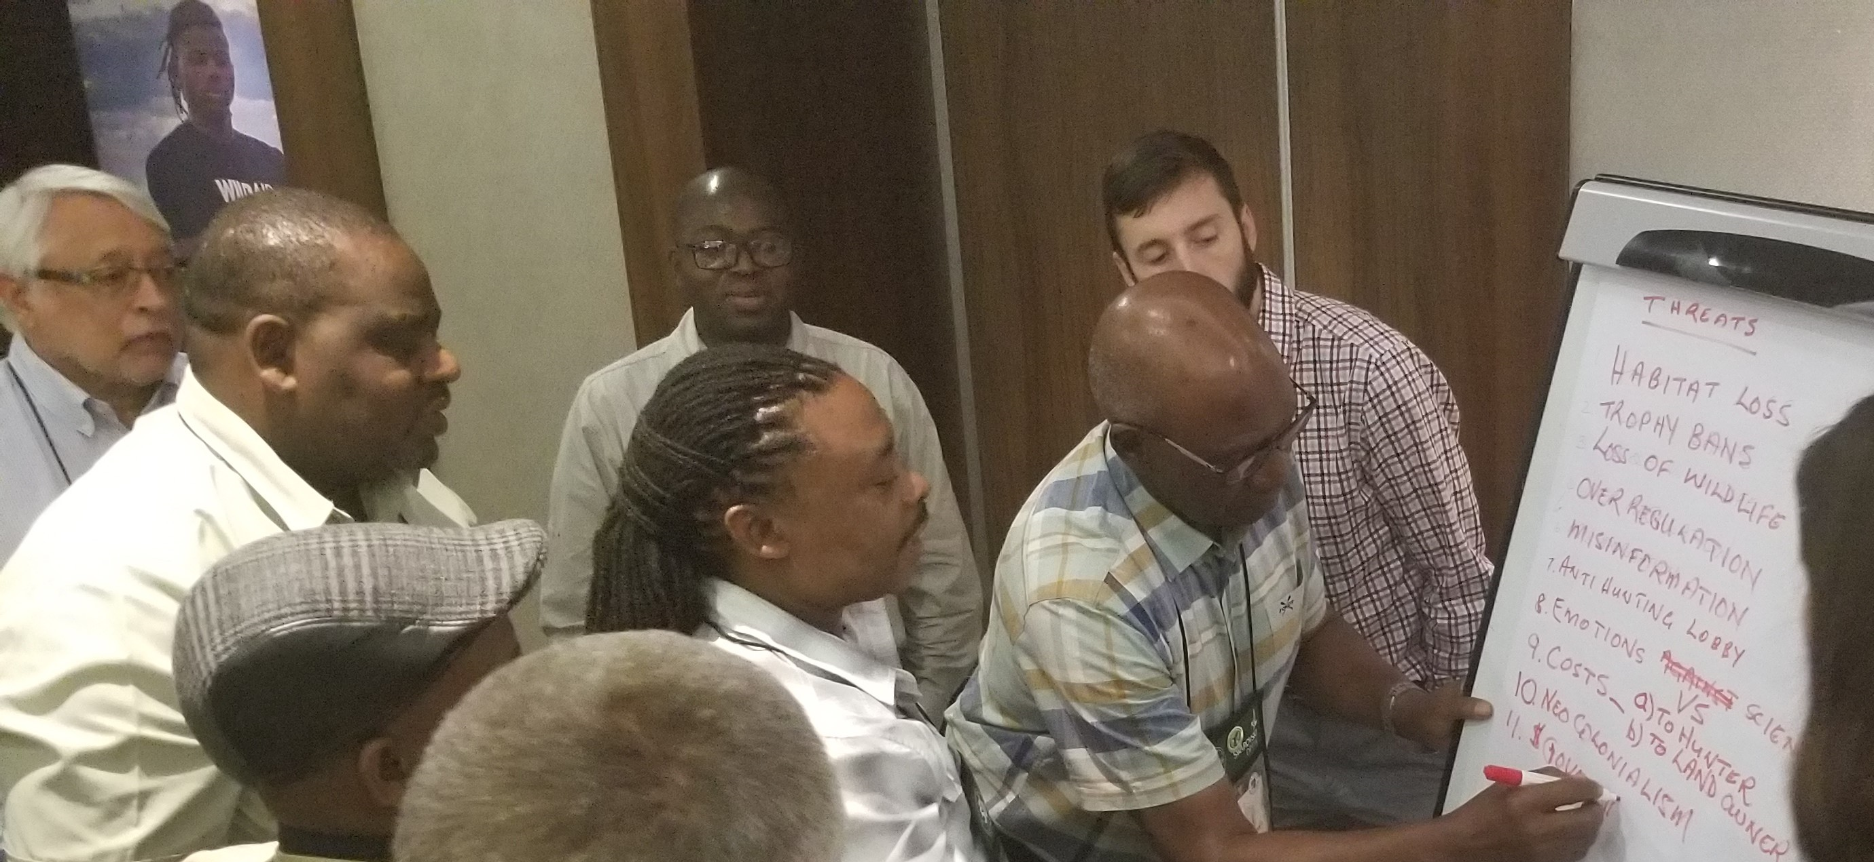
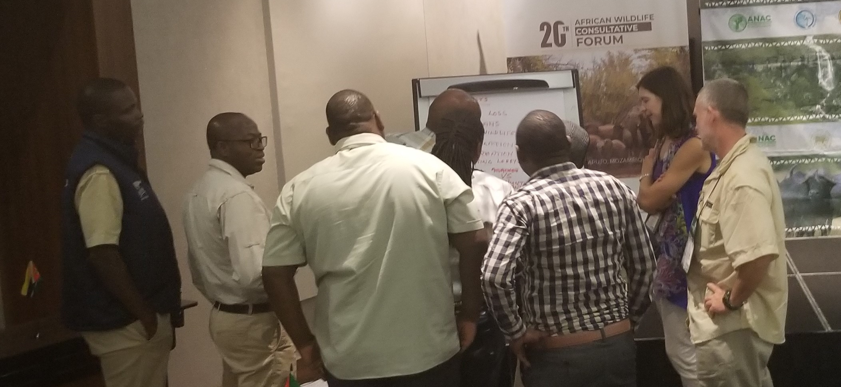
What we learned last year at this time--
At the 2022 AWCF in Mozambique we engaged in rigorous discussions in the form of break out groups to “take the pulse” of the state of the Hunting Industry within the African Wildlife Economy.
The team from Cornell University conducted a S.W.A.T exercise and broke up into four groups to address Strengths, Weaknesses, Opportunities, and Threats as perceived by the group assembled.

Slide 9
AWCF 2022 Hunting Industry S.W.A.T. Exercise Results
Strengths Connection to wild lands and habitat conservation Climate solutions Benefits to communities Economic Nutritional Regulatory framework Species conservation Role in wildlife management Diverse value chain Taxidermy, hotel, transport, supplies, etc. Also other products (skin, meat, etc.) High value, low environmental impact Utilize remote landscapes not used for other things Economic multiplier effect | Weaknesses Word “trophy” should be deleted/replaced Poor communication on benefits of hunting There is too much emphasis on species and not the ecosystem as a whole in habitat degradation Lack of information on the management regimes
Opportunities New markets Problem animal control Employment Developing rural economy Training and more experts on trophy hunting Communication/public education/political education Trading legislation and regulations Rebranding trophy hunting | Threats Habitat loss Trophy bans External Internal Overregulation Misinformation (communication + apathy) Anti-hunting lobby (communication + apathy) Emotions vs science | Costs To hunter To landowner Neocolonialism Governance Corruption Insecurity Lack of ethics Hunters and standards

Slide 10
AWCF 2022 Hunting Industry S.W.A.T. Exercise Results
Strengths Connection to wild lands and habitat conservation Climate solutions Benefits to communities Economic Nutritional Regulatory framework Species conservation Role in wildlife management Diverse value chain Taxidermy, hotel, transport, supplies, etc. Also other products (skin, meat, etc.) High value, low environmental impact Utilize remote landscapes not used for other things Economic multiplier effect | Weaknesses Word “trophy” should be deleted/replaced Poor communication on benefits of hunting There is too much emphasis on species and not the ecosystem as a whole in habitat degradation Lack of information on the management regimes
Opportunities New markets Problem animal control Employment Developing rural economy Training and more experts on trophy hunting Communication/public education/political education Trading legislation and regulations Rebranding trophy hunting | Threats Habitat loss Trophy bans External Internal Overregulation Misinformation (communication + apathy) Anti-hunting lobby (communication + apathy) Emotions vs science | Costs To hunter To landowner Neocolonialism Governance Corruption Insecurity Lack of ethics Hunters and standards

Slide 11
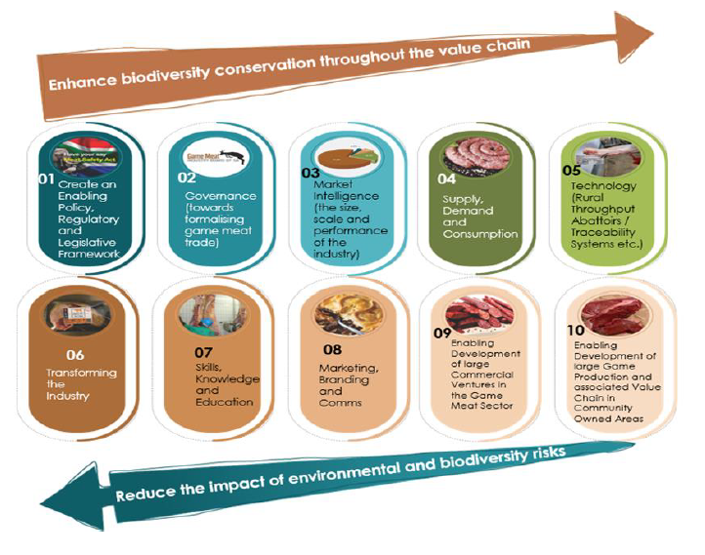
There appears to be forward motion in this space here in Africa… examples

Slide 12
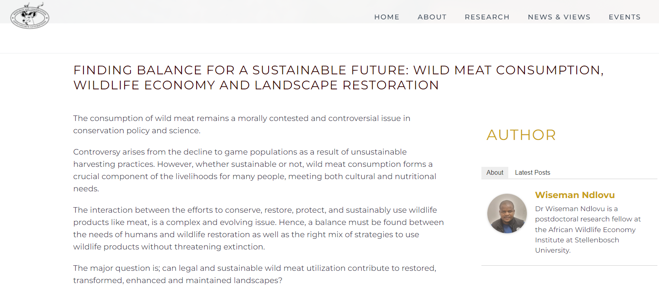

Slide 13
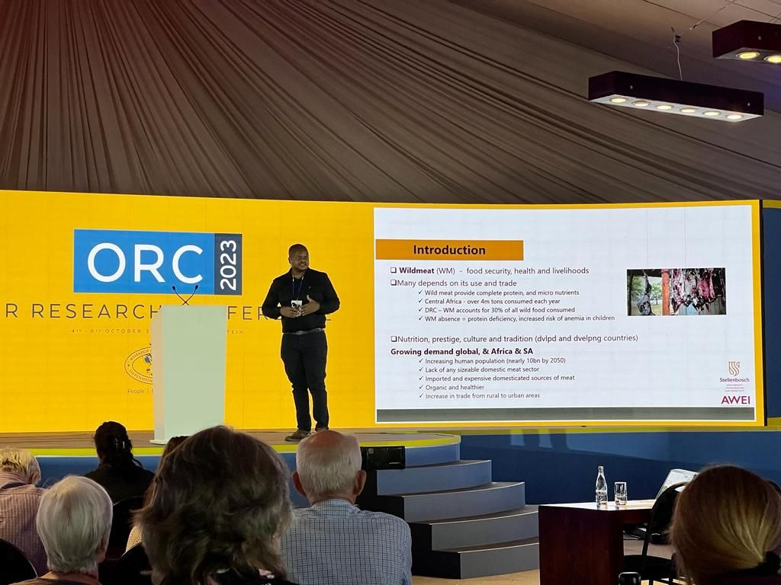
Dr Peter Oberem- 8th All Africa Conference on Animal Agriculture (AACAA8) September 2023
Dr Wiseman Ndlovu-
Eating wild meat for the restoration of African landscapes and sustainable livelihoods - 12th Oppenheimer Research Conference
04 Oct 2023 - 06 Oct 2023

Slide 14
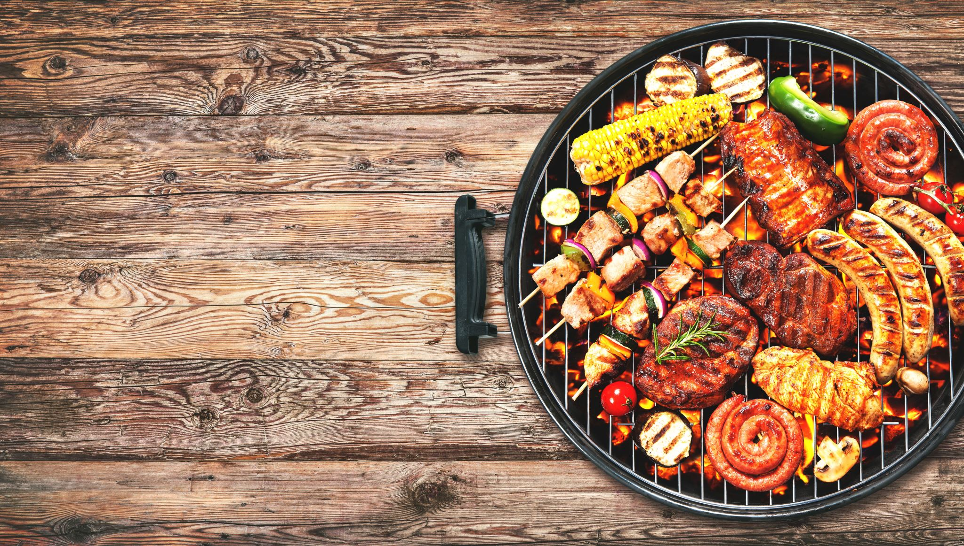
Key Points
A value chain-based sustainability approach may therefore answer the question on sustainable wild meat specie utilisation. Thus, studying and profiling activities that add or subtract sustainability in the entire value chain of each wild meat species will potentially offer opportunities for entrenching and retaining sustainability.
A value chain assessment addresses a range of questions:
Who are the consumers, producers, harvesters, processors, wholesalers and traders?
What is being supplied or demanded?
What are the barriers/opportunities in wild meat value chains?

Slide 15
Implications for North American consumers?
Hunting for food is (still) favorable in the USA
Conversely "Trophy" narratives and orientations are not favorable.
Women continue to be the fastest growing demographic in hunters in the USA - similar trends in other countries. They frequently mention food at the top of their motivations for hunting.
General tourism trends are moving away from "opulent luxury" and towards "authentic" (we can have both) and "educational" (the lesson of the Backcountry Hunters and Anglers phenomenon)
**Food motivations for the hunters coming to Africa need a closer look.**

Slide 16
Three Spheres of Food Motivations in Hunting
Food Ethics
Culinary Quality & Adventurous Eating
Nutrition & Health

Slide 17
Three Spheres of Food Motivations in Hunting
Food Ethics
Consumers want to "know where their food comes from" and to be assured that their protein "had a high quality of life" before becoming food.
Consumers express interest in having evidence of (seeing) their food sources existing in perceived "natural" environments.
Food security for indigenous people - this needs to evolve beyond ad hoc philanthropy.
Contribution of meat to local economies needs to be measured and tracked.
Growing call for more thought around legal and regulated hunting for indigenous people, in the food Ethics/food security context.

Slide 18
Three Spheres of Food Motivations in Hunting
Requires empirical data and analysis. There are two main components here.
1. Nutritional content of game meat component.
This needs funding, laboratories, etc.
Need to have scientific studies completed for every species hunted and consumed.
This nutritional data should be publicly available.
Excellent opportunity for government agency/University collaboration.
2. Health and wellness component.
Includes actual physical exercise as well as psychological and holistic health benefits of outdoor recreation.
There are particular benefits accrued to those engaged in hunting and fishing, as is currently being studied and demonstrated in context of therapeutic hunting and angling among those who have experienced trauma (combat veterans, first responders, war & disaster survivors).
Nutrition & Health

Slide 19
Three Spheres of Food Motivations in Hunting
Culinary Quality & Adventurous Eating
We need look no further than the successful "Carnivore" restaurants South Africa, Kenya, and Cairo to see that there is strong demand for a high-quality game meat prepared by trained chefs.
In the US, a growing number of outdoor recreation media “shows” focus on the food component of hunting.
Though many, if not most, Safari operators do offer game on the menu, my personal observations are that this component could be enhanced across the industry - there are opportunities to market to foodies, especially women hunters, which will improve over-all acceptance of Safari hunting.

Slide 20
Example of Efforts to Leverage Food Motivations in US for Hunter Recruitment & Retention
Tidball lab at Cornell
Focused effort to address the “there is no nutrition data on game” arguments – a few papers and a model for going forward.
Explicit interrogation of food motivations in hunting
Assessment of hunting-focused outdoor rec therapy programs

Slide 21
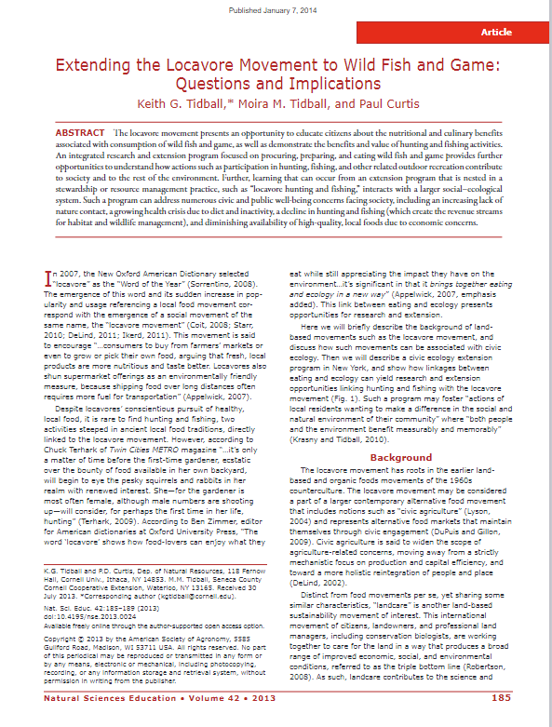
“Take-aways” from this paper
Food motivations in hunting present opportunities to educate citizens about the nutritional and culinary benefits associated with consumption of wild fish and game, as well as demonstrate the benefits and value of hunting and fishing activities.
An integrated research and extension program focused on procuring, preparing, and eating wild fish and game provides further opportunities to understand how actions such as participation in hunting, fishing, and other related outdoor recreation contribute to society and to the rest of the environment.
https://acsess.onlinelibrary.wiley.com/doi/10.4195/nse.2013.0024
2013

Slide 22
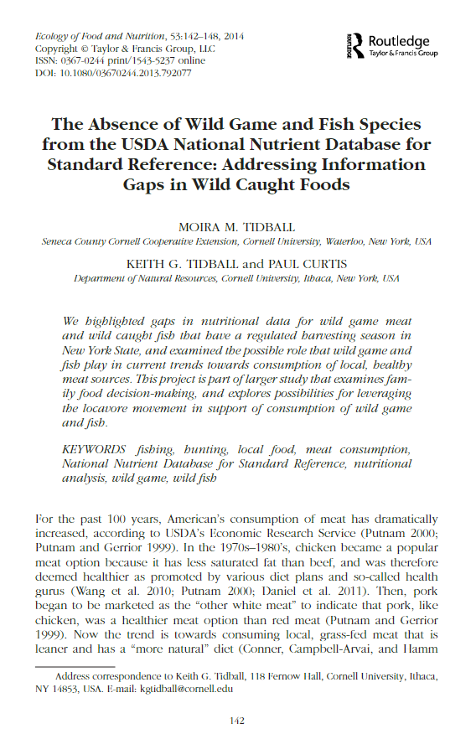
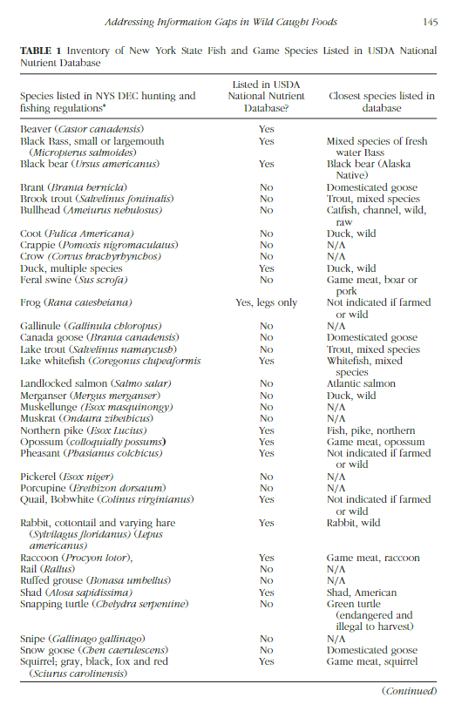
2014

Slide 23
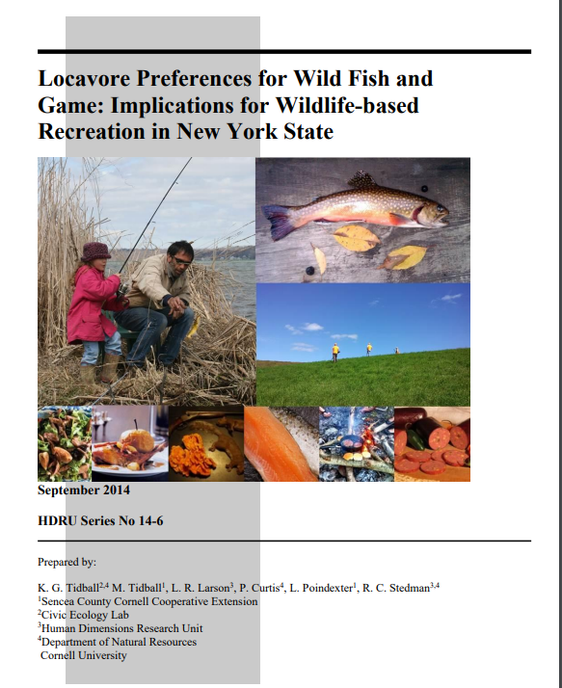
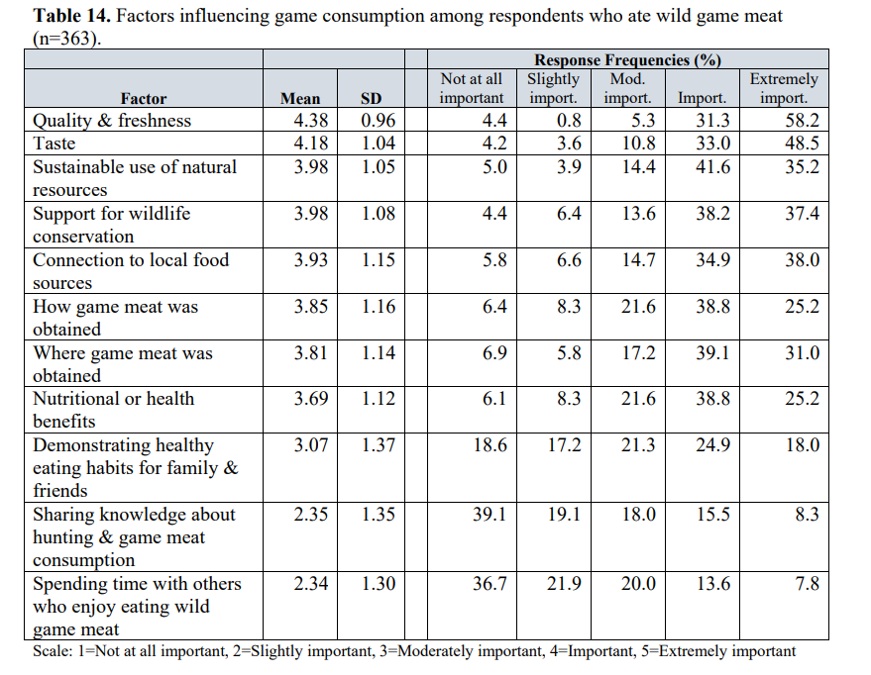
2014

Slide 24
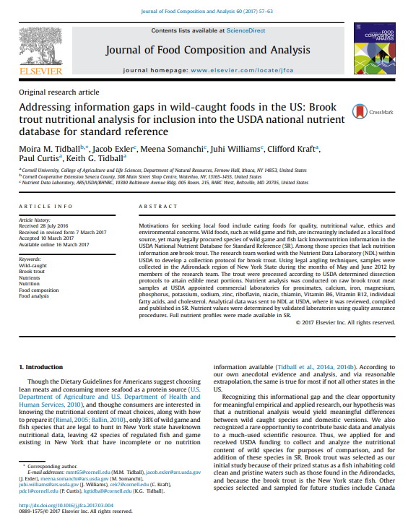
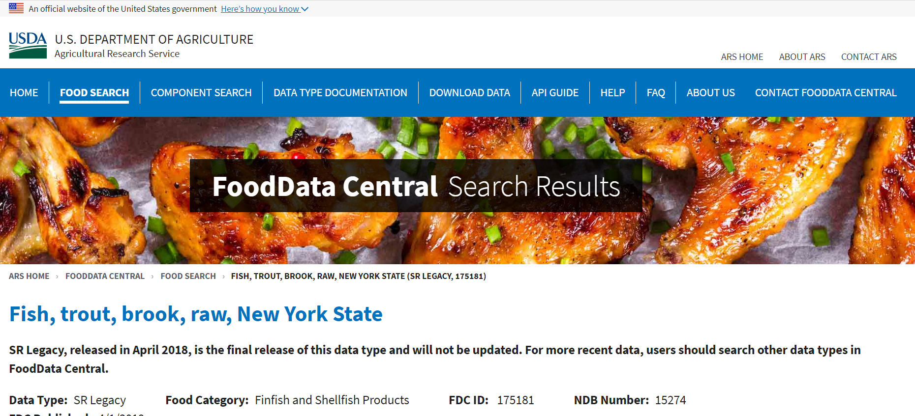
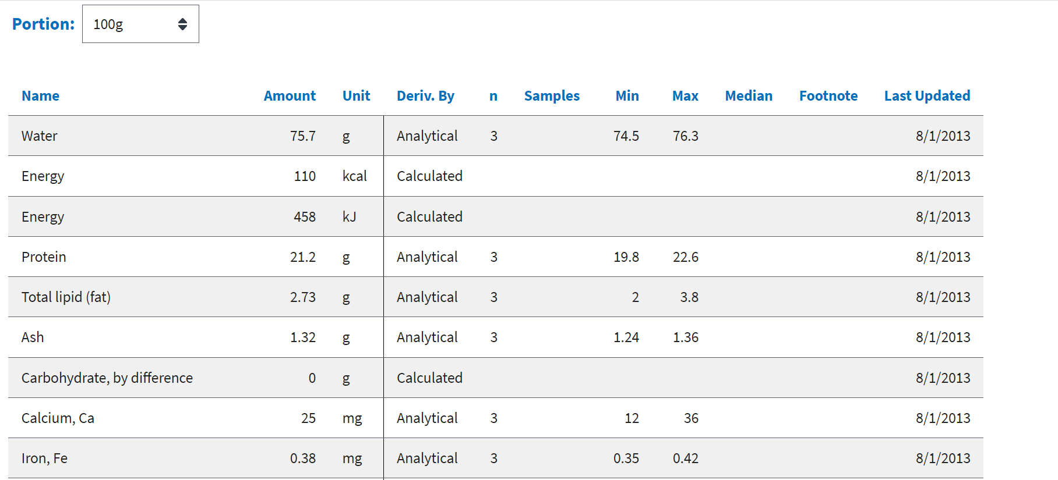
2017

Slide 25
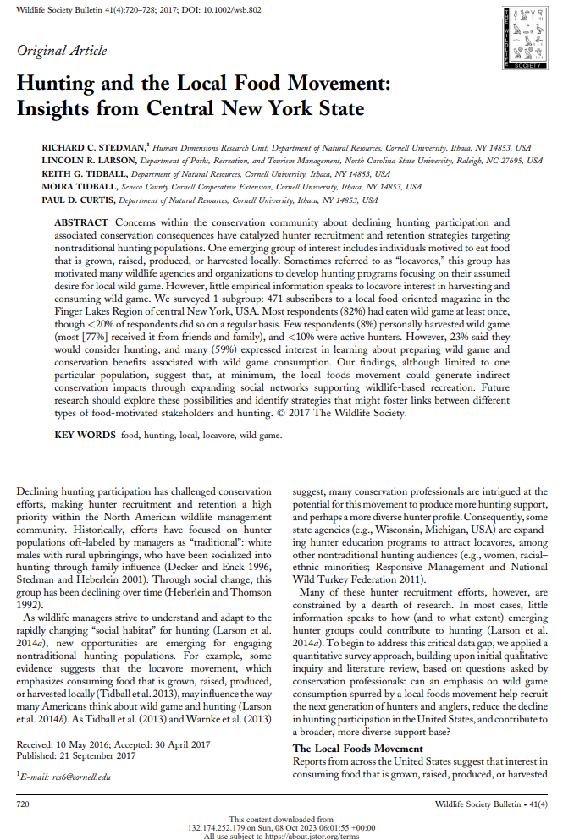
“The inclusion of those who are unlikely to ever hunt, but who are included as part of a broader culture of conservation, is an underappreciated element … the female, affluent, well-educated, urban– suburban element… represents a diversifying influence, compared with characteristics of hunters as a whole.
If conservation professionals are able to leverage this group’s interest in consuming wild game, this may both strengthen and diversify support for hunting and conservation.”
2017

Slide 26
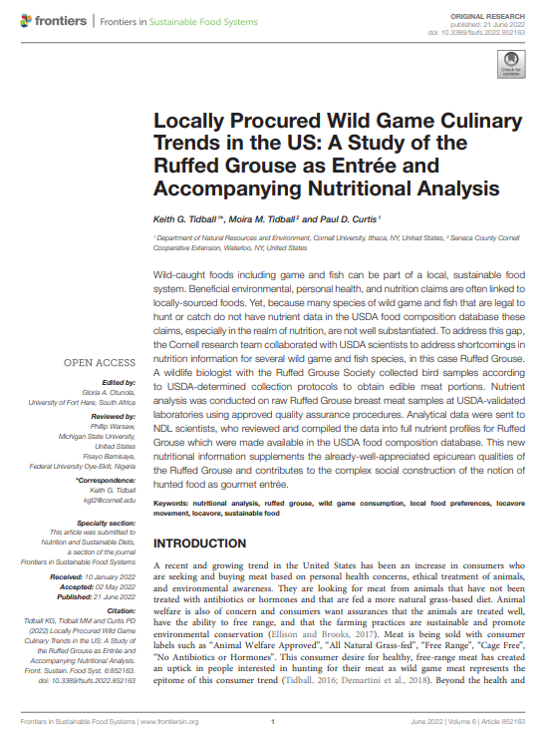
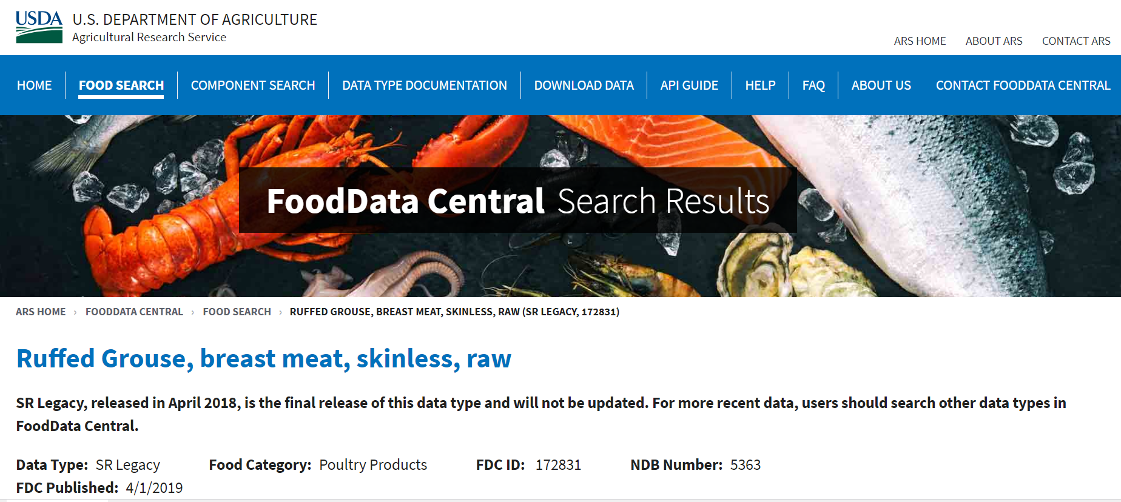
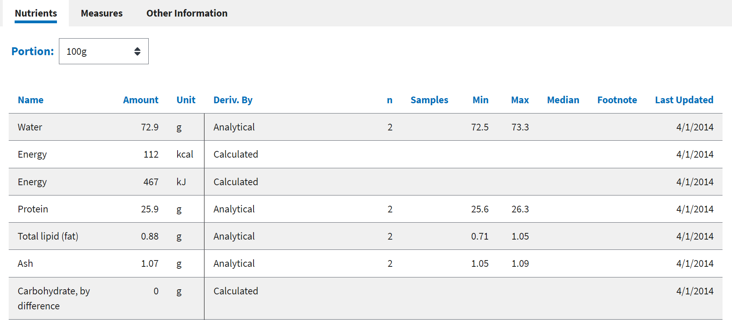
2022

Slide 27
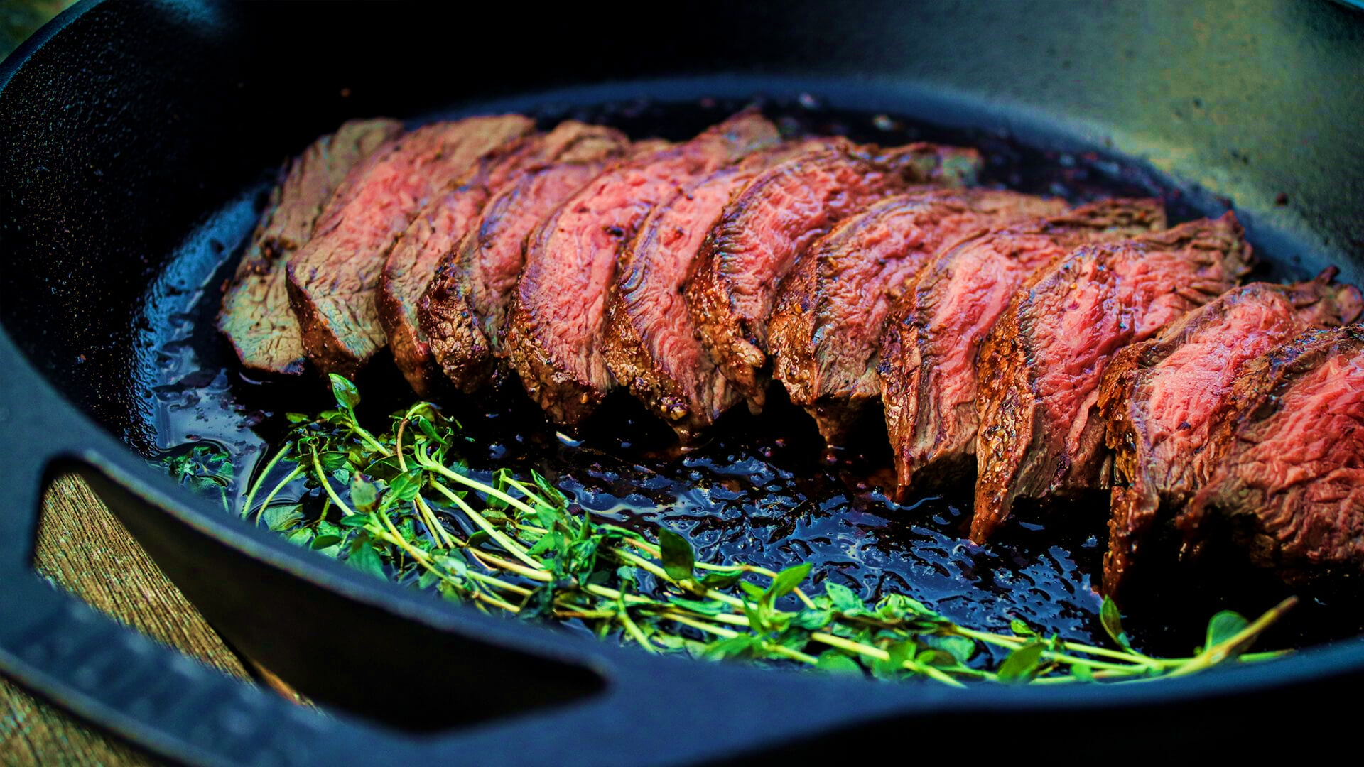
Calls to Action
Continue to invest in all of the Three Spheres of Food Motivations in Hunting – but include the experience of the hunting tourist more explicitly
Food Ethics
Seek or create opportunities to better communicate all the food ethics implications for future safari hunting participants
Explore models for how indigenous participation in hunting for food is a part of the hunting safari experience
Nutrition & Health Sphere
Prioritize research partnerships between govt agencies and research universities to gather and analyze nutritional data for ALL species (don’t neglect big 5! )
Invest in social science to document health and wellness outcomes of participation in ecosystems and the African Wildlife Economy
Culinary Quality & Adventurous Eating
Encourage and support hunting operations to experiment with enhancing “foodie” experiences
Willingness to adapt models to include desires of some consumers to be involved with field dressing/processing

Slide 28
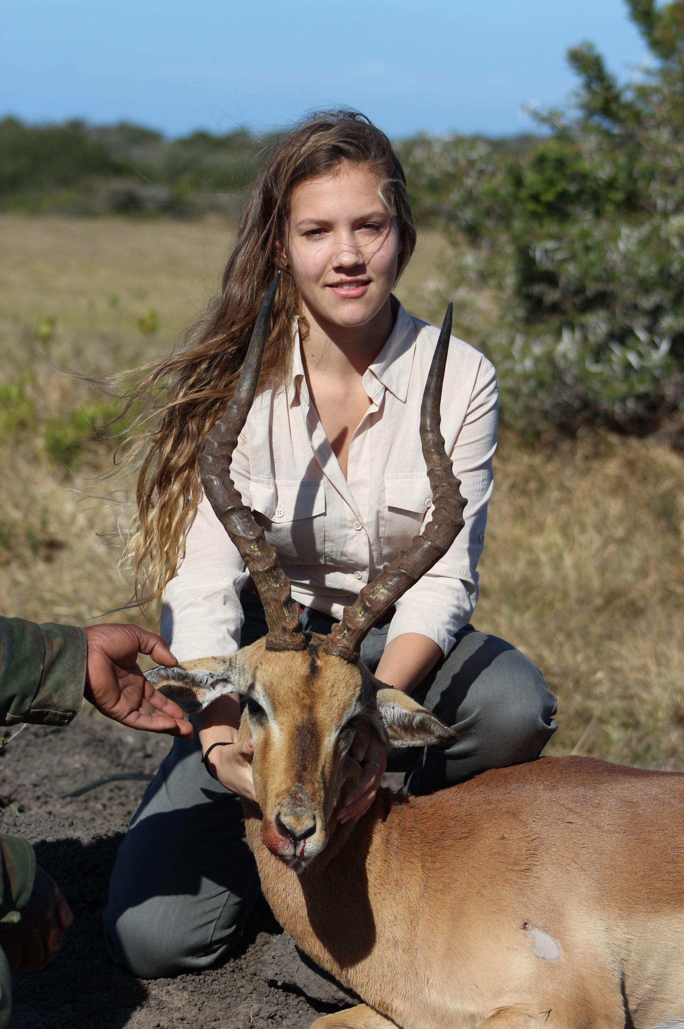
Is the African Safari Hunting Industry Ready for this?
But is the industry ready for food-motivated hunters? Or women hunters more broadly? Beyond observer rates and accompanying spouses? There are some (but few?) examples - - entrepreneurial opportunities here
If the number of women hunters doubled next year, would they have a great experience, or would they feel that operators aren't set up for solo women hunters and groups of women?
Improving upon the Safari Industry's capabilities to leverage food motivations will require analysis around the industry's ability to welcome new audiences/participants – especially women.

Slide 29
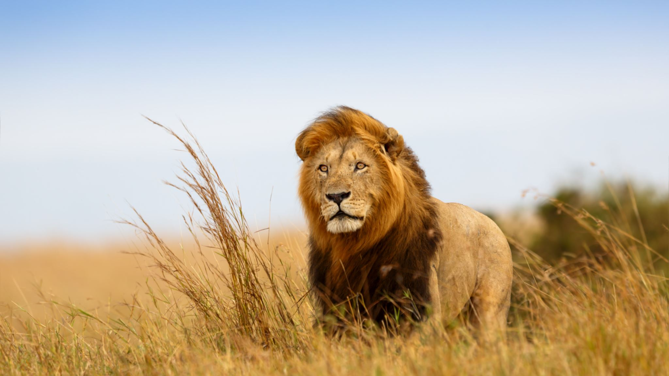
Thank you!

