Slide 1
Part 3.
What’s in our Future?
Worm Control Strategies in Development

Slide 2
Fecal Fungus – Duddingtonia flagrans
There are >100 species of Nematophagus (nematode eating) fungi. Many are found in livestock feces where they trap and eat gastrointestinal worm larvae as they hatch and molt.
The most heavily researched is D. flagrans. Originally much of the research on it was done by Hansen Biosystems. When they ceased work on it, International Animal Health, an Australian company, continued lab and field testing of the fungus, identifying the strain IAH 1297 as having the most suitable properties for commercial production.
Applications for approval as a new active ingredient and for commercial marketing have been submitted in Australia, New Zealand and the United States.
The EPA public comment period has passed in the U.S. and the FDA has approved the product. It is currently “in the hands” of the Regulators in all three countries with anticipation of commercial release sometime in 2018.

Slide 3
Feeding protocol for D. Flagrans
D. Flagrans does not kill either mature worms or larvae inside the goat or sheep. Instead, it kills larvae in the feces, reducing pasture contamination and breaking the cycle of infection.
International Animal Health is seeking to market two products:1) BioWorma (500,000 chlamydospores/gram ) designed to be top dressed or incorporated into a feed supplement , and 2) Livamol with BioWorma (an Australian supplement with BioWorma already added).
After ingestion by livestock in their feed, the D. flagrans spores readily survive passage through the digestive tract to be excreted in the animal’s manure along with any worm eggs the animal is passing simultaneously. Once excreted, the spores germinate and trap and consume the newly hatched worm larvae. Livestock must eat the fungal spores (chlamydospores) daily to have sufficiently constant supply in the feces to impact the worm population in the pastures.
International Animal Health recommends that farmers start feeding the spores to their livestock at the beginning of the grazing season or earlier before barber pole worm or other strongyles become a major problem, and continue feeding it through the worst of the worm season.
duddingtonia.com/ is a website set up to inform interested farmers about the product and alert them when anf if it is released into the general market.
https://archive.apvma.gov.au/application_summaries/106347.pdf 40 pages of d.flagrans lists several pages of past testing on d. flagrans.

Slide 4
New Class of Dewormer
Zolvix (monepantel) by Novartix in Australia & NZ
Kills almost all worms resistant to current dewormers. Monepantel acts on a particular nicotinic acetylcholine receptor subunit (Hco-MPTL-1) present only in nematodes and absent in mammals and other organisms. Monepantel blocks these receptors causing the worm to become paralyzed and either die or be expelled.
Expensive, and Worms in some flocks/herds in Australia, NZ and Europe showed drug resistance within the first 2 years of use.
In June 2013 was “close to FDA approval”. However, Novartix was acquired by Elanco in 2014 and the approval process had to “restart”. It is thought that Elanco then decided not to pursue it. Elanco did submit a request to the EPA in 2015 for establishing an import tolerance for monepantel for lamb imported from Australia and NZ and the request was granted.

Slide 5
Zolvix® is currently registered in the following countries:
European Union
Iceland (ISL)
Liechtenstein
Norway
Switzerland
South Africa
https://www.fda.gov/downloads/AnimalVeterinary/Products/ImportExports/UCM482354.pdf
http://www.airr.com.au/news/elanco-zolvix-plus-new-to-market.html
Australia
New Zealand
Argentina
Chile
Uruguay

Slide 6
Vaccines
Breakthrough → grow adult worms in lambs, harvest at slaughter, method developed to centrifuge worms and harvest the specific immunity-inducing antigen. Further breakthrough → now only need to slaughter 1 sheep to get enough antigen to vaccinate 100 sheep. Still dependent on having slaughterhouses that process lots of lambs or goats.
Vaccine called BarberVaX started being marketed in Australia in October 2014. Attempted to extend registration to goats but vaccine effectiveness was too variable among the 3 study farms and request denied in 2017.
The vaccine requires 5 boosters, first 3 are given 3 to 4 weeks apart, next 2 are given 6 weeks apart. Protection only lasts ~6 weeks and does not start until 3rd dosage. Cost effective? Not much savings over deworming.
General thought is that it is unlikely to be marketed in U.S.

Slide 7
University of Rhode Island Research
Effect of Vitamin E supplementation on parasite resistance
  Elevated levels of vitamin E supplementation had beneficial effect on the abomasal worm burden.
VE 10 lambs tended to have
  Lower mean FEC
  Higher eosinophil and globule leukocyte counts
Compared adding 5 iu of Vitamin E/kg live weight to adding 10 iu of Vit E/kg (most recent NRC recommendation) live weight in creep feed.

Slide 8
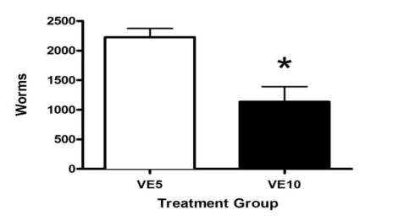
URI Vitamin E study results
Compared adding 5 iu of Vit E / kg live weight versus adding 10 iu of Vit E/ kg live weight in creep feed for lambs
*p = 0.002 vs VE5

Slide 9
For the last 4 years, Cornell has collaborated on studies testing:
the effectiveness of dosing sheep and goats with copper oxide wire particles (COWP) to control Haemonchus contortus (barber pole worm),
whether establishing and grazing birdsfoot trefoil pastures has potential to control barber pole worm and other strongyles, and
whether ivermectin should be included in the arsenal of treatments of animals infected with deer-worm.
Funding thru NESARE, USDA OREI, Federal Formula Funds and NNY Ag Dev. Program.

Slide 10
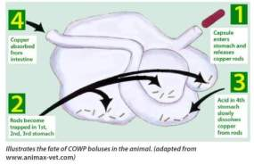
Copper Oxide Wire Particles
Copper oxide wire particles (COWP) were developed as a slow release source of copper for cattle on copper deficient soils.
Sheep are ten times more susceptible to copper toxicity than cattle.
12.5 and 25 gram boluses for calves and cows need to be repackaged into far smaller doses suitable for growing goats and sheep!
COWP particles must be retained in the abomasum long enough to permit acid solubilization of the copper. The stomach acids are responsible for this. If the pH of the stomach is not acidic enough, the copper will not go into solution and will be ineffective .
Acid solubilization results in gradual
release of copper from the COWP
which reduces risk of copper toxicity.
omasum
rumen
reticulum
abomasum

Slide 11
Copper Oxide Wire Particles
Works only on worms in stomach, not worms in intestines. Damages barber pole worm but not brown stomach worm.
If there are too many brown stomach worms, the copper will not be available, why?
SE researchers said - worked poorly in animals that were stressed or run down. Did not appear effective in just weaned kids or lambs – instead give 2 weeks before or after weaning
When it worked → Quite effective, killing 75-95% of Barber pole worms

Slide 12
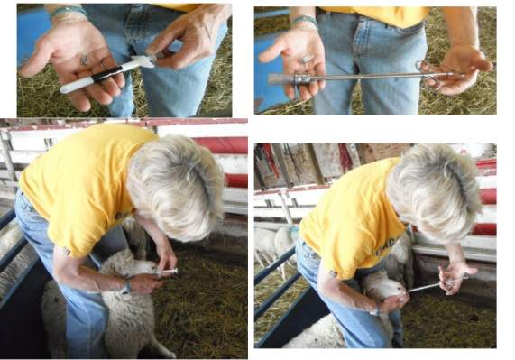
Using a cat pill gun
Using a metal bolus or balling gun with plastic head
Large boluses are easier to see if spit out

Slide 13
NEW YORK
1 Goat Dairy
Treatments consisted of
  1 gram COWP/head,
  2 gram COWP/head, or
  1 gram COWP/22 lb. live weight
15 to 16 lactating does per treatment
Looked at fecal egg counts, FAMACHA scores, curd formation in 4 cheeses, Cu in milk, AST in blood)

Slide 14
Effect of copper oxide wire particles (COWP) on the change in fecal egg counts after 14 days. Did not appear to have a long term effect.
COWP | Strongyles | Haemonchus
1 g/22 lb. BW | -1185 | -1153
2 g/doe | -1226 | -1191
1 g/doe | 107 | 75
SE | 484.6 | 477.9
P-value for 1 g/doe vs average of 1 g/22 lb. and 2 g/doe | 0.034 | 0.036
P-value for 1 g/22 lb. vs 2 g/doe | 0.914 | 0.993

Slide 15
Looked for signs of copper problems
Sampled milk on Day 0 (immediately before) COWP dosing, Day 14 and Day 42 to analyze for Cu content using plasma-atomic emission spectroscopy
Cheese maker reported no changes in time to set curd and consistency of curd for 4 different cheeses made first week immediately following COWP treatments
Blood samples taken on Day 42 and the plasma then analyzed for aspartate aminotransferase (AST) enzyme activity – an indicator of poor liver function and possible copper toxicity

Slide 16
Changes in Cu Level in Milk after COWP Treatment
Treatment | Day 0 – Immediately before treatment | Day 14 | Increase
1 gram/22 lb livewt. | 0.105 ppm (0.042 – 0.33) | 0.171 ppm (0.083 – 0.322) | 0.066 ppm
2 gram/head | 0.135 ppm (0.056 – 0.398) | 0.161 ppm (0.103 – 0.282) | 0.026 ppm
1 gram/head | 0.153 ppm (0.043 - 0.551) | 0.191 ppm (0.121 – 0.358) | 0.039 ppm

Slide 17
AST Enzyme Levels in Plasma after COWP Treatment
Treatment | DAY 42
1 gram/22 lb livewt. | 117.9 (89 – 221)
2 gram/head | 120.6 (76 – 203)
1 gram/head | 112.9 (86 – 138)
Copper toxicity elicits AST enzyme activity values > 300 - 400 units.
Only two goats had values > 200 units.

Slide 18
Conclusions
Not as effective as a dewormer (assuming there is no resistance to the dewormer). No long term significant effect noted.
No discarding of milk necessary
Curd formation normal
Cu in milk well below allowable levels, AST levels in blood did not indicate any Cu toxicity.
2 grams per head appeared to work as well as 1 gram per 22 lb. live weight in adult, lactating dairy does and did not significantly increase the copper levels in milk

Slide 19
Effect of COWP level administered on Day 0 (2 weeks prior to weaning) on barber pole worm egg counts in lambs over a 42 day period at the St. Lawrence County Extension Leaning Farm (ELF).
Table 4. ELF 2013.
 |  |  |  | Strongyles |  | Haemonchus
Effect | Level | Weight | FAMACHA | Log10 | Geometric mean | Log10 | Geometric mean
COWP
 | 0.0 | 64.1 | 2.2 | 3.11 | 1283 | 3.07 | 1180
 | 0.5 | 60.6 | 2.3 | 2.10 | 124 | 1.97 | 92
 | 1.0 | 63.5 | 2.0 | 2.16 | 142 | 1.98 | 94
 | SEM | 3.72 | 0.15 | 0.240 |  | 0.262
 | P-value | 0.771 | 0.352 | 0.012 |  | 0.011
Day
 | 0 | 59.0 | 1.7 | 2.15 | 141 | 2.10 | 125
 | 14 | 64.0 | 1.9 | 1.87 | 74 | 1.74 | 55
 | 28 |  | 2.3 | 2.85 | 712 | 2.71 | 516
 | 42 | 65.2 | 2.8 | 2.93 | 858 | 2.80 | 628
 | SEM | 2.19 | 0.13 | 0.223 |  | 0.228
 | P-value | <0.001 | <0.001 | 0.001 |  | 0.001
COWP x Day | P-value | 0.369 | 0.079 | 0.114 |  | 0.051

Slide 20
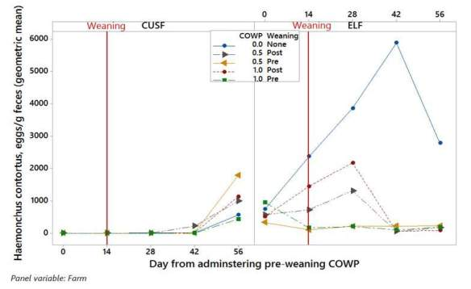
Effect of COWP level on barber pole worm egg counts in lambs over a 56 day period at the Cornell Univ. Sheep Farm (CUSF) and at the St. Lawrence County Extension Learning Farm (ELF) when given 2 weeks pre-weaning, 2 wks. post weaning or not at all. Note while it was very effective at ELF there was essentially no effect at CUSF possibly because worm infection did not start until after either the pre-weaning or post weaning dosing. Also CUSF lambs received free choice total mixed ration as well as pasture.

Slide 21
Conclusions
  In most herds, COWP did not work as effectively or abruptly as chemical dewormers.
  .5 gram per head dosages appears to be as effective as 1 gram per head for lambs. More uncertain on goat kids. The Cornell Veterinary Diagnostic lab has observed some toxicity in some lambs at 2 g dosages.
  Although it had a very effective, long term impact at one farm for 3 years of testing, it only had a short term effect on most farms and was ineffective on some. Why do results vary across different farms?
  Possible explanations: diet, timing of dosing in relationship to timing of infection, exposure of earlier generations of worms to other sources of copper, acidity of true stomach? Seemed to work best when animals already had some worm load when dosed, pre-weaning, and when animals were not consuming large quantities of grain.
  Need controlled studies comparing different types of flock management to identify why we see so much variation in its effectiveness among farms.

Slide 22
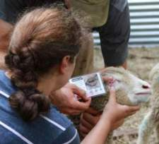
Copper Oxide Wire Particles continued
We advise that farmers wanting to use COWP follow the recommendation of COWP researchers in SE US:
Use it in combination with FAMACHA and 5 point checks – give COWP to your vulnerable “3s” (lambs, kids, lactating or late pregnant females) rather than giving a commercial dewormer,
Give animals with a FAMACHA
score of 4 or 5 an effective
dewormer instead,
Follow up with regular FAMACHA
scoring, fecal egg sampling,
to see if COWP actually works in
your herd or flock.

Slide 23
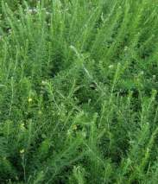
Condensed Tannins
Grazing the forage legume, Sericea lespedeza (SL), for 4 weeks or more as ≥25% of the diet reduces strongyle worm populations in sheep and goats. Attributed to its condensed tannins. Condensed tannins (CT) bind with the plant’s protein → increased level bypass protein.
Immune response to parasite infection requires protein in excess of what is needed for growth; rumen bypass protein could be limiting in grass-fed lambs and kids.
Not all condensed tannins work –
Oak, peanut skins, grape pulp have not
worked well in experiments thus far
Promising studies with cranberry leaves
(Univ. RI), pine bark (11 to 13% Crude
Protein. As 33% of the DM diet, it reduced
worms 30% more than the controls,
Tuskegee Univ.).
SL not winter hardy in Northeast. Potential for
Birdsfoot trefoil?

Slide 24
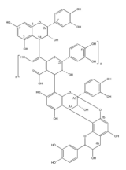
Condensed Tannins
Condensed-tannin (CT) forages
include birdsfoot trefoil (BFT) but not alfalfa or clovers
  Leaves and stems of BFT contain CT (proanthocyanidin)
  CTs increase nitrogen utilization in ruminants
  CTs have a complex structure
→ formation of rumen bypass protein→ less ammonium released into the environment, higher milk solids, anti-bloat.

Slide 25
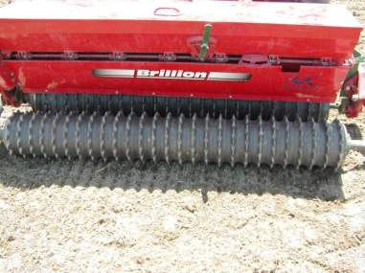
Establishing Birdsfoot Trefoil
Small seed – need smooth, firm bed for good seed-to-soil contact without planting too deep (seeding depth is only ¼ inch). Use Brillion seeder or plan to cultipack before and after seeding

Slide 26
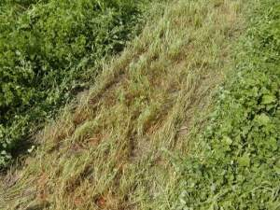
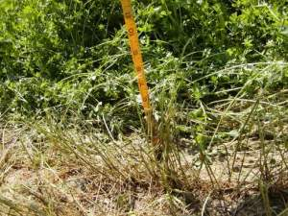
Unlike alfalfa and clovers, BFT regrows from stems not crown, thus you can set BFT back if mowing it lower than 5 inches. Also important to avoid grazing or mowing it within 4 weeks of the first killing frost and to let it set seed periodically to sustain the stand.

Slide 27
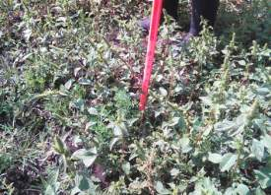
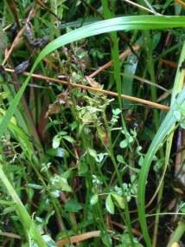
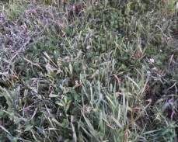
Need to control weeds and other forages

Slide 28
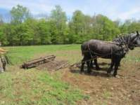
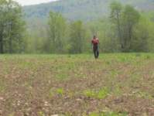
2 Acre Field Birdsfoot Trefoil
Marathon, NY
Cortland County
Soil Type: Volusia
Soil pH: 5.3
Buffer pH: 5.2
P: 2 lbs/acre
K: 147 lbs/acre
Ca: 1,372 lbs/acre
Mg: 148 lbs/acre
% OM: 6.8

Slide 29
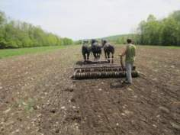
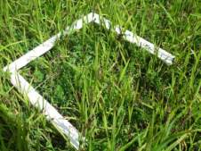
Soil Preparation and Planting
Plowed in 2012 with horses
Disked in 2014 with horse
teams
Cultipacked with horses
On May 20th,2014 BFT (17 lb. per acre) planted along with millet nurse crop (20 lb. per acre) using hand-held broadcast spinner.
Cultipacked again after seeding
Millet harvested for hay on Aug 11th . Any millet regrowth to be winter
killed so not an issue

Slide 30
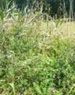
On average, the Birdsfoot trefoil group had better FAMACHA scores (lower is better) on wk. 4 & 6 – almost one whole point better. The difference between forage treatments was statistically significant (P = 0.039 for fixed effect of forage, P=0.053 for fixed effect of forage*day).

Slide 31
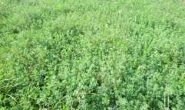
Fecal egg counts were similar between the two groups until week 6 when the average egg count for the BFT group increased (very few of the strongyle worms were barber pole worms, most were nodular worm) . The difference between forage treatments was not statistically significant.
Birdsfoot Trefoil Paddocks
7/15/2015 = 72% BFT
7/29/2015 = 78% BFT
8/12/2015 = 86% BFT

Slide 32
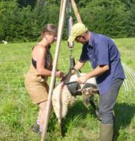
Birdsfoot trefoil group gained substantially more (P=0.000)
 | Birdsfoot Trefoil Lambs | Unimproved Pasture Lambs
7/15/2015 | 57.1 | 60.8
8/24/2015 | 70.3 | 65.5
Gain (lb) | 13.1 | 4.8
Days | 40 | 40
DailyGain (lb) | 0.33 | 0.12
 | 1/3 lb | < 1/8 lb

Slide 33
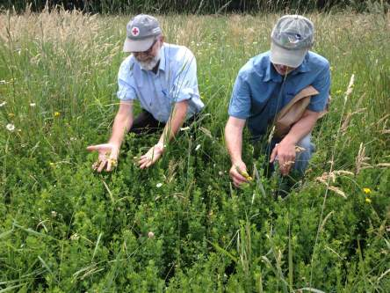
Status of BFT field on June 26th, 2017
Percentage of BFT in the field still >25%. Six samples averaged 46% BFT and 37% BFT in fresh and dry matter biomass, respectively. Much of the remainder of the forage was mature grasses.

Slide 34
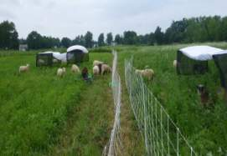
1.6 Acre Field Bruce BFT
Germantown, NY
Colombia County
Soil Type: Raynham
Soil pH: 6.0
Buffer pH: 6.0
P: 4 lbs/acre
K: 249 lbs/acre
Ca: 2,706 lbs/acre
Mg: 351 lbs/acre
% OM: 3.9
400 lb. bone char per acre (65 lb. P²0⁵) banded in at planting

Slide 35
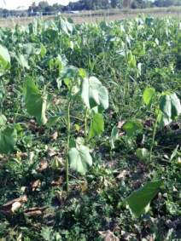
Soil Preparation and Planting
Pasture limed in 2013
Fall 2014 - Pasture mowed close and plowed next day. 1 in. rain on Aug 5th
6 days later on Aug 6th, 2014 disked and planted Bruce BFT at 12 lb. per acre
400 lb. bone char per acre (65 lb. P205) banded in at planting
Emerged Aug 16th then drought
Mowed to control Velvet Leaf on Oct 2nd after rain finally came
Frost seeded additional BFT March 2015
Mowed to control weeds June 2016 and conventional pasture hayed at same time.

Slide 36
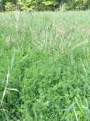
On average, the FAMACHA scores were the same for both groups until Wk 6 when the BFT group averaged better FAMACHA scores by one whole point
(BFT*Day P value =0.001)

Slide 37
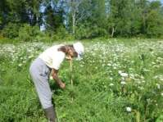
Fecal egg counts for both groups rose sharply after weaning but were similar until Wk 6 when the average egg count for the BFT group was substantially less. Spot checks indicated that most strongyles were barber pole worms. BFT * Day interaction not statistically significant but 4 of 10 CP lambs had to be dewormed at the study’s end based on FAMACHA score and poor health and only 1 of 9 BFT lambs was dewormed and that was based on diarrhea later attributed to Queen Anne’s Lace

Slide 38
LOG10 strongyle worm eggs per gram for individual lambs over time. One CP ram lamb, #688, was quite an outlier and appears to have developed his own immune response.

Slide 39
Weight Gain (lb.) by Treatment during
41 d. Grazing Trial
 | Birdsfoot Trefoil | Conventional Pasture
7/30/2015 | 45.8 | 44.4
9/9/2015 | 65.9 | 60.9
Gain (lb) | 20.1 | 16.5
Days | 41 | 41
Daily gain (lb) | 0.46 | 0.38

Slide 40
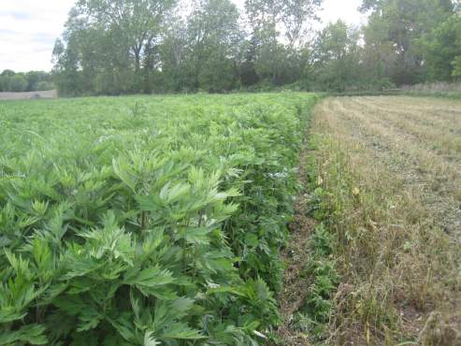
A year later, almost half the BFT field is pure mugwort

Slide 41
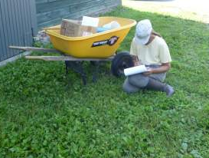
Remaining thoughts on the part of the farmer
How much BFT would be necessary to have a significant impact on animal health?
If pure stands and extended time periods necessary (6 weeks?), how would that fit into
an intensive rotational grazing system?

Slide 42
St. Lawrence County
Extension Learning Farm
3 Acre Field Birdsfoot Trefoil
Canton, NY
Soil Type: Muskellunge
Soil pH: 5.9
Buffer pH: 6.0
P: 2 lbs/acre
K: 75 lbs/acre
Ca: 1,932 lbs/acre
Mg: 300 lbs/acre
% OM: 2.9

Slide 43
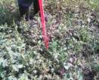
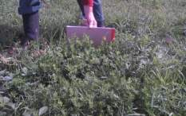
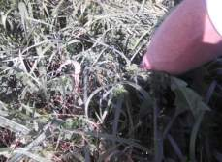
Soil Preparation and Planting
Plowed in 2013
Disked 2 or 3 times for weed suppression in 2014
Planted with no till seeder June 4th, 2014
Pardee BFT seeded at 7-8 lb per acre with Sunset II Timothy at 4 lb per acre. Emerged June 18th
Mowed for weeds Aug 6th, 2014
Fertilized Oct 15th, 2014
Manure spread October 21st, 2014
Frost seeded additional Birdsfoot Trefoil seed with broadcast seeder in early Spring 2015

Slide 44
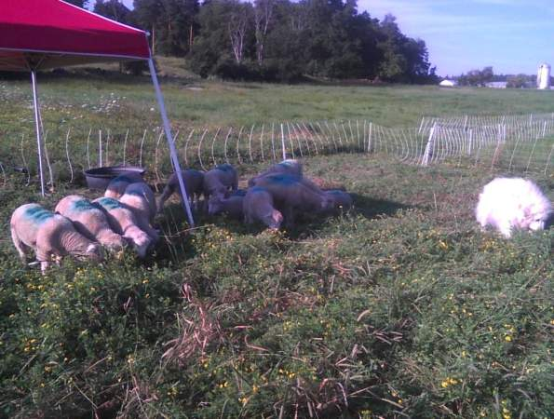
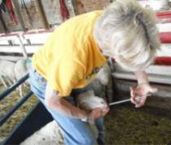
After weaning, 16 lambs grazed on birdsfoot trefoil paddocks
(43 to 58% BFT)
Half of these lambs received 1 gram of copper oxide wire particles (COWP) 2 weeks prior to weaning

Slide 45
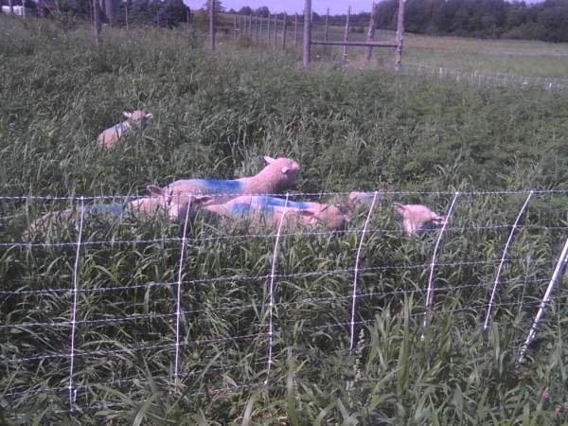
After weaning, 16 lambs grazed on conventional pastures
Half the lambs received 1 gram of COWP 2 weeks prior to weaning

Slide 46
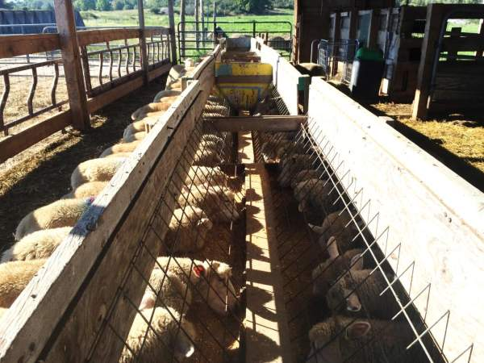
8 lambs were tracked in a Control group fed 2nd cut hay ( 12% CP) and grain (16% CP).
Each lamb received 1 gram COWP 2 weeks prior to weaning

Slide 47
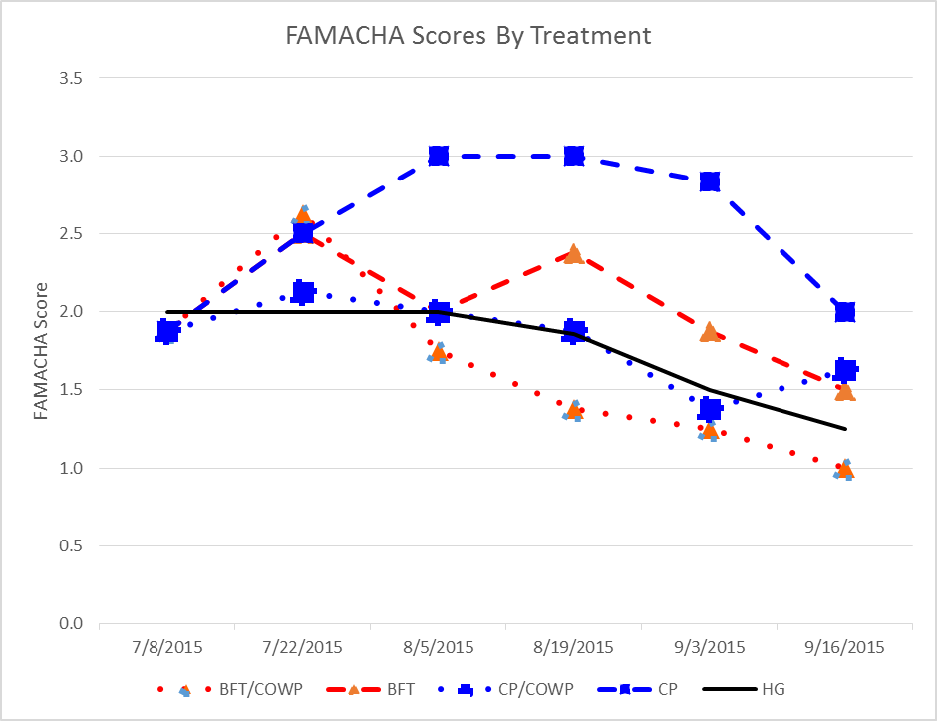
During the grazing trial, the lambs on conventional pasture w/o COWP averaged the highest FAMACHA scores (lower is good). Differences were statistically significant for Treatment (P=0.006) and Treatment*Day (P=0.004)
Figure1. FAMACHA Scores by Treatment
4 lambs had been
dewormed and no
longer included
COWP given
Lambs weaned
2 lambs had been
dewormed and no longer
included

Slide 48
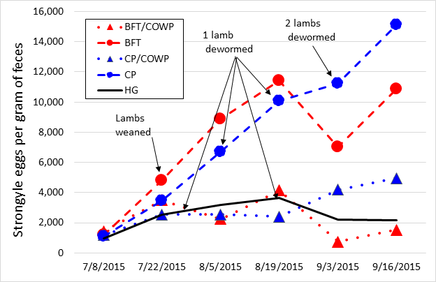
Treatments that got COWP appeared to have lower worm egg counts throughout the study. We were excited by the dip in worm egg counts for the two BFT groups at 6 wks. although it was temporary. When we looked at forage separate from COWP, COWP * Day interaction for egg count was significant (P =0.001) but Forage*Day interaction was not statistically significant . However, if we looked at the 5 treatments separately, Treatment*Day was significant (P =0.001).

Slide 49
The treatments on BFT appeared to gain weight similarly to the treatment on hay and grain while the treatments on conventional pastures appeared to grow slower

Slide 50
Table 1. Weight Gain by Treatment during 70 d. Grazing Trial. The post weaning ADG was significantly different by treatment (P=0.000)
 | Birdsfoot Trefoil + COWP | Birdsfoot Trefoil | Conventional Pasture + COWP | Conventional Pasture (4 lambs dewormed) | Hay & Grain + COWP (2 lambs dewormed)
Date | Weight (lbs.)
7/08/2015 | 46.4 | 49.0 | 45.5 | 43.9 | 46.9
Weaning 7/22/2015 | 49.0 | 53.3 | 50.9 | 53.3 | 52.5
9/16/2015 | 67.6 | 64.3 | 56.9 | 56.3 | 64.3
Gain (lbs.) | 21.3 | 15.3 | 11.4 | 12.4 | 17.4
Days | 70.0 | 70.0 | 70.0 | 70.0 | 70.0
Daily gain (lbs.) | 0.304 | 0.218 | 0.163 | 0.178 | 0.248

Slide 51
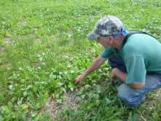
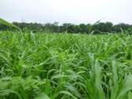
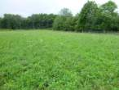
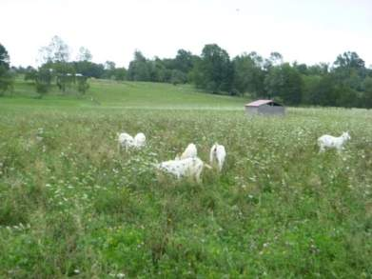
Acre Field Bruce BFT
Athens, NY
Greene County
Soil Type: Kingsbury
pH: 6.1, 5.8
Buffer pH: 5.7, 5.8 east, west
P: 2 lbs/acre
K: 161, 142 lbs/acre
Ca: 4334, 4021 lbs/acre
Mg: 873, 865 lbs/acre
% OM: 7.8, 7.7

Slide 52
Soil Preparation and Planting
2012 - Cover cropped with cereal rye.
2013 – planted peas, oats, vetch, crimson clover in spring, hayed summer, grazed fall, and disked.
2014 – planted soybeans in spring, turnips in summer, cereal rye cover crop in fall.
Fertilizer – composted manure 2012, composted wood chips and Sulfur 90% 2 days before planting in May 2015, foliar application of Neptune’s Harvest (Hydrolyzed Cold Processed Fish) and Sea 90 Minerals in May, July, Sept 2015 and soluble Boron 20% July 2015
Planted May 8, 2015 – 17.5 lb. Bruce BFT /acre and 50 lb oats/acre
Grazed oats July 12th – 20th and clipped ungrazed portion July 25th . Baled for hay Sept 16th .
Frost seeded 5 lb. Bruce BFT/acre March 4, 2016 (spinner spreader)

Slide 53
Kid Management
Grass fed herd of 43 does and 82 kids
Male kids selected for study were born from Mar 31st thru Apr 15th 2016, and
Ranged from 50 to 100% Kiko. Remainder of genetics included Boer and Dairy breeds such as LaMancha.
Got BoSe injections within 3 days of birth, Clostridium C&D and Tetanus boosters at 6 and 10 wks. old
Weaned July 3rd and fed hay in barn
Grazing trial started July 6th

Slide 54
Dry Matter Yield/Acre for Pastures and Percentage and Amount of Birdsfoot Trefoil in BFT Pasture
 | BFT Pasture |  |  | Other Pasture
Date | DM Yield (lbs./acre) | BFT Yield (lbs./acre) | %BFT | DM Yield (lbs./acre)
7/6/2016 | 4396 | 1794 | 40.8% | Permanent 1884.1
7/21/2016 | 3331 | 1088 | 32.7% | Permanent 2299.0
8/4/2016 | 3230 | 751 | 23.3% | Annual - Ray’s Crazy Mix Regrowth 3162.5
8/16/2016 | Mowed 7/26 1570 | 785 | 50.0% | Annual - Ray’s Crazy Mix Regrowth 1749.5

Slide 55
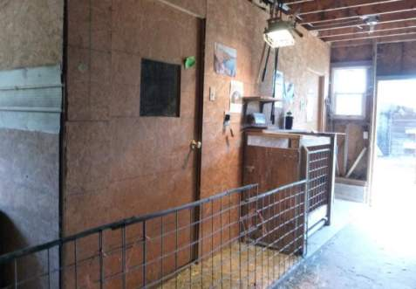
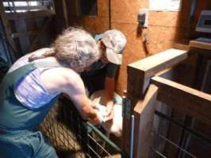
Holding pen was dark so a high intensity 500 watt quartz work light was used above chute for FAMACHA scoring

Slide 56
Differences in FAMACHA scores approached statistical significance for Forage (BFT versus non BFT; P=0.07) but not for COWP dosing, Day or Forage*Day
Dosed with COWP then put on
Ray’s Crazy Summer Mix regrowth
(cowpea, sorghum sudan, radish,
millet, sunflowers)

Slide 57
Differences for Strongyle Worm Egg Counts were statistically significant for Forage (BFT vs. non BFT; P=0.007), COWP dosing (P=0.005 ), Day (P=0.000 ) and Forage*Day (P=0.028)

Slide 58
Weight Gain (lb.) by Treatment during
57 d. Grazing Trial was statistically significant (P=0.022)
 | BFT | CAP | CAP + COWP
7/6/2016 | 53.4 | 50.2 | 49.3
7/21/2016 | 53.6 | 51.5 | 48.9
8/4/2016 | 55.5 | 51.1 | 48.6
8/16/2016 | 60.6 | 53.9 | 51.4
9/1/2016 | 65.2 | 54.0 | 55.1
Gain (lb) | 11.7 | 3.8 | 5.8
Days | 57 | 57 | 57
Daily gain (lb) | 0.21 | 0.07 | 0.10

Slide 59
Average dairy gains in lbs. (ADG) for grazing trials on weaned kids and lambs comparing Birdsfoot trefoil (BFT) to other forages (OF). In some cases treatments also included oral dosing with copper oxide wire particles (COWP).
Farm | ADG on BFT | ADG on BFT + COWP | ADG on OF | ADG on OF + COWP | ADG on Hay + Grain | P value | Type of OF | Concentrate supplemented
Clinton Cty, NY Goat kids | 0.34 | NA | 0.34 | NA | NA | 0.787 | Conventional pasture (CP) | ½ to 1 lb/head/day
Greene Cty, NY Goat kids 57 d | 0.21 | NA | 0.07 | 0.10 | NA | 0.022 | CP, then annual mix (millet, cow peas, brassica) | None
Penoloscot Cty, ME Goat kids | 0.18 | NA | 0.13 | NA | NA | 0.008 | Woodlot regrowth | ¼ lb/head/day
Tompkins Cty, NY Goat kids | 0.20 | NA | 0.10 | NA | NA | 0.002 | CP | ¼ lb/head/day
Columbia Cty, NY Lambs 41 d | 0.46 | NA | 0.38 | NA | NA | 0.208 | CP | None
Cortland Cty, NY Lambs 40 d | 0.33 | NA | 0.12 | NA | NA | 0.000 | Unimproved pasture | None
Oneida Cty, NY Lambs | 0.20* | NA | 0.23* | NA | NA | 0.208 | CP | 1/3 lb/head/day*
St. Lawrence Cty, NY Lambs | 0.20 | 0.33 | 0.05 | 0.11 | 0.22 | 0.000 | CP | None except for hay/grain treatment – 1 lb/head/day
Final weight comparison may not be equitable between BFT and CP treatments in the Oneida Cty, NY study. BFT lambs were given no grain the last week of study and were held in barn 15 to 18 hrs. prior to final weighing while CP lambs got grain all week and were brought to barn only 1 to 2 hours prior to weighing.

Slide 60
Conclusions
When animals have worm loads, animals on BFT appear to be more resilient
  Is this simply due to better nutrition?
  Or are there compounds in BFT that boost their immune systems and make them more able to cope?
Grassfed lambs and kids appear to grow well on lush BFT pastures
Will grazing BFT for at least 4 weeks help to control strongyle worms? Jury is still out.
In grass-fed flocks where COWP is effective and barber pole worms are present, dosing with COWP and feeding BFT appear to improve lamb/kid performance (lower FAMACHA scores and weight gains) as compared to doing only one or the other.
In our studies, we had no replicates of pasture groups. Therefore difficult to separate out the effects of better nutrition versus the possible anthelmintic effects of BFT.

Slide 61
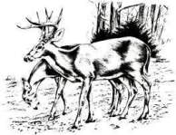
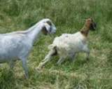
Meningeal worm (deer, brain worm)
Parelaphostrongylus tenuis by Dr. Mary Smith DVM, Michael Thonney & Dr. tatiana Stanton
Parasite of White Tail Deer - Nonpathogenic
Small ruminants are an abnormal host (sheep, goats, fallow deer) also llamas, alpacas, elk, etc.
Parasite has indirect life cycle – snails and slugs needed for infection

Slide 62
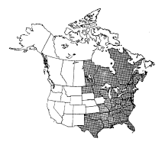
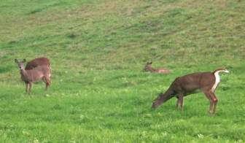
Prevalence of P. tenuis in
White-tailed Deer
Minnesota – 59% of adults
New York –
  58% of adults, 33% of juveniles
Ontario, CA – 41% of adults
Few in each deer
but very long living

Slide 63
Life cycle in deer
Deer eats forage that contains a slime trail, slug or snail that is infected with the 3rd stage larvae
Larvae migrate through the stomach wall to the peritoneal cavity
enter lumbar spinal nerves
reach spinal cord in 10 days
develop in an orderly manner in the grey matter of the spinal cord
return to surface of spinal cord at 40 days
mature and migrate to cranium to live and reproduce -> eggs laid into blood vessels
Eggs hatch into first-stage larvae in the lungs
1st stage larvae enter bronchial tree, coughed up, swallowed and passed in feces

Slide 64
Larvae of P. tenuis
1st stage larvae excreted in the mucous coat of fecal pellets 90+ days after deer infected
killed by drying, solar radiation but resist freezing
land snails and slugs crawl over deer feces
larvae penetrate gastropod’s foot
develop to infective (3rd stage) in 2 to 3 mo. (depends on temperature)
persist for life of snail or slug or excreted in slime trail onto vegetation
mean of 3 larvae for each infected snail

Slide 65
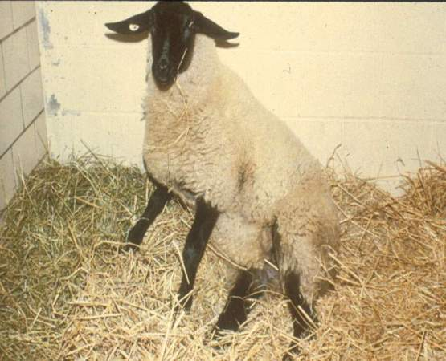
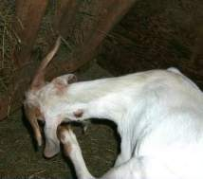
In Abnormal Hosts - Larvae travel from intestinal tract to the grey matter of the spinal cord and become disoriented, causing → Nerve damage (can include lameness, gait abnormality, or constant itching in one spot) → can be as extreme as paralysis or even
DEATH (rare)
→ Animals typically maintain appetite

Slide 66
Current research – takes a little over 2 to 3 months to develop to L3 in snail -> possibly less chance of infection for about 3 months after winter is over
Sheep or goat does not have to eat the snail or slug. The L3 emerge from snail/slug in slime trail and can survive on vegetation
After about 10 days of infection much harder to kill worm in sheep or goat. May take up to 60 days for signs to develop.

Slide 67
Treatment of P. tenuis in aberrant hosts
no controlled studies in sheep and goats
Cornell has completed a 3 year study comparing two treatment protocols on naturally infected sheep and goats on 14 farms in Ithaca, NY region
Infected animals scored on a “neurologic score card” and video taped within the first day or two of treatment and post treatment

Slide 68
Research Study
Goal- Determine if Ivermectin is needed in the treatment P. tenuis in sheep and goats. Theoretically, Ivermectin cannot pass through the blood brain barrier → should not aid in treatment
Treatment Protocol:
  Dexamethasone: 0.2 mg/kg IM for 3 days, 0.1 mg/kg for 2 days (if instead Banamine, 50 mg flunixin per cc at 1 cc/100 lb. lw, 60 d withdrawal sheep)
  Fenbendazole (Safeguard): 25mg/kg PO for 5 days
  (10 d withdrawal goats, 54 d sheep)
  Ivermectin or Placebo: 0.5mg/kg SQ for 5 days
  (96 d withdrawal for goats & sheep)

Slide 69
Study Design
Producer recognizes an animal with signs of P. tenuis and begins treating with either Treatment A or B
A veterinarian or researcher does an initial neurologic exam on the animal when treatment is started
A second neuro exam is done after treatment is completed
Improvement based on the neuro exam and final outcome of the animal were compared to determine ivermectin’s role in improving the outcome

Slide 70
Binary logistic regression model
38 animals treated over 3 years
  Goats- 20, Sheep- 18
Animals were scored initially and after treatment on a 1 (unable to stand) to 5 (no detectable neurologic deficits or only an expert would notice) scale, with a score of 4 indicating likely to function in the herd for breeding though noticeably impaired.
Animals were classified as recovered if they required no further treatment to potentially remain in the breeding herd after the 5-day treatment period.
statistical model included the effect of animal species
pretreatment neurological score from 1 (unable to stand) to 4 (likely to function for breeding but noticeably impaired) as a continuous variable.

Slide 71
Study Results
Higher pretreatment scores improved outcome (P = 0.002).
Because all 11 goats treated with ivermectin were categorized as recovered, differences between species on the effect of ivermectin (P = 0.073) could not be tested with binary logistic regression. Species differences were not significant.
Six of 9 sheep treated with ivermectin recovered without further treatment, but 3 had to be euthanized.
Five of 9 sheep treated with the placebo recovered without further treatment; 2 required additional treatment, and 2 had to be euthanized.
All 11 of the goats treated with the ivermectin recovered, while six of the nine treated with the placebo recovered without further treatment, and 3 required additional treatment.
These better outcomes for goats are probably explained by closer observation of goats (brought in every night) which resulted in higher pre-treatment neurological scores.

Slide 72
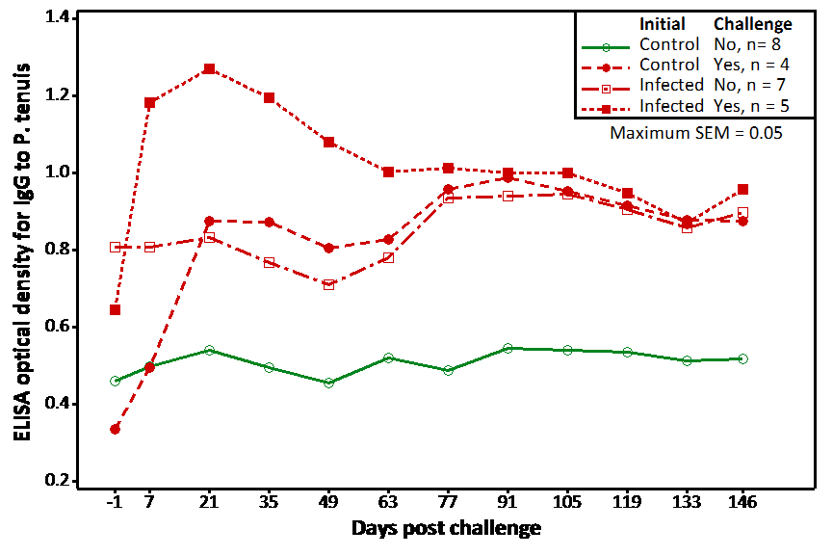
Figure 1. CHALLENGE STUDY
Serum antibody concentrations to P. tenuis in 19 mo. old ewes. initially in either a control group or a group treated with 20 L3 at 7 mo of age → then challenged or not challenged with 100 L3 at 19 mo of age. The group that had been previously infected responded to the challenge at 19 mo. with significantly higher antibody concentrations (P < 0.001).

Slide 73
Conclusions
Given the significance of pretreatment score, close observations of animals at high risk for P tenuis infection is recommended in order to start treatment promptly.
Studies with larger numbers of animals are needed to definitively state whether including ivermectin improves outcome and is worth the substantially increased drug withdrawal period.
We had no Control Group. However, general consensus is that our overall recovery rates especially for goats were far better than if animals had been left untreated.
Anecdotally, events such as breeding and birthing stress animals that have exhibited noticeable neurological damage from deer worm even if the animals initially appear to have recovered well. However, animals that are caught early before symptoms advance often appear to recover fully.
Challenge study indicates the potential for a deer worm vaccine for sheep & goats

Slide 74
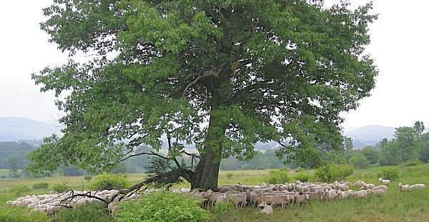
QUESTIONS?

