Slide 1
Cereal Rye Management Prior to Organic Soybean: Effects on Weed Suppression, Soil Health, Yield, and Profitability
Kiera Crowley, M.S. Candidate, Cornell University
Matthew Ryan, Harold van Es, Miguel Gomez

Slide 2
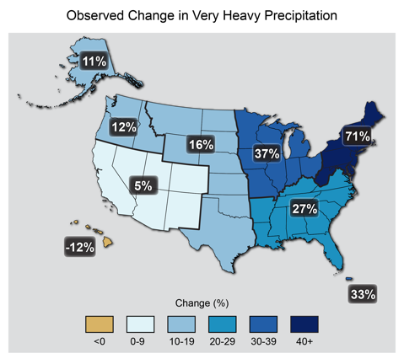
Introduction
330,000 acres of soybean in New York in 2016, up 2.5x since 2000 (USDA NASS Quick Stats)
New York #3 in the country in the number of organic farms (USDA NASS, 2014 Organic Survey)
1958 - 2012
Research Justification
Challenges with weed suppression
Reliance on tillage
Increased climate variability
Updated from Karl et al. 2009. Downloaded from the National Climate Assessment.
Notes:
This research aims to quantify to what extent cover crops (in this case cereal rye) can help to address these challenges
“From 1958 to 2012, the NE has observed a 71% increase in the amount of precipitation falling in heavy rainfall events (defined as the heaviest 1% of all daily events).”
More soybean being grown in NYS, both organic and not

Slide 3
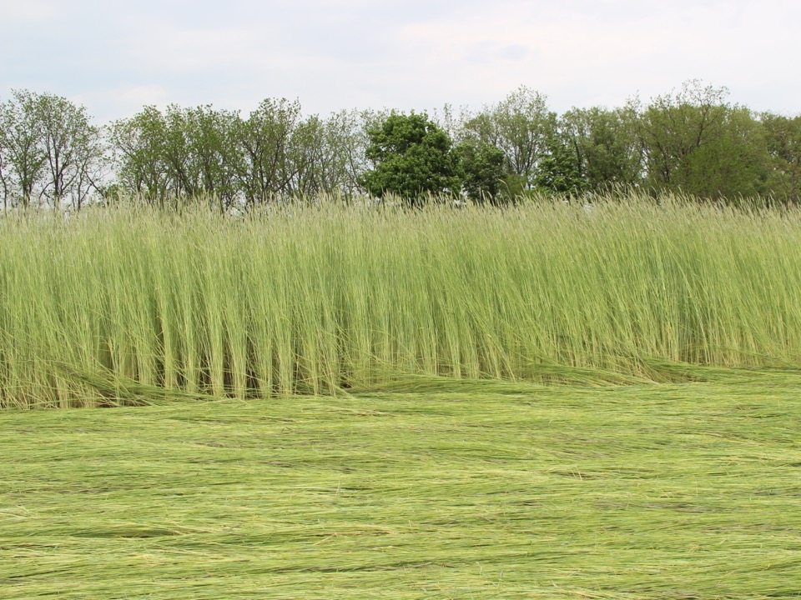
Cereal Rye (Secale cereale)
Feasible for late fall planting
Reduces winter soil erosion
Produces large amount of biomass
Weed suppression
Possible use as forage

Slide 4
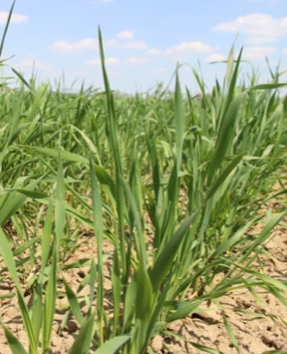
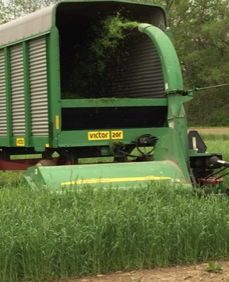
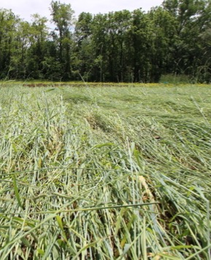
Cereal Rye Management (Experimental Treatments)
Plow down: rye is incorporated at jointing
Ryelage: rye is harvested at boot stage
Roll down: rye is roller-crimped immediately prior to planting at 50% anthesis
No cover: No rye cover crop seeded.
Notes:
5/22: control and ryelage plowed
We are especially interested in looking at the ryelage and roll down
Roll down: reducing labor and fuel use, reduce tillage
Ryelage: increasing interest in harvesting

Slide 5
Hypotheses
Cereal rye mulch will be as effective as tillage in suppressing weeds.
Soil health will be greater in all treatments with cover crops.
Crop yield will not differ among treatments.
Profitability will be greatest in the Ryelage treatment.

Slide 6
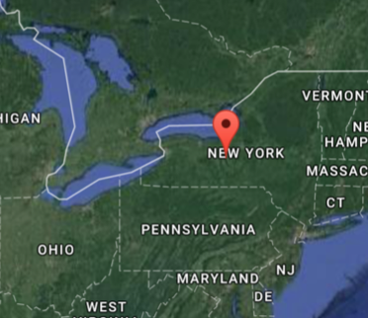
Materials and Methods
Aurora, NY
Initiated in 2014, repeated in 2015
Randomized Complete Block Design with 4 replicates
Cereal rye (Aroostook) drilled at 188 kg/ha
Organic soybean (Viking 2299, maturity group 2.2) planted at 618,000 seeds/ha
Data Collection
Cover crop biomass (One 0.5 m² quadrat per plot)
Soil sampling (15-cm depth)
Respiration
Weed biomass (Two 0.5 m² quadrats per plot)
Grain yield
Partial budget analysis

Slide 7
Accumulated Precipitation (cm)
Created from Northeast RCC CLIMOD 2
Notes:
Normal: 1981 to 2010 averages
2016 flatline between June and July (insert arrows or fly-in box)

Slide 8
Cereal Rye Biomass
Seeding dates:
2014: Oct 7
2015: Sep 18
Dry weight (kg ha¹)
2015
2016
Early May
Late April
Mid May
Early May
Early June Late May
Notes:
Letters in all results charts represent differences significant at the .05 alpha level, using a Tukey pairwise comparison of means.
This chart is based on a tukey pairwise comparison of overall treatment means (not split by year)
Treatment effect:
P < 0.001
Year effect:
P < 0.001
Mixed model:
Fixed effects: Treatment, Year
Random effects: Block

Slide 9
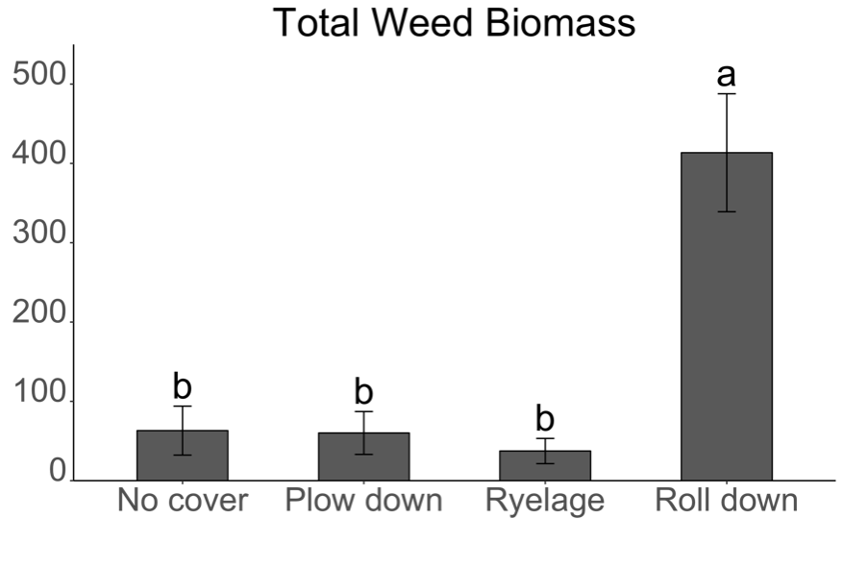
Hypothesis #1: Weeds will be suppressed by the cereal rye mulch as effectively as in the treatments using moldboard plow tillage and inter-row cultivation.
*Measured in early September both years
Biomass (kg ha¹)
Notes:
Although weed biomass was significantly higher in the No till treatment, it was still not very high
*Highest weed biomass recorded in a Rodale org experiment was 6000 kg/ha
Under 1000 is good for organic
Treatment effect: P < 0.01
Year effect: Not significant
Mixed model:
Fixed effects: Treatment, Year
Random effects: Block
Log-transformed for analysis

Slide 10
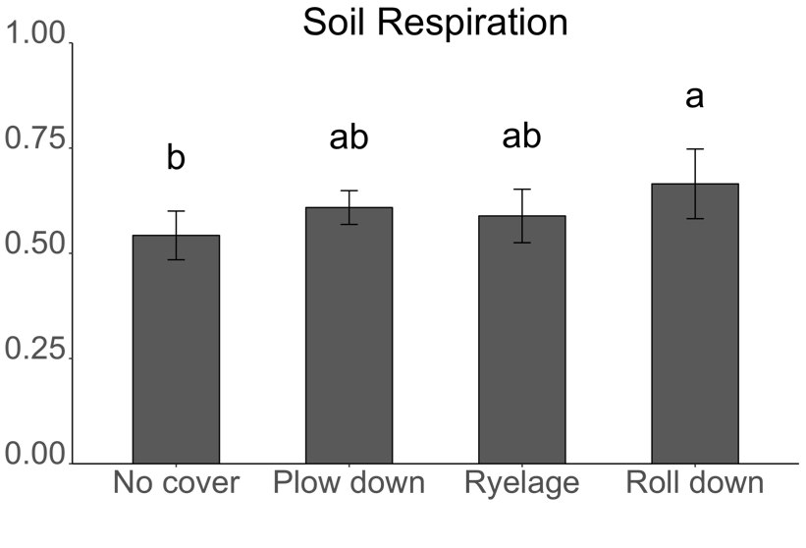
Hypothesis #2: Soil health will be greater in the three cover crop treatments.
Respiration (mg CO₂ / g dry weight)
*Measured in August both years
Notes:
Mention that aggregate stability and active carbon were measured and did not produce significant results
Compared to the No cover treatment, the only trt that had sig greater respiration was the Roll down trt
TRT effect: P<0.05
Scores are in the middle
Mixed model:
Fixed effects: Treatment, Year
Random effects: Block, Year x Block

Slide 11
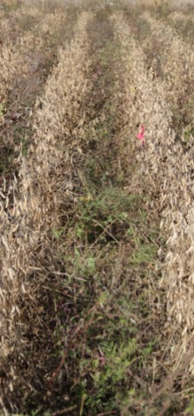
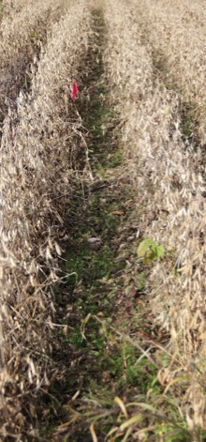
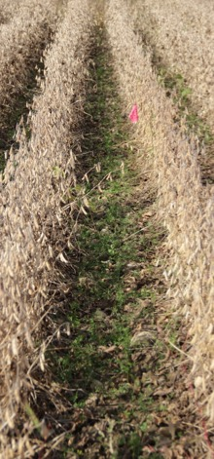
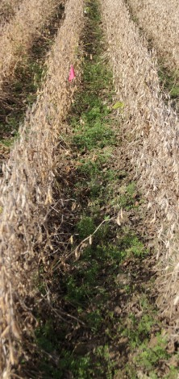
Treatment Comparison at Harvest, October 8, 2015
No cover
Plow down
Ryelage
Roll down

Slide 12
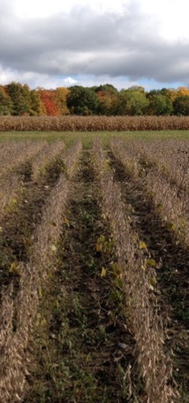
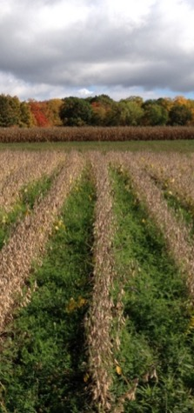
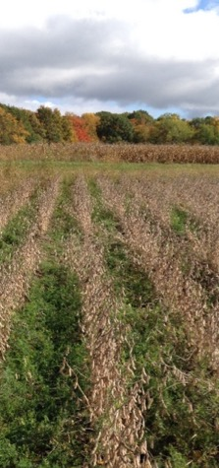
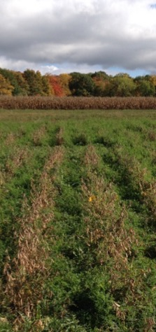
Treatment Comparison at Harvest, October 19, 2016
No cover
Plow down
Ryelage
Roll down

Slide 13
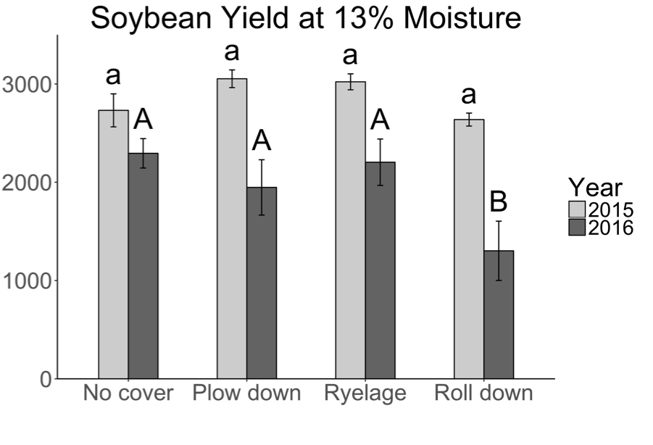
Hypothesis #3: Crop yield will not differ among treatments.
Yield (kg ha¹)
Notes:
TRT:YEAR interaction P < 0.1 (= .06)
Mixed model with:
Fixed effects: Treatment, Year, Treatment x Year
Random effects: Block, Block x Year

Slide 14
Partial Budget Analysis: Assumptions
Income Sources
Soybean yield (kg/ha) | Trial data, 13% moisture
Value of soybeans¹ ($/kg) | 2015 average, organic feed-grade
Ryelage yield (kg/ha) | Trial data, 70% moisture
Value of ryelage² ($/kg) | Trial data, forage quality analysis
Costs
Cereal rye seed³ ($/ha) | Seeded at 188 kg/ha
Field operations (various) | Pennsylvania and Michigan State 2016 Custom Rates
¹USDA National Organic Grain and Feedstuffs; ²Penn State Feed Calculator; ³Aroostook, Ernst Conservation Seeds Inc.

Slide 15
No cover | Plow down | Ryelage | Roll down
Fall
 | Moldboard plow | Moldboard plow | Moldboard plow
 | Disk, cultipack | Disk, cultipack | Disk, cultipack
 | Drill rye | Drill rye | Drill rye
Spring
 |  | Mow rye
 |  | Rake rye
 |  | Bale rye
 |  |  | Roll/crimp rye
Moldboard plow | Moldboard plow | Moldboard plow
Disk, harrow | Disk, harrow | Disk, harrow
Summer
Cultivate | Cultivate | Cultivate
Cultivate | Cultivate | Cultivate
Cultivate | Cultivate | Cultivate
Cultivate | Cultivate | Cultivate
Notes:
This table is showing the difference in field operation between treatments. It is clear that the ryelage treatment has the most operations. However, it has the added income from the ryelage.

Slide 16
Hypothesis #4: Partial profitability will be greatest in the Ryelage treatment.
USD ha¹
Notes:
**These are differences significant at the .05 level, but there are some (No cover and Plow down compared to Ryelage in 2015) that were on the edge, at .06. So, still might be a difference that is worth it for the grower.
“The Ryelage treatment did have significantly greater partial profitability compared to the Roll down treatment in both years, and compared to the Plow down treatment in 2016, but its partial profit was not significantly different from the No cover treatment in either year, and was not significantly different from the Plow down treatment in 2015.”
In 2015, the Ryelage treatment had significantly greater profitability compared to the Roll down treatment, but neither the No cover nor Plow down treatment differed significantly from the Ryelage or Roll down treatments.
In 2016, the Ryelage treatment had significantly greater profitability compared to the Plow down and Roll down treatments, but did not differ from the no cover treatment. The Roll down treatment this year was extremely unprofitable, due to poor yields.
INTERPRETATIONS FROM MATT:
* Ryelage really performs quite well.
* Dry weather exaggerated differences among treatments in 2016.
* Labor and fuel savings did not offset lower yields in no-till in 2015 (I’m a bit surprised with this finding. Really thought that the no-till would come out on top by saving more even with lower yield in 2015).
* No-till failed in dry conditions in 2016; and ryelage had a higher profit than plow down in 2016

Slide 17
Conclusions
Weed biomass was greater in the ‘Roll down’ treatment, but still relatively low for organic production
Compared to the ‘No cover’ treatment, greater soil respiration in the ‘Roll down’
Yield was lower in the second year of the ‘Roll down’ treatment, but otherwise comparable yields between treatments
Partial profitability in the ’Ryelage’ treatment greater than in the ‘Roll down’ treatment
Notes:
Recommendations to a farmer, next steps
Ryelage: profitable
Roll down: soil health, but yields and profitability variable

Slide 18
Thank you!
USDA ORG Program Project #2014-03385
Sustainable Cropping Systems Lab:
Sandra Wayman
Chris Pelzer
Connor Youngerman
Margaret Ball
Jeff Liebert
Brian Caldwell
Ann Bybee-Finley
Eugene Law
Research assistants:
Kirby Peters
Lauren Hill
Julian Garcia
Laurel Wolfe
Ellie Crowell
Tânia Carvalho Carli
Jake Katzenberg
Douglas Macedo

