Slide 1
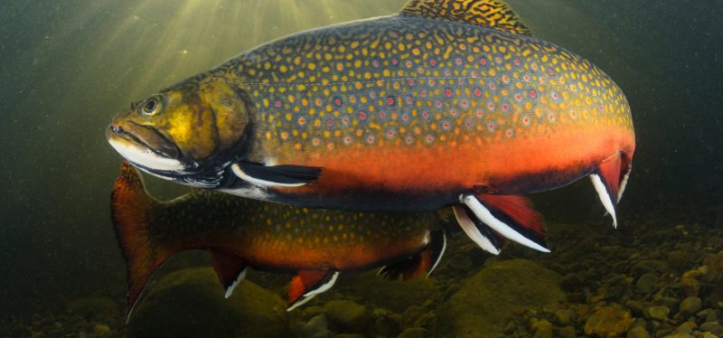
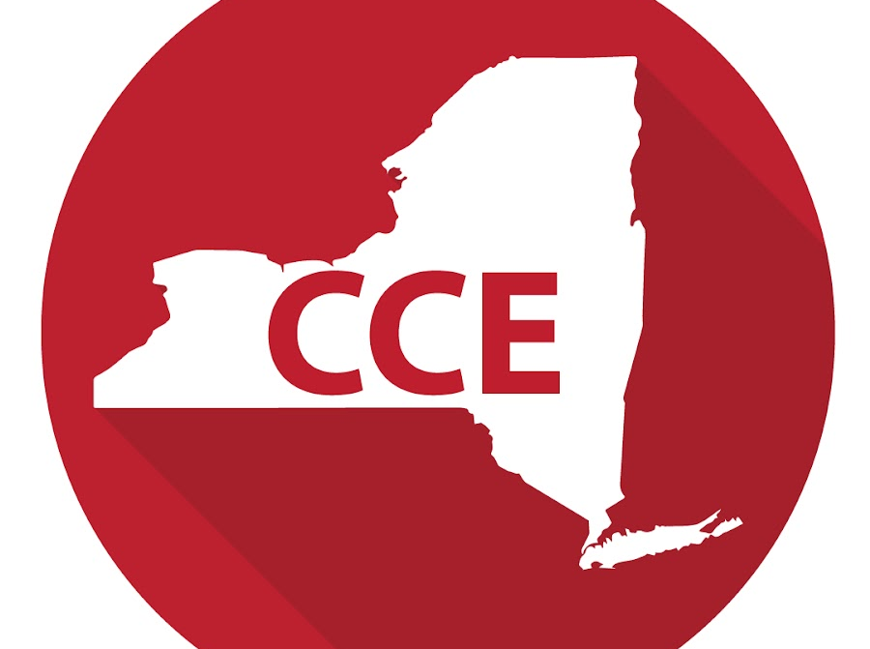
Climate Change Education through Cold-Water Fisheries Extension
Keith G. Tidball, PhD
Ag In-Service 2020
Wildlife, Forestry and Fisheries Track

Slide 2
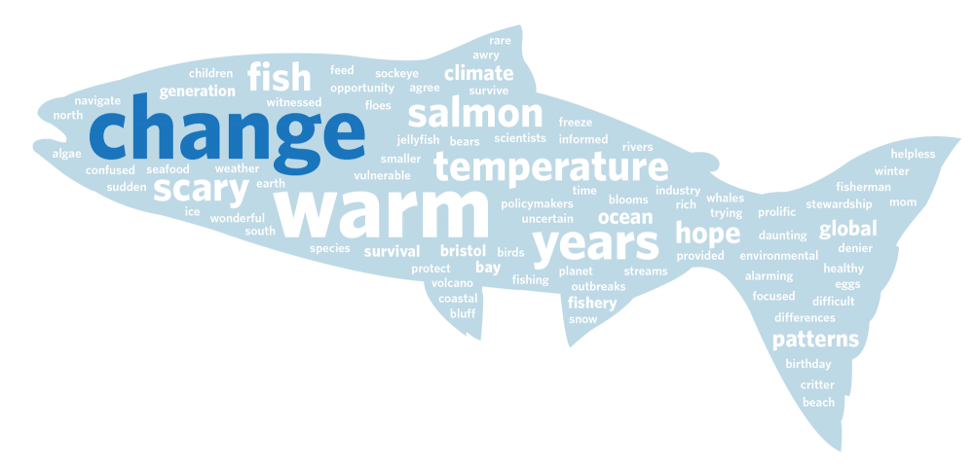
Climate change is an important and growing area of emphasis for CALS and Cooperative Extension, but climate change education efforts must be integrated into existing areas of inquiry and outreach.
Within the area of natural resources conservation, aquatic environments and the fish that live within them are areas of intense scientific scrutiny and provide attractive and popular opportunities for extension education.

Slide 3
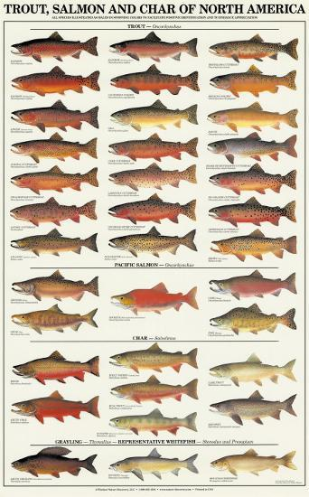
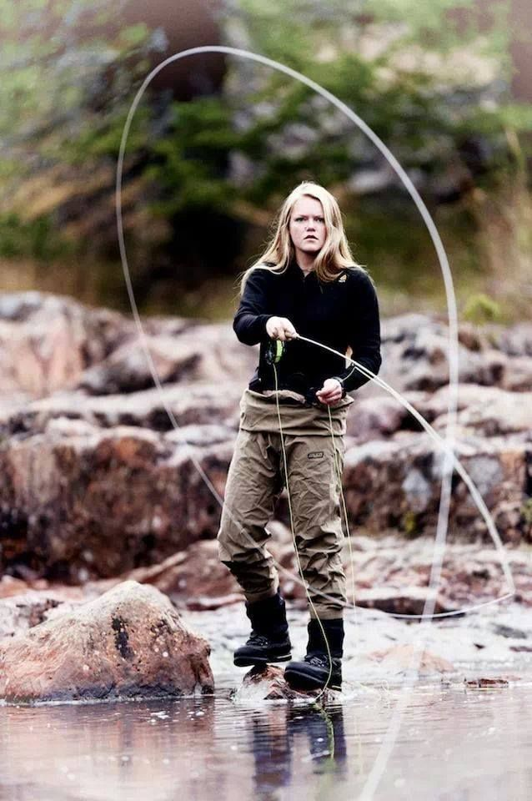
Fishes of the family Salmonidae, including trout (Oncorhynchus), char (Salvelinus), salmon (Oncorhynchus and Salmo), grayling (Thymallus), and whitefish (Prosopium), are likely to be particularly vulnerable to climate change because of their dependence on cold, clean water. Salmonids are also among the most popular and sought-after fish by recreational anglers.

Slide 4
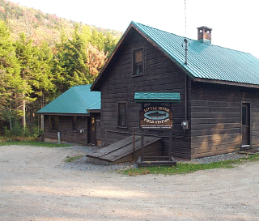
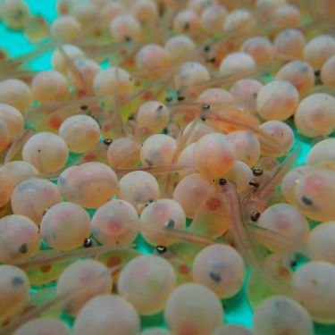
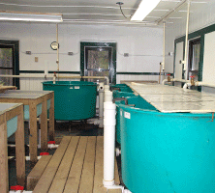
The Department of Natural Resources has vibrant and world-class fisheries research capacity, including renowned scientists, excellent facilities, and a high degree of academic productivity. Two field stations, one in the Adirondacks (Little Moose Field Station), and one on Oneida Lake (Cornell Biological Field Station at Shackelton Point) produce long-term ecological studies and state-of-the-art fisheries management recommendations for regional, state, and federal managers. Yet, historically, very little extension activity has been generated from this significant fisheries research capacity. Therefore, neither DNR or CALS has fully leveraged or experienced the fullest impact of the extension of this work to the citizens of New York. This lack of fisheries extension is magnified by the loss of the Sport-Fishing and Aquatic Resources Education Program (SAREP) in 2001.

Slide 5
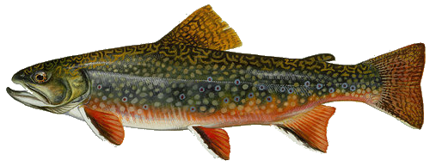
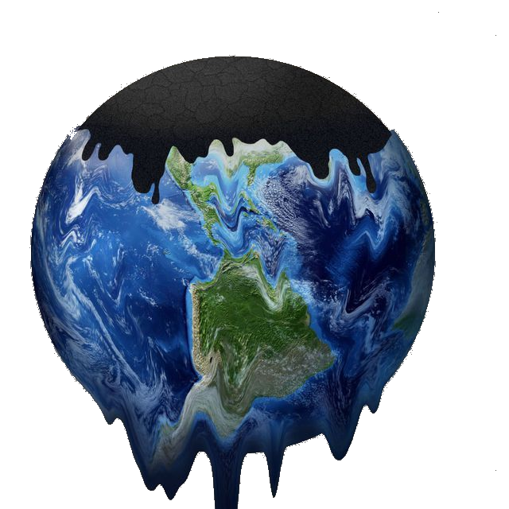
Despite these setbacks and missed opportunities, the current attention on climate change and the direct linkages between climate change and the health of cold-water fisheries presents a new and novel opportunity to reinvigorate fisheries extension in DNR via an innovative multi-pronged approach. This occurs at a time when there is increasing interest in fly-fishing among youth and adults, especially women, and increasing interest in brook trout (New York’s State fish) restoration, in tandem with increasing interest in the plight of Loons, a water bird that is dependent on healthy cold-water systems in the Adirondacks.
Brook Trout Conservation
Climate Change Education
Habitat Restoration & Protection

Slide 6
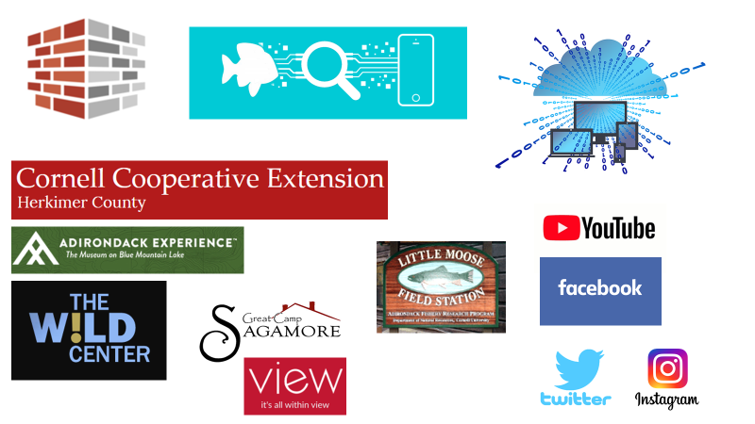
Pairing general citizen interest in these charismatic species (brook trout and loons) and places (the Adirondacks) with existing partnerships with Trout Unlimited, the Adirondack League Club, Great Camp Sagamore, Trout Power, and NYS DEC fisheries, as well as the three most prominent museums in the Adirondacks (The View in Old Forge, ADK Wild Center in Tupper Lake, and the Adirondack Experience in Blue Mountain Lake), will no doubt catalyze our efforts to work with CCE County Associations in the Adirondacks (Clinton, Essex, Franklin, Fulton Montgomery, Hamilton, Herkimer, Lewis, St. Lawrence, Saratoga, and Warren Counties) to better educate New Yorkers about climate change and its impacts on the lakes and streams of the Adirondacks, and the fish living within them.
This extension education will lead to New Yorkers who are better educated about threats to our climate, to clean water, and who are also better educated about their land grant university and its engaged scholarship efforts through cooperative extension

Slide 7
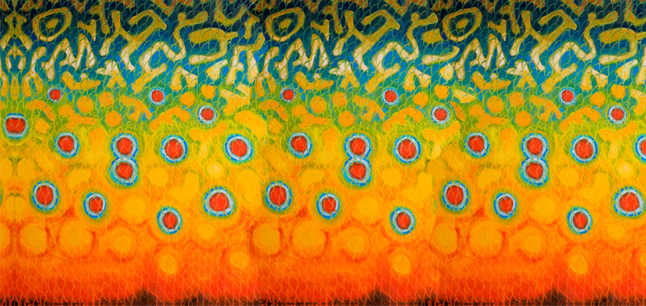
Use a cherished, charismatic and iconic creature as Innovative Pathway & Portal for climate change education.
Innovative new extension education Products & Publications
New Partnerships
New Programs
Innovative new extension Presence (social media)
New Participants

Slide 8
Extension Objectives
Objective 1 – Innovate and reorganize internal extension strategies and approaches by using a cherished, charismatic and iconic creature as Pathway & Portal for climate change education.
1a. We will develop a forward looking, innovative, extension plan of work for a targeted program at the nexus of brook trout conservation/climate adaptation/ natural resources management.
1b. This plan of work will explicitly bring in new and exciting partnerships with CCE Associations and other partners in the Adirondacks that will form an Adirondack Brook Trout Alliance that will be a model of a new way of doing business in the domain of research outreach and cooperative extension as it relates to the AFRP and Little Moose Field Station.
1c. We will track execution of this plan of work and derive best management practices which may be of use in bringing innovative cooperative extension approaches to other existing CALS programs.

Slide 9
Extension Objectives
Objective 2 – Develop Innovative Revised and New Fisheries Extension Education Products & Publications
A review of Department of Natural Resources extension publications having to do with fisheries or activities focused on fish revealed that there are a number of highly informative and previously popular publications that are no longer in print. Others, though still available, are very dated.
2a. The Climate Change Education through Cold-Water Fisheries Extension team will identify and prioritize a list of out of date fisheries publications. This group of publications will each be reviewed for proposed revisions having to do with content (are there climate change cold water fisheries linkages in the text?) and visual, formatting, and design updates.
2b. The Climate Change Education through Cold-Water Fisheries Extension team will assemble and evaluate the collection of high-quality videos created by the Adirondacks Fisheries Research Program (see http://www2.dnr.cornell.edu/cek7/Videos.html), edit them as needed, and upload them to a brand-new Adirondack Brook Trout Alliance YouTube-like Channel hosted by CCE that we will create.
2c. At the completion of the publication review, the Climate Change Education through Cold-Water Fisheries Extension team will produce a first revised publication using an accessible digital delivery application or platform such as Flip Book technology (see https://www.paperturn.com/us/flipbook/what-is-a-flipbook). The technology allows the insertion of web-hosted videos into the publication. This first new and innovative Adirondack fisheries extension product will then be shared with partners and evaluated.
2d. Based on the reviews of the initial digital delivery application or platform, the team will develop a publication plan for remaining dated publications in future years.
2e. The Climate Change Education through Cold-Water Fisheries Extension team will also identify four (4) entirely new topics for new publications
and will draft and produce one (1) new publication in year 1.
A flipbook is an interactive, HTML5 online publication that has the look and feel of a real, page-turning publication (complete with page-turning sound effects, page shadows and more). Flipbooks are currently used to replace conventional digital PDFs and paper-based documents such as reports, presentations, magazines, catalogs, brochures, books and more. It is responsive and available across all devices which makes it much easier for the user to navigate through in comparison to the PDF. Additionally, internal links to other pages in the flipbook can be inserted to facilitate navigation and enhance the user experience.

Slide 10
Extension Objectives
Objective 3 – Create an Innovative Fisheries Extension Web Presence and Experience
The Adirondack Fishery Research Program and Little Moose Field Station have a dated website presence (see http://www2.dnr.cornell.edu/cek7/afrp_index.htm) and no explicit extension content on the website. There are no social media platforms that drive traffic to the website or to Cornell Cooperative Extension more broadly.
3a. The Climate Change Education through Cold-Water Fisheries Extension team will redesign the Adirondack Fishery Research Program website, and will build a new extension component of the website. This technological innovation will serve as a repository of and access point for the many other innovations described in this proposal. The production of new websites will allow us to bring the web-based home of this project into accessibility compliance.
3b. The Climate Change Education through Cold-Water Fisheries Extension team will develop and release new Facebook, Instagram, and YouTube social media platforms. These platforms will be used to create virtual groups and networks of members of the proposed Adirondack Brook Trout Alliance.

Slide 11
Extension Objectives
Objective 4 – Build New CCE North Country ADKs and Fisheries Partnerships
Cooperative extension is a nationwide, non-credit educational network that addresses public needs by providing non-formal education and learning activities to communities throughout New York and the nation. With an organization that has been operating for over a century, cooperative extension is well positioned to efficiently get needed tools and knowledge into the hands of the people who need them. However, due in part to the geographic remoteness of the Adirondacks, the full measure of cooperative extension has not yet been reached in the Adirondack region. There is a need for greater partnership, especially in the domain of natural resources management.
4a. The Climate Change Education through Cold-Water Fisheries Extension team will work to create the Adirondack Brook Trout Alliance via a series of organizational and informational roundtables. These “Square Tail Summits” (square tail is a nickname of the brook trout) will be co-organized by the Climate Change Education through Cold-Water Fisheries Extension team and Adirondack Brook Trout Alliance partners, with CCE Herkimer and Cornell DNR in the lead.
4b. Once the Adirondack Brook Trout Alliance is established, it will be called upon to provide stakeholder input into future Climate Change Education through Cold-Water Fisheries Extension activities and to provide review and evaluation assistance of extension products and programs. As the alliance will include numerous Adirondack museums, we anticipate additional innovations in the form of exhibits and interpretive projects in the future.

Slide 12
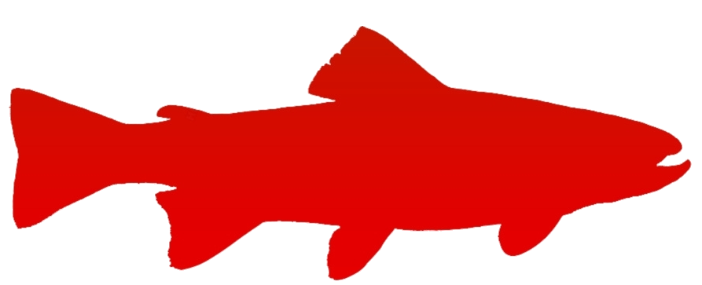
Cornell DNR
AFRP
ADK CCE Associations
ADK Museums
Great Camp Sagamore
ADK Trout Unlimited Chapters
Trout Power
Adirondack League Club/ALC Research Forum
NYS DEC
ADK Brook Trout Alliance

Slide 13
Extension Objectives
Objective 5 – Initiate New Innovative Cold-Water Fisheries Extension Programs
The Climate Change Education through Cold-Water Fisheries Extension team will initiate four (4) new innovative extension programs by leveraging existing small-scale activities among partners (future Adirondack Brook Trout Alliance members).
5a. We will partner with Adirondack Trout Unlimited chapters and CCE 4H Clubs to conduct Trout in the Classroom (see http://www.troutintheclassroom.org/home ) educational experiences. We will innovate the existing curriculum, which focuses primarily on Brown trout or Rainbow trout, and re-focus it on Brook trout. We will also work to include climate-change awareness and education as a part of the Trout in the Classroom experience. Sullivan County CCE has utilized the Trout in the Classroom resources with their 4H program, so we will consult with them to enhance our success rate in the Adirondacks counties.
5b. In partnership with the Cornell Program Work Team Youth Nature Outdoor Education (YNOE), we will develop a prototype NY Wildlife Leadership Academy, modeled after the successful Pennsylvania program (see https://wildlifeleadershipacademy.org/ ). The prototype will parallel the PA program focused on Brook Trout (https://wildlifeleadershipacademy.org/brookies-tour/ ), which serves as a springboard to learn about biology, stream ecology, habitat, watersheds, and coldwater conservation. After field school, armed with knowledge, leadership skills, and the support of Academy staff, students return to their communities to serve as Conservation Ambassadors. The program will be targeted at high school age youth.
5c. In partnership with Trout Power, NYS DEC, and Great Camp Sagamore, we will conduct a citizen science activity in Spring of 2021 wherein we recruit interested anglers to fish for brook trout in predetermined Adirondack streams to accomplish two scientific objectives. The first objective is to document brook trout occurrence and to geo-locate brook trout. The second objective is to conduct genetic microsatellite analysis on each fish caught to determine the genetic uniqueness of individual fish and fish populations. This is accomplished via a fin clip and sample quality protocol that is already well tested by Trout Power (https://www.troutpower.org/).
5d. Similar to an agricultural experimental field trial, we will build upon existing partnerships with Trout Power, the Sagamore Great Camp, and the DEC to conduct a citizen science based long term brook trout water quality study in a watershed near the Little Moose Field Station which will provide significant “wrap-around” social media and interactive learning opportunities for the North County and Adirondack Park visitors.

Slide 14
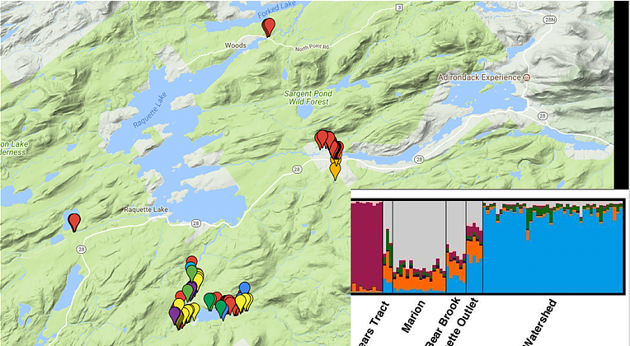

Slide 15
Extension Objectives
Objective 6 – Recruit New CCE Partners Participants
6a. We will work with the following museums in the Adirondacks to innovate the ways in which cooperative extension products, programs, and outcomes are described and interpreted:
The View in Old Forge
ADK Wild Center in Tupper Lake
The Adirondack Experience in Blue Mountain Lake
Preliminary discussions indicate that there is great interest in cooperating with the Climate Change Education through Cold-Water Fisheries Extension team to design novel and new multifaceted, interactive exhibits. These exhibits would provide significant new exposure for Cooperative Extension among those unfamiliar, while simultaneously providing an opportunity for reacquainting for others.
6b. Introduce Cornell students to Cooperative Extension and the Land Grant Mission by providing a pathway for their engagement in this work. This will require developing a plan with Engaged Cornell.

Slide 16
Questions?
Use a cherished, charismatic and iconic creature as Innovative Pathway & Portal for climate change education.
Innovative new extension education Products & Publications
New Partnerships
New Programs
Innovative new extension Presence (social media)
New Participants

Slide 17
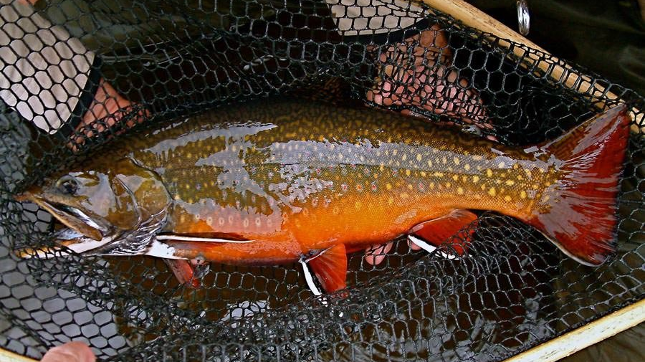
Thank you!

