Slide 1
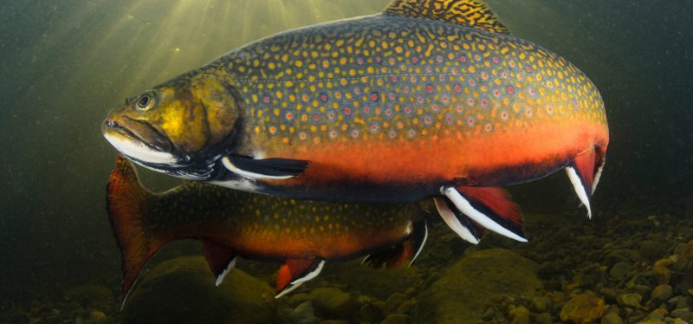
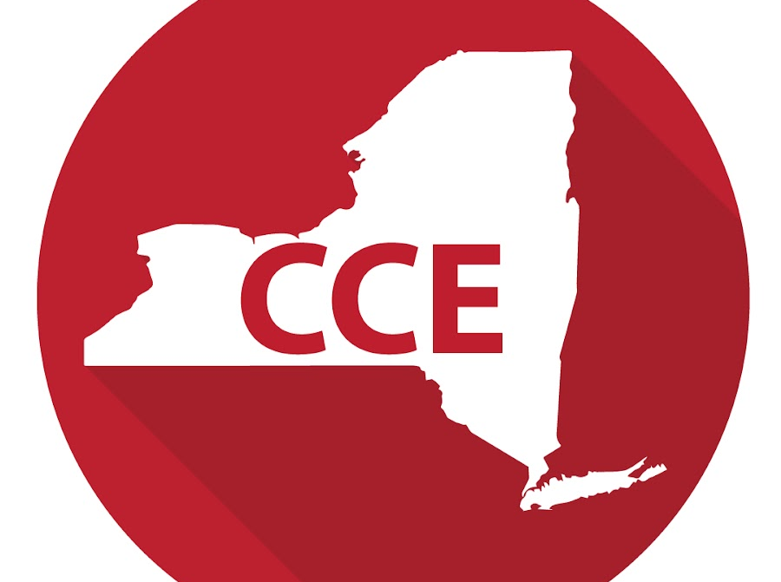
Climate Change Education through Cold-Water Fisheries Extension : Climate Narratives
Keith G. Tidball, PhD
AG (and Natural Resources) In-Service
November 2021

Slide 2
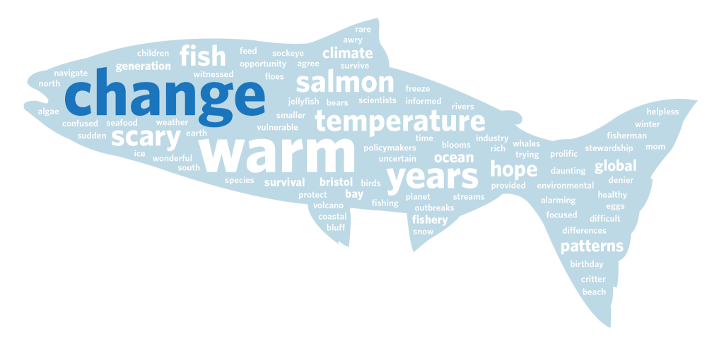
Climate change is an important and growing area of emphasis for CALS and Cooperative Extension, but climate change education efforts must be integrated into existing areas of inquiry and outreach.
Informing climate change narratives is perhaps the key objective of Cooperative Extension today. Within this challenging effort, outreach and education to rural Americans, especially sportsmen and women, may be the most challenging objective, and the most important.
Within the area of natural resources conservation, aquatic environments and the fish that live within them are areas of intense scientific scrutiny and provide attractive and popular opportunities for extension education.

Slide 3
https://brage.inn.no/inn-xmlui/bitstream/handle/11250/2712526/fpsyg-10-01026.pdf?sequence=2&isAllowed=y

Slide 4
A climate change narrative represents people’s understanding of the climate change issue, including political and scientific aspects.

Slide 5
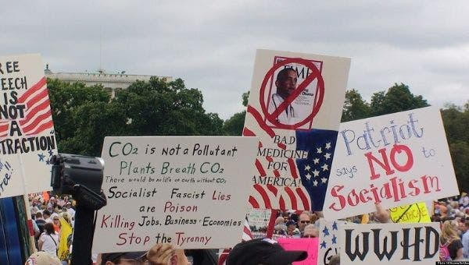
Whereas the vast majority of scientists agree about the scientific evidence concerning climate change, its dynamics and its causes (IPCC, 2014), popular narratives may range from outright disbelief, regarding climate change as a hoax contrived by left-wing ecologists, to viewing climate change as the most pressing problem of humankind, caused by greedy and reckless capitalists.

Slide 6
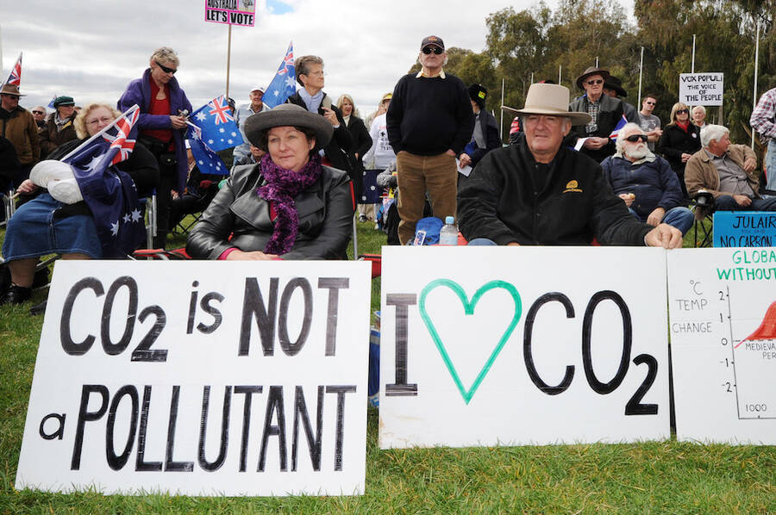
Evidence suggests that narratives rather than scientific facts represent people’s understanding of climate change (Lowe et al., 2006; Fløttum and Gjerstad, 2013, 2017; Jones, 2014; Paschen and Ison, 2014; Brown, 2017).

Slide 7
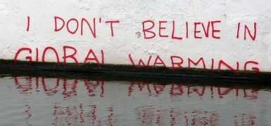
Important elements of narratives are:
(a) causal relations (e.g., what are the causes of climate change, how can climate change be mitigated?)
(b) intentions of relevant actors (e.g., who is responsible for climate change?) (Böhm and Pfister, 2001, 2005, 2008; Bostrom et al., 2012)
(c) affective and moral evaluations of strategies to mitigate climate change as well as of consequences of climate change (Böhm et al., 2018; Doran et al., 2018).

Slide 8
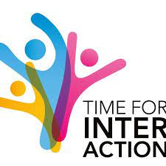

Slide 9
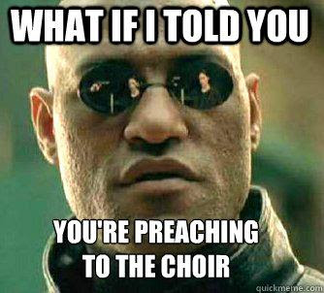
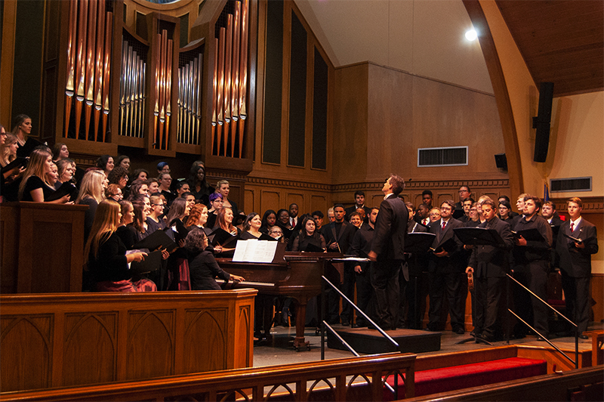

Slide 10
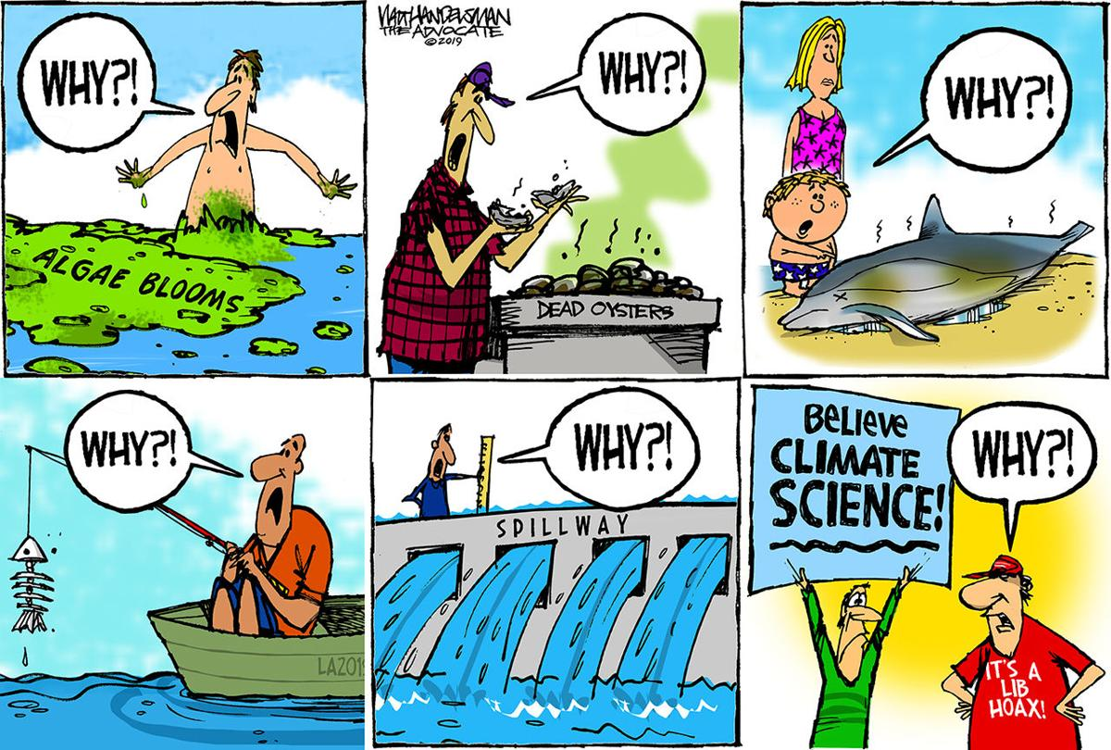

Slide 11
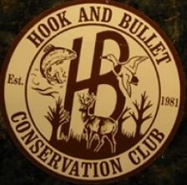
Start w the Hook & Bullet Crowd…
Rather than debating specific points of air temperature or carbon dioxide data, we are developing a framework that focuses on the cascading effects of a changing climate in the biological world, including impacts to species of fish and game most important to sportsmen and women. We highlight on-the-ground projects that help fish and wildlife adapt to a changing environment.

Slide 12
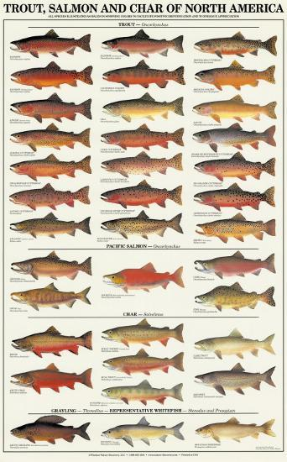
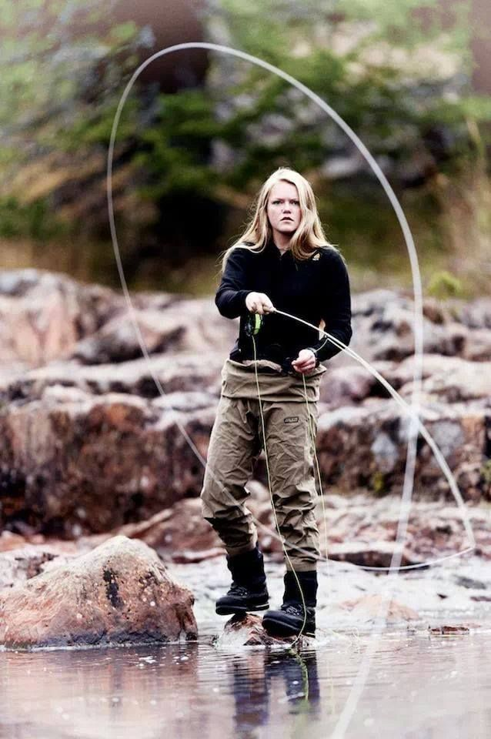
Fishes of the family Salmonidae, including trout (Oncorhynchus), char (Salvelinus), salmon (Oncorhynchus and Salmo), grayling (Thymallus), and whitefish (Prosopium), are likely to be particularly vulnerable to climate change because of their dependence on cold, clean water. Salmonids are also among the most popular and sought-after fish by recreational anglers.

Slide 13
What is the Threat?

Slide 14
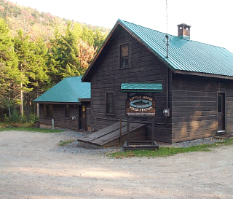
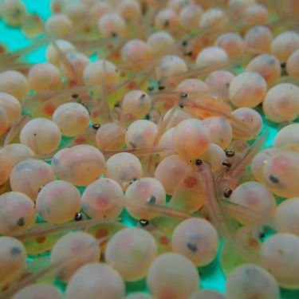
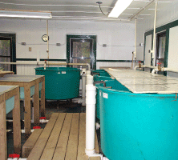
The Department of Natural Resources & Environment has vibrant and world-class fisheries research capacity, including renowned scientists, excellent facilities, and a high degree of academic productivity.
Two field stations, one in the Adirondacks (Little Moose Field Station), and one on Oneida Lake (Cornell Biological Field Station at Shackelton Point) produce long-term ecological studies and state-of-the-art fisheries management recommendations for regional, state, and federal managers.
Yet, historically, very little extension activity has been generated from this significant fisheries research capacity.
Therefore, neither DNRE or CALS has fully leveraged or experienced the fullest impact of the extension of this work to the citizens of New York.
This lack of fisheries extension is magnified by the loss of the Sport-Fishing and Aquatic Resources Education Program (SAREP) in 2001.

Slide 15
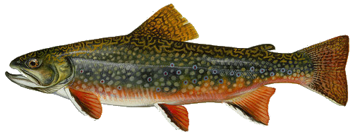
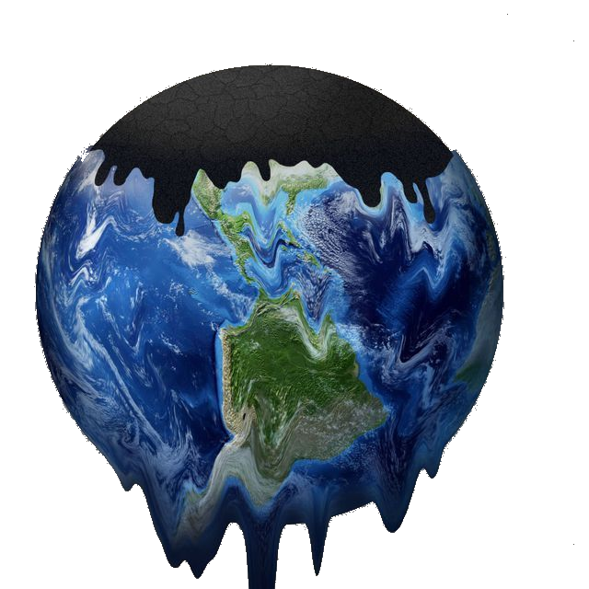
Current attention on climate change and the direct linkages between climate change and the health of cold-water fisheries presents a new and novel opportunity to reinvigorate fisheries extension in the Natural Resources & Environment portfolio via an innovative multi-pronged approach.
This occurs at a time when there is increasing interest in fly-fishing among youth and adults, especially women, and increasing interest in brook trout (New York’s State fish) restoration, in tandem with increasing interest in the plight of Loons, a water bird that is dependent on healthy cold-water systems in the Adirondacks.
Brook Trout Conservation
Climate Change Education
Habitat Restoration & Protection

Slide 16
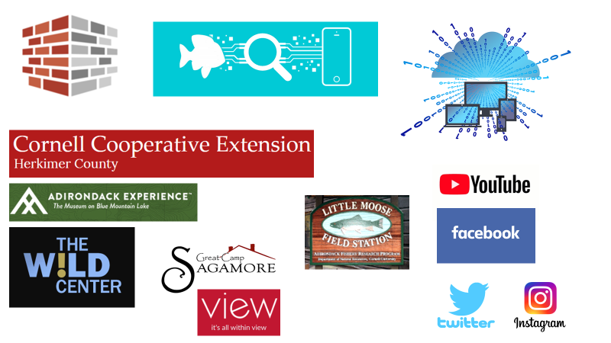
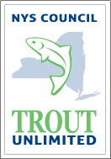
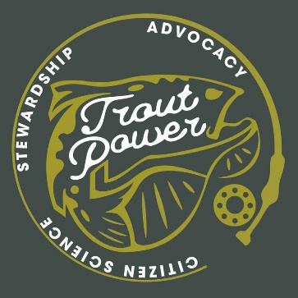
Pairing general citizen interest in these charismatic species (brook trout and loons) and places (the Adirondacks) with existing partnerships with Trout Unlimited, the Adirondack League Club, Great Camp Sagamore, Trout Power, and NYS DEC fisheries, as well as the three most prominent museums in the Adirondacks (The View in Old Forge, ADK Wild Center in Tupper Lake, and the Adirondack Experience in Blue Mountain Lake), will no doubt catalyze our efforts to work with CCE County Associations in the Adirondacks (Clinton, Essex, Franklin, Fulton Montgomery, Hamilton, Herkimer, Lewis, St. Lawrence, Saratoga, and Warren Counties) to better educate New Yorkers about climate change and its impacts on the lakes and streams of the Adirondacks, and the fish living within them.
This extension education will lead to New Yorkers who are better educated about threats to our climate, to clean water, and who are also better educated about their land grant university and its engaged scholarship efforts through cooperative extension

Slide 17
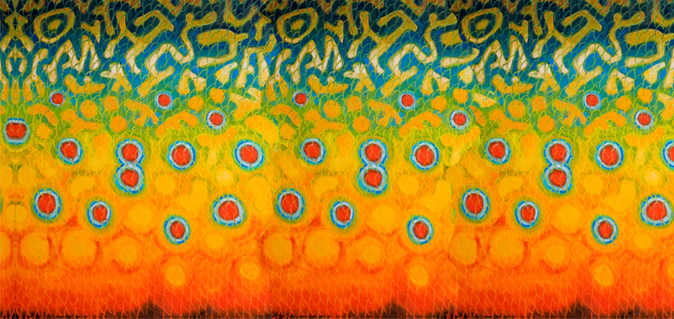
Use a cherished, charismatic and iconic creature as Innovative Pathway & Portal for climate change education.
Innovative new extension education Products & Publications
New Partnerships
New Programs
Innovative new extension Presence (social media)
New Participants

Slide 18
Extension Objective 1: Innovate and reorganize internal extension strategies and approaches by using a cherished, charismatic and iconic creature as Pathway & Portal for climate change education.
Develop a forward looking, innovative, extension plan of work for a targeted program at the nexus of brook trout conservation/climate adaptation/ natural resources management.
Explicitly bring in new and exciting partnerships with CCE Associations and other partners in the Adirondacks that will form an Adirondack Brook Trout Alliance that will be a model of a new way of doing business in the domain of research outreach and cooperative extension as it relates to the AFRP and Little Moose Field Station.
Track execution of this plan of work and derive best management practices which may be of use in bringing innovative cooperative extension approaches to other existing CALS programs.

Slide 19
Extension Objective 2: Develop Innovative Revised and New Fisheries Extension Education Products & Publications
Identify and prioritize a list of out of date fisheries publications. This group of publications will each be reviewed for proposed revisions having to do with content (are there climate change cold water fisheries linkages in the text?) and visual, formatting, and design updates.
At the completion of the publication review, produce a first revised publication using an accessible digital delivery application or platform such as Flip Book technology The technology allows the insertion of web-hosted videos into the publication. This first new and innovative Adirondack fisheries extension product will then be shared with partners and evaluated.
Assemble and evaluate the collection of high-quality videos created by the Adirondacks Fisheries Research Program (edit them as needed, and upload them to a brand-new Adirondack Brook Trout Alliance YouTube-like Channel hosted by CCE that we will create.

Slide 20
Extension Objective 3: Create an Innovative Fisheries Extension Web Presence and Experience
Redesign the Adirondack Fishery Research Program website, and build a new extension component of the website. The production of new websites will allow us to bring the web-based home of this project into accessibility compliance.
Develop and release new Facebook, Instagram, and YouTube social media platforms. These platforms will be used to create virtual groups and networks of members of the proposed Adirondack Brook Trout Alliance.

Slide 21
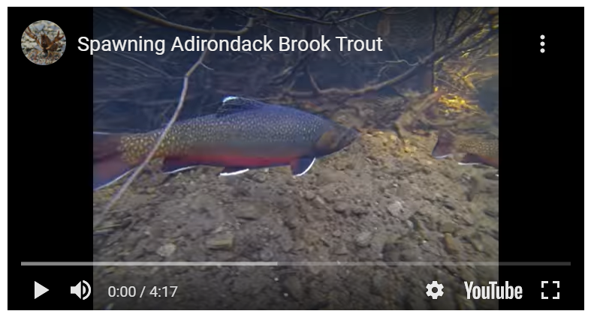
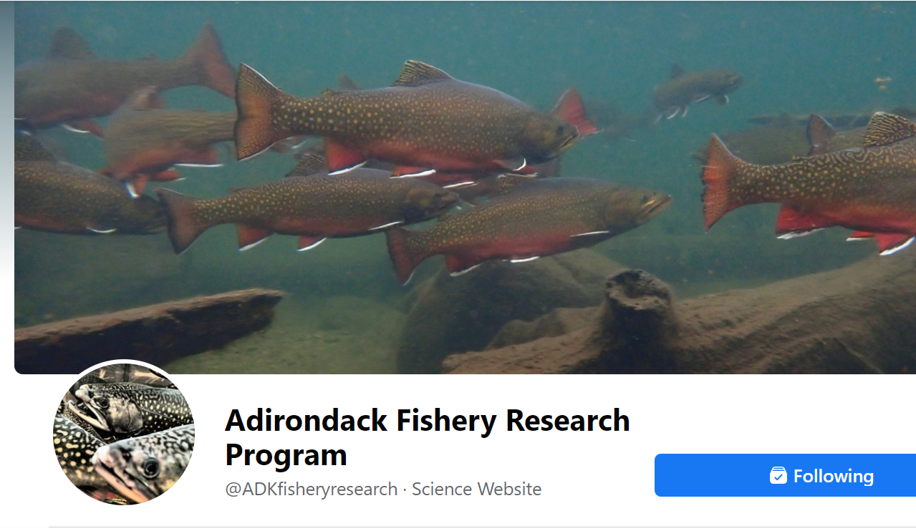
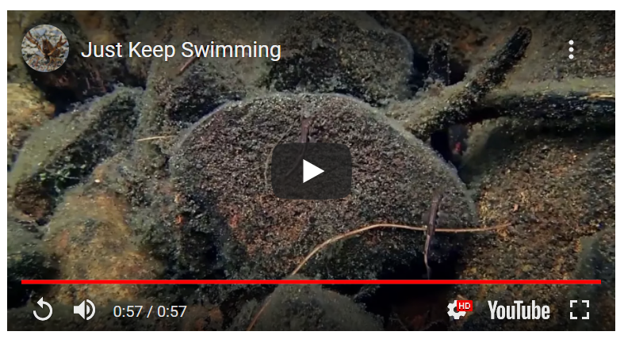
https://www.facebook.com/ADKfisheryresearch
@ADKfisheryresearch

Slide 22
Extension Objective 4: Build New CCE North Country ADKs and Fisheries Partnerships
Work to create the Adirondack Brook Trout Alliance via a series of organizational and informational roundtables. These “Square Tail Summits” (square tail is a nickname of the brook trout) will be co-organized by the Climate Change Education through Cold-Water Fisheries Extension team and Adirondack Brook Trout Alliance partners, with CCE Herkimer and Cornell DNR in the lead.
Once the Adirondack Brook Trout Alliance is established, it will be called upon to provide stakeholder input into future Climate Change Education through Cold-Water Fisheries Extension activities and to provide review and evaluation assistance of extension products and programs. As the alliance will include numerous Adirondack museums, we anticipate additional innovations in the form of exhibits and interpretive projects in the future.

Slide 23
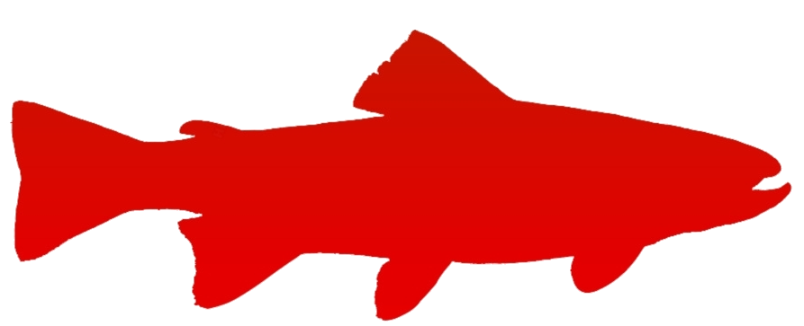
Cornell DNRE
AFRP
ADK CCE Associations
ADK Museums
Great Camp Sagamore
ADK Trout Unlimited Chapters
Trout Power
Adirondack League Club/ALC Research Forum
NYS DEC
ADK Brook Trout Alliance

Slide 24
Extension Objective 5: Initiate New Innovative Cold-Water Fisheries Extension Programs
Partner with Adirondack Trout Unlimited chapters and CCE 4H Clubs to conduct Trout in the Classroom (see http://www.troutintheclassroom.org/home ) educational experiences .Evolve the existing curriculum, which focuses primarily on Brown trout or Rainbow trout, and re-focus it on Brook trout. Work to include climate-change awareness and education as a part of the Trout in the Classroom experience. Sullivan County CCE has utilized the Trout in the Classroom resources with their 4H program, so we will consult with them to enhance our success rate in the Adirondacks counties.
In partnership with the Cornell Program Work Team Youth Nature Outdoor Education (YNOE), develop a prototype NY Wildlife Leadership Academy, modeled after the successful Pennsylvania program (see https://wildlifeleadershipacademy.org/ ). The prototype will parallel the PA program focused on Brook Trout (https://wildlifeleadershipacademy.org/brookies-tour/ ), which serves as a springboard to learn about biology, stream ecology, habitat, watersheds, and coldwater conservation. After field school, armed with knowledge, leadership skills, and the support of Academy staff, students return to their communities to serve as Conservation Ambassadors. The program will be targeted at high school age youth.
In partnership with Trout Power, NYS DEC, and Great Camp Sagamore, conduct a citizen science activities wherein we recruit interested anglers to fish for brook trout in predetermined Adirondack streams to accomplish scientific objectives.
Similar to an agricultural experimental field trial, build upon existing partnerships with Trout Power, the Sagamore Great Camp, and DEC to conduct a citizen science based long term brook trout water quality study in a watershed near the Little Moose Field Station which will provide significant “wrap-around” social media and interactive learning opportunities for the North County and Adirondack Park visitors.

Slide 26
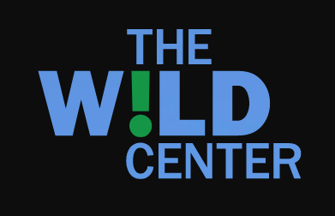
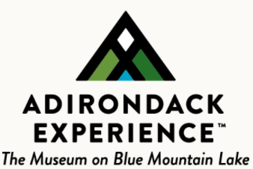
Extension Objective 6: Recruit New CCE Partners & Participants
Work with museums in the Adirondacks to innovate the ways in which cooperative extension products, programs, and outcomes are described and interpreted

Slide 27
Questions?
Use a cherished, charismatic and iconic creature as Innovative Pathway & Portal for climate change education.
Innovative new extension education Products & Publications
New Partnerships
New Programs
Innovative new extension Presence (social media)
New Participants

Slide 29
A parting shot…
https://blogs.cornell.edu/spear4/289-2/

Slide 30
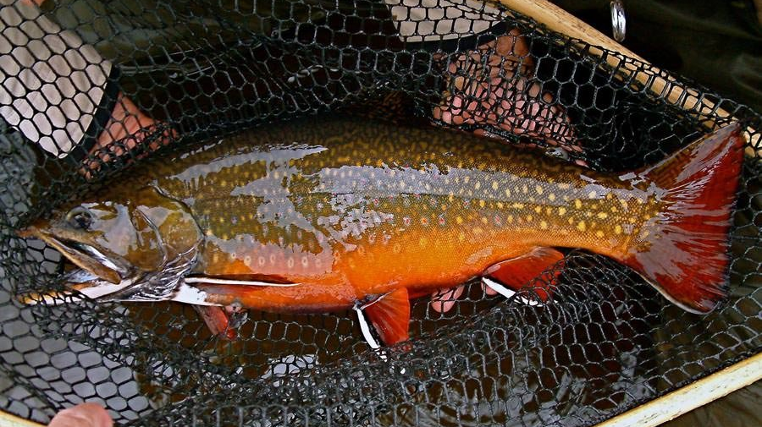
Thank you!
Next Up – A CCE Association Perspective with Garett Livermore from Herkimer County CCE

