Slide 1
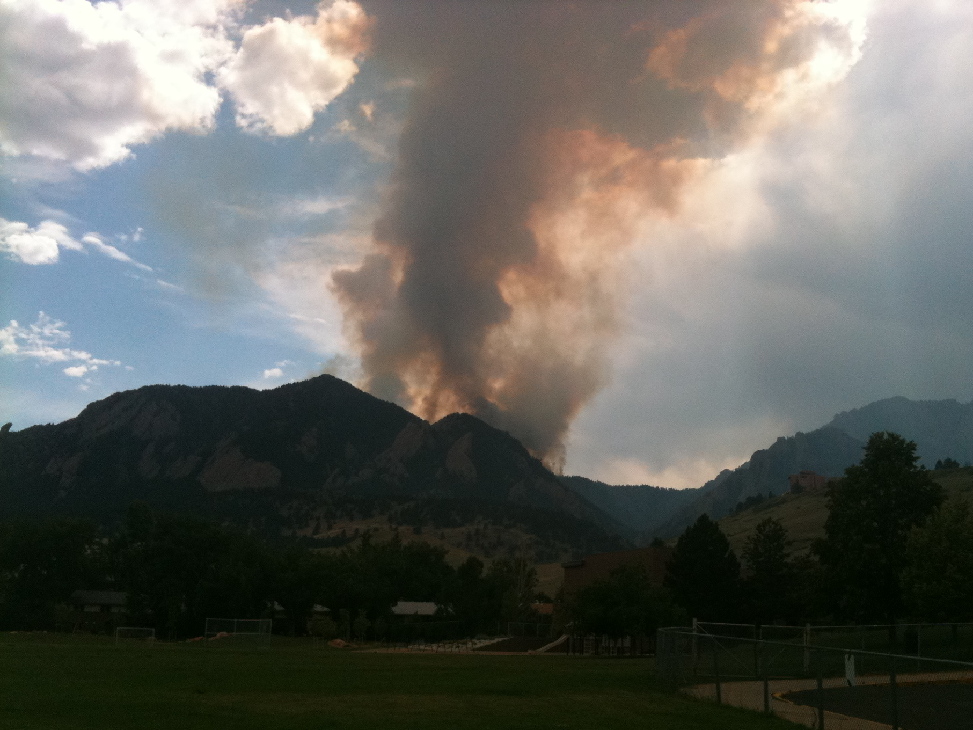
What are we talking about when we talk about drought?
Lecture 1
MISU Drought Seminar Series
Spring, 2022
Toby R. Ault
Visiting Professor, Fulbright Scholarship Program
Dept. of Earth & Atmospheric Sciences
Cornell University

Slide 2
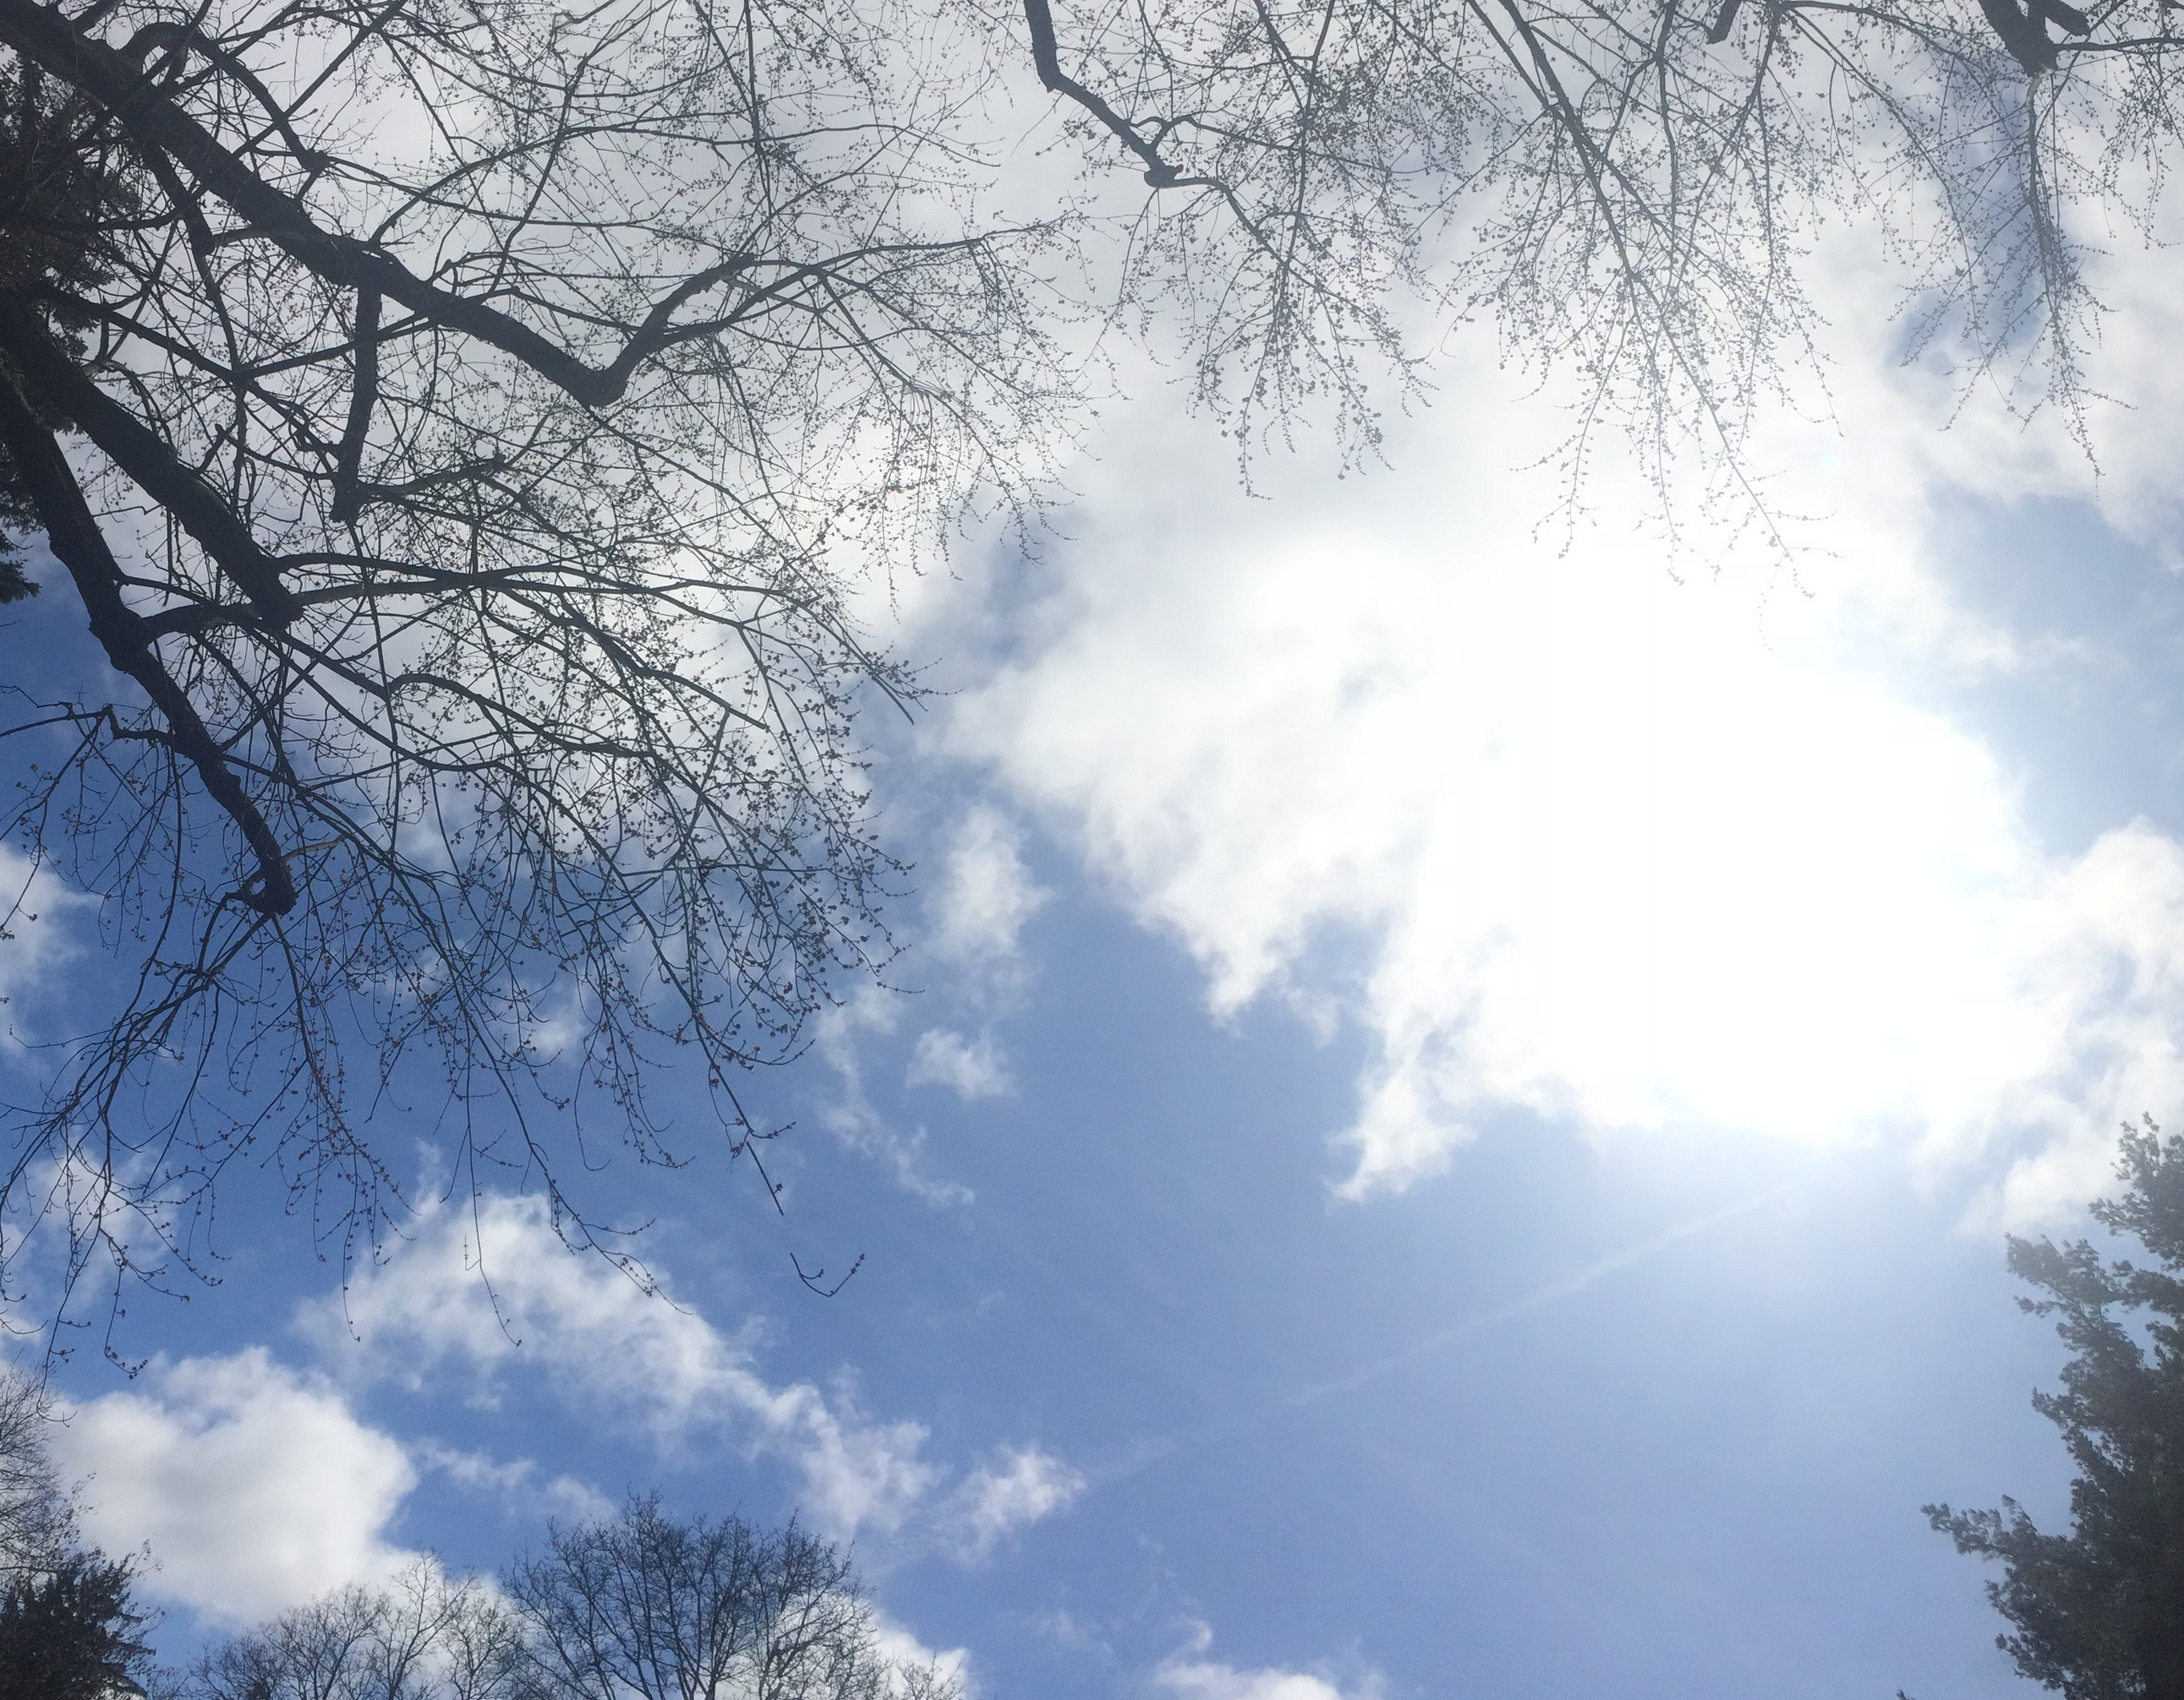
Meteorological Drought (Weeks/Months)
Cayuga Heights, NY (Ault)

Slide 3
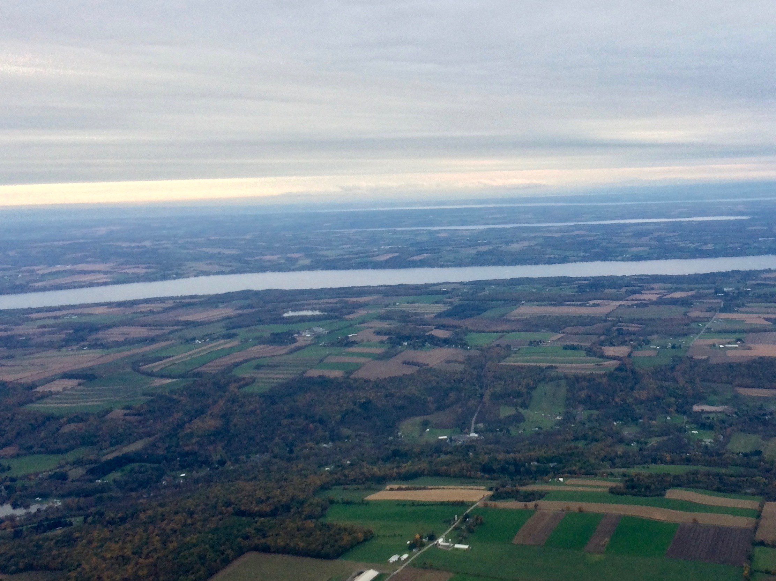
Agricultural Drought (Months/Seasons)
Tompkins County, NY (Ault)

Slide 4
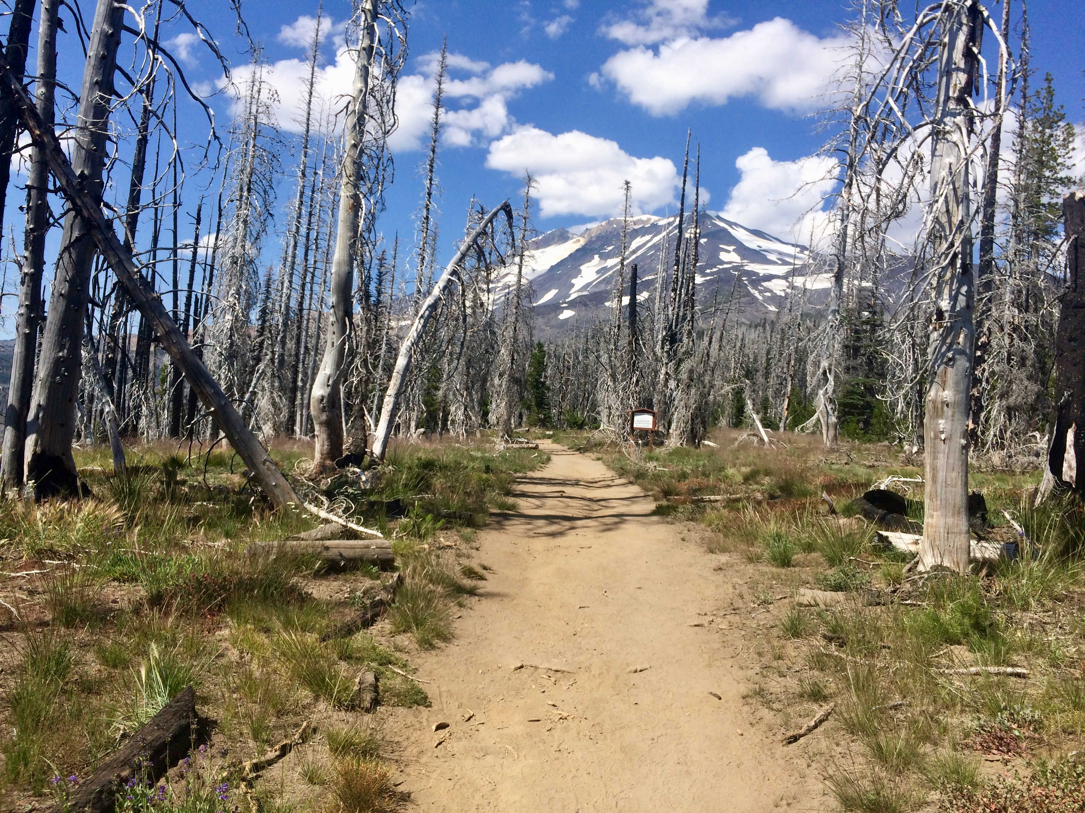
Ecological Drought
Gifford Pinchot National Forest, WA (Ault)

Slide 5
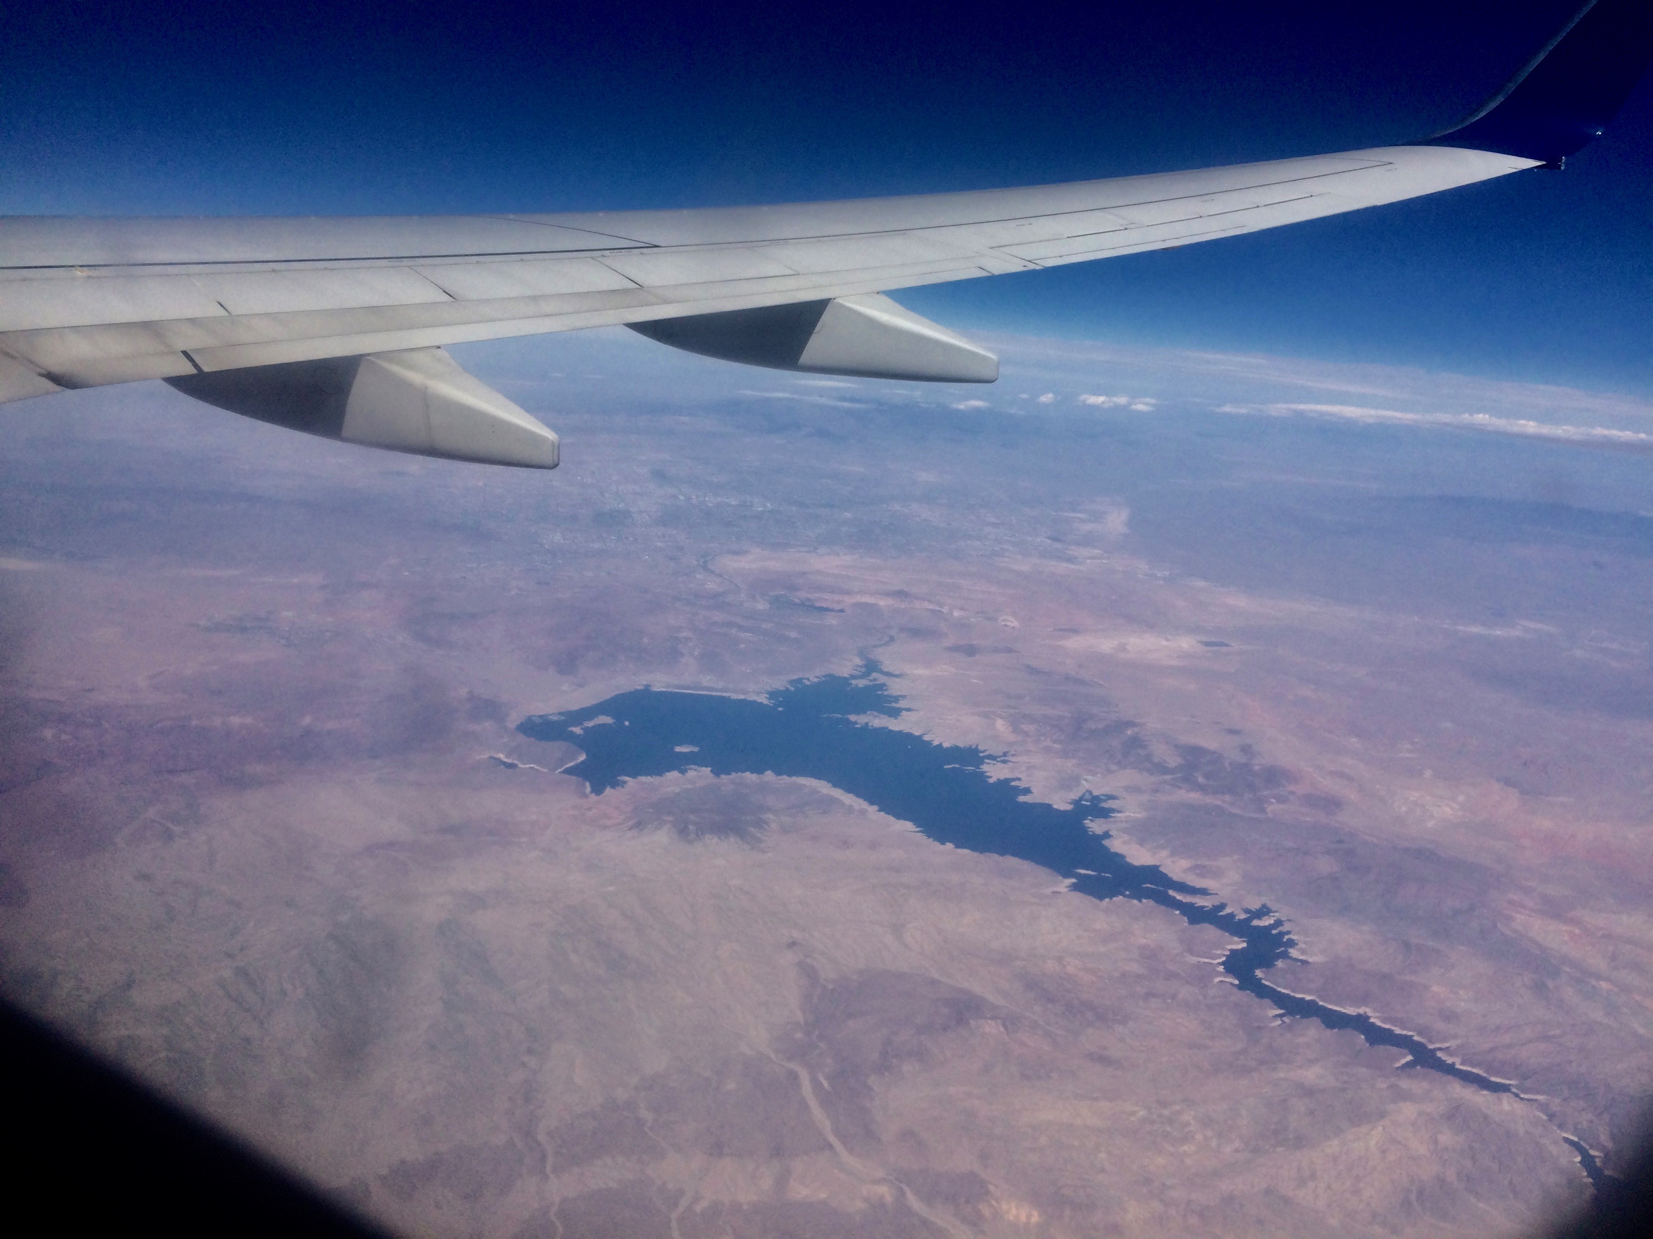
Hydrological Drought (Seasons/years)
Lake Mead, NV/AZ (Photo by T. Ault)

Slide 6
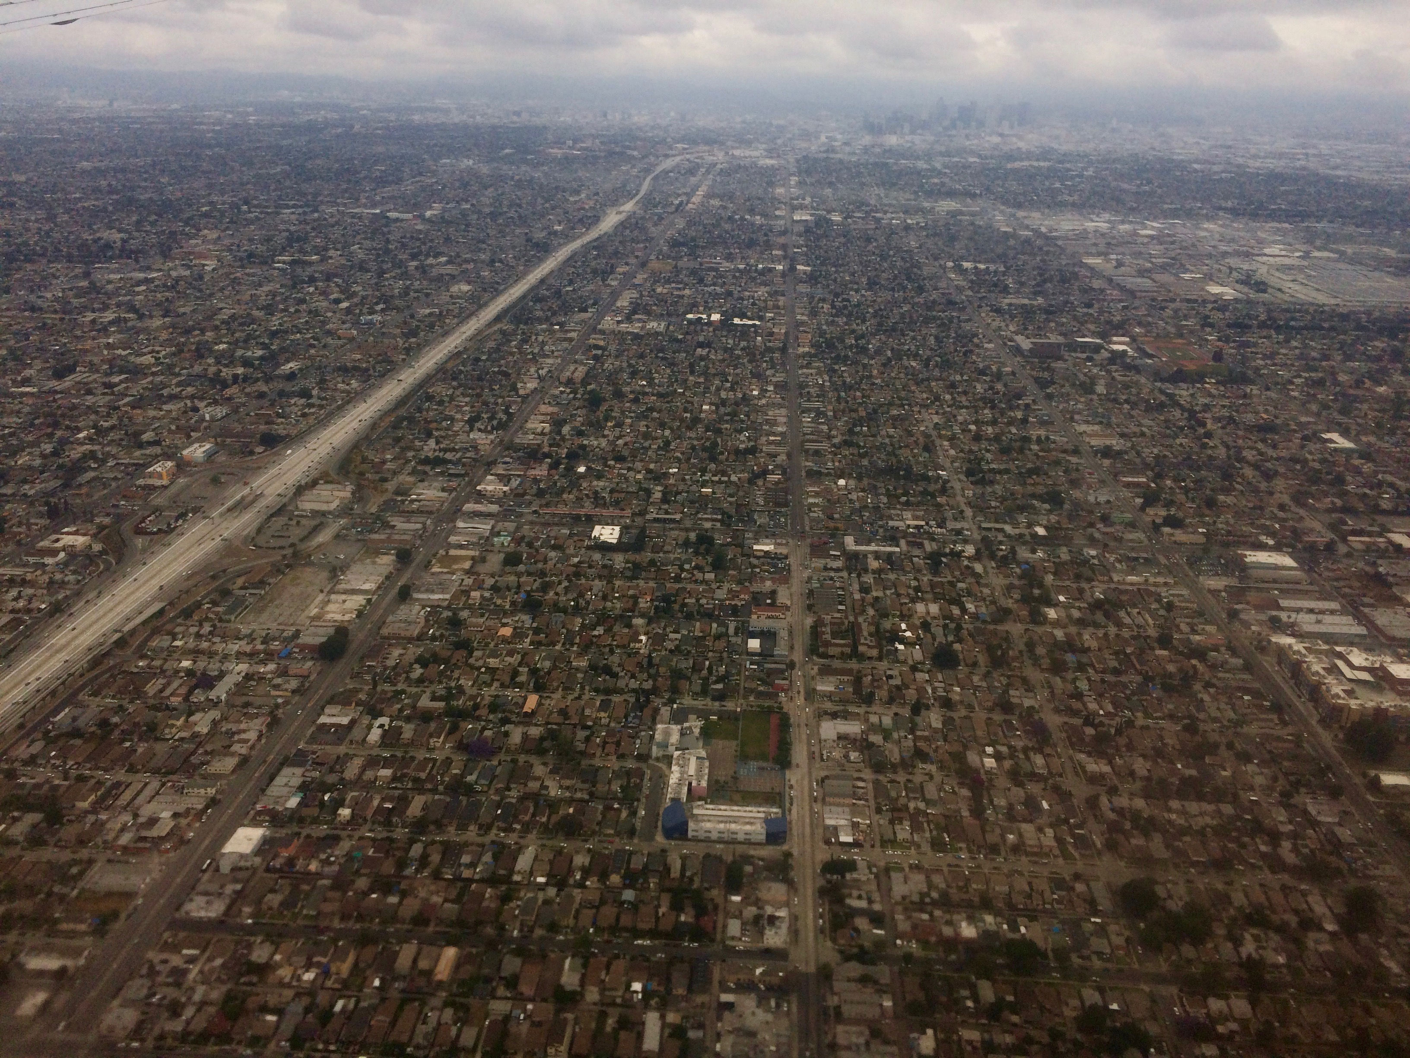
Socio-economic drought
Los Angeles, CA (Ault)

Slide 7
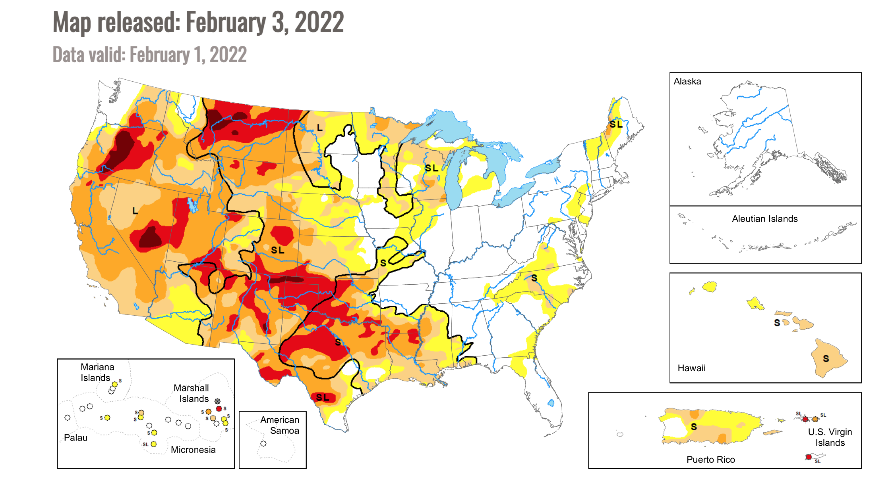
How do we monitor it?

Slide 9
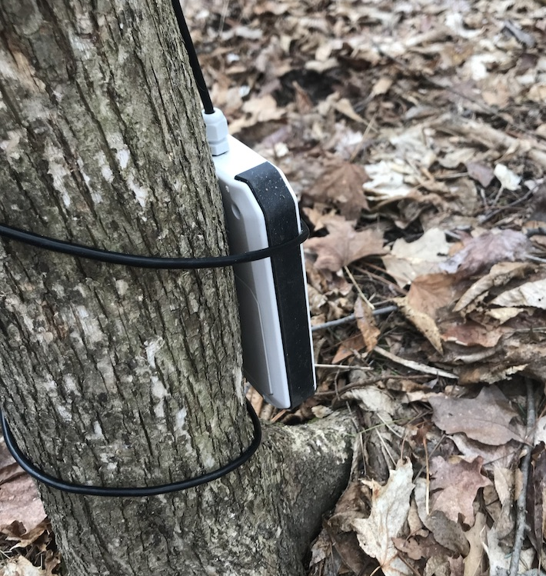
In Situ Measurements
Cayuga Nature Center, Trumansberg, NY (Ault)

Slide 10
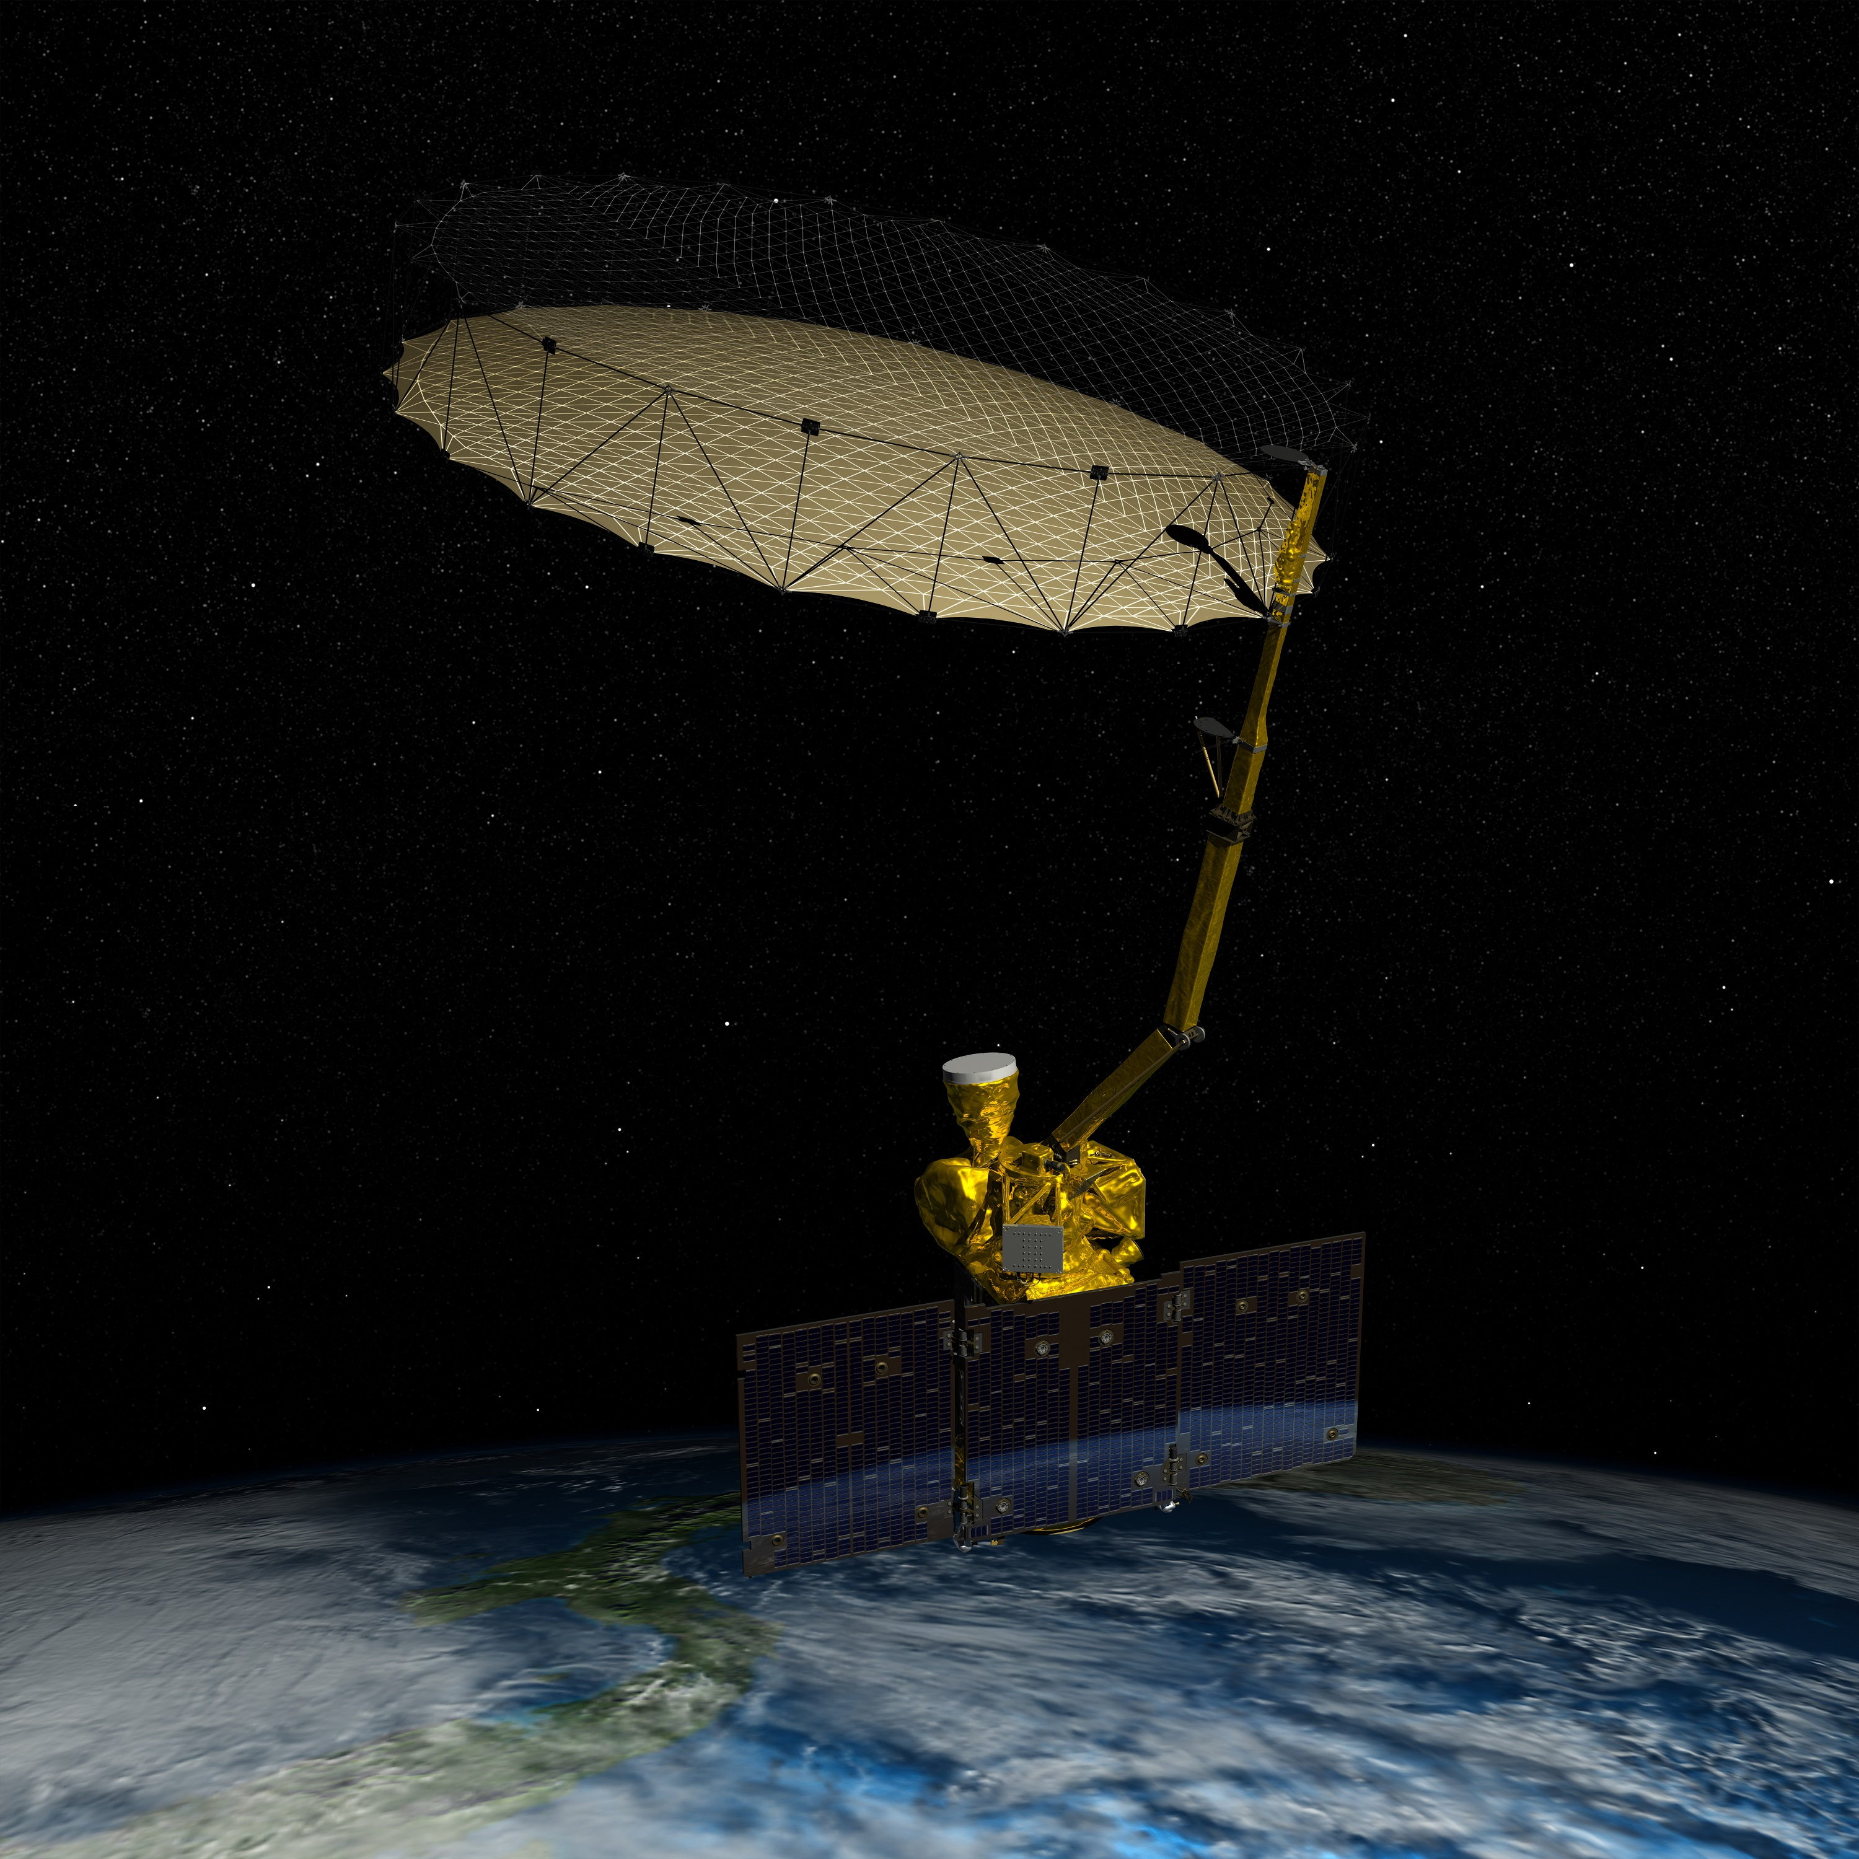
Remote Sensing
https://www.nasa.gov/sites/default/files/thumbnails/image/15-180.jpg

Slide 11
How do we model it?

Slide 12
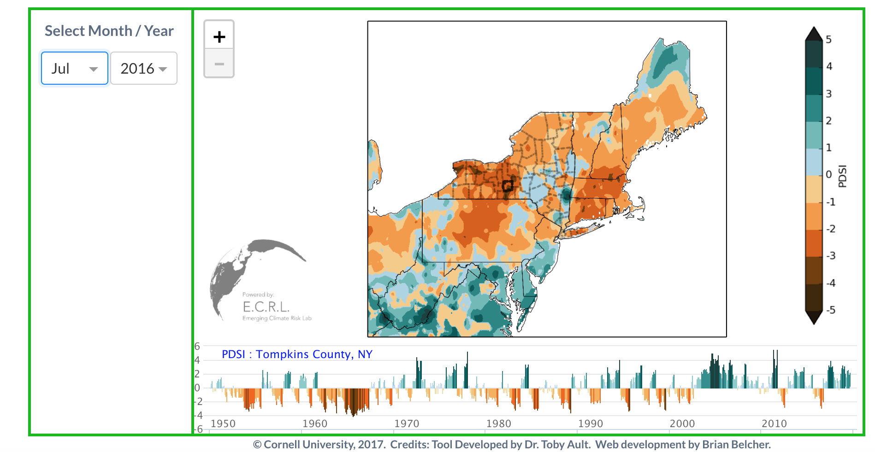
Drought Indices

Slide 13
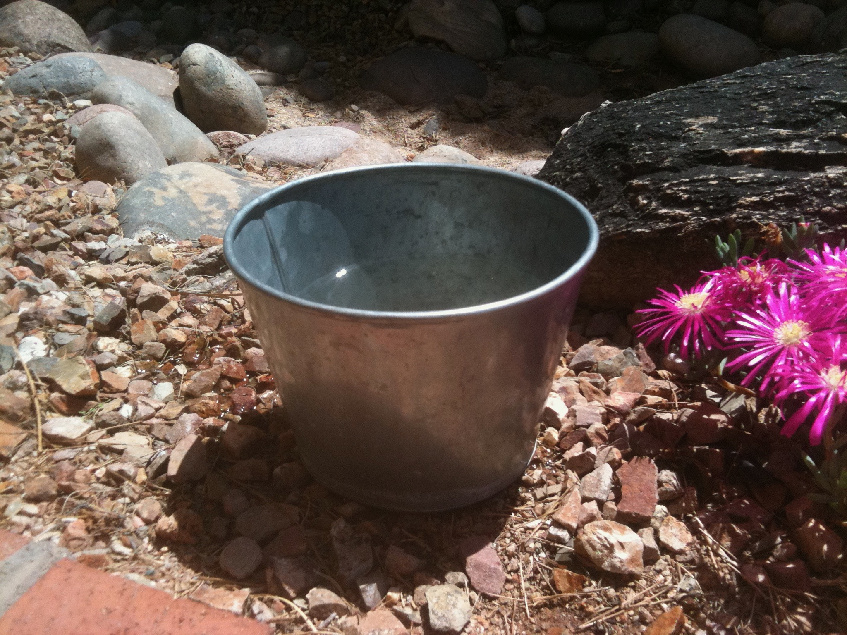
“Leaky bucket” models
Tucson, AZ (Ault)

Slide 14
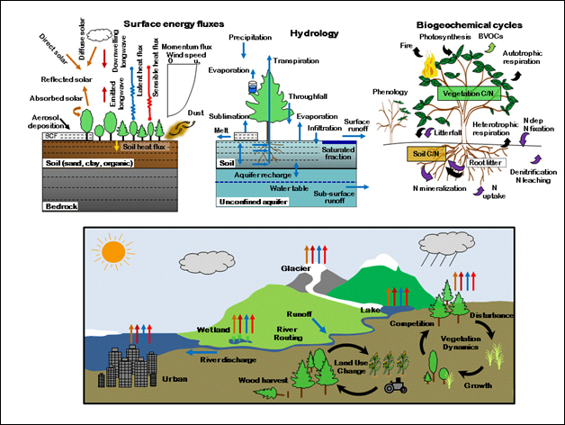
Land surface models
https://www.cesm.ucar.edu/models/clm/

Slide 15
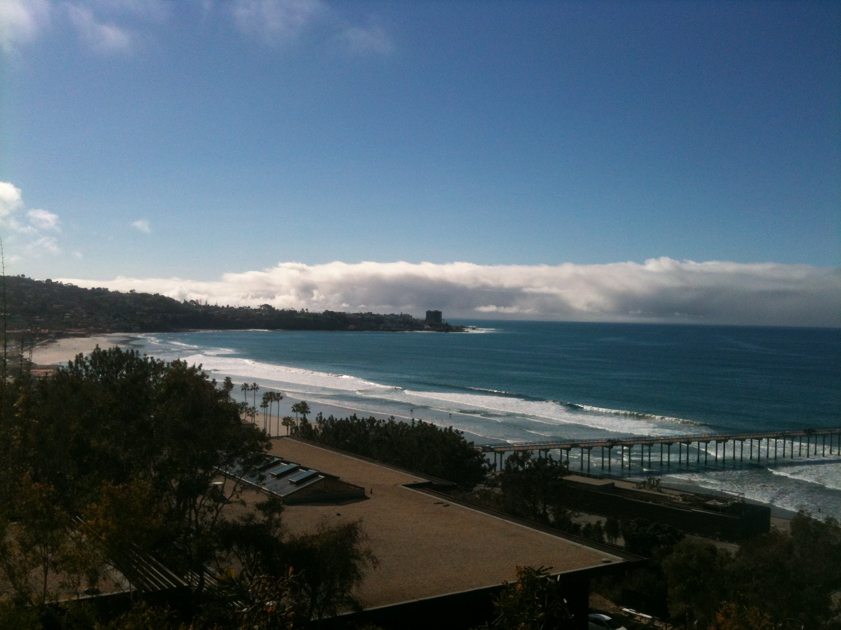
What causes drought?
La Jolla, CA (Ault)

Slide 16
From Ault, 2020 (Science)

Slide 17
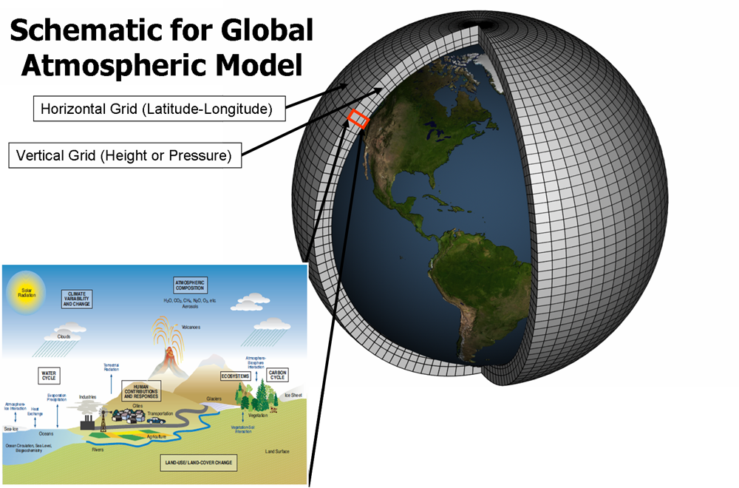
Drought in Climate Models
https://str.llnl.gov/december-2017/bader

Slide 18
From Ault, 2020 (Science)

Slide 19
From Ault, 2020 (Science)

Slide 20
From Ault, 2020 (Science)

Slide 21
Timeline of recent developments
 | 1990s | 2000s | 2010s | 2020s
Technology | Widespread PCs | HPC & Super-computers | Satellite remote sensing (SMAP) | AI, Machine Learning, low-cost sensors…
Impact on drought research | Proliferation of drought indices, early soil moisture models | Land surface models become widely used and usable (NLDAS, GLDAS, CMIP, etc…) | Unprecedented global observations of surface soil moisture | (Up to you!)

Slide 22
Further Reading
K. T. Redmond, “The depiction of drought - A commentary,” Bulletin of the American Meteorological Society, vol. 83, no. 8, pp. 1143–1147, 2002.
T. R. Ault (2020): On the essentials of drought in a changing climate. Science, 368 (6488), 256-260. DOI: 10.1126/science.aaz5492
D. A. Wilhite, Chapter 1 Drought as a Natural Hazard: Concepts and Definitions. Lincoln, NE: Drought Mitigation Center Faculty Publications, 2000.
A. K. Mishra and V. P. Singh, “A review of drought concepts,” JOURNAL OF HY- DROLOGY, vol. 391, pp. 204–216, sep 2010.

