Slide 1
Cracking the Emerging Markets Enigma
Andrew Karolyi
Professor of Finance & Alumni Professor of Asset Management, Cornell University
Presentation to Cornell International Business Association, March 19, 2015

Slide 2
I. The Phenomenon: EMs in 2013

Slide 3
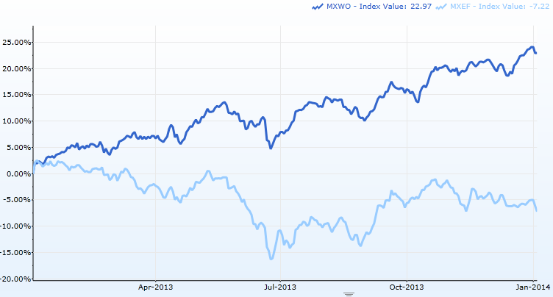
2013: A Tough Year for EMs
MSCI World
MSCI Emerging Markets

Slide 4
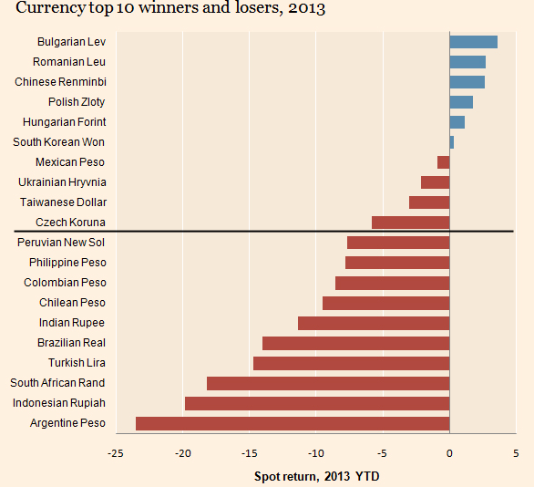

Slide 5
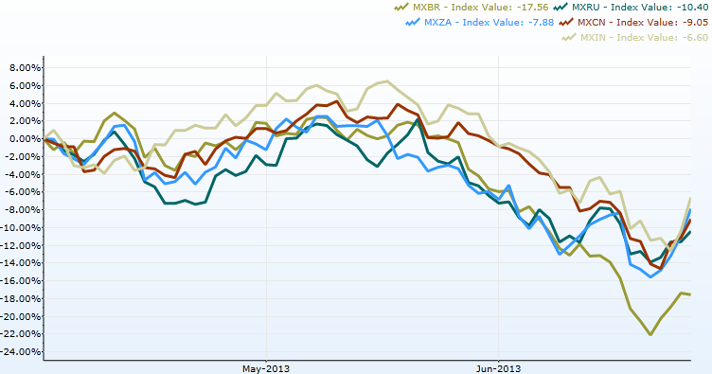
Sliding BRICS in May & June

Slide 6
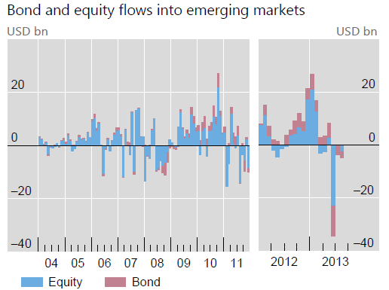
?
Bank for International Settlements Quarterly Review

Slide 7
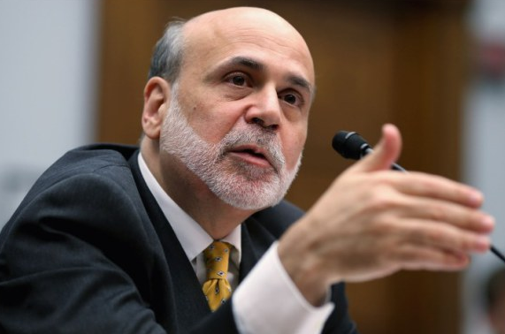
What happened in May & June?
“Normalize”?

Slide 8
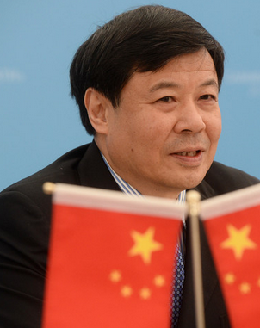
And the Taper Tantrums Began!
“We hope that the issuing
country of the largest reserve
currency in the world should
be mindful of the spillover
effects of its macroeconomic
policies.” Zhu Guangyao, China’s Deputy Finance Minister

Slide 9
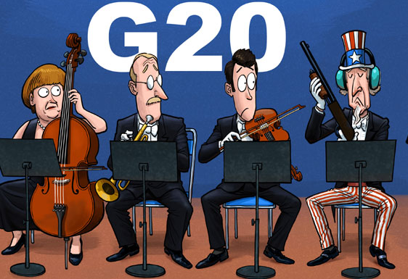
China Daily, September 6, 2013

Slide 10
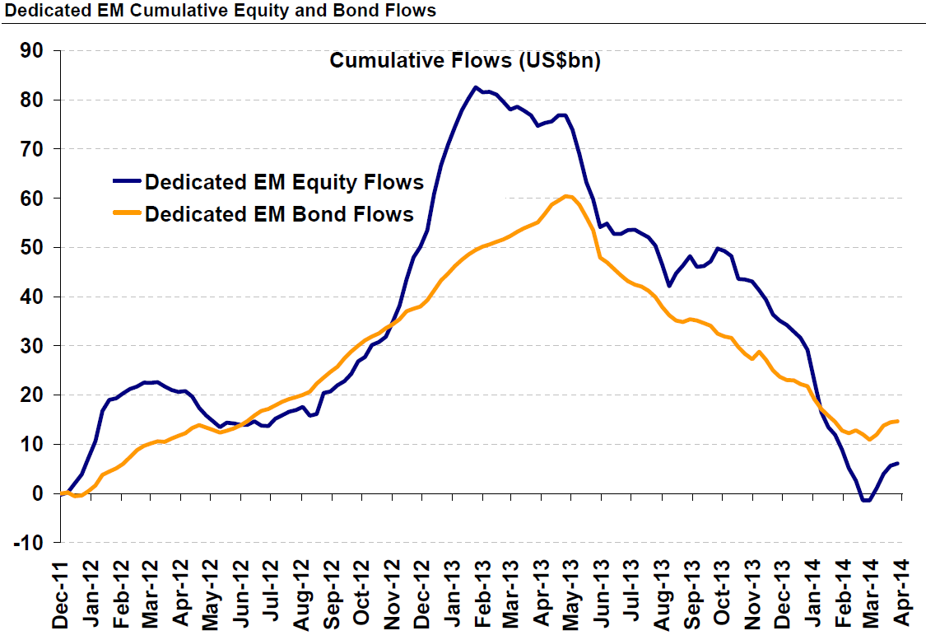
EM outflows continue in 2014…

Slide 11
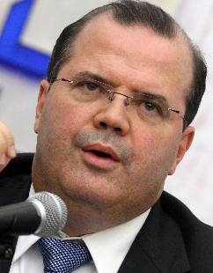
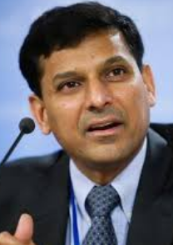
…and so do the Taper Tantrums
“International monetary cooperation
has broken down…Industrial countries
have to play a part in restoring that
[co-operation], and they can’t at this
point wash their hands off and say, we’ll
do what we need to and you do the
adjustment.” RBI Governor Raghu Rajan
“… a lack of a coordinated exit from
exceptionally loose monetary policies
was done at the expense of emerging
markets.” Alexandre Tombini, Governor of Central Bank of Brazil

Slide 12
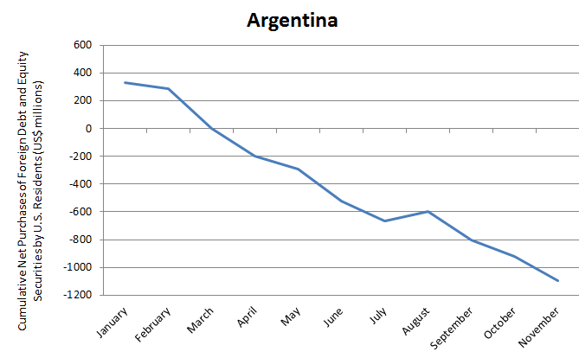
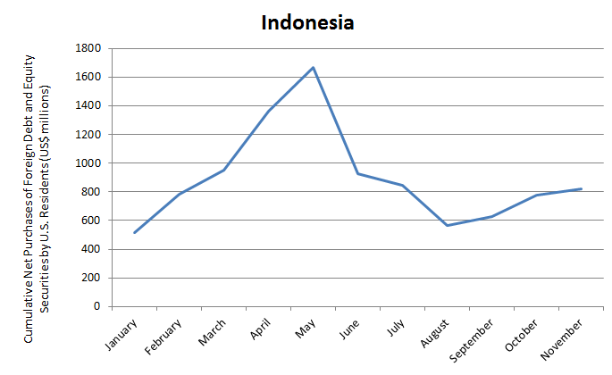
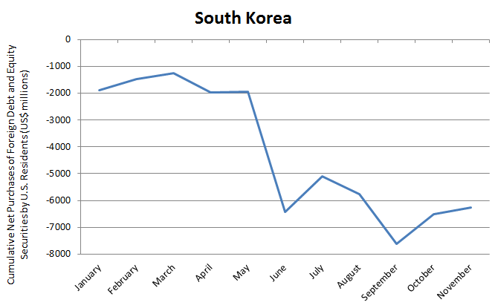
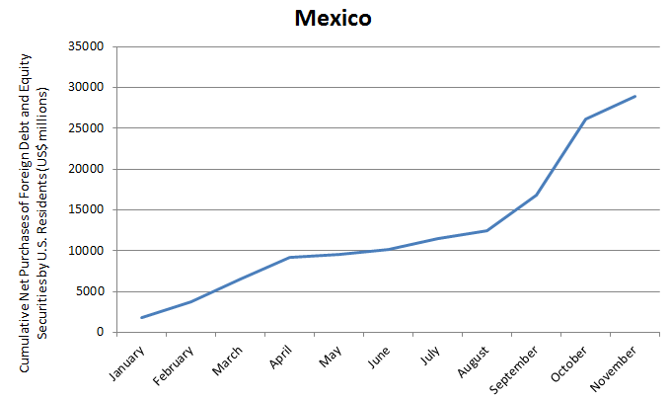
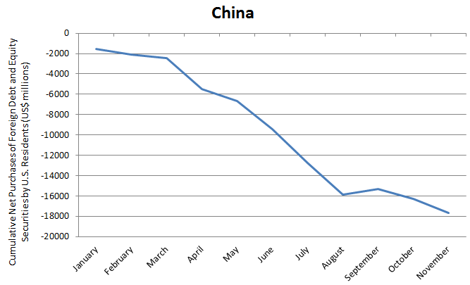
Different countries hit differently?
? ? ?

Slide 13
So what do we have?
Some Observations:
The tapering talk had a sharp negative impact on emerging markets
It was surprisingly large
Different countries were affected differently
Some Questions:
Which were hit hardest by Fed’s taper talk?
Why these and not others?
Is it related to “fundamentals”? Which ones?

Slide 14
II. A (biased) perspective on the EM Experience in 2013

Slide 15
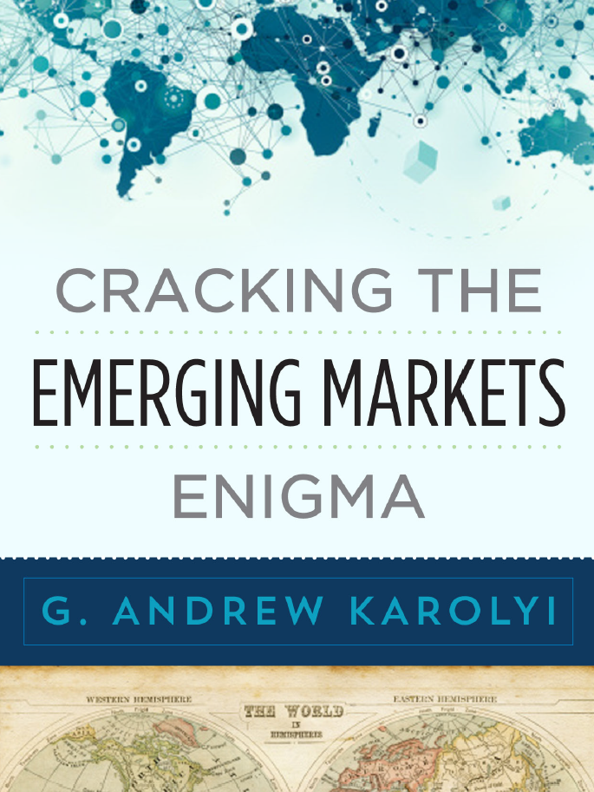
Forthcoming
May 2015

Slide 16
What is the new book about?
I develop a rigorous, comprehensive, and practical framework to measure the fundamental risks associated with investing in emerging markets:
Rigorous. Foundation of sound academic research at its core.
Comprehensive. Multiple dimensions of risks reflecting the uneven quality of institutions that assure integrity of markets.
Practical. I devise a scoring system that ranks EMs on each dimension of risk using principal component analysis (PCA).
I build the indicators for 33 EMs plus 24 developed using publicly-available data sources and show they work very well in explaining foreign investor cross-country holdings

Slide 17
Why bother writing it?
To elevate the quality of the discourse in industry circles about what an emerging market really is
Answer? Page 1, first sentence: “Underfunded growth opportunities with problems”
Why bother?
Refocus attention: NOT JUST the growth potential
Emphasize multiple dimensions of risk that can matter
Stop with the endless race to coin a new acronym! (BRIC, BRICS, N-11, TIMPS, CIVETS, MINT, etc.)
Useful to explain how investors think based on actions?
Academics? A useful summary of our collective wisdom?

Slide 18
What are my risk indicators?
Market Capacity Constraints
Market cap to GDP
GDP per capita
Private/public bond market capitalization
Turnover ratios
New issues to GDP
Limits on Legal Protections
Anti-self-dealing
Anti-director rights
Creditor info, registry
Director liability, shareholder suits, contract enforcement
Insider trading laws
Foreign Investability Restrictions
S&P/IFC accessibility
Registration rules, ownership restrictions, FX convertibility limits
Withholding taxes, double taxation treaties
Political Instability
Political constraints (PolConV, PolityIV, DPI)
Voice & Accountability, Govt. Effectiveness, Rule of Law, Regulatory Burden
Transparency International’s Corruption
Heritage Foundation’s Freedom Index
Operational Inefficiencies
Brokerage commissions, transfer taxes, market impact costs
Illiquidity proxies
Short-sales constraints
Settlement cycles (T+N), book-entry, delivery vs. payment (DVP)
Corporate Opacity
Governance rankings
Accounting standards
Earnings management
Blockholder control
Closely-held shares

Slide 19
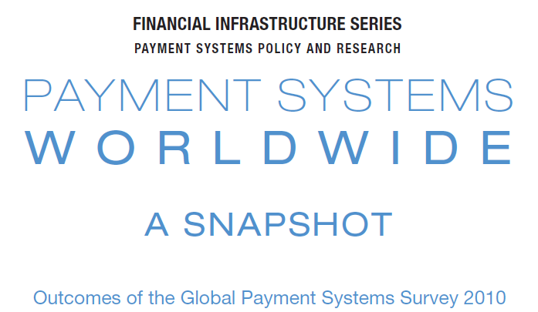
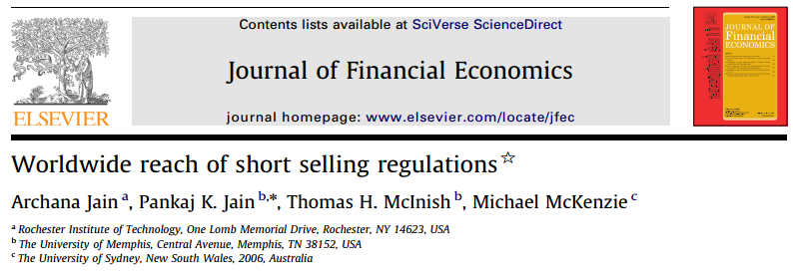
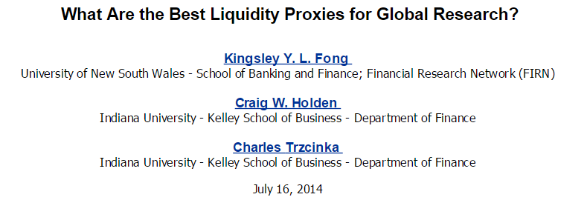
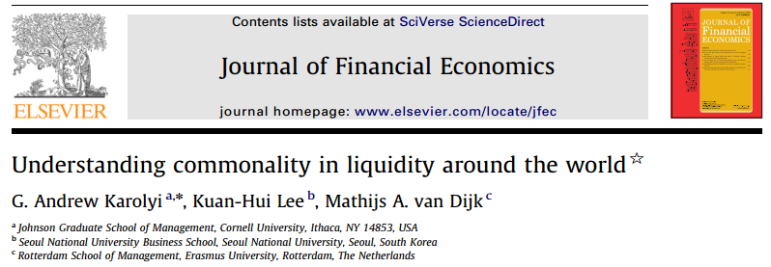
How do I build them?
Step 1: Harvest the wisdom of academic research
For example: Lots of research on market microstructure around the world for “Operational inefficiencies”
Step 2: Combine with other useful data
Step 3: Synthesize into single risk index with PCA

Slide 20
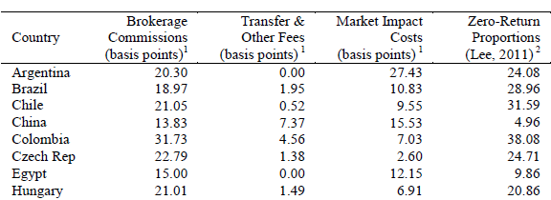
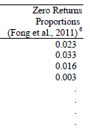
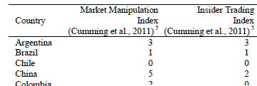
How do I build them?

Slide 21
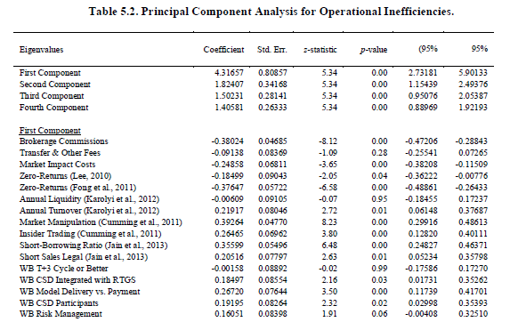
PCA for Operational Inefficiencies
Why need four components?
?!?!

Slide 22
How is the book organized?
Part I. Setting the Stage:
Accepting the challenge
Defining my EM universe
A Primer on PCA methodology
Part II. Building the EM Risk Indicators
Part III. Validating the EM Risk Indicators
I conduct three experiments
Part IV. Conclusions and Caveats

Slide 23
How do the indicators look?

Slide 24
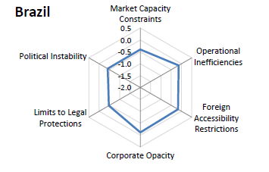
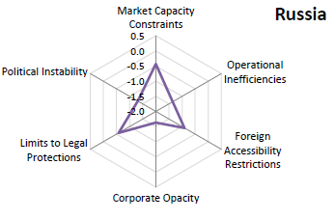
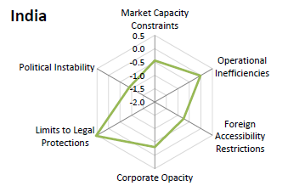
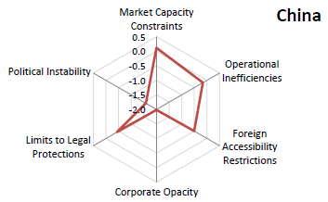
How do the indicators look?

Slide 25
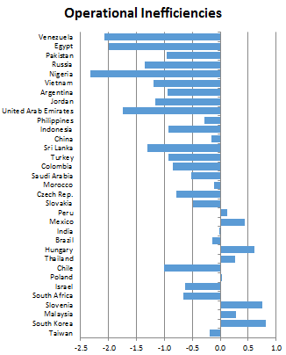
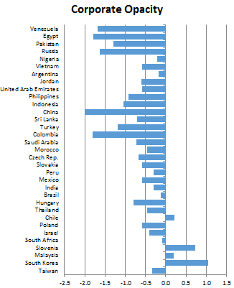
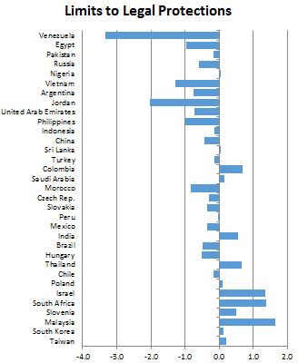
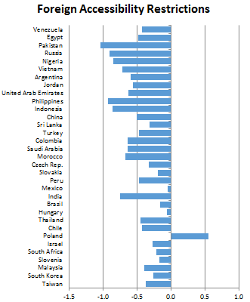
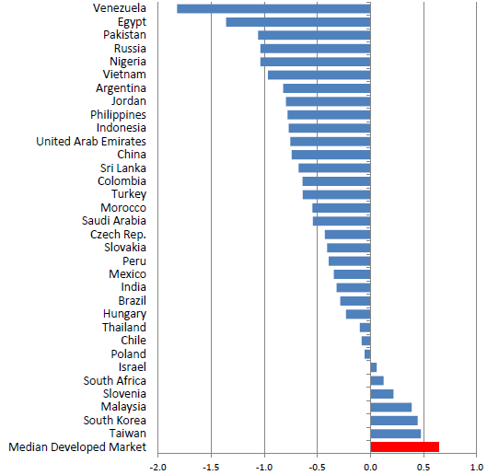
How do the EMs rank overall?

Slide 26
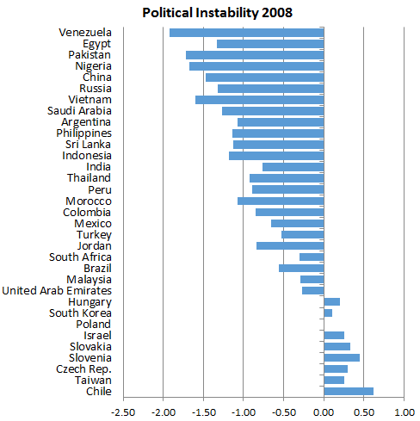
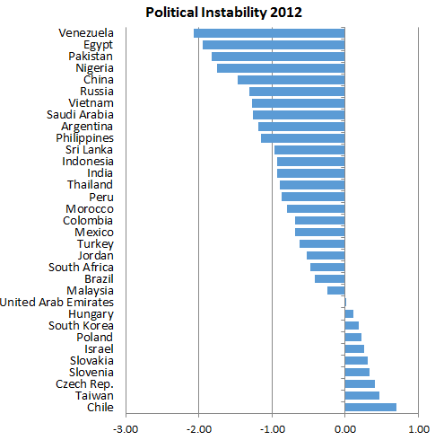
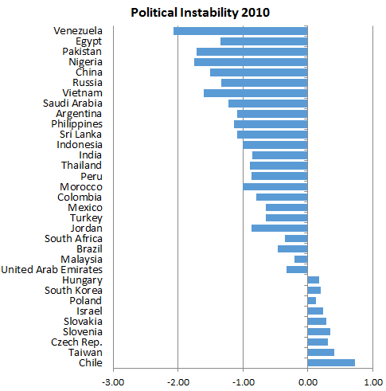
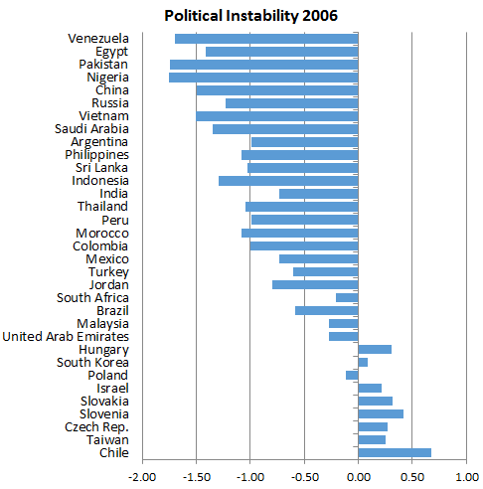
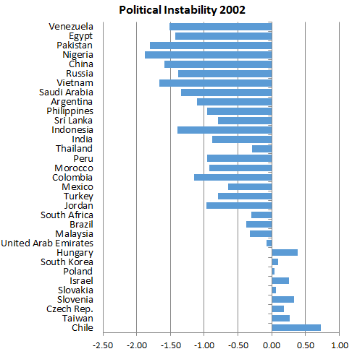
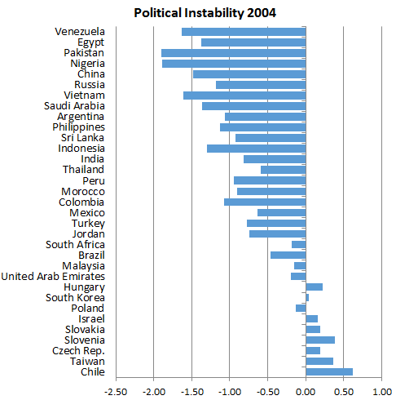
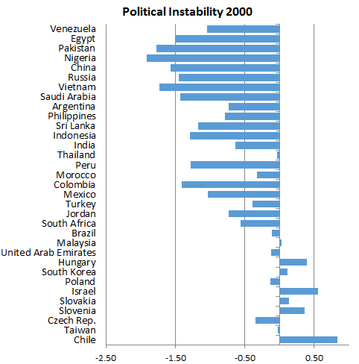
They can evolve over time

Slide 27
III. Validating EM Indicators

Slide 28
Validating EM Indicators: Part I
In Part III of the book, I test whether the six risk indicators can help “explain” foreign portfolio holdings in 2012:
FactSet (formerly Lionshares), global institutional; over $23.6 trillion AUM, $6.3 trillion is foreign only
U.S. Treasury International Capital (TIC), U.S. residents only, retail and institutional, $7.9 trillion
Focus is on excess holdings relative to MSCI ACWI weights to capture potential “biases”

Slide 29
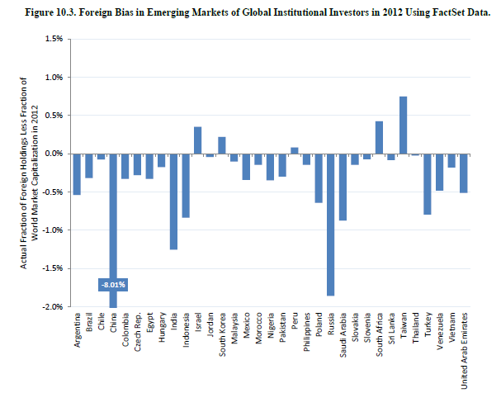
Biases in Foreign Holdings
U.S. residents invest $1.01 trillion in 2012
South Africa
Taiwan
Israel
Indonesia
Turkey
India
China
Russia

Slide 30
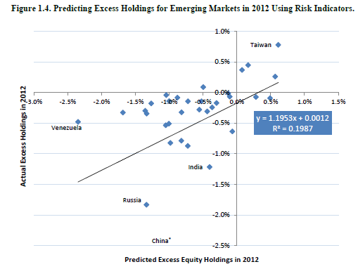
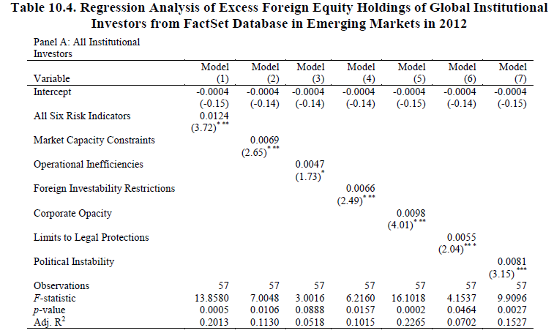
Regression Evidence
A 1σ increase in quality of corporate governance – from Philippines to South Africa – is associated with 0.98% increase (decrease) in over (under) weight
Yikes!

Slide 31
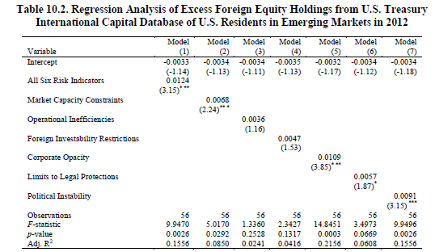
More Evidence on US Investors
Very similar predictive relationship for U.S. investors alone, especially for “softer” constraints

Slide 32
IV. New Risk Indicators and the EM Experience in 2013?

Slide 33
A Quasi-Natural Experiment?
What about “taper talk” and EM portfolio flows in 2013?
Are they linked empirically to the cross-country differences in fundamental risks?
An out-of-sample experiment? (Chapter 11)

Slide 34
Validating EM Indicators Part II: 2013 EM portfolio flows
Lots of cross-country variation!
U.S. Residents Only

Slide 35
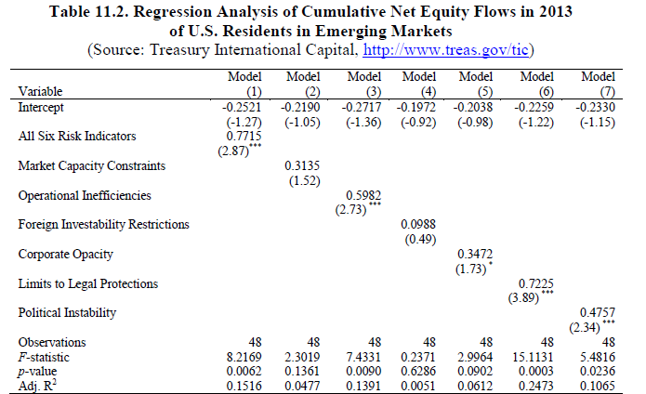
What about 2013 EM flows?
A 1σ increase in limits to legal protections – from Argentina to Korea – is associated with 0.72% higher inflows (lower outflows) in 2013 as a % of 2012 holdings

Slide 36
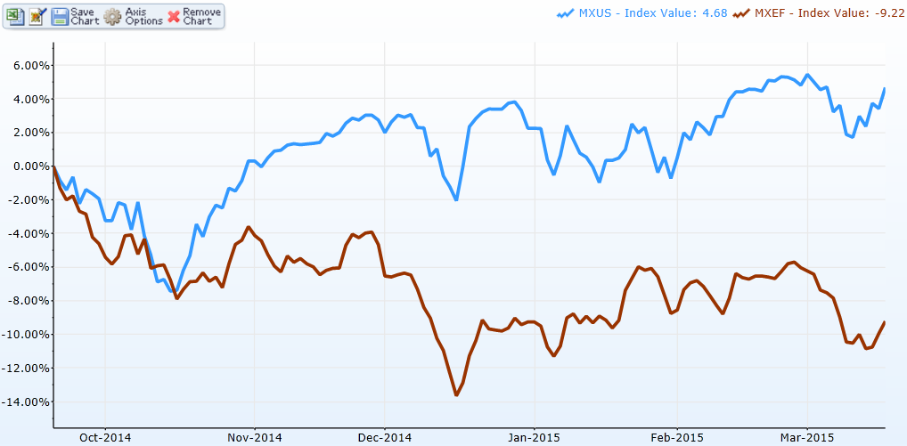
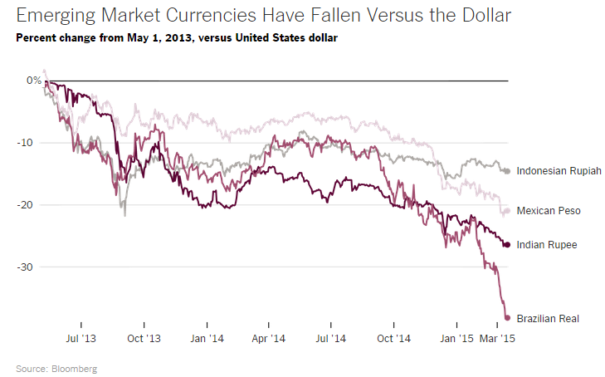
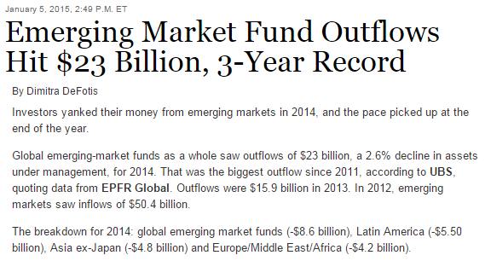
Emerging Market Enigma Cracked?
Hardly!
And 2013 is a useful quasi-natural experiment to evaluate what institutional attributes of EMs really matter to global investors
“Softer” constraints like corporate opacity, limits on legal protections, political instability seem to matter more than “basic” risks like operational costs, market capacity constraints, foreign restrictions
What about EMs in 2015?

