Slide 1
Cracking the Emerging Markets Enigma
Andrew Karolyi
Professor of Finance & Alumni Professor of Asset Management, Cornell University
Dimensional Fund Advisors, Austin, TX March 23, 2015

Slide 2
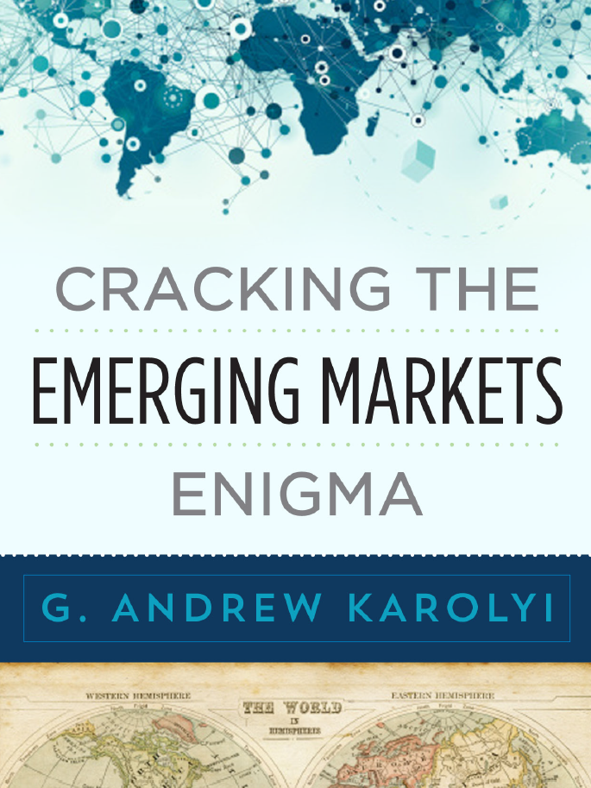
Forthcoming
Oxford
University Press,
May 2015

Slide 3
What is the new book about?
I develop a rigorous, comprehensive, and practical framework to measure the fundamental risks associated with investing in emerging markets:
Rigorous. Foundation of sound academic research at its core.
Comprehensive. Multiple dimensions of risks reflecting the uneven quality of institutions that assure integrity of markets.
Practical. I devise a scoring system that ranks EMs on each dimension of risk using principal component analysis (PCA).
I build the indicators for 33 EMs plus 24 developed using publicly-available data sources and show they work very well in explaining foreign investor cross-country holdings

Slide 4
Why bother writing it?
To elevate the quality of the discourse in industry circles about what an emerging market really is
Answer? Page 1, first sentence: “Underfunded growth opportunities with problems”
Why bother?
Refocus attention: NOT JUST the growth potential
Emphasize multiple dimensions of risk that can matter
Stop with the endless race to coin a new acronym! (BRIC, BRICS, N-11, TIMPS, CIVETS, MINT, etc.)
Academics? A useful summary of our collective wisdom?

Slide 5
What are my risk indicators?
Market Capacity Constraints
Market cap to GDP
GDP per capita
Private/public bond market capitalization
Turnover ratios
New issues to GDP
Limits on Legal Protections
Anti-self-dealing
Anti-director rights
Creditor info, registry
Director liability, shareholder suits, contract enforcement
Insider trading laws
Foreign Investability Restrictions
S&P/IFC accessibility
Registration rules, ownership restrictions, FX convertibility limits
Withholding taxes, double taxation treaties
Operational Inefficiencies
Brokerage commissions, transfer taxes, market impact costs
Illiquidity proxies
Short-sales constraints
Settlement cycles (T+N), book-entry, delivery vs. payment (DVP)
Political Instability
Political constraints (PolConV, PolityIV, DPI)
Voice & Accountability, Govt. Effectiveness, Rule of Law, Regulatory Burden
Transparency International’s Corruption
Heritage Foundation’s Freedom Index
Corporate Opacity
Governance rankings
Accounting standards
Earnings management
Blockholder control
Closely-held shares

Slide 6
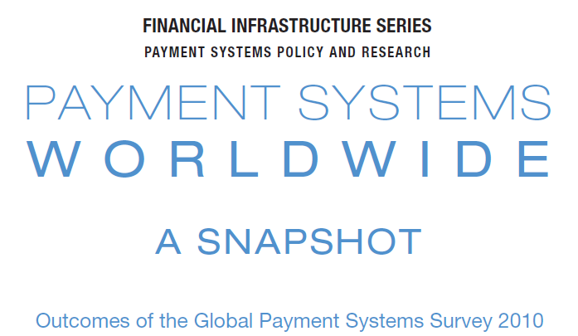
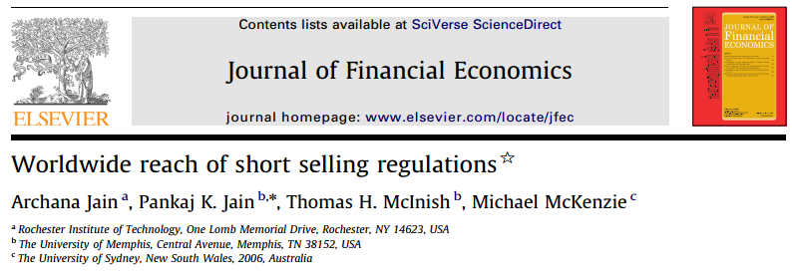
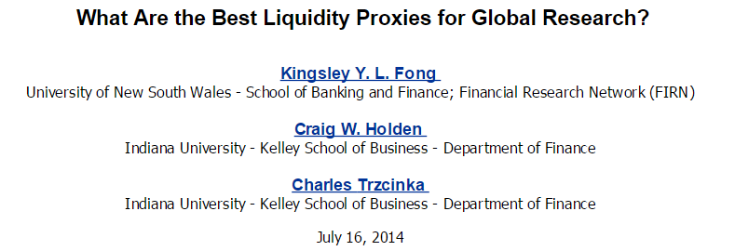
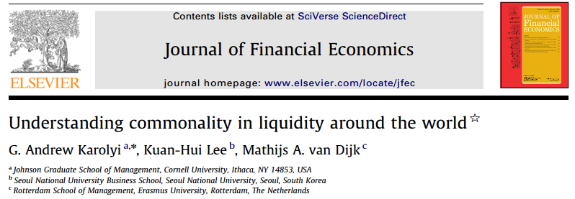
How do I build them?
Step 1: Harvest the wisdom of academic research
For example: Lots of research on market microstructure around the world for “Operational inefficiencies”
Step 2: Combine with other useful data
Step 3: Synthesize into single risk index with PCA

Slide 7
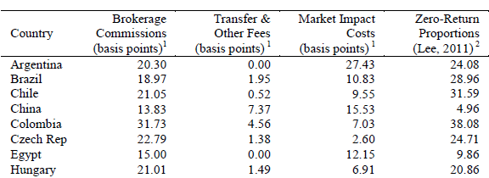
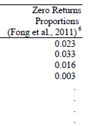
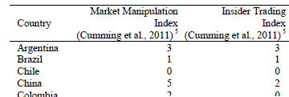
How do I build them?

Slide 8
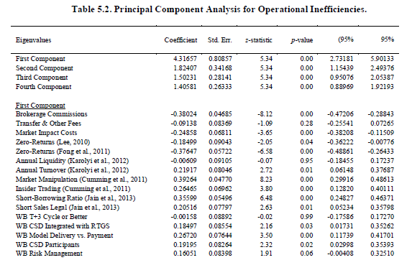
PCA for Operational Inefficiencies
???

Slide 9
How is the book organized?
Part I. Setting the Stage:
Accepting the challenge
Defining my EM universe
A Primer on PCA methodology
Part II. Building the EM Risk Indicators
Part III. Validating the EM Risk Indicators
I conduct three experiments
Part IV. Conclusions and Caveats

Slide 10
How do the indicators look?

Slide 11
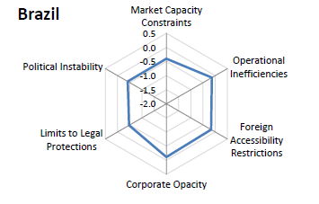
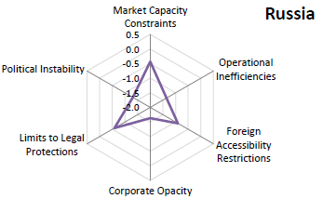
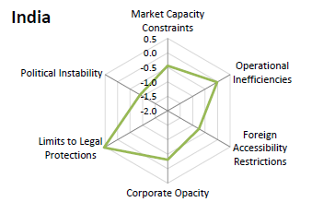
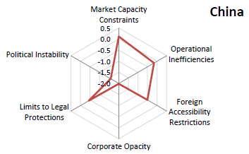
How do the indicators look?

Slide 12
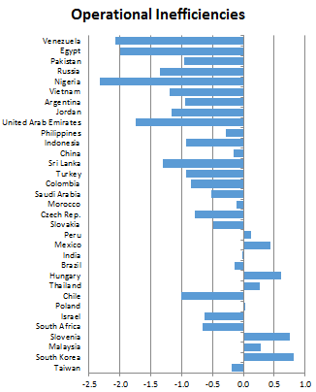
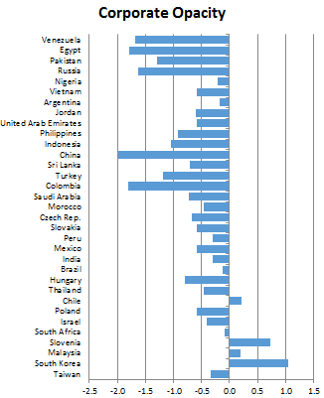
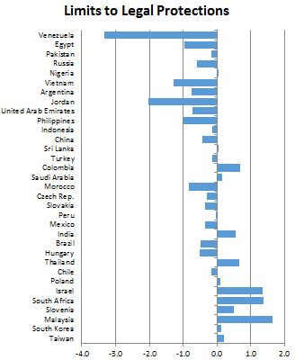
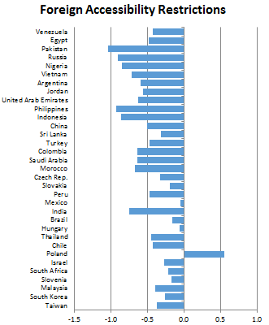
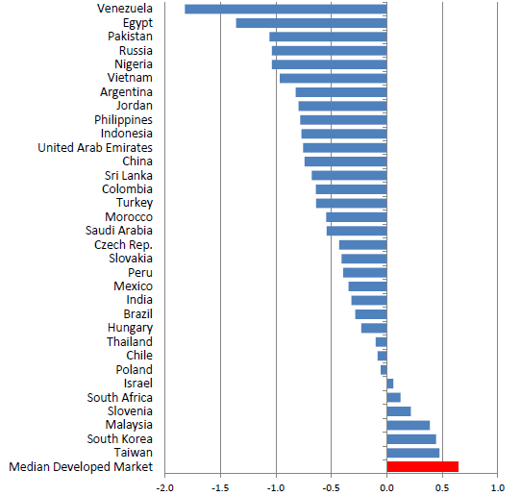
How do the EMs rank overall?

Slide 13
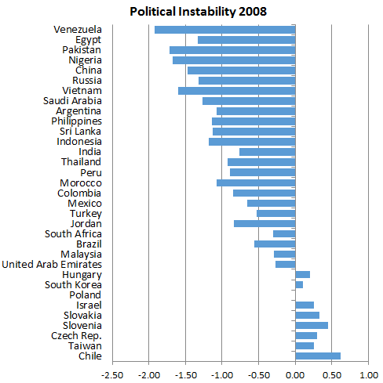
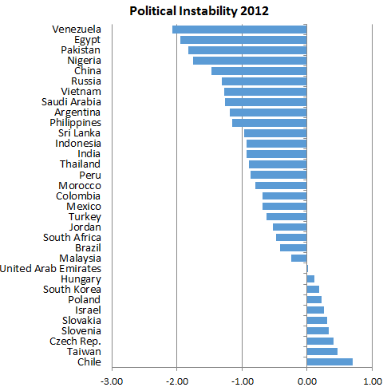
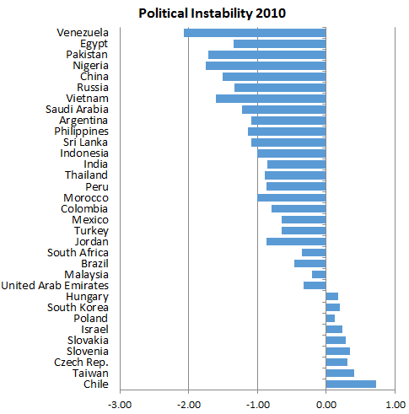
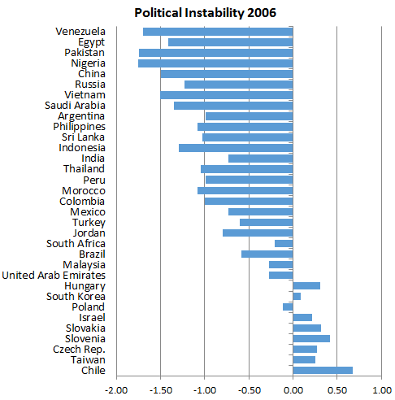
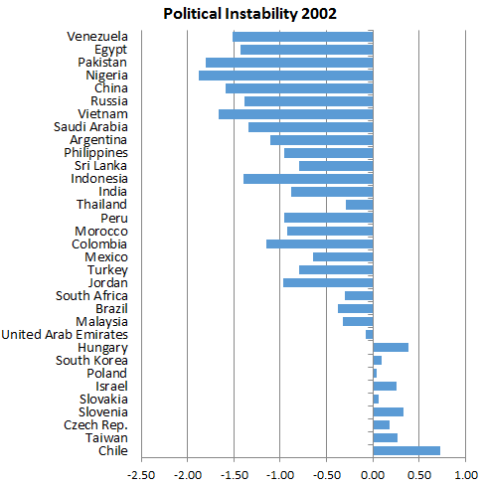
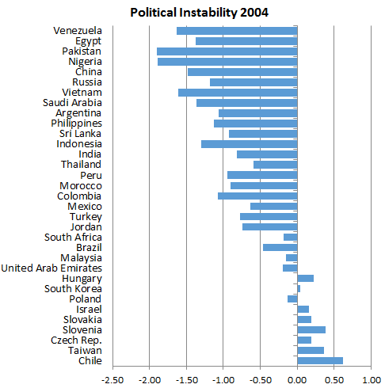
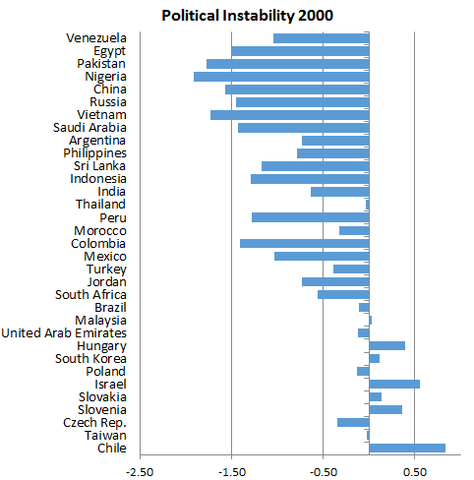
They can evolve over time

Slide 14
Validating EM Indicators: Part I
In Part III of the book, I test whether the six risk indicators can “explain” foreign portfolio holdings in 2012:
FactSet (formerly Lionshares), global institutional; over $23.6 trillion AUM, $6.3 trillion is foreign only
U.S. Treasury International Capital (TIC), U.S. residents only, retail and institutional, $7.9 trillion
Focus is on excess holdings relative to MSCI ACWI weights to capture potential “biases”

Slide 15
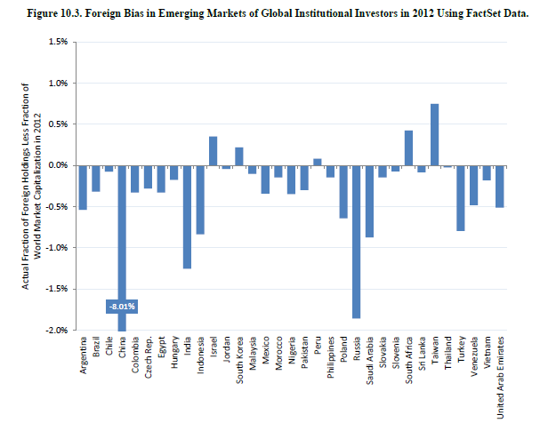
Biases in Foreign Holdings
South Africa
Taiwan
Israel
Indonesia
Turkey
India
China
Russia

Slide 16
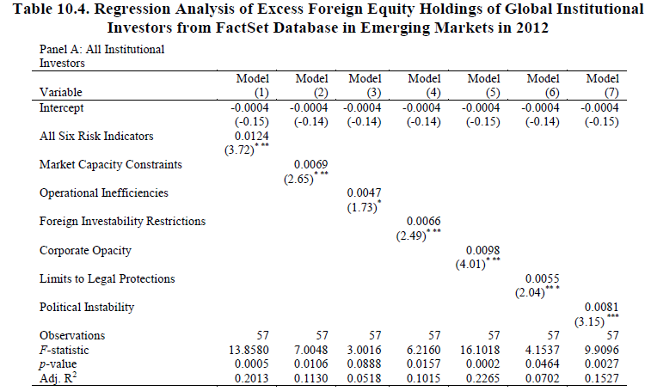
Regression Evidence
A 1σ increase in quality of corporate governance – from Philippines to South Africa – is associated with 0.98% increase (decrease) in over (under) weight

Slide 17
A Quasi-Natural Experiment?
Massive $35b portfolio outflows from EMs in May/June 2013 around Fed’s “taper talk”
Some countries were affected more than others, some unaffected by flows
Are they linked empirically to the cross-country differences in fundamental risks?
An out-of-sample experiment? (Chapter 11)

Slide 18
Validating EM Indicators Part II: 2013 EM portfolio flows
Lots of cross-country variation!
U.S. Residents Only

Slide 19
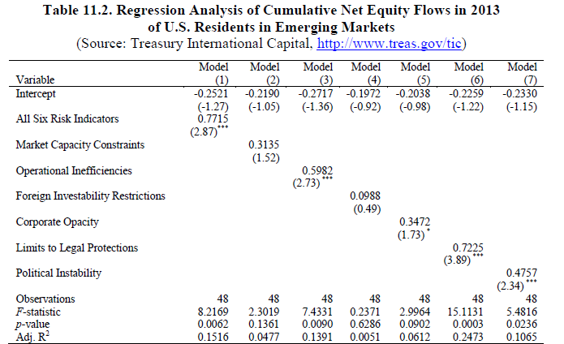
What about 2013 EM flows?
A 1σ increase in limits to legal protections – from Argentina to Korea – is associated with 0.72% higher inflows (lower outflows) in 2013 as a % of 2012 holdings

Slide 20
A new study (in the works)
“Racing to the Exit: Emerging Market Mutual Funds during the Fed Taper Talk of 2013” by Andrew Karolyi and Kirsty McLaren (PhD, Judge Business School, Cambridge University)
Who? 312 active EM mutual funds with Morningstar individual holdings through 6/30/13, $318 billion AUM
What? We compute their country-level active bets (Cremers-Petajisto, 2009) and flow-induced fund allocations (Jotikasthira, Lundblad, Ramadorai, 2012)
Why? Which funds made big bets? Which direction? What fund attributes matter? What country attributes?

Slide 21
Emerging Market Enigma Cracked?
Hardly!
But now we have a new, easy-to-use framework
“Underfunded growth opportunities with problems”
What problems? Multidimensional, fundamental risks
“Softer” constraints like corporate opacity, limits on legal protections, political instability seem to matter more than “basic” risks like operational costs, market capacity constraints, foreign restrictions

Slide 22
Appendix Slides

Slide 23
The GEM Fund Sample

Slide 24
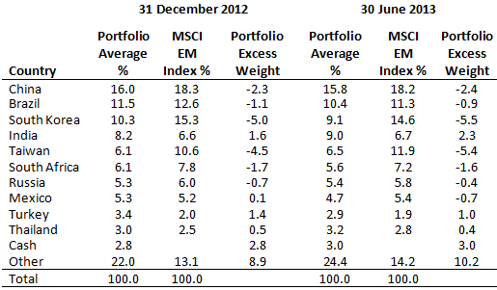
Overall Small Adjustments…

Slide 25
…but lots of variation in active bets
ΔActive Share
$$\text{Δ}\frac{1}{2}\sum_{i=1}^{N countries}{|w_{fund,i}−w_{index,i}|}$$

Slide 26
…And especially their timing bets
Market Timing
$$\sum_{i=1}^{N}{Δ[w_{fund,i}−w_{index,i}]×R_{i,t}}$$
Which EM funds
are these?!?

Slide 27
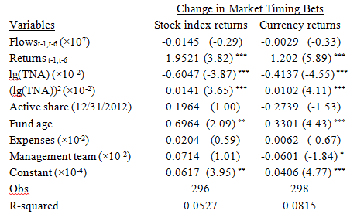
Which funds timed their EM bets?
Market Timing
$$\sum_{i=1}^{N}{Δ[w_{fund,i}−w_{index,i}]×R_{i,t}}$$
Which GEM mutual funds strategically timed the markets?
Smaller funds in total net assets!
Funds that had stronger returns leading up to taper talk !!!!
Next question: Which EMs were focus of “market timers”?

Slide 28
FIFAs versus Risk Factors

