Slide 1
New York Certified Maple
New York State Department of Ag and Markets
New York State Maple Producers Association
Cornell Maple Program

Slide 2
Training Outline
Introduction
AEM Tier I & II
Food Safe Practices
Best Management Practices
The Manuel of Recommended Food Safe Practices
What is a Certified Training
The Certificate of Training
The Application to Be Certified
Identification and Recognition of Being Certified

Slide 3
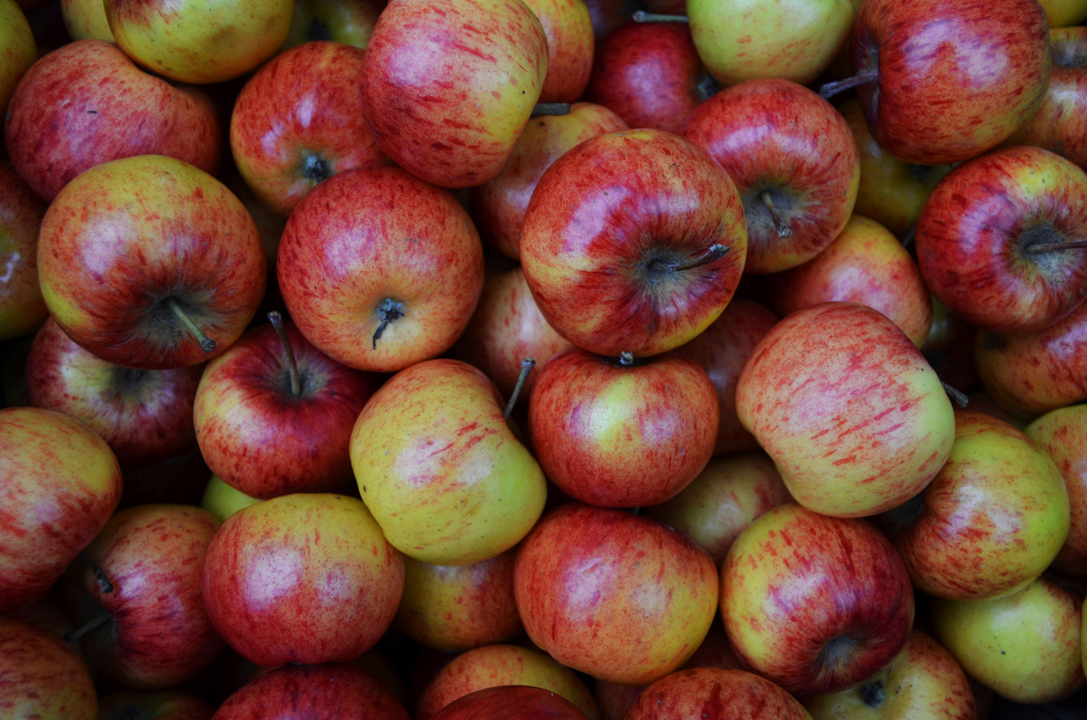


Introducing the New York State
GROWN & CERTIFIED PROGRAM
Jessica Brooks
Kevin King
Notes:
http://www.usatoday.com/story/travel/destinations/2014/07/03/upscale-highway-service-plazas/10391721/

Slide 4
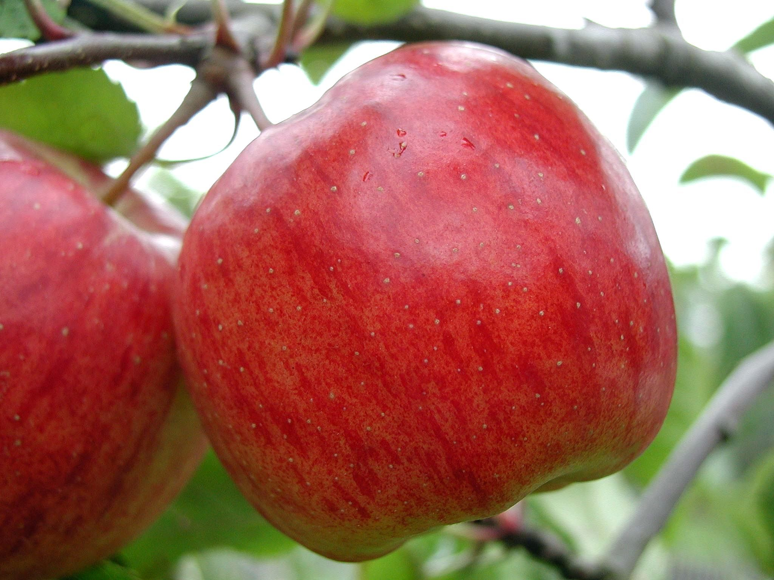
WHAT is NYS G&C?
  Marketing Campaign to promote NY ag products
  Evolution of Pride of NY Program
  Multi-Commodity, farm-based
  First state program to certify safe food handling and environmental stewardship
  Incorporated into the Ag and Markets Rules and Regulations

Slide 5
WHAT DOES THIS CERTIFICATION PROGRAM DO?
  Differentiates New York’s agricultural products in the marketplace
  Addresses consumer awareness of food safety and environmental issues
  Provides producers with meaningful branding and an on-label logo

Slide 6
WHAT ARE PEOPLE SAYING ABOUT THE NYS GROWN & CERTIFIED LABEL
Quantitative research of the NYS Grown and Certified label revealed that:
74% of people said they would buy more product with the label
49% said they would pay more
96% of respondents favored food bearing this label over food that did not

Slide 7
z
PARTICIPATION BENEFITS
Statewide advertisement campaigns aimed at restaurants, institutional buyers, and retail consumers
Free use of the New York State Grown & Certified seal and access to marketing materials through a fulfillment site
Presence on the New York State Grown & Certified website that maps qualified producers and retailers

Slide 8
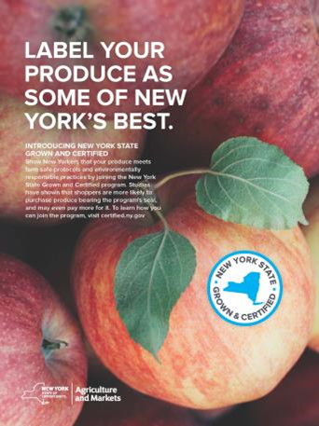
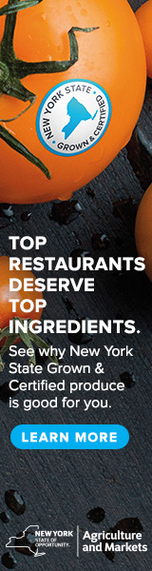
Promotion
Print
Digital
Commercials 2018

Slide 9

HOW DOES ONE QUALIFY FOR THIS PROGRAM?
GROWS OR PRODUCES IN NEW YORK STATE
ADHERES TO FOOD SAFETY GUIDELINES
FOLLOWS ENVIRONMENTAL STANDARDS

Slide 10
AGRICULTURAL ENVIRONMENTAL MANAGEMENT (AEM)
AEM links farmers with local conservation professionals to identify existing environmental stewardship, address natural resource concerns, and enhance farm viability. Participation requires completion of AEM Tier 2.
How does AEM work?
ASSESSES EXISTING STEWARDSHIP AND ENVIRONMENTAL CONCERNS
DEVELOPS FARM-SPECIFIC CONSERVATION PLANS
IMPLEMENTS THE BEST MANAGEMENT PRACTICES IDENTIFIED IN THE PLAN
UPDATES PLANS AND CONSERVATION PRACTICES OVER TIME

Slide 11
HOW TO APPLY
Go to certified.ny.gov or email nyscertified@agriculture.ny.gov
Provide:
      Application
      AEM Tier 2 cover letter
      food safety verification (if applicable)
      Trademark licensing agreement
Mail to: NYS Dept. of Agriculture and Markets
10B Airline Drive, Albany, NY 12235
Email to: nyscertified@agriculture.ny.gov

Slide 12
Participating Retailers and Distributors
TOPS
Stewart’s
Hannaford
Price Chopper
ALDI
ShopRite
Baldor
Greenmarket Co.
Hudson Valley Harvest

Slide 13
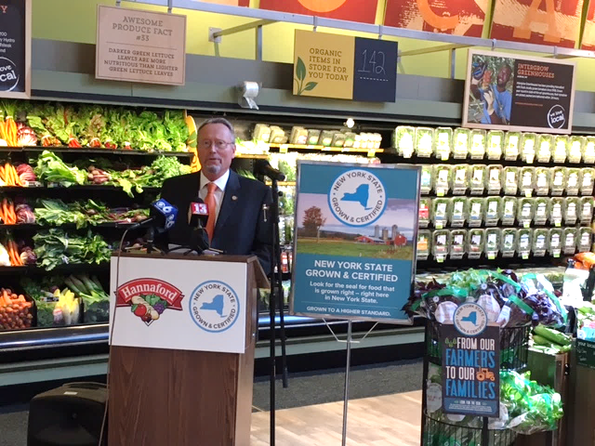
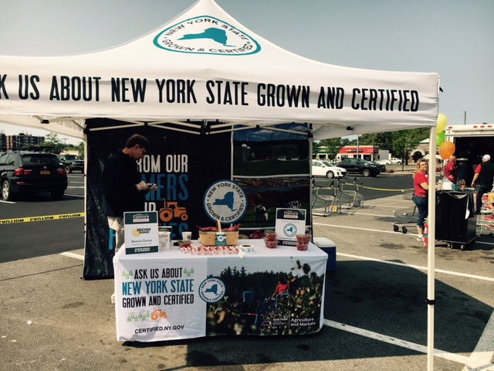

Slide 14
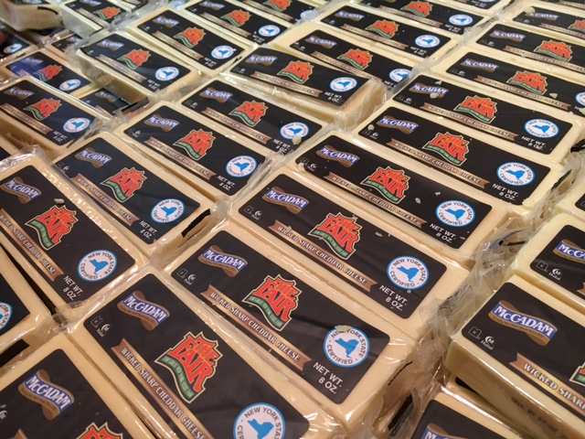
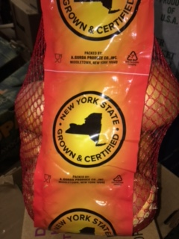

Slide 15
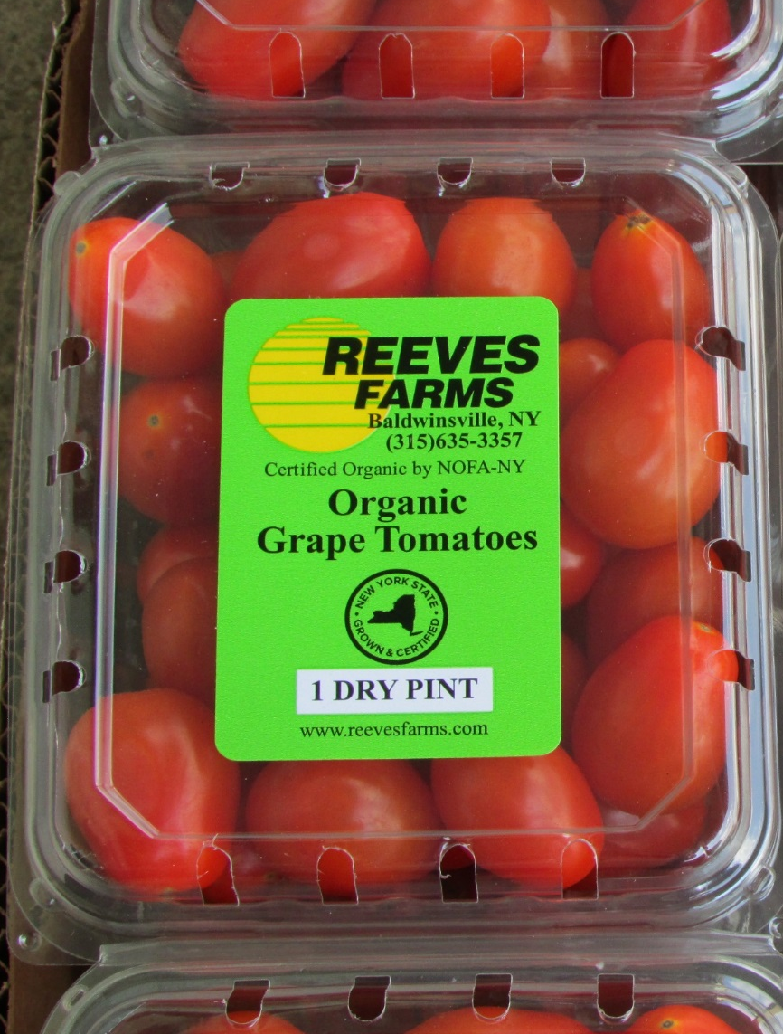
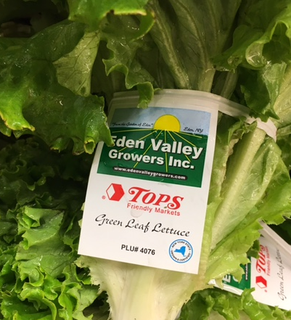

Slide 16
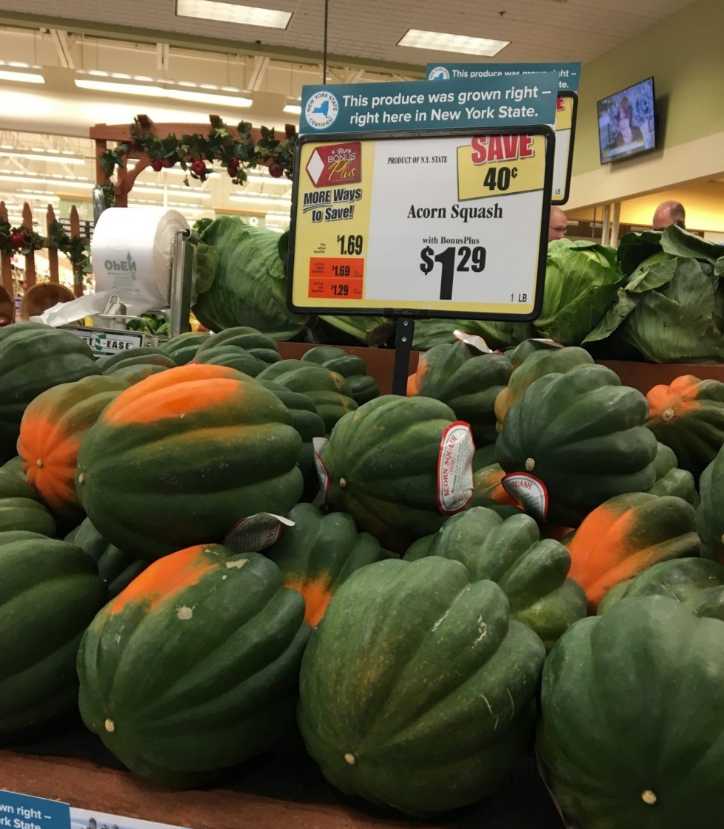
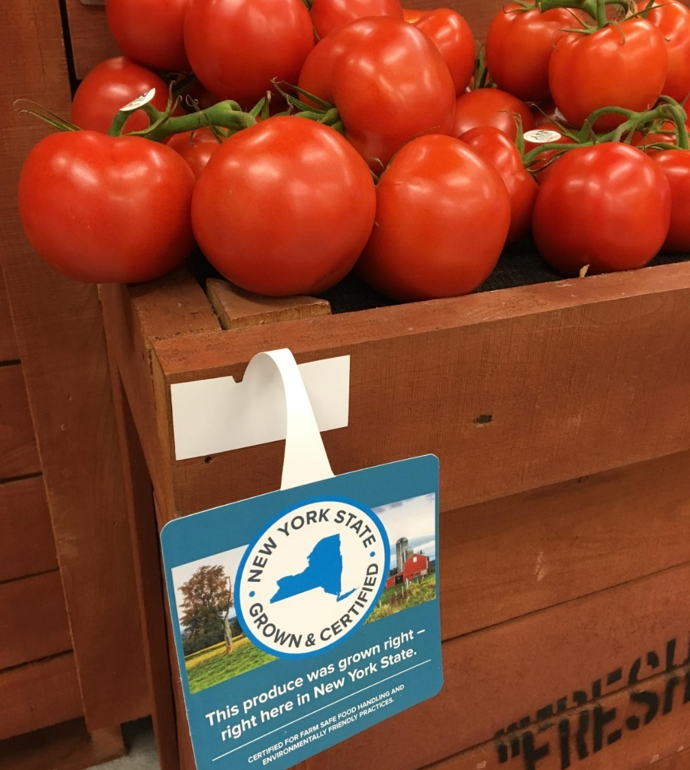

Slide 17
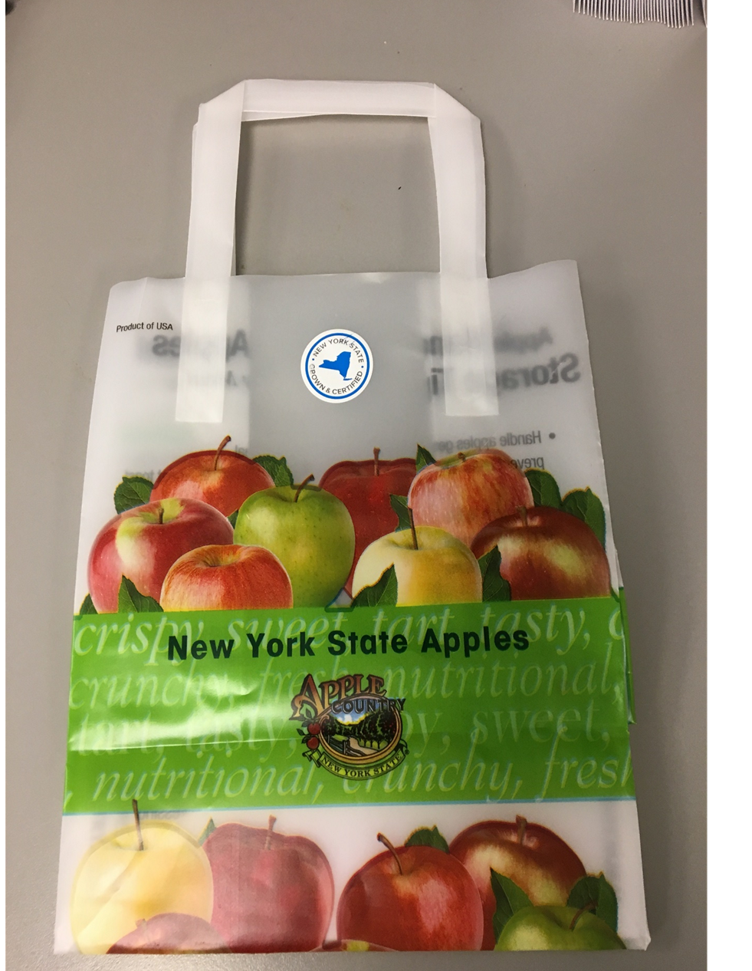
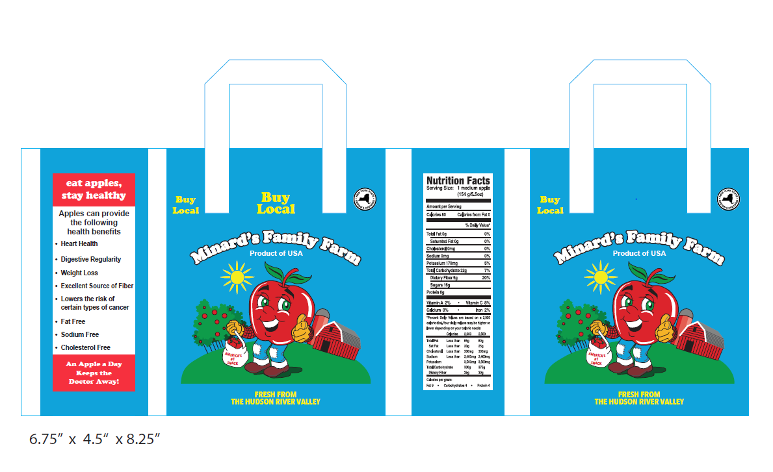

Slide 18
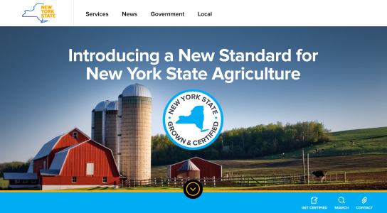
NEW YORK STATE GROWN AND CERTIFIED WEBSITE
http://certified.ny.gov

Slide 19
Contact
Kevin King
518-485-7728
Kevin.King@agriculture.ny.gov
Jessica Brooks
518-402-7398
Jessica.Brooks@agriculture.ny.gov

Slide 20
AEM Tier I & II

Slide 21
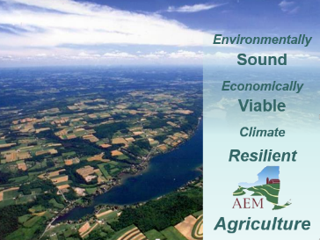
Agricultural Environmental Management
Working with farm families in their pursuit to protect the environment, enhance farm viability, and grow agriculture in New York State.
Core Concepts
  Voluntary, incentive-based
    Non-regulatory
  Locally-led & delivered
  Farmers
  Soil & Water Conservation Districts
  Natural Resources Conservation Service
  Cornell Cooperative Extension
  Farm Service Agency
  Agri-Business
  Watershed Groups
  Environmental Organizations
  Based on watershed needs and Local AEM Strategic Plans
  Customized farm by farm
  Confidential
  Promotes teamwork
  Coordinates assistance
    Technical and financial
Notes:
The core concepts of AEM are that it is voluntary, incentive based, and locally-led and delivered.
Soil and Water Conservation Districts and partners at CCE, NRCS, and private sector planners and crop consultants provide on-farm environmental assessments, conservation planning and technical services through the AEM program.
It is centered around water quality and plans are customized by farm.

Slide 22
AEM Framework – 5 Tier Approach
AEM Tier | Purpose
Tier 1 – Inventory (Questionnaire) | Basic farm info and interests
Tier 2 – Assessment (Worksheets) | Identify existing stewardship, resource concerns, and opportunities
Tier 3 – Planning | Develop conservation plans
Tier 4 – Implementation | Implement conservation practices based on the plans
Tier 5 – Evaluation | Evaluate plans, practices, and programs
Notes:
AEM is a Tiered Process. To get into more detail regarding the Tiered process:
AEM starts with an inventory (Tier 1) of a farm’s activities, future plans and documenting environmental stewardship.
Tier 2 is the use of Assessment Worksheets specific to the type of farm operation used to identify potential concerns & opportunities. There are approximately 20 worksheets
After the assessment, A customized conservation plan is then developed meeting the needs and resources of the farmer.
Conservation practices are implemented utilizing local, state and federal resources.
This is followed by an evaluation to ensure that goals were met to protect the environment and the farm business.
AEM collects information for:
Sound decision making
Strategic planning
Prioritization
Effective response to future mandates, environmental standards & emerging issues

Slide 23
AEM Tier 2 Worksheets – potentially for Maple
www.agriculture.ny.gov/soilwater/aem/techtools.html
Core
Watershed Site Evaluation
Agriculture & the Community
Soil Management
Manure & Fertilizer Mgmt
Manure & Fertilizer Storage
Waste Disposal
Pesticide Use
Pesticide Storage, Mix & Load
Farmstead Water Supply
Stream & Floodplain Mgmt.
Petroleum & Oil Product Storage
Forest Management
Irrigation Water Management
Livestock
Livestock Heavy Use Areas
Silage Storage
Process Wash Water
Management of Feed Nutrients
Water-Bourne Pathogens
Pasture Management
Livestock Odor Management
plus
GHG
Equine
Greenhouse
Vineyard (www.vinebalance.com)
Fruits & Vegetables
Long Island
Notes:
* Long Island
Nutrient Management
Fruit Tree
Sustainable Viticulture
Greenhouse
Pesticide Management
Fruit Tree
Sustainable Viticulture
Greenhouse
Waste Management
Soil Management
Water Management

Slide 24
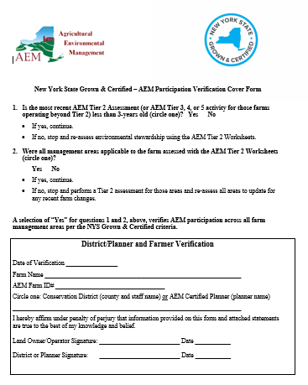
NYS Grown & Certified / AEM Linkage
AEM Requirement within NYS Grown & Certified
Participation in AEM at the Tier 2 level or higher in the last 3 years.
  Contact your Soil & Water Conservation District
  Some caveats for specific commodity groups
Submit completed AEM Verification Cover Form with NYS Grown & Certified application.

Slide 25
NYS Grown and Certified Contacts
AEM Contacts
Greg Albrecht – Statewide AEM Coordinator
607-229-4654
Greg.Albrecht@agriculture.ny.gov
Judy Littrell – AEM Outreach Coordinator
518-457-6320
Judy.Littrell@agriculture.ny.gov
Judy.Littrell@agriculture.ny.gov
Soil & Water Conservation District Directory
www.nys-soilandwater.org/contacts/county_offices.html
Theresa Sweeney
518-457-6773
Theresa.Sweeney@agriculture.ny.gov
Jessica Brooks
518-402-7398
Jessica.Brooks@agriculture.ny.gov

Slide 26
Recommended
Food Safe Best Practices for
Producing Maple Syrup
In
New York State

Slide 27
The purpose of this guide is to define best practices for maple sugaring operations in order to:
maintain high standards of cleanliness in all phases of production
reduce to the lowest extent the potential for contamination
create the highest quality pure maple syrup.

Slide 28
It is critical to maintain the highest standards of cleanliness and food safety.

Slide 29
Sugarbush Management
Identify and clean up any sources of toxic waste or pollution in or adjacent to the site.
Roadside tree use only in areas where pesticides and other chemicals are not in use.
A cemetery, golf course, residential trees, or where lawn pesticides are used should not be part of a commercial syrup production system.

Slide 30
Sugarhouse Design & Construction
Exclude bats, birds, rodents, insects, and other pests
Walls and ceiling should be made of materials that allow them to be kept free of cobwebs and dirt, Rough walls and ceilings are acceptable only if hoods are on pans and tanks have covers.
Floors should be designed for hosing down
LEDS bulbs are a preferable, older styles should be protected with shields to avoid contamination if breakage occurs.

Slide 31
Sugarhouse Design & Construction
All equipment that contacts syrup should be lead-free stainless steel or other food-grade materials.
Avoid galvanized or brass plumbing materials for sap transfer.
Food preparation surfaces of impermeable, food-safe materials that can be cleaned and sterilized

Slide 32
Sugarhouse Design & Construction
A closed storage cabinet - preferably metal - to store cleaning solutions & caustic chemicals
Only chemicals used in cleaning and maintenance of equipment should be stored in the sugarhouse

Slide 33
Sugarhouse Design & Construction
A potable water source annually tested
Permeate from an RO or condensate from a pre-heater system are excellent for cleaning.

Slide 34
Sap Collection
Spouts must be food grade materials.
Buckets can be aluminum. Plastic buckets or bags need the HDPE or number 2 recycling symbol
Never use a container that held a hazardous material or is non-food
Don’t use buckets that have been painted inside
Don’t reuse containers used to store potential allergens such as dairy, nuts or nut oils.

Slide 35
Sap Collection
Buckets with lead in soldered joints or galvanized buckets should not be used
At the start of the next season, washing buckets with water and sanitizing solution followed by thorough rinsing.

Slide 36
Sap Collection
Tubing systems may be drained to dry using vacuum or by letting spouts hang free to drain by gravity immediately after the syrup season.

Slide 37
Sap Collection
2. Tubing systems may be rinsed with water, then drained to dry using vacuum or by letting spouts hang free to drain by gravity after the syrup season.

Slide 38
Sap Collection
3. Tubing systems may be rinsed with water plus bleach or food grade peroxide used according to label directions *, then drained to dry using vacuum or by letting spouts hang free to drain. The first sap in the next season should be discarded for the first 2 to 8 hours, depending on the length of the tubing system, to flush any cleaner residue from the sap.

Slide 39
Sap Collection
4. The tubing system can be left full of sap. The sap ferments to ethanol and acetic acid as a natural cleaner. The first sap in the next season should be discarded for the first 8 to 24 hours of sap flow, depending on the length of the tubing system, to flush all residue and prevent contamination of the sap to be used.

Slide 40
Sap Collection
All sap holding, piping, and transfer equipment must be food grade
Use food grade lubricants for any equipment used in handling sap, concentrate or syrup (for example, quick-connect fittings, gear pumps, filter presses, vacuum pumps)

Slide 41
Sap Collection
Clean storage tanks with water using a high pressure sprayer or brush between runs.
When sanitizing solutions are used follow product labels and rinse thoroughly.

Slide 42
Sap Processing
Refer to manufacturers’ technical guide on installation, use, cleaning and storage of RO.
Follow manufacturer guidelines for wash water neutralization. (See appendix C for NYS DEC ruling on RO machine wash water usage).
Keep a daily cleaning record.

Slide 43
Sap Processing
Evaporator should be stainless steel with welded or lead-free soldered pans. Lead in any component part is not acceptable.

Slide 44
Sap Processing
Filter finished syrup with paper and cloth filters, cone, canister, flat or plate-type pressure filters.
New cloth filters and paper should be boiled in water (not in sap). Never with bleach, detergent, or other cleaners.
“Musty” smelling filters, worn or moldy filters must never be used.
Filter presses are cleaned with water. Only food-grade filter-aid (diatomaceous earth) used. All components of food-grade material.

Slide 45
Sap Processing
Maple syrup required minimum density of 66° BRIX at 68° F. NYS regulation allows a range of 66 to 68.9.

Slide 46
Maple Syrup
Follow NYS Ag and Markets grading regulations for clarity, color – light transmittance, density and flavor

Slide 47
Packaging & Storage
All drums must be food grade and examined inside using a bright light before use and thoroughly cleaned using steam or potable water.
Bungs should be cleaned prior to use, replacing gaskets if necessary.

Slide 48
Packaging & Storage
Best results are achieved by packing hot (180° - 195 F.) and filling completely.
Tighten bung securely.
Store bulk drums under refrigeration or in a cool, dry place. Once a bulk drum is opened, it is best if the entire drum is packed at one time.

Slide 49
Packaging & Storage
A log of every drum should be kept. Date produced, grade, weight (or volume), container id number should be the minimum of information
Mark each drum with syrup grade, and the date produced/packed.
Label and keep at least one sample jar per drum packed as a record of the syrup characteristics.
When the barrel is used or sold, keep a record of disposition. Keep logs for at least 3 years from the date of disposition.

Slide 50
Packaging & Storage
Use only retail containers that are new, undamaged, clean, dry, and free of foreign matter, and pack them hot (i.e., between 180° to 195° F.)
Syrup must be filtered prior to packaging.
Turn hot containers on their sides then cool the sealed containers as quickly as possible.
Store in a cool, dry environment or refrigerate.

Slide 51
Packaging & Storage
Follow labeling regs - product name, grade, container volume, and producer name and address.
Assign a batch number when packaging any syrup. Batch number should be logged with drum number, production date, and date packaged.
Batch number should be on every retail package

Slide 52
Sugarhouse Cleanliness
Animals of any type are not welcome in a sugarhouse at any time

Slide 53
Sugarhouse Cleanliness
Mouse or rat poisons should not be used inside the sugarhouse
Use them outside the sugarhouse in clearly marked bait stations.

Slide 54
Sugarhouse Cleanliness
Pre-season: Clean everything!
Post-Season: Clean everything!

Slide 55
Sugarhouse Cleanliness
End-of-Season Sugarhouse Wrap-up
  Clean Everything!

