Slide 1
The Natural History of White-tailed Deer
Collaborative Deer Management Outreach Initiative

Slide 2
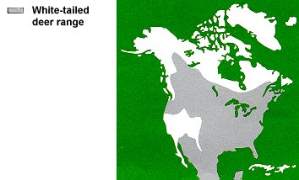
New York’s Most Popular Game Animal
Family Cervidae (paired antlers) – other family members living in North America include the elk, caribou, and mule deer
Found from Canada to Panama
Throughout New York State
Notes:
The white-tailed deer is New York’s most popular game animal and the second largest hoofed mammal in the state, with moose being the largest. They belong to the family Cervidae. Members of this family have paired antlers that are shed and re-grown annually.

Slide 3
History of Deer Abundance
Prior to European settlement much of the state covered by mature forest habitat
Deer prefer “edge habitat”
Deer were probably not plentiful in most areas of the state, though locally abundant in some areas with suitable habitat
Deer were restricted to places where disturbances created by beaver, blowdowns and fires created openings
Probably more abundant in the Lake Plains and Finger Lakes regions where habitat was more abundant
Notes:
Prior to European settlement much of the state was covered with mature forests. Deer, however, prefer “edges”— theses are habitat transition zones along the borders of forest clearings and waterways, or between various habitat types where grass and brush are available for food and cover. Mature forests with little undergrowth provide neither the food nor cover that deer need to thrive. Therefore, it is very likely that in pre-colonial New York deer were restricted to places where disturbances created by beaver, blowdowns, and fires created openings in the otherwise dense forest.

Slide 4
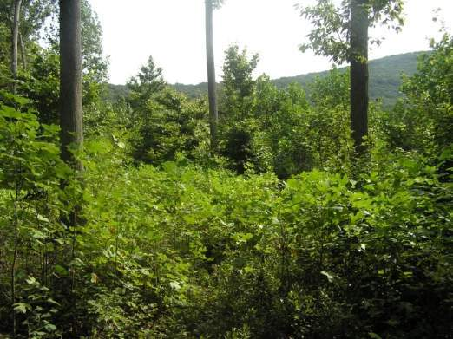
History of Deer Abundance
Native Americans and early European settlers implemented controlled burns, cut trees for homes and cleared and burned forests for cropland and pastures
Shrubs and saplings flourished and provided excellent conditions for deer
Gradual extermination of wolves and mountain lions
Notes:
As European settlers entered the state they added to the forest openings already being created by the Native Americans when they cut trees and cleared land. Shrubs and saplings grew in these openings. An increase in habitat plus loss of major predators led to increasing deer numbers until the middle of the 19th century.

Slide 5
History of Deer Abundance
Mid-1800s - large-scale clearing of land for agriculture and timber reduced the area of forest and available habitat significantly
Habitat loss combined with market hunting and hunting for food led to lowest deer population in history by 1880
Deer absent or rare in much of the state
Meyer, 1995.
Notes:
By the mid-1800s, the tremendous increase in farmland – especially outside the Adirondack Region of northern New York – had more than counter-balanced the earlier beneficial effects of predator extirpation and clearing of land. Edge was greatly diminished again, but this time it was because very little forest was left. In addition, many more people were seeking deer to supplement their food supply. If each farm family harvested only one deer per year, the total harvest would have been several times the current legal harvest in New York. Moreover, market hunting (legal at the time) was taking thousands of deer for consumption by city dwellers.
Except in the more inaccessible areas of the Adirondacks, the combined impact of these factors caused a rapid decline in deer throughout the state. By the 1880s, the deer population had reached its lowest point in recorded history. Deer had become extremely rare or absent in large portions of the state.

Slide 6
Deer Harvest Regulations
Hunting regulations became much stricter in early 1900s
Farmland abandonment led to habitat recovery and deer populations began to rebound
Today over 1 million deer in New York State
Notes:
By 1890 deer had become so scarce in most of the state, that market hunting was almost nonexistent. Hunting regulations became much stricter in the early 1900s, and deer populations began to build in response. More importantly, large areas of farmland were abandoned during the first half of this century. This abandoned farmland was soon invaded by shrubs and pioneer tree species. Habitat conditions once more became suitable for deer in many parts of the state outside of the central Adirondacks. Herds increased rapidly in some areas and more slowly in others. Starvation became serious as deer densities became too high, particularly in a few local areas of the Catskills. Hunting regulations were adjusted to take more animals where they were ruining their own range or causing significant crop damage on the remaining farms.
Today, whitetails are widely distributed throughout the entire state of New York. Deer can be found in forested and agricultural areas, and even in urban and suburban developments. Only in the most densely developed places are deer usually absent. Over one million deer currently inhabit New York State.

Slide 7
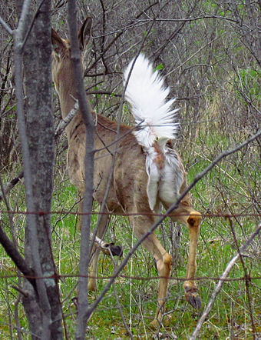
White-tailed Deer
Named for the white hairs on the underside of the tail
When they sense danger, whitetails “flag” their tail as a warning signal to other deer
Notes:
White tailed deer are named for the white hairs on the underside of the tail which they flag as a warning signal

Slide 8
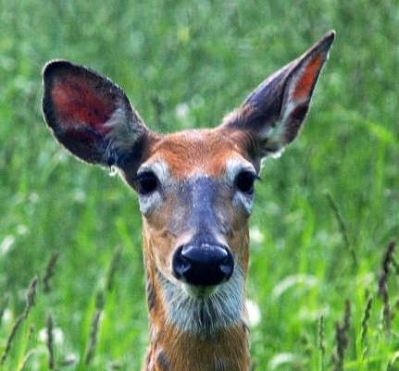
Keen Senses
A whitetail’s well-developed senses of smell, vision, and hearing help them detect danger from predators including bear, coyotes, bobcats and humans!
Large part of the brain devoted to odor reception and interpretation
Excellent vision in low light or darkness
Difficulty detecting stationary objects but can easily detect motion
Large, cupped ears help pinpoint sounds
Notes:
A whitetail’s keen senses help them detect danger.
Smell – Few animals have a better sense of smell than the whitetail.
A large portion of whitetail’s brain is devoted to odor reception and interpretation
Vision – Whitetails have excellent vision in low light or darkness, strong peripheral vision, and can easily detect motion. Whitetails don’t see the colors we do and have difficulty detecting stationary objects.
The eyes are located on the sides of its head allowing it to scan nearly 180 degrees.
A whitetail’s retina is dominated by rod or light receptor cells making it 1000 times more sensitive to light than our own.
The retina also has a reflective pigment called the tepatum which reflects light back to the retina.
The whitetail’s pupil opens much wider than a humans allowing it to gather 9 times more light
Hearing – large, cupped external ears gather and amplify sound.
A whitetail’s ears are able to rotate in different directions enabling it to pinpoint sources.

Slide 9
Vocalizations
Deer use different sounds to
Keep in contact with each other
Express alarm and distress
Express dominance/threaten other deer
Facilitate courtship and breeding behavior
Examples:
Doe bleat
Buck grunt
Fawn bleat
Notes:
Deer are also very vocal animals. Buck, does and fawns all make sounds, communicate vocally in some manner. Here’s the sound of a doe bleating. And a buck grunting. And now a fawn bleating.

Slide 10
Antlers
Not hollow like horns
Growing antlers soft, covered with velvety skin rich with blood vessels
Begin growing in May and finish growing in September
Antlers harden and “velvet” is rubbed off
Antler size determined by genetics, age and nutrition
Notes:
Male whitetails grow and shed antlers annually. Antlers are bone-like structures, and are not hollow like horns. While growing, antlers are covered in velvet which the buck rubs off once they’ve hardened. Antler size is determined by age, genetics and nutrition.

Slide 11
Summer vs Winter Coat
Thin, reddish summer coat
Shed and replaced by a dense winter coat of darker gray/brown hollow hairs about 2 in long, with an undercoat of short, soft hairs
Hollow hairs trap warm air and insulate the animal
Notes:
In the summer whitetails coats are relatively thin and reddish in color. For the winter this is replaced by a dense gray-brown coat with hollow outer hairs and a shorter undercoat. The hollow hairs trap warm air for insulation.

Slide 12
Mating Season (rut)
Breed October - January, with the peak breeding period in mid-November
Bucks usually become sexually mature when 1 ½ years old (their second fall)
Most females begin breeding at 1 ½ years
Doe fawns reaching critical size (80-90 lbs) come into estrous their first fall; but breed later than adult does
Peak breeding by fawns - late November and early December
Notes:
The mating season is also called the rut. The peak of the rut is in mid-November. Bucks usually become sexually mature by their second fall and most females also begin breeding at the same age. However, doe fawns can and sometimes do breed in their first fall if they’ve grown large enough.

Slide 13
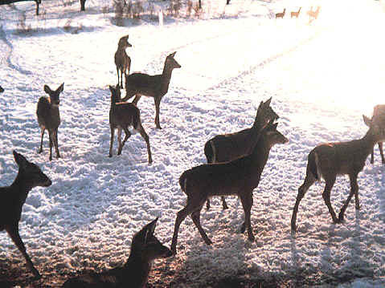
Deer Populations Can Grow Quickly
Over 50% of the herd must die or go elsewhere annually just for population to stay the same
Notes:
In just 6 years 2 deer can turn into 64 deer. The actual reproductive potential is higher where the buck to doe ratio is skewed toward does. Due to this high growth rate, if one wishes to have the population remain the same, more than 50% of the herd needs to die or be removed annually (from all causes).

Slide 14
Fawns
Most fawns are born during May and June
Fawns born to females in their first year born later in the summer
Fawns can stand within minutes after being born
In good habitat most does give birth to two fawns (3 possible)
Notes:
Most fawns are born during May and June. However, birth can take place from March to early August
Fawns can stand within minutes after being born.
In good habitat most does give birth to twin fawns. Younger does generally have just one fawn.

Slide 15
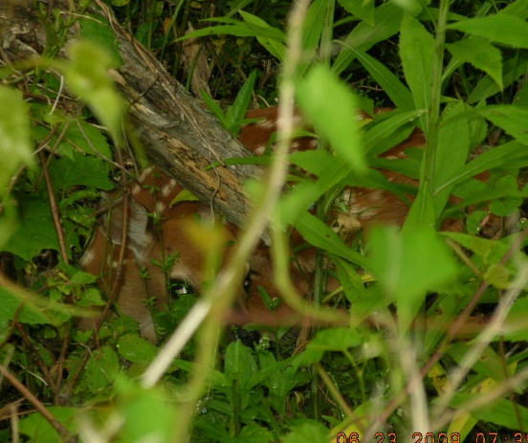
Fawns
Reddish brown with white spots for camouflage
Spots look like sunlight hitting the forest floor
The mother leaves the fawns well-hidden for hours while she feeds nearby
Fawns lay still on the ground, making it difficult for predators to find them
Notes:
Fawns’ coats are camouflaged to blend in with its surroundings. The spots look like sunlight hitting the forest floor. Does will leave fawns hidden for hours while she feeds. Fawns lay perfectly still in order to elude predators.

Slide 16
Predation
Bears, coyotes and bobcats most common predators
Predation most common on fawns during their first 9 weeks
Adult deer are rarely killed by predators (<1% of mortality in adults due to predators)
Predation on fawns can slow population growth but does not reduce population size
Notes:
Adult deer in NY are rarely killed by predators. Predation is most common on fawns during their first 9 weeks. Bears, coyotes and bobcats are the most common predators.
In a Penn State study, bears and coyotes were most responsible for predator-caused mortality in fawns. Bears were more common than coyotes. Although predation on fawns can slow population growth, it does not reduce the population size.

Slide 17
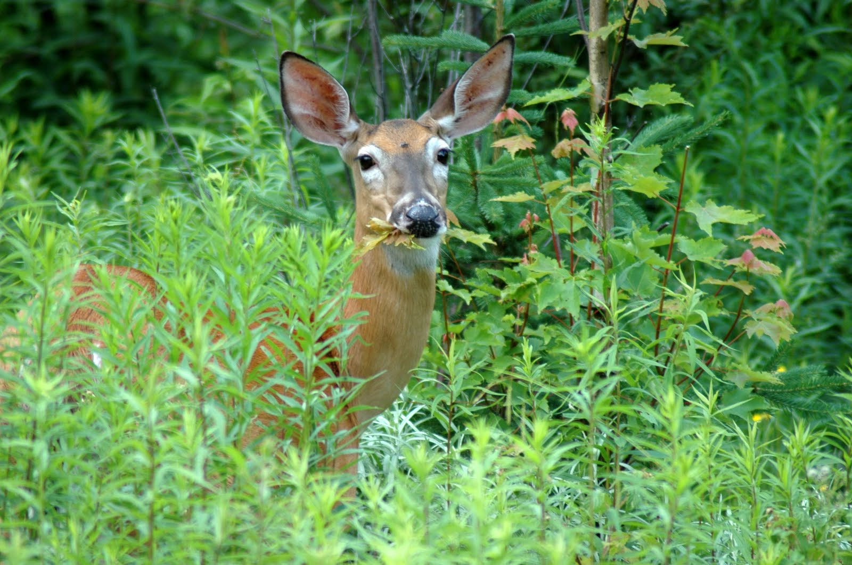
Food
Spring and Summer – deer feed on grasses and other herbaceous vegetation in addition to leaves, buds and twigs
Fall – hard mast (acorns, beech nuts, etc.), apples and other foods available
Winter – primarily buds and twigs (woody browse)
Notes:
Deer are herbivores. They are primarily browsers rather than grazers. This means that during much of the year their diet consists mainly of leaves, buds and young twigs from trees and shrubs rather than mainly grass as a grazer would eat. However, deer also eat large quantities of grass and other herbaceous vegetation, especially when it first becomes available in the spring.
Deer need 5 to 7 lbs of good food each day, and more if it is of poor quality. This means that each deer will eat more than a ton of food in a year.

Slide 18
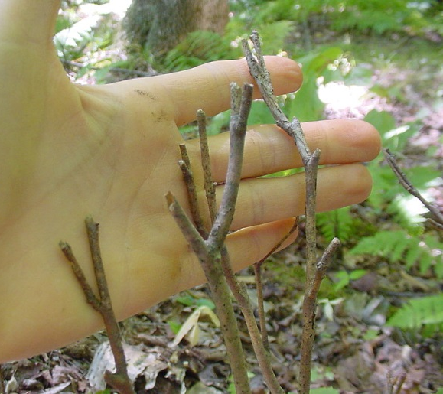
Browse Facts
Deer need 6 to 8 lbs of woody browse per day
At 600 seedlings/lb that is:
- 4,200 seedlings per day
- >1.5 million seedlings/year/deer
Fortunately, most deer have access to other food resources in the fall and summer
Notes:
Deer need 6 to 8 lbs of woody browse per day. At 600 seedlings per pound that works out to 4,200 seedlings per day or over one and a half million seedlings a year per deer. Fortunately, most deer have access to other foods in the fall and summer.

Slide 19
Deer are Ruminants
Deer are ruminants, like cows and goats
They have a stomach system with four separate chambers for digesting food
Food is stored in the rumen (1st chamber) and is regurgitated, chewed and swallowed
They do not have digestive juices like most
mammals, but instead rely upon micro-organisms to break down the food
The concentration of micro-organisms is
specific for the type of food consumed
Notes:
Like cattle and sheep, white-tailed deer are ruminants and have a four-part stomach. The first part, the rumen, is a large storage chamber. In deer, it can hold as much as 8 quarts of partially chewed food and water. Before passing to other parts of the stomach, partially chewed food from the rumen is regurgitated and chewed as a cud. This digestive mechanism allows deer to browse and graze rather rapidly. They may then retire to safer locations to complete the digestion of their meal. By themselves, deer are unable to digest the cellulose in many of the woody types of foods they eat. However, they have a combination of microflora in another stomach chamber called the reticulum composed chiefly of bacteria which, through fermentation, are able to convert cellulose into useable nutrients.

Slide 20
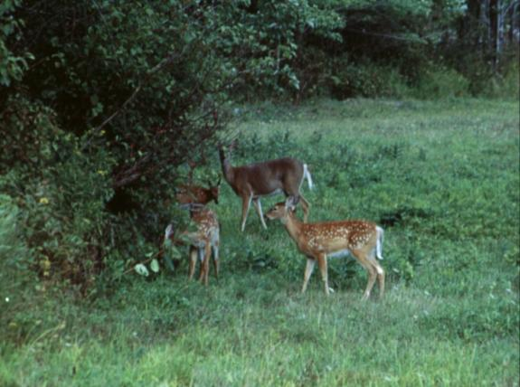
More About Deer Digestion
In response to winter, deer transition from a
diet of green, herbaceous vegetation
to a diet of woody browse, buds and twig
tips
Notes:
Deer transition their diet and their digestive system in winter, going from a green diet to a woody one.

Slide 21
More About Deer Digestion
Digestibility of winter browse is low, and
rumen function depends on fiber in the diet
Major changes in diet require a change in the type and concentration of micro-organisms needed to break down food material
The transition to the new micro-organism culture can take two to three weeks to occur, during which time little, if any, nutrition is realized
Notes:
Winter browse is not very digestible. Major changes in diet require a change in the type of micro-organisms needed to break down food. The transition to the new micro-organisms required to digest winter food can take 2 to 3 weeks during which time little, if any, nutrition is gained.

Slide 22
Feeding Deer has Risks
Abrupt changes in diet can result in a
significant period of time when no nutrition
is received
Sudden changes can cause the micro
organisms to die, rendering the deer unable
to digest any food
Food high in carbohydrates can also result
in fermentation occurring within the rumen
causing gastrointestinal distress, or rumenitis
Notes:
Feeding deer in the winter time, although well intentioned, can lead to death. When a deer’s digestive tract is primed for digesting twigs and buds, they can die with a stomach full of corn. Abrupt changes in diet can result in a period of time when no nutrition can be gained from the new food or the changes can cause the deer’s micro-organisms to die. A quick change to a high carbohydrate diet such as corn or other grains can cause lactic acid build up in the rumen leading to rumenitis and a condition sometimes called corn toxicity, which is deadly.

Slide 23
Deer are Well Adapted for Winter Survival
Develop of a winter coat of hollow guard hairs
Lower basal metabolism by as much as 30%
Build fat reserves to serve as both additional
insulation and reservoirs for stored energy
Become less active and confine movements to
stands of cover vegetation and south facing slopes
with greater thermal exposure
Notes:
Over generations deer have adapted to winter survival with physical, physiological and behavioral changes to better cope with the increased stress. They lower their basal metabolism to conserve the fat reserves they’ve built up in the summer and fall. They also conserve energy by becoming less active and staying in habitats that offer shelter and access to south facing slopes for thermal exposure.

Slide 24
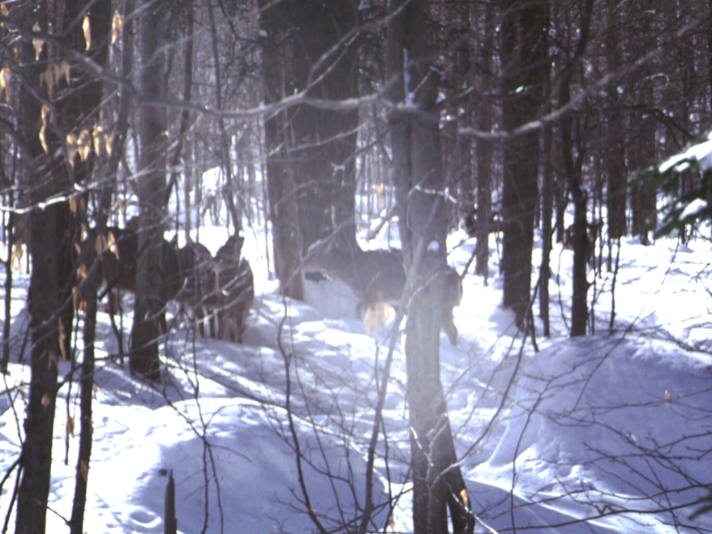
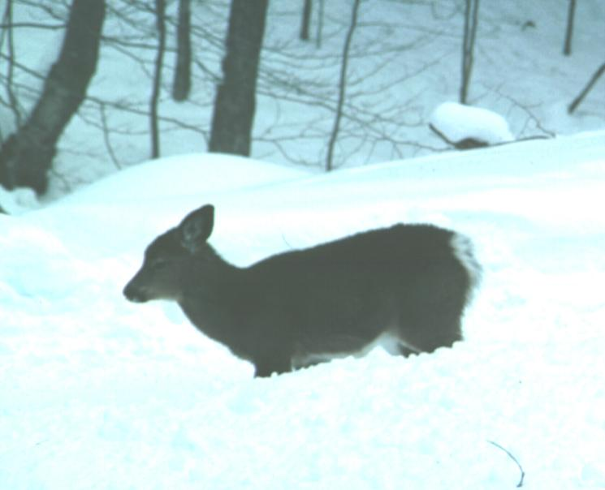
Factors Affecting Winter Survival
Mobility Issues: Snow Depth
Snow Crust
Thermal Energy Loss Issues:
Temperature
Wind
Relative Humidity
Fawns, yearling males, aged and injured most likely to be affected during severe winters
Notes:
Fat reserves represent a limited amount of stored energy. The faster they are utilized, the shorter the period of time that a deer can depend upon them for drawing energy.
Snow depth, snow crust, temperature, wind, and relative humidity all affect the rate at which deer utilize their fat reserves. Conditions making it difficult for deer to move or keep warm can hasten the use of fat reserves.

Slide 25
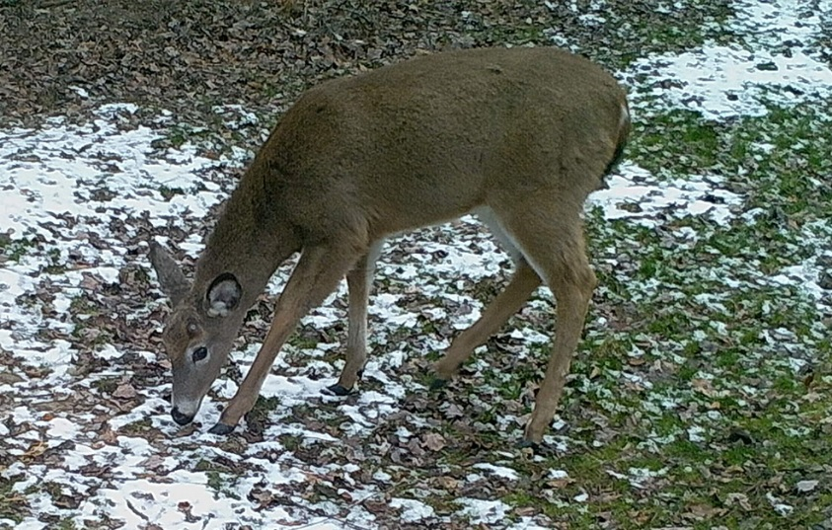
The White-tailed Deer is a Valuable Resource
Notes:
The white-tailed deer is a fascinating, charismatic animal enjoyed by New York citizens. With proper management healthy deer populations can be enjoyed by future generations.

