Slide 1
Healthy Forests, Healthy Deer
Collaborative Deer Management Outreach Initiative

Slide 2
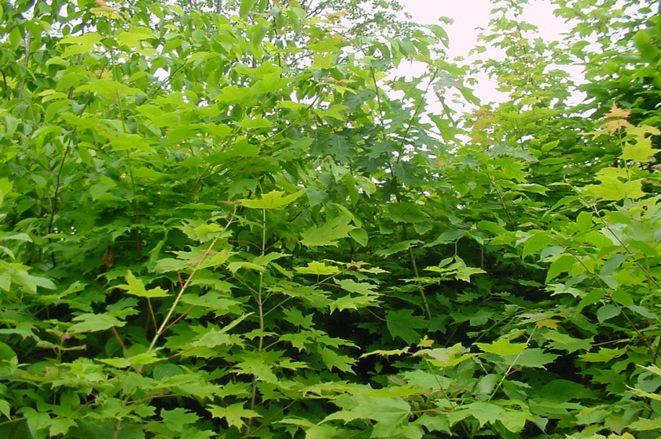
What makes a healthy forest?
A variety of native plant and tree species
Ability for a new forest to grow or “regenerate” in the case of disturbance (natural disturbance or timber harvest)
Notes:
There are many factors that determine whether or not a forest is a “healthy” forest, but the ability for a variety of native plant and tree species to grow where conditions are appropriate, and the ability for a new forest to grow when the existing forest canopy is disturbed or intentionally removed (as is the case when timber is harvested) are two key factors.

Slide 3
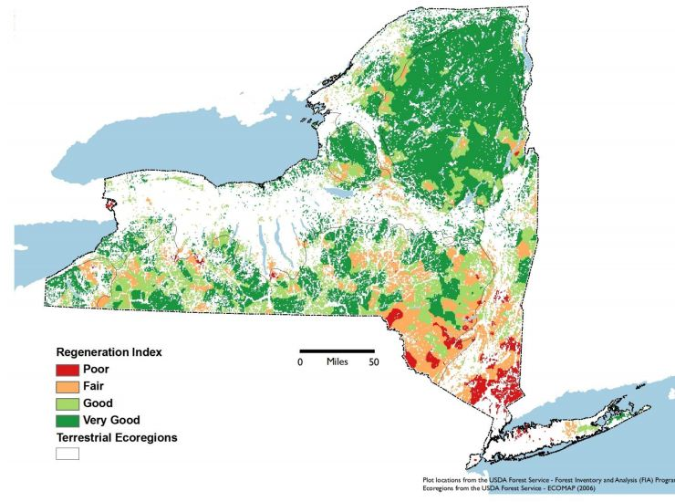
Predicted Regeneration of Native Tree Canopy Species in New York State
68% good – very good
~1/3 poor-fair
Source: Forest Regeneration in NYS, The Nature Conservancy, 2010
Notes:
In New York State, as well as other states in the northeast, it is becoming increasingly difficult to regenerate the variety of canopy trees we currently have growing in our forests. According to a study by the Nature Conservancy (2010), only about 2/3 of the forests throughout the state would have good or very good regeneration in the face of a disturbance (some or all canopy trees removed). One third of our forests would have only a fair or poor chance of regenerating sufficiently.

Slide 4
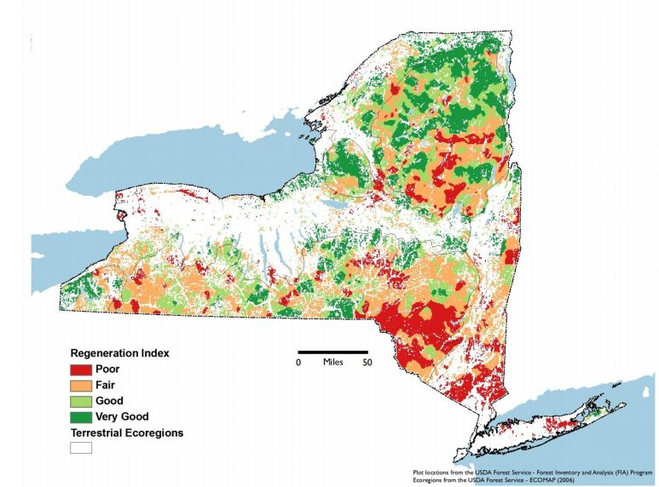
Predicted Regeneration of Desirable Timber Species in New York State
43% good – very good
>half poor-fair
Source: Forest Regeneration in NYS, The Nature Conservancy, 2010
Notes:
If only the tree species that are desirable timber species are considered (eg oak, maple, etc.), these species would regenerate in less than half of the forests across the state. This is particularly true in the lower Hudson Valley, Long Island, and the Catskills region.

Slide 5
Forest Regeneration Success?
Based on Cornell University 2009 Survey of Foresters (% of forest stands)
 | Statewide | Adirondacks | Southern Highlands | Other Regions
Highly successful | 13 | 12 | 16 | 8
Moderately successful | 17 | 31 | 13 | 16
Marginally successful | 45 | 50 | 47 | 38
Complete failure | 25 | 7 | 24 | 38
Notes:
Researchers in the Department of Natural Resources at Cornell surveyed foresters and asked them to rank the level of regeneration success they are seeing in forests in New York State. Seventy percent responded that, in their experience, regeneration success was either marginally successful or a complete failure.

Slide 6
Reasons for Marginal or Failed Forest Regeneration?
Based on Cornell University 2009 Survey of Foresters (% of respondents)
 | Statewide | Adirondacks | Southern Highlands | Other Regions
Deer browsing | 72 | 38 | 76 | 81
Interfering vegetation | 50 | 42 | 60 | 39
Landowner lack of interest or knowledge | 27 | 9 | 23 | 40
Landowner did not invest adequate $$ | 14 | 16 | 17 | 9
Soil or site limitation | 14 | 14 | 11 | 19
Forest health | 10 | 11 | 6 | 15
Notes:
When asked what they thought were the reasons for failed regeneration, deer browsing was the number one reason identified followed by interfering vegetation (either native or non-native).

Slide 7
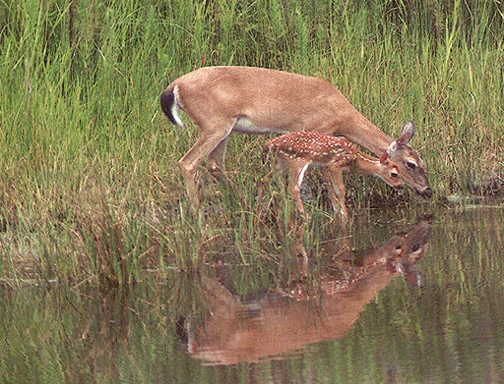
White-tailed Deer
Ability to change their own habitat and the habitat of other species
Notes:
How do deer affect the forest? Because deer feed on forest plants and trees, over time they have the ability to affect the quality and structure of forest habitat, which in turn determines the quality of habitat the forest provides for deer and for other wildlife species.

Slide 8
How Do Deer Affect the Forest?
Change the Forest Structure
Missing layers of vegetation
Notes:
Over-browsing can completely eliminate the shrub and understory layers of the forest, causing park-like forests like the one pictured here. Young tree seedlings begin to grow but are browsed, leaving no young trees to replace the old.

Slide 9
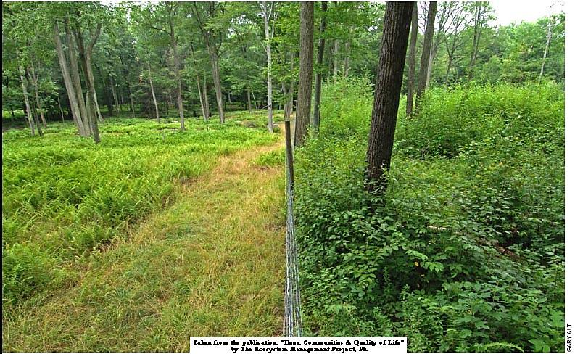
How Do Deer Affect the Forest?
Change the Forest Structure
Notes:
The forest depicted in this picture is the same on both sides except that deer have been excluded (fenced out of) the area on the right. Note the abundance of young seedlings in the area where deer have been excluded, and the complete lack of vegetation (with the exception of ferns) on the left. Note the “browse line” evident in this forest. There are no branches below the height deer can reach (5-6 feet).

Slide 10
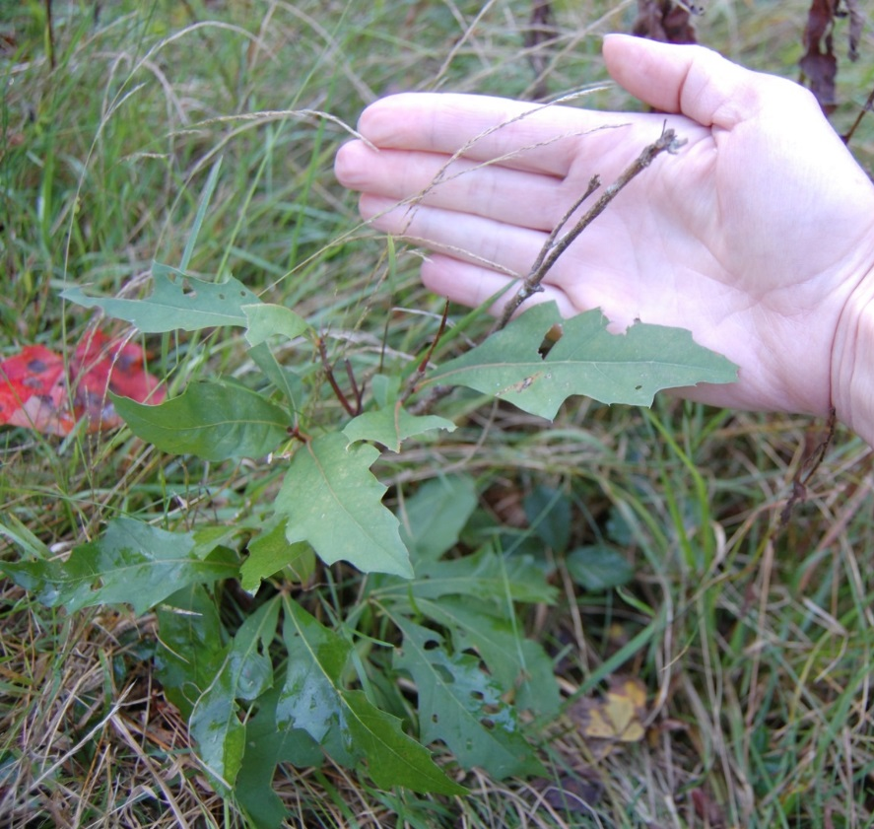
Browsed Seedlings
Notes:
Browsing by deer during winter often prevents seedlings from growing any taller than the typical snow depth and can deform seedlings.

Slide 11
How Do Deer Affect the Forest?
Influence the kinds of plants growing in the forest
High Preference Species | Low Preference Species
Red maple (Acer rubrum) | American beech (Fagus grandifolia)
Sugar maple (Acer saccharum) | Hop hornbeam (Ostraya virginiana)
White ash (Fraxinus americana) | Striped maple (Acer pensylvanicum)
Aspen (Populus spp.) | White pine (Pinus strobus)
Oak (Quercus spp.) | Red pine (Pinus resinosa)
Basswood (Tilia americana) | Spruce (Picea spp.)
Eastern hemlock (Tsuga canadensis) | American hornbeam (Carpinus carolinensis)
Birch (Betula spp.) | Black cherry (Prunus serotina)
Maple–leaf viburnum (Viburnum acerifolium)
Red elderberry (Sambucus racemosa)
Blackberry and raspberry (Rubus spp.)
Notes:
In addition to affecting the structure of the forest, deer browsing can influence the types of trees and other plants that will grow. Because they prefer to feed on some plant over others, the species preferred can be eliminated or reduced in abundance, while other species persist. Overall, this can lead to a reduction in the diversity of species in a forest.

Slide 12
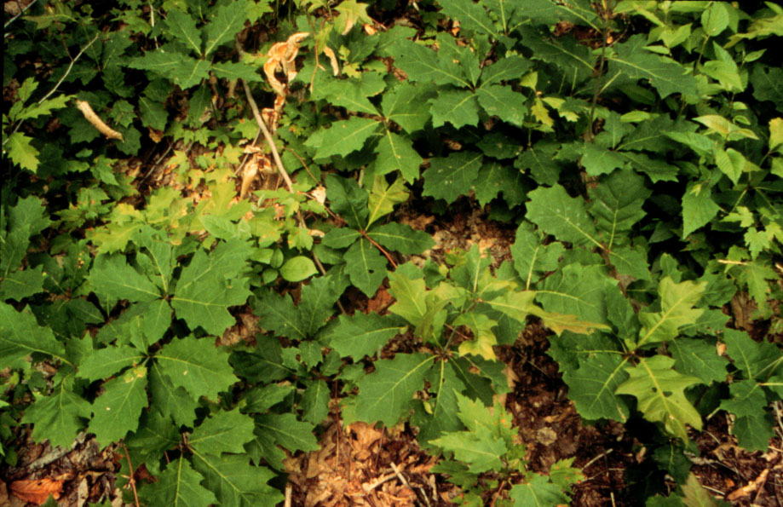
Economic Effect
Species preferred by deer also tend to be the most economically valuable timber species (oak, maple, etc.)
Notes:
The effects from deer over-browsing can have economic as well as ecological impacts, as many of the species preferred by deer are also the more valuable timber species.

Slide 13
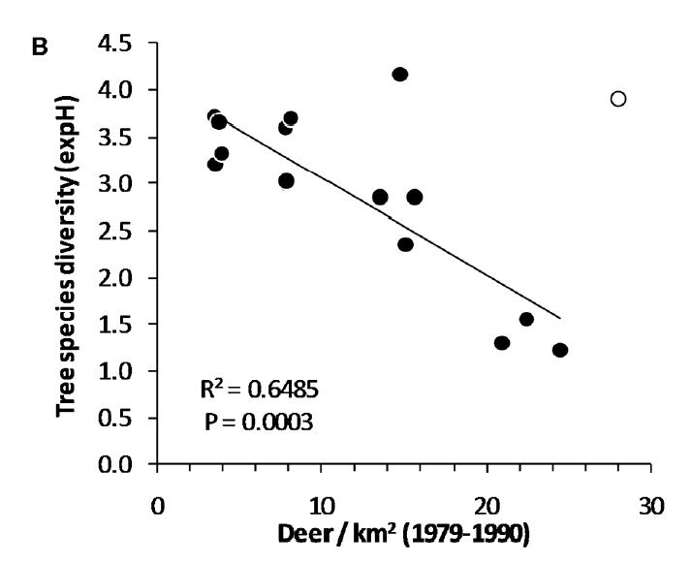
Legacy Effect Tree Species Diversity 2005
Notes:
What is left behind in heavily browsed forests is often a monoculture of American beech (a species not preferred). And, in fact, the lack of tree species diversity can persist for years, leaving behind a long-lasting “legacy” effect even if deer browsing pressure is reduced. In Allegheny National Forest in Pennsylvania, researchers fenced deer INTO areas of forest at varying densities from 1979-1990. In 2005, they went back and measured tree species diversity in each of the enclosures. Fifteen years after removing the deer enclosures, the forests with the highest deer densities in the past still had the lowest tree species diversity.

Slide 14
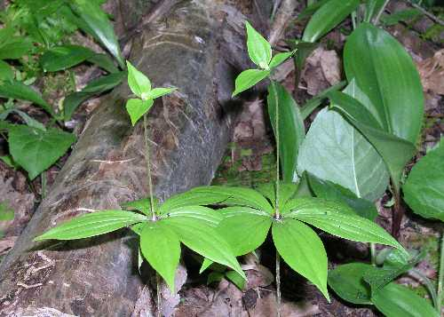
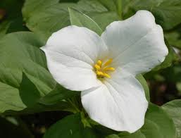
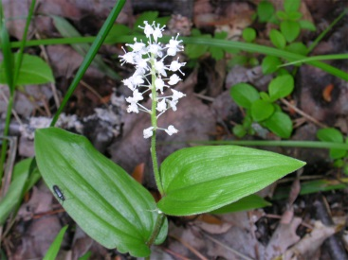
Deer Density versus
Wildflower Species Richness
# Wildflower Species
Deer Density #/Square Mile
Notes:
This is true of trees, wildflowers, and other plants as well. In Allegheny National Forest in Pennsylvania, researchers fenced deer INTO areas of forest at varying densities from 1979-1990. The number of different kinds of wildflowers decreased as the number of deer increased. Flowers like Indian cucumber (upper left), Canada mayflower (lower left), Trillium (lower right) and others can be eliminated by deer.

Slide 15
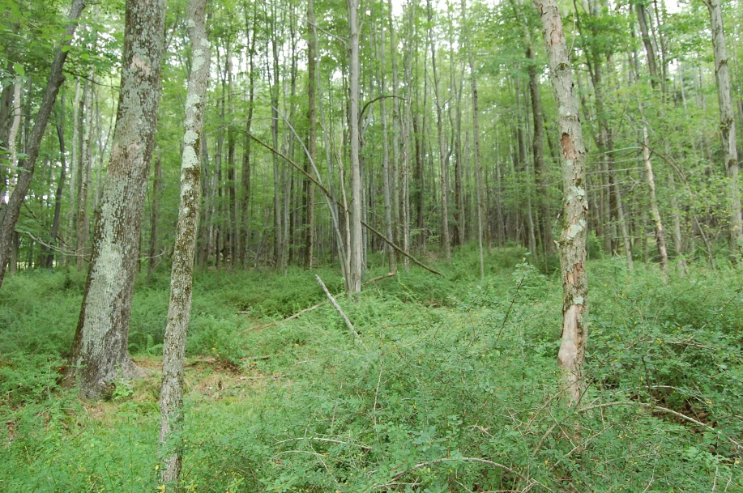
How Do Deer Affect the Forest?
Browsing native plants allows room for invasive plants to take over
Degraded plant community, structure favorable for black-legged ticks
Notes:
When browsing by deer removes native vegetation from the forest floor, invasive plant species often move in to fill the void (garlic mustard pictured left; Japanese barberry pictured right). Monocultures of invasive species that result can further prevent native plants from becoming re-established. In addition, thick stands of barberry shrubs provide ideal conditions for the black-legged tick which transmits Lyme disease.

Slide 16
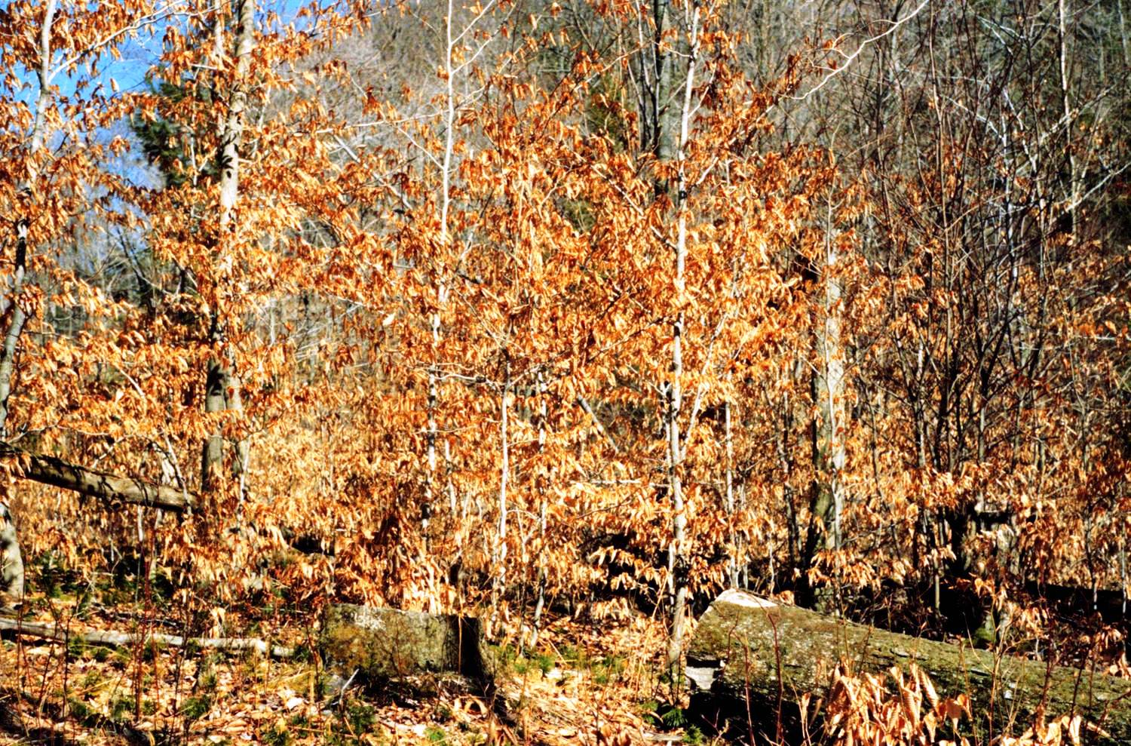
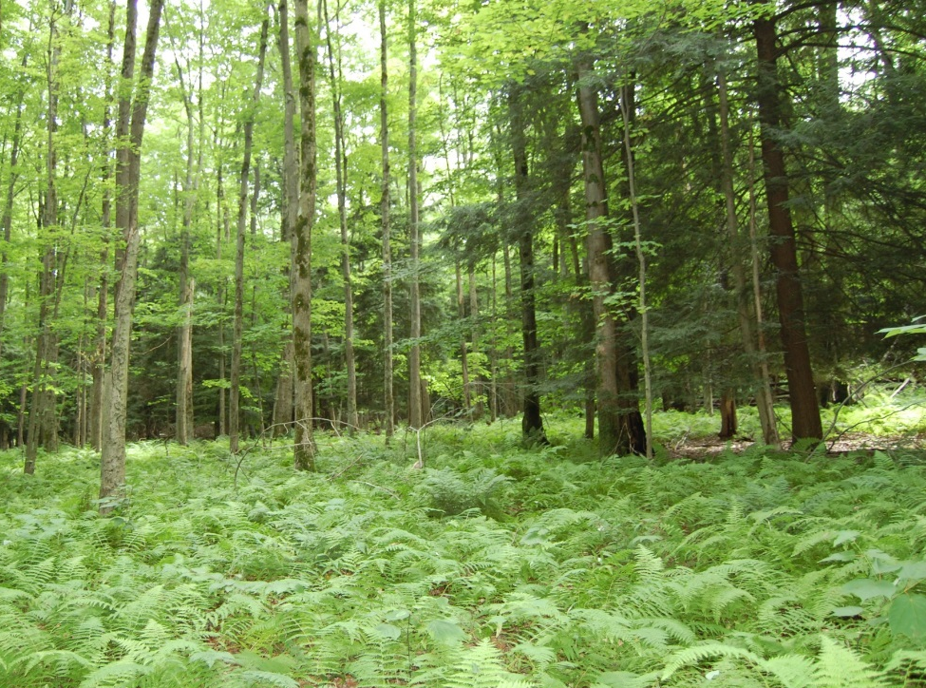
Browse tolerant native plants can also take over and may require purposeful management to restore even if deer populations are reduced
Notes:
Monocultures of native, browse tolerant species like American beech (left) or hay-scented fern (right) can also become established. These thickets shade the forest floor and prevent sunlight from reaching the forest floor, thereby limiting the growth of new seedlings. Without management to remove the existing vegetation, these monocultures can persist long into the future.

Slide 17
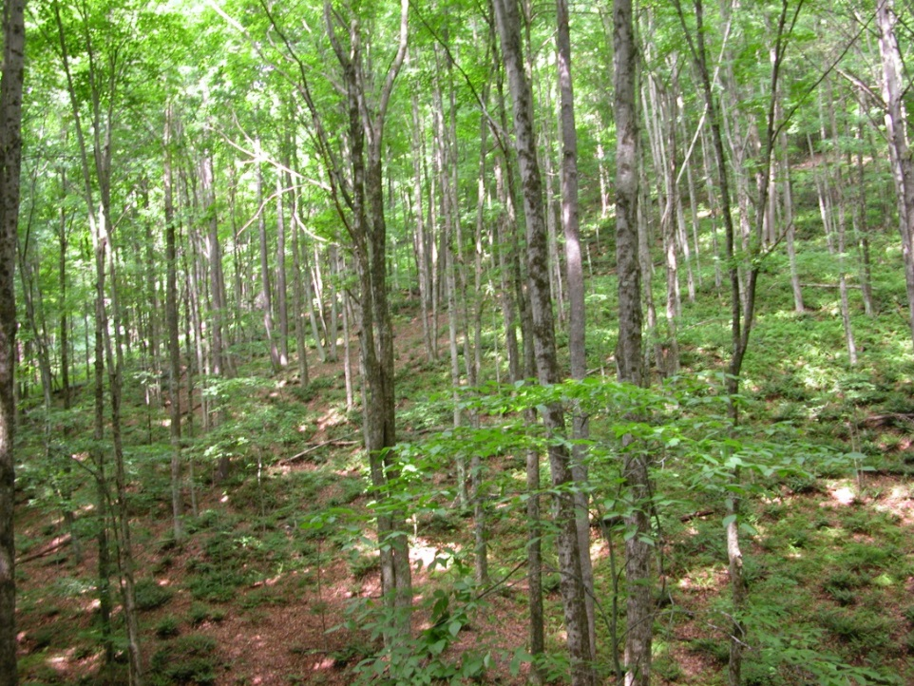
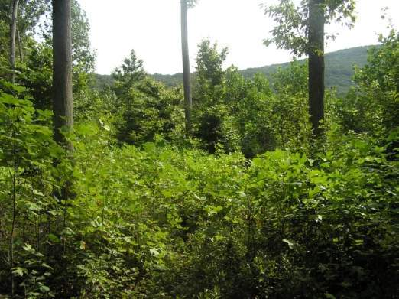
How Do Deer Affect other Wildlife?
Change the Habitat Structure and Composition
vs
Notes:
By simplifying the structure and species found in the forest, deer also affect the habitat of other wildlife. Different kinds of birds, for example, use different layers of the forest vegetation for feeding and nesting. The scarlet tanager uses the tree canopy, the black-capped chickadee feeds in the mid-layers of the forest and the ovenbird uses the forest floor. More layers of vegetation mean that more types of birds can live there.
Fewer plants also means less food for wildlife. The number of caterpillars and other insects may decline when there are fewer leaves for them to feed on and, in turn, insect food for birds is reduced. By selecting some tree species over others, deer can also prevent some important wildlife food trees, such as oak, from becoming established, reducing the availability of acorns and other foods.

Slide 18
Deer Density and Songbird Abundance
# Songbirds Observed
Deer Density #/Square Mile
Notes:
In the study from Allegheny National Forest (previously referenced) researchers found that the number of songbirds decreased as the number of deer increased.

Slide 19
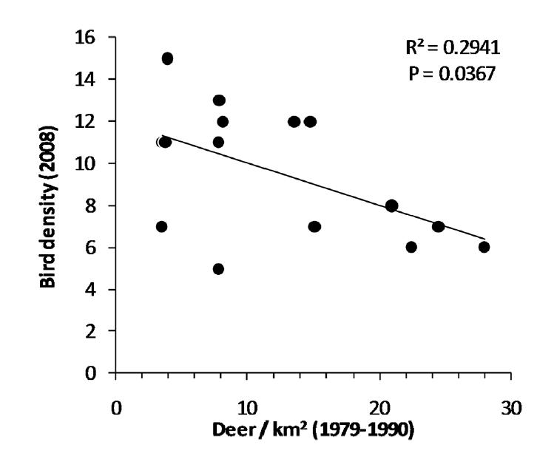
Legacy Effect on Bird Density - 2008
Notes:
And that continued to be true in those areas yet in 2008.

Slide 20
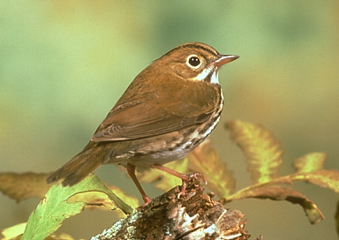
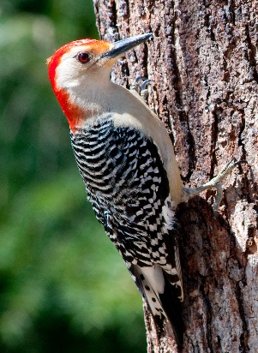
Forest breeding bird species trends 1980-2005
Mid-story, shrub, and ground nesters
Canopy nesters
or stable
Photo credit: Cheep shot
Photo credit: Bonnie Gruenberg
Photo credit: Andy Reago & Chrissy McClarren
Photo credit: Andy Reago & Chrissy McClarren
Notes:
In a study in New Jersey the researchers found that, from 1980-2005, populations of many bird species that nest in the forest canopy (Right from top to bottom = tufted titmouse, red-bellied woodpecker, warbling vireo) have been increasing or staying stable, whereas many species nesting in the mid-story or at shrub or ground level (Left from top to bottom = ovenbird, rose-breasted grosbeak, wood thrush) are declining. This trend reflects the loss of habitat layers these birds depend upon.

Slide 21
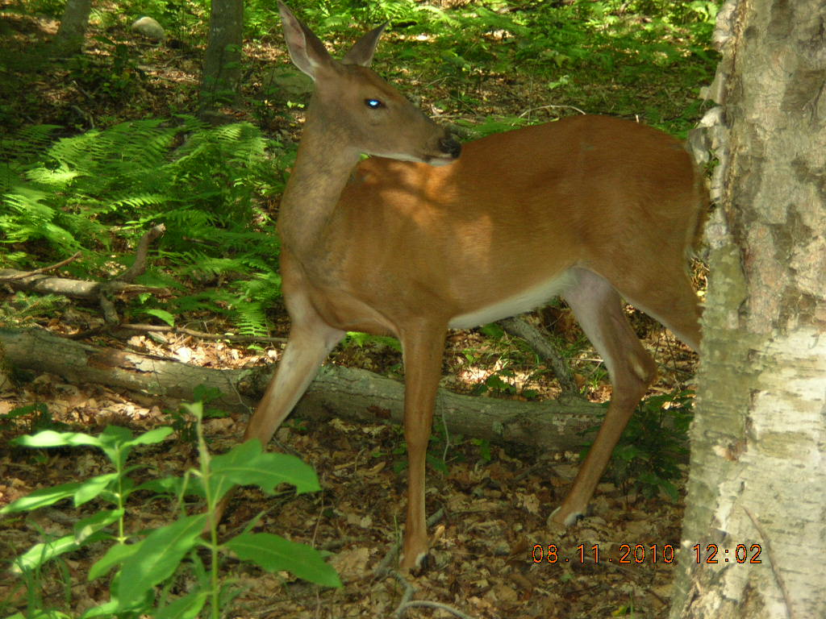
Deer Can Have a Long-lasting Effect on their OWN Habitat
Notes:
An overabundance of deer and lack of understory vegetation limits the forage available to deer both in the present and for the future. Keeping deer populations in balance with available habitat results in fewer, but often healthier deer, more diverse wildlife populations, and increased forest health and diversity.

Slide 22
Deer Management Options
What can you do?
Fencing
Individual tree protection
Increase harvest of female deer
Encourage hunters on your land to shoot a doe before shooting a buck
Obtain Deer Management Assistance Program (DMAP) permits for hunters to use on
your land

Slide 23
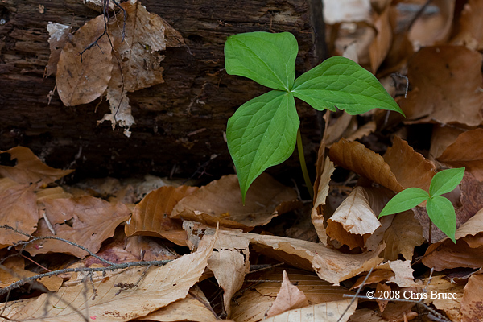
What can you do?
Step 1. Assess the situation
Visual signs
Are there wildflowers present? Do they flower?
Is there a variety of seedlings present? Are any of them growing past the height that deer can reach?
Is there evidence of browsing (browse line, direct browse to seedlings, etc.)
Notes:
In many instances, you can tell if deer are affecting your forest or the forests in your community by looking for some key features. For example, does trillium, Canada mayflower, indian cucumber and other wildflowers preferred by deer grow and flower in your woods? Is there a variety of different kinds of seedlings growing in the understory? If not, that could indicate deer are affecting the vegetation. Do you see a “browse line” (little or no vegetation growing under 5 feet in height) when you look out through your woods?

Slide 24
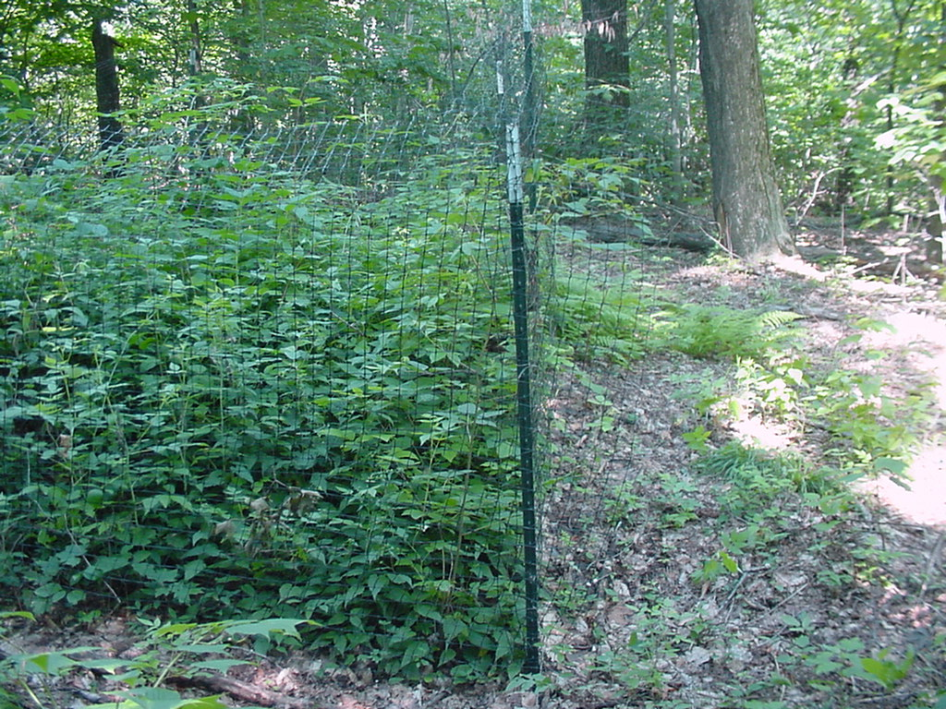
Step 1. Assess the situation (continued)
b. Create your own exclosure
c. Monitor your forest land
Notes:
Another way to assess the impact deer are having on your woods is to fence a small area to keep deer out. After just 2 or 3 years, if you see a big difference between the vegetation inside and outside the fence, you will know deer browsing is seriously affecting your woods.
Cornell University, SUNY ESF and NYSDEC have developed a method for citizens to monitor wildflowers and tree seedlings on their lands and submit the information to help DEC determine whether deer are impacting forests in their region.

Slide 25
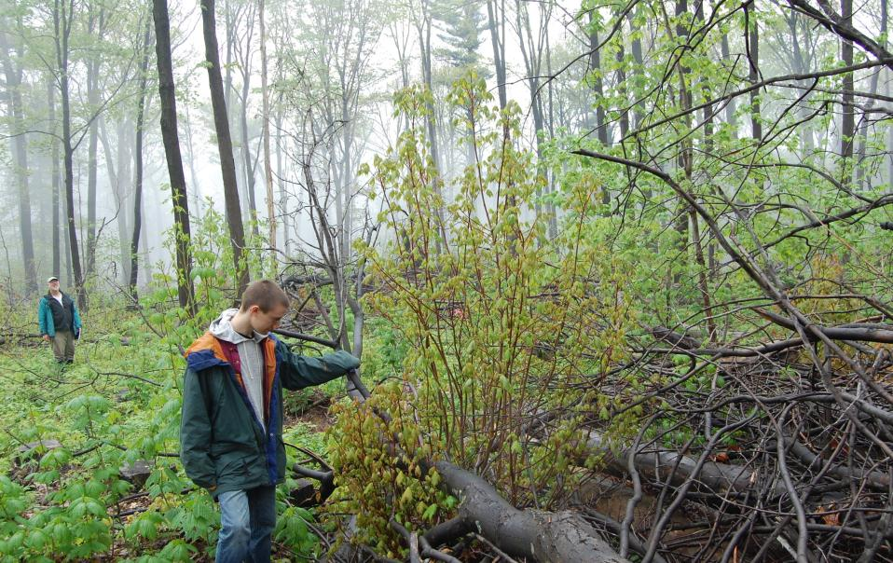
Step 2. Continue to monitor the situation
Substantial impact = no? Continue to monitor the situation
Substantial impact = yes?
Potential solutions – Manage – reduce deer numbers; fence to exclude deer (even small exclosures beneficial);
etc.
Notes:
If you don’t see signs that deer are affecting your woods you can continue to monitor the situation over time. If you do see signs of impact, you can work to harvest more deer on your land, fence important areas to exclude deer, etc.

Slide 26
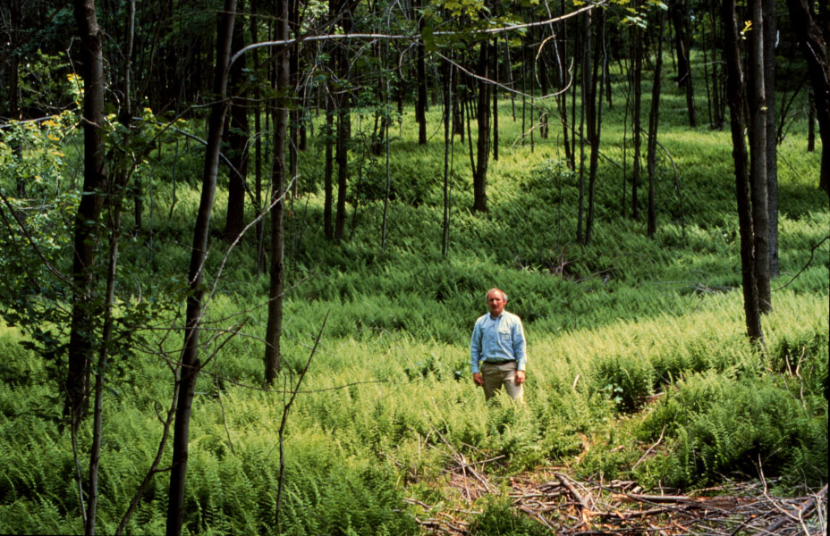
Step 3. Restore your woodland (overcome legacy effects)
Remove competing vegetation (beech brush, ferns, invasive species)
Fence after you remove or problem will return
Planting may be necessary in severely degraded habitats with long history of deer impacts (no remaining seed source)
Notes:
However in some situations (when invasive species or even some native species have taken over the understory and are preventing other plants from becoming established), reducing deer populations alone or excluding them from the forest may not be enough. Other actions to remove the competing vegetation will have to take place as well and then the area will need to be protected until native vegetation becomes established.

Slide 27
Success!
Notes:
In some areas a healthy forest with diverse vegetation and many different layers may be easy to establish, but in many areas of New York State, regenerating a new forest has become increasingly challenging for the forest owner.

