Slide 1
Deer-related Impacts
Collaborative Deer Management Outreach Initiative
Notes:
INTRODUCTION
The purpose of this module is to define and describe a concept called wildlife impacts, as it relates to deer and deer management in New York State.
We begin the module by defining what we mean when we talk about wildlife impacts and providing general examples of deer-related impacts in New York.
We conclude the module with discussion of how wildlife managers and citizens with a stake in deer management (i.e., stakeholders) can use the wildlife impacts concept as a focus for discussion about local deer management, including developing management objectives couched in terms of impacts desired by stakeholders.

Slide 2
What is wildlife management?
Notes:
We find that a useful way to begin discussion about the impact concept is to spend a few moments contemplating a very basic question
– what is wildlife management?
We ask people, “What is it that comes to mind when you think about the phrase ‘wildlife management?’ ”

Slide 3
Improving habitat
Informing
and educating
Controlling
Populations
Creating
recreation
opportunity
Enforcing laws
Regulating
land use
Notes:
When asked that question (“what does wildlife management mean to you?”), people commonly mention the actions that wildlife agencies might take to achieve outcomes desired by society.
--Actions such as controlling wildlife populations, improving wildlife habitat, or enforcing laws and regulations. These types of responses are common because people (individually and collectively) have a natural tendency to jump right to the means of achieving their goals.
However, thinking of wildlife management as a set of actions –starting with the means of achieving goals instead of thinking about the goals themselves—is really a partial definition. It leaves out much of what wildlife managers do in practice, and it does not describe the underlying reasons for wildlife management.
Starting with a more comprehensive definition can provide a better foundation for discussions about wildlife management generally, and deer management in particular.

Slide 4
Management is:
Deciding how to use resources to influence future conditions through deliberate, goal-focused actions.
Notes:
So as a starting point, we find it useful to begin discussions by thinking about management in generic terms.
Management –of any kind—is essentially: deciding how to use resources to purposefully influence future conditions through deliberate, goal-focused actions.
A key concept in this definition is the idea that actions are designed to achieve goals, or desired outcomes.

Slide 5
Wildlife management is:
Making decisions and taking actions to purposefully influence people, wildlife and habitats to produce outcomes that are important to society.
Notes:
Now we can move from a generic definition to a specific definition. Wildlife management can be defined as: Making decisions and taking actions to purposefully influence people, wildlife and habitats to achieve impacts that are important to society.
Those outcomes are conceptualized as impacts addressed by or created by management, generally some type of reduction of negative impacts or expansion of positive impacts.
Within this definition, impacts are positive and negative effects that are important to people who have a stake in wildlife management decisions --stakeholders.

Slide 6
Wildlife management:
Notes:
The definition stated in the previous slide is useful because it addresses two important questions.

Slide 7
Wildlife management:
What is management? A process of making decisions and taking actions.
Notes:
What is wildlife management? It is a process – a process of making decisions and taking actions.

Slide 8
Wildlife management:
What is management? A process of making decisions and taking actions.
Why is it done? To achieve outcomes valued by society (impacts defined by stakeholders)
Notes:
The other question is, “Why do we manage? And the answer is, wildlife agencies conduct management to achieve outcomes valued by society.
The definition provided here emphasizes the fundamentally human purpose of wildlife management.
It is aimed at production of value defined by and for society, where value or benefits are the outcomes (i.e., positive impacts created or negative impacts reduced) that are experienced by stakeholders as the results of wildlife management.

Slide 9
Guiding Questions
What effects do stakeholders regard as impacts?
Is the deer management program focused on those impacts?
What actions could be taken to increase or decrease impact levels?
Notes:
The definition I’ve just outlined is useful because it leads to a few guiding questions for wildlife managers. Those questions are:
What outcomes do stakeholders want managers to address in a particular situation?
i.e., What positive impacts do people want the management program to create?
i.e., What negative impacts do people want the management program to reduce or minimize?
Is the management program focused on those outcomes (impacts)?
What actions could be taken to increase or decrease impact levels experienced?

Slide 10
Effects and Impacts:
Notes:
The terms “effects” and “impacts” have a specific meaning in the definition of wildlife management provided here, so we provide more description of those terms in the remaining slides.

Slide 11
Effects and Impacts:
Effects: Positive and negative outcomes produced by interactions among wildlife, people, and the land/habitat.
Notes:
Effects are positive and negative outcomes of events or interactions -- interactions between wildlife people, or land/habitats.

Slide 12
Effects and Impacts:
Effects: Positive and negative outcomes produced by interactions among wildlife, people, and the land/habitat.
Impacts: A subset of effects (or outcomes) recognized and regarded by stakeholders as important enough to warrant management attention.
Notes:
Impacts, therefore, are a subset of effects of wildlife-related interactions and events that are determined to be sufficiently important to warrant management attention; they can be thought of as the priority effects from a management perspective. Or as stated previously, they can be thought of as the desired outcomes of a management program.

Slide 13
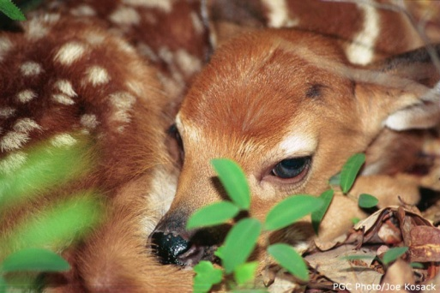
Impacts are a subset of effects regarded by stakeholders as important enough to warrant management attention.
PGC Photo, Joe Kosack
Notes:
To illustrate the impact concept, we have chosen to use an example related to deer fawn mortality.

Slide 14
Impacts are a subset of effects regarded by stakeholders as important enough to warrant management attention.
Effects
Recognized
Events or interactions
Unrecognized
PGC Photo, Joe Kosack
Notes:
A few years ago, researchers found evidence that black bear predation is a significant source of fawn mortality in Pennsylvania. Scientists now recognize bear predation as an event or interaction that can have an effect on fawn survival rates.
Many nonhunters don’t recognize that bear predation may influence fawn survival rates. Others do recognize that bears may influence fawn survival, but they don’t find that effect to be important enough to receive management attention.
Some deer hunters have read about those research findings, now recognize that effect, and they think it is a VERY important source of fawn mortality. Those hunters regard bear-related deer mortality as an impact that should be managed by their state wildlife agency. In other words, one of the outcomes they desire from deer management is reduced bear-related mortality of deer fawns.
If a stakeholder recognizes an effect and regards it as enough to be a focus of management, then that effect is an impact for that stakeholder.
Understanding how various stakeholders define impacts is an important foundation for deer management decisions.

Slide 15
Impacts are a subset of effects regarded by stakeholders as important enough to warrant management attention.
Impacts
High importance
Effects
Low importance
Recognized
Events or interactions
Unrecognized
PGC Photo, Joe Kosack
Notes:
Those hunters regard bear-related deer mortality as an impact that should be managed by their state wildlife agency. In other words, one of the outcomes they desire from deer management is reduced bear-related mortality of deer fawns.
If a stakeholder (like deer hunters) recognize an effect and regard it as important enough to be a focus of management, then that effect is an impact for that stakeholder group.
Understanding how various stakeholders define impacts is an important foundation for deer management decisions.

Slide 16
Impact Categories
Ecological
Economic
Health/safety
Sociological
Psychological
Notes:
Based on a wealth of experience and stakeholder input over many years, several broad categories of deer-related impacts have emerged. We have labeled these categories of impacts as ecological, economic, health/safety, sociological, and psychological.
We briefly define each of these broad categories of impacts in the following slides.

Slide 17
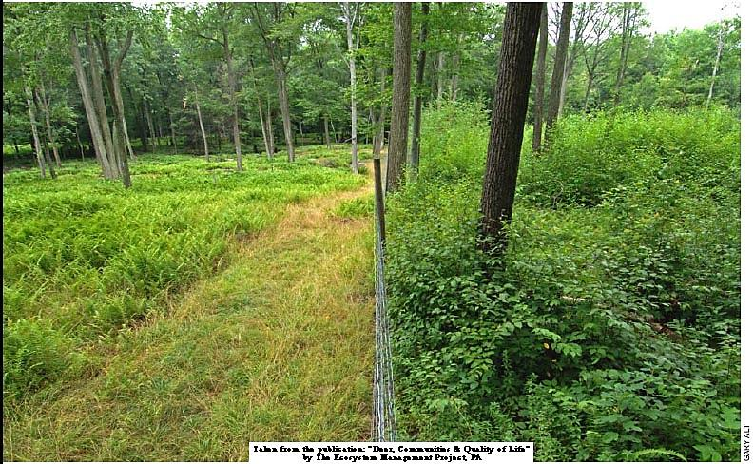
Ecological Impacts
Effects deer have on native plant and animal communities
Effects of deer herbivory on forest regeneration
Source: The Nature Conservancy, photo by Ron Rathfon
Notes:
Deer are the largest native herbivore in New York State (other than moose), and their foraging habits can have profound ecological impacts, especially when numbers of deer on the land are high.
Some of the effects of deer foraging are easily observed. For example, this photo of a hillside in Pennsylvania demonstrates how an abundant deer population can denude a forest floor of nearly all herbaceous plants, shrubs, and tree seedlings. Many scientists and conservationists are concerned about the effects that deer feeding is having on forest regeneration in New York and across the northeastern United States.
Many of the ecological effects associated with deer foraging activities are more subtle and difficult for the average resident to observe. For example, deer browsing can lead to changes in the structure and diversity of plant communities, which in turn can change the structure and diversity of animal communities in a given area. Sustained ecological damage associated with deer foraging can create a tipping point at which ecosystems change from one state to another. For example, with sustained heavy deer browsing, a forested area may lose its ability to regenerate after a disturbance (like a timber harvest), because deer foraging has led to changes in nutrient cycling, soil composition, and other ecological processes necessary to sustain the forest.
(For more on this topic, see Cote et al., Annual Review of Ecological and Evolutionary Systems 2004, Volume 35, pages 113–147.)

Slide 18
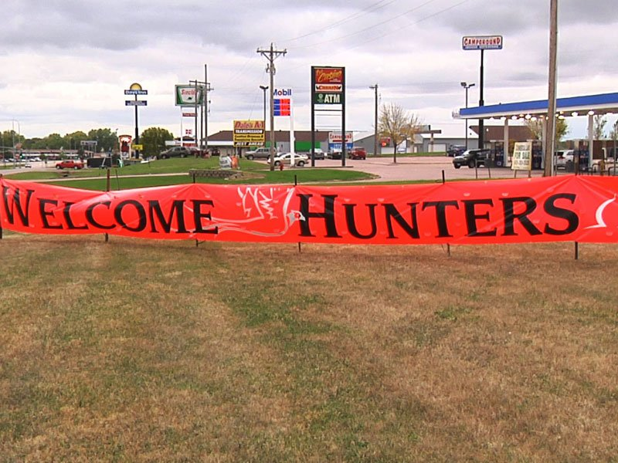
Economic Impacts (+)
Expenditures for hunting and other deer-related activities
Source: NSSFblog.com
Notes:
Expenditures, primarily related to regulated hunting, represent an important economic impact associated with presence of deer. Many communities welcome the economic impact associated with hunter purchases of food, fuel, lodging, and equipment. Deer hunting is often regarded as a significant positive economic activity, especially in rural areas of the state.
According to the New York State Department of Environmental Conservation (NYSDEC):
“Each year, more than 500,000 deer hunters contribute nearly $690 million to New York State's economy through hunting related expenses, and through license purchases and federal excise taxes hunters generate over $35 million to support management activities of NYSDEC.
(NYSDEC website, http://www.dec.ny.gov/animals/6965.html)

Slide 19
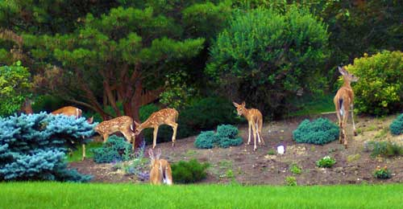
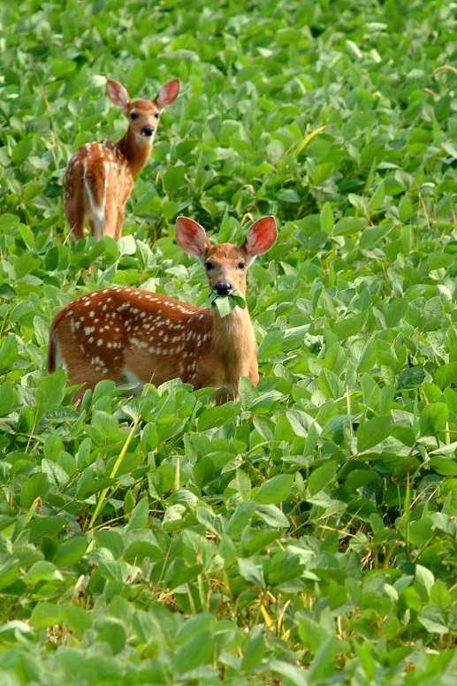
Economic Impacts (-)
Cost of property damage
Photo: Michigan State University Extension
Source: Purdue Agric. Communications photo/Mike Kerper
Notes:
On the negative side of the economic ledger, deer foraging results in significant economic damage to producers of row crops, fruits, and tree nursery stock.
Costs associated with deer-vehicle collisions also run into the millions of dollars annually in New York State, though exact estimates of such costs are difficult to estimate. And, while this represents a negative economic impact to residents, it could be considered a positive economic impact for vehicle repair businesses.

Slide 20
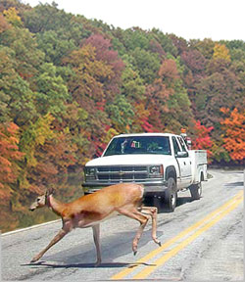
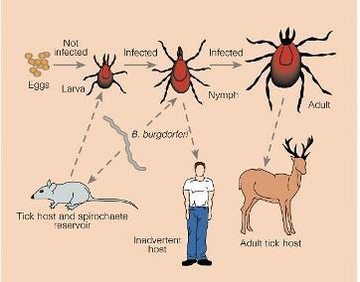
Health/Safety Impacts
Source: Nature 390, 553-554 (11 December 1997)
Notes:
Lyme disease and Deer related vehicular accidents (DRVAs) represent perhaps the most common sources of concerns about threats deer present to human health and safety.
Deer-vehicle collisions are difficult to estimate, because no single government or nongovernment organization tracks these incidents. State Farm Insurance Company used their own claims data and state licensed driver figures to estimate the number of deer-related vehicle accidents in New York, so their data provides one reasonable estimate. They estimated that motorists hit 80,262 deer on New York roadways between July 1, 2011 and June 30, 2012. By that estimate, New York State had the third highest rate of deer-related vehicle accidents (only Pennsylvania and Michigan had more accidents during that period, estimated at 115,571 and 97,856, respectively).
The New York State Department of Transportation reported that in 2011, there were 35,159 reported deer/ motor vehicle accidents in New York State, with four fatalities and 1,311 injuries to drivers statewide.

Slide 21
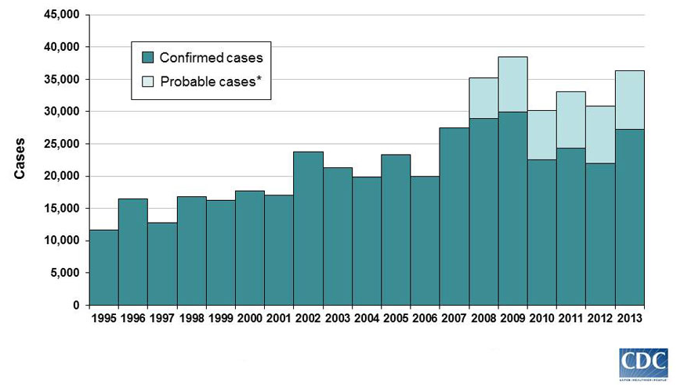
Reported Cases of Lyme Disease by Year, United States, 1995-2013
Notes:
On a national level, confirmed cases of people contracting Lyme disease in the United States have generally increased over the past two decades, with a peak of reported cases in 2009.

Slide 22
Confirmed cases of Lyme in NY, 2004-2013
Notes:
In New York State, incidence of Lyme disease peaked a few years ago (2008), but surveys of wildlife management stakeholders routinely find that public concern about transmission of tick-borne diseases to humans and their pets remains an issue of great concern to residents of New York.
Incidence of Lyme disease varies across the state, and is still an important issue in central New York. For instance, reported Lyme disease cases in Onondaga County have steadily increased in the past 10 years.

Slide 23
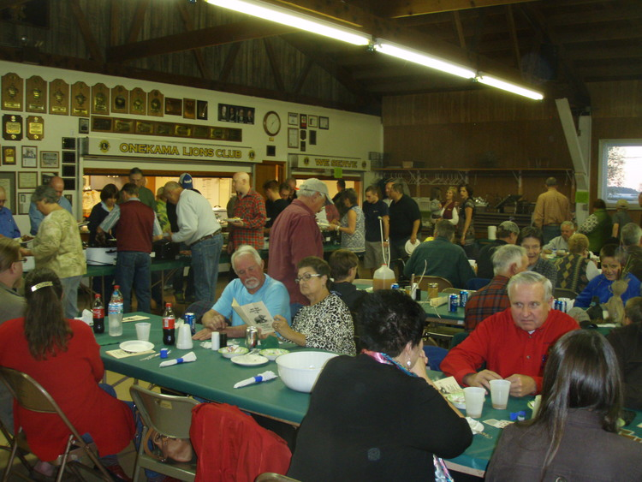
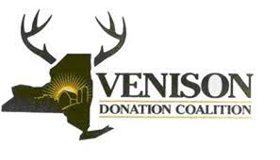
Social Impacts (+)
Positive social interaction related to deer hunting
Photo: http://bigbearsportsmansclub.com
Notes:
Social effects can be positive or negative, and are a product of people interacting with one another because of deer or deer management.
On the positive side, people strengthen family and other group bonds when they collectively engage in activities like deer hunting.
For example, NYSDEC estimates that “Hunters take some 220,000 deer annually, filling freezers with roughly 10.8 million pounds of high quality local venison…”
(NYSDEC website, http://www.dec.ny.gov/animals/6965.html). That venison is shared at family meals, community game dinners, and is donated to food pantries through programs like the Venison Donation Coalition.

Slide 24
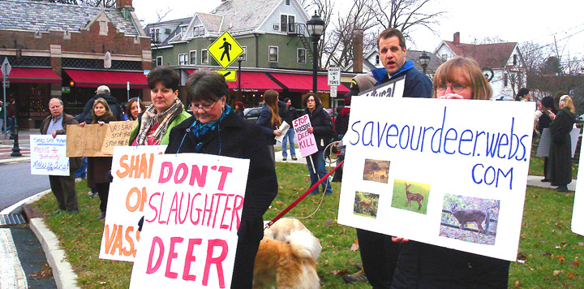
Social Impacts (-)
Conflicts between people over management
Photos: Joe Paulin
Notes:
On the negative side of the ledger, social effects can take form as conflict between stakeholder groups focused on how deer numbers should or should not be managed. In New York, these kinds of conflicts have emerged across the state, from the Buffalo and Rochester areas, to central New York (Cayuga Heights), and downstate areas (Westchester County, Long Island communities).

Slide 25
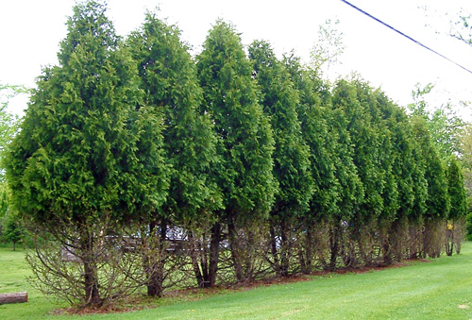
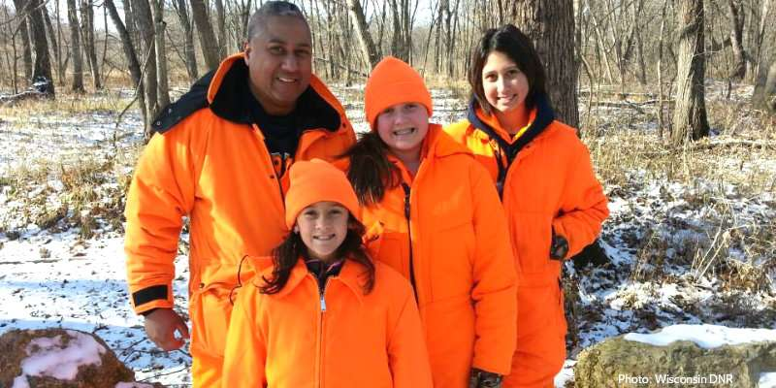
Psychological Impacts
Positive
Recreation satisfactions
Source: Michigan State University Extension
Negative
Frustration
Anxiety
Fear
Source: Wisconsin DNR
Notes:
The psychological category of impacts includes a wide range of positive and negative attitudes and emotions.
On the positive side, people derive recreational satisfactions from hunting, viewing, and photographing deer.
On the negative side, people experience emotions such as frustration, anxiety and fear associated with interactions like deer damage to flower and vegetable gardens, and worry about contracting Lyme disease or being hurt in a deer-related vehicular accident.

Slide 26
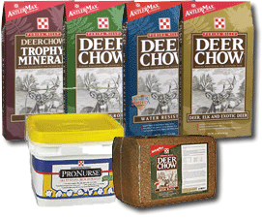
Secondary Impacts
Secondary effects produced by management actions
Notes:
In addition to primary impacts, deer management actions can lead to what are called secondary impacts.
For example, a few years ago the NYSDEC took administrative action that prohibits deer feeding. The feeding prohibition was taken to reduce spread of chronic wasting disease among deer that congregate around feeding stations. This prohibition had a recognized (though unintended) economic effect on private business enterprises that sell products to hunters and nonhunters who wish to feed deer.
The administrative action was taken primarily to address large-scale feeding stations associated with deer hunting. It also had the unintended effect of leading to suburban residents being fined for backyard deer feeding (such as the example shown here, in which an elderly resident of Cheektowaga, New York receiving a citation for feeding deer in in her back yard).
Wildlife managers can anticipate and try to mitigate recognized secondary impacts.

Slide 27
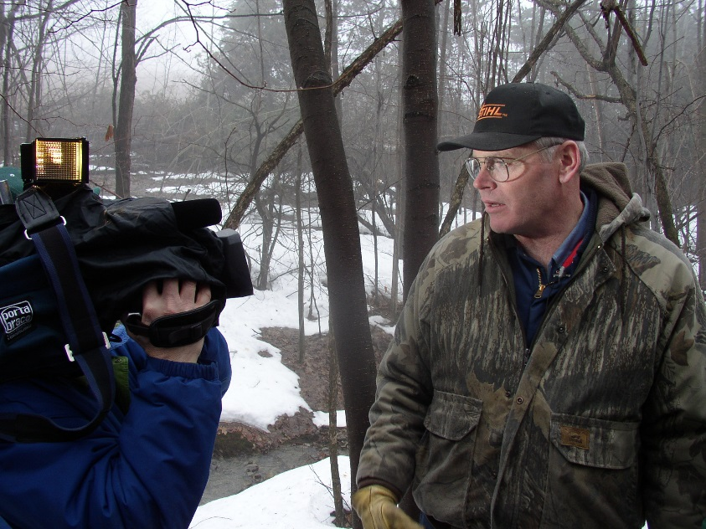
Key Roles for Researchers and Managers
Identify and raise awareness of effects
Increase understanding of the management system
Notes:
When communities or wildlife agencies focus on managing deer-related impacts, key roles for wildlife researchers and managers include:
identifying and raising awareness of deer-related effects, and
increasing public understanding of the interconnected ecological and social components in a deer management system.

Slide 28
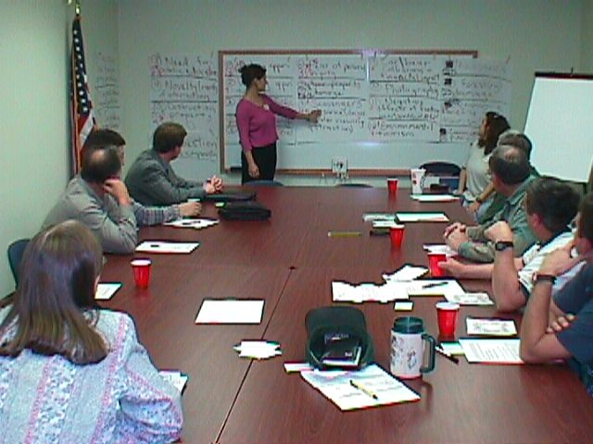
Key Roles for Stakeholders
Identify effects
Identify which effects should be considered impacts
Provide input on social acceptability of management alternatives in their communities
Notes:
When deer management has an impacts focus, key roles for deer management stakeholders include:
identifying how they are affected by deer and
identifying which of those effects are important enough to receive management attention (i.e., which effects should be considered impacts to manage)
They also provide input of social acceptability of management alternatives being considered or implemented in their local area.

Slide 29
Our Best Tool
Asking “Why?”
Notes:
In an impacts-based approach to deer management, it is critical to focus on the goals for deer management in a given management unit. The best way to identify those goals is for stakeholders and managers to work together to ask why they want deer management to occur.
Often when managers and stakeholders meet, discussion quickly turns to “how” deer ought to be managed (e.g., stakeholders may suggest that deer be managed using lethal means or nonlethal means; archers versus gun hunters; volunteer hunters versus professional sharpshooters, etc.). Before discussion such methods, it is useful for stakeholders to think about why they want particular methods to be used. Answering the question, “why do you want action “x” taken?” can allow groups to articulate the goals for deer management in their area. Once goals are clearly established, more constructive discussion about means of achieving goals can proceed.

Slide 30
Guiding Questions
What effects do stakeholders regard as impacts?
Is the deer management program focused on those impacts?
What actions could be taken to increase or decrease impact levels?
Notes:
In a nutshell, stakeholders and wildlife managers using an impacts approach to deer management deliberate around four guiding questions:
What effects do stakeholders in our area regard as impacts?
Is the management program in focused on those impacts?
What actions could be taken to increase or decrease impact levels in our area?
(and, if a community-based deer management [CBDM] is warranted in a local area) Who might come together in our community to form an effective coalition of partners who collectively and sustainably can provide capacity, political will, and mutual support for CBDM?

