Slide 1
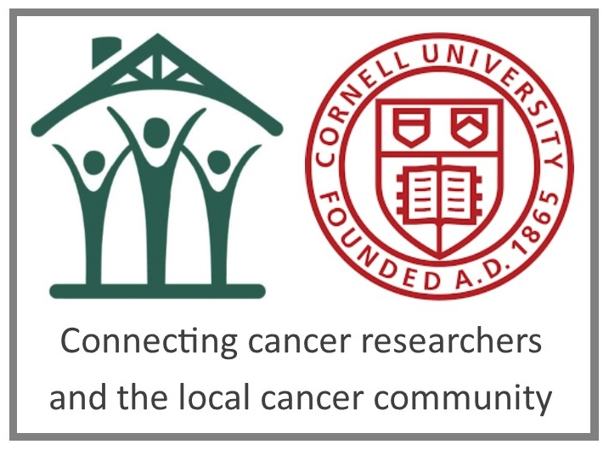
Talking with cancer patients:
Suggestions for students
Bob Riter
Patient Advocate
Cornell University Physical Sciences Oncology Center

Slide 2
Two perspectives
On a personal level, cancer is stressful and life-altering.
On an intellectual level, cancer can be fascinating.
Embrace both perspectives in this class.

Slide 3
We’re all different
There are 15,000,000 cancer survivors in the United States. Every cancer, every situation, and every individual is different,

Slide 4
Common themes
Everyone is scared
Being diagnosed with cancer is like traveling to a foreign country where you don’t understand the language or customs.
It’s unbelievably expensive
The public tends to think of cancer as one disease, not 200.
People with cancer worry about metastases.

Slide 5
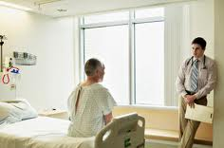
Periods of Transition: Times of special concern
First diagnosed
When treatment ends
If cancer returns
If active treatment is no longer appropriate

Slide 6
Language
Be cautious of using military analogies. (e.g., “He lost his battle with cancer.”)
Don’t use euphemisms like “the Big C.” We know that we have cancer.
In this class, it’s not a matter of “dumbing down” the science. It’s finding a common language.
But don’t get too self-conscious about your language. What’s in your heart comes through.

Slide 7
Ask us questions!
We want to share with you!
This is a safe place to make mistakes.

Slide 8
A few phrases that do make us cringe
“Don’t worry – you’ll be fine.”
“You have to stay positive.”
“Do you smoke?”
“I know how you feel.”

Slide 9
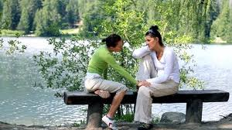
Advice for Friends
Don’t immediately say, “You’re going to beat this!”
Listen more than talk
Don’t give unsolicited advice

Slide 10
Don’t assume people will be rational
Even very bright and otherwise rational people will make unexpected decisions when diagnosed with cancer.

Slide 11
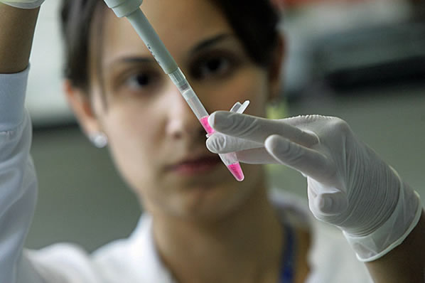
Special cautions for researchers

Slide 12
Special cautions for researchers
Family and friends will turn to you for cancer advice.
Your words will be given added weight and credibility.
What’s promising in the lab is years away from potentially helping patients.
Sometimes the patient wants you to be the researcher/scientist. Other times, they want you to be a loved one or friend.

Slide 13
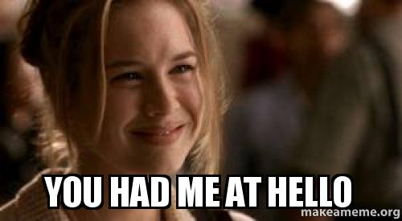
We’re happy that you are in this class!

Slide 14
Bob Riter
Physical Sciences Oncology Center
Cornell University
163 Weill Hall
Ithaca, NY 14853
RNR45@cornell.edu

