Slide 1
Women Who Lead: Brazil
Amina Kilpatrick, Ciarra Lee, & Jasmine Scott

Slide 2
I: Race and Gender in Brazil
Notes:
amina

Slide 3
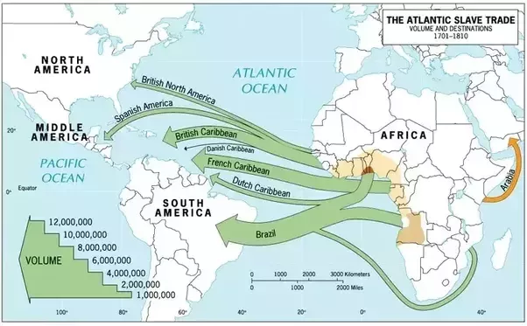
History of Race in Brazil
Notes:
The Portuguese first arrived to Brazil in 1500
The colonial period lasted from 1500 to 1822, during which 4 million African slaves were brought to Brazil
In comparison, 400,000 slaves went to the US and Canada

Slide 4
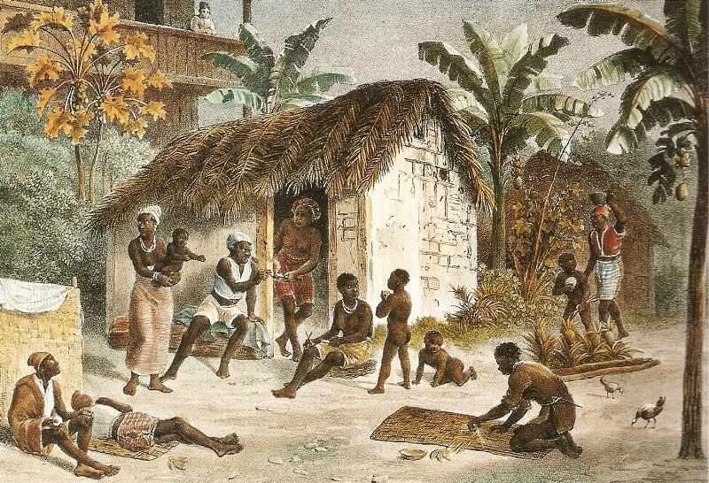
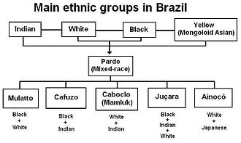
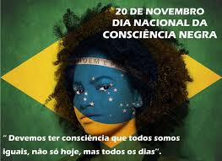
The History of Brazil's "Racial Enigma"
Slavery and Colonization
Brazil "Doesn't See Color"
Uma Democracia Racial
A Current Enigma?
Only when convenient...
Gilberto Freyre and the 1940s
Real world consequences
Five million slaves from 1501-1888
Notes:
(3 mins intro)
Jasmine Scott
the Portuguese arrived on the Bahian shores of Rio Buranhém, under the direction of Pedro Alvares Cabral.
A legacy of slavery
In comparison to the United States, Between 1501 and 1866, Brazil received up to 5 million African slaves (from where is this data)? I say this not to compare two different versions of this awful institution but rather to demonstrate the sheer mass of black people and black social and cultural capital that was forced, really, into a region that didn’t desire it
Why did they have so many slaves?
Brazil Doesn’t see race during Jim Crow
Brazil likes to brag that they did not have de facto policies around segregation like Jim Crow and Apartheid
Yet around both of these two separate times, there very much was segregation in which you saw only blacks on the bus and only whites on
Racial democracy:
much of the twentieth century, intellectual and political leaders promoted the idea that Brazil was a “racial democracy,” whose history favorably contrasted with the state-enforced segregation and violence of Jim Crow America and apartheid South Africa. “Racial democracy,” a term popularized by anthropologists in the 1940s, has long been a source of pride among Brazilians.
Sociologist Gilberto Freyre came up with this idea because he claimed that black slaves
Blacks in the 1960s used Brazil to compare to US
An enigma with real world consequences
Afro-Braziliness:
A legacy of slavey
In comparison to the United States, Between 1501 and 1866, Brazil received up to 5 million African slaves (from where is this data)? I say this not to compare two different versions of this awful institution but rather to demonstrate the sheer mass of black people and black social and cultural capital that was forced, really, into a region that didn’t desire it
Why did they have so many slaves?
Brazil Doesn’t see race during Jim Crow
Brazil likes to brag that they did not have de facto policies around segregation like Jim Crow and Apartheid
Yet around both of these two separate times, there very much was segregation in which you saw only blacks on the bus and only whites on
Racial democracy:
much of the twentieth century, intellectual and political leaders promoted the idea that Brazil was a “racial democracy,” whose history favorably contrasted with the state-enforced segregation and violence of Jim Crow America and apartheid South Africa. “Racial democracy,” a term popularized by anthropologists in the 1940s, has long been a source of pride among Brazilians.
Sociologist Gilberto Freyre came up with this idea because he claimed that black slaves
Blacks in the 1960s used Brazil to compare to US
An enigma with real world consequences
compare two different versions of this awful institution but rather to demonstrate the sheer mass of black people and black social and cultural capital that was forced, really, into a region that didn’t desire it
Why did they have so many slaves?
Brazil Doesn’t see race during Jim Crow
Brazil likes to brag that they did not have de facto policies around segregation like Jim Crow and Apartheid
Yet around both of these two separate times, there very much was segregation in which you saw only blacks on the bus and only whites on
Racial democracy:
much of the twentieth century, intellectual and political leaders promoted the idea that Brazil was a “racial democracy,” whose history favorably contrasted with the state-enforced segregation and violence of Jim Crow America and apartheid South Africa. “Racial democracy,” a term popularized by anthropologists in the 1940s, has long been a source of pride among Brazilians.
Sociologist Gilberto Freyre came up with this idea because he claimed that black slaves
Blacks in the 1960s used Brazil to compare to US
An enigma with real world consequences
Afro-Braziliness:
A legacy of slavey
In comparison to the United States, Between 1501 and 1866, Brazil received up to 5 million African slaves (from where is this data)? I say this not to compare two different versions of this awful institution but rather to demonstrate the sheer mass of black people and black social and cultural capital that was forced, really, into a region that didn’t desire it
Why did they have so many slaves?
Brazil Doesn’t see race during Jim Crow
Brazil likes to brag that they did not have de facto policies around segregation like Jim Crow and Apartheid
Yet around both of these two separate times, there very much was segregation in which you saw only blacks on the bus and only whites on
Racial democracy:
much of the twentieth century, intellectual and political leaders promoted the idea that Brazil was a “racial democracy,” whose history favorably contrasted with the state-enforced segregation and violence of Jim Crow America and apartheid South Africa. “Racial democracy,” a term popularized by anthropologists in the 1940s, has long been a source of pride among Brazilians.
Sociologist Gilberto Freyre came up with this idea because he claimed that black slaves
Blacks in the 1960s used Brazil to compare to US
An enigma with real world consequences
Afro-Braziliness:
A legacy of slavey
In comparison to the United States, Between 1501 and 1866, Brazil received up to 5 million African slaves (from where is this data)? I say this not to compare two different versions of this awful institution but rather to demonstrate the sheer mass of black people and black social and cultural capital that was forced, really, into a region that didn’t desire it
Why did they have so many slaves?
Brazil Doesn’t see race during Jim Crow
Brazil likes to brag that they did not have de facto policies around segregation like Jim Crow and Apartheid
Yet around both of these two separate times, there very much was segregation in which you saw only blacks on the bus and only whites on
Racial democracy:
much of the twentieth century, intellectual and political leaders promoted the idea that Brazil was a “racial democracy,” whose history favorably contrasted with the state-enforced segregation and violence of Jim Crow America and apartheid South Africa. “Racial democracy,” a term popularized by anthropologists in the 1940s, has long been a source of pride among Brazilians.
Sociologist Gilberto Freyre came up with this idea because he claimed that black slaves
Blacks in the 1960s used Brazil to compare to US
An enigma with real world consequences

Slide 5
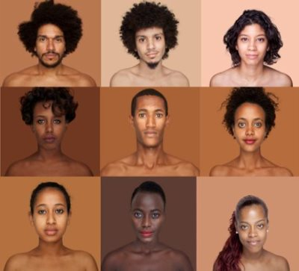
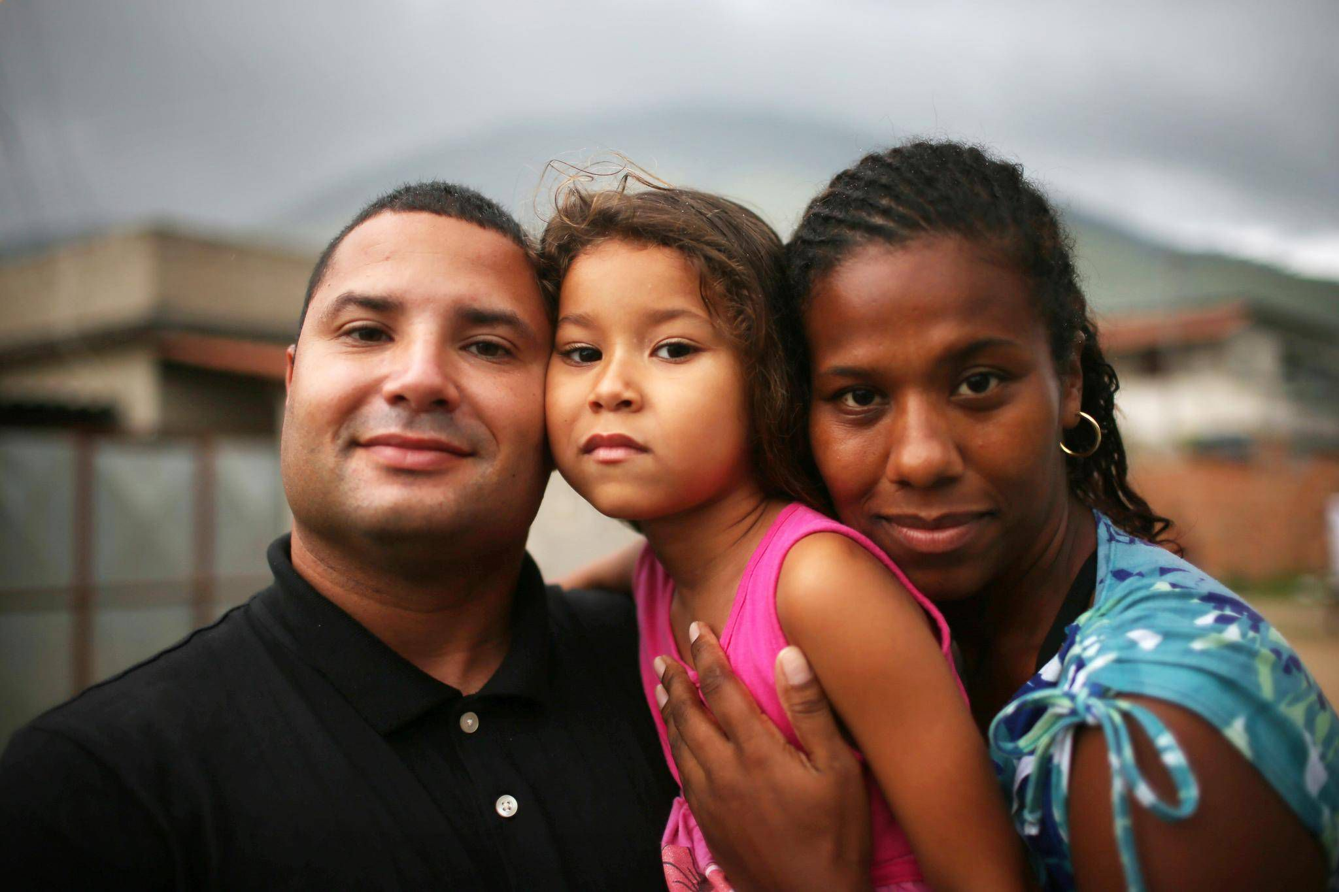
The Myth of Brazilian Racial Democracy
There are no hard racial delineations or clear-cut indicators of racial purity
The narrative of racial democracy involves the idea that Brazil is uniquely post-racial:
“The discourse was that we don’t have race in Brazil, so you don’t have race problems in Brazil, and you don’t need to discuss the inequality.”
In reality, the division of power and wealth operates along racial lines
Race is a sliding continuum in Brazil
Notes:
Ciarra
The National Statistics Institute conducted a survey to determine what word people used to self-identify their color
Ended up being a list of 136 delinations
Amarela-queimada (burnt yellow)
Canela (cinnamon)
Morena bem-chegada (variation of brown)

Slide 6
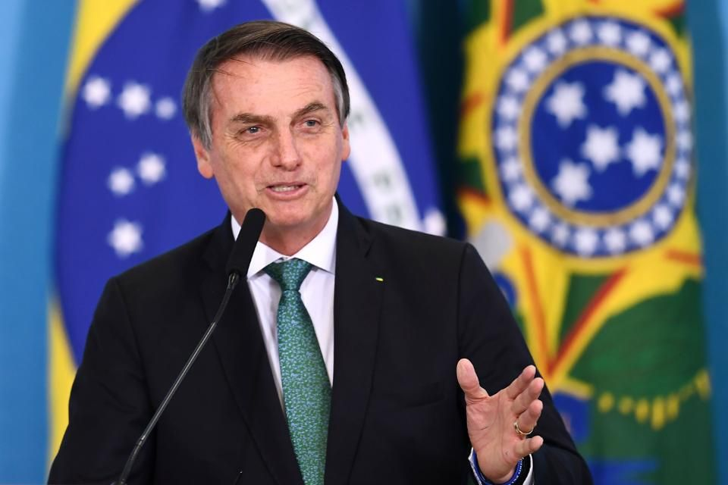
“...here in Brazil there is no such thing as racism.”
– President Jair Bolsonaro
Notes:
Statements like this are attempts to mask structural racism.
Restricting abortion rights, which disproportionately affect afro-brazilian women, restricting sex education, and contraceptive access

Slide 7
Debunking Racial Democracy: Manifestations of Racial Consciousness
“Pigmentocracy”
80% of the the top 1% is white
75% of the bottom 10% is black/mixed-race
80% of the Brazilian National Congress is white
0.2% of executives of Brazil’s 500-largest companies are black
References to slave quarters (‘senzala’) are a common way of telling Brazilians of visible African decent to stay in their place
Lack of media representation of dark skin tones
“Embranquecer” – generational whitening
Skin bleaching
Notes:
Ciarra

Slide 8
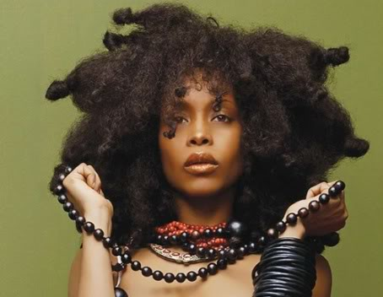
Black Womanhood in Brazil
Afro-Brazilian women make huge contributions to Brazilian culture but are largely erased and excluded
Ex) Carnival, Samba
Typical image of black women is associated with domestic service or prostitution
Body politics and policing make it difficult for black women’s agency
Ex) Natural Hair Movement
Notes:
Natural hair movement
Body Politics and Policing
Natural hair movement is a symbol of pride and identity + a political act of resistance
High levels of state-sanctioned violence
Typical image of black women is associated with domestic service or prostitution
Only 7.4% of commercials feature black women in a leading role

Slide 9
Nayara Justino ‘Too Black’ to Be Globeleza Carnival Queen
Notes:
Add timestamps: 3:16-6:10

Slide 10
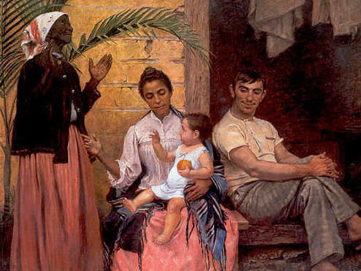
What does this photo represent?
Notes:
amina

Slide 11
II: Black Women’s Movement

Slide 12
Black Women in Brazil: By the Numbers
25%
7.7reales
103%
Of Brazil’s population is Afro-Brazilian women
Avg. Hourly wage for Afro-Brazilian women
Increase in femicide rate from 2003 - 2013
Afro-Brazilian Women umber more than 49 million in a country with a total population of :
On Average Afro Brazilian Women make approx. $2.50 USD/ hour compared to $4.02 for white women and $5 for white men.
Afro-Brazilian women have a greater chance of violence in life and in death.
They make up a sizable Brazil population due to the unique history of slavery and colonialism.
Afro-Brazilian women often face discrimination for jobs. The majority of Afro-Brazilians, live under the poverty line.
In the same time period, the overall rates of homicide had decreased in Brazil, while it increased for Afro-Brazilian women who are a greater risk for violence.
Notes:
amina

Slide 13
Issues Facing Afro-Brazilian Women
Racism
Violence
Sexism
Economic disparity
Workplace Discrimination
Body Exploitation
Sexual Tourism
Michel Temer Presidency
Notes:
amina

Slide 14
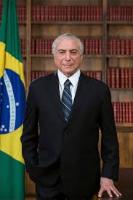
Michel Temer
President of Brazil from August 2016 to December 2018
Took office after impeachment of predecessor
Restricted rights to abortions and reproductive health which disproportionately affect black women.
President of Brazil
Notes:
(5 mins)
https://blackwomenofbrazil.co/taliria-petrone-of-niteroi-has-received-numerous-death-threats/

Slide 15
Odara Black Women’s Institute
Mission: “The organization’s mission is to strengthen the fight against racism, sexism, lesbophobia and all forms of intolerance to ensure freedom, autonomy and a good living of Black women and their families.”
Founded in August 2010
Consortium of five feminist organizations:
N’Zinga – Black Women’s Collective
Women’s Rebirth Association
I’m Divine
Uniart
Obirinlá
Addresses sexism, wage gap, unemployment, lack of access to training, etc.
Notes:
Amina

Slide 16
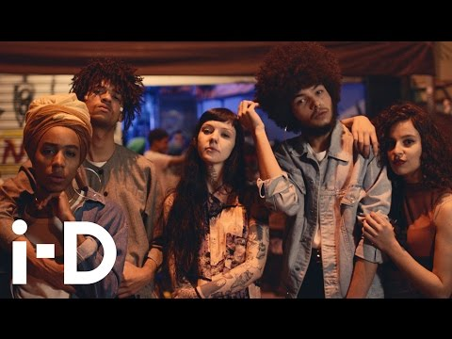
Natural Hair Movement
Notes:
3:57-5:32

Slide 17
Why is there often an additional movement to advocate for Black Women’s issues?
Notes:
Amina/ciarra- add questions

Slide 18
III: Black Women Political Figures

Slide 19
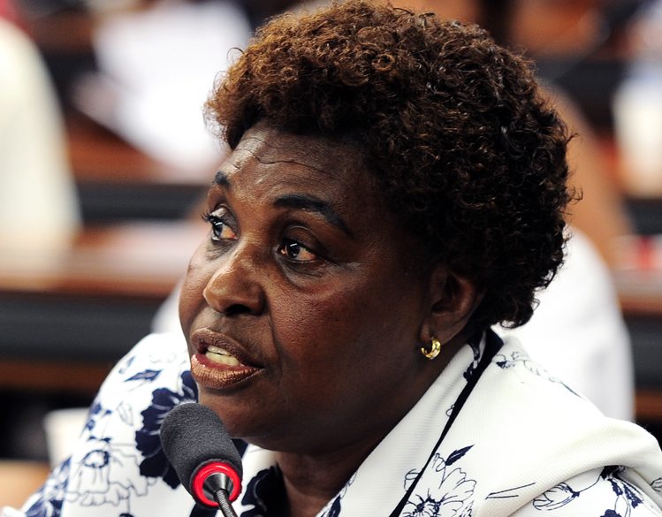
Benedita da Silva
Born in 1942, grew up in a favela
1st Afro-Brazilian woman member of the Senate and Governor of Rio
PT: Workers Party
Political Legacy
Started a health campaign that virtually eradicated TB in Chapeu Mangueira
Pushed for 20% women’s quota in Congress
Domestic worker legislation (minimum pay, maternity/retirement benefits)
Fought to ban employers from requiring proof of sterilization for women applying for jobs
Initiated Black Consciousness Day and passed a law requiring that African history be incorporated into school curricula
Notes:
Ciarra
Book Highlights
Workers Party – agrarian reform, workers rights, land titles for faveladas
“Three times a minority”
Winnie Mandela comparison
Ellen Johnson Sirleaf comparison

Slide 20
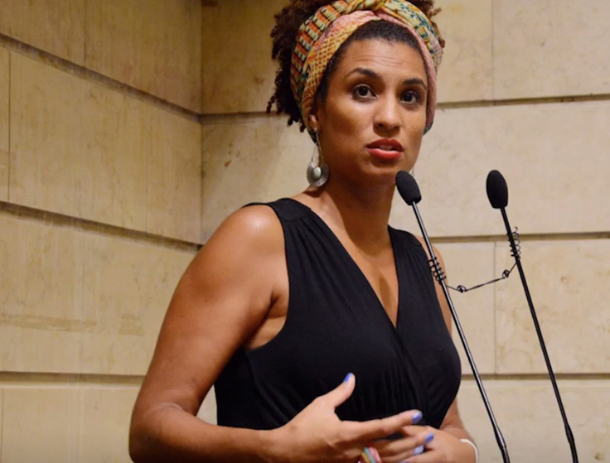
Marielle Franco
Born on July 27, 1979
City Councillor of Municipal Chamber of Rio De Janeiro for the Socialism and Liberty Party
Ran for City Council in Jan 2017, had 5th highest votes out of 1,500 candidates
Grew up in Favela in Rio
Outspoken afro-brazilian queer activist.
Gender violence
Reproductive rights
Rights of favelas
Wrote thesis about UPP presence in favelas
Notes:
Amina - UPP- pacifying police unit- goal is to reclaim terrorists from gang presence, mainly the favelas. She was bisexual, adovated for rights of LGBTQ people, wanted a lesbian day of visibility

Slide 21
Death of Marielle Franco
On March 14, 2018 Marielle Franco was murdered. A day after giving a speech on extrajudicial killings.
In March of 2019 Ronnie Lessa, a retired military police officer, and Élcio Vieira de Queiroz, a former police officer were arrested for her murder.
https://www.aljazeera.com/programmes/peopleandpower/2019/06/murder-marielle-franco-190605100430174.html
Notes:
1:15-4:00

Slide 22
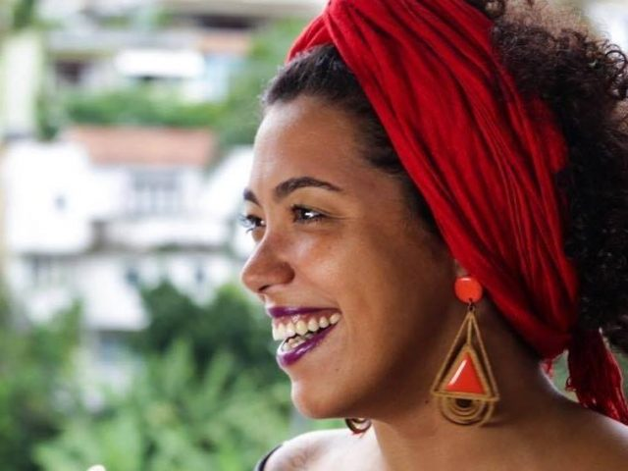
Taliria Petrone
34 years old
Neterói city councilwoman and Chair of Commission on Human Rights, and only woman (2016-2018)
Federal Deputy Representative of Río de Janeiro (2018-Present)
Masters in Social Work
Public school teacher, history professor at Rio de Janeiro State University
PSOL: Socialism and Liberty Party
Friendship with Marielle Franco: Black woman bonds bring death threats
Socialist, Feminist, Black Woman
Notes:
(5 mins)
https://blackwomenofbrazil.co/taliria-petrone-of-niteroi-has-received-numerous-death-threats/

Slide 23
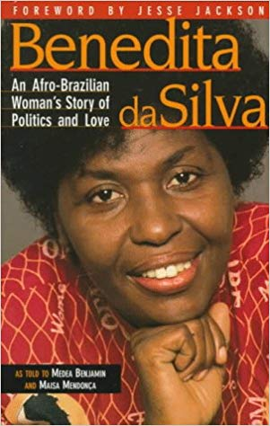
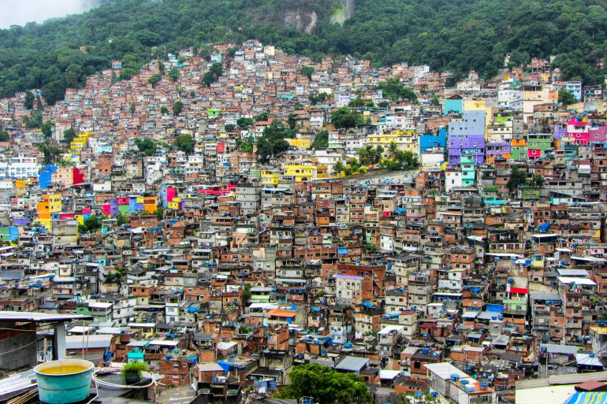
Overarching Themes
Violence in the lives of women
Love and sexuality for women in politics
Class and the favela
Notes:
Jasmine (7 mins)
Pg. 18 for maid work

Slide 24
Do you think that the aforementioned problematic attitudes held by Da Silva toward low-income women are inevitable for those who achieve institutional political power or are they formed by other actors beforehand?
Notes:
Jasmine - So we talked about class as one of the overarching themes in Benedita Da Silva's books. I'd be interested to hear what you think about this:

Slide 25
References
Nolen, S. (2017, June 19). Brazil's colour bind: How one of the world's most diverse countries is just starting to talk about race. Retrieved from https://www.theglobeandmail.com/news/world/brazils-colour-bind/article25779474/.Quem
Somos. (n.d.). Retrieved from https://www.taliriapetrone.com.br/quem-somos.
Silva, B. da., Benjamin, M., & Mendonça Maisa. (1997). Benedita da Silva: An Afro-Brazilian Woman's Story of Politics and Love. Oakland: Institute for Food and Development Policy.
Travae, M. (2018, October 24). Talíria Petrone of Niterói has received numerous death threats. Retrieved from https://blackwomenofbrazil.co/taliria-petrone-of-niteroi-has-received-numerous-death-threats/.
Travae, M., Thomas, A., Lulendo, & Samson, K. (2018, December 5). When racist stereotyping of black women. Retrieved from https://blackwomenofbrazil.co/when-racist-stereotyping-of-black-women/.

