Slide 1
Caribbean Women &
First Lady Issue
By La’Treil Allen, Theresa Grace & Sydney Gates

Slide 2
Jamaican Political Conflict
Series of riots and violence against the British Empire over low wages, and high unemployment spurred the creation of two main political parties in Jamaica in a feud over control of the island.
Jamaica Labour Party (JLP) is a conservative party that strived for market driven economy.
People’s National Party (PNP) is a social democratic party
Notes:
This anti colonial period was known as the carribean labour unrest. This feud between the two parties has resulted in violence and warfare in Kingston. Created political driven gangs. Both parties think the other is controlled by foreign elements.
Norman Manley founded PNP (1938) and his cousin Alexander Bustamante founded JLP (1943) -- Manley family being very political
-- manley was prime minister but under colonial rule still so many see Bustamante as the first real prime minister since it was after independence
Jamaican became officially independent in 1962, parties formed a bit earlier than independence because WW2 really broke down british colonial influence, but it still took a few years for full liberation
PNP- coalition of classes

Slide 3
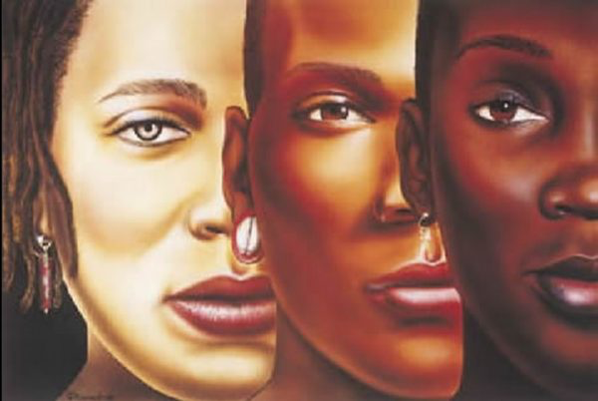
Colorism & Class Within the Caribbean
Socialization
Eurocentric beauty standards
“Our Jamaican obsession that qualified hair as superior according to the extent of its Caucasian-ness”
The prominence of skin bleaching
Class having long standing impact
History of using black and Amerindian labor while sparing mixed race
“Roast Breadfruit”
Quest for economic independence
Marriage/ Relationship dynamics
Status vs wealth as two separate things
Notes:
Pg- 18, 44, 63,66
Socialization -- mom saying that nothing black was good
For a long time she felt unattractive to men
Class- quest for women to gain economic independence
-- class difference made marriage and relationships different
-- marry man for economic prospects through necessity at a certain class level
-- women being the money managers across class levels
What people bring to a relationship-- turning back on class
“Education as the only way to negotiate your place out of poverty” Manley
Jamaica 78% black but even more complex when you break that down with different complexions
75% lower class, 19 percent middle class-- effect of huge middle class- steps away from stability but fresh out of recession and post independence
Class more prevalent than race
Huge black middle class

Slide 4
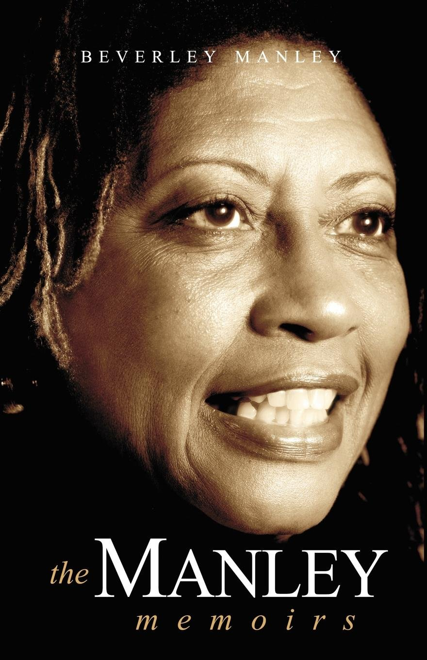
The Manley Memoirs
MOBILITY
Education attainment
Economic independence
MARRIAGE
Unwavering loyalty to husband
Place as a first lady: theme of “active” first lady
MOTHERHOOD
Guided political ideologies
Created a divide in their marriage
Notes:
Personal life and professional had to intersect.
Michael married Beverley and as a result could win over darker skinned women.
Detached fathering she saw in her father and in Michael (taking notes during meetings to remember them and seeing family once a week)
MOBILITY-- “To be black, working class, and have ‘bad hair’ meant you had three strikes
Manley dismanteld eurocentic beauty standards; Black Power Movement
MARRIAGE-- Opposition from Jamaican people on her role

Slide 5
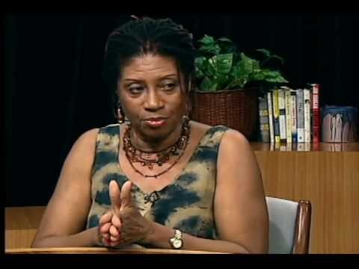

Slide 6
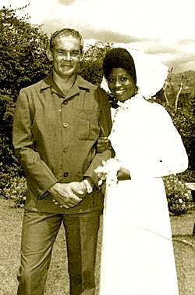
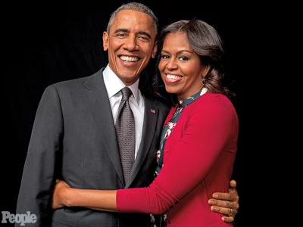
The Role of Race in Political Marriages
Dominance of a Eurocentric aesthetic
Praised for publicly claiming a dark-skinned women
Perceived as a way to win over black constituents
Notes:
Always question of political figures race and used it to discredit them.
Beverley is a black woman, so it helped Michael in the election win the darker skin vote.
Michelle is a Black darker skinned woman. So how does that affect how she is seen in public eye?

Slide 7
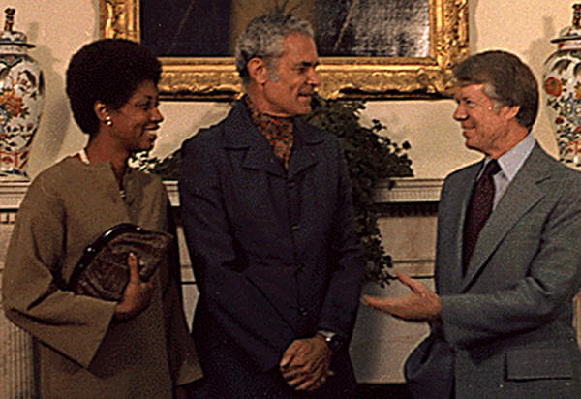
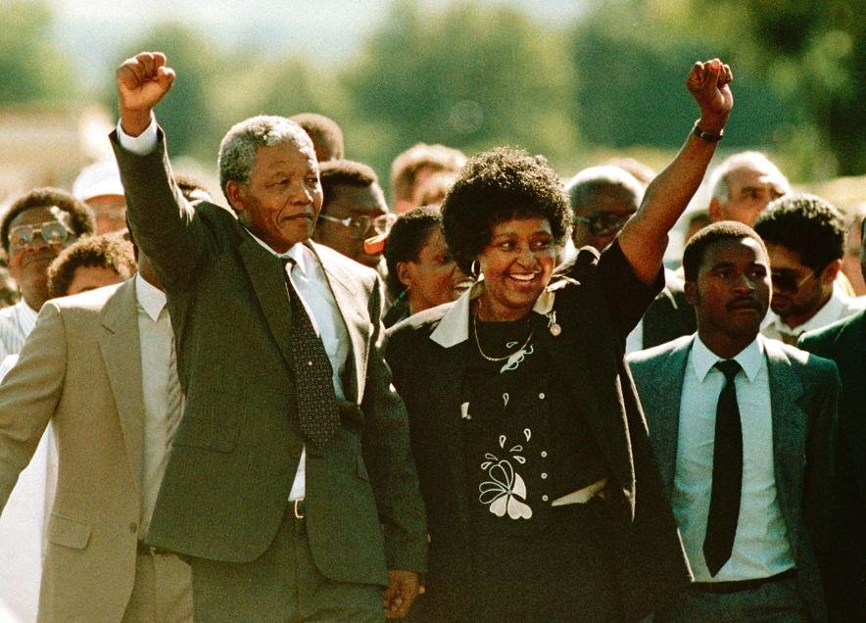
Leaving (or Staying with) the ‘Great Man’
Marriages are highly publicized
Maintaining a united front publically
Political loyalty vs. Personal loyalty
Using marriage as a form of agency
Women struggle to establish their own political platform
Establish a movement in their husband’s name
Manley dared to leave the ‘Great Man’
Michael Manley: “You will never make it without me”
Has a long-term relationship with D.K. Duncan
Notes:
Gives them and their movements credibility

Slide 8
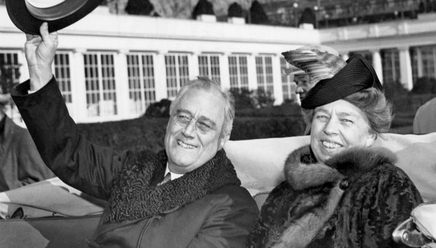
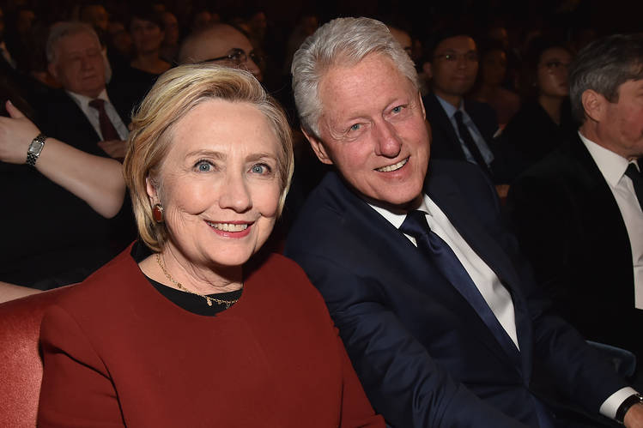
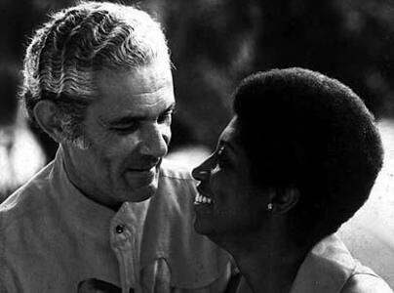
Beside Every Successful Man....
Notes:
Beverley shaped michael as a political candidate. Gave him speech practice.
-The fact that all these women stayed by them even in infidelity. Helped their image

Slide 9
Does marriage help or hinder one’s political image?

Slide 10
First Lady Themes & Issues:
Themes
Advocate for social issues
Seen as more suitable responsibilities for women
Issues
Confined to domestic focused policies/reforms
Manley’s case: childcare, municipal services, education reform
Michelle: childhood obesity, education access
Notes:
Manley focused on these policy issues in relation to how they affected working class women
“The people closest to the pain should be closest to the power.”
Democratic socialism- belief that capitalism goes against the values of freedom and equality-- important for a newly independent nation in Manley’s eyes
-- pushing democracy into economics
-- collective ownership

Slide 11
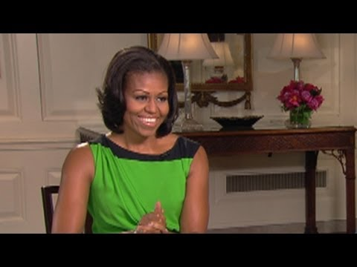
Notes:
Start at 4:00

Slide 12
What are the roles and responsibilities of the First Lady?
Notes:
Talk about if these roles are a part of a larger gender role. Is someone’s change discounted because of their role as a first lady?

Slide 13
Caribbean Women

Slide 14
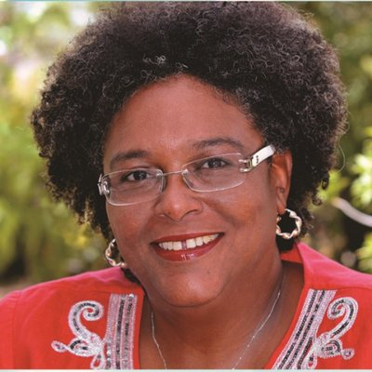
Mia Mottley
-Prime Minister of Barbados and leader of Barbados Labour Party (BLP)
- Homophobic attacks against her because of her decision to support of the LGBTQ community
- Early political career as Minister of Education and Minister of Economic Affairs and Development
- Pushing social democratic model to honor Barbados history of slavery and colonialism
Notes:
Won seat in 2018-- so recent but how many of us have hear about her?
Talk about how homosexuality is illegal in barbados.
Redistributing wealth, state regulations to help counterbalance economic inequality
Burden should be shared by all not some -- relation to Manley
Social welfare programs --- following trend of putting social justice at the forefront of policy in some way for women in politics

Slide 15
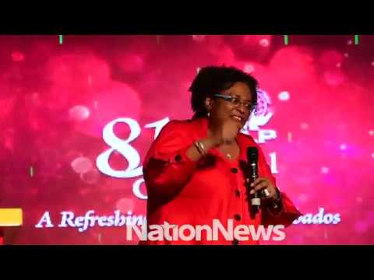

Slide 16
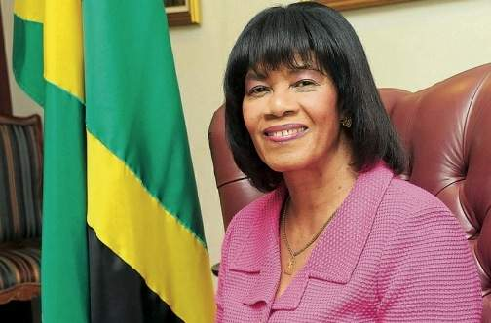
Portia Simpson Miller
Prime Minister of Jamaica in March 30, 2006 as well as minister of Defence, Development, Information and Sports.
First head of government to endorsed civil rights of LGBTQ+ members.
In 2006, became president of People’s National Party (PNP) of Jamaica.
Leader PNP’s Women Movement
Recieved media backlash in re-election
Portia Simpson aka “Sista P”
Notes:
-Parliamentary secretary in Office of Prime Minister during Michael Manley administration
Prime Minister Campaign “Come to Mama”.
Before she became prime minister, she was minister of labour and welfare/Labor social security and sports, tourism and sports.
Criticized for being unqualified for prime minister. -Modest education, undistinguished performance in parliament

Slide 17
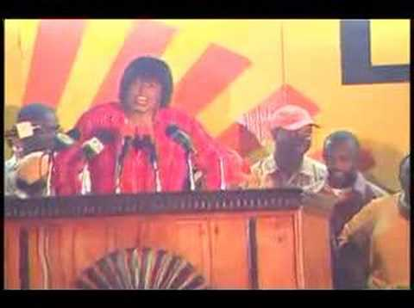
Drawing Sister P’s Tongue
Notes:
Her words were distorted and enhanced to make her appear mad. Appealed to class prejudice of Jamaica
-She was then seen as a virago
-Very contrast from her Motherly image before
-Even people apart of the PNP were convinced

Slide 18
Are the roles for black women in political leadership often predetermined?
Notes:
Do you they have the space to make their own agendas and choose the issues that they want to advocate for? Does intersectionality of being a black women confine you to being an advocate for ONLY black advancement or ONLY women’s rights?

