Slide 1

Perspectives on the Safety of the U.S. Beef Supply.
Michael J. Baker
Beef Extension Specialist

Slide 2

Summary
Definitions
Use of antimicrobials
  Guidance #209
  Approval process
  Antimicrobials used
  Residues levels
  Processes to assure compliance
Beef Quality Assurance
Growth promoting hormones
Cattle nutrition – what do they eat?

Slide 3
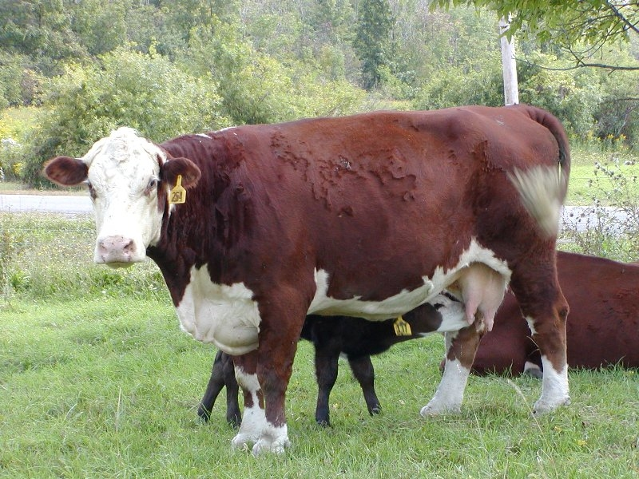
Cow/calf

Slide 4
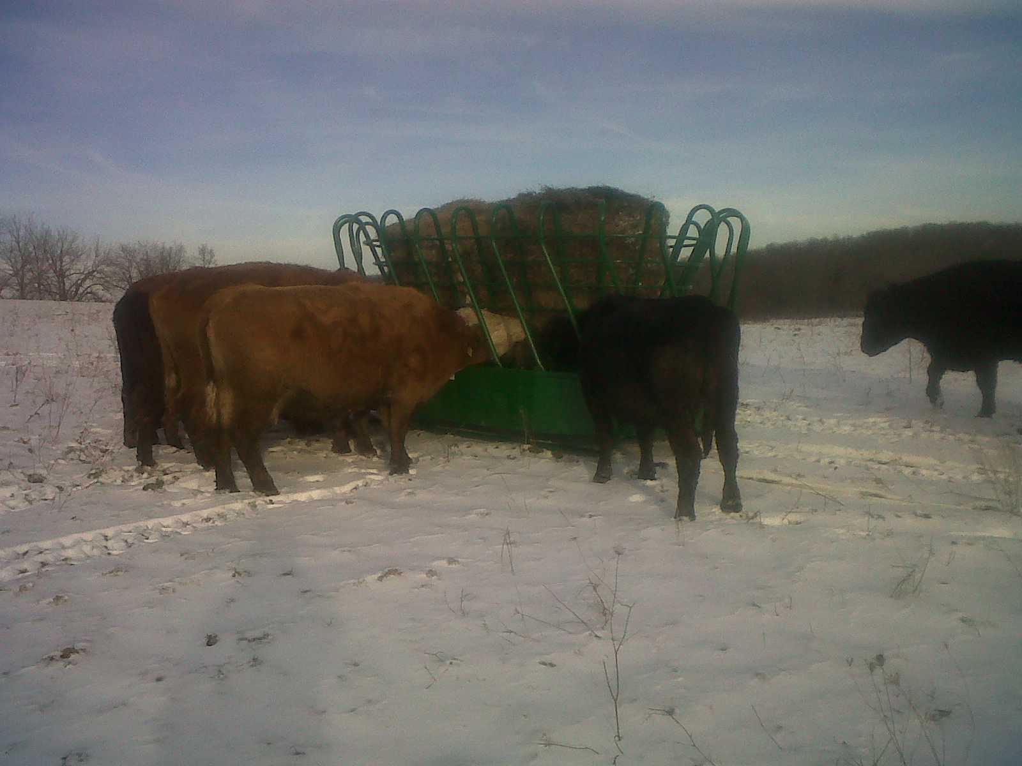
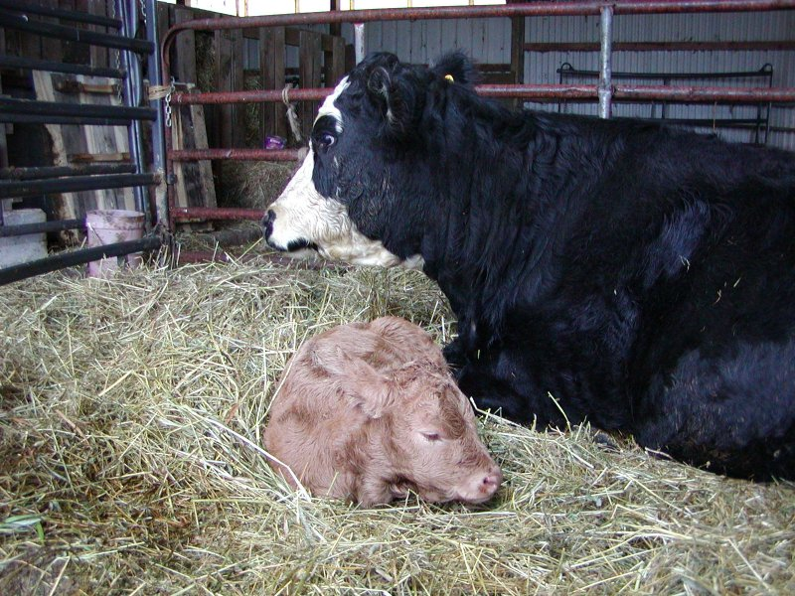
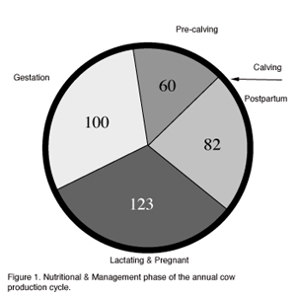
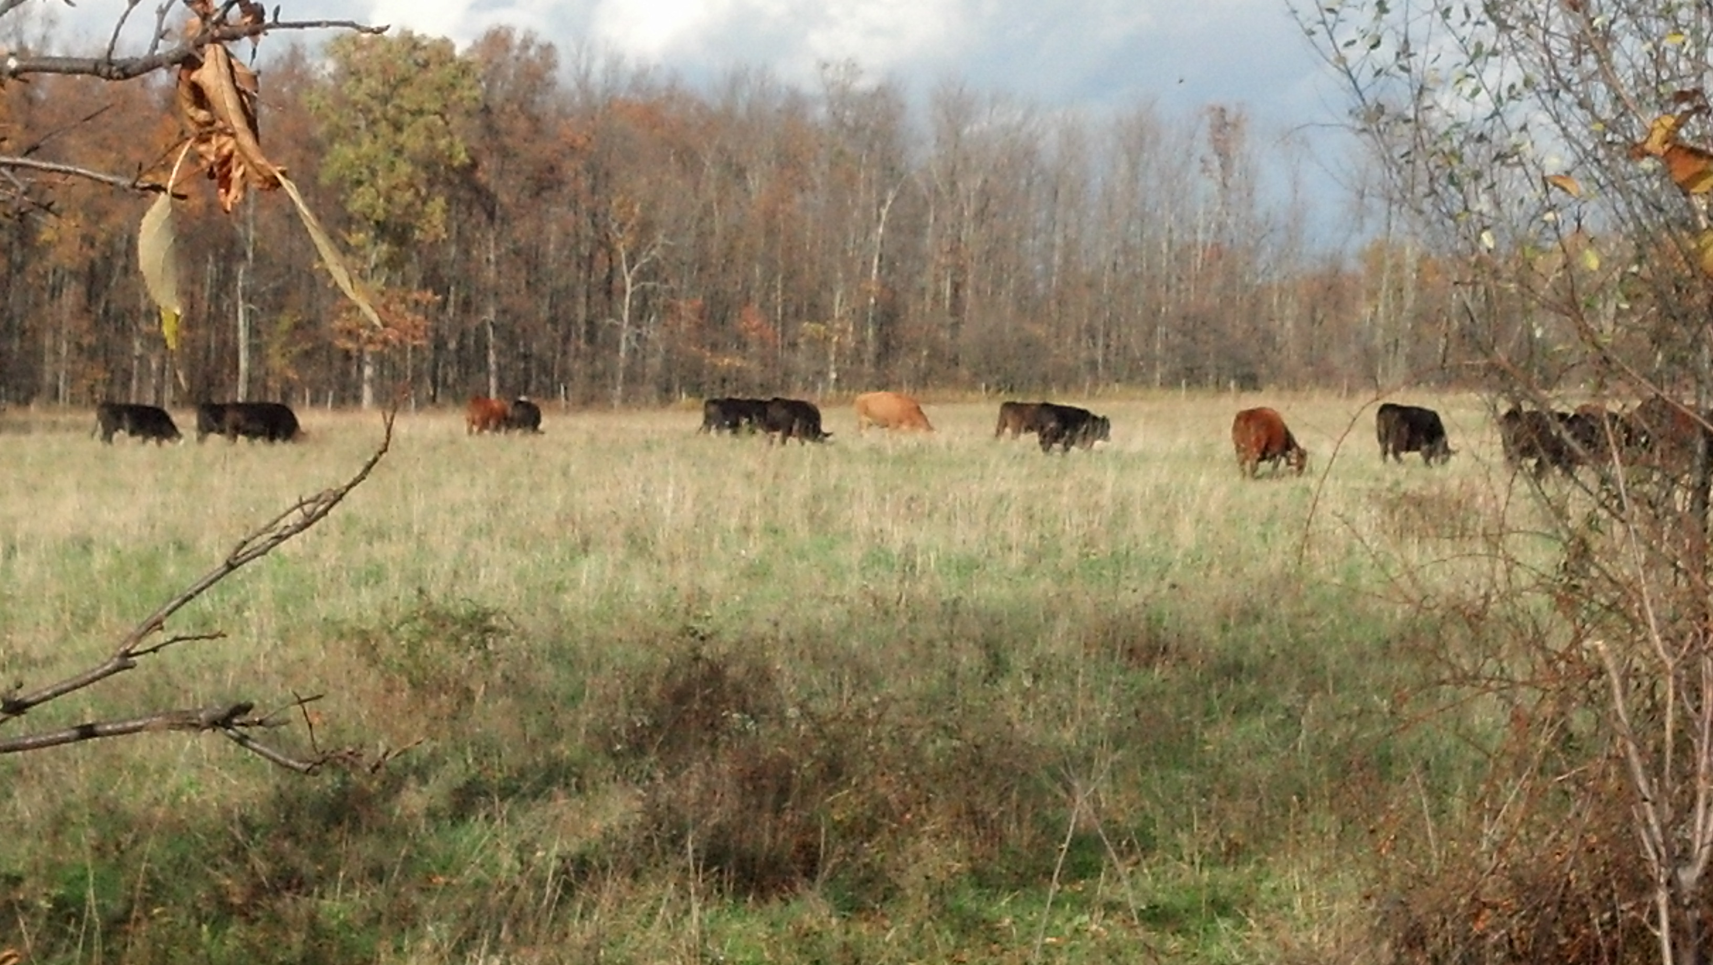

Slide 5
Antibiotics may receive approval by the FDA for these indications:
Therapeutic
  Treatment of disease
  Prevention of disease
  Control of disease
  Improved feed efficiency
  Improved rate of gain
Sub-therapeutic
Production

Slide 6
Virtually no antibiotics used
Notes:
Mainly therapeutic use, sometimes given Ionophores.

Slide 7
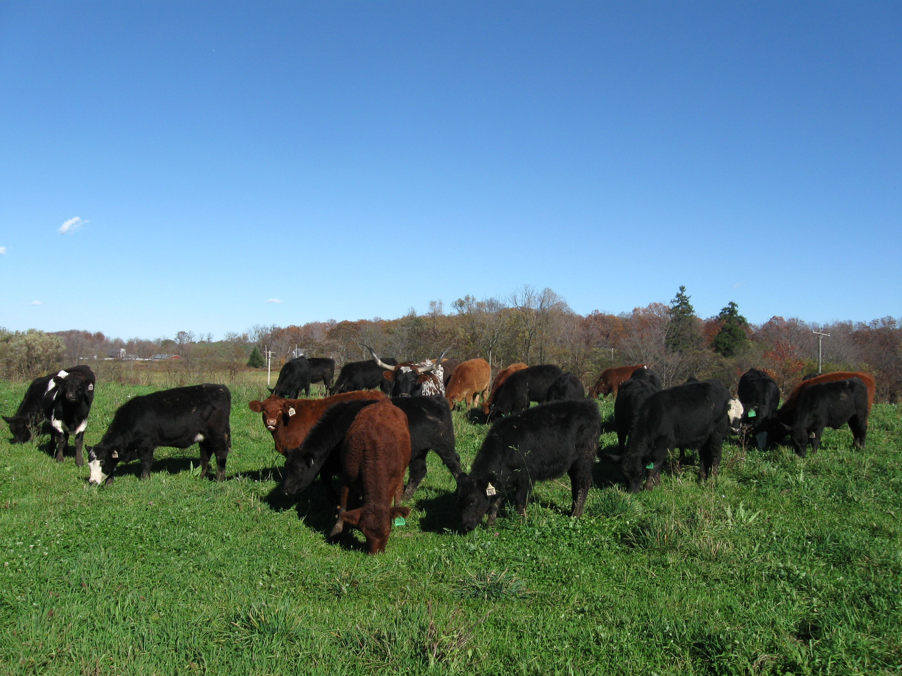
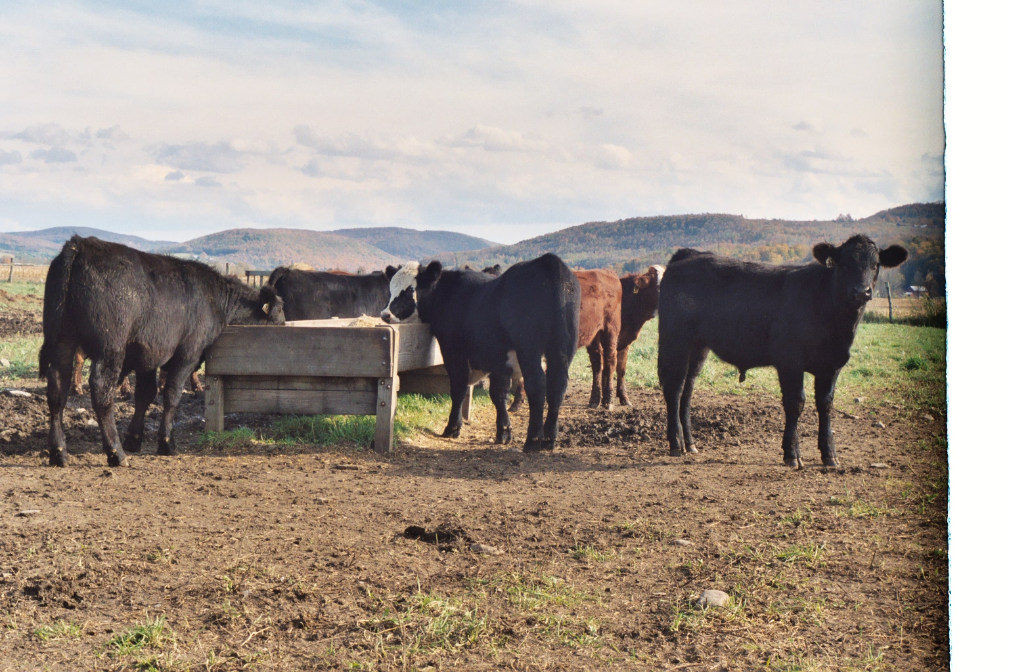
Backgrounder/stocker
“Teenager Phase”
400 lbs. – 800 lbs.
Moderate growth rate
Forage based rations
Commingling challenge
Receiving programs critical

Slide 8
Backgrounder/stocker
Antibiotic use:
  Therapeutic (BRD¹)
  Sub-therapeutic (BRD¹ prevention)
  Production – primarily ionophores
¹BRD = bovine respiratory disease

Slide 9
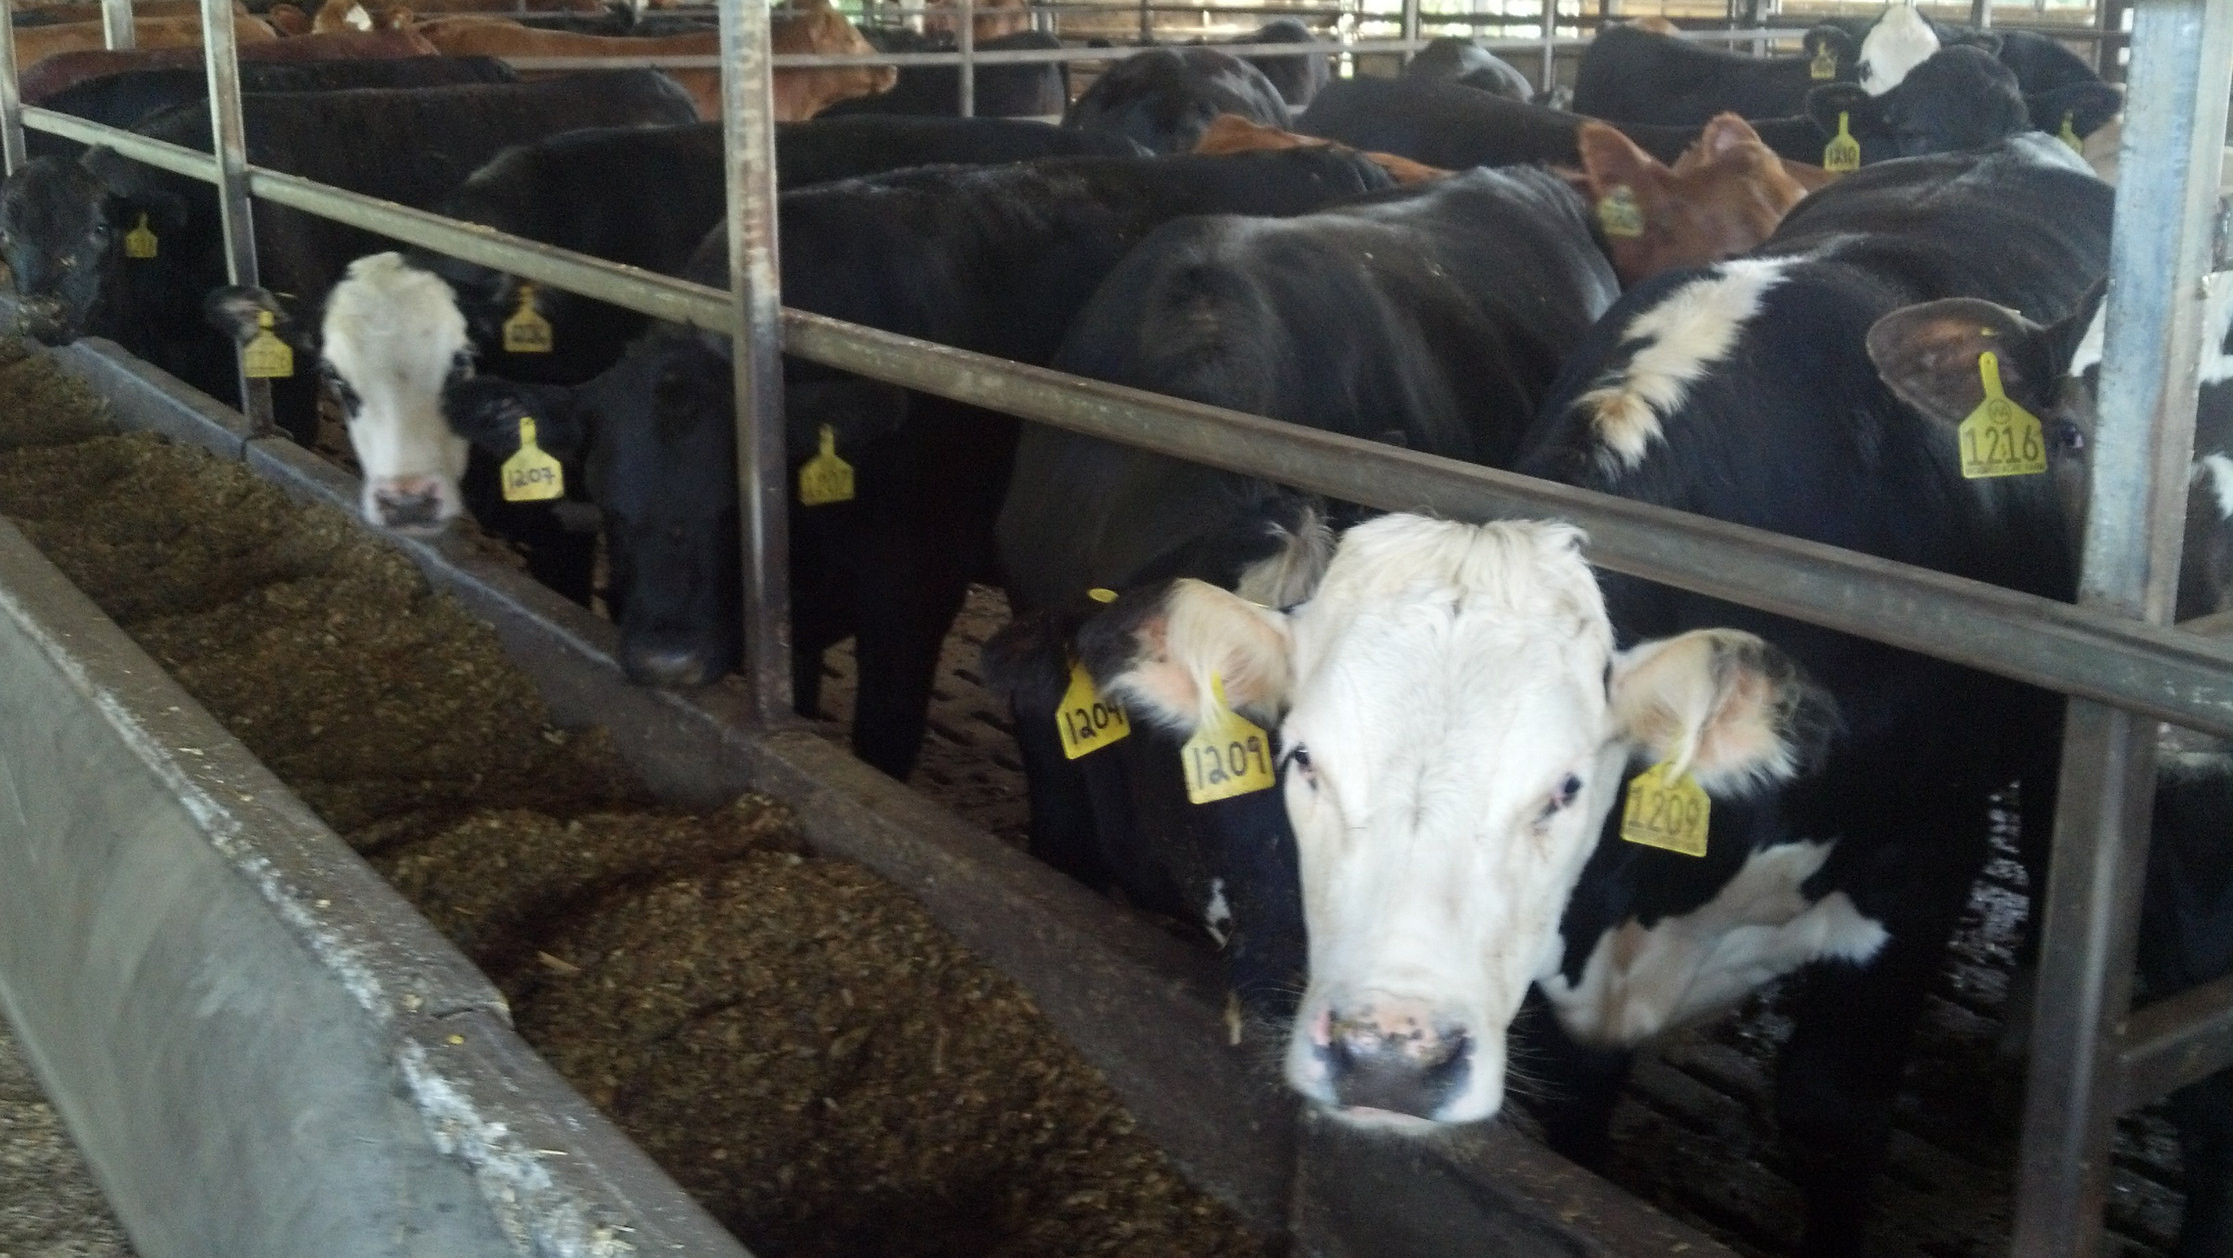
Finishing phase
Grass
Grain

Slide 10
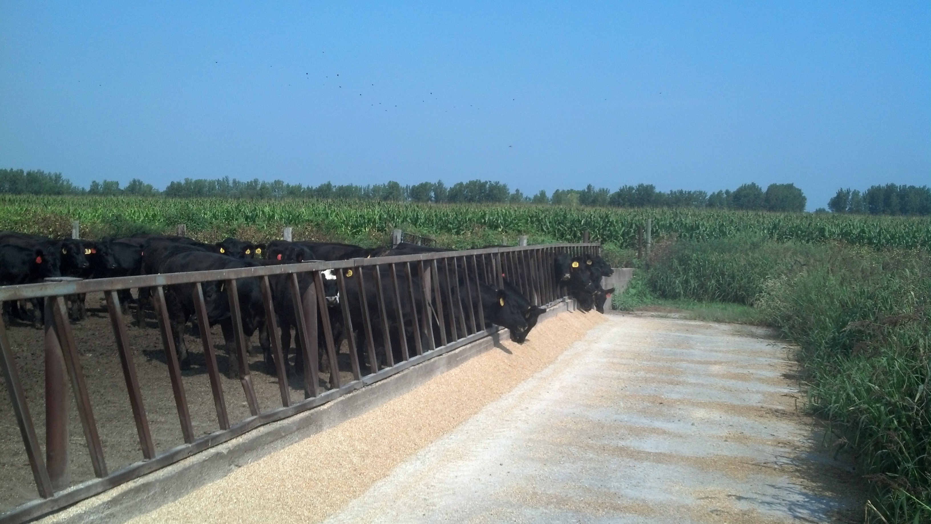
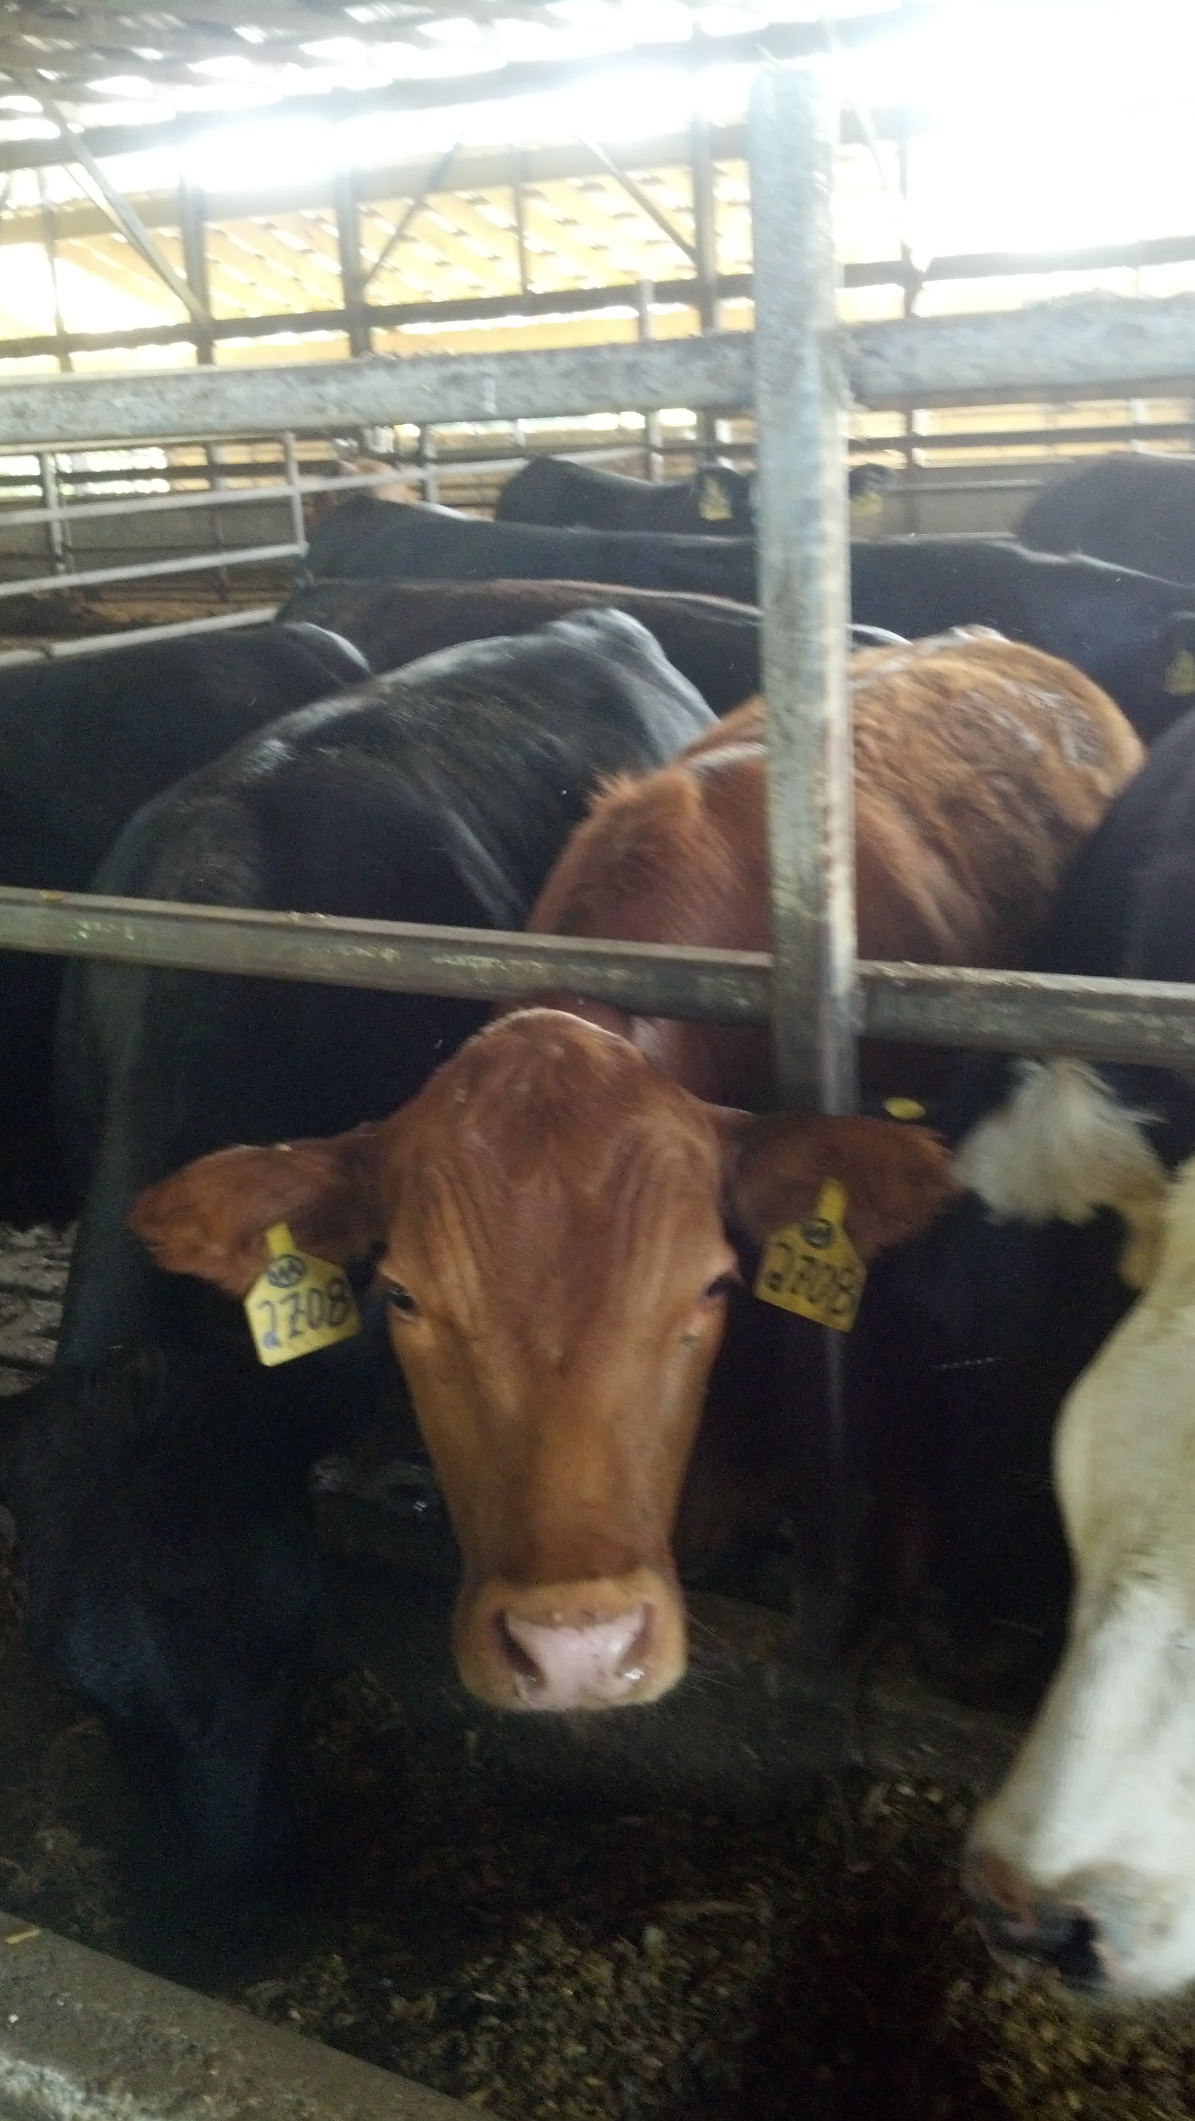
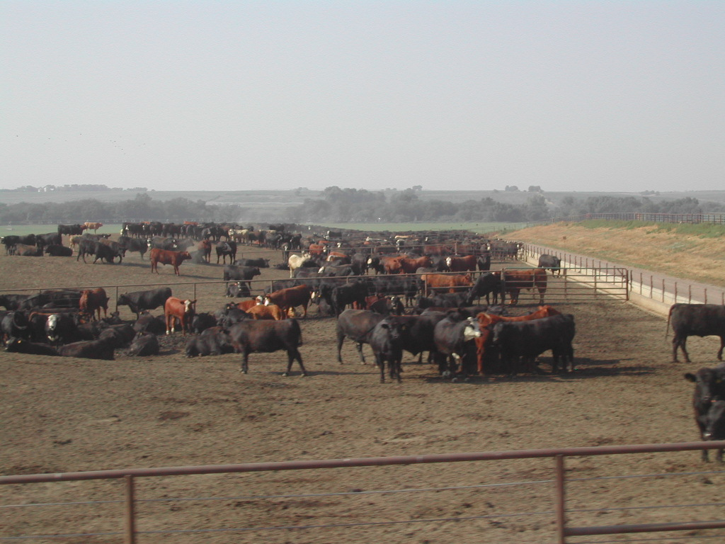
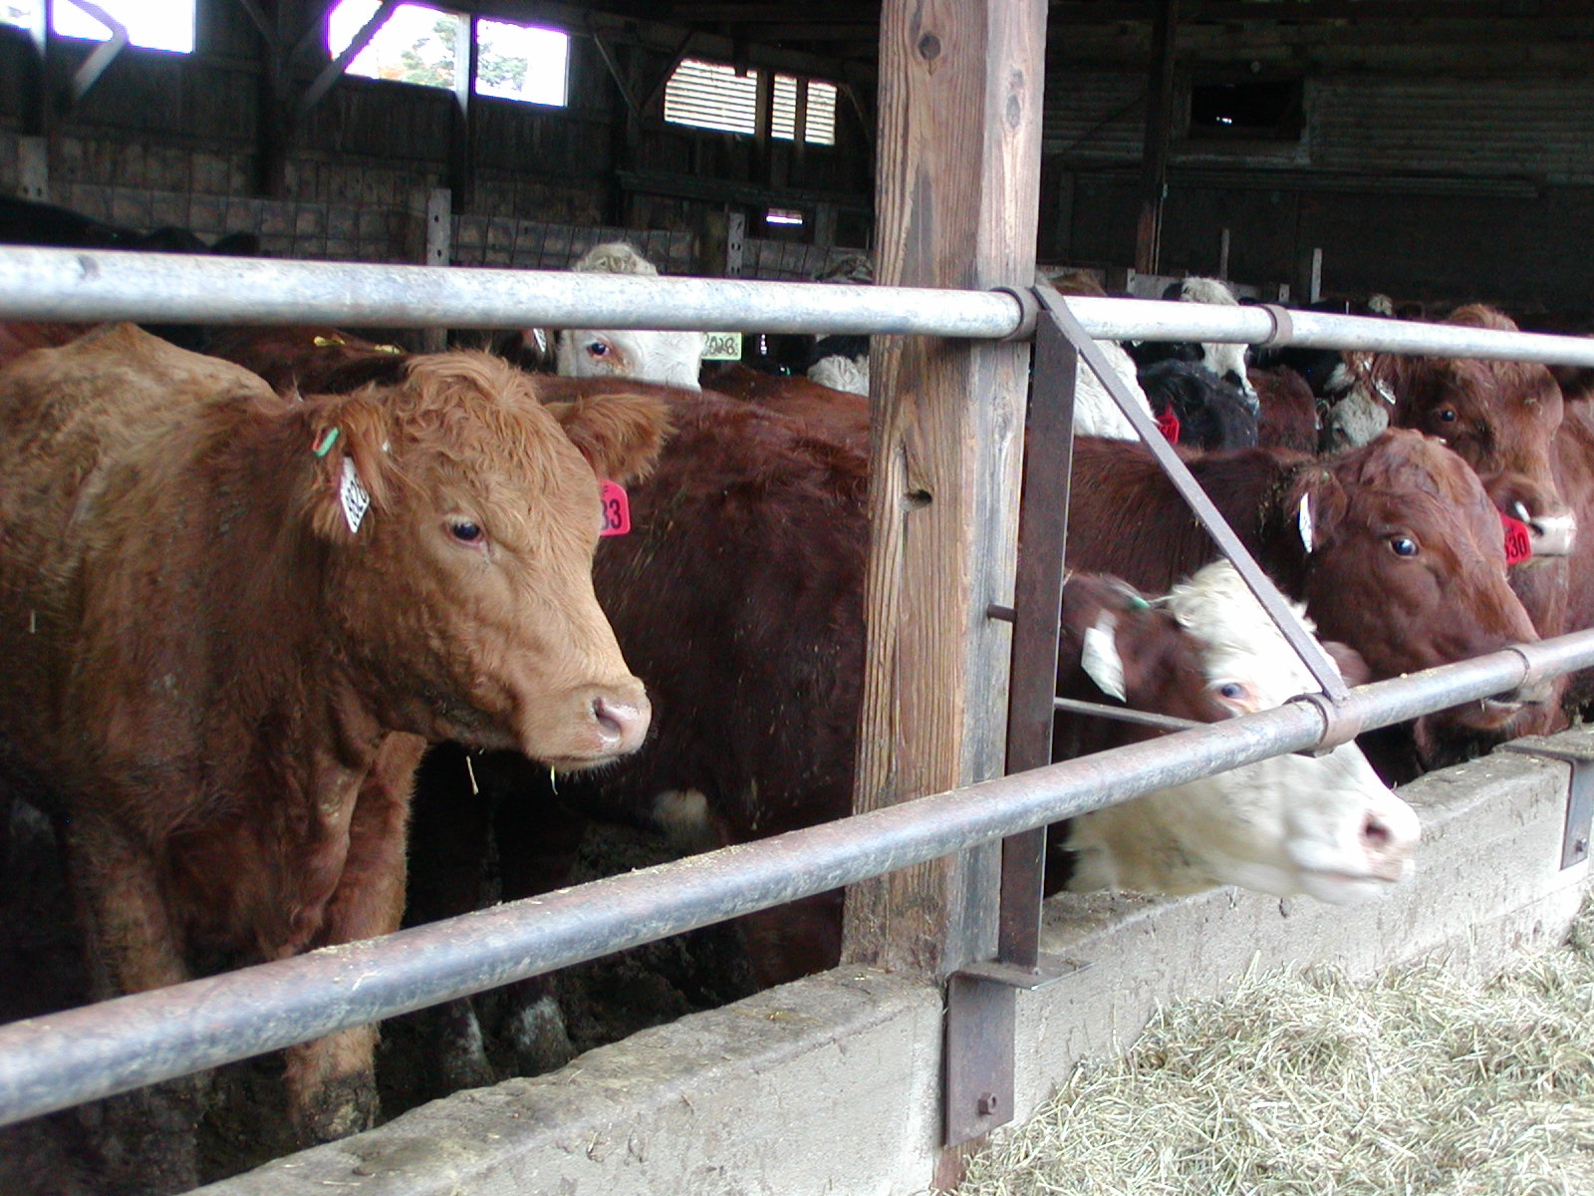
Grain finished
Mature calves are moved to feedlots.
Typically spend 4-6 months.
Have constant access to water, a balanced grain
based ration and free to room to move around.
Veterinarians, nutritionists and cattlemen/women
work together to look after each animal.
Notes:
In left corner picture, cattle are congregated in one location, yet have lots of room in the pen. Cattle are social animals and this is there natural behaviour.

Slide 11
Grain finished
Antibiotic use:
  Therapeutic (BRD)
  Sub-therapeutic (BRD prevention)
  Production – primarily ionophores, but
  low levels of antibiotics are fed.

Slide 12
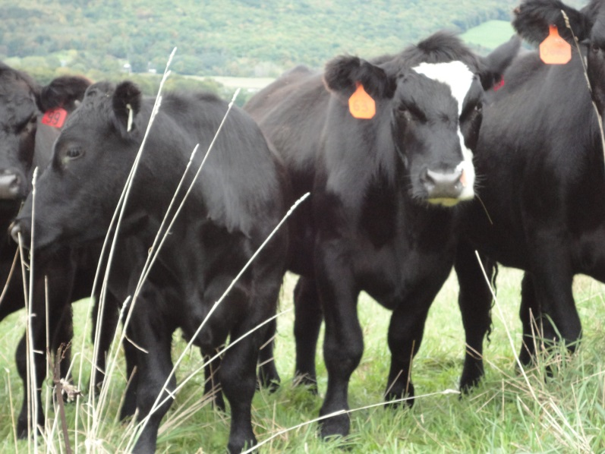
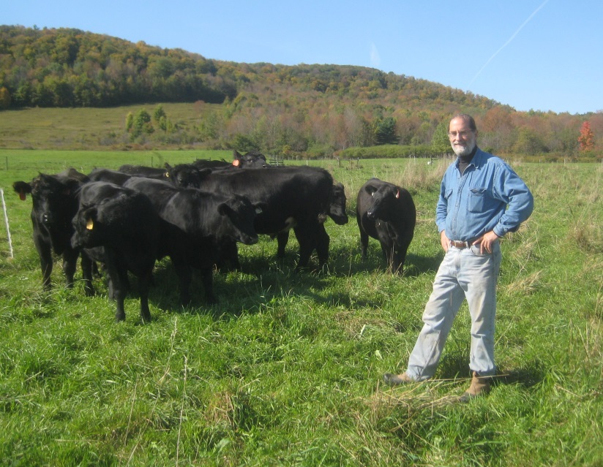
Grass finished
100% pasture or hay
Antibiotics and growth promotants allowed
Vitamin and mineral supplements
Winter performance a challenge
USDA label is available

Slide 13
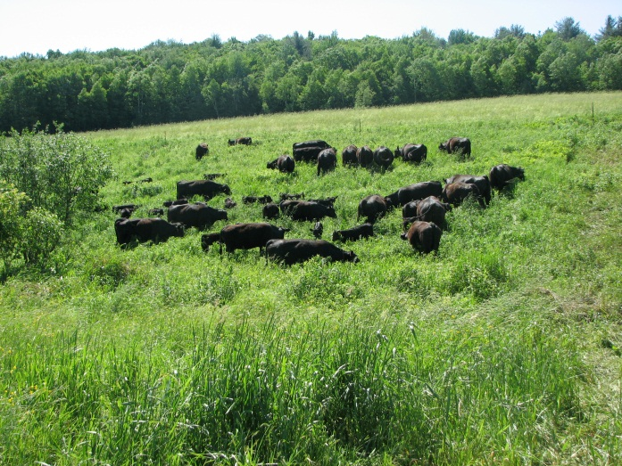
Naturally Raised
Finished on grain or grass
Can be “never-ever” or therapeutic
Never fed antibiotics or received growth promoting hormones
Vitamin & mineral supplements
USDA label available for processing but not for how the cattle are raised

Slide 14

Organic
Grain or grass-finished; all feed 100% organic
No antibiotics or growth promoting hormones
Vitamin & mineral supplements
Must be certified by USDA’s Agricultural Marketing Service
Look for the official label

Slide 15
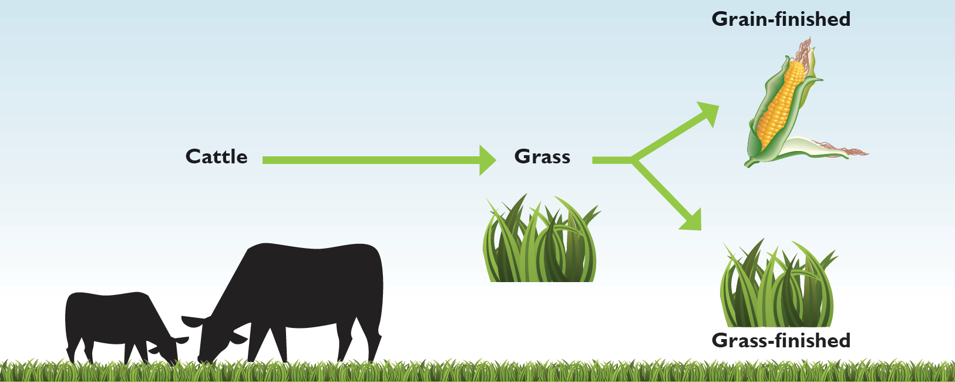
All beef is…
Grass-based
Natural
Nutritious
Safe

Slide 16
Antibiotic use in livestock

Slide 17
Antimicrobial Resistance in Perspective
Complex, multifactorial issue
  Acquired vs natural
Driver of resistance
  All uses (human, animal, horticulture) are part of the issue
Gaps in understanding of the issue
  The science is evolving
But the complexities and uncertainties don’t mean that steps can’t be identified to mitigate risk
Dr. Craig Lewis, DVM. Veterinary Medical Office, CVM, FDA

Slide 18
Antimicrobial Use in Animal Agriculture
Has been a source of debate for decades
Consumers, public health advocates, congress continue to be concerned about public health impacts
Rather than continue the debate, identify measures that address public health concerns and continue to assure animal health needs are being met.
Dr. Craig Lewis, DVM. Veterinary Medical Office, CVM, FDA

Slide 19
FDA Measures to address Antimicrobial Resistance Risks
Since late 1980’s all new antimicrobials are Rx or VFD
1996 – National Antimicrobial Resistance Monitoring System (NARMS) established
Extra-label use of flouroquinolones and glycopeptides prohibited
2003 FDA establishes framework for assessing antimicrobial resistance risks as part of drug approval
2010 Judicious us of medically important drugs (Guidance 209)
Dr. Craig Lewis, DVM. Veterinary Medical Office, CVM, FDA

Slide 20
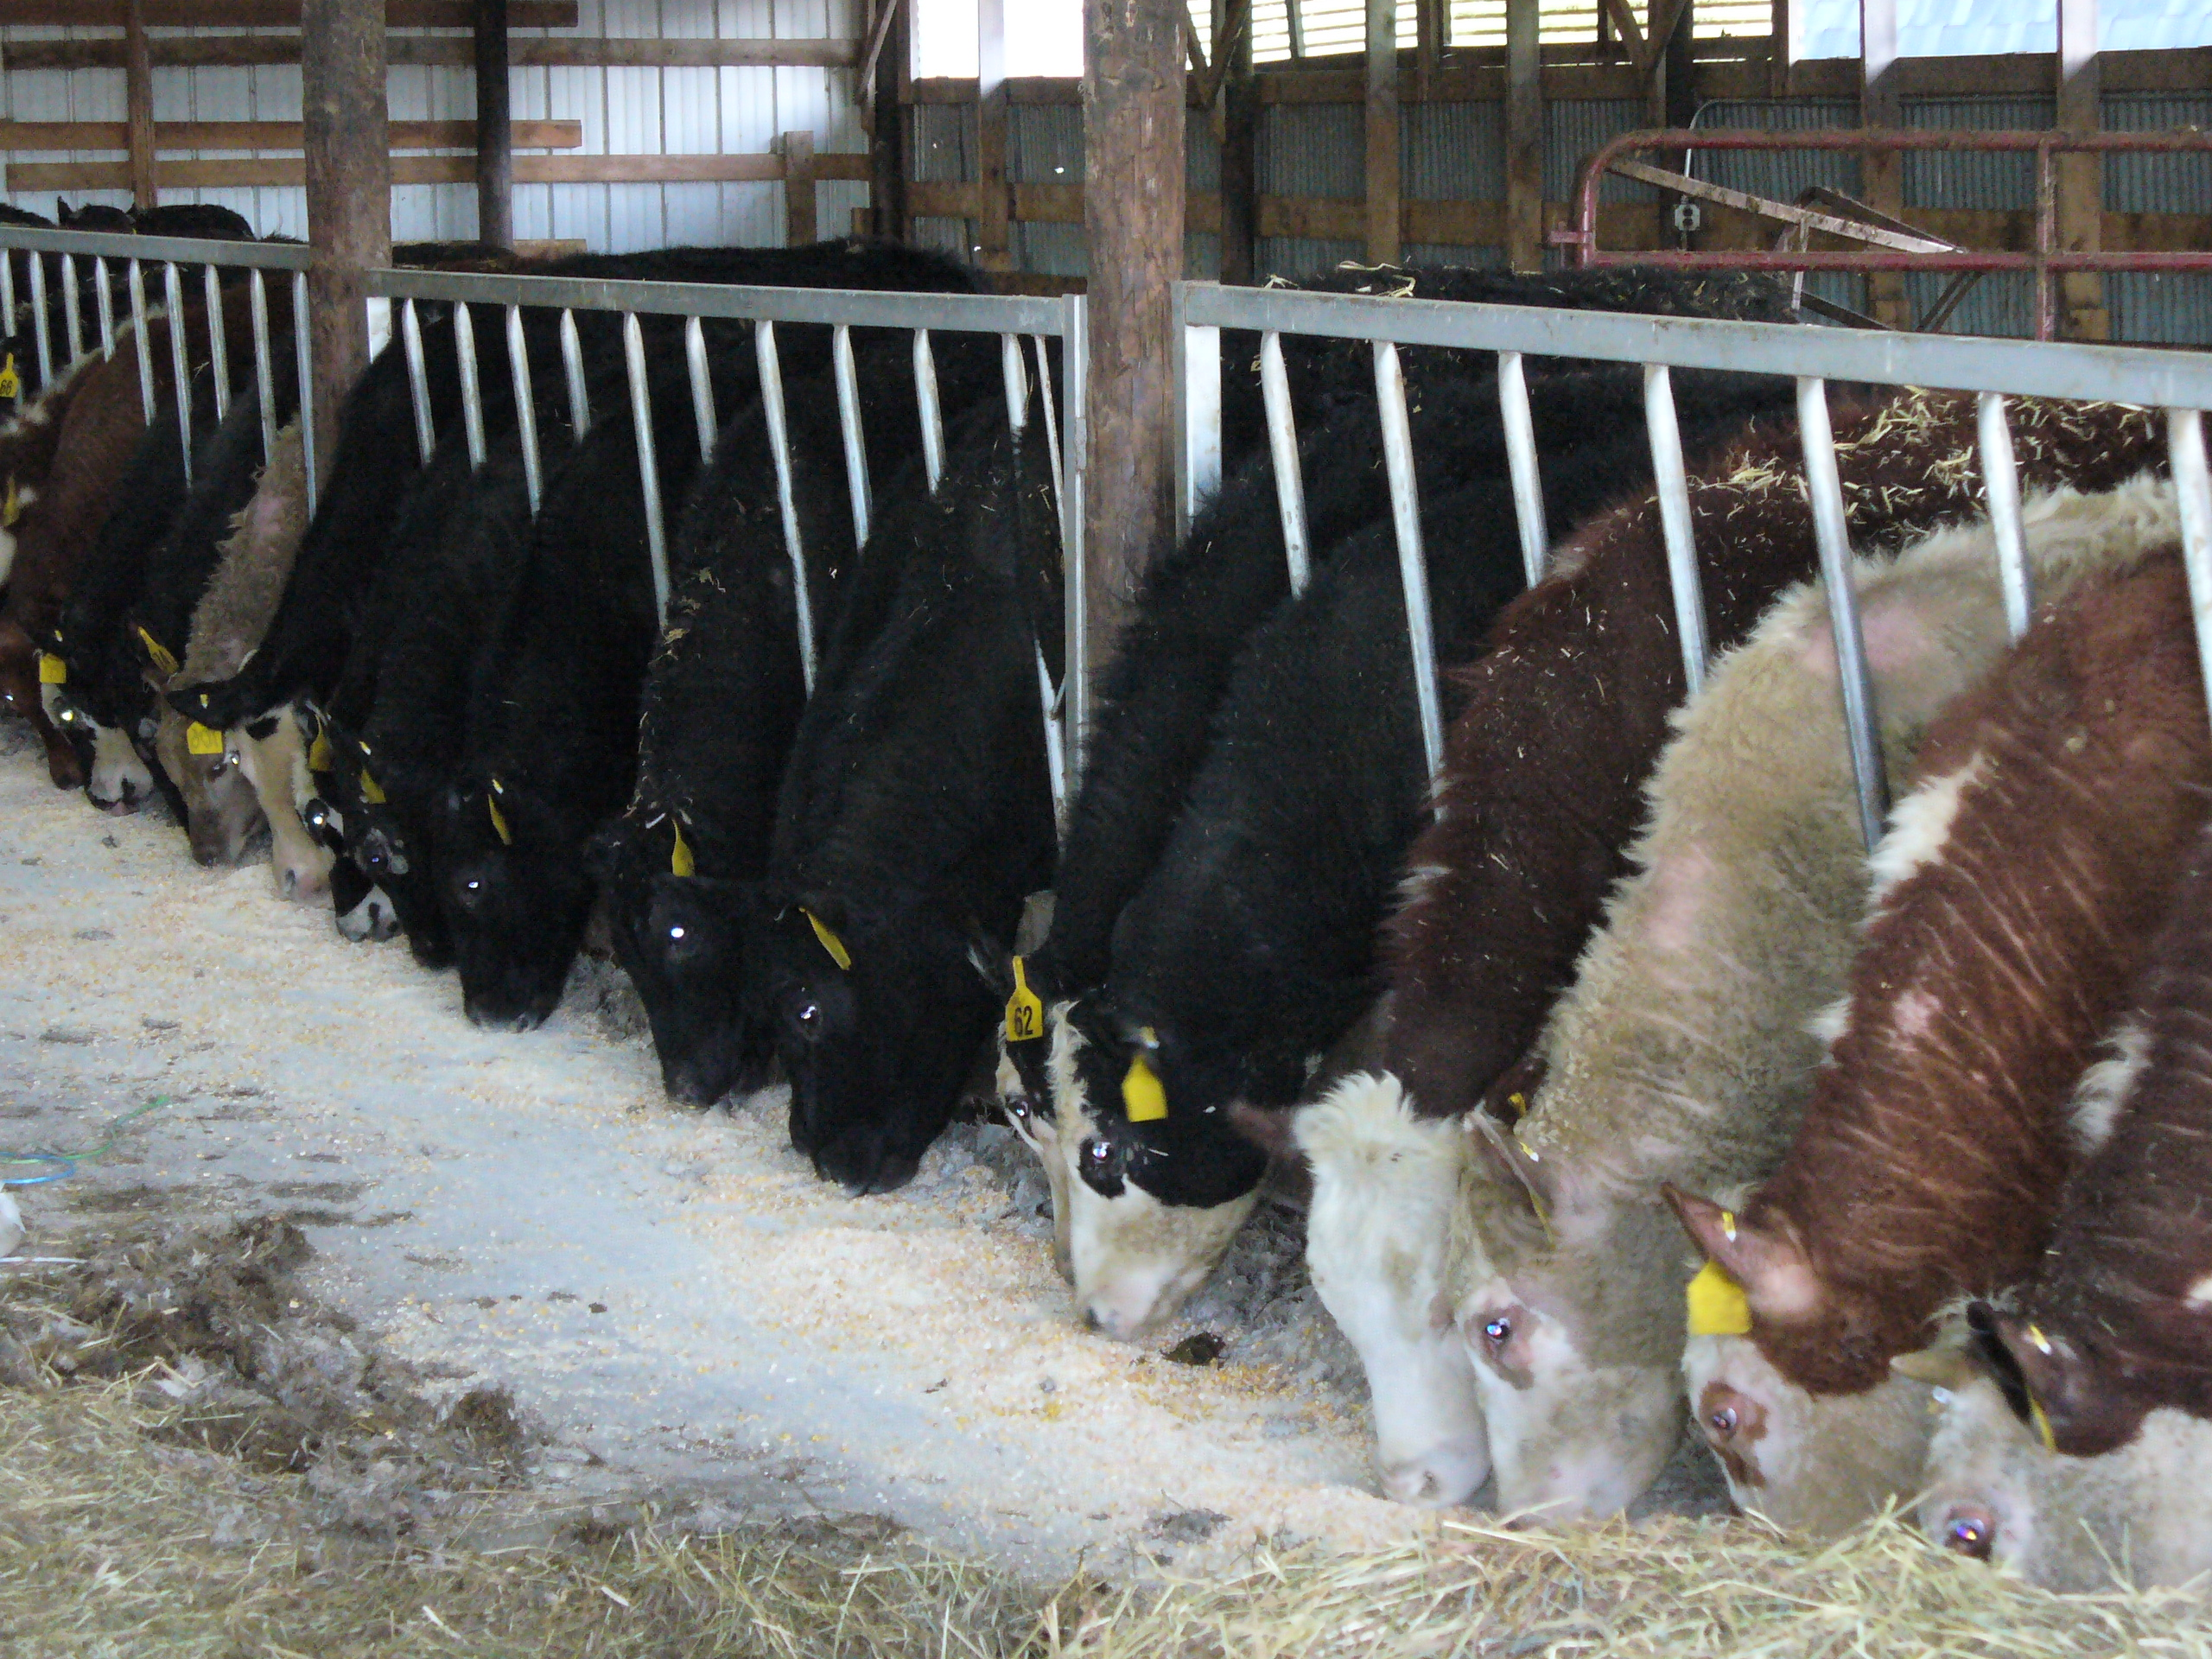
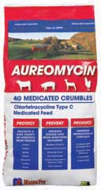

FDA/CVM Guidance for Industry #209
Antibiotics considered medically important will no longer be labeled for production.
As extra label use of feed delivered antibiotics is illegal, they will no longer be available.
All antibiotics considered medically important will need veterinary prescription to be delivered in the feed.
X

Slide 21
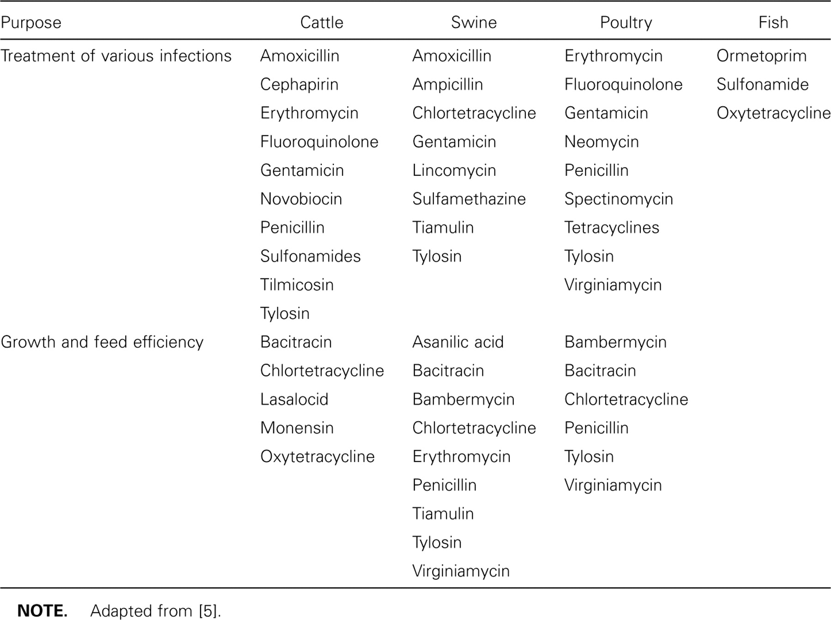

Examples of antimicrobials approved for use in the United States in food animals.
McEwen S A , and Fedorka-Cray P J Clin Infect Dis. 2002;34:S93-S106
© 2002 by the Infectious Diseases Society of America

Slide 22
FDA Drug Approval
Review process of pharmaceuticals for animals is the same as that for humans
Drug must be shown to be effective with no serious side effects
Drugs for animals undergo additional assessment:
  If risk to humans, not approved
  Assessment of meat safety (residues)
  Must not increase risk of resistance
Assess quality of manufacturing site and facility.
http://www.fda.gov/AnimalVeterinary/GuidanceComplianceEnforcement/GuidanceforIndustry/ucm123817.htm
http://www.fda.gov/AnimalVeterinary/ResourcesforYou/AnimalHealthLiteracy/ucm219207.htm#Target_Animal_Safety

Slide 23
FDA Drug Approval (cont.)
Toxicology test to determine No Observable Effect Level (NOEL).
Safety factor (up to 1,000 times)
Allowable Daily Intake (ADI)
Safe concentration (ppm) = ADI ug/kg/day) x 60 kg
grams consumed/day
http://www.fda.gov/AnimalVeterinary/GuidanceComplianceEnforcement/GuidanceforIndustry/ucm123817.htm
http://www.fda.gov/AnimalVeterinary/ResourcesforYou/AnimalHealthLiteracy/ucm219207.htm#Target_Animal_Safety
Notes:
NOEL is determined on the most sensitive dose on the most sensitive animal.
Mike Apley:
The first step in determining a drug’s withdrawal time is to determine its NOEL, which is the dose of the drug that results in no toxic effects in test animals. A safety factor is then applied, which may decrease the NOEL by up to a thousand fold.
For example, if tests indicate that 1 milligram (mg; 1,000 mg = 1 gram) of the drug per kilogram (kg, or 2.2 lbs.) of body weight is the NOEL, a thousand fold safety factor would drop that dose to 1 microgram (mcg)/kg (1 gram = 1 million mcg).
The NOEL is then multiplied by the average body weight of a human (60 kg for this purpose), resulting in the total ADI. ADI is the total dose of the drug that an average human could ingest on a daily basis for his or her entire life with no adverse effects. In our example, the ADI would be 60 mcg/day (1 x 60).
The ADI is then used to determine how much of the drug can be in each of the edible tissues, or the safe concentration. For this purpose, CVM considers that people will eat only one of the following edible tissues (and related quantity) as their main meal for the day — muscle (300g), liver (100g), kidney (50g) or fat (50g). In our example, safe concentration for muscle would be 0.2 mcg of drug per gram of tissue (60/300).
The safe concentration is for all residues of the drug, which may include multiple chemical metabolites due to the breakdown of the drug in the animal. The U.S. only tests the carcass for one of these compounds, known as the marker residue. The percentage of the safe concentration represented by the marker residue becomes the tolerance for the marker residue. For example, if the marker residue is the original drug molecule, and it constitutes 50% of the total residues, the tolerance in our example now becomes 0.1 mcg/gm for muscle (0.2 X 50%).
That was a lot of math and several million dollars’ worth of studies to get us to this point. The final step is a study where animals receive the drug and are then sacrificed at different time points to determine when the marker residue drops below the tolerance in the target tissue (the edible organ that maintains drug residues the longest, usually the kidney or liver).
When the target tissue is below the tolerance, so are all the other tissues. Statistical methods are used to estimate the withdrawal time, so that only one in 1,000 animals would potentially have a marker residue concentration in the target tissue which would be above the tolerance.

Slide 24
Does animal agriculture use 80% of antibiotics produced?
Drugs sold for food animal use | 30.3 | million lb. |  | 4:1
Drugs sold for human use | 7.2 | million lb.
Total | 37.5 | million lb.
Ionophores | 9.1 | million lb.
Adjusted drugs for food animal use | 21.2 | million lb. |  | 3:1
Animal weight | 135 | billion lb.
human weight | 46.5 | billion lb. |  | 3:1
Per capita food animals | 0.16
Per capita, humans | 0.16
http://www.fda.gov/downloads/ForIndustry/UserFees/AnimalDrugUserFeeActADUFA/UCM338170.pdf
http://www.fda.gov/downloads/Drugs/DrugSafety/InformationbyDrugClass/UCM319435.pdf

Slide 25
Does animal agriculture use 80% of antibiotics produced?
Drugs sold for food animal use | 30.3 | million lb. |  | 4:1
Drugs sold for human use | 7.2 | million lb.
Total | 37.5 | million lb.
Ionophores | 9.1 | million lb.
Adjusted drugs for food animal use | 21.2 | million lb. |  | 3:1
Animal weight | 135 | billion lb.
human weight | 46.5 | billion lb. |  | 3:1
Per capita food animals | 0.16
Per capita, humans | 0.16
http://www.fda.gov/downloads/ForIndustry/UserFees/AnimalDrugUserFeeActADUFA/UCM338170.pdf
http://www.fda.gov/downloads/Drugs/DrugSafety/InformationbyDrugClass/UCM319435.pdf

Slide 26
Does animal agriculture use 80% of antibiotics produced?
Drugs sold for food animal use | 30.3 | million lb. |  | 4:1
Drugs sold for human use | 7.2 | million lb.
Total | 37.5 | million lb.
Ionophores | -9.1 | million lb.
Adjusted drugs for food animal use | 21.2 | million lb. |  | 3:1
Animal weight | 135.0 | billion lb.
human weight | 46.5 | billion lb. |  | 3:1
Per capita food animals | 0.16 |  |  | 1:1
Per capita, humans | 0.16 |  |  | 1:1
http://www.fda.gov/downloads/ForIndustry/UserFees/AnimalDrugUserFeeActADUFA/UCM338170.pdf
http://www.fda.gov/downloads/Drugs/DrugSafety/InformationbyDrugClass/UCM319435.pdf

Slide 27
Percent of cattle that received antimicrobials
31% labeled for production, but report did not distinguish if production
or treatment.
AHI in 2007 87% of antimicrobials used in animals was for therapeutic reasons
http://www.aphis.usda.gov/animal_health/nahms/feedlot/downloads/feedlot99/Feedlot99_dr_PartIII.pdf

Slide 28
The average number of days that cattle received the following antimicrobials by arrival weight
http://www.aphis.usda.gov/animal_health/nahms/feedlot/downloads/feedlot99/Feedlot99_dr_PartIII.pdf

Slide 29
Percent of feedlots that utilize the services of veterinarians and nutritionists
http://www.aphis.usda.gov/animal_health/nahms/feedlot/downloads/feedlot99/Feedlot99_dr_PartIII.pdf

Slide 30
Percent of feedlots that provided formal training on the use of antimicrobials
http://www.aphis.usda.gov/animal_health/nahms/feedlot/downloads/feedlot99/Feedlot99_dr_PartIII.pdf

Slide 31
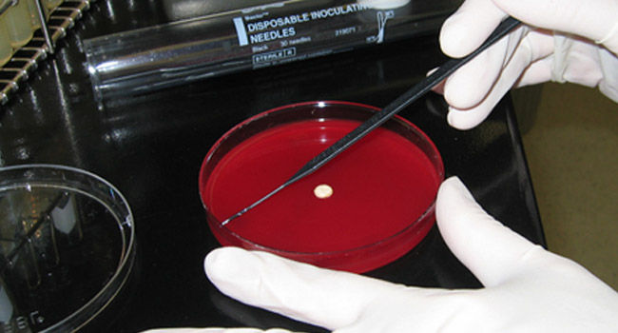
Sampling and antibiotic violations, all beef classes 2012
Sample type | Number
Inspector generated | 165,063
Scheduled (Random) | 2,736
Total samples | 167,799
Number of violations | 807
Percent violations | 0.48
http://www.fsis.usda.gov/wps/portal/fsis/topics/data-collection-and-reports/chemistry/residue-chemistry

Slide 32
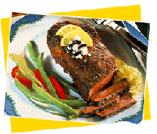
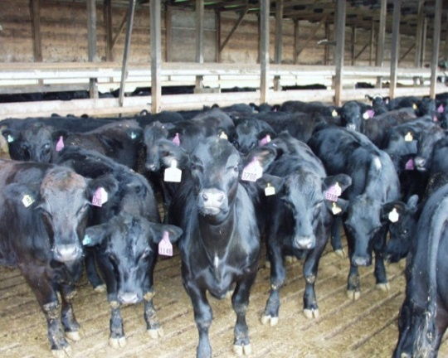
Notes:
The program is funded by the Beef Checkoff. It is a national program that is run by the states. NY is part of the mid-Atlantic region, a loose coalition of states. We set our own requirements for certification.

Slide 33
What is Beef Quality Assurance?
Assurance of a safe and wholesome beef product for the consumer.
The BQA is based on national guidelines and scientific research.
The purpose of BQA is to enhance carcass quality & safety thereby protecting consumer confidence in the beef supply.

Slide 34
Certification Requirements
Level I
  Classroom training and/or self study to satisfactorily pass a written test
  Attend chute side training
  Sign BQA contract
Level II
  Level I
  Veterinary/Client Patient Relationship Form
Notes:
Level 1 certification does not require valid VCPR. Some parts of the state have limited availability of large animal veterinarians. A farm sign is available to purchase if level 2 certified; $10 for one-sided, $15 for 2-sided.

Slide 35
The purpose of BQA is to enhance carcass quality & safety thereby protecting consumer confidence in the beef supply through:
Care and husbandry
Feedstuffs
Feed additives and medications
Processing and treatment records
Injectable health products

Slide 36
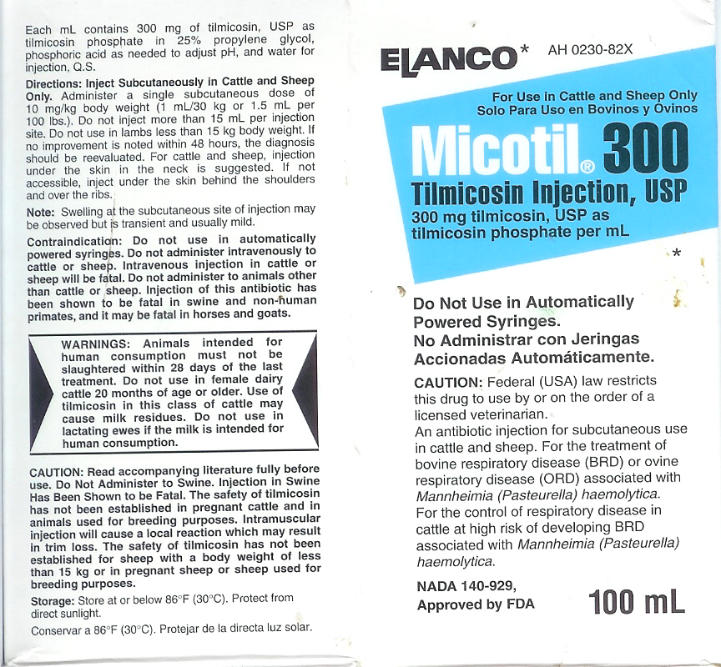
Directions: Inject SQ in cattle and sheep only. Administer a single SQ dose of 1.5 ml per 100 lbs of body weight
Warning: Animals intended for human consumption
Must not be slaughtered within 28 days of the last treatment.
Notes:
The purpose of this slide is to introduce the chute side training where participants will be asked to find indication for use, dosage, route of administration and withdrawal time.

Slide 37
Growth Promoting Implants

Slide 38
Growth Promoting Implants
What do growth promotants do?
  Natural GP increase anabolic rate
  Synthetic GP decrease catabolic rate
  GPs increase mature size
  Act on metabolism to increase net protein growth rate, which increases mature size resulting in increased:
    Growth rate (8-15%)
    Feed efficiency (8-10%)
    Carcass leanness (~22%)
  When harvested at same compositional endpoint, no difference in eating quality (though there may be a decrease in IMF)
  Lower cost of production
  Lower cost of beef to consumer

Slide 39
Growth Promoting Implants
1943 - Diethystillbestrol first used in poultry
1953 – DES first used orally cattle
1957 – Estrogenic implants developed
1972 & 1973 – DES banned in U.S.
1987 – Androgenic (tissue building) implants

Slide 40
Growth Promoting Implants
Hormone | Maximum residue, µg/kg | Tissue from non- implanted beef, µg/kg | Tissue from implanted beef, µg/kg
TBA | 50 | 0 | 0.65
Zeranol | 150 | 0 | 0.23
 | Allowable incremental increases above naturally occurring, µg/kg
Estradiol | 0.12 | 0.0028 | 0.033
Progesterone | 3.0 | 10.1 | 0.77
Testosterone | 0.64 | 0.16 | 0.36
http://fri.wisc.edu/docs/pdf/hormone.pdf

Slide 41
Growth Promoting Implants
Toxicology test to determine NOEL (300,000 ng/d).
Safety factor - 100
Allowable Daily Intake (ADI) = 3000 ng/d
Requires consumption of 50-66 lbs. beef/d to exceed ADI.

Slide 42
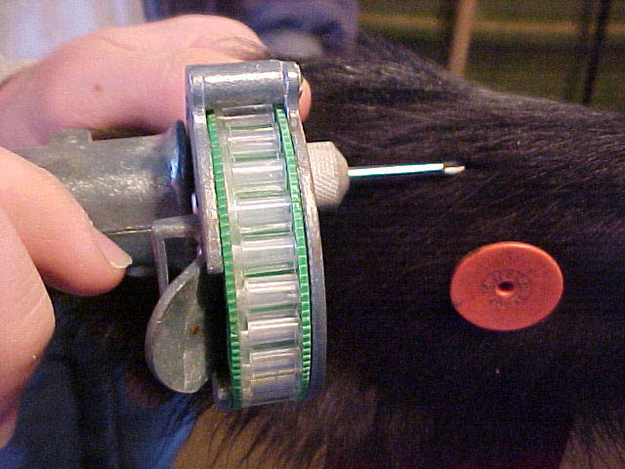
Mode of Delivery
Hormones are compressed into carrying matrices to produce a pellet or implant
Hormone is released
over 60 to 200 days

Slide 44
Effect of implant on final weight adjusted to 28% empty body fat

Slide 45
Nutrition-what is safe to feed?
Effect of diet on presence of E. coli 0157-H7
  Increasing hay (2000 J Dairy Sci. 83:863–873)
  Wet distillers grains (2009 J. Food Prot., Vol. 72, No. 8)
No difference in percentage of E. coli 0157-H7 or Salmonella between grass or grain finished beef
  (2010. Foodborne Pathogens and Disease. 7(11): 1331-1336)

Slide 46
National health objective target
Escherichia coli O157-H7 infection has declined to the 2010 national health objective target of ≤1 case per 100,000.
Salmonella infections, which cause the largest numbers of illnesses, hospitalizations, and deaths, have not declined during the past decade.
Salmonella infections can be prevented using approaches similar to those that were successful in reducing E coli O157-H7:
  Monitoring food production.
  Preventing food contamination. (food handling)
  Investigating illnesses and outbreaks.
http://www.cdc.gov/mmwr/preview/mmwrhtml/mm6022a5.htm
Notes:
Key Points
Despite broad declines in several foodborne infections, Salmonella infections, which cause the largest numbers of illnesses, hospitalizations, and deaths of any pathogen under surveillance in the Foodborne Diseases Active Surveillance Network (FoodNet), have not declined during the past decade.
In contrast, Shiga toxin--producing Escherichia coli (STEC) O157 infection has declined to the 2010 national health objective target of ≤1 case per 100,000.
Salmonella infections can be prevented using approaches similar to those that were successful in reducing STEC O157: --- Monitoring food production. This includes monitoring the safety of ingredients, reducing contamination in factories and slaughterhouses using proven measures, and maintaining refrigeration in transport.
--- Preventing food contamination. This includes training restaurant managers in food safety and educating consumers about preparing foods safely at home.
--- Investigating illnesses and outbreaks. This includes improving detection and investigation of outbreaks, so contaminated products are removed before more persons become ill and public health and food safety agencies can learn about new food safety challenges and how to address them.

Slide 47
What do cattle eat?
In wt., lb. | Out wt., lb. | Avg., lb. | DOF | DMI, lb./d | TDMI, lb. | % Forage | ForageDMI, lb.
1450 | 1450 | 1450 | 365 | 31.9 | 11644 | 95% | 11061
80 | 500 | 290 | 191 | 6.4 | 1218 | 100% | 1218
76% forage
500 | 800 | 650 | 150 | 14.3 | 2145 | 50% | 1073
800 | 1350 | 1075 | 157 | 23.7 | 3716 | 25% | 929
Total |  |  |  |  | 18723 |  | 14281

Slide 48
Industry references
More on beef nutrition http://beefnutrition.org/
Beef in a heart healthy diet http://www.beefnutrition.org/beefandhearthealth.aspx
Farm to Fork - grass-fed vs grain-fed http://www.beefnutrition.org/farmtofork.aspx
Antibiotics and Food Safety http://factsaboutbeef.com/2012/09/24/are-antibiotics-in-cattle-routinely-overused-absolutely-not-strict-guidelines-ensure-antibiotics-in-cattle-are-used-safely-and-appropriately-to-prevent-control-and-treat-disease-2/
Preventing Foodborne Illness and Improving Beef Safety http://factsaboutbeef.files.wordpress.com/2013/01/preventing-foodborne-illness-and-improving-beef-safety-fact-sheet_final.pdf

Slide 49
Summary
Definitions
Use of antimicrobials
  Guidance #209
  Approval process
  Antimicrobials used
  Residues levels
  Processes to assure compliance
Beef Quality Assurance
Growth promoting hormones
Cattle nutrition

Slide 50
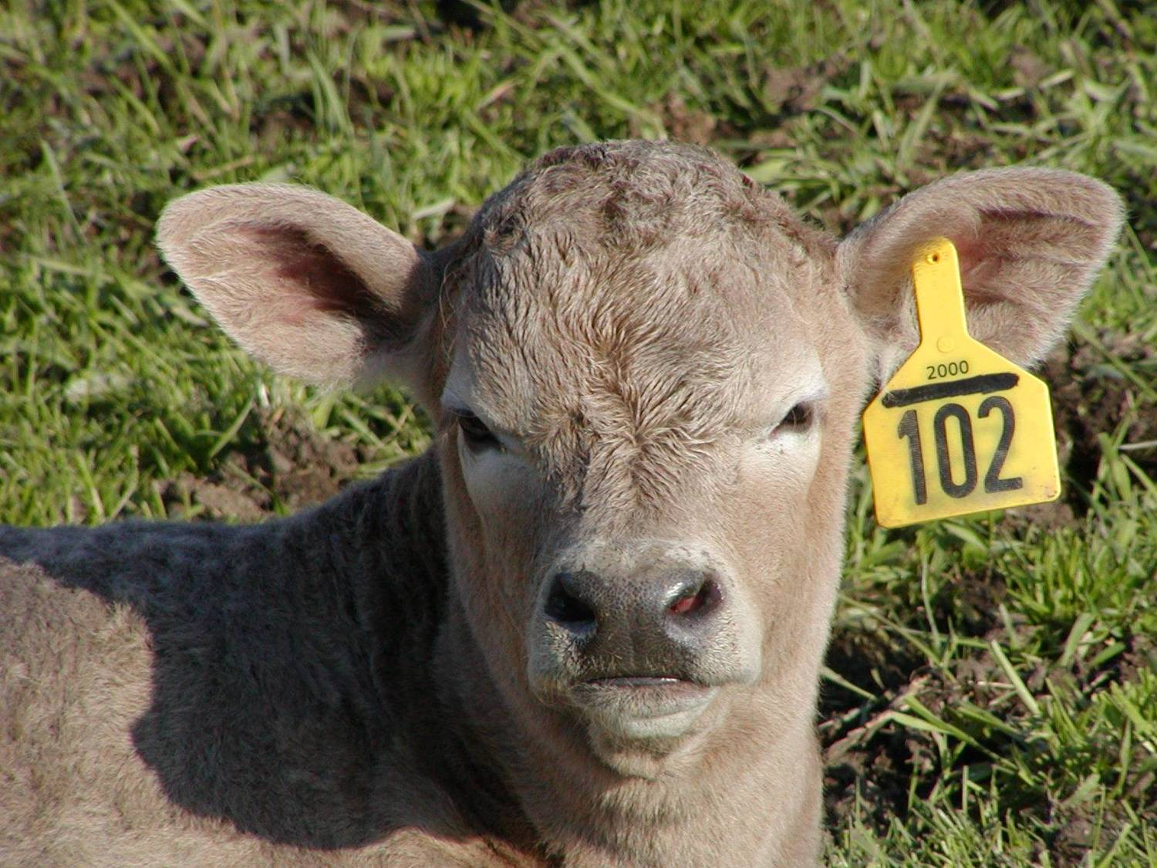
Thank you.

