Slide 1



Slide 2


Computer Maintenance, Support,
Training and Resources
Presented By:
Jennifer Carges, jar97@cornell.edu
WSBN Lead IT Coordinator
Click info icon on a slide to find out more information
Click video icon on a slide to watch related video clip
Notes:
Hello. My name is Jenn Carges. I am the Lead IT Coordinator for the Western NY Shared Business Network. Today, I wanted to come talk with you about how to keep your computer running well, how your data backup works and some other resources that are available to you. Before I begin, I just wanted to give you all fair warning. I like to try and fit as much information as I can into my meetings with staff, whether they are through my new staff orientation one-on-one talks or group meetings like this. While all things IT is my top priority, I know that IT is not usually a top priority for educators and staff, and it shouldn’t be, it’s a tool that’s there to assist you (or to make you grumble when something isn’t working right!).
What I want to do today is share as much knowledge and resource information that I can so you can lessen those IT moments when things aren’t working right and find more tools to help assist you in your work.
There is a lot of information that I am going to try and pack into this one hour presentation. Some slides I’ll go over in detail and others I will only lightly touch on. You will notice that throughout my slides there are two little icons where I’ve either linked to a great website with more information about the topic and/or a video clip on how to do the task discussed in the slide. I won’t be clicking on these icons now during this presentation but you can find this presentation in the X drive under IT then under Professional Development). I have put this presentation in there so if and when you want to, you can open up this PowerPoint presentation file and click on the hyperlinked icons for more information.
Feel free to interrupt me any time if I’m not talking loud enough or if you need me to explain a bit more about the topic on the slide!

Slide 3
Today’s Topics
Computer Maintenance
  Updating software, scanning computer for file and hard drive errors and scanning for viruses
Protecting Your Computer’s Hardware
Protecting Your Data
Backing Up Your Data
What To Do When Malware Is Detected
Available Online Training and Resources
Where To Go For IT Support
Notes:
The main topics I want to cover today are computer maintenance, protecting your computer’s hardware, protecting your data, backing up your data, what to do when malware is detected, some of the available online training and resources that are available to you and where to go for IT support.

Slide 4



Computer Maintenance
Notes:
The first section is an important one…. Computer Maintenance.

Slide 5
How Information Is Stolen
Computer Maintenance
When a hacker exploits a vulnerability in software, they take advantage of an existing weakness by creating a piece of software, data or command that allows them to access to your system. Once a hacker has access to your organization’s network, they can steal a variety of information.
Hackers can install monitoring tools such as key loggers and network sniffers to capture traffic on your network and monitor data you type into your keyboard.

Slide 6
How Information Is Stolen
Computer Maintenance
Hackers can also install ‘back door’ software known as a Trojan Horse, which gives them the ability to enter your PC without your knowledge at anytime.
Hackers can use the access they have to your computer to launch attacks against other people and have the trail lead back to you.

Slide 7
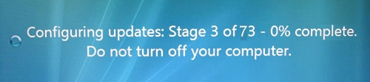
Windows and Office Updates
Computer Maintenance
Important Updates are set to Install automatically
Windows updates can update Office software
  Check to be sure you are receiving automatic updates for Microsoft Office products. Windows Update screen should say: “You receive updates: For Windows and other products from Microsoft Update”
Do NOT turn off or interrupt Windows when it is updating
Notes:
Windows and Office updates are very important to keep up with. If you don’t allow the updates to install on your computer, your computer might be at risk for attack from malicious software, and or you might experience problems and slowness with Windows or your others programs installed.
With a quick show of hands, is anyone still running Windows XP? You may have heard that Windows XP and Office 2003 are no longer supported by Microsoft, as of April 8th. If you have any computers still out there with XP installed, I strongly encourage you to get them upgraded to Windows 7 as soon as possible or have them replaced. With Microsoft no longer pushing out Windows updates for XP, these computers still running it will become a security risk on the network.. Every vulnerability that hackers find with XP now will not be patched which makes XP more and more insecure each day. And according to Cornell policy, any computer that doesn’t have the latest patches installed should not be on the Cornell network.
Now let me take you through how to look to see if any updates need to be installed on your computer and where you can change your Microsoft update settings.
Okay one last item about these updates… How many people have seen this lovely message when you are rushing to pack up your computer and leave the office? When your computer says “installing or configuring updates, do not turn off your computer”. It really means don’t turn off your computer. If you interrupt this process, the best case scenario is that your computer will turn on just fine the next time it starts up, and install the updates again perfectly the next time it tries. Worst case scenario: your Windows Operating System becomes corrupted and the computer will no longer boot up into Windows.

Slide 8


Other Software Updates
Computer Maintenance
Adobe Flash and Java
  Automatically updated from the server, no need to manually update these two programs.
Don’t Ignore Automatic Updates for
  Adobe Reader, Acrobat, InDesign…
    Local IT contact is the only person that can install and update these programs for you
Notes:
You shouldn’t ignore updates for other software you have installed on your computer as well. The most common software that are installed on computers include Adobe software and Java.
Since your work computers are joined to the Cornell domain, I have Flash and Java set to install automatically when I push out a new update. Other software updates you shouldn’t ignore are Adobe Reader and or Acrobat. With the way Windows is set up on our work computers, only your local IT contact can update this software. If you see a prompt that Adobe failed to do an update, please go see your local IT contact.
(again these updates are your first line of defense against malware – the updates address software bugs and security weaknesses in the software)

Slide 9
Virus and Malware Protection
Viruses, Worms, Malware.. Oh My!
All CCE-owned computers should have
Symantec Anti-virus installed
Download here:
http://www.it.cornell.edu/services/antivirus/about.cfm
  Recommend setting up a weekly, full scan
  Do NOT install more than one anti-virus program on the same computer – causes conflicts and significantly slows down the computer.
Malwarebytes
Download here: http://www.malwarebytes.org/lp/malware_lp_form/
  Free version very useful for catching malware
  but updates and scans have to be manually run
Notes:
Malware, short for malicious software, is any software used to disrupt computer operation, gather sensitive information, or gain access to computer systems. It is often installed without your permission or knowledge. When you hear the terms viruses, worms, ransomware, spyware, adware, and so on… these are all malware. The differences between them is how they can get into your system and what kinds of problems they can cause. The first line of defense against malware is having up to date software, which we just went over, the second is having anti-virus and anti-malware software installed, updated and used for scanning your files.
All Cornell owned computers should have Symantec Anti-virus installed on them. I recommend setting up a full, weekly scan, which I will demonstrate how to do in a moment. What I don’t recommend is installing more than one anti-virus program on your computer. For example, don’t install Symantec and McAfee on the same computer. One might logically come to the conclusion that more is better… but unfortunately in this case, having more than one anti-virus program installed can cause conflicts and significantly slow down your computer.
What I do recommend is having another program installed that can work along side your anti-virus program. In my experience, the program malwarebytes has worked exceedingly well at detecting and deleting malicious files and programs from computers. Unfortunately with the free version of malwarebytes, you do have to update and scan the software manually, you cannot schedule automatic scans, but it is definitely worth having on your computer if you run into a nasty bit of malware.
We’ll talk more about what to do if Symantec or Malwarebytes catches any malicious files or programs in a little bit but first, let me show you how to update and scan with these two programs now.

Slide 10
Cleanup, Scan and Defrag
Computer Maintenance
Perform regular maintenance.
  Learn how to use the utilities that diagnose
  your system for problems.
    Disk Cleanup Run Once Schedule
    Disk Scan
    Disk Defragmenter More details and how to:
These utilities can prevent little problems from becoming big problems, and will keep your system running at top speed.
Notes:
The three utilities I’m going to go through right now are built into Windows and can help prevent little problems from becoming big problems, and will keep your system running at top speed.
First, is disk cleanup. Running this will help your PC run faster. It can delete temporary files, empty the Recycle Bin, and remove a variety of other system files that you no longer need. (You can either run this manually or you can use the Windows Task scheduler to schedule disk cleanup to run on a regular basis – file is cleanmgr.exe)
Next is disk scan… You can help solve some computer problems and improve the performance of your computer by making sure that your hard drive has no errors. Disk scan can fix file system errors and it can also scan for and attempt recovery of bad sectors on the physical harddrive. (right click computer, properties, tools, error-checking) (To check for both file errors and physical errors, select both Automatically fix file system errors and Scan for and attempt recovery of bad sectors.)
Now let’s talk about disk defragmenter. This utility is essentially taking some time to reorganize where your files and programs are physically saved on harddrive so the next time you go to open a file or program, it will open quicker. In Windows 7, disk defragmenter is already set to automatically run weekly.. you do have the option to change the time it runs or do a manual scan if you want to.
I do need to mention that some newer, more expensive laptop harddrives and usb thumbdrives are made using a different technology and are called SSDs - solid state harddrives (the ones most of us use now are called HDD – Hard disk drive). SSDs don’t need defragmentation, defragmenting these drives could actually cause more harm than good because of the way they work. (you would have to check on your computer invoice where it lists the harddrive to see what type of harddrive you have installed.)
Checking for type of harddrive on a Mac: https://discussions.apple.com/message/23729997#23729997
I’ve included links on how to run these tasks in this slide.
I recommend setting up scheduled, weekly Symantec scans to check for viruses, usually during lunch hour on Fridays but you can choose any time to schedule the scan, as long as it’s a time that the computer is normally on. On newer computers, you should be able to let the scan run in the background while working on other things without it affecting you. For older computers though, you will probably notice a significant delay in opening and working with files while the scan is running… best to let it scan when you have other things to do away from your computer. You do have the option of pausing the scan and letting it resume later though.
As for Malwarebytes, again remember, there isn’t a way to set up scheduled updates and scans with the free version but I do recommend that maybe bi-weekly, you open up the program, let it install any updates and then run a full scan.

Slide 11

Protecting Your Computer
Tips For
Notes:
This next section of this presentation goes over tips on how to protect your computer, the physical components (the shells and guts of the computer hardware).

Slide 12
Extreme Hot & Cold Temperatures
Protect Your Computer
Protecting Your Computer From The Weather
Extreme heat and direct sunlight can degrade components and even cause the screen to crack.
  A sleeping computer still generates some heat, so you should also take care to turn your computer off–not just put it to sleep–before you slip it into a bag.
Low temperatures make moving parts (like those inside your hard drive) much more rigid and breakable.
Both extremes will lessen the battery’s lifespan.
  Don’t leave your computer in a hot or cold car even for a short time.
Notes:
Extreme heat and cold can be detrimental to a computer. Just recently a laptop was left in a car overnight, and without waiting for it to return to room temperature, it was turned back on. Turning it on while it was still very cold ended up damaging the video circuit and the display screen no longer works. I know many of us are constantly traveling and it can happen where we forget to bring our laptops in. If and when this happens, please just remember, give the laptop time to come back to a safe temperature before trying to use it.

Slide 13

Don’t keep your laptop on your lap!
Protect Your Computer
Go Get a Cooling Pad
Notes:
If you are working on your laptop and don’t have a better place to set it other than your lap, please invest in a cooling pad. Using your laptop on a surface which blocks the fans will cause your laptop to overheat and slowly degrade the hardware.

Slide 14
The Lifespan of a Battery
Protect Your Computer
Always Leave Laptop Plugged In or Let It Discharge?
All rechargeable batteries have a finite lifespan and will slowly lose storage capacity as they age whether it is used or not.
Here are my recommendations for improving its life expectancy:
Mix It Up: Plug it in when you are at your desk, then use the battery in a short meeting.
Going on vacation (and not taking your laptop)?
  Don’t leave your battery at full charge in the laptop. Unplug your laptop and take the battery out. (Don’t store in on empty either.)
Avoid constantly charging and discharging the battery.
Avoid allowing the battery to drain too low.
Avoid extreme temperatures.
  Heat can activate chemical reactions that can wear down batteries.
  Aside from draining the battery faster, cold weather can cause condensation inside the battery, which can cause permanent damage.
Notes:
Here's one of those sad facts of life that you just can't avoid: Like cars, clothing, and people, batteries wear out. You can't stop this process, but with proper care you can slow it down.
With the older Nickel-cadmium batteries, it was recommended to constantly charge and then unplug the laptop and then let the battery fully discharge. The new batteries that are in laptops are Lithium ion batteries, which do not need to do this… this type of charging and discharging could actually significantly shorten its life. So here are some of my suggestions to care for your battery: plug it in when at your desk, but let it run on the battery at least once in a while, such as in short meetings, don’t let the battery drain too low and try to avoid constantly charging and discharging it. Avoid extreme temperatures whenever possible and if you are going on vacation and not taking your laptop, don’t leave your battery in. Unplug your laptop and take out the battery while you are gone (be sure you aren’t doing this when the battery is low though).

Slide 15
Make Your Battery Last Longer
Protect Your Computer
Tips for Extending Battery Life When You Can’t Plug In
Turn down the brightness on your screen.
Change your power settings to decrease the amount of
time that elapses before your screen dims and before it
goes to sleep.
Defrag your hard drive. The faster your hard drive does its work the less demand you are going to put on the hard drive and your battery. Make your hard drive as efficient as possible by making sure that it is being defragged regularly.
Cut down on external devices. USB devices & WiFi drain down your laptop battery. Remove or shut them down when not in use.
Notes:
The time a battery will last when unplugged is dependent on the battery, its capacity, what's being done on the laptop, and how old the battery is.
If you plan on being in a position where you won’t be able to plug it in for a long period of time but need to use it, try these simple solutions to extend your time: turn down the screen brightness, adjust your power settings, make sure your harddrive is defragged, and avoid constantly having usb devices plugged in and when wi-fi isn’t needed, turn it off.

Slide 16

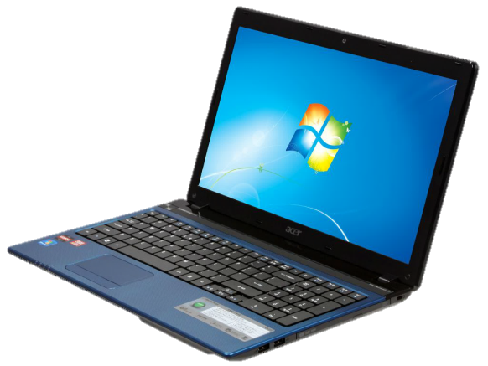
Park That Drive
Protect Your Computer
Stop the hard drive before moving
  Before moving to a meeting room or
  another office, close your laptop lid and
  make sure it’s either shut down or in
  sleep mode. Remember, your data is
  most vulnerable to knocks and bumps when in use. When the machine enters sleep mode, the hard drive stops spinning, as well as the optical drive.
When you put your PC to sleep, wait 20 seconds for the hard drive to park itself before moving the laptop.
Hard Drive Failing Causes and Symptoms:
Inside Look At A Hard Drive
Notes:
If you’ve never seen the inside of a harddrive, think of it as an old school record player, that spins around very fast with a head that hovers over the platter for reading and writing. The head never touches the hard drive though, data is stored and retrieved magnetically. (One great reason to keep magnets away from computers!) When you suddenly move your computer, it’s possible to send the read/write head slamming down onto the platter, or skittering across the surface, which can cause damage. (Have you ever heard of a harddrive crash? This is where the term came from.) Most laptops these days have a sudden motion sensor to try and protect in case of a fall but it’s still prudent to put your computer to sleep or shut it down, wait 20 seconds and then pick it up.

Slide 17
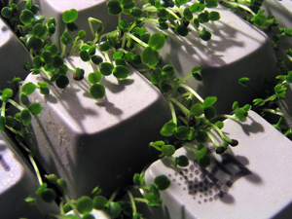
Keep You and Your Computer Healthy
Protect Your Computer
Your computer accumulates dust, grime,
bacteria and germs.
Clean Your Computer On A Regular Basis
  TURN OFF & UNPLUG COMPUTER
  BEFORE CLEANING!
  Things You’ll Need:
    Compressed Air Can (to blow out particles)
    Cotton swabs and cotton balls SLIGHTLY dampened with
    Isopropyl Alcohol OR use disinfecting wipes to clean keyboard
    Screen cleaner with a Lint-free cloth (microfiber clothes are great)
    (many brands available – 3M makes one that is available at
    Wal-Mart, Staples, and Amazon.)
Your Keyboard: Dirtier Than a Toilet?
Notes:
Another way to care for your laptop is to keep it clean. It can accumulate all sorts of dust, grime, bacteria and germs over time. What I do on the laptops I work on is this: first, turn the computer off and unplug it, use a can of compressed air to blow out dust and particles, then use cotton balls and q-tips slightly dampened with rubbing alcohol to clean the keyboard and touchpad, and then last I use screen cleaner with a microfiber cloth to gently wipe down the screen.

Slide 18
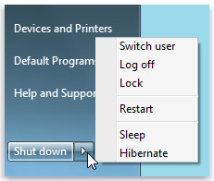
Shut down or Sleep?
To Leave On Or Not Leave On? That is the Question.
The Software Side of Things:
Give Your Computer A Fresh Start
  An operating system and the programs you run on it tend to accumulate all sorts of cruft over extended periods of use - temporary files, disk caches, page files, open file descriptors, pipes, sockets, zombie processes, memory leaks, etc. etc. etc. All that stuff can slow down the computer, but it all goes away when you shut down or restart the system.
From a hardware perspective: Live Long and Prosper
  Hard drives, because they have moving parts, will age when they are kept powered on. Silicon chips age with heat and power on cycles. Even though the operating system will run without a problem, the hardware will age when left on and when initially powered on.
Notes:
I can’t count how many times I have been asked this question. Is it okay to leave my laptop on at night, in sleep mode? Or should I shut it down? I’ll start off by asking this: Have you heard the saying “when it doubt, restart”? There’s a good reason to try this first when things start not working correctly. The programs you use and the operating system tend accumulate all sorts of cruft over extended periods of use. All those temporary files can slow down the computer but they go away when you shut down or restart. And from a hardware perspective, even when in sleep mode, heat is still being generated because the hardware is still running in a low energy state allowing your OS and programs to come quickly back online. So my answer to this question when it comes to me is this: Leaving your computer in sleep mode once in a while at night isn’t going to hurt, maybe you have documents open or websites up that you want to start right back on when you come back in… But to do this every night isn’t recommended. Give your computer a rest and let it refresh by shutting it down. And remember, after your important windows updates are downloaded and installed, the computer needs that restart in order to fully implement those new updates.
Cruft is jargon for anything that is left over, redundant and getting in the way. It is used particularly for superseded and unemployed technical and electronic hardware and useless, superfluous or dysfunctional elements in computer software.

Slide 19
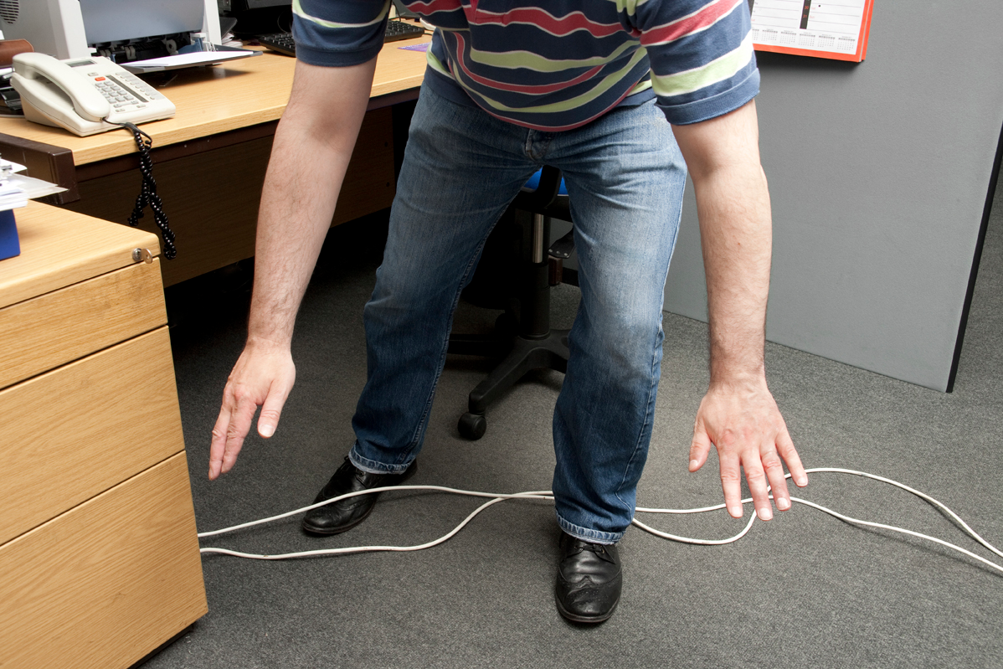
More Ways to Protect Your Computer
Protect Your Computer
Power Cable – winding cable, placing on floor
Food & Drink
Hardware Warranty – Accidental insurance
Notes:
A few other things are this: be gentle when winding up your power cable to put in your bag – it can put strain on the cord and cause it to go bad - and be wary of laying it on the floor where it could be stepped on or rolled over by a chair. (same goes for your network cables) Avoid eating or drinking near your laptop (if you do this a lot, I highly suggest you make sure you have accidental insurance on your laptop!) There have been a couple times this year where I’ve kicked myself for not pushing harder for buying the accidental insurance when buying laptops. Dell doesn’t cover a cracked screen on a brand new laptop that has been run over by a vehicle. It also doesn’t cover water damage from a leaking roof without it.

Slide 20

Protecting Your Data
Tips For
Notes:
Now that we’ve gone over protecting the actual computer, let’s go over protecting something much more important: your data.

Slide 21
Password Protection
Protecting Your Data
Association computers are joined to the Cornell domain which means users are logging in with NetID and password.
NEVER share your NetID password with anyone.
  Not your supervisor, not your assistant, not your family members, spouse, or friends.
  Sharing your NetID password is a violation of university policy.
To change your NetID password, go to:
  netid.cornell.edu
Notes:
And it just wouldn’t be me if I didn’t include this slide. If you are in my region, you may have heard me say this once, twice, a dozen times… Never share your NetID password with anyone. Not your supervisor, not your assistant, not your family members, spouse or friends. It is a violation of university policy. No one will ever legitimately ask you for your password either. Also, please don’t use your netid password for any other login password. If you ever need to change your NetID password, I have included the web link here.

Slide 22
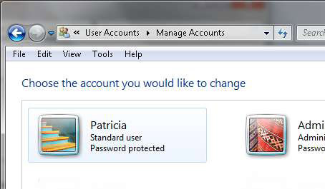
Password Protection for non-CCE computers
Protecting Your Data
Password protect
your computer!
Use Cornell’s password
complexity rules
http://www.it.cornell.edu/security/identity/passwords/strong.cfm
Is your password strong enough? Test it! https://netid.cornell.edu/psc/lookup.html
Notes:
First, password protect your computer! I’m not sure how many of you have your computer joined to the Cornell domain, if you do then you are already using your netid and password to log in, which is great. If you aren’t joined to the Cornell domain or another domain, which requires password protection… please make sure your computer is password protected. And I highly suggest using Cornell’s complexity rules when picking a password. Using a strong password is among the most important steps you can take to protect your computer from hackers and other unwelcome users.

Slide 23

Password Storage Utilities
Protect Your Data
Windows
  Password Safe
  http://www.schneier.com/passsafe.html
  A free Windows utility where users can keep
  their passwords securely encrypted on their
  computers. A single Safe Combination--just one
  thing to remember--unlocks them all.
  Keepass
  http://keepass.info/
  Another free utility where you can put all your passwords in one database. You only have to remember one single master password or select the key file to unlock the whole database.
Notes:
For those of you now saying, but I have dozens of accounts out there, how am I supposed to remember all these different passwords? There are free password storage utilities out there which will put all your passwords in a secure database and you only have to remember the one master password to unlock the database. I included on these slides the three utilities suggested by Cornell IT, two utility programs for windows and one for a mac.

Slide 24

Password Storage Utilities
Protect Your Data
Macintosh
  Pastor
  http://www.mehlau.net/pastor/
  For more information: http://www.it.cornell.edu/security/identity/pwdstorageutils.cfm

Slide 25
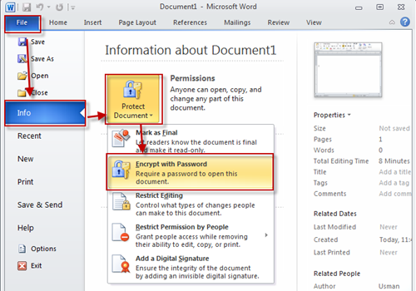
Password Protect Documents
Protect Your Data
You can protect your documents, workbooks, or presentations with passwords, permissions and other restrictions.
Learn how: http://goo.gl/lQvtc
Notes:
Now that we’ve covered protecting your Operating System with a login password, I want to mention that you can also password protect individual Office documents. I’ve included a link in this slide on how to do this.

Slide 26

When You Walk Away….
Protect Your Data
Taking steps to secure your computer not only helps keep your data safe, it keeps all data created, stored, and shared over the network safe.
Lock your computer when you
walk away!
Set your computer to go to sleep after a short time in case you forget to lock your computer.
Notes:
Now having a password protected computer isn’t going to do you much good if you walk away from your computer without locking it. Of course, this is great for me when I walk into an office to work on a computer and the staff person isn’t there…. I can do whatever I need to the computer because it’s wide open, and most of you probably have administrator rights on your laptop and are always logged into your Outlook e-mail so I really could do whatever I wanted on it. Not that I would, but keep this in mind when you walk away from your computer. Try making a habit out of hitting the windows key and the L key on your keyboard to quickly lock your computer before you step away from it, just like having a habit of locking your doors when you walk away from your car. Also, make sure your power settings are set so that your computer will automatically lock after a certain amount of time on its own.
Let me quickly show you where these settings are. (sleep time, what happens when the lid is closed…)

Slide 27

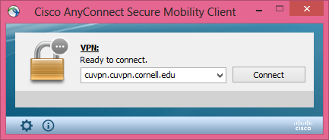
Internet Safety
Protect Your Data
Use the Cornell VPN (Virtual Private Network)
when working from home
or traveling
Use the VPN when you need to
connect to campus resources,
such as file servers, print
services, the Business Launchpad, Sharepoint team sites, and the CCE Staff site.
Once connected to the VPN, it provides an added layer of security by sending all of your Cornell-related traffic through an encrypted "tunnel" to campus.
How to Install: http://www.it.cornell.edu/services/vpn/howto/index.cfm
Notes:
Cornell has a VPN (virtual private network) program called Cisco AnyConnect that allows you to securely connect to the Cornell network. It’s very simple to connect to using your netID credentials and it will allow you to securely access internal campus or CCE office resources such as the CCE staff page, the Business Launchpad, a file server, a SharePoint team site or maybe you need to print a document to a network copier or printer in the office… as long as you have a network connection where you are, you can do this by connecting to the Cornell VPN software first.
I’ve included a link on this slide on how to install and connect to the VPN.

Slide 28
Internet and E-mail Safety
Protect Your Data
Cornell’s Phishbowl: http://www.it.cornell.edu/security/safety/phishbowl.cfm
Do NOT download unnecessary, non-work related software.
Do NOT forward non-work related e-mails, especially ones with web links and attachments.
    Malicious software can end up on your computer via email attachments and drive-by downloads. It can sneak in when you download free software.
Don’t Fall for PHISHING
  Fraudulent, or "phishing," emails try to trick you into replying with information the sender wants, or
  visiting a bogus web site.
Email Phishing 101
Notes:
The best line of defense against viruses and malware is user knowledge: Knowing what to look for and stay away from. Don’t download unnecessary, non-work related software – many free software programs out there like to sneak in other installations when you are installing their program. Some can be harmless, and some aren’t. (Be especially wary of free screensaver downloads, free fonts, clipart software and music lyric websites.) If you aren’t sure about a program, ask your IT support person first.
And if I had to pick just one thing that I hope you click on later in this PowerPoint, it’s this CIT video about E-mail Phishing. Fraudulent, or "phishing," emails try to trick you into replying with information the sender wants, or
visiting a bogus web site…. Unfortunately, we tend to see a lot of these being on the Cornell e-mail system.

Slide 29

E-mail Safety
Don’t Fall for PHISHING (continued)
  When you aren’t sure whether a request for personal information is legitimate, confirm it at the source.
    If it appears to be from a Cornell department, contact that department or contact the CIT HelpDesk (phone 607 255-8990, email helpdesk@cornell.edu).
    If it appears to be from a service outside Cornell, such as your bank or PayPal, look up their contact information using a trusted source, such as the 800 number on the back of your credit card or the service’s official web site. Then call and ask.
For more information: http://www.it.cornell.edu/security/safety/phishbowl.cfm
For more information: http://www.it.cornell.edu/security/safety/phishbowl.cfm
Notes:
Cornell has a website called the Cornell Phishbowl, where you can view all the past and ongoing phishing attempts going around the e-mail system. If the phishing e-mail you received isn’t listed, you can forward it to the CIT security helpdesk so they are aware of it, possibly block more coming in like it and add it to their list.

Slide 30
Dealing With Sensitive Data
Protect Your Data
Credit Card Numbers, Social Security Numbers, Bank Account Numbers
Step 1 – Know What Information Is On The Computer
  Scan computer with Identity Finder
  http://www.it.cornell.edu/services/idfinder/
  (free for use with Cornell-owned computers)
    University recommends scanning computers twice per year
Step 2 – Removing sensitive data from documents or save the document in a secure place
  Options For Saving Sensitive Data: Secured File Server, Encrypt entire computer drive (PGP, BitLocker, FileVault (Mac), store on CD or USB in a locked secure location
    Overview of University Policies on Computer Security and Data Protection
Notes:
The last bit I want to talk about concerning protecting your data involves sensitive information. Social security, driver’s license, credit card, and bank account numbers, plus protected health information, are currently classified as confidential, sensitive data. Cornell has paid for a program called Identity Finder that is available to all staff so that we can scan our Cornell owned computers on a regular basis to ensure we are not storing any of this information on our computers. Identity Finder can be download from CIT’s website and they have instructions on how to use it there as well. Cornell recommends we scan our computers at least twice per year and clean off any sensitive data the program finds.
If you need to hold onto any documents with sensitive information, you have a few options. The preferred option is you can keep the document but delete the sensitive information that is in it.
If you really need to keep the sensitive information in the document, then the choices are the following: the data can be stored on a secured file server, you could encrypt your entire computer drive with a program such as PGP, or Windows Enterprise and Ultimate has Bitlocker built-in to do this. FileVault is the encryption program for a Mac. You also have the option of storing the data on a CD or USB drive. If you do this, it needs to be kept locked in a secure location – preferably in a locked cabinet behind a locked door. If you do have sensitive data you need to keep, contact the CCE Helpdesk for more information about your options.
Cornell has and will hold staff accountable for lost or stolen sensitive information.

Slide 31
Cornell DropBox
Protecting Your Data
https://dropbox.cornell.edu
Cornell Dropbox
  Can be used to send/receive confidential data
  Files are stored for up to 21 days
  Accepts files up to 2 GB in size
  FAQs: https://dropbox.cornell.edu/help
Don’t confuse the Cornell Dropbox (https://dropbox.cornell.edu)
with Cornell Box (http://box.cornell.edu)
and the commercial Dropbox site(https://www.dropbox.com/).
Only Cornell Dropbox can be used to send confidential information.
Notes:
If you need to send or receive any sensitive information or passwords, never send it via e-mail which is a very unsecure way of transmitting data. I recommend sending it via the Cornell Dropbox.
Now, it can get a bit confusing because of its name. Also out there is Cornell box and the commercial Dropbox site… but only the Cornell Dropbox can be used to send confidential information.
For more information about how to use the Cornell Dropbox, you can click on the informational icon which will take you to CIT’s help document.

Slide 32

Back Up Your Data!
Notes:
Okay, we’ve talked about ways to protect your computer and your data but the most important part is backing up. If your computer decided that today was the day, it’s done, it quits.. and the data on the hard drive is unrecoverable….. What would you lose? Do you have a good backup of your data somewhere else?

Slide 33
What Data is Being Backed Up?
Back Up Your Data
Folders already set to sync/backup to your User Drive (U:) on the file server
  My Documents
  My Pictures
  Internet Explorer Favorites
Other Folders/Items to consider:
  Other Web Browser Favorites:
    Firefox Bookmarks – Firefox Sync
    Google Bookmarks
  Desktop Documents
  My Downloads

Slide 34

Microsoft Sync
Back Up Your Data
Sync Center is designed to help you sync files between your local computer and files on your User drive.
Allows you to access copies of your files on the U drive even when your computer isn't connected to the network.
When your computer is back on the Cornell network, it will automatically sync any changes to the server so your files are always backed up.

Slide 35
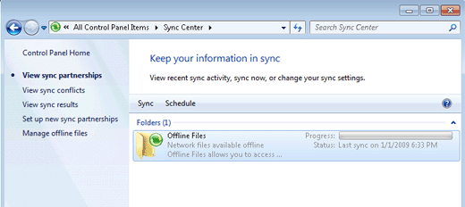
Microsoft Sync
Back Up Your Data
To view status or to initiate a manual Sync, click on the Sync icon in the notification area in the lower right of your screen next to the clock.

Slide 36

Want Your Own Backup?
Back Up Your Data
On-Site Backup Options
  Best Hardware Options: USB Drives, External Hard drives
  Free Backup Programs:
    Windows Backup and Restore
    SyncBack
    http://www.2brightsparks.com/download-syncbackfree.html
Off-Site Backup Options
  File Server
  Cornell Box
  http://cornell.box.com
Notes:
I’m a big believer in having multiple backups. One stored locally on an external harddrive or thumbdrive, and another backup that is stored remotely.
There are many backup programs out there but I like free so I listed my two favorite free ones that you can use to backup to a usb drive. I’ve included two video links on this slide that walk you through how to set up scheduled backups with these two programs.
There is also a great feature that you will find when you right click on any of your folders and files, called previous versions, which I will demonstrate to you now since it’s such a great feature to know about.
Now having a local backup is all well and good, but you really need to have an off-site backup as well. To protect you from natural disasters, maybe you come in one day to find your desk completely covered in water from a roof leak and both your laptop and external harddrive have been damaged…. Now what do you do? You want that off-site backup.

Slide 37

Securing USB Drives
Back Up Your Data
Convenience and portability make thumb drives a
security risk because they can be easily lost or stolen.
Here are some simple strategies to secure the drive:
Physical Security
  The first line of security: Don't lose it.
Password Protect the Drive and/or Documents
  Bitlocker is free on Windows 7 Enterprise or Ultimate
  PGP available through Cornell
Viruses and Malware
  Scan the drive for viruses and malware any time you've used it with a computer with which you are not familiar.
Safely Remove Device Info
Notes:
I want to go back for a minute and talk about the security of usb drives. Convenience and portability make these little magical data sticks one of my favorite and most useful inventions in the last decade. But they can be a security risk since they can easily be lost or stolen. First line of defense: don’t lose it (easier said than done some days, right?) Second line of defense: password protect the drive or at the very least the important documents on it that you don’t want anyone to get in to. And lastly, these little sticks can get around (I know mine do). Every time you plug your usb drive back into your computer after letting it be plugged into a computer you aren’t familiar with, scan the drive with Symantec and Malwarebytes for infection before using it.
I also want to mention here that if you unplug a usb storage device or removable drive from your computer while it’s still transferring or saving information, you might risk losing some information. If the device has a small light that shows its in use, wait a few seconds after the light finishes flashing before unplugging it. Or better yet, use the Safely Remove Hardware icon in the notification area, next to the clock – I’ve included a link in this slide in the top right for more information.
PGP available through Cornell: http://www.it.cornell.edu/services/pgp/about/index.cfm

Slide 38
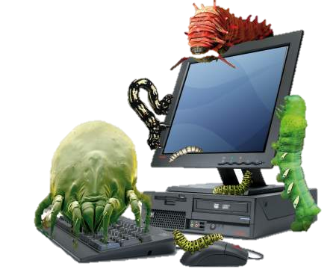
Viruses, Worms, Malware.. Oh My!
Notes:
The next section is about malware, viruses, worms… any malicious program out there that can do damage to your computer and/or files.

Slide 39

Potential Signs That Your Computer
May Be Infected
Viruses, Worms, Malware.. Oh My!
Sometimes, security issues aren’t recognized right away, because it’s difficult to tell the difference between your computer’s everyday quirks and things caused by a security problem.
Your antivirus software, anti-spyware software, or personal firewall reports a problem.
When browsing the web, you see lots of popup windows, or your web browser takes you to different sites than expected.
Your computer seems slower than usual, crashes more often, or runs out of disk space unexpectedly.
looking for potential signs of an infection
Notes:
Sometimes, security issues aren’t recognized right away, because it’s difficult to tell the difference between your computer’s everyday quirks and things caused by a security problem. Here are a few potential signs to be on the lookout for: Your antivirus software reports a problem (pretty obvious sign), when browsing the web, you see lots of popup windows, or your web browser takes you to different sites than expected, Your computer seems slower than usual, crashes more often, or runs out of disk space unexpectedly.

Slide 40

I Caught A Virus… Now What?
Viruses, Worms, Malware.. Oh My!
Take your computer off the network
immediately (unplug and turn off wireless)
Contact your local IT support person, or if he/she unavailable, contact Regional IT Coordinator (me!)
If after hours, write down what infections/files were caught and then allow program to delete malicious files.
Also, if no IT support around and you feel comfortable doing it: Reboot your computer in safe mode, backup data to USB drive and rescan with MalwareBytes
Be aware that the safest solution for getting rid of malware completely is to reinstall Windows.
Notes:
If Symantec or Malwarebytes does pop up and show that your computer has some malicious files or programs on it, the very first thing to do is disconnect your computer from the network. Unplug the network cable and shut off the wireless. This will help prevent the potential spread of a malicious program. At this point, I would recommend you go talk with your IT support person, let them view what files popped up and determine the next course of action.
If IT support isn’t around, maybe it’s the weekend or you’re working late and you are on your own… then write down what infections/files were caught to let your IT person know later (or even better, if you have a smartphone, take a picture of your screen), then then I recommend letting the program delete the malicious files, if it hasn’t already.
Now if it’s not too nasty of a program, it hasn’t messed with system files and is pretty easy to remove, your IT support person will probably look over your Operating System and then reboot your computer into safe mode and run Symantec and Malwarebytes again to ensure that everything is removed. But if the malware has spread through system and or program files, then the safest solution is to reinstall Windows (dangerous software has a way of hiding and creeping back later).
Again if IT support isn’t around and you feel comfortable doing it – you could restart your computer into safe mode. To do this, you restart your computer and right when it starts booting back up hit F8 a few times, you will see a menu pop up with the option of booting into safe mode. Once you are logged in to safe mode, run Symantec and Malwarebytes again. If it comes back with no more files detected, you should be okay to reboot back into normal mode.. but still contact your IT person with that list you wrote down. And be very diligent in updating and scanning your harddrive every day for the next week. Malware always seems to have a way of hiding and creeping right back, even after the files caught are deleted. If your scans are still popping up with malware in safe mode after you’ve scanned once in safe mode, restarted and scanned again in safe mode, then it’s time to stop using the computer and hand it over to be looked at by IT support. Just be aware that the safest solution for getting rid of malware is to reinstall Windows. (This is where your great on-site and off-site backups will come in handy!)
Dangerous software hides from repair tools.
Don’t contact your IT person using the infection computer….
USB drives should be scanned with Symantec and/or Malwarebytes on alternate computer before copying the data onto it.

Slide 41

Resources & Training
Notes:
The next section I’ll go through quickly. I have many resource handouts uploaded to the Box folder I created and shared with all of you that go these resources and others in more detail that you can browse through later if you would like.

Slide 42
Software Available
Resources
Full Listing of Software: http://www.it.cornell.edu/services/software_licensing/available/
 | Cornell-Owned Computer | Personal Use
Microsoft Office | Free! http://www.it.cornell.edu/services/software_licensing/available/ms_office.cfm | http://www.it.cornell.edu/services/software_licensing/available/ms_office.cfm#ms_hup $9.95 1 license per staff person
Symantec Anti-virus | Free! http://www.it.cornell.edu/services/antivirus/howto | Free!
Identity Finder/Sweeper | Free! http://www.it.cornell.edu/services/idfinder/ | http://www.identitysweeper.com/Products Limited Free Version Available $39.95 Identity Sweeper Pro
Adobe Acrobat Professional | $66.84 | http://store.cornell.edu/c-565-adobe.aspx $119
Adobe CS6 Design & Web | $312.77 Premium Version | http://store.cornell.edu/c-565-adobe.aspx $449 Standard Version
Notes:
First, let’s go through some software that is available. Microsoft Office, Symantec Anti-virus and Identity Finder are all free to download from CIT’s website and install on Cornell owned computers.
.
For personal computers, Symantec is also free to use and through Microsoft’s Home Use Program, you can get Office for $9.95.
The link at the top of this slide will take you to a full listing of other software available.
I also want to mention Adobe’s Licensing policy. Adobe allows one license of its software to be installed on two computers, BUT those two computers must belong to the same user. So Joe Smith could purchase Adobe Acrobat Pro and install it on his primary Cornell computer and also install it on his second computer. This second computer could be another of his Cornell-owned computers or a personally-owned computer. Joe could not take this license though and install it on his and Mary’s computer. This is against Adobe’s licensing policy. It’s one user per license.

Slide 43
Exchange Group Accounts
Resources
X:\IT\IT Resources\Exchange Resource Account
A resource account can be a group e-mail address or an object that represents a room or a piece of equipment. The resource can be "invited" to meetings just like people can be invited.
How To Add A Group E-mail to Your Outlook
  http://www.it.cornell.edu/services/resource-accounts/howto/config-outlook-2010.cfm
Current Chautauqua County EGAs:
  Chautauqua@cornell.edu
  Chautauqua4H@cornell.edu
ChautauquaMG@cornell.edu
ChautauquaWIC@cornell.edu

Slide 44
Cornell’s Box
Resources
http://cornell.box.com
Your 50GB Cornell Box account is free, thanks to a campus-wide license.
Box allows you to share and collaborate on documents and other files online. With a Cornell Box account, you can invite both Cornell and non-Cornell people to collaborate with you.
Access content through all major browsers, and through mobile devices running iOS, Android, and Blackberry
Notes:
With Box, you can access your files from any computer by logging into cornell.box.com with your netid and password. And if you download and install Box Sync on your computer, it can back up files automatically to your Cornell Box account.
I also want to mention that Box is not just a way to back up your documents. You can invite your Cornell co-workers and also people outside of Cornell to collaborate on certain folders and files of your choosing within your Box account. With your shared folder, you have the options of allowing people to just view your files or edit them as well. I have shared one of my Box folders with all of you so that you can view this powerpoint presentation and other informational sheets that may be useful to you.
Tyler Poole, from Tioga County, put together a great PowerPoint presentation about using Box so I uploaded that to our X drive as well.
And another great use of Box I just recently discovered is the upload only feature, which includes html code that you can cut and paste into your website. This allows anyone to upload a document to one of your folders without actually having access to the rest of the contents of that folder. (Show upload test on wyoming’s site - http://wyoming.cce.cornell.edu/4-h-youth-development/test-dropbox-upload) Our camp is actually going to use this feature this year so campers can upload 30-second videos about why they love camp. (Remember, Box is not an option for uploading or storing any sensitive data.)

Slide 45
SharePoint Team Site
Resources
http://teams.cce.cornell.edu
Collaborative workspace: Share documents, calendars, discussions, and lists
Accessible only to authorized team members
(members listed on right hand side of team site)
Accessible via the web (Internet Explorer)
Managed by CCEIT (soon to be managed by CIT)
Can set up a mapped network drive to the document library (which will allow you to access and upload documents without having to go through the web interface)
Recorded Webinar: https://www.youtube.com/watch?v=1LhX_5XsrXc
Notes:
While we are on the subject of sites that give you the ability to collaborate on documents with your team. I want to also mention the SharePoint team sites, which is currently available to CCE staff but will be available to all Cornell users later this year. If you go to the CCE Staff site you’ll find recorded webinars about how to use it and you can always e-mail the cce-helpdesk if you need some extra help getting started.
If your team is looking for a way to collaborate on documents, you may want to look at the pros and cons of using the SharePoint team sites, or Box or some other collaboration tool. A couple of the pros and cons for sharepoint and box are: Document ownership – If a staff person leaves, their shared folders in Box will no longer be accessible to anyone, unlike the Sharepoint documents which will not be lost to the other team members if the person who shares them leaves Cornell. On the other hand Sharepoint is limited to only those within Cornell, unlike Box which allow you to share folders with anyone with a Box account, so it’s not limited to just people at Cornell.

Slide 46

Qualtrics
Resources
Online Survey Software Provided For Free Through Cornell
http://surveys.cornell.edu/
Build simple surveys from scratch or use a template to get started.
There is no limit to the number of surveys/responses that we can accept for no charge
It is very intuitive and easy to use.
Learn how to use:
http://www.qualtrics.com/university/researchsuite/
Notes:
Cornell has also provided us for free with an online survey software tool called Qualtrics. You can build your own surveys from scratch or use a template from the site. I’ve provided the link to the site to login and get started and also Qualtric’s webpage that walks you through how to use it.

Slide 47
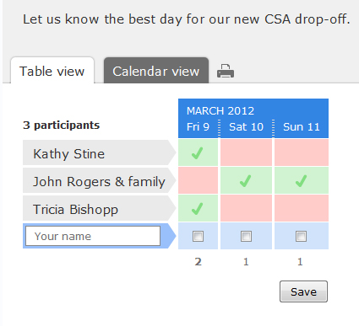
Doodle Poll
Training and Resources
Are you trying to schedule a meeting and having a hard time agreeing on a date and time?
Doodle enables you to propose several dates and times and the participants can indicate their availability online.
Doodle Poll is free and easy to use.
Participants do not need to sign up
for an account to add their name
and available times.
More information about using Doodle Poll:
http://www.doodle.com/about/about.html
Notes:
Doodle Poll is a great little (again free) tool to pick a time for scheduling meetings. It lets you propose several dates and times and then e-mail a web link out to everyone involved in the meeting so that they may check off the dates and times that work best for them.

Slide 48
CCE Staff Site Training Opportunities
Training and Resources
Upcoming & Recorded Webinars
Learn more about:
CCE Sharepoint team sites
PCI Compliance (Policies regarding accepting credit card payments)
Digital Literacy and Media
Outlook 2010
Designing publications and/or editing photos
These are just a few of the things you can learn from the CCE webinars. http://staff.cce.cornell.edu/Pages/webinars.aspx
Please note: If you would like to access the CCE staff site when away from the office, you will need to use the Cornell VPN.
Notes:
Next I want to give you some sites where you can do some free online training.
First, how many people have visited the CCE staff page lately? You know the Apple trademark saying “there’s an app for that?” Well, the CCE staff site should be “There’s a webinar for that!” You can find recorded and upcoming webinars listed here where you can learn more about a wide variety of topics.

Slide 49
Annual CCE Tech Fairs
Training and Resources
2-Day Online Event Every April
These Tech Fairs are not just for tech people!
20 sessions covering a broad range of IT related topics, including:
  Tips and Tricks with Windows 7 and Office 2010
  Windows 8 & Office 2013
  Using VIVO to find Campus Connections
  Using ACCPAC (Presented by Donna James)
  Writing for the web
Past years’ sessions were recorded and are available online for you to watch on CCE’s YouTube Channel: http://goo.gl/YZ8oT5
Notes:
In another couple weeks, CCE Admin and the Lead IT Coordinators will be hosting another annual CCE tech fair. And these webinars are not just for tech people. Some of the sessions that will be held will be about learning more about how to get around in Windows, Office, Vivo and even ACCPAC. I’ve also included a link to CCE’s YouTube channel where you can watch past years’ sessions that were recorded.

Slide 50

Lynda.com
Training and Resources
Online Training
Academic Technologies is now providing unlimited access to lynda.com online training for all faculty, students, and staff.
Offers 2,500 detailed courses with over 80,000 high-quality instructional videos on the latest software, creative, and business skills for people at all experience levels.
Notes:
Cornell Academic Technologies is now providing unlimited access to lynda.com online training for all faculty, students, and staff. So far, I’ve found videos to help staff learn how to use Adobe InDesign for designing publications, Microsoft Movie maker for editing videos and uploading them to YouTube and learning more about Windows 8.

Slide 51
Microsoft Office Trainings
Training and Resources
Free Online Training from Microsoft
Free, downloadable versions of Office 2010 training courses.
  http://office.microsoft.com/en-us/support/download-office-2010-training-HA101901726.aspx?CTT=1
15-minute weekly online trainings
http://blogs.office.com/2013/03/19/free-office-webinars-every-tuesday-watch-videos-anytime/
  Older recordings: http://blogs.office.com/2012/03/07/office-15-minute-webinar-archive/
Notes:
There are many free, online resources and trainings that can help you advance your Microsoft Office skills. I want to encourage everyone to go through one or two of these, even the most advanced users learn something new when taking these trainings! A simple, newly-learned task could save you time and headaches later when working with e-mail and/or documents!

Slide 52
Extra Tips
Training and Resources
Keep track of license numbers for paid software
(ex. Adobe Acrobat Pro) and recovery keys for encryption software (if you use it)
  E-mail a copy of the license number to me, your Lead IT, if I wasn’t the one to purchase the software – I keep a record of all licensed software on computers!
OpenOffice.org
http://www.openoffice.org/download/index.html
  Open files from WordPerfect (.wpd), Microsoft Works (.wps)
Access your Cornell e-mail from any computer by going to http://outlook.cornell.edu
  You can add your photo to your e-mail here too!
Notes:
Lastly, I wanted to note a couple of other things. First, make sure you keep track of your license numbers for any software you purchase and recovery keys for encryption software. This will come in handy if your computer ever needs Windows reinstalled and the programs reloaded. If you do use any encryption software, keep track of the recovery key – I also recommend you share it with your supervisor or IT support. (the ole bus theory in play here..)
Also, once in a while, I run into a staff person who receives a document that they can’t open because it was created in WordPerfect or Works, OpenOffice is a free program that will give you the ability to open these types of documents and save them as Word documents if you want to.
You can access your Cornell e-mail from any computer that has an internet connection by going to outlook.cornell.edu. And keep in mind – some websites work better in different web browsers. If you mainly use Chrome or Firefox, try Internet Explorer. If Internet Explorer isn’t working right, try Firefox or Chrome.
And use the best tried and true method of IT support – when in doubt, reboot - a clean slate clears up many wonky-laptop issues, even on a Mac.
Okay, that was my quick highlight of some available resources and training opportunities. If you check out the Box folder that I have shared with you, you will find a bunch of handouts and also a handy 4-page Word document called “CCE Resources” that has a list of resources, a quick blurb about the resource and a link for more information. Whenever I make a new handout or update my resources booklet, I will try to make sure that I upload them into this folder for your use as well.

Slide 53
Extra Tips
Training and Resources
If one web browser doesn’t work, try another one
When In Doubt Reboot – A clean slate clears up many wonky-laptop issues, even on Mac.
Notes:
Lastly, I wanted to note a couple of other things. First, make sure you keep track of your license numbers for any software you purchase and recovery keys for encryption software. This will come in handy if your computer ever needs Windows reinstalled and the programs reloaded. If you do use any encryption software, keep track of the recovery key – I also recommend you share it with your supervisor or IT support. (the ole bus theory in play here..)
Also, once in a while, I run into a staff person who receives a document that they can’t open because it was created in WordPerfect or Works, OpenOffice is a free program that will give you the ability to open these types of documents and save them as Word documents if you want to.
You can access your Cornell e-mail from any computer that has an internet connection by going to outlook.cornell.edu. And keep in mind – some websites work better in different web browsers. If you mainly use Chrome or Firefox, try Internet Explorer. If Internet Explorer isn’t working right, try Firefox or Chrome.
And use the best tried and true method of IT support – when in doubt, reboot - a clean slate clears up many wonky-laptop issues, even on a Mac.
Okay, that was my quick highlight of some available resources and training opportunities. If you check out the Box folder that I have shared with you, you will find a bunch of handouts and also a handy 4-page Word document called “CCE Resources” that has a list of resources, a quick blurb about the resource and a link for more information. Whenever I make a new handout or update my resources booklet, I will try to make sure that I upload them into this folder for your use as well.

Slide 54

Computer Support
Getting Help
Notes:
And finally, getting support..

Slide 55
Who Can Help Me?
Computer Support
Computer Support Options
Association’s Local IT Contact
  Shared Business Network’s Lead IT Coordinator
CIT – Cornell Information Technology
  Contact info: CIT 607-255-8990 or helpdesk@cornell.edu
CCE IT – Cooperative Extension Administration IT
  Contact Info: cce-helpdesk@cornell.edu
Notes:
It’s always good to know who you can turn to with computer and software issues. Within Cornell, we have the CIT helpdesk, the CCE IT helpdesk (check out the CCE staff site, click on IT, if you want to know more about who works is IT at CCE on campus) and also the association’s local IT contact, as well as the SBN Lead IT coordinator for the region you are in.

Slide 56
Association's Local IT Contact
Support Includes
Computer Support
  1st Point of contact for IT issues within the Association
  Connecting to association’s copier(s) and/or network printer(s)
  Connecting to association’s wireless access point
  Association’s Polycom system
  Hardware / Software support
  Who is Your Local Technology Contact? https://apps.cce.cornell.edu/org_report/main/summary.cfm

Slide 57
Lead IT Coordinator
Support Includes
Computer Support
  Backup contact for association equipment and network connection help when local IT contact unavailable or needs additional assistance
  Troubleshooting association’s networking equipment (wireless access points, routers, switches, printers, servers)
  Hardware / Software Purchasing
  Hardware / Software support when needed
    Start by contacting your local IT person

Slide 58
Cornell IT Helpdesk
Support Includes
Computer Support
  E-mail (including Outlook, OWA, Mobile Devices, EGAs)
  E-Lists
  DropBox
  Identity Finder
  Anti-virus (Symantec)
  Cornell VPN
  Mac Support
  WebEx
  EZ-Backup
  NetIDs
  Software Licensing
  Training
    CIT Training
    Lynda.com
    Skillsoft
  Contact Info: http://www.it.cornell.edu/support/
  607-255-5500 or E-mail: helpdesk@cornell.edu

Slide 59
Cornell Cooperative Extension IT Helpdesk
Support Includes
Computer Support
  CCE Business Systems
  (Includes CCE Org Report and Online Event Registration)
  https://apps.cce.cornell.edu/
  Moodle (creating online courses)
  SharePoint Team Sites (until CIT takes over later this year)
  http://staff.cce.cornell.edu/Information_Technology/Pages/CollaborationTools.aspx
  CCE E-Lists
  View Current CCE e-Lists: https://apps.cce.cornell.edu/org_report/main/exportElist.cfm
  Hardware Support, Recommendations and Purchasing
  Software Support, Recommendations and Purchasing
  Contact Info: http://staff.cce.cornell.edu/Information_Technology
  E-mail: cce-helpdesk@cornell.edu

Slide 60

North
HR = Tracy Sanford
IT=Gale McArdell
Finance=Betsy Klug
ED=Kevin Jordan
Capital
HR = James McNaughton
IT=Erik Yager
Finance=Michael Ryan
ED=Lisa Godlewski
Finger Lakes
HR = Renee Smith
IT=Cate Sirek
Finance=Barb Elias
ED=Bo Freeman
Western
HR = Kimberly Amey
IT=Jenn Carges
Finance=Donna James
ED=Shawn Tiede
Mid Hudson
HR = Leah Cadwallader
IT=Sean Carbine
Finance=Roxanne Churchill
ED=Lydia Reidy
Central
HR = Krystal Dunn
IT=John Stine
Finance=Joann Huddle
ED=Ken Schlather
Leatherstocking
HR = Mary Beth McEwen
IT=Andrew Damin
Finance=Mary Teller
ED=Ron Bunce
Suffolk
HR = Eileen Heely
IT=Richard Marino
Finance=Catherine Berkham
ED=Vito Minei
  Lead Map: http://goo.gl/vJ5cGy

Slide 61
Questions?

