Slide 1
Tile Drainage
Economics & Agronomic Benefits

Slide 2
Tile Drainage
Disclaimers
* A Southern Washington County Perspective
* Unabashed proponent of sub-surface drainage
* Observing Laws while achieving success
* Recognition of changing perceptions
* Classical Economic evaluation – ???

Slide 3
Disclaimers
* A southern Washington County Perspective

Slide 4
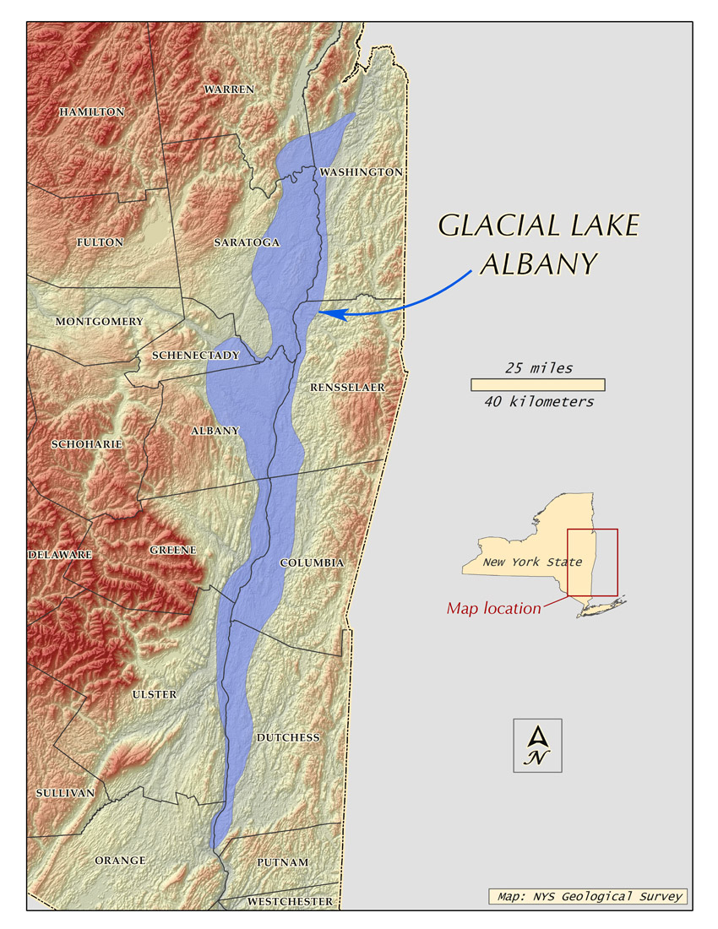

Slide 5
Disclaimers
* Unabshed proponent of sub-surface drainage

Slide 6
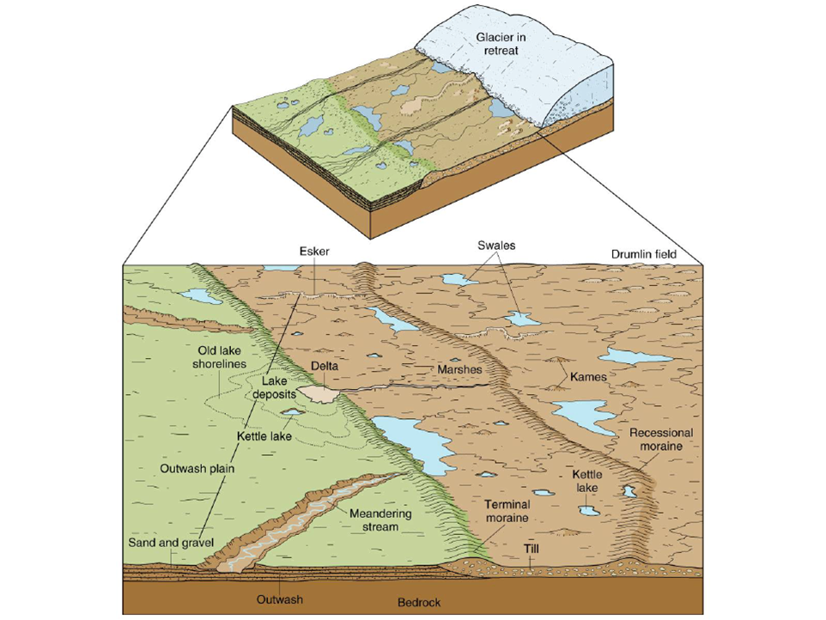

Slide 7
Tile Drainage
Disclaimers
Observing Laws while achieving success
Sodbuster
Swampbuster
Protected streams

Slide 8
Tile Drainage
Disclaimers
Recognition of changing perceptions
Drainage water concerns
Changes to definitions of water

Slide 9
Tile Drainage
Disclaimers
Classical Economic evaluation
No side-by-side in field comparisons
Other approaches?
Historical
Eyeball test
Timeliness factors
Yield “what ifs”
Agronomic considerations

Slide 10
Tile Drainage
What are we really trying to accomplish?

Slide 11
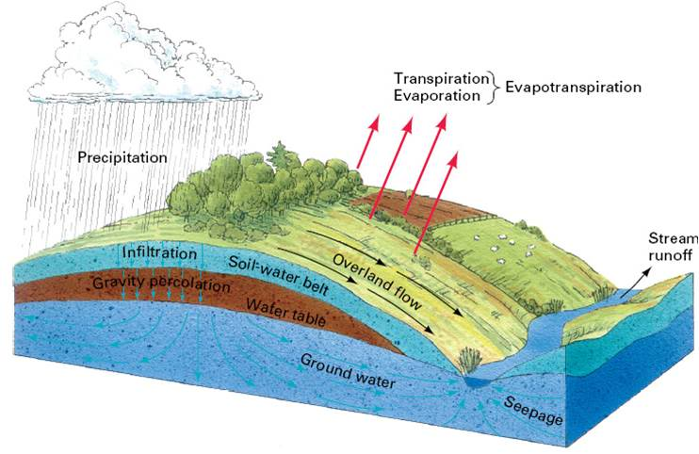

Slide 12
Tile Drainage
A long ways from ideal

Slide 13
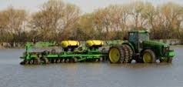
How about getting rid of a little excess water??

Slide 14
Tile Drainage
Poor drainage:
A CROP DISEASE
More noticeable in some places than others
We’ve all seen acute symptoms

Slide 15
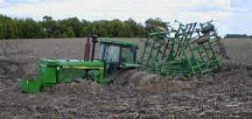
Guess another day or two of sunshine maybe?

Slide 16
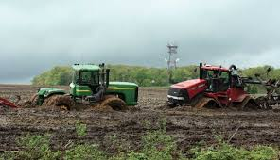
Mud doesn’t discriminate

Slide 17
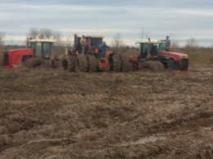
Three’s a crowd

Slide 18
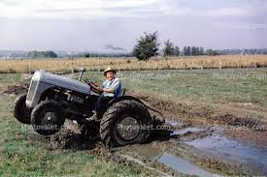
Less is more?

Slide 19
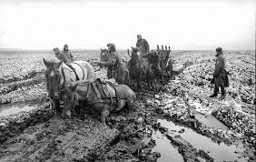
Or horses?

Slide 20
Tile Drainage
How much do we spend every year on other crop conditions?
Herbicides
Fungicides
Insurance

Slide 21
Tile Drainage
What are the minimum needs?
A suitable outlet
Some grade (elevation)

Slide 22

Tile Drainage
Some things don’t change

Slide 23
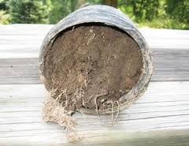
Tile Drainage
Never a good sign

Slide 24
Tile Drainage
Economic evaluation
Historical

Slide 25
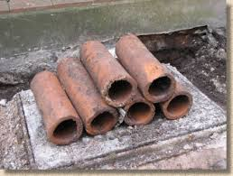
Tile Drainage

Slide 26
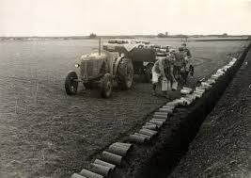
Tile Drainage
Who convinced these guys this needed to get done?

Slide 27
Tile Drainage
Economic evaluation
“Eyeball”

Slide 28
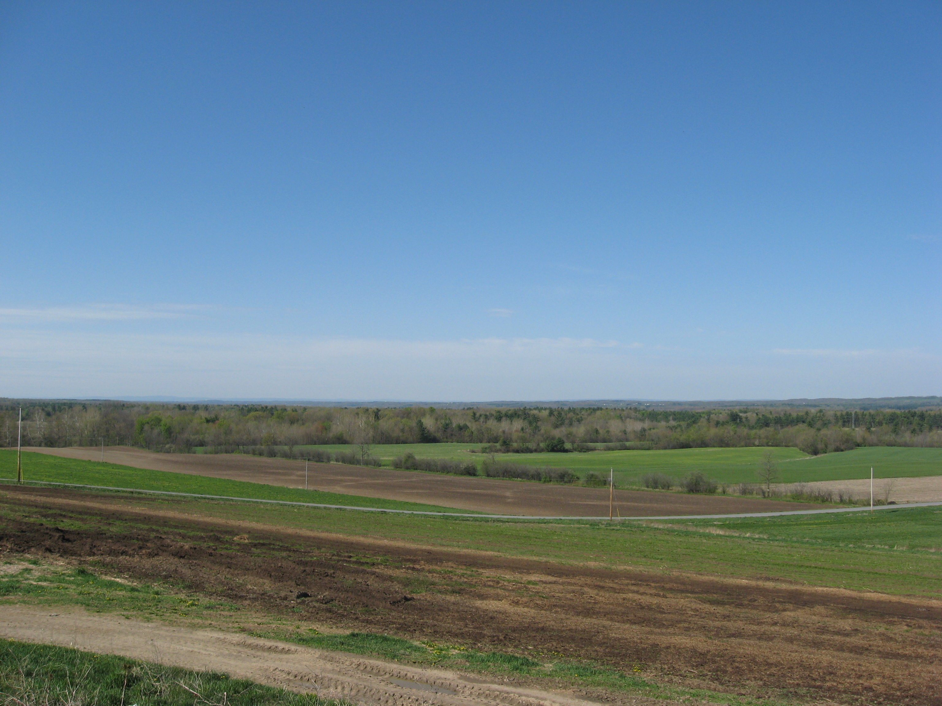
Tile Drainage

Slide 29
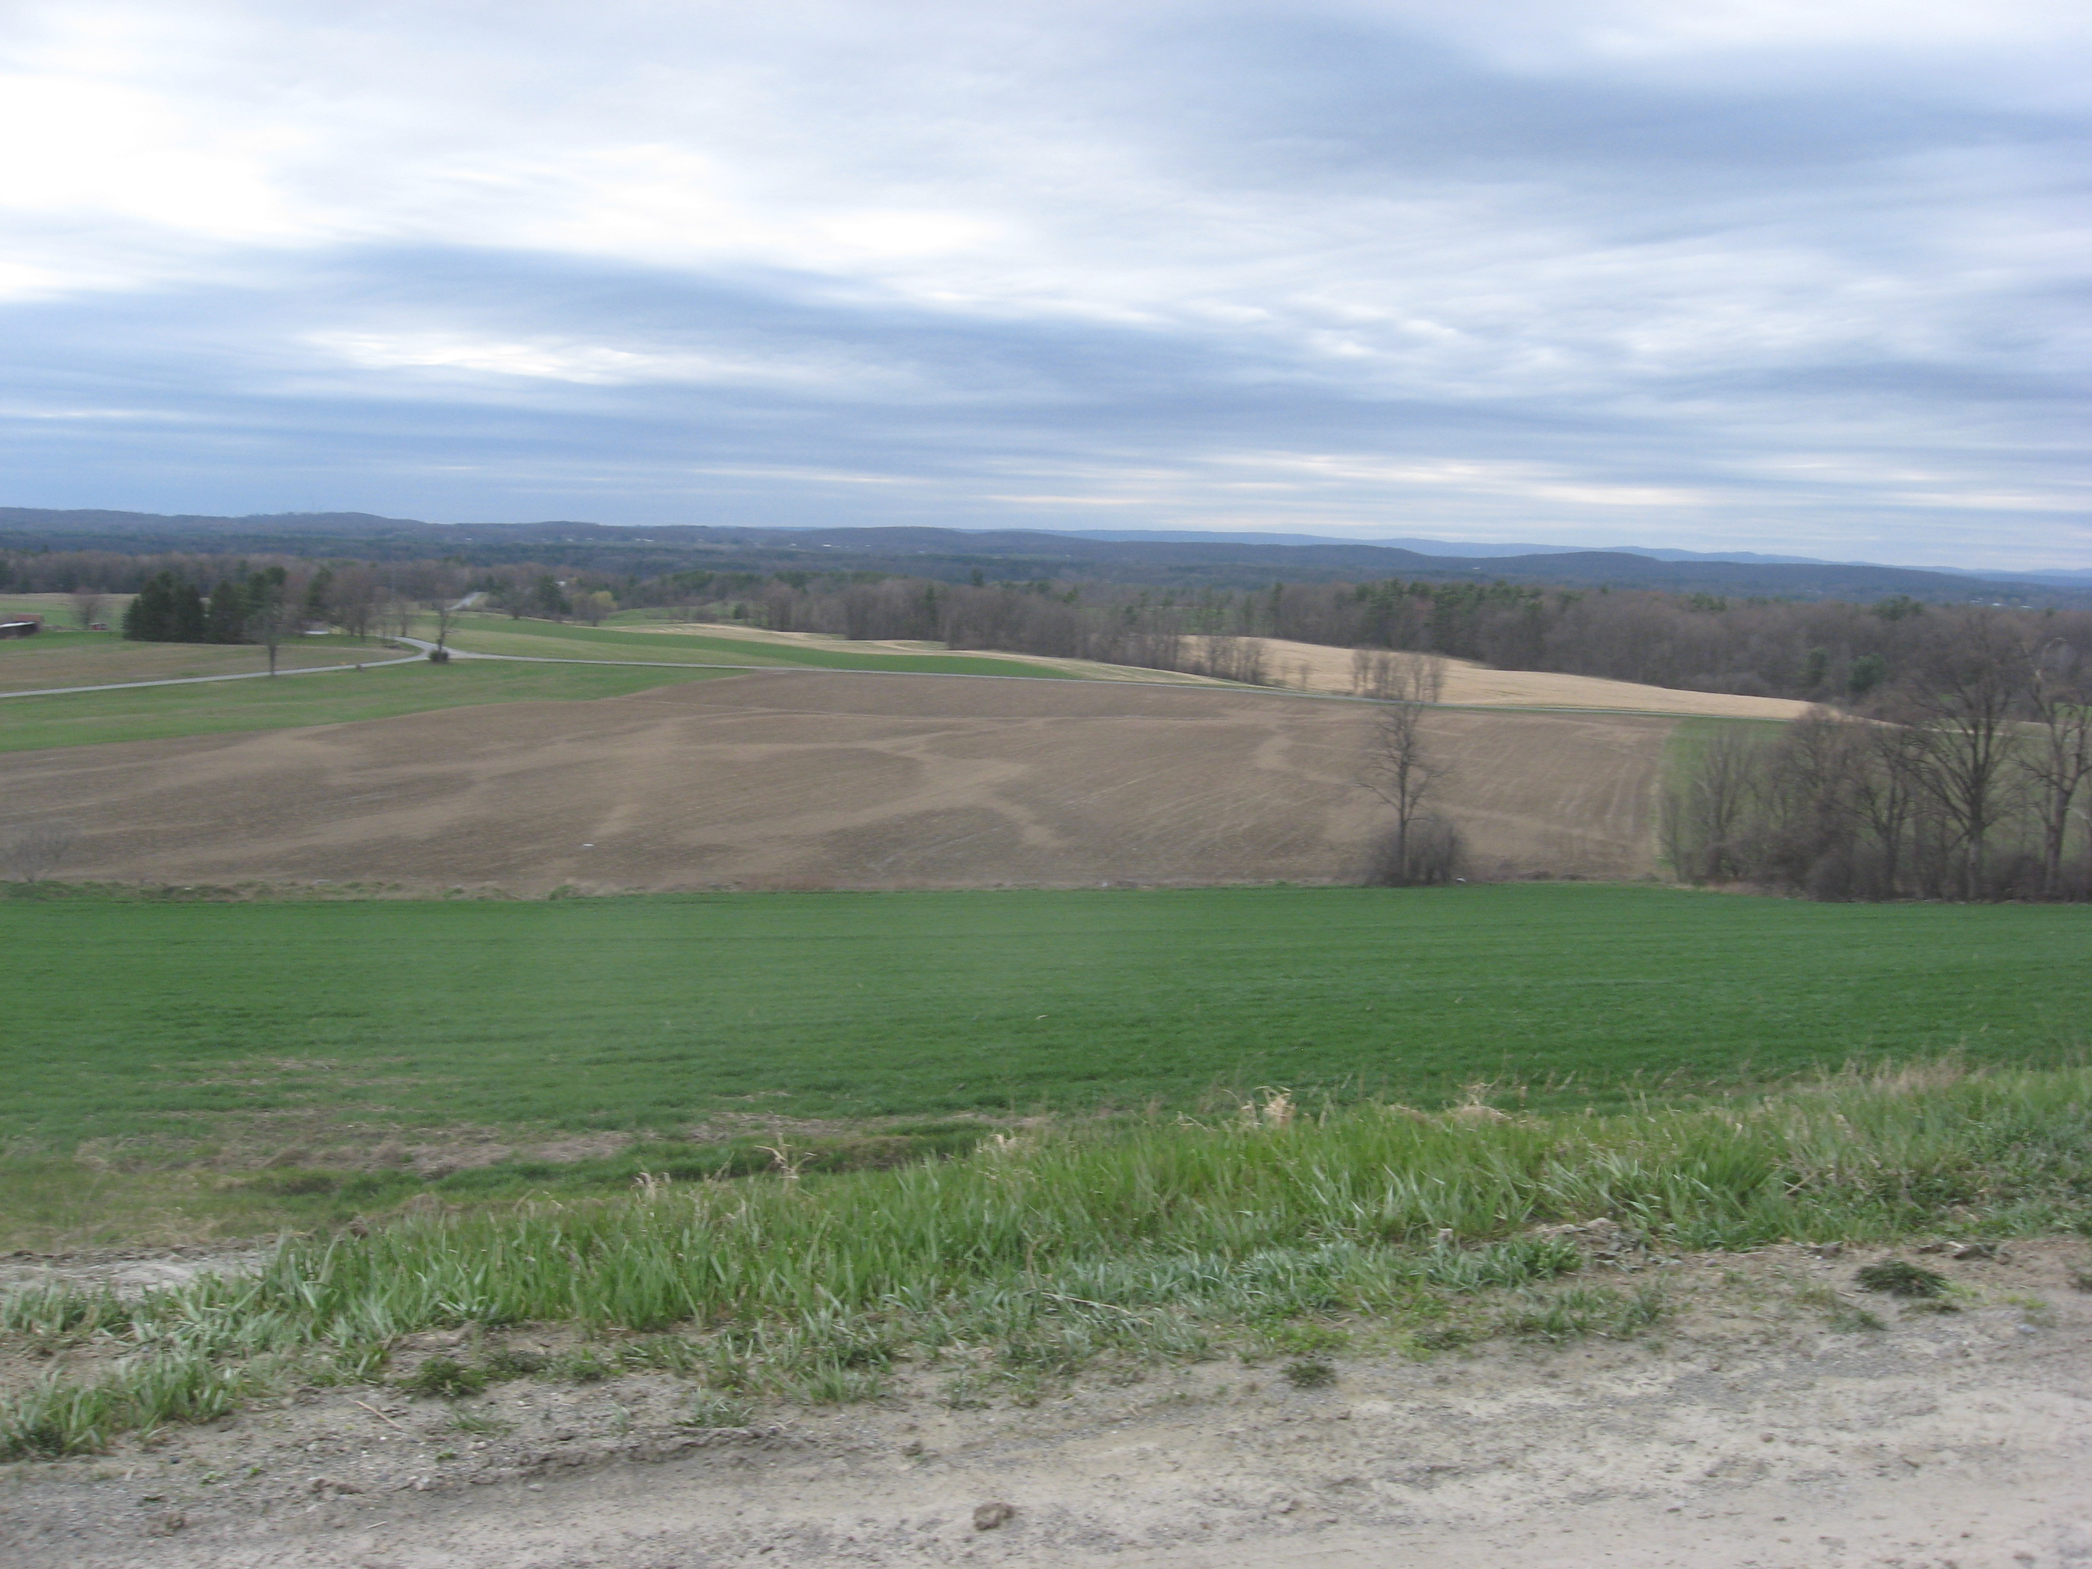
Tile Drainage

Slide 30
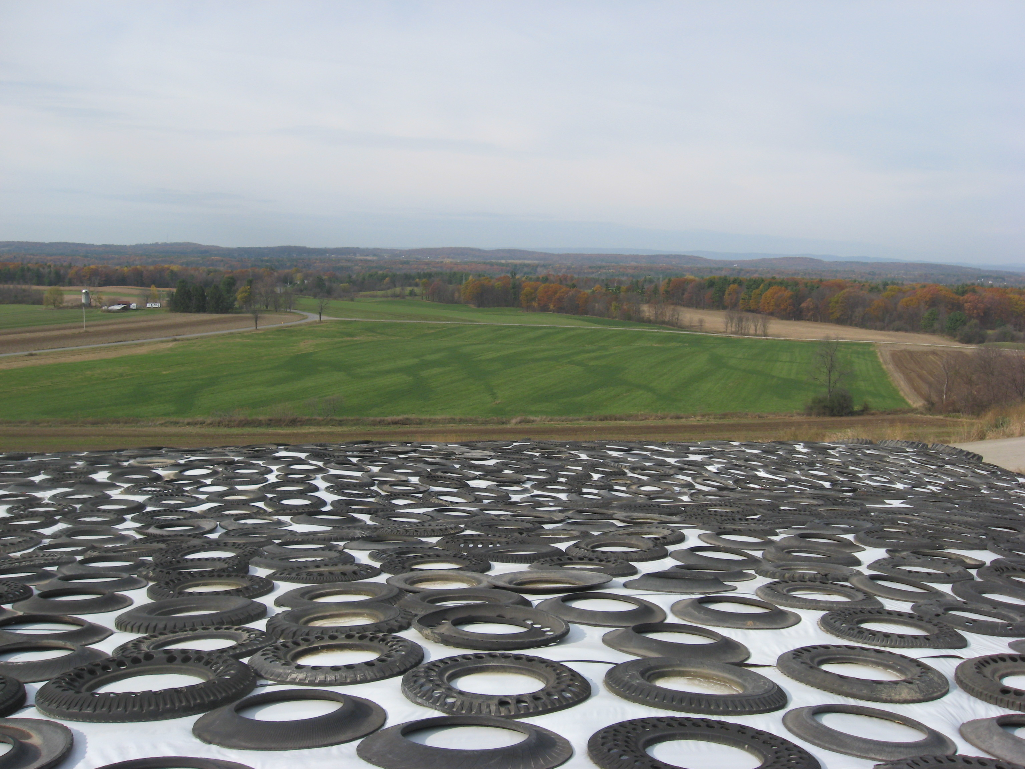

Slide 31
Tile Drainage
Economic evaluation
Timeliness
Larger herds and/or more acres
Bigger machines need wider spaces
Downtime more critical than ever
Same number of sunny days

Slide 32
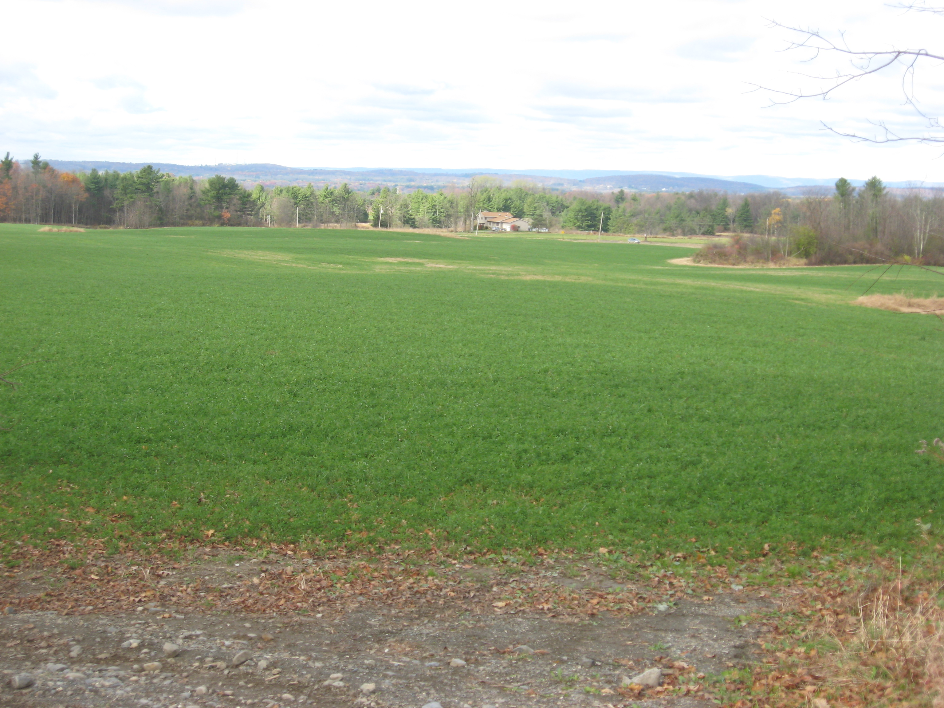

Slide 33
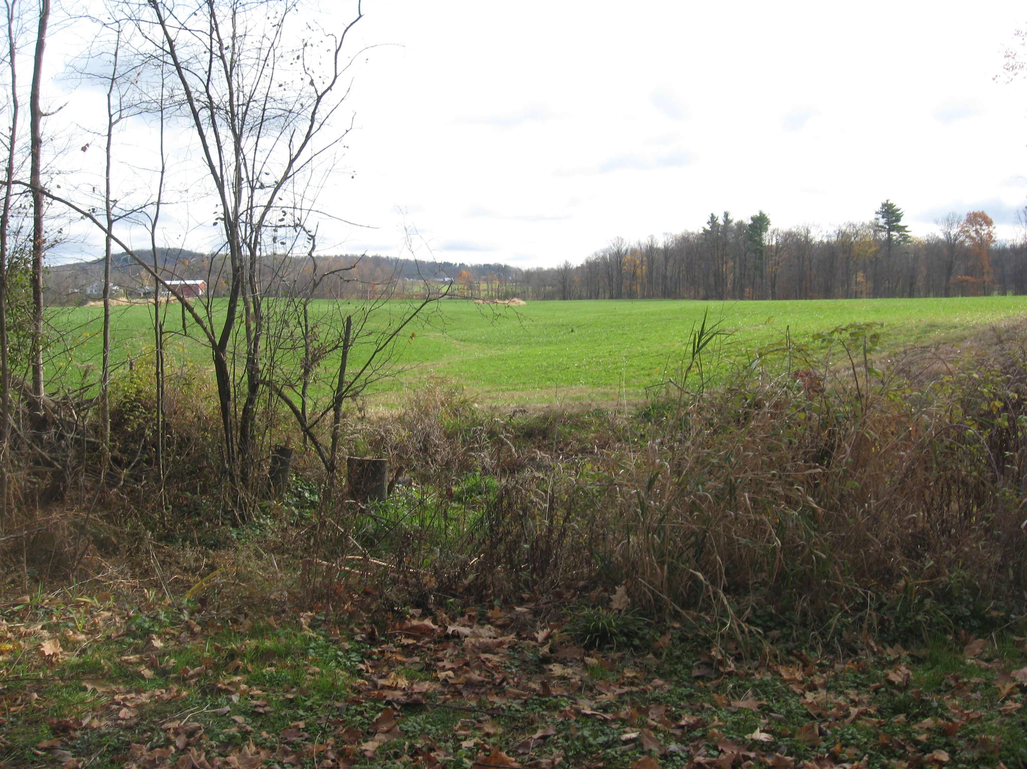

Slide 34
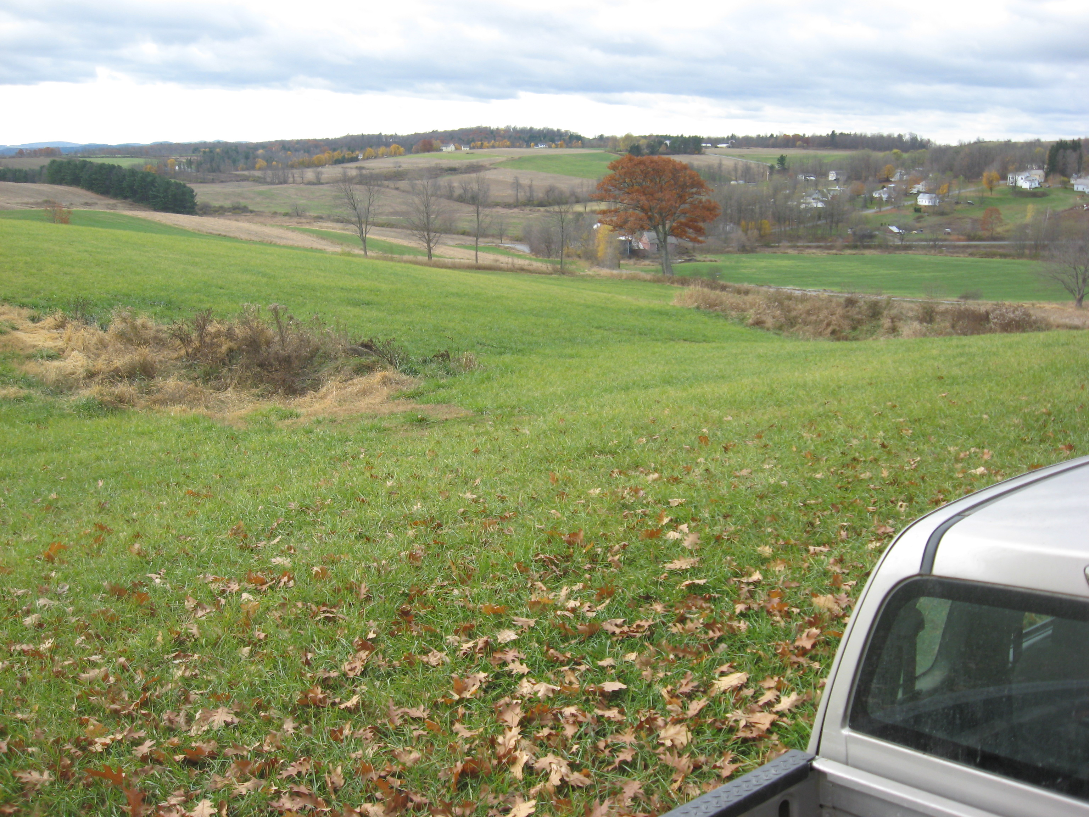

Slide 35
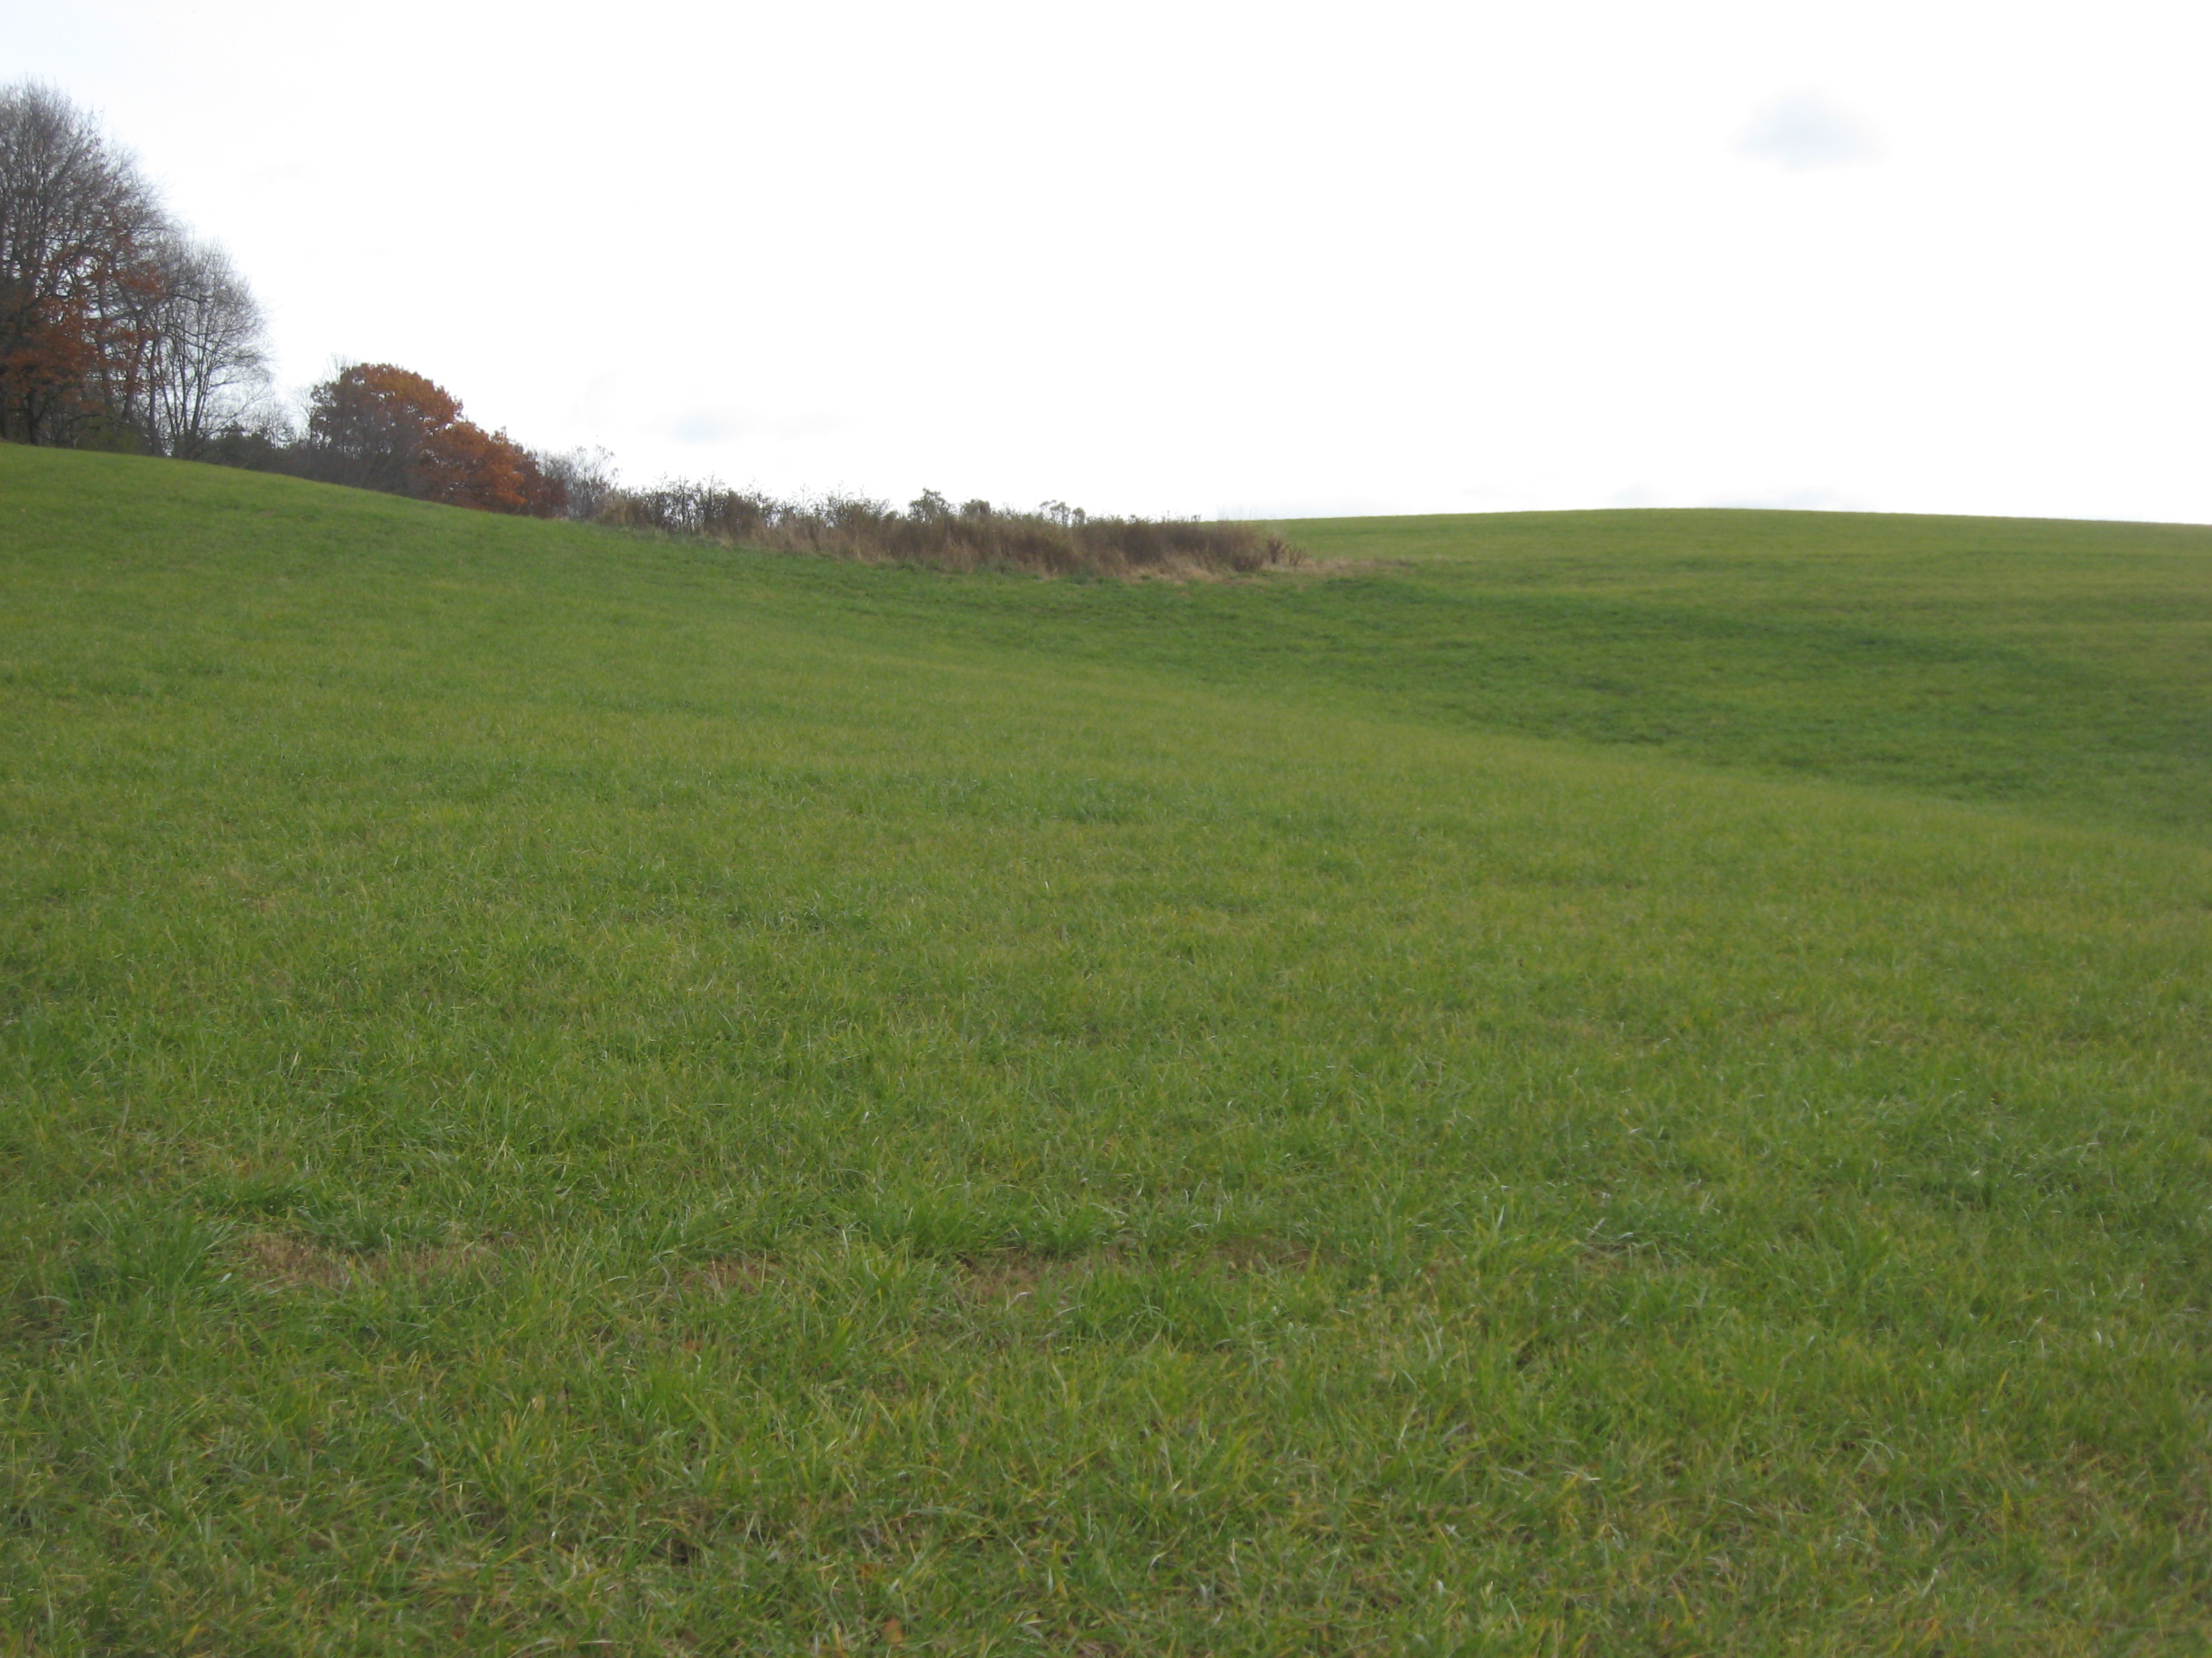

Slide 36
Hmmm…after 150 years of sub-surface work, it almost looks like a pattern drainage design

Slide 37
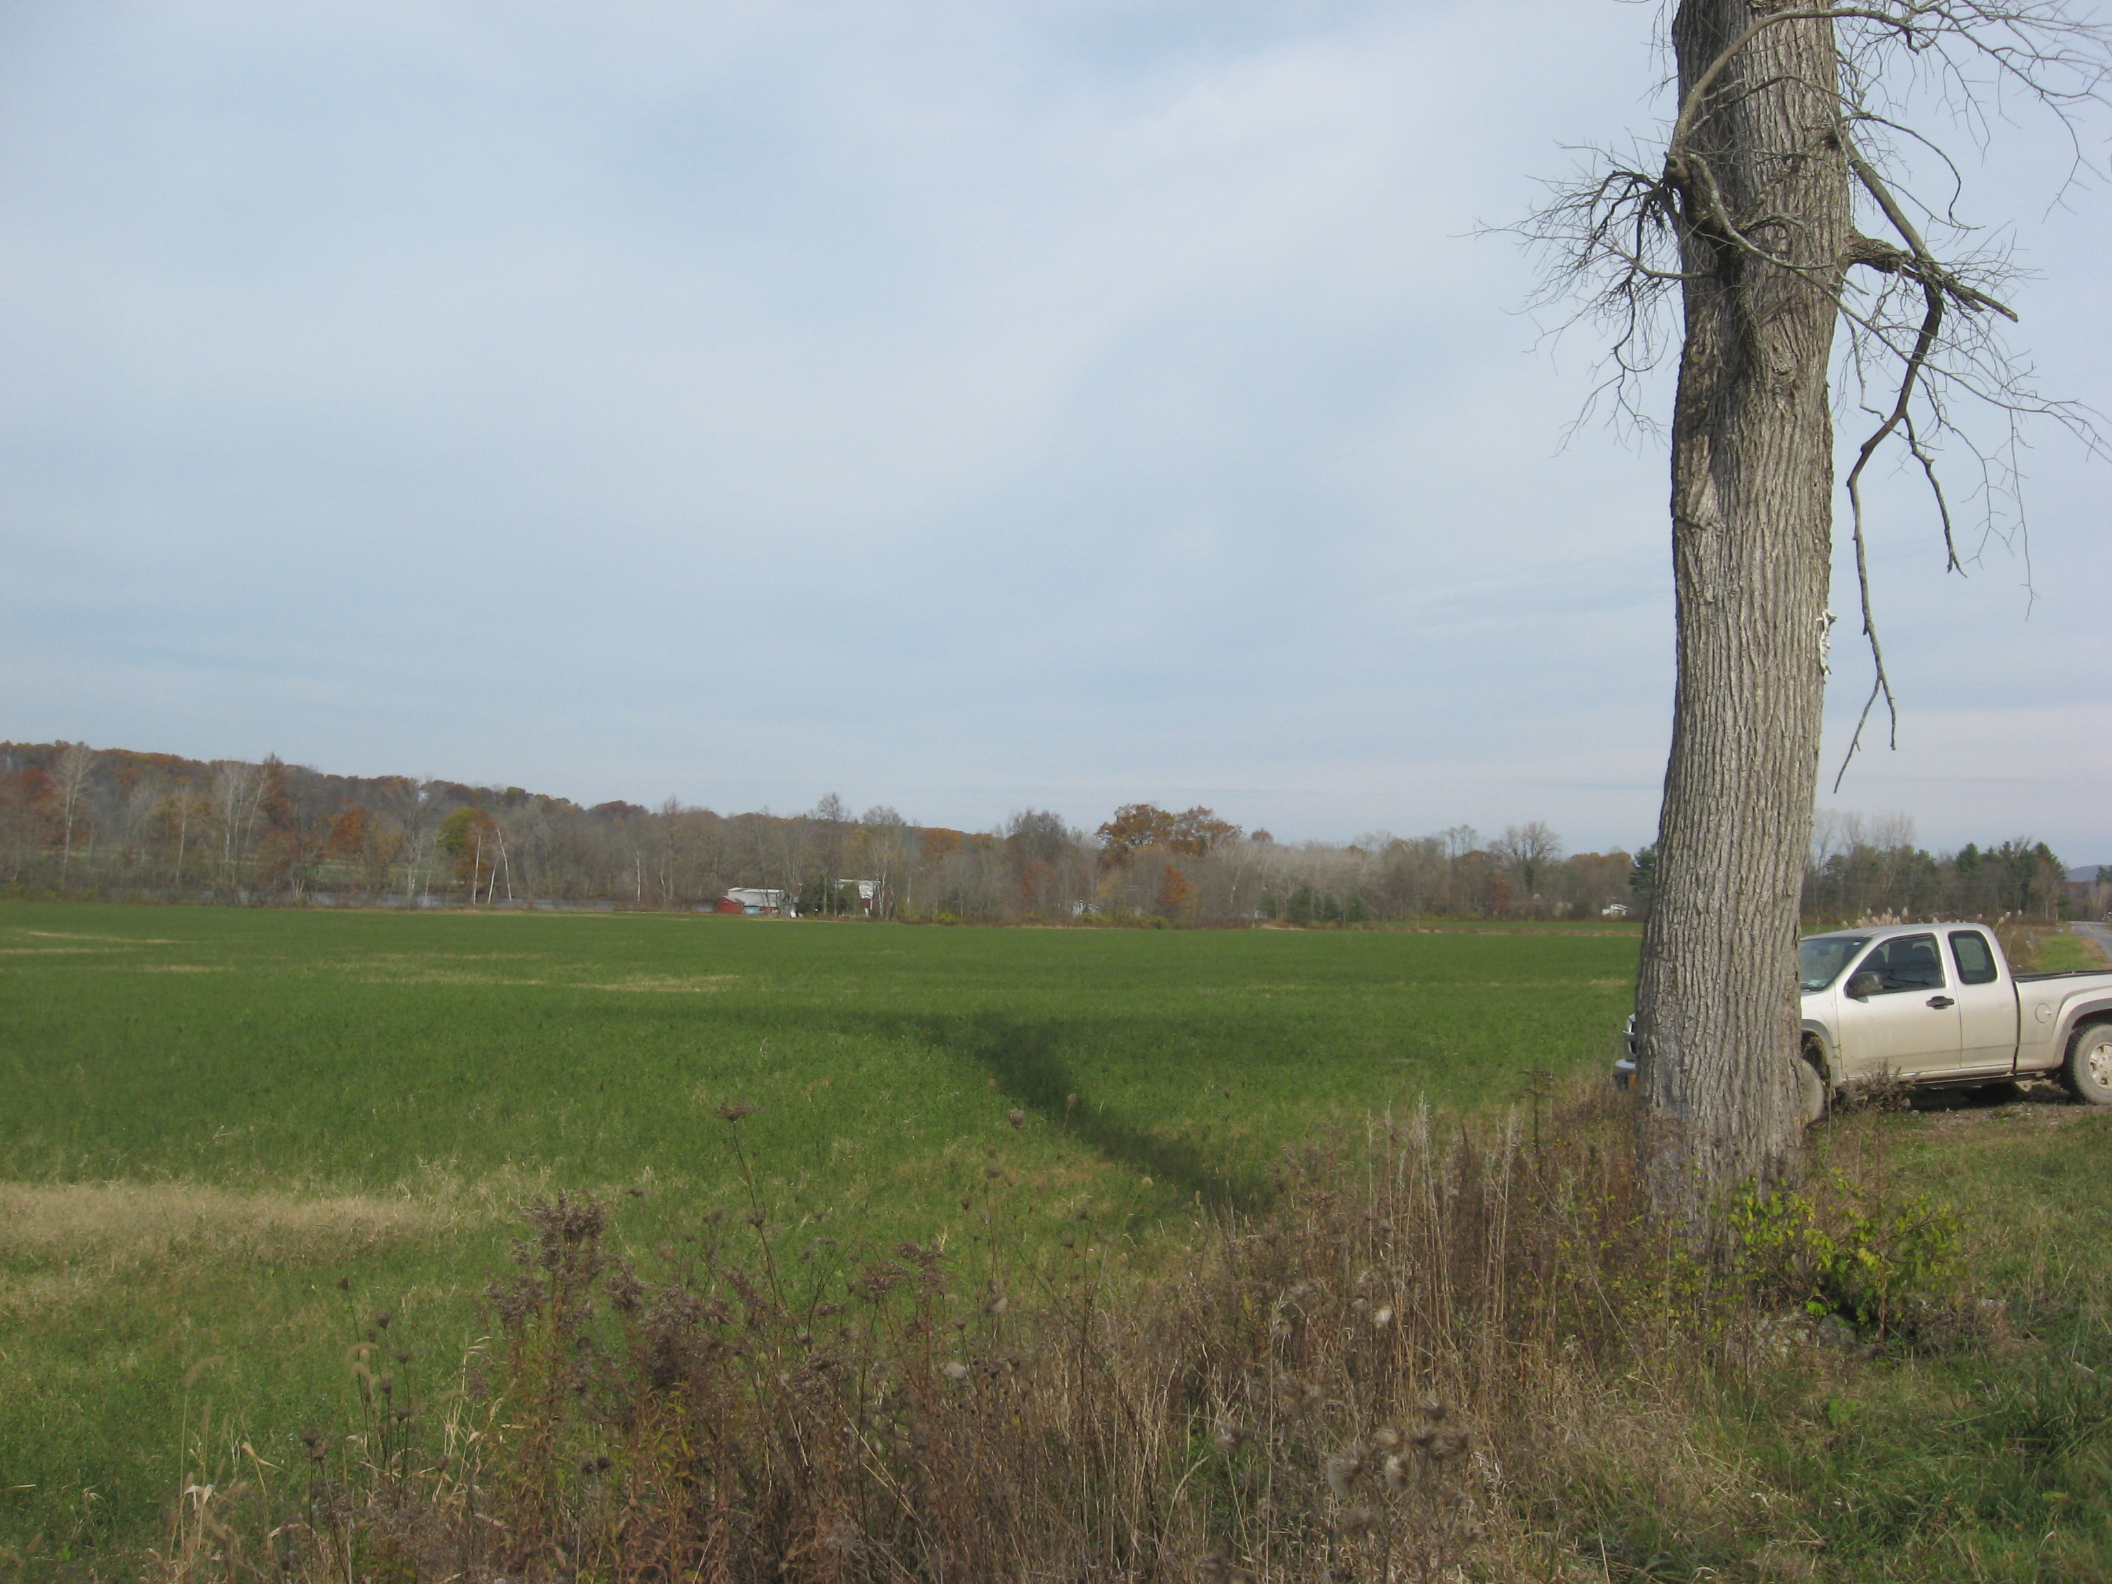
Recently installed pattern system. Getting 150 years of work done in two days

Slide 38
Tile Drainage
Economic evaluation
Yield “what-ifs”

Slide 39

 |  | CORN PRODUCTION BUDGET- 2014
 |  |  |  |  |  |  |  |  |  | Updated: | 5/15/2014
ITEM |  |  |  |  |  |  |  | $$ /UNIT |  | YIELD (bu/A)¹
 |  |  |  |  |  |  |  |  | 128 | 160 | 192 | 200
RECEIPTS
 | Corn (/ bu) |  |  |  |  |  |  | $4.50 | 576.00 | 720.00 | 864.00 | 900.00
 | Grower or Market Premium |  |  |  |  |  |  |  | 0.00 | 0.00 | 0.00 | 0.00
TOTAL RECEIPTS |  |  |  |  |  |  |  |  | 576.00 | 720.00 | 864.00 | 900.00
TOTAL FIXED COSTS |  |  |  |  |  |  |  |  | 347.37 | 399.57 | 461.77 | 463.57
TOTAL VARIABLE COSTS
 |  |  |  |  |  | -Per Acre |  |  | 387.05 | 430.23 | 469.34 | 473.85
 |  |  |  |  |  | -Per Bushel |  |  | 2.99 | 2.69 | 2.44 | 2.37
TOTAL COSTS |  |  |  |  |  | -Per Acre |  |  | 730.42 | 829.79 | 931.11 | 937.42
 |  |  |  |  |  | -Per Bushel |  |  | 5.71 | 5.19 | 4.85 | 4.69
RETURN ABOVE VARIABLE COSTS |  |  |  |  |  |  |  |  | 192.95 | 289.77 | 394.66 | 426.15
RETURN TO LAND, LABOR & MGMT |  |  |  |  |  |  |  |  | 69.38 | 166.21 | 271.09 | 302.58

Slide 40
Tile Drainage
Economic evaluation
Agronomic/Environmental Considerations
Yield improvement/Higher quality
Reduction of soil compaction risks
Improved water holding capacity
(Saturated root zone periods decreased)
Winter cover crop – higher probability

Slide 41
Courtesy: Ev Thomas, Miner Institute

Slide 42
Tile Drainage
Is it possible to have too much??

Slide 43
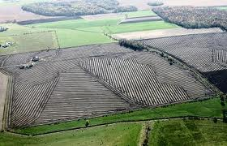
Tile Drainage
Well, maybe!

Slide 46
Tile Drainage

