Slide 1
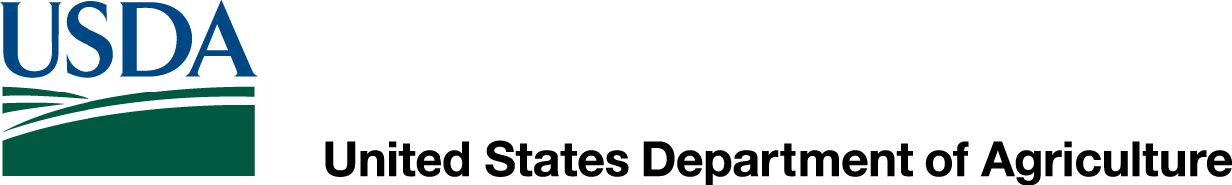
Tile Drainage on Cropland-Implications for Wetland Compliance
Scott Fitscher
Natural Resources Conservation Service
November 12, 2014

Slide 2
Food Security Act of 1985, as Amended
Why regulation exists
What are the Wetland Conservation provisions of the Food Security Act
Which producers are affected
How does a producer stay in compliance
What are a producer’s appeal rights
How a producer regains compliance
Notes:
1985 Farm Bill; first time WC and HEL provisions appeared in a Farm Bill

Slide 3
HISTORY OF WETLAND REGULATION
FIRST RECORDED NATIONAL WETLAND LEGISLATION (ACT)?
  Swamp and Overflowed Lands Acts of 1849, 1850, and 1860 (U.S. Congress)
  Swamp: “land, whether open or timbered, above tide water that is too wet for cultivation.”
  Overflowed land: “bottom land along streams that cannot be cultivated safely because of overflow.”
  Focus on draining wetlands.
Notes:
Wetland “regulation” dates back to 1849, but dealt more with draining wetlands

Slide 4
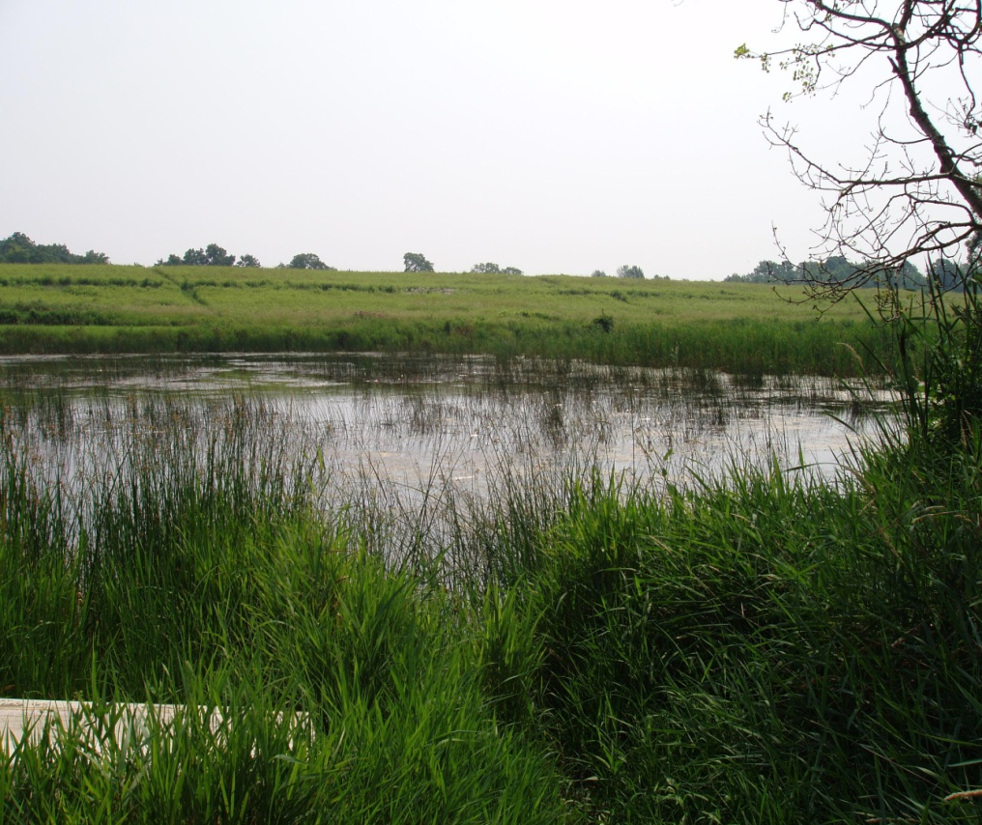
WETLAND LOSSES
By 1980’s, over 53% of wetlands lost nationwide (117 million acres)
60 acres of wetland every hour between 1780’s and 1980’s.
New York had lost 60% of wetlands (1.5 million acres).
Dahl, Thomas E. 1990. Wetland losses in the United States 1780’s-1980’s.
Notes:
And the nation drained, including SCS.

Slide 5
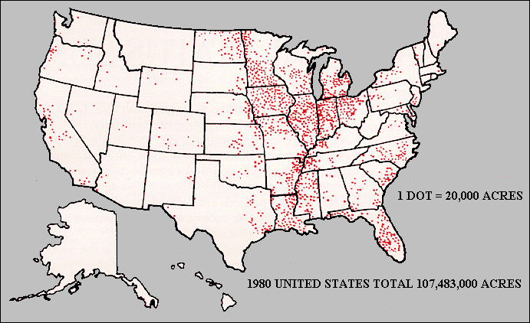
EXTENT OF ARTIFICIALLY DRAINED AGRICULTURAL LAND 1985
87% of wetland losses from 1950’s to 1970’s due to agriculture.
(U.S. Department of Agriculture Economic Research Service)
Notes:
87% of wetlands drained were for agriculture.

Slide 6
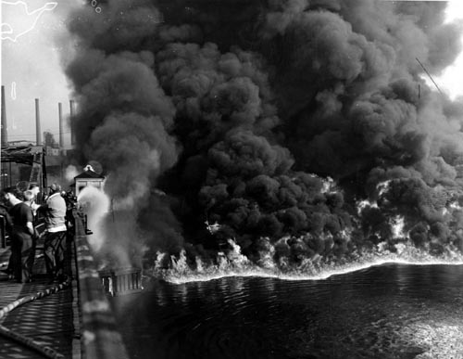
WATER QUALITY
Cuyahoga River, Cleveland, June 1969-Time Magazine
Notes:
But by late 1960’s, water quality was a disaster across the nation. Floating oil slick caught fire on Cuyahoga River, 1969 (1952). Nation waking up to the need for better water quality, which included protecting wetlands.

Slide 7
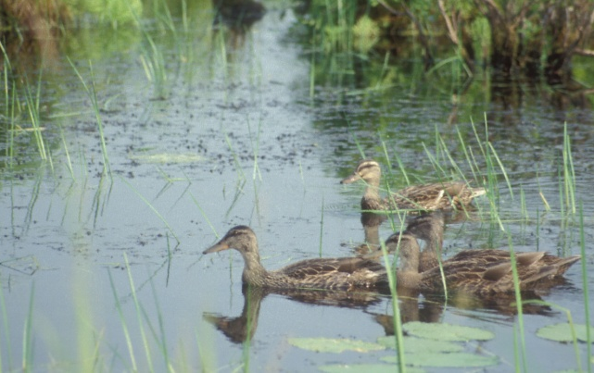
WETLAND LOSSES
By 1985, waterfowl populations were at record lows.
3.2 million hunters spending $1 billion.
18.6 million people photographing and watching waterfowl.
As early as 1934, federal duck-stamp program started to fund wetland protection.
Notes:
Lobbying for improved protection of wetlands came from multiple sources, including sportsmen.

Slide 8

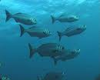
WETLAND LOSSES
1960’s, public made aware of linkage between coastal marshes and fisheries.
Ozcoast.org.au
Notes:
Nation made aware of linkage between declining fisheries and declining wetlands.

Slide 9
Wetland Conservation Laws
Clean Water Act of 1972 (U.S. ACOE, U.S.EPA)
  Waters of the U.S.
  Regulates discharge of pollutants and fill
State Laws and Regulations (NYSDEC)
NYS Freshwater Wetlands Act of 1975
Protection for wetlands 12.4 acres and larger
Food Security Act of 1985 (FSA/NRCS)
  Agricultural lands and activities
  Eligibility for USDA programs
Notes:
The result; wetland regulation as we know it today begins.

Slide 10
CONSERVATION PROVISIONS OF THE FOOD SECURITY ACT OF 1985
Highly Erodible Land Conservation (HELC) “Sodbuster”
Wetland Conservation (WC) “Swampbuster”
Notes:
Two components: planting, or converting Commodity crop-planted and produced by annual tilling, including no-till.

Slide 11
WETLAND CONSERVATION PROVISIONS
“…a person shall be ineligible for all
or a portion of USDA program benefits
listed in this section if:
(2) The person produces an agricultural
commodity on a wetland that was
converted after December 23, 1985;”
CFR 12.4(a)
(Land could have been converted by another person)
Notes:
No. 1 (missing) references HEL provisions (sodbuster); No. 2 references a planting violation; original provision from 1985

Slide 12
WETLAND CONSERVATION PROVISIONS
“…a person shall be ineligible for all or a portion of USDA program benefits listed in this section if:
(3) After November 28, 1990, the person converts a wetland by draining, dredging, filling, leveling, removing woody vegetation, or other means for the purpose, or to have the effect, of making the production of an agricultural commodity possible.”
CFR 12.4(a)

Slide 13
WHO IS AFFECTED?
Producers receiving or who have received:
Farm operating loans
Conservation program payments (CSP, CRP, EQIP, FRPP, GRP, WRP, WHIP)
Agricultural Credit Act payments
Watershed Protection and Flood Prevention Act payments
Agricultural Market Transition Act payments
Etc.
Notes:
Conservation Security Program, Conservation Stewardship Program, etc.

Slide 14
MAINTAINING COMPLIANCE:
ASK BEFORE YOU ACT
Bringing new land into production
Land clearing
Land leveling
Land filling or dredging
Excavation or stump removal
Installing new drainage
Improving an existing drainage system
Maintaining an existing drainage system
Check with Farm Service Agency or NRCS

Slide 15
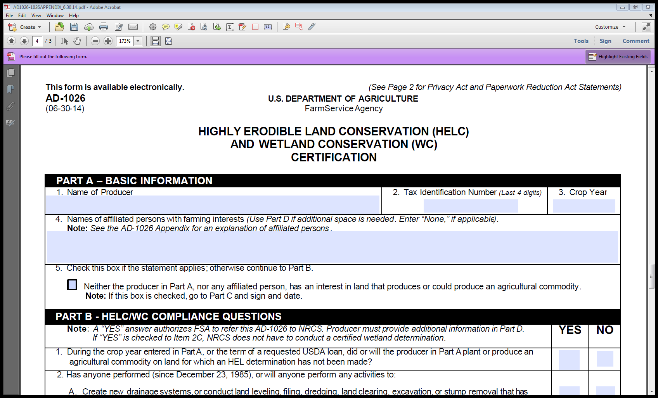
MAINTAINING COMPLIANCE:
FORM AD-1026

Slide 16
MAINTAINING COMPLIANCE:
FORM AD-1026
Completed with Farm Service Agency on an annual basis
Checking “yes” to 2A or 2B begins wetland determination process
2C allows for self-certification by producer

Slide 17
FORM AD-1026
QUESTION 2
2. Since December 23, 1985, or during the current crop year, or during the term of a requested USDA loan, has anyone performed, or will anyone perform any activities to:
Notes:
Three components: since act went into effect, during current crop year or during term of loan; past and present

Slide 18
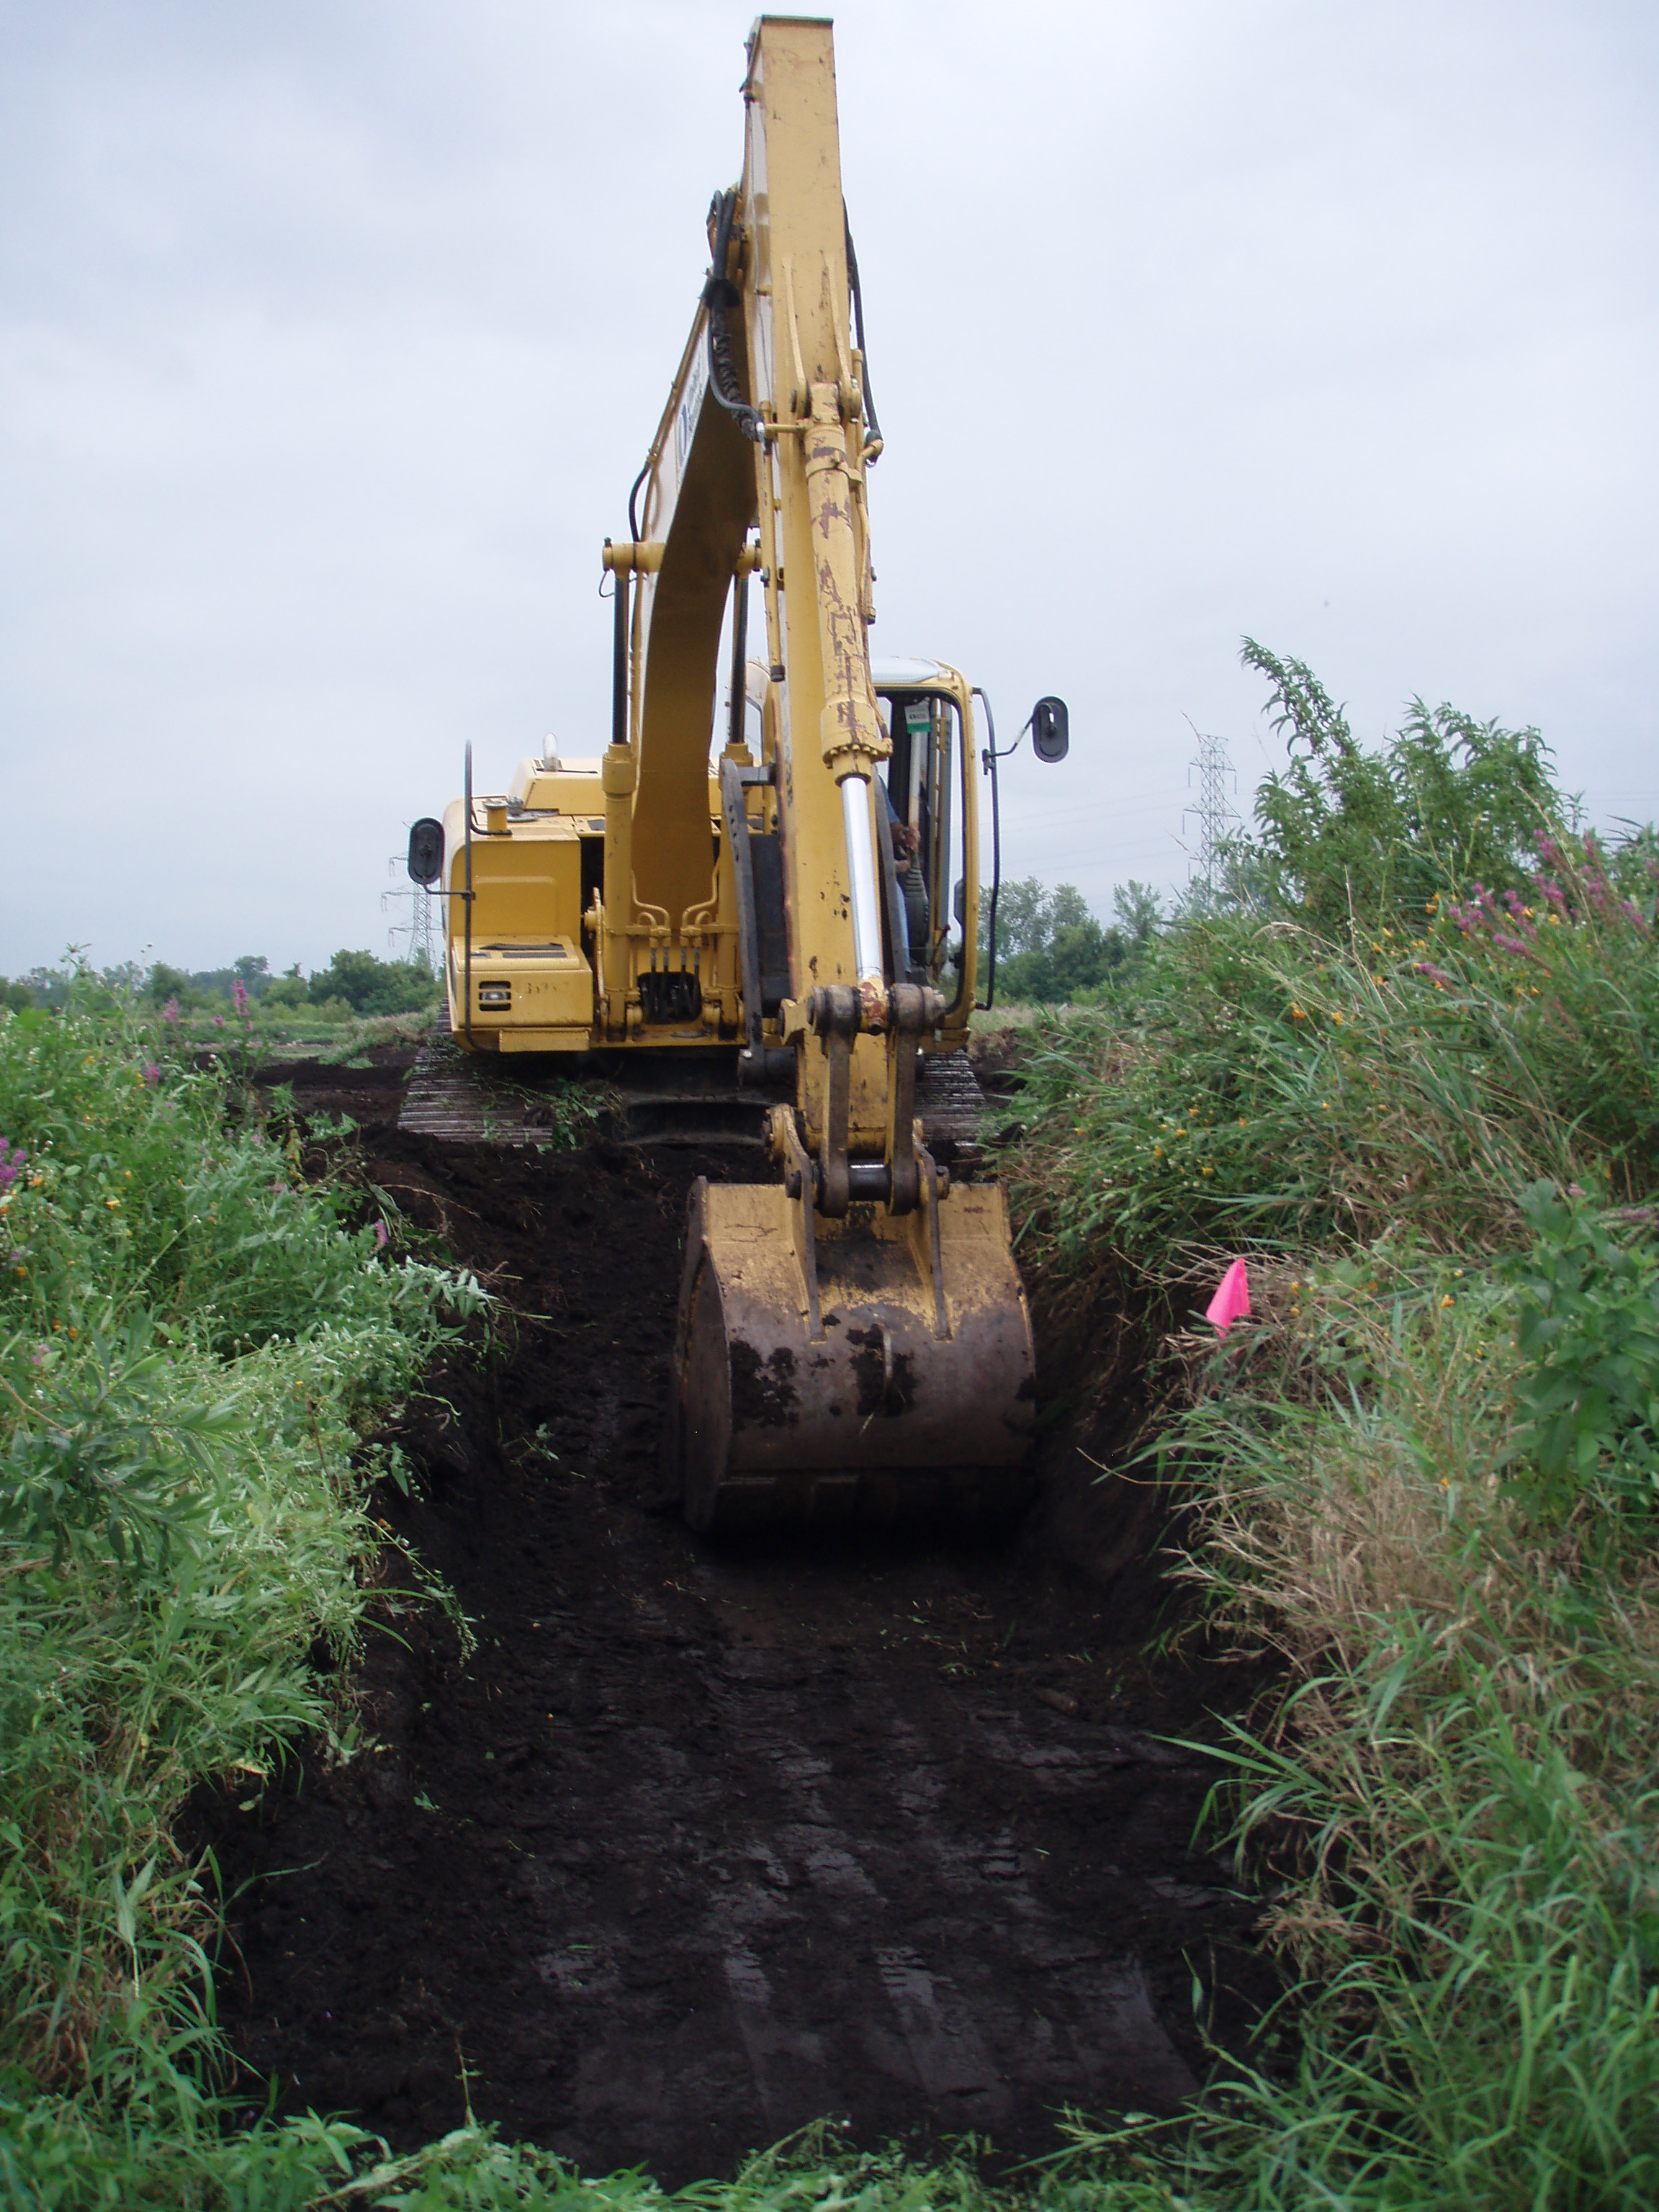
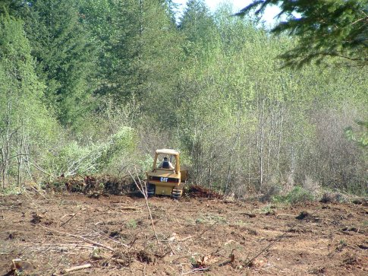
FORM AD-1026
QUESTION 2
Create new drainage systems, or conduct land leveling, filling, dredging, land clearing, excavation, or stump removal, that has NOT been evaluated by NRCS?
Notes:
NOT evaluated: once producer receives certified determination, doesn’t need to be re-certified

Slide 19
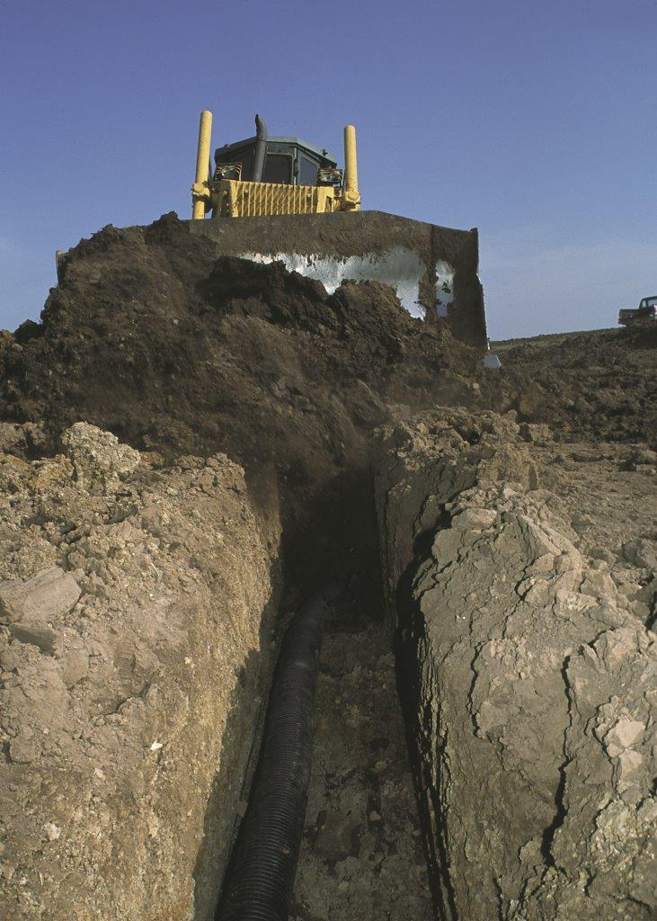
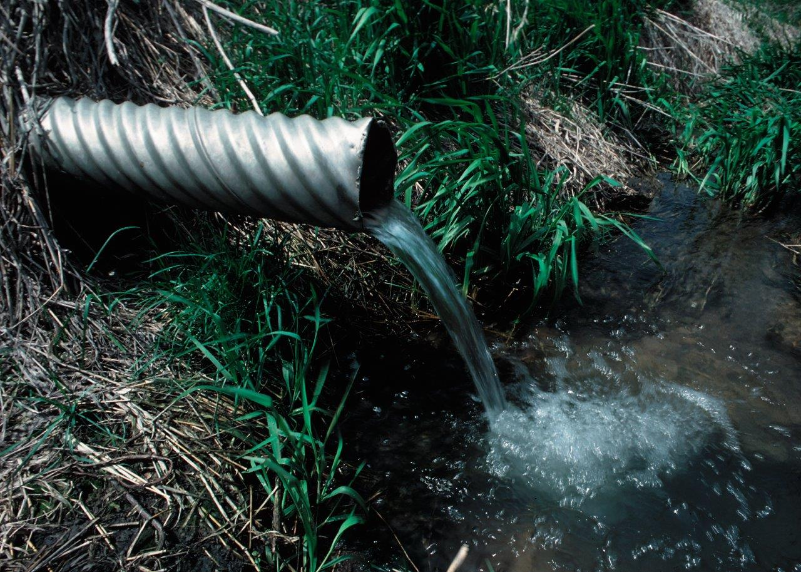
FORM AD-1026
QUESTION 2
B. Improve or modify an existing drainage system that has NOT been evaluated by NRCS?
Notes:
NOT evaluated: once producer receives certified determination, doesn’t need to be re-certified

Slide 20
FORM AD-1026
A ''YES'' answer in Items 2A or 2B authorizes FSA to refer the AD-1026 to NRCS.
If you check "YES" to Item 2C, NRCS does not have to conduct a certified wetland determination.

Slide 21
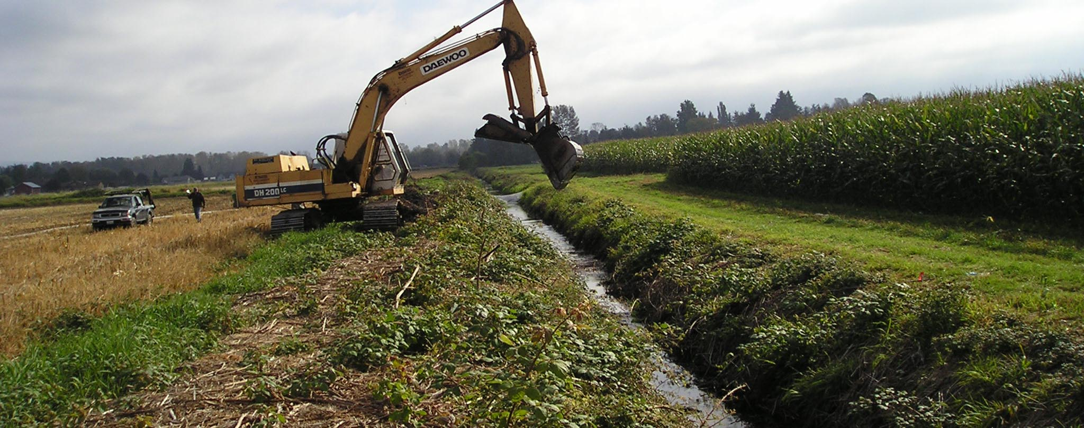
FORM AD-1026
QUESTION 2
Whatcom Drainage District
C. Maintain an existing drainage system that has NOT been evaluated by NRCS?
Notes:
NOT evaluated: once producer receives certified determination, doesn’t need to be re-certified

Slide 22
FORM AD-1026: 2C
MAINTENANCE
“Maintenance is the repair, rehabilitation, or replacement of the capacity of existing drainage systems to allow for the continued use of wetlands
currently in agricultural production and the continued management of other areas as they were used before December 23, 1985. This allows a person to reconstruct or maintain the capacity of the original system or install a replacement system that is more durable or will realize lower maintenance or costs.”
Notes:
10 C allows for self-certification. By signing AD-1026, producer is certifying maintenance.

Slide 23
FORM AD-1026
11. If "YES" to 2A and/or 2B or 2C, producer writes in:
A. Farm and/or tract/field number:
B. Activity:
C. Current land use (specify crops):
D. County:
AND shows location of planned activity by drawing on a recent aerial photo provided by FSA.
Notes:
Emphasize producer telling us what they plan to do, not asking “what can I do”. Tract vs. field determinations

Slide 24
MAINTAINING COMPLIANCE:
FORM AD-1026
“I have read the AD-1026 Appendix and understand and agree that my eligibility for certain USDA program benefits is contingent upon this certification of compliance with highly erodible land and wetland conservation provisions of the Food Security Act of 1985 as amended, and if a determination is made that results in a violation and ineligibility, I agree to refund all applicable payments.”

Slide 25
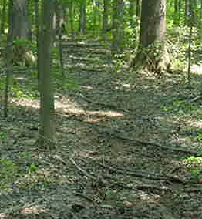
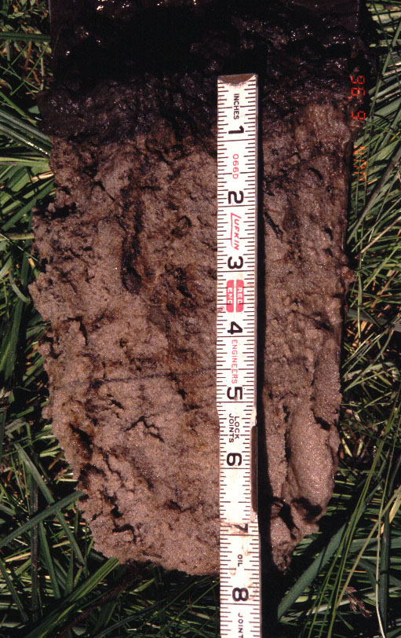
NRCS
WETLAND DETERMINATION PROCESS
Offsite and onsite procedures
Offsite based on GIS data (agricultural lands)
Onsite based on indicators of hydrology, hydric soils and hydric vegetation (non-agr. land)
Onsite conducted by NRCS Soil Scientist and Biologist
Notes:
On-site required most often when can’t evaluate potential wetland off-site; frequently new land being brought into production.

Slide 26
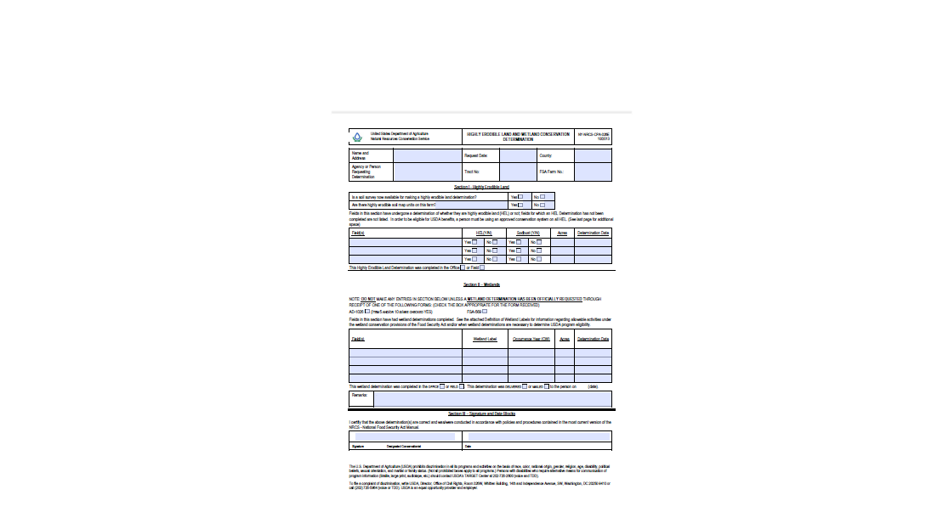
NRCS
WETLAND DETERMINATION PROCESS
RESPONSE
NRCS-CPA-026e
Determination Map
Don’t provide or accept a verbal reply
Documentation is critical

Slide 27

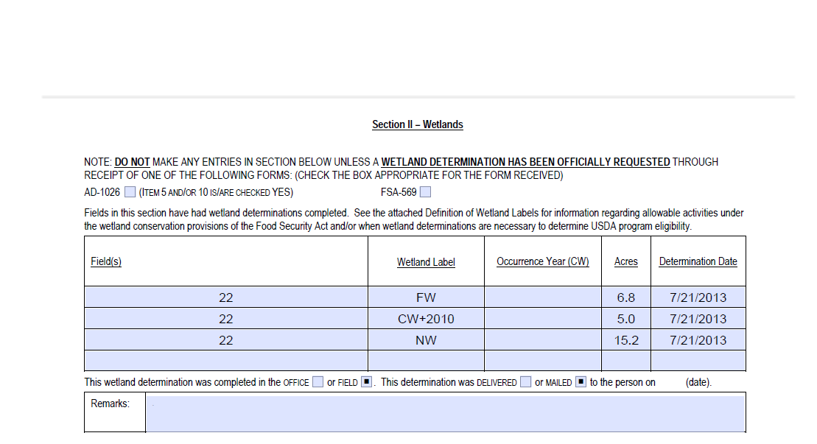
NRCS
WETLAND DETERMINATION PROCESS
RESPONSE: NRCS-CPA-026e
Notes:
CPA-026 and determination map

Slide 28
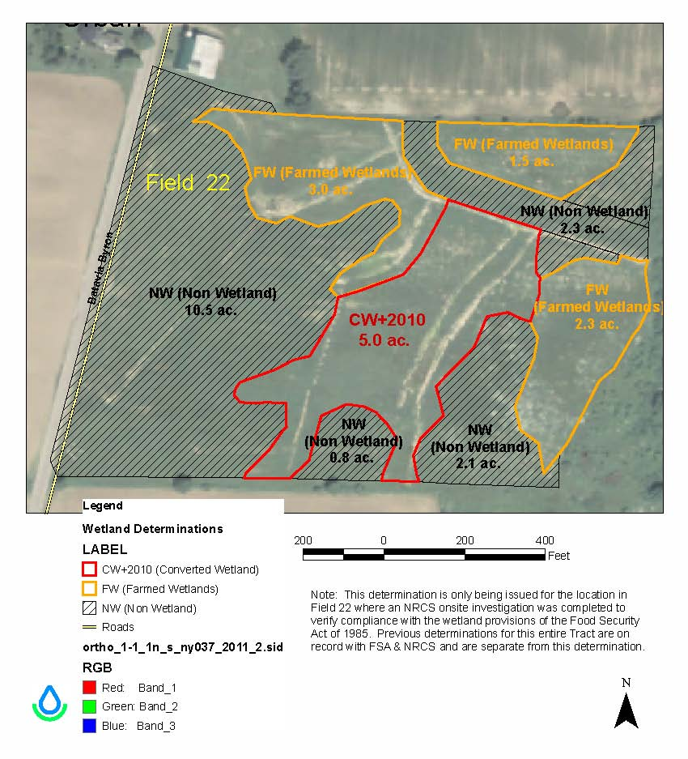
Notes:
CPA-026 and determination map

Slide 29
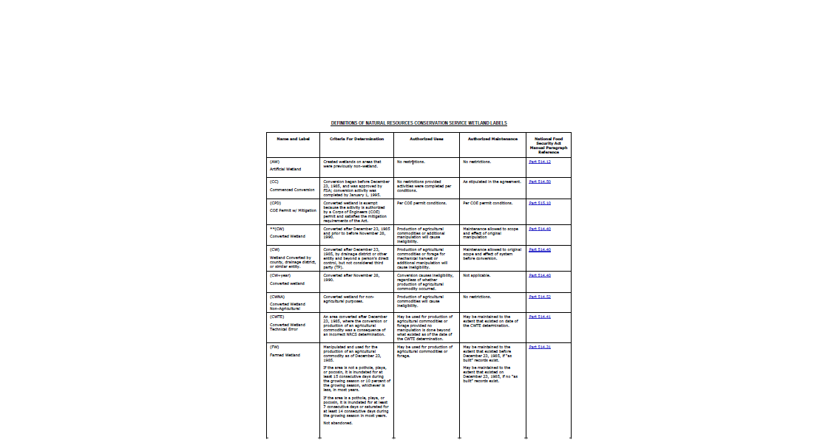
NRCS
WETLAND DETERMINATION PROCESS
LABELS

Slide 30
NRCS
WETLAND DETERMINATION PROCESS
LABELS
Prior converted (PC)
Wetland (W)
Farmed wetland (FW)
Farmed wetland pasture (FWP)
Converted wetland (CW+year)
Non-wetland (NW)
Ask NRCS for clarification
Notes:
Definitions on remaining pages of CPA-026

Slide 31
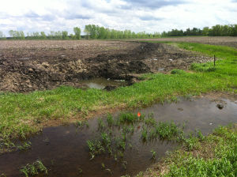
NRCS
WETLAND DETERMINATION PROCESS
APPEAL RIGHTS
Preliminary Wetland Determination
  30 days to appeal
  Request reconsideration by NRCS
    Producer provides information NRCS did not consider in the preliminary determination
  Request mediation (stops appeal clock)
Tim Kizer, Theodore Roosevelt Conservation Partnership

Slide 32

NRCS
WETLAND DETERMINATION PROCESS
APPEAL RIGHTS
Final Wetland Determination
  30 days to appeal
  Appeal to FSA County Committee
  Appeal to the National Appeals Division (NAD)
Rocketswag.com

Slide 33
REGAINING ELIGIBILITY-MITIGATION
“A person…shall be ineligible for all or a portion of the USDA program benefits…until the converted wetland is restored or the loss of wetland values, acreage, and functions have been mitigated….” CFR 12.4(c)
NRCS assists producer in developing an approved wetland mitigation plan to replace the functions and acres lost through conversion.

Slide 34
REGAINING ELIGIBILITY
Converted wetland functions, values, and acres can be mitigated by:
Restoration of converted wetland (on-site mitigation)
Restoration/enhancement of a degraded wetland (off-site mitigation)
Creation of a new wetland (off-site mitigation)

Slide 35
REGAINING ELIGIBILITY
OFF-SITE MITIGATION
Mitigation site located by producer
Easement recorded in public record
No liens allowed on mitigation land
Mortgages must be subordinated to USDA easement
All expenses paid for by producer

Slide 36
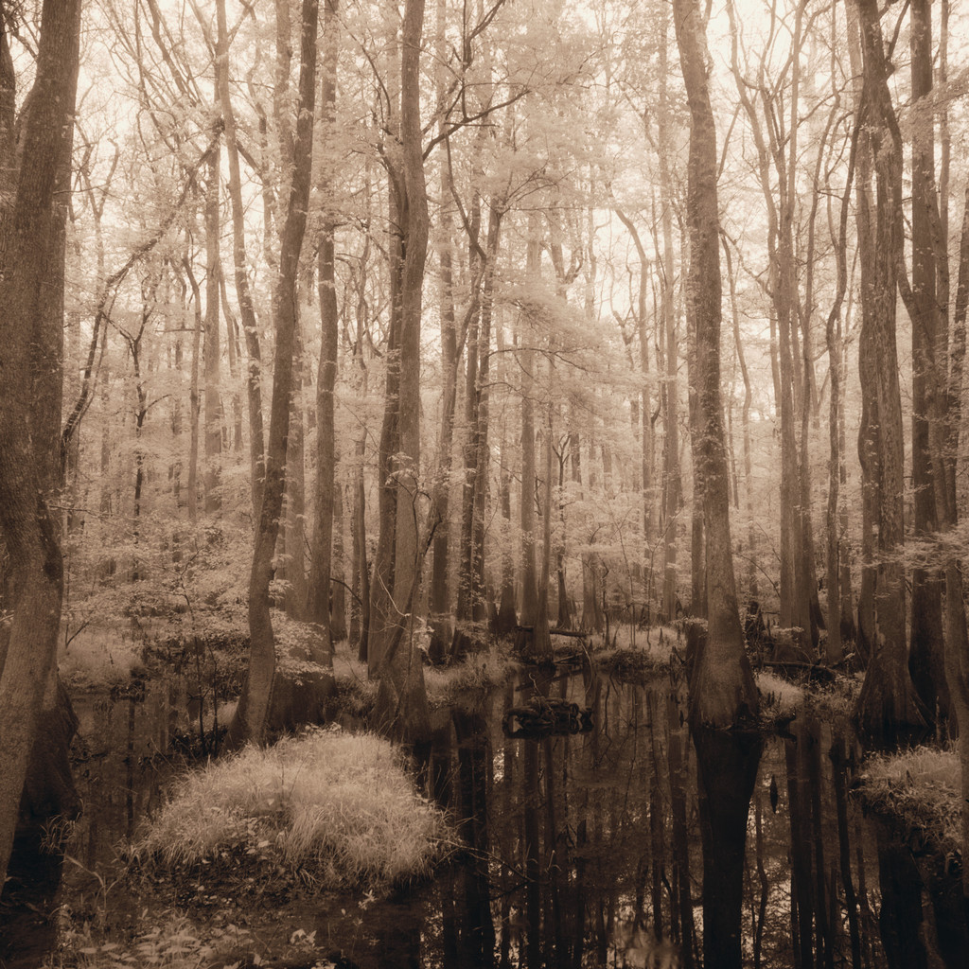
QUESTIONS?

Slide 37
“The U.S. Department of Agriculture (USDA) prohibits discrimination in all its programs and activities on the basis of race, color, national origin, age, disability, and where applicable, sex, marital status, familial status, parental status, religion, sexual orientation, genetic information, political beliefs, reprisal, or because all or a part of an individual's income is derived from any public assistance program. (Not all prohibited bases apply to all programs.) Persons with disabilities who require alternative means for communication of program information (Braille, large print, audiotape, etc.) should contact USDA's TARGET Center at (202) 720-2600 (voice and TDD)."

